Slide 1
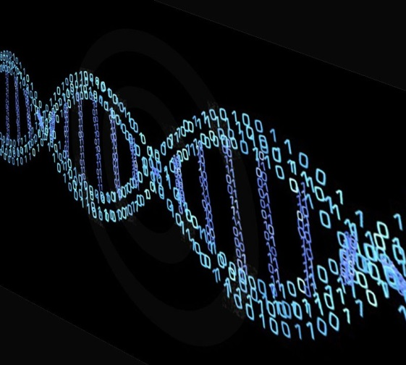
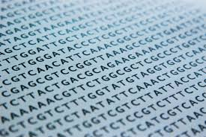
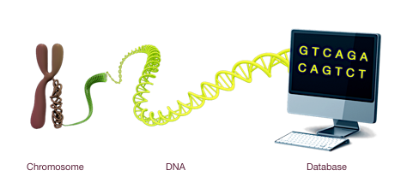
Careers in Bioinformatics
Dr. Matthew Cserhati (UNMC)
Nebraska Wesleyan
Phage Symposium
April 15, 2016

Slide 2
Personal introduction
MSc: biology, Eotvos Lorand University, Hungary
BSc: University of Szeged, software engineering, Hungary
PhD: biology, University of Szeged
Post-doc: University of Nebraska-Lincoln
University of Nebraska Medical Center
  Durham Research Center 1
Bioinformatics programmer
Email: matyas.cserhati@unmc.edu

Slide 3
Research responsibilities, projects
NeuroAIDS database development
  XHTML, Java, Javascript, MySQL
  Jboss server
  Linux environment
Next Generation Sequencing data generation
  Demultiplexing (index-based read sequence generation)
  Data transfer & storage
Differential gene expression analysis
Staphylococcus SNP detection and analysis
In silico assembly and annotation of giant virus genomes (in collaboration with Nebr. Wesleyan)

Slide 4
What is bioinformatics?
A science which deals with the production, analysis, modelling, depiction and storage of biological data
Biological data: sequence, gene expression value, 3D protein structure
Analysis can be done with an algorithm, program/script or pipeline of different tools
Storage in databases for restricted/public use
Terms:
  In vitro (experimental system)
  Iivo (living system)
  „In silico”: analysis which is done in part or in whole using computational tools

Slide 5
An interdisciplinary science
Bioinformatics builds on:
  Biology: uses and analyses data mainly from molecular biology
  Computer science: programming, running programs, applications
  Mathematics, statistics: evaluation of results and algorithm development

Slide 6
Some sub-disciplines within bioinformatics
Data storage and retrieval (databases)
Data analysis (genomics, proteomics, microarrays)
Data curation and annotation (prediction tools)
Structural bioinformatics (macromolecular 3D structures)

Slide 7
Data storage and retrieval

Slide 8
The NCBI (National Center for Biotechnology Information) database
Most widely known and used database in bioinformatics and which contains millions of sequences
Also contains millions of published papers (PubMed-PMC)
  Mainly biology papers
  Can do complex queries with it
Sequence analysis tool (BLAST)
Gene Expression Omnibus (GEO)

Slide 9
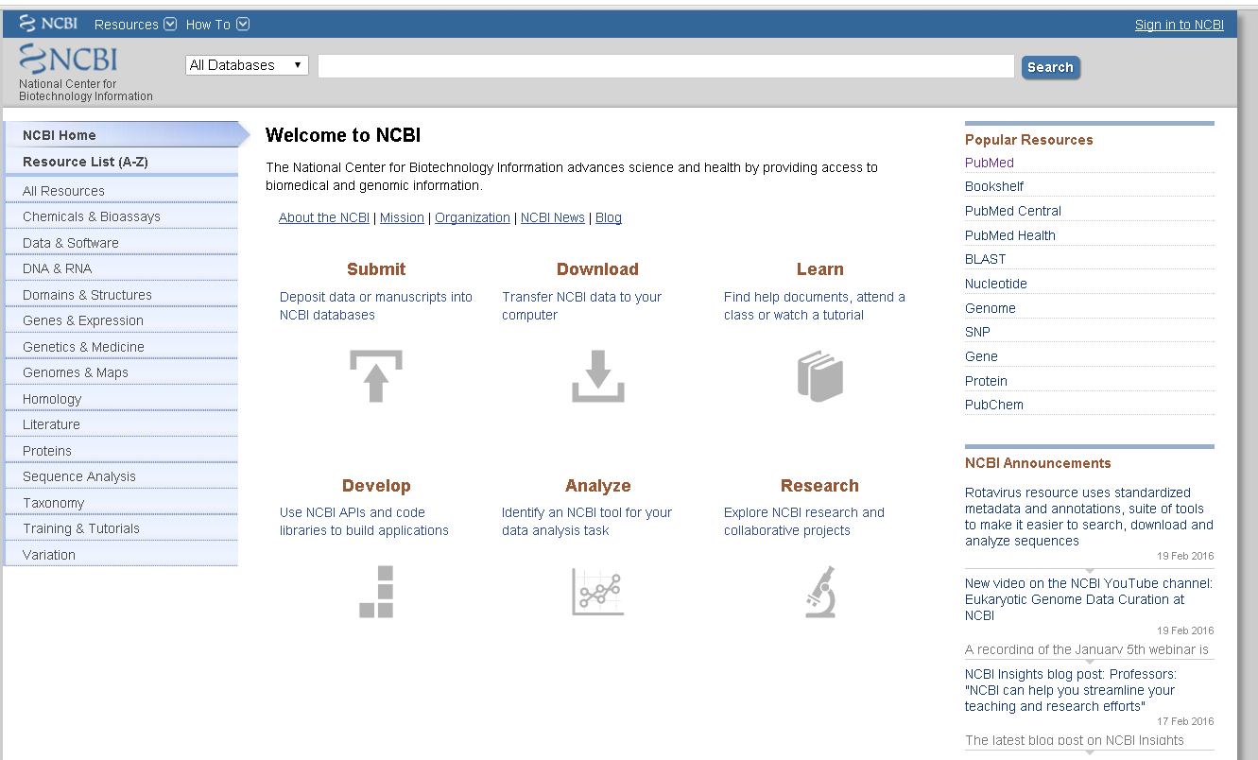

Slide 10
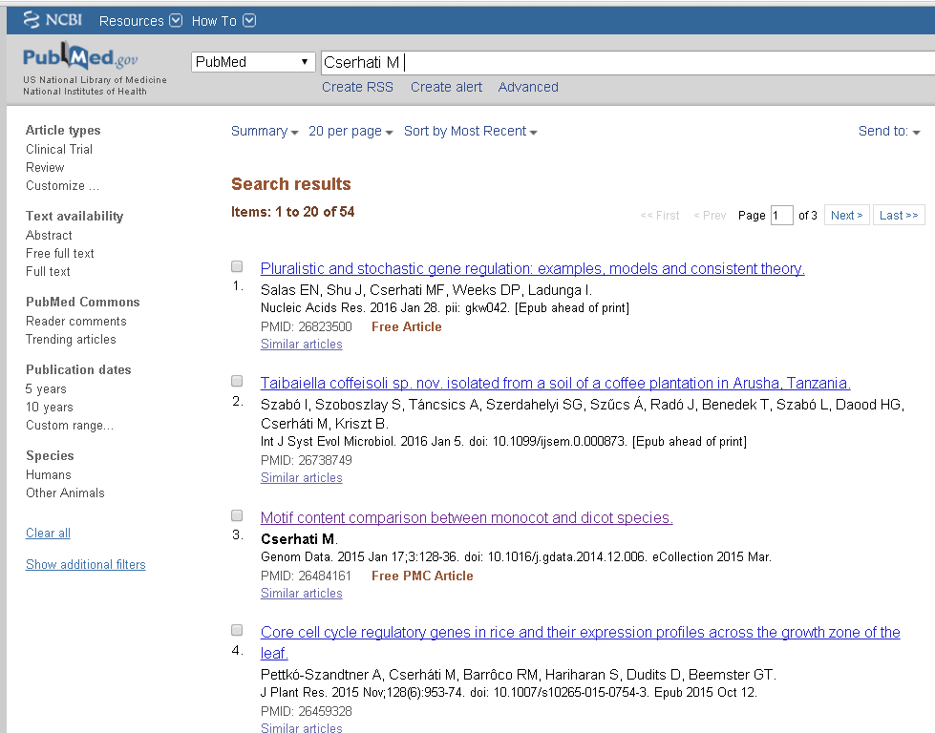

Slide 11
NCBI stats (2016)
RefSeq (experimentally validated seuqences)
  58.5M protein sequences
  13.7M transcripts (mRNA)
  60.000 species
Newly determined sequences are sent to NCBI prior to publication
  GenBank

Slide 12
BLAST
Basic Local Alignment Search Tool
Basic function is to measure similarity between two sequences (nucleotide and/or protein)
  Same/similar number/% of bp, aa
  Length of alignment
  E-value (probability of getting similar alignment by chance)
Otherwise used to compare a shorter query sequence with subject sequences in a database

Slide 13
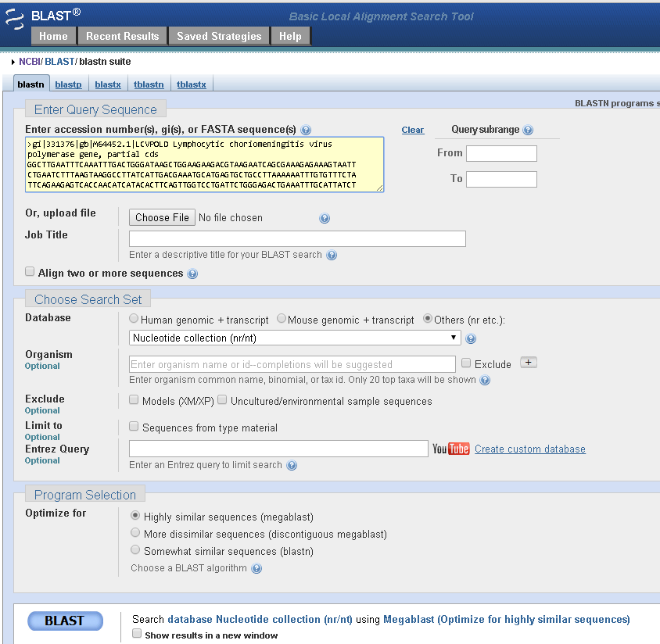
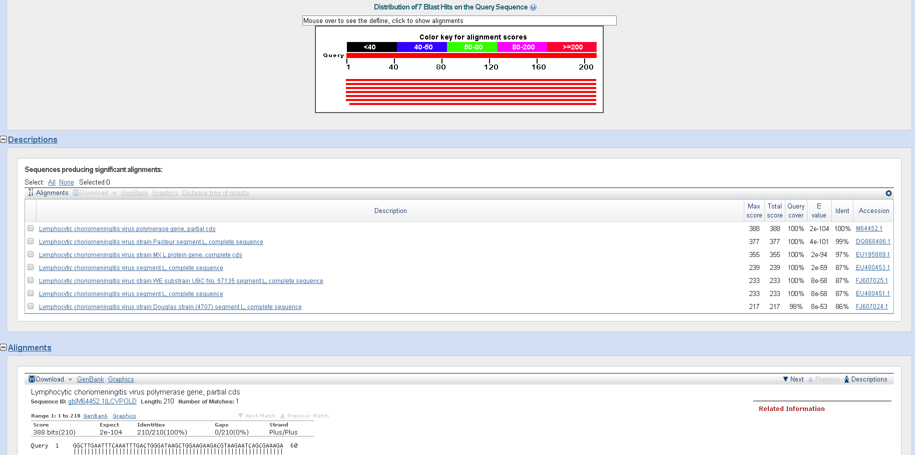
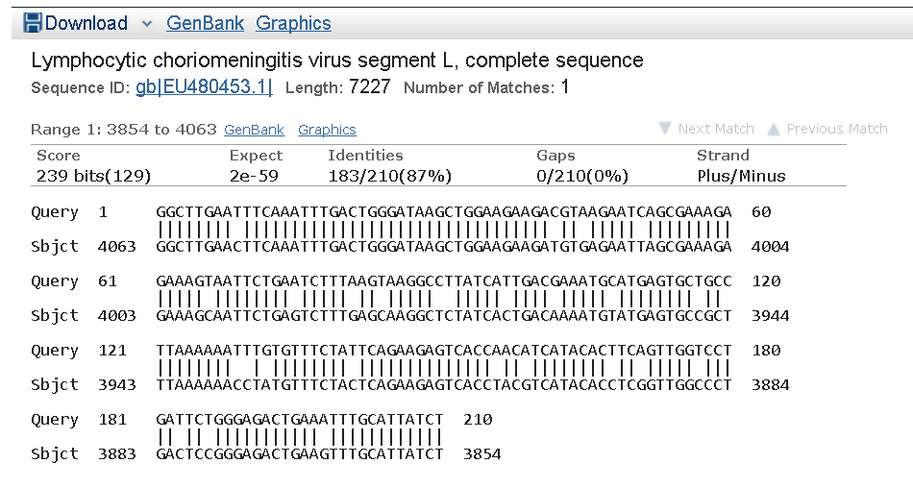

Slide 14
MySQL
Most commonly used database language
SQL: Structured Query Language
  Database design
  Data storage
  Data query
Command line language like Linux
Data stored in databases, data tables, columns, and rows
A single database can have 20-1000 tables for one project

Slide 15
Other well-known databases
EBI: European Bioinformatics Institute
Swissprot: protein database
EMBOSS: bioinformatics software
Transfac: regulatory motifs
PATRIC: pathogenic interactions db
UCSC Genome Browser
Ensembl: genetic data
JGI: curated db with genome, gene, protein sequences for different species
https://en.wikipedia.org/wiki/List_of_biological_databases

Slide 16
Dedicated databases
Data for one/few specific organisms
  Experimental systems
TAIR: Arabidopsis genetics data
Xenbase: frog (X. laevis)
Wormbase (C. elegans)
RGD: rat genome database
SGD: Saccharomyces genome db
FlyBase: D. melanogaster
SNiPHunter: SNP db/human

Slide 17
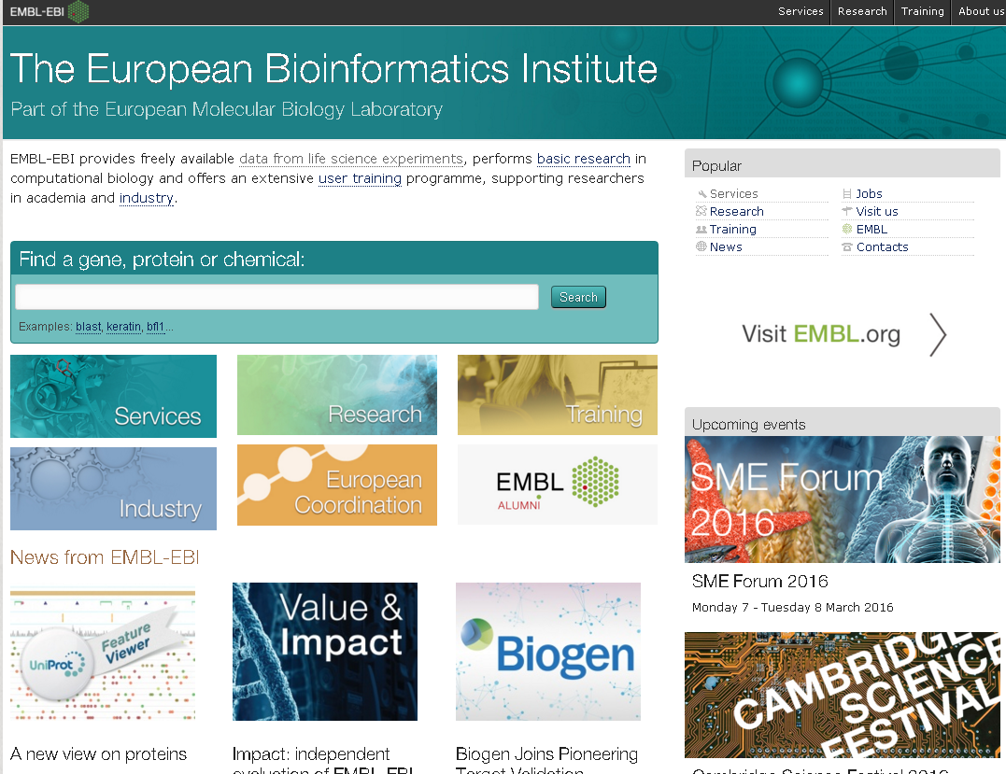
European Bioinformatics Institute (EBI)

Slide 18
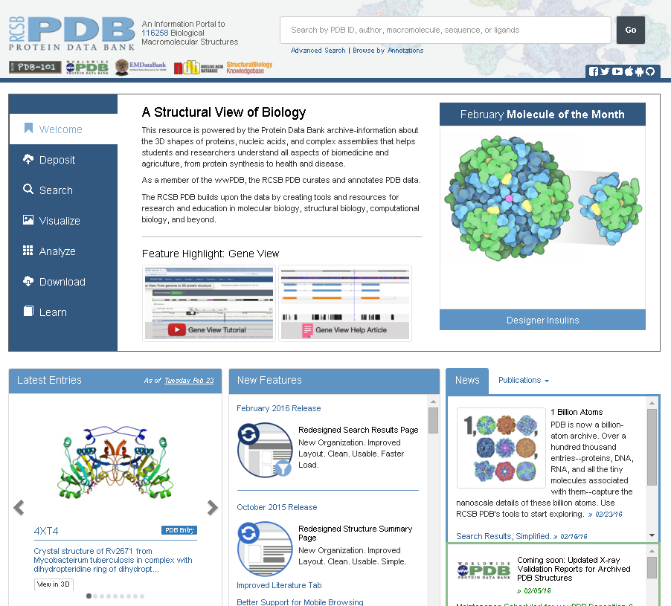
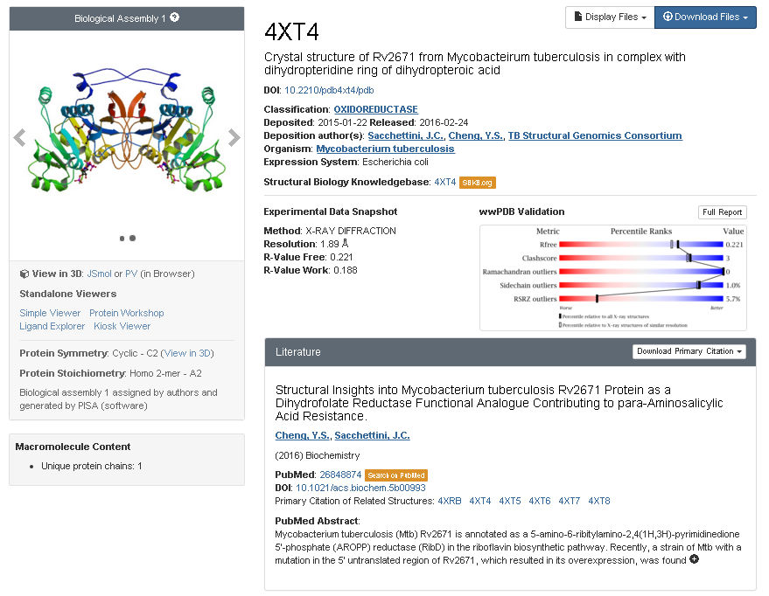
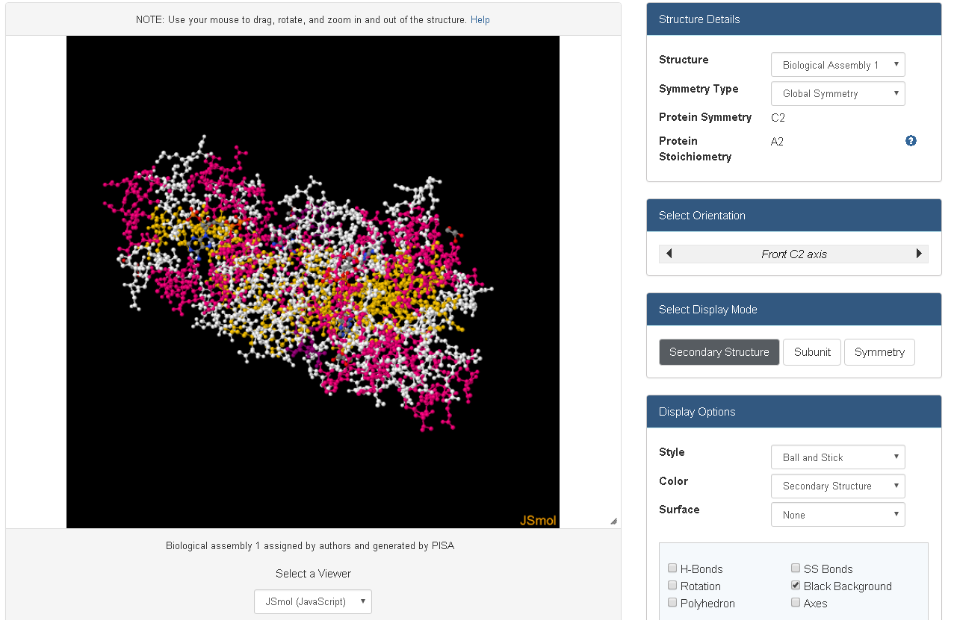
4XT4

Slide 19
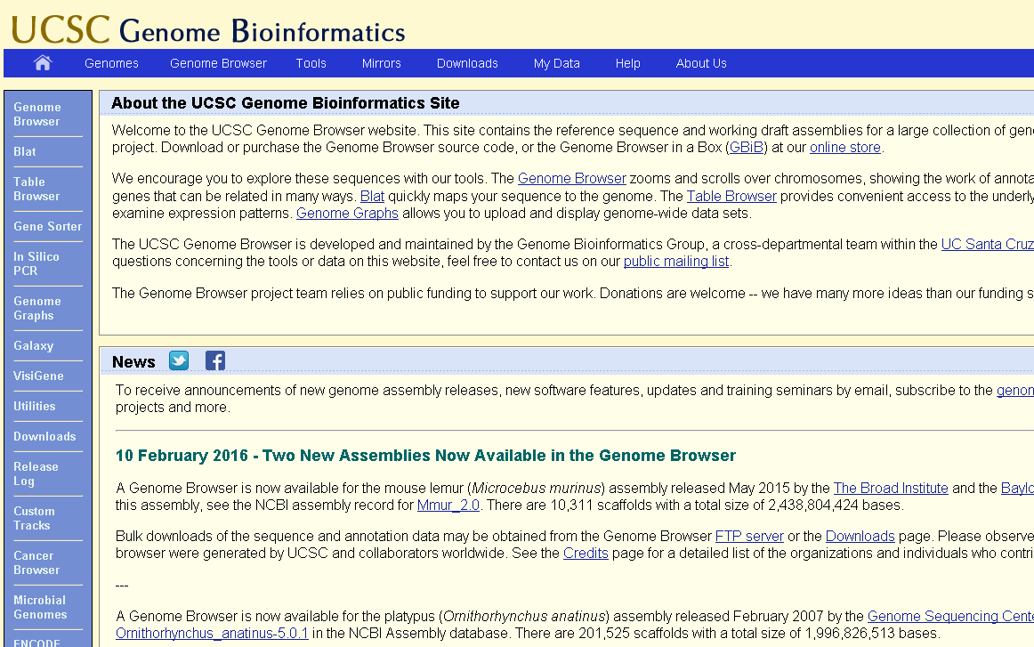

Slide 20
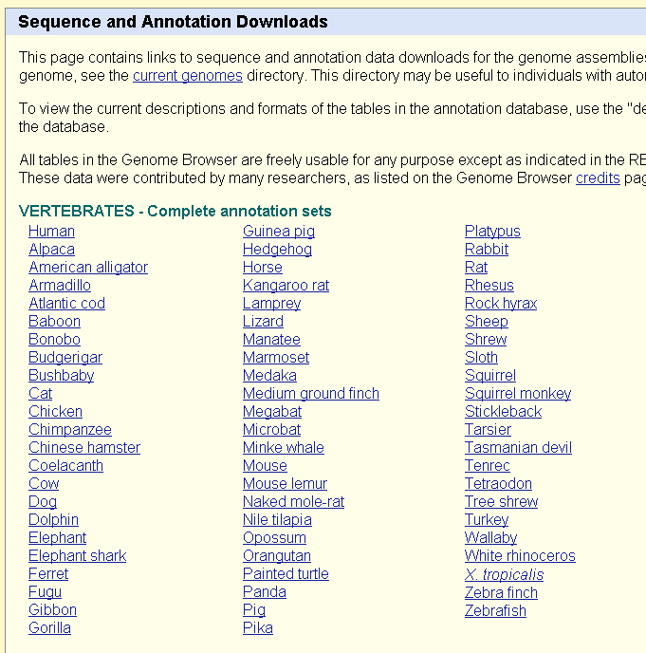
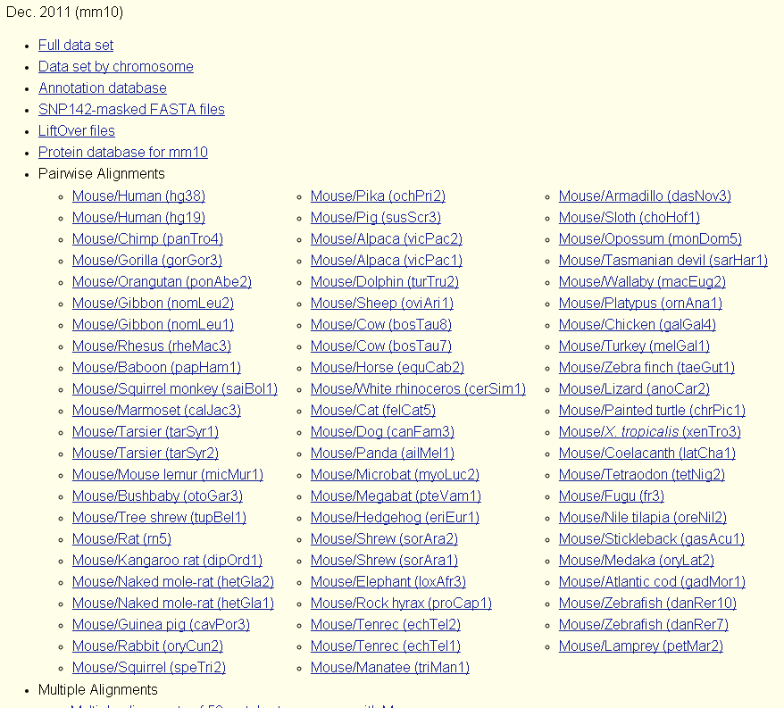

Slide 21
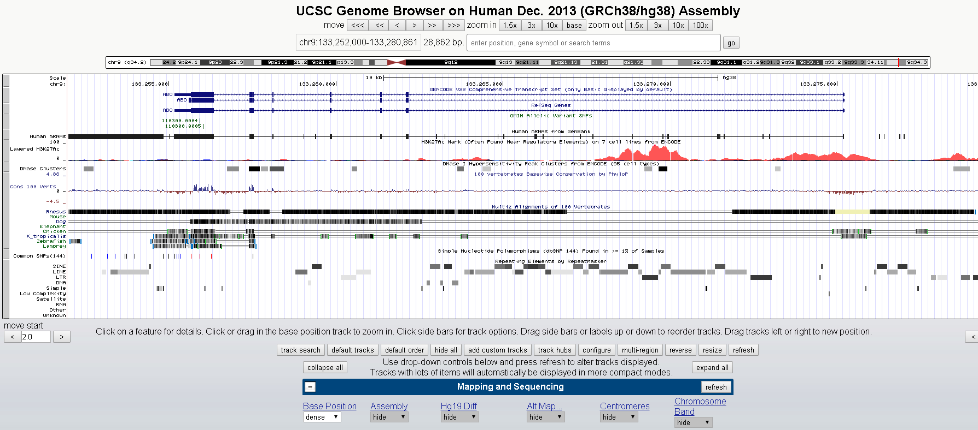

Slide 22
Data analysis

Slide 23
Tools used in data analysis
For those with background in genomics, proteomics, microarrays
Operating system is usually Linux but also Windows
  Linux is used for precise calculations, and code development
    RedHat, Centos
  Windows is used mainly for modelling

Slide 24
Languages used in bioinformatics
Data analysis languages: Matlab, perl, python, C, R (statistical functions)
  Modules: BioPerl, BioPython, Bioconductor
Database languages: PHP (Laravel), Java, Javascript, jQuery (dynamic content)
Data storage languages: MySQL, noSQL
Modelling software: Cytoscape, Matlab

Slide 25
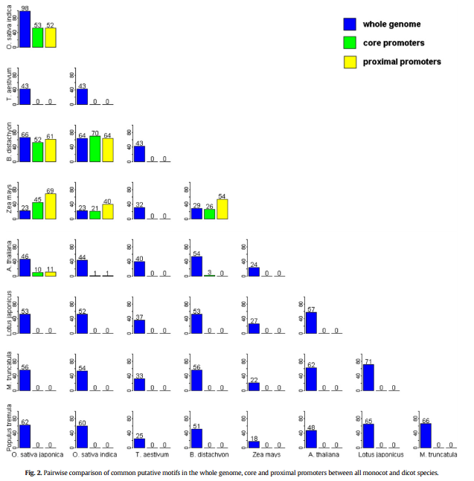
Figure from paper constructed in R

Slide 26
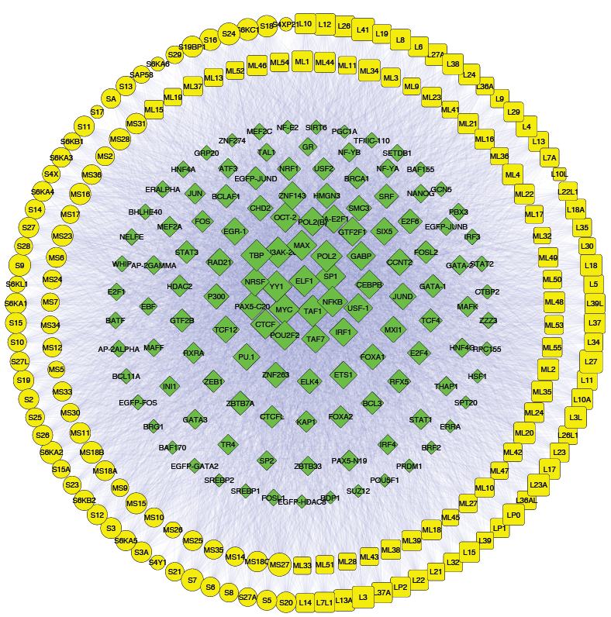
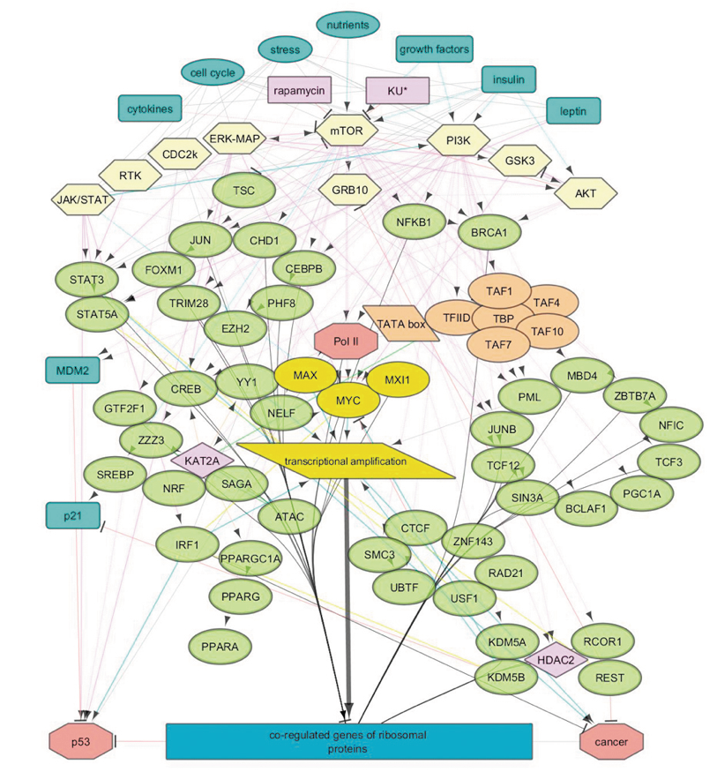
Ribosomal protein networks
Figures from presentation constructed in CytoScape

Slide 27
Linux
Command line operating system similar to DOS
Hierarchical folder system with permissions on files/directories
Useful for running programs and storing files in a systematic way
Not difficult to learn
  A lot can be done with 50 commands
  Many online guides

Slide 28
Data curation and annotation
Involves using algorithms in predicting biological structures
E.g. functional annotation of genes in virus genome project
  Using CLC Genomics to predict ORFS in de novo (unguided) assembled virus genome
  Using blast to find homologous viral genes with same function
  Structural prediction programs to predict 3D structure of proteins

Slide 29
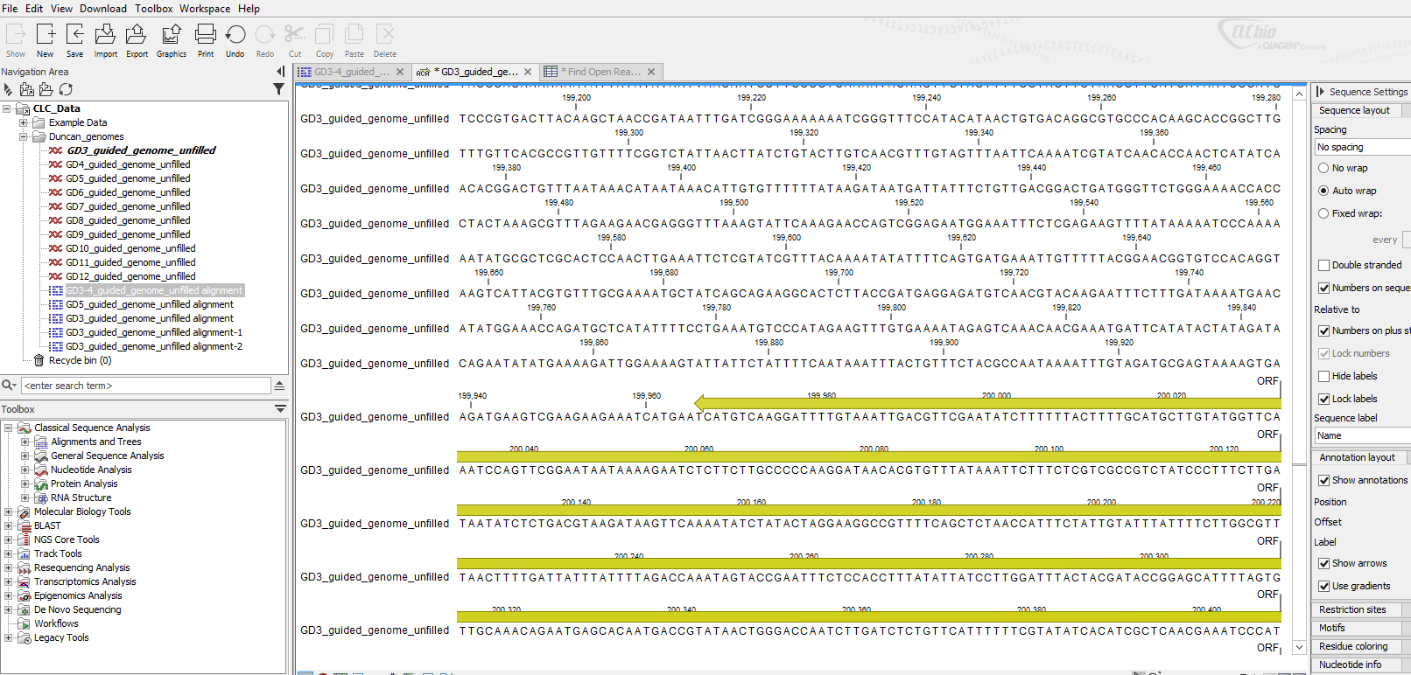

Slide 30
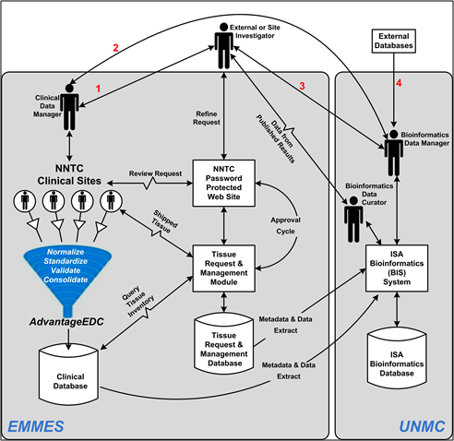

Slide 31
Structural bioinformatics
Deals with the prediction of 3D structures of biological macromolecules
  DNA, RNA, proteins
Disciplines: biochemistry, biophysics
Useful databases:
  Molecular Modeling database
  Protein Data Bank
  SCOP: Structural Classification Of Proteins

Slide 32
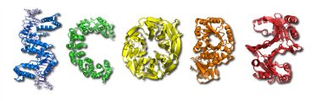
SCOP 2
http://scop2.mrc-lmb.cam.ac.uk/front.html
Classifies proteins into folds, superfamilies, families
More detailed structures at lower level of hierarchy
  E.g. b.1.12.1 - Purple acid phosphatase, N-terminal domain

Slide 33
Emboss programs for structural prediction
Nucleic 2d structure tool group
Protein 2d, 3d structure tool group
Nucleic RNA folding
Protein domains, functional sites, modifications

Slide 34
INBRE and the Guda lab at UNMC

Slide 35
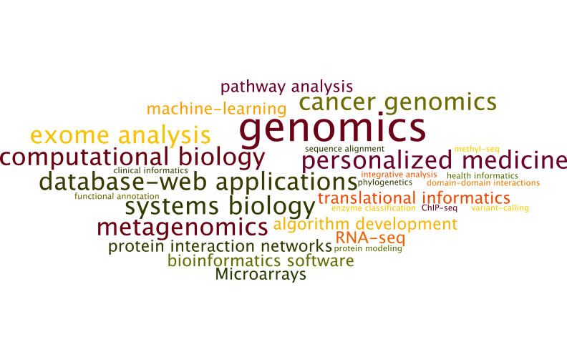
Thematic areas of research in Guda lab

Slide 36
Institutional Development Award Program (IDeA) Networks of Biomedical Research Excellence (INBRE) program
$17.2 million National Institutes of Health grant for Nebraska
biomedical research infrastructure that provides research opportunities for undergraduate students
pipeline for those students to continue into graduate research

Slide 37
INBRE Bioinformatics Core
  Infrastructure development
    Research IT Infrastructure (hardware, software, storage)
    Bioinformatics Infrastructure (computer servers, databases, software tools)
  Services, data analysis and application development
    An array of data analysis
    Development of new methods to keep up with emerging technologies (metagenomics, single-cell NGS data analysis, etc.)
    Software applications, web-based tools
  Educational and training activities
    Multi-omics Journal club
    Summer workshop on bioinformatics
Notes:
I have been working in this field for over a decade, and during this period I got an opportunity to work on a variety of problems related to Bioinformatics. I can broadly group all these projects under three research themes.

Slide 38
List of publicly available Bioinformatics programs on INBRE server
Affymetrix Annotation Converter
BLAST
BLAT
BRB-Array Tools
BioPerl
Bioconductor
Bowtie
Clustal2
Ensembl
Erlang
FASTX-Toolkit
Git
Glimmer
HMMER
I-TASSER
In-Silico PCR
MATLAB
MEME Suite
MaxQuant
Mfold
Microarray Analysis in R
Muscle
PHYLIP
PERL Modules
R
RiboSW
SQLite
Samtools
Weka

Slide 39
Survival analysis of TCGA Glioblastoma patients
Median: 345 days
Std dev: 201 days
Red: short-term survival group (med - 1 x std dev)
Green: long-term survival (med + 1 x std dev)
Blue: intermediate
Notes:
Calculated median and median absolute deviation for all patients with survival time data (346 patients)
▪Median: 345.5 days
▪MAD: 201 days
I divided the patients into long survival (survival > 345.5 + 201) and short survival (survival < 345.5 – 201)
Median closely matches 12 month median survival time reported in literature
Ran RnBeads again, noting these separate groups in the annotation file

Slide 40
TCGA-Pancreatic Cancer Data from 450K Methylation data (n=174 tumors, 10 normal)
Mishra and Guda (manuscript in preparation)
300 hypermethylated probes, 200 hypomethylated
Notes:
Short details for clustering of TCGA PAAD DNA methylation data:
We downloaded TCGA level3 Illumina Human Methylation 450kBeadArray DNA methylation data of 174 primary tumors and 10 normal samples by using Bioconductor tool “RTCGAToolbox”. We are using R package “impute” for the handling of missing values (but, if any probe are missing in more than 15% samples we are not considering those probes for further analysis). For differential methylation analysis we used Bioconductor tool “samr”. We did 1000 permutation and used cutoff 0.01 for both P-value and BH-Adjusted P-value for differential methylation analysis.
Details of figure:
We used β value of primary tumor samples (0.3 considered normal, <0.3 is hypo and >0.3 is hypermethylated) of top 300 hypermethylated and 200 hypomethylated probes for hierarchical clustering. For hierarchical clustering we are using Ward’s distance methods in R tool “hclust”. Our clustering method finds four major clusters in TCGA pancreatic cancer data.
(In clustering figure patients ID’s are on X-axis and CpG-ID’s on Y axis.)

Slide 41
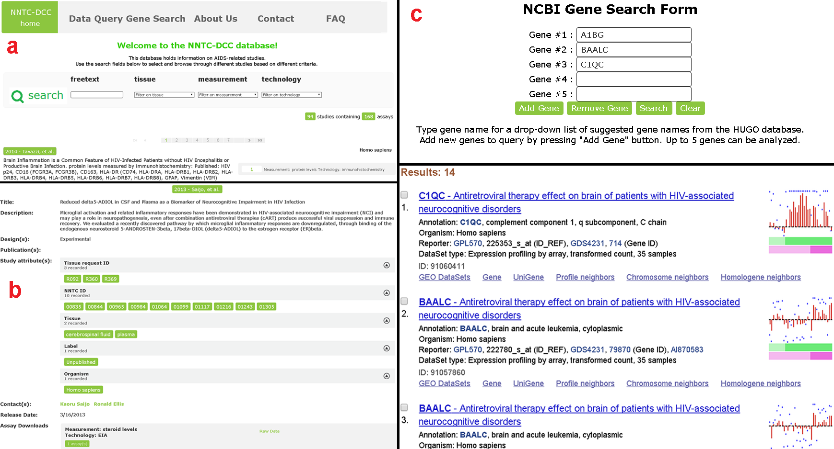
National NeuroAIDS Tissue Consortium Database
Cserhati et al, 2015

Slide 42
Assembly and annotation of large virus genomes
Ten giant virus genomes assembled de novo from read sequences (~330 kbp)
  Paramecium bursaria Chlorella virus (PBCV)
ORF discovery resulting in several hundred candidate gene sequences per strain
ORF sequences tblastx’d against known viral protein sequences
Many new genes with unknown functions
  Giant viruses a new domain of life
  Possible functional annotation with 2D/3D Emboss programs

Slide 43

The latest technology in Next Generation Sequencing
Genome assembly of Neanderthal and Denisova in 2010
  Low coverage (<5x)
Nanopore technology
Denisovan tooth from cave in Siberia
https://www.youtube.com/watch?v=3UHw22hBpAk

Slide 44
Summer Workshop on Bioinformatics
Workshop taught by Kiran Bastola (dkbastola@unomaha.edu) and Mark Pauley (mpauley@unomaha.edu) at UNO
Workshop Format
  Dates: July 2016
  Four consecutive Fridays from 9am to Noon
  Taught at 276, PKI
  Four modules, one on each day
  Topics covered:
    Gquery Entrez
    Biological database search
    Vector NTI
    Vector NTI/Ingenuity

Slide 45
Some useful links (hundreds of jobs)
http://www.jobs.com/q-bioinformatics-l-nebraska-jobs
http://www.iscb.org/iscb-careers-job-database (international level, good idea to be part of ISCB)
http://jobs.sciencecareers.org/jobs/bioinformatics/
http://jobs.newscientist.com/jobs/bioinformatics/ (international)
https://www.sciencemag.org/careers/features/2014/06/explosion-bioinformatics-careers (paper with tips on how to apply for bioinformatics jobs)

Slide 46



Acknowledgements
INBRE Bioinformatics Core Personnel Babu Guda, PhD Ashok Mudgapalli, PhD Mike Gleason, PhD Sanjit Pandey, MS Jim Eudy, PhD Genomics Core, UNMC Dr. Jim Turpen, UNMC | Support from Funding from INBRE
Thanks for your attention!

