Slide 1
Improving physician handoffs from EM to inpatient services:
SBAR-DR and .edadmit

Slide 2
Objectives
List barriers to safe patient care handoff between EM to admitting physicians
Describe elements of effective ED to inpatient handoff
Explain the SBAR-DR mneomic, and demonstrate it’s use in ED to inpatient handoff
Demonstrate use of handoff note template (.edadmit)

Slide 3
Our Team
Christopher Smith
Chad Branecki
Jordan Warchol
Nate Anderson
Stephen Ducey
Joel Michalski
Russ Buzalko

Slide 4
Current State Video
Link to video: http://www.unmc.edu/emergency/research/research.projects.html
Notes:
Bad Communication: https://dl.dropboxusercontent.com/u/42444517/BadComm3_FINAL.mp4?dl=1

Slide 5
Definitions
Handoff:
Communication between health professionals that accompanies the transfer of patient care responsibility
One form of ED consultation

Slide 6
The Problem
Poor communication and care transitions leading causes of sentinel events¹
Poor handoffs associated with unsafe, inefficient care²⁻⁴
Handoffs from ED to hospital especially challenging⁵⁻⁹
  Change in personnel, provider discipline, location
  Uncertain clinical trajectory, pending tests, uncertain responsibilities
  Surrogates with variable experience
  Inter-disciplinary conflict & cultural differences
Standardized communication rarely used and resident training uncommon¹⁰

Slide 7
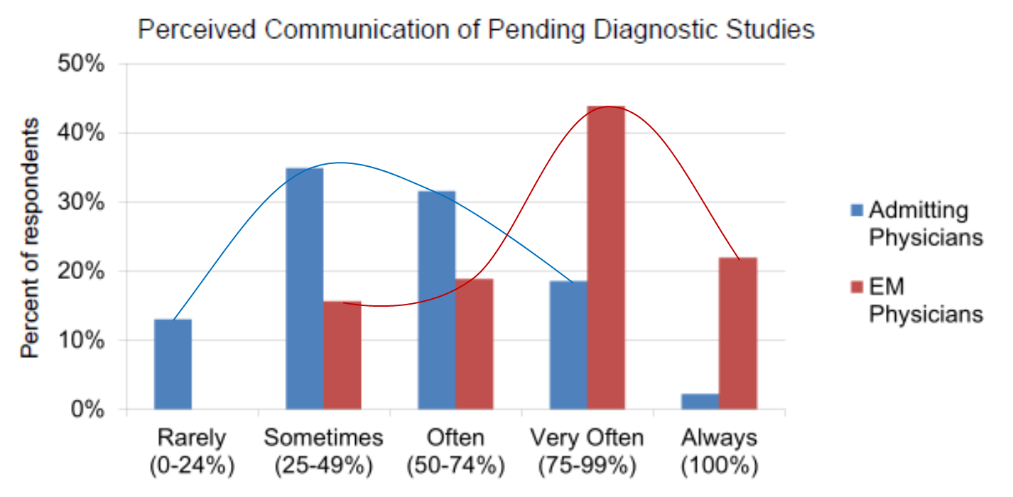
Internal Survey Data
Divergent perceptions (EM vs admitting)
  Quality of communication
  Safety of handoffs
  Clinical information (e.g. test results, treatments)
P<0.05

Slide 8
Internal Survey Data
Uncertain assignment of responsibility
94% of EM physicians felt defensive at least “sometimes”
30% of all physicians reported adverse events related to ED admission handoff in past 3 months

Slide 10
SBAR-DR
Goal: To improve the quality and reliability of verbal and written handoff communication between EM and admitting physicians
  Based on evidence and expert recommendations.
  Clinical judgment & discussion, rather than one-way “data dump”
  Explicit assignment of responsibility

Slide 11
Situation | Introduction: name, rank, and department Admission vs. consult Working diagnosis/Ddx
Background | Patient identification Relevant history, demographics, medications, etc. Relevant exam findings, with vitals Relevant test results
Assessment | Severity: assess on the floor/within 1 hr/ASAP Treatments in ED and patient response Degree of certainty in diagnosis and rationale
Responsibilities & Risks | Pending tests/tasks and who is responsible Risks to patient/special circumstances (e.g. boarding)
Discussion & Dispo | Questions Can ED place bed request? Yes→Admitting accepts responsibility No→Admitting to assess prior to accepting responsibility*
Read-back & Record | Admitting doc read-back of pending tests and dispo EP completes written handoff note (.edadmit)

Slide 12
Situation
Introduction: name, rank, and department
Admission vs. consult
Working diagnosis/Ddx

Slide 13
Background
Patient identification
Relevant history, demographics, medications, etc.
Relevant exam findings, with vitals
Relevant test results and interpretation

Slide 14
Assessment
Severity of illness (3 levels):
  Stable – can assess on the floor
  Intermediate – assess within 1 hr
  Cautious – assess ASAP
Treatments in ED and patient response
Degree of certainty in diagnosis and rationale

Slide 15
Responsibility & Risk
• Pending tests/tasks and who is responsible for f/u
• Risks to patient/special circumstances
  Prolonged boarding times
  Active psychiatric conditions
  Language barriers
  Isolations
  DNR status

Slide 16
Discussion and Disposition
Questions/discussion
Can ED place bed request?
  Yes→Admitting accepts responsibility prior to patient assessment
  No→Admitting to assess prior to accepting responsibility. Dispo plan within 60 min.
Responsibility for patient care transferred at time of admission order.

Slide 17
Read-back & Record
Read-back from admitting physician
  Case summation & severity of illness
  Pending tests and responsible party
  Disposition plan
EP completes written handoff note
  .edadmit

Slide 18
Situation | Introduction: name, rank, and department Admission vs. consult Working diagnosis/Ddx
Background | Patient identification Relevant history, demographics, medications, etc. Relevant exam findings, with vitals Relevant test results
Assessment | Severity: assess on the floor/within 1 hr/ASAP Treatments in ED and patient response Degree of certainty in diagnosis and rationale
Responsibilities & Risks | Pending tests/tasks and who is responsible Risks to patient/special circumstances (e.g. boarding)
Discussion & Dispo | Questions Can ED place bed request? Yes→Admitting accepts responsibility No→Admitting to assess prior to accepting responsibility*
Read-back & Record | Admitting doc read-back of pending tests and dispo EP completes written handoff note (.edadmit)

Slide 19
SBAR-DR Video
http://www.unmc.edu/emergency/research/research.projects.html
Notes:
Good Communication: https://dl.dropboxusercontent.com/u/42444517/GoodComm2_FINAL.mp4?dl=1

Slide 20
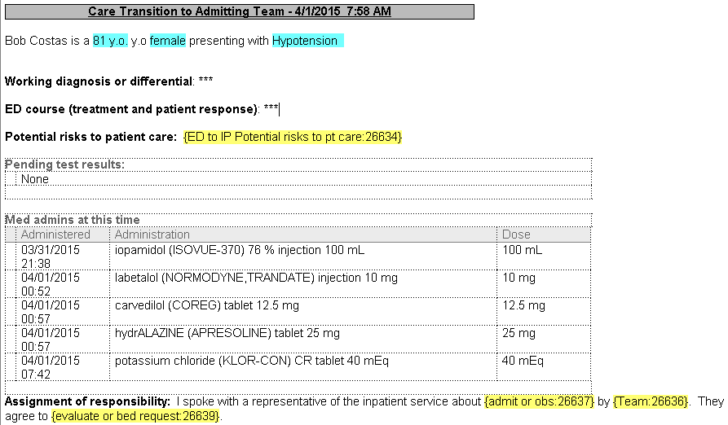
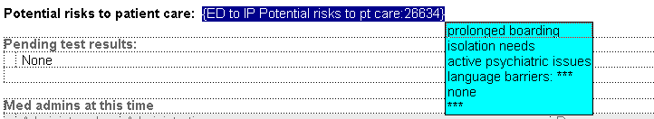
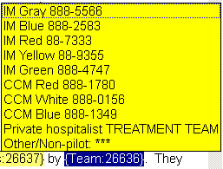

Handoff note (.edadmit)

Slide 21
Pilot
Go-live April 9, after training sessions complete
Services:
  Academic IM
  Private hospitalists
  CCM

Slide 22
Final thoughts
Handoff communication is context specific
  Simple vs. complex patient
  Experienced vs. novice physician¹⁰
Locate ED nurse to review POC.
Physician conflict mitigated by trust and familiarity^{9,11}
  Be nice and get to know each other
We welcome feedback.
Notes:
Consider learn needs and provide feedback

Slide 23
References
The Joint Commission. Sentinel event data: root causes by event type 2004-2013. http://www.jointcommission.org/assets/1/18/Root_Causes_by_Event_Type_2004-2Q2013.pdf. Accessed July 25, 2014.
Kitch BT. Handoffs causing patient harm: A survey of medical and surgical house staff. Jt Comm J Qual Patient Saf. 2008; 34:563.
Horwitz LI. Consequences of inadequate sign-out for patient care. Arch Intern Med. 2008; 168:1755.
Ong MS, Coiera E. A systematic review of failures in handoff communication during intrahospital transfers. Jt Comm J Qual Patient Saf. 2011; 37:274-284.
Hilligoss B, Cohen MD. The unappreciated challenges of between-unit handoffs: Negotiating and coordinating across boundaries. Ann Emerg Med. 2013; 61:155-160.
Beach C, Cheung DS, Apker J, et al. Improving interunit transitions of care between emergency physicians and hospital medicine physicians: A conceptual approach. Acad Emerg Med. 2012; 19:1188-1195.
Horwitz LI, Meredith T, Schuur JD, Shah NR, Kulkarni RG, Jenq GY. Dropping the baton: A qualitative analysis of failures during the transition from emergency department to inpatient care. Ann Emerg Med. 2009; 53:701-10.e4.
Apker J, Mallak LA, Gibson SC. Communicating in the "gray zone": Perceptions about emergency physician hospitalist handoffs and patient safety. Acad Emerg Med. 2007; 14:884-894.
Matthews AL, et al. Emergency physician to admitting physician handovers: An exploratory study. Proceedings of the human factors and ergonomics society 46th annual meeting 2002.
Kellser C, et al. A survey of handoff practices in emergency medicine. Amer J of Med Qual. 2014;29(5):408-414.
Chan T, Bakewell F, Orlich D, and Sherbina J. Conflict prevention, conflict mitigation, and manifestations of conflict during emergency department consultations. Acad Emer Med. 2014; 21(3):308-13.
Chan T, et al. Understanding communication between emergency and consulting physicians: a qualitative study that describes and defines the essential elements of the emergency department consultation-referral process for the junior learner. CJEM. 2013;15(1):42-51.
Chan t, Sabir K, Sanhan S, Sherbino J. Understanding the impact of residents’ interpersonal relationships during emergency department referrals and consultations. JGIM. 2013 Dec;5(4):576-81.

