Slide 1
Multicolor Flow Cytometry: Optimizing Performance for Expanding Colors into High Parameter DATA collection
Anthony L. Steichen, Ph.D.
High Parameter
Field Application Scientist
For Research Use Only. Not for use in diagnostic or therapeutic procedures.
APC-Cy7: US Patent 5,714,386
Alexa Fluor® is a registered trademark and Pacific Blue™ is a trademark of Life Technologies Corporation.
CF is a trademark of Biotium, Inc.
Cy™ is a trademark of GE Healthcare. Cy™ dyes are subject to proprietary rights of GE Healthcare and Carnegie Mellon University and are made and sold under license from GE Healthcare only for research and in vitro diagnostic use. Any other use requires a commercial sublicense from GE Healthcare, 800 Centennial Avenue, Piscataway, NJ 08855-1327, USA.
BD, BD Logo and all other trademarks are property of Becton, Dickinson and Company. © 2014 BD
Notes:
How we are going to do this, we have the talks in several parts, and I will give the first talk, and that is REVEAL. What we’re going to talk about in this first segment is the importance of fluorochromes in panel design. You’re all doing flow cytometry and you’re all using various fluorochromes. And what we will do in this first talk is really take you through what is new in the choices that you have in the fluorochromes that are available to you and how you can incorporate that into your panel design to make the best multicolor panel possible.

Slide 2
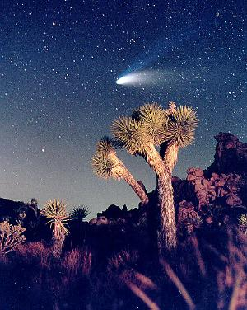
Revealing What is Hidden
CD19→
The most basic information to be derived from any flow cytometry experiment is whether the cells of interest are positive for a given marker
  Flow cytometry’s major challenge is revealing dim events / populations which are hidden in the background.
CD8→
CD25→

Slide 3

What are TWO major considerations BEFORE embarking on Multicolor panel design?
Experimental Goal/Question
Instrument Configurations and Capabilities

Slide 4
Elements of Multicolor
Flow Cytometry
Considerations in designing panels:
Fluorochrome Characteristics and Availability
Biology: Cell Type, Antigen Characteristics
Instrument Setup and QC; Spillover
Notes:
This morning you have heard about fluorochromes, biology, and characteristics of the instrument that are very important to take into consideration when it comes to panel design.
In this talk I am going to take all that information and show you how to apply it in order to logically design multi-color flow cytometry panels.

Slide 5
Fluorochromes
Expanded range of choices to
reveal biological context

Slide 6
Evolution of Fluorochromes
Sirigen
polymers
367 CD markers
Intracellular proteins
  Cytokines
  Cell signaling
  Transcription factors
  Phosphoproteins
Availability of fluorochromes has driven major advances in flow cytometry
Qdots®
Tandems
(protein)
Phycobiliproteins
Organic Dyes
Notes:
At this time we have over 367 CD markers have been put through the HLDA workshops and this graph shows how the fluorochromes have evolved over time
Started with the organic dyes – a couple of them and then came the phycobiliproteins – they provided limited options – and were followed by the tandem dyes – which while they had some limitations in use – provided some choices. Most of these were off the blue and red lasers, which was the most used configuration
The next set of fluorochromes available were the Qdots and they used the violet laser and provided some choices and allowed use of increasing number of colors in experiments being done.
In the last 2 years – we have a new set of dyes – using the novel patented technology from Sirigen – violet and UV dyes – these are bright dyes and significantly increase the choices available and allows us to continue to evolve the fluorochromes available

Slide 7
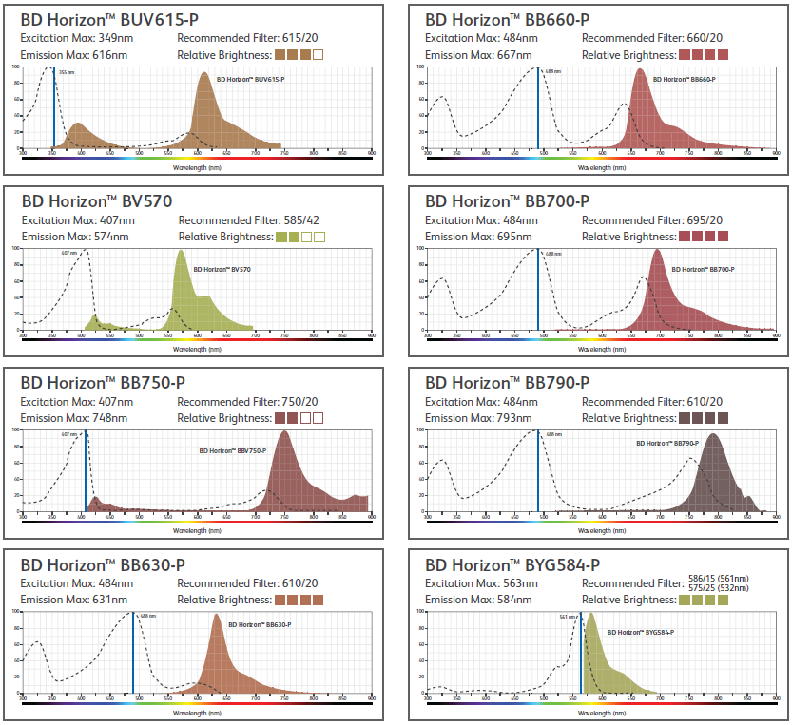
High parameter dye portfolio
COMPANY CONFIDENTIAL
BV750

Slide 8
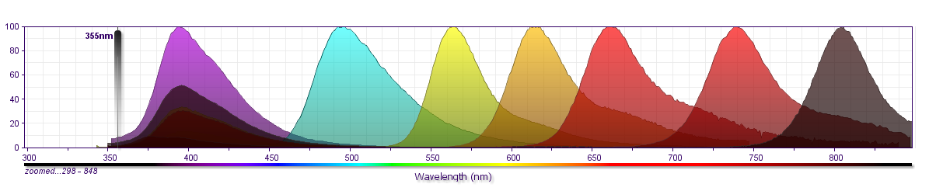
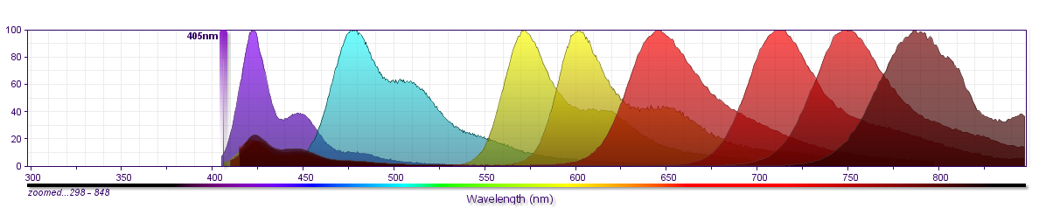
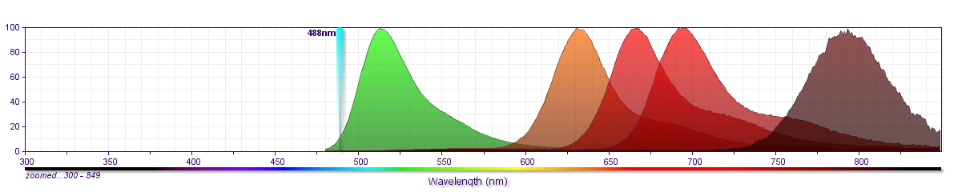
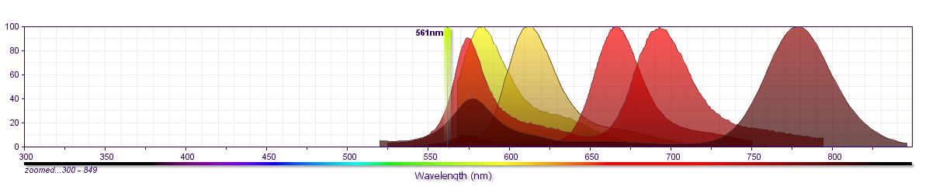
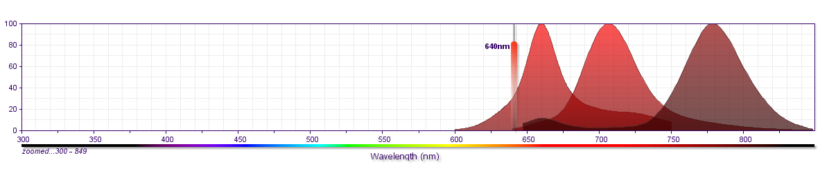
Dye Menu (Commercial + HP)
Laser | #
UV | 7
Violet | 8
Blue | 5
Green | 5
Red | 3
Fluorochrome Menu
1 | UV | BUV395
2 |  | BUV496
3 |  | BUV563
4 |  | BUV615-P
5 |  | BUV661
6 |  | BUV737
7 |  | BUV805
8 | Violet | BV421
9 |  | BV480
 |  | BV510
10 |  | BV570
11 |  | BV605
12 |  | BV650
13 |  | BV711
14 |  | BV750
15 |  | BV786
16 | Blue | BB515
 |  | FITC
 |  | AF488
17 |  | BB630-P
18 |  | BB660-P
19 |  | BB700-P
 |  | PerCP
 |  | PerCP-Cy5.5
20 |  | BB790-P
21 | Yel-Grn | BYG584-P
 |  | PE
22 |  | PE-CF594
23 |  | PE-Cy5
24 |  | PE-Cy5.5
25 |  | PE-Cy7
26 | Red | APC
 |  | AF647
27 |  | APC-R700
 |  | AF700
28 |  | APC-Cy7
 |  | APC-H7
BUV496
BUV615-P
BUV737
BUV395
BUV563
BUV661
BUV805
BV421
BV570
BV650
BV750
BV480
BV605
BV711
BV786
BB630-P
BB700-P
BB515
BB660-P
BB790
PE-CF594
PE-Cy5.5**
BYG584
PE-Cy5
PE-Cy7
APC-R700
APC
APC-H7

Slide 9
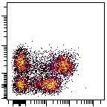
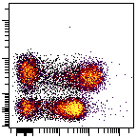
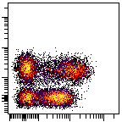
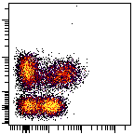
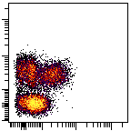
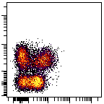
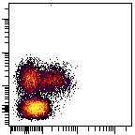
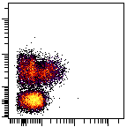
Fluorochromes Reveal Biology
PE
PE-CF594
BV421
Alexa Fluor 647
CD3
PerCP-Cy5.5
Alexa Fluor 700
V450
FITC
CD197 (CCR7)
Choice of fluorochrome helps understand more about the biology of the experiment.
Bright dyes are important when looking at dim antigens.
Notes:
Here what we are showing is cd197 on the x axis and cd3 on the y axis. And here, we are pairing cd197 with fluorochromes of different brightness. If you are familiar with these fluorochromes, looking at the first three, PE, PE-CF594, and BV421. So if we look at those three fluorochromes, you see that your best able to resolve the four subsets that you are looking for in that experiment. So, depending on what you’re studying, it’s very important to have the right fluorochromes paired with the right partners. And the rule of thumb is that we are always pairing dim low density antigens with bright fluorochromes to make sure we are not missing any of the biology.

Slide 10
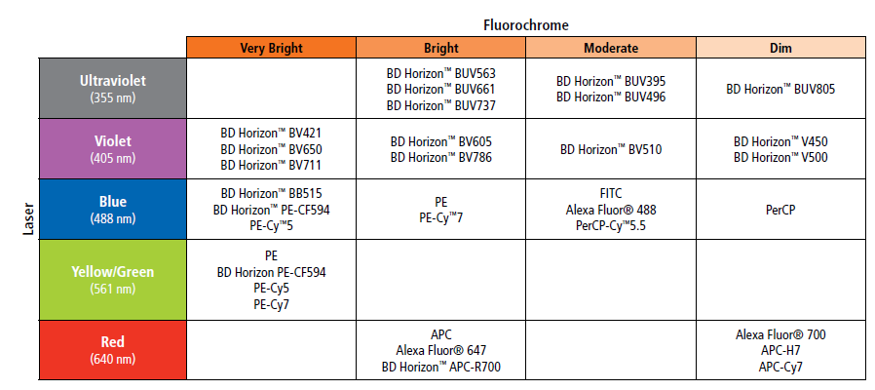
Fluorochrome Resolution Ranking
Rankings were determined by comparing the resolution of LWB cells stained on several clones run on a variety of flow cytometers.
Many factors can influence the relative fluorochrome/reagent performance on a given instrument, including laser power, PMT voltage, optical filters, antibody clone, biological sample, and staining methodology.

Slide 11
Elements of Multicolor
Flow Cytometry
Considerations in designing panels:
Fluorochrome Characteristics and Availability
Biology: Cell Type, Antigen Characteristics
Instrument Setup and QC; Spillover
Notes:
This morning you have heard about fluorochromes, biology, and characteristics of the instrument that are very important to take into consideration when it comes to panel design.
In this talk I am going to take all that information and show you how to apply it in order to logically design multi-color flow cytometry panels.

Slide 12
Poll
Are you currently using Antigen Density information to help you build your panels?
How are you currently getting information about Antigen expression characteristics to inform multi-color panel design?
Notes:
Before we start, and I share with you data. I’d like to ask you a couple of questions:
If you haven’t used this technique, are there other ways you have used or know of that give you the relative numbers on a cell. One way…to take all of the different antibodies that you’re going to use in cocktail and get them in a PE-conjugate. And then test in different tubes, each one of them separately and monitor the MFI shift. …a high shift, many receptors…a small shift, very few receptors. This is a common way that may people do it…and it gives very useful information that we can then use to design our multicolor panels. But there’s a lot of information that we can get from a cell if we understand how many receptors are on the surface of a cell.
--------
Trying to get the audience involved.
We will be providing this information across all the different Ags, and across many different subsets

Slide 13
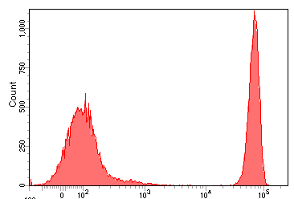
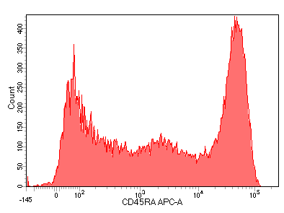
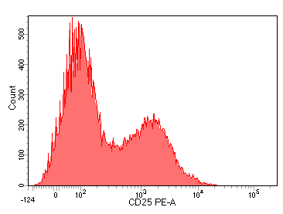
Classification of Antigens
Leucocyte antigens can be categorized based upon their patterns of expression
Primary: Well characterized, easily classified as positive or negative, typically define broad subsets or lineages
  Examples: CD3, CD4, CD19
CD4
CD45RA
Secondary: Well characterized, typically expressed at a higher density, often over a continuum
  Examples: CD27, CD28, CD45RA, CD45RO
Tertiary: Expressed at low levels, variable upon activation unknown, critical
  Examples: CD25, STAT5, FoxP3
CD25
Mahnke YD, Roederer M. Optimizing a multicolor immunophenotyping assay. Clin Lab Med. 2007;27:469-485.
Notes:
They classified the antigens on the surface in three different way.
They called primary antigens so your CD3, CD4, CD19, where there is a very nice difference between your positive and your negative. Again, you can dilute those antibodies down. We all know that we are building those multicolor panels you can get away with a little less antibody in there. But these are antigens that highly expressed and don’t really change over time and there is a fairly good separation between the negative and the positive.
The second category is the secondary antigens. These were usually typically higher densities expressed over a continuum. CD45RA is a great example. But, really what this is is many different subsets of cells that express different amounts of CD45RA. It’s not that all cells produce those different amounts, it’s that there are different subsets of CD45RA that produce different amounts of CD45RA and have unique numbers and if we can pull those out we can figure out which one is which.
Then the third one is the one that are expressed at low levels. When they are pushed with antigens or are activated, then again we can get a bigger separation. The choice of the colors that you have based if you have an activation marker for example matters a lot too.

Slide 14
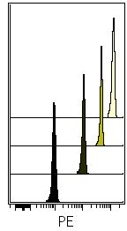
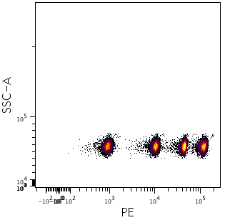
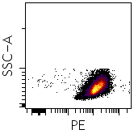
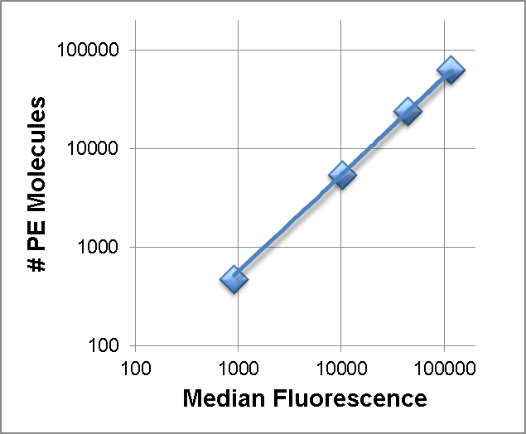
Using BD Quantibrite™ Beads
For Antigen Enumeration
Quantibrite Beads
# PE Molecules | Median Fluorescence
474 | 913
5359 | 10367
23843 | 44342
62336 | 117857
Gate four
Populations
Determine relationship of
# PE molecules to MFI
Use MFI of stained
sample to calculate
Ag density
# PE =.53 x MFI
Notes:
Several years ago there was a technology developed by bd, it had a name, quantibrite. It is a technology that was developed to give us the amount of receptor on a cell. It has two parts. There are beads with different amounts of pe. On the second side, was the Ab. We can purify pe-Ab conjugates such that we have 1:1 conjugates, 1 molecule of pe and 1 molecule of Ab.
We take the four populations run on a flow cytometer and we can express the median channel fluorescence shift and correlate that to the number of pe molecules. We can graph that information from low to high. Using that approach then, if we take an ab with a 1:1 conjugate for any specificity, we can then take the MFI for that population and simply read it on the graph and be able to express the number of pe molecules on the surface of the cell.
This is an approach that is used by many people to determine the number of pe molecules for any receptor.

Slide 15
Antigen Density Project
Antigen density analyses was performed on blood cells from 12 individuals, covering a range of ages and genders (3 male/3 female each from young/old groups).
Each antigen of interest was measured using a PE-conjugated antibody.
 | Antibodies in Panel | Cell Populations Identified
Panel 1 (B/T) | CD3, CD4, CD8, CD25, CD127, CD45RA, CCR7, CD19, IgD, CD27 | Naïve, EM, CM, and TEMRA populations (defined by CD45RA & CCR7) from CD8 & Th cell subsets CD45RA⁺ Treg cells CD45RA⁻ Treg cells | Naïve B cells Non−class-switched memory B cells Class-switched memory B cells
Panel 2 (non-B/T) | CD61, CD45, CD3, CD19, CD14, CD16, CD56, HLA-DR, CD123, CD11c | Platelets Neutrophils Basophils Eosinophils Monocytes (subsets based on CD14 & CD16) | CD56^{dim}CD16⁺ NK cells CD56^{bright} NK cells NKT cells (CD3⁺ CD56⁺) mDC pDC
Notes:
We created two panels. We used a panel design method that you are going to see later…for the selection of colors
The first is a B/T panel, and you can see all of the different subsets that we’re able to identify with that panel
We used PE as a drop in. so we made 367 cocktails, and then we put PE CD1 in the first, and PE CD2…and all the way to CD367
In the Ag density Program – we examined the cells from 12 individuals covering age groups and genders – but to address at a higher plex at the subset level for many cell types – we established two different panels – a B/T cell and a non B/T myeloid panel. Point out the antibodies used and the different subpopulations that can be identified using the panel.

Slide 16
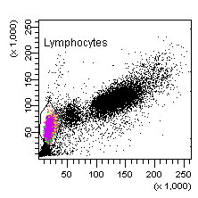
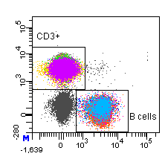
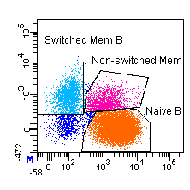
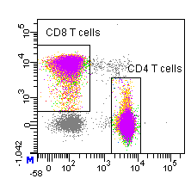
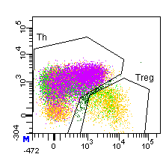
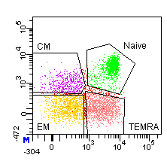
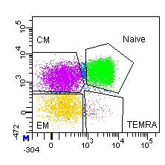
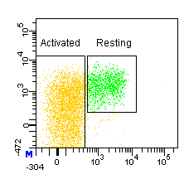
B/T Panel
Singlets
Lymphocytes
B cells
Fluorochrome | B/T Panel
BD Horizon™ V450 | CD45RA
BD Horizon™ V500 | CD3
FITC | CD4 + IgD
PerCP-Cy™5.5 | CD19
PE | Drop-in
PE-Cy™5 | CD25
PE-Cy™7 | CD127
APC Alexa Fluor® 647 | CCR7 (Ax647)
Alexa Fluor® 700 | CD27
APC-H7 | CD8
FSC
CD3
CD27
SSC
CD19
IgD
CD3⁺ Lymphocytes
CD4 T cells
CD8
CD127
CD4
CD25
CD8 T cells
Th cells
Treg cells
CCR7
CCR7
CCR7
CD45RA
CD45RA
CD45RA
Notes:
Goal is to find out the expression level of a certain marker that we are putting on pe.
Repeat back the full method…say the gating, the expression of marker, and relate back to quantibrite
Here is the data, here’s how it looks. So first we created the panel. You can see the panel here. We made 367 cocktails, and then a different cd marker – conjugated to PE – into those separate cocktails. PE-CD1, PE-CD2, all the way to PE-CD367. and then we analyzed the data. Here you can see the populations we have gated on in this B/T panels…we used those gated populations to determine antigen expression levels – for each one of those CDs – in each one of those subsets you see here. This study created over 200,000 data points. that are going to be shared, that are going to be published, and they will be presented on the BD website for you to use in help design of your multicolor panels.

Slide 17
Grouping Antigen Density: T Cells
When evaluating antigen density, it can be useful to group antigens based on their relative levels of expression.
Average number of molecules on T cells
High
>15,000
100,000
BD LSRFortessa™
40,000
BD FACSVerse™
Sample
Medium
1,000–15,000
10,000
4,000
No. PE Molecules
Low
<1000
1,000
400
100
Notes:
Now we took a cocktail, a T-cell cocktail that’s going to be used all throughout this presentation. We took on two different instruments that were set up with CST and we had three different samples for each one of them and we took a panel and we simply calculated the number of molecules of PE on each one or the number of antibodies that were bound per cell. So we calculate, to the best of our ability, the number of molecule of antibodies bound to CD8 at the surface of the cell all the way to CD132. We simply plot them here.
When we look at it, as we can group with color we can group with antigen density. We have a group that is greater than 15000, we have a group that is 1000 to 5000 and we have a group that is very very low.
Now it is very interesting that in flow, the efficiency of calculating a photon of light is actually very good. When we worked with our Cytof technology, again, as a scientist that was part of those original publications myself, being able to look at those low cell surface number or low antigen numbers is kind of an issue when working with the Cytof. It is a little bit harder at the end, just because the efficiency of calculating or measuring a mass unit. So the data we are going to show you can help you both in your mass cytometry as well as with your flow.

Slide 18
Antigen Density
T cell panel
B cell panel
  Expression of a given antigen can vary based upon the cell type.
Notes:
When you’re looking at it, the cell type matters. The project we’re going to talk about does it in different cell types. Ag density must be done in context of cell type of interest
As an example of that. If we take two different cell types that we use the quantibrite technology on. One the t cell panel that you just saw, and the other a B cell panel, we can focus on the expression of cd27 that is within the box. Now for the t cell expression side cd27 is approximately 10k receptors, but as you can see in the far panel for the b cells, they express only 4k receptors. Thus, we understand more about the expression of receptors on different cells and we can – depending upon the unique receptor of interest and on the cell type(s) of interest – we could choose a more correct color.

Slide 19
Antigen/Fluorochrome Combinations
Low
Medium
High

Slide 20
Elements of Multicolor
Flow Cytometry
Considerations in designing panels:
Fluorochrome Characteristics and Availability
Biology: Cell Type, Antigen Characteristics
Instrument Setup and QC; Spillover
Notes:
This morning you have heard about fluorochromes, biology, and characteristics of the instrument that are very important to take into consideration when it comes to panel design.
In this talk I am going to take all that information and show you how to apply it in order to logically design multi-color flow cytometry panels.

Slide 21
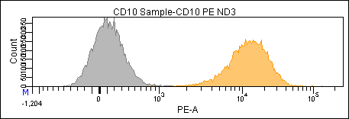
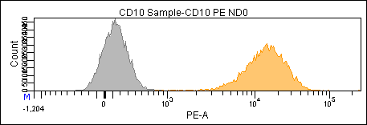
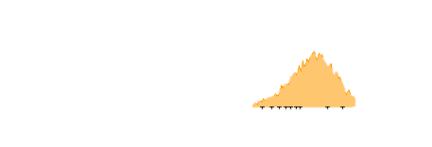


Resolution vs Background
Resolution: The degree to which a flow cytometer can distinguish dimly stained cells from unstained cells.
This can be challenging in a polychromatic scenario.
“Negative”
Dim
Bright
Negative population has
low background;
populations well resolved
Negative population has
high background;
populations not resolved
Negative population has
low background but high rSD (spread); populations not resolved
The ability to resolve populations is a function of both background and spread of the negative population.
Notes:
So, there are many factors that can affect the resolution of dim populations, but they can be broken down into various sources.
CLICK
The first one is that what were talking about is resolving either a bright population or a dim population from the negative.
Resolving the bright population is very easy under any conditions, typically the difficulty in resolving a dim population from the negative population.
CLICK
Now, historically, in the early days, reagents tended to have higher backgrounds and we had more issues with autofluorescence, so we had a situation something like this…where because of high autofluorescence or nonspecific staining, the negative cells would be brought forward and we would be unable to resolve dim cells from the negative cells.
CLICK
That’s not much of a problem anymore with better reagents and better instruments, but what we now have to deal with is fluorescence spillover and its impact on spread, as can be seen here, where what you can see is these populations all have the same median value.
But in this case in particular, what we are seeing is that the population has been spread out, that’s
measured as the standard deviation so this spread, even thought the MFIs are identical between the two populations we’re now unable to resolve those two populations.

Slide 22
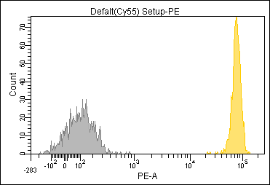
Stain Index:
The Standard Metric of Resolution
The brightness is a function of the
  Reagent
    Antigen density, fluorochrome used.
  Instrument
    PMT gain setting, laser power
Brightness
Width of negative
The width of the negative is a function of
  Instrument performance
    Spillover (multi-color panels)
Notes:
Spread is measured by a metric called SI. It was developed by David Parks at Stanford University a number of years ago, and it takes into account these two concepts. First of all, you look at the MFI and what you’re looking at there is the difference between the brightness of these two populations. So, the difference is the positive versus the negative. And this difference can be due to a variety of factors. It can be due to the fluorochrome brightness, which we talked about in the first lecture. IT can be due to the antigen density, which we talked about in the second lecture. So you can see how these concepts all come together. It can also be due to factors with respect to the instrument…the pmt voltage.
The second part of the equation, the bottom half, is due to the spread of the negative population. And the spread of the negative population is due to a number of factors including those associated with the instrument that we’ll talk about greatly, and the second half of the talk will deal with fluorescence spillover because that’s the other major source of the spread.

Slide 23
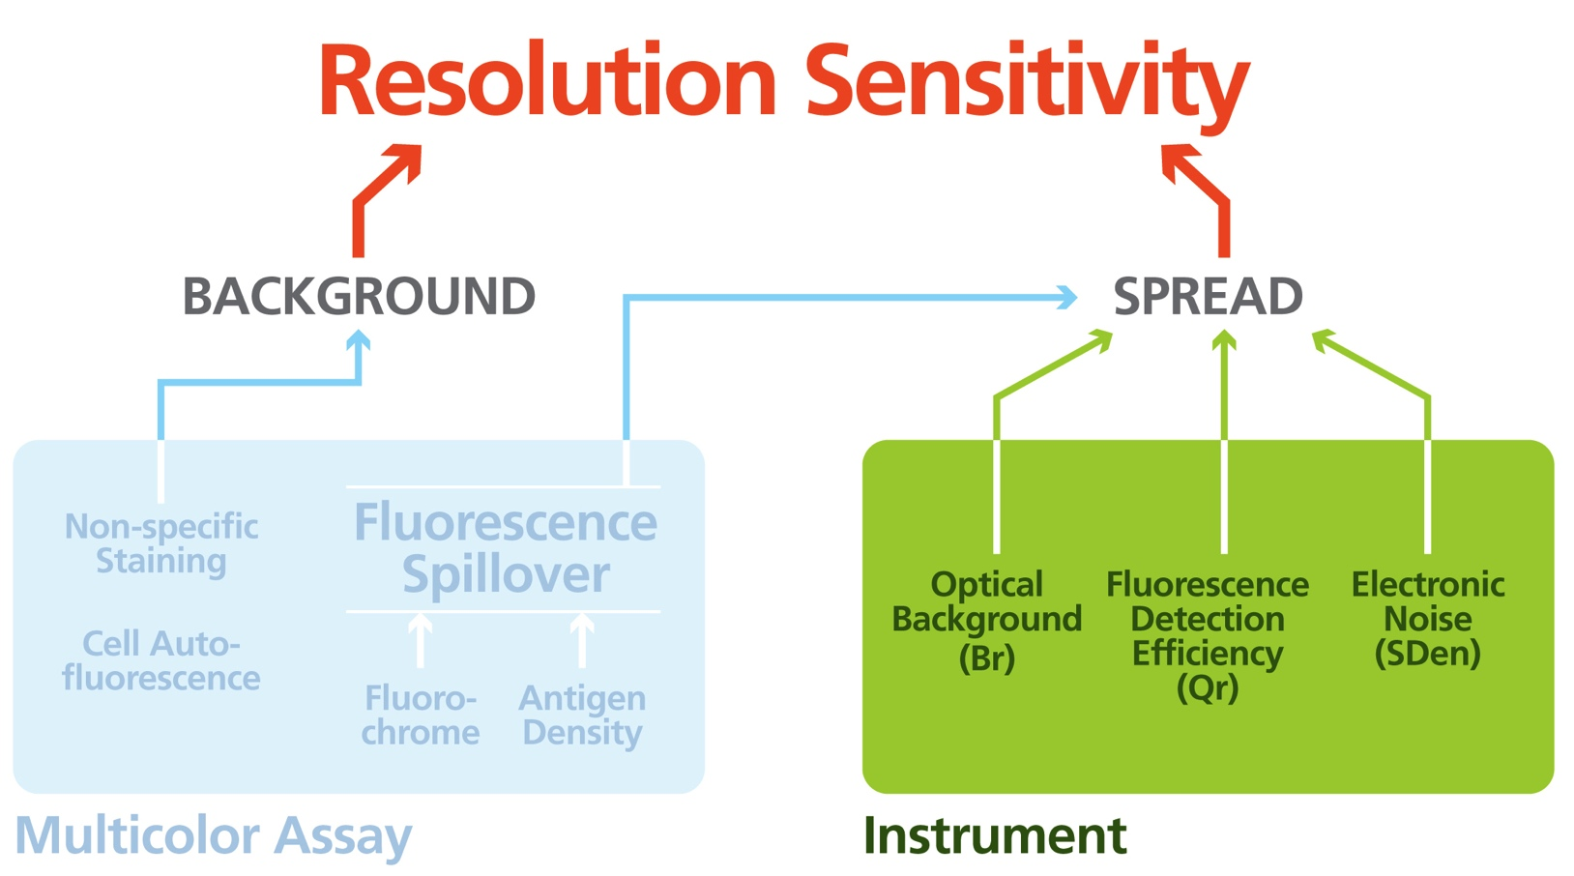
Factors Impacting Resolution
Notes:
So If we think of resolution sensitivity, it really breaks into two parts, the first is the multicolor assay itself, and we’ll talk about that in the second half of the lecture.

Slide 24
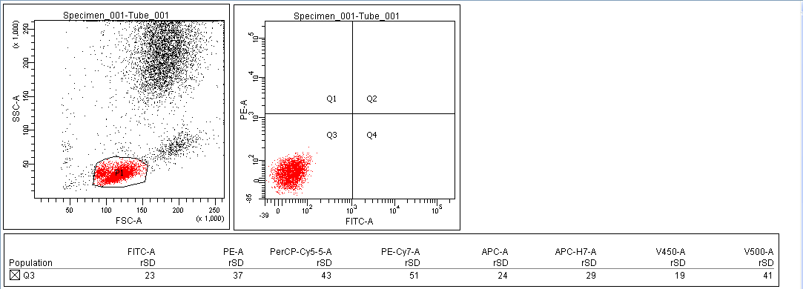
Instrument Setup
Optimizing PMTVs to Maximize Dim Cell Resolution
Negative Cell Standard Deviation Method
  Adjust the PMTV such that
    This is a simple, easy method that provides robust values for all detectors.
    Uses unstained cells.
Notes:
What we now recommend is that you want to set the robust standard deviation of your negative cells – and again if you look at your report, you can always check sd or rsd, the rsd is the robust standard deviation and it’s a more accurate measure of standard deviation over various sets of conditions. So, if you look at the rsd of your negative cells, you want to increase your pmt voltage such that this value as at least 2.5x what your electronic noise is. And if you remember earlier, it’s very easy: you go back to your cst baseline report, all the numbers are there. In two minutes you can calculate exactly what that number needs to be for each cell detector, so all you have to do is take your negative cells, run them on the instrument, adjust your pmt voltage until you meet that condition.
Now, what I’m going to show you is why that works. I’m not going to show you in a very complicated system, but you’ll see how that value is very useful.

Slide 25
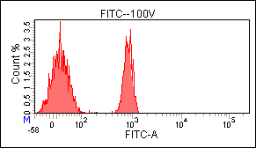
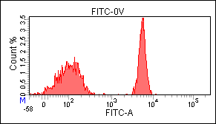
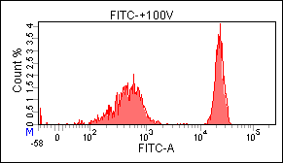
Adjusting PMTV to Maximize Resolution (SI)
FITC Detector (SD_{EN} = 20)
rSD is > 2.5 SDen (~20)
Increasing the voltage from 370 to 470 significantly (2.6X) improves the resolution (Stain Index) in that detector.
Increasing the voltage from 470 to 570 just increases the MFI of the positive and negative cells equivalently providing minimal improvement in resolution.
~470 volts is a good PMT setting. The rSD of the negative cells (64) is 2.5 times greater than the SDen.(20) [2.5 x 20 = 50]
Notes:
So here we have an example, and we’re looking at the fitc channel, and what you can see is, that if we look at the resolution, if we look at these two green lines. You can see here that we have a nice resolution, but with those lines put the same distance apart, you can see here we’re really arent resolving those populations as well. We can see this directly by doing a stain index – again, our measure of resolution – and we can see here that we have a stain index of 15 and here we have a stain index of almost 40. what’s interesting is, as you increase the voltage, and this is just by increasing voltage from 370 to 470, if we continue to increase the voltage, what you can see is, we really have not significantly improved the SD of the populations. So the question is: why? Well, what you can see here is that if we look down at the rsd of the negative cells, the rsd is 20, so 2.5x that is 50, and you can see that here we have 64, we have met the condition that says you want to be at least 2.5 times. Once you’ve met that condition, increasing the pmt voltage gives you no advantage.

Slide 26
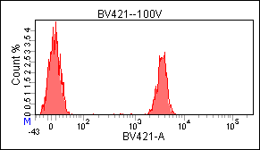
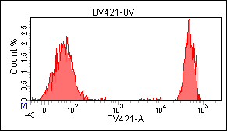
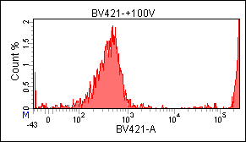
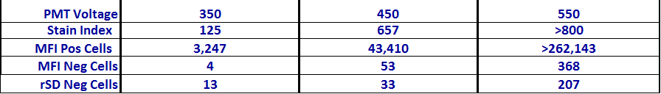
Adjusting PMTV to Maximize Resolution
BV421 Detector (SD_{EN} = 22)
Increasing the voltage from 350 to 450 improves the Stain Index of BV421 (5.3x).
Increasing the voltage from 450 to 550 continues to improve the Stain Index. However, the positive cells are off scale and outside the area of linearity.
A PMT voltage setting of 450 sufficient to resolve BV421. Keeping cells within the limits of linearity takes precedence over maximizing the stain index.
  The rSD of the negative cells of 33 is less than the target of 55.
Notes:
Now here’s another example, but this time with a very bright fluorochrome, BV421, which is one of our brightest fluorochromes.
We do the same titration with BV421-CD4 stained cells.
And again, at a lower voltage, we have a stain index of about 125 and what you can see is that again, just by increasing the voltage 100V, we’ve gone from a stain index of 125 to a stain index of 657.
CLICK
If we continue to increase the voltage we would in fact still improve the SI. However we run into the problem of the positive cells going off scale.
CLICK
So we need to pull the voltage back to where the positive cells are appropriately on scale. For the CD4+ cells 450V is a reasonable value as the MFI of the positive cells is approximately 40,000.
However, you can see that this is a compromise and that we have not met the 2.5x SDen guideline. But this is the best general setup. If you were designing a setup for and assay with a very dim marker in the BV421 detector it would be possible to squeeze a little more resolution by increasing the PMT voltage.
Again to emphasize what this means is by just turning the nob or just by pressing a button, you have improved the resolution of your populations 5 fold!
There is nothing you can do in terms of buying reagents, optimizing filters, whatever, that will get you that level of improvement as cheaply, i.e. zero! It cost you no money to change the PMT voltage, and yet you have a massive improvement in the quality of your data.
It is important to note, that for very far red detectors like PE-Cy7, BV786 and BUV805 there are so few autofluorescence photons that you can always marginally increase the apparent stain index by increasing the voltage. It is almost impossible to meet the 2.5X SDen at any voltage. This can lead to overly high PMTV settings. In these cases you should compromise with lower voltages where the improvement is the greatest.
So I highly recommend that you go back, look at your instrument, look at how it’s set up, and ask yourself are you really getting the most out of your instrument.
This procedure does not have to be performed repeatedly. One time per Application setting is sufficient.

Slide 27
Maximizing Resolution
Using Instrument Setup
The goal of instrument setup for any application is to optimize the instrument to maximize the potential resolution (Stain Index) of each detector.
Electronic Noise
  For each detector, find the gain setting (PMT voltage) that meets these two conditions:
    Brings the negative population out of the Electronic Noise (SD_{EN}) to maximize the resolution (Stain Index)
      SD_{EN} values are given in the CS&T Baseline Report.
    Keeps (bright) positive cells within the linear range of the detector
      Linearity values are given in the CS&T Baseline Report.
350 V
450 V
550 V
Notes:
So now were going to talk about how you can use information from the CS&T reports to set up your instrument to maximize resolution. And again, that’s the general theme that we are talking about. Everything goes back to improving a multicolor panel.
So we’re going to talk about maximizing resolution. And if you remember earlier we talked about electronic noise, this is again noise that is just in the system. But it is noise that affects the spread of the background. The interesting thing about electronic noise, as opposed to optical background is that with optical background, when you increase the gain, you increase the MFI of the positive cells, but you also increase the MFI of whatever optical background you have. So background increases with the gain.
Electronic noise is very different than that: when you increase the gain the PMT voltage on your instrument, you do not affect the electronic noise, it stays constant.
One way to think about electronic noise is to think of it as the background noise in a room where you are listening to music. If the background noise is high you will not be able to hear the soft parts of the music, only the loud crescendos. If you increase the volume (i.e. the gain) of your music amplifier then you can hear both the soft and loud parts.
That’s what you want to do with your flow cytometer..
So what you can see here is a diagram. I’m showing this gray area here as an idea of where this electronic noise is.
What you want to do to optimize the setup of your instrument to maximize resolution.
You want to bring the neg cells out from this background noise by increasing the PMT voltage.
But you have to be very careful that you do not increase the gain so much that you now take your positive cells off scale.
So, increase the gain to bring your neg cells out of the background, but make sure you have the gain such that you have your positive cells within the linearity. Now, again, CS&T provides you the information on SDen, electronic noise and linearity maximum that allows you to logically determine the best PMT voltage for each detector.

Slide 28
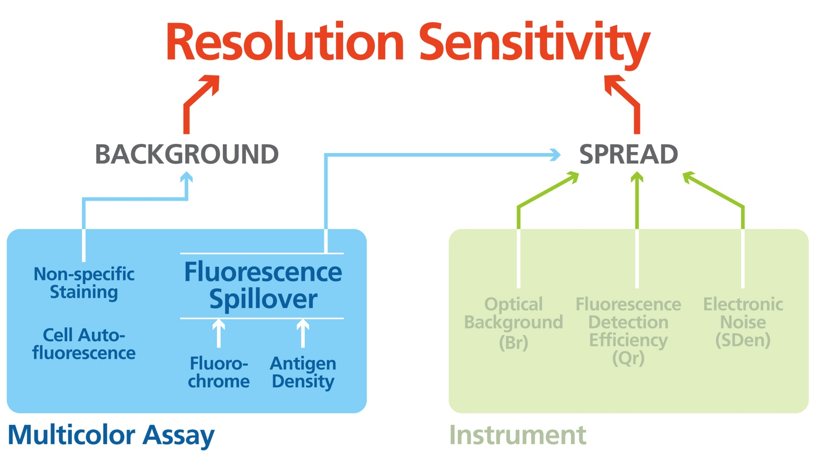
Factors Impacting Resolution
Notes:
So If we think of resolution sensitivity, it really breaks into two parts, the first is the multicolor assay itself, and we’ll talk about that in the second half of the lecture.

Slide 29
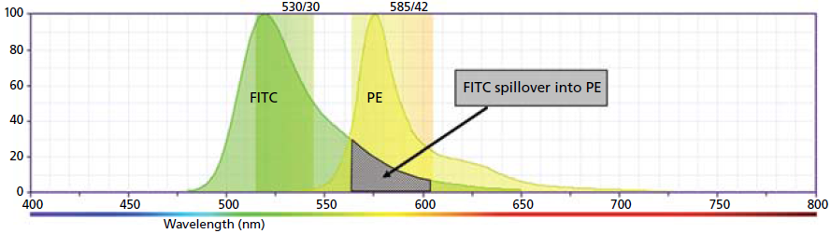

Fluorescence Spillover
Is the single most important factor affecting resolution sensitivity (SI) in multicolor flow cytometry experiments
Fluorescence spillover from other channels:
    Directly and irreversibly reduces the resolution sensitivity of that channel
    Contributes to background
This “background” is subtracted in the process called compensation.
Automatic compensation in Diva

Slide 30
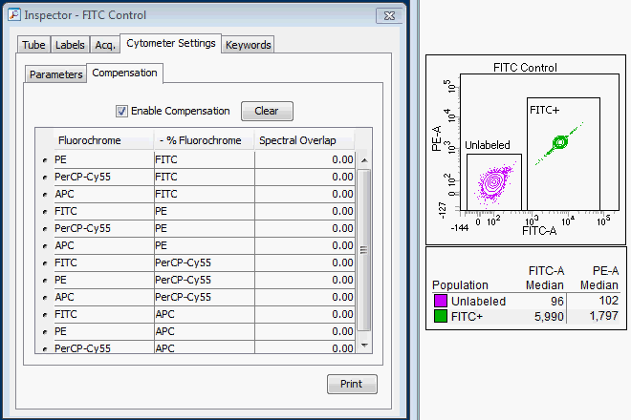
Fluorescence Spillover Introduces Background / Spread Into Other Detectors
Notes:
Here we can see the classic cause of fluorescence spillover. You can see that we have, here we have percp, it has a spectrum, an emission spectrum. These are the two windows for the two detectors: percpcy55 and pecy7, and you can see part of the fluorescence from this dye is spilling into this detector, so what does that mean? It means that you’ve now got a background in the pecy7 detector just as with a background in any type of assay you have, whether it’s an elisa assay, and type of competitive inhibition assay. And what you can see here in this example is we have percpcy55 in this direction, they’re stained with cd4 and we’re getting positive signal in this direction, but there is no pecy7 in that sample. So this is a background coming from this spillover. And we can see that background in the mfi of the positive cells. So what do we want to do in any type of assay where we have background?: you want to subtract it out of the sample. So how do we subtract it out? We subtract it out using a process we call compensation. We create a spilllover matrix and we create a compensation matrix, and that then subtracts out that background. But the other thing that I want to point out actually is that the second thing that’s really important to that background here is: that it also has a variance, a spread. You’re gonna hear that word a lot for the rest of this talk and actually the rest of the day. think of spread as how wide the population begins to spread out. It’s a function, when you think of it as a measurement, think of standard deviation or robust standard deviation. So what you can see is, even though this population looks to be very tight, similar to this population, in fact the rSD is 10 times higher. So what happens when we subtract out the background through compensation? Well, the first thing that happens is that we in fact do subtract out that signal, so now if we look at the median in the pecy7 the median of the negative pop is exactly equivalent to the positive population: that is a successful compensation, but what you can see is that even though we have subtracted out the background, we have not gotten rid of th spread. Many people think that compensation causes this spread, that it’s some type of mathematical error and that if you compensation with software or if you compensate with the instrument that you’ll get different values…you will get the exact same value no matter how you do it, whether or not you use diva or flowjo or cell quest. So that is what’s inherent in the system, and that is what you have to deal with in a multicolor scenario.

Slide 31
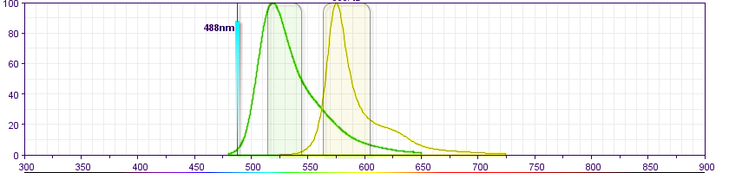
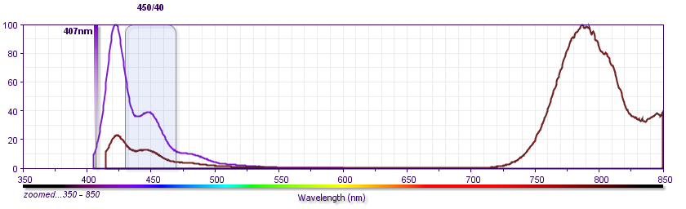
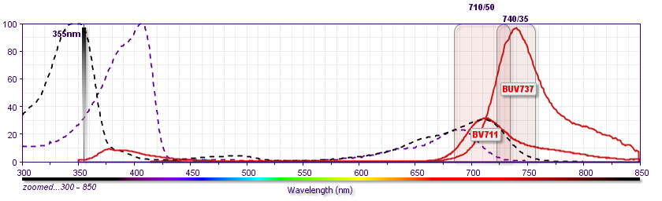
Spillover: Sources
FITC / PE
Adjacent Detectors
Residual
Base
Fluorescence
BV786 / BV421
Similar
Emission
Spectra
(Cross-laser)
BUV737 / BV711
Notes:
The first is adjacent detectors, and this is what we showed before, here’s fitc and pe, and clearly the fitc is going into the pe channel
The second one is the residual base fluorescence. And what you can see here is what we have is bv421 and bv786, this is a tandem of 421, and it still has a little bit of residual fluorescence here. That is a function of every single tandem. So, this residual fluorescence is typically what causes what we call lot-to-lot variation from tandem reagent to tandem reagent.
And the last one is similar emission spectrum. And this is often the case when you have overlapping excitation of the base polymer. So here we have bv711, it’s actually excited off the violet laser, right here. And buv737, excited off the uv laser, but what you can see is that buv737 has virtually no excitation off of the violet laser, therefore there will be no emission anywhere off the violet laser. But, the bv 711 actually does have a little bit of residual, about 20-25%, excitation off the uv laser. And since the emission of these two dyes is very very similar, you will get some fluorescence spillover of the bv711 into the buv737 channel.

Slide 32
Compensation Controls
Errors in compensation calculation are often due to errors on compensation controls
4 key considerations for compensation
  Control and sample should use the same fluorophore (do not use A488 for FITC)
  Neg and Pos should have equivalent autofluorescence
  Collect at least 5000 events per control
  Positive control should be as bright as possible
1% Error
SOV
Spillover
Detector MFI
CORRECT
SOV
10¹
10²
10³
10⁴
10⁵
Primary Detector MFI

Slide 33




Fluorescence Spillover Introduces Background / Spread Into Other Detectors
Fluorochromes spillover into other detectors; e.g. PerCP-Cy™ 5.5 spills into the PE-Cy7 detector.
This fluorescence spillover contributes to
increased background (MFI)
This “background” is subtracted in
the process called Compensation.
spread (rSD)
 | Negative |  | Positive
 | MFI | rSD | MFI | rSD
No Comp | 12 |  | 3098
Comp
29
291
PE-Cy7
rSD
4
29
3
289
A sample is correctly compensated when, in the spillover detector (PE-Cy7), the MFI of the positive population is equivalent to that of the negative population.
rSD
However, the spread (rSD) introduced by the spillover is not removed by the compensation and reduces the resolution (SI) of any double positive cells.
PerCP-Cy5.5
Notes:
Here we can see the classic cause of fluorescence spillover. You can see that we have, here we have percp, it has a spectrum, an emission spectrum. These are the two windows for the two detectors: percpcy55 and pecy7, and you can see part of the fluorescence from this dye is spilling into this detector, so what does that mean? It means that you’ve now got a background in the pecy7 detector just as with a background in any type of assay you have, whether it’s an elisa assay, and type of competitive inhibition assay. And what you can see here in this example is we have percpcy55 in this direction, they’re stained with cd4 and we’re getting positive signal in this direction, but there is no pecy7 in that sample. So this is a background coming from this spillover. And we can see that background in the mfi of the positive cells. So what do we want to do in any type of assay where we have background?: you want to subtract it out of the sample. So how do we subtract it out? We subtract it out using a process we call compensation. We create a spilllover matrix and we create a compensation matrix, and that then subtracts out that background. But the other thing that I want to point out actually is that the second thing that’s really important to that background here is: that it also has a variance, a spread. You’re gonna hear that word a lot for the rest of this talk and actually the rest of the day. think of spread as how wide the population begins to spread out. It’s a function, when you think of it as a measurement, think of standard deviation or robust standard deviation. So what you can see is, even though this population looks to be very tight, similar to this population, in fact the rSD is 10 times higher. So what happens when we subtract out the background through compensation? Well, the first thing that happens is that we in fact do subtract out that signal, so now if we look at the median in the pecy7 the median of the negative pop is exactly equivalent to the positive population: that is a successful compensation, but what you can see is that even though we have subtracted out the background, we have not gotten rid of th spread. Many people think that compensation causes this spread, that it’s some type of mathematical error and that if you compensation with software or if you compensate with the instrument that you’ll get different values…you will get the exact same value no matter how you do it, whether or not you use diva or flowjo or cell quest. So that is what’s inherent in the system, and that is what you have to deal with in a multicolor scenario.

Slide 34


Fluorescence Spillover Introduces Background and Spread
SOV =
9.15%
PE
PE-Cy5
The Amount of
the Spread
∝
Amount of
Spillover
Notes:
So, here we have an example, what we know is that when we have spillover, you will always have spread. And spread is measured by robust standard deviation. The amount of the spread is proportional to a variety of factors. In these examples we are looking at beads stained with different levels of a PE reagent.
CLICK
It’s proportional to the amount of the spillover. Here we see the spillover of the PE into the PE-Cy5 detector. The spillover is a moderate 9.15%.

Slide 35
Fluorescence Spillover Introduces Background and Spread
SOV =
0.86%
PE
FITC
The Amount of
the Spread
∝
Amount of
Spillover
Notes:
The spillover into the FITC detector is very low (0.86%) and there is minimal spread at any point.

Slide 36

Fluorescence Spillover Introduces Background and Spread
SOV =
26.40%
PE
PE-CF594
The Amount of
the Spread
∝
Amount of
Spillover
Notes:
In the other direction, the spillover into the adjacent PE-CF594 detector is high (26.4%), resulting in very significant spread.
CLICK
Note the PE-CF594 axis. The lower boundary is -2500. The brightest beads are spreading between -2500 to +2500. You have lost the ability to resolve populations in the bottom three decades of the PE-CF594 detector.
As you notice, the spread is actually a V shape, so it’s going out here, and it’s going out here. So as you’re up here, the v shape is going to be going from here to here.
So the relative amount of the spillover is an important feature that you have to think about.

Slide 37

Fluorescence Spillover Introduces Background and Spread
MFI =
35,000
7,000
PE
1,500
420
PE-CF594
The Amount of
the Spread
∝
Amount of
Spillover
×
Reagent Brightness
Notes:
As is obvious from these examples, the amount of the spread is also proportional to the fluorescence intensity of the positive population
CLICK
If the population is duller (lower MFI) the spread is less.
CLICK
CLICK
The brighter the population the more the spread into the other detectors.

Slide 38



Fluorescence Spillover Introduces Background and Spread
Population resolution for a given fluorescence parameter (for example, PE-CF594) is decreased by increased spread due to spillover from other fluorochromes (for example, PE).
PE
PE-CF594
The Amount of
the Spread
∝
Amount of
Spillover
×
(
Antigen
Density
Fluorochrome
Brightness
)
×
To maximize the resolution of a given double-positive subpopulation:
  Minimize fluorescence spillover into the detector that defines that population
Notes:
But what makes reagent brightness? It is a function of the antigen density and the fluorochrome brightness.
So you can see how we are building on the information we provided in the first two lectures and how this all ties together.
You can play with the reagent brightness by changing either of those two factors. You can decrease reagent brightness by using a marker on a lower antigen density (such as CD25 versus CD4), or by using a dimmer fluorochrome (such as V500 versus BV421).
You will utilize these concepts to maximize the resolution for a double positive population co-expressing two markers. This is a concept that you’re going to hear over and over again in ACHIEVE.
CLICK
Let’s consider a population that dimly expresses a marker with a PE-CF594 reagent.
If it’s a single positive population and doesn’t express the PE marker, you can see here that you can resolve that dim population very, very easily.
CLICK
And now lets think about if that population is double positive in that is co-expresses the two different markers.
If the expression of the PE marker is low the spread from PE will be minimal and the double population can still be readily resolved from the single PE positive cells.
CLICK
Here as the fluorescence in the PE channel increases the spread is making full resolution of the double positive cells problematic.
CLICK
As the highest level of PE fluorescence the spread into the PE-CF594 detector has a major negative impact on the resolution of any dim populations in that detector.
Note that there is spread of both the PE single and double positive populations, making resolution of these two biologically distinct population impossible
CLICK
now co-expresses those two markers, now you can see, you’re not going to be able to resolve those two populations. And that is going to be the dominant theme of what you’re going to be hearing in the ACHIEVE lecture after lunch. So, in general, I’m showing you an example with just two different colors. The considerations that you have to take in mind become more and more with the more colors that you have.

Slide 39


Quantifying the Impact of Fluorescence Spillover
Spillover Values (SOVs):
  Are totally dependent upon gain settings (PMTVs)
– 50 Volts
Reference Voltage
165%
44%
Not
Compensated
Notes:
Historically spillover values (SOVs) have been used to evaluate the impact of one fluorochrome on another.
Many of you probably have spillover tables tapes to your instruments. As we just saw these values can be helpful, however they can also be misleading.
Here we have the exact same sample run at two different voltages for the X axis. For each sample the SOV was calculated as described earlier.
What is clear is that SOVs are totally dependent upon the PMTV (gain) settings of the two detectors.

Slide 40




Quantifying the Impact of Fluorescence Spillover
Spillover Values (SOVs):
  Are totally dependent upon gain settings (PMTVs)
– 50 Volts
Reference Voltage
SOV: 165%
44%
Compensated
  Do not always accurately reflect the impact of spread
SOV: 18.1%
15.4%
PE
PerCP-
Cy5.5
CD4 FITC
CD4 PE
Notes:
However what we can see is that while changing the PMTV changed the calculated spillover value it DOES NOT change the actual number of photons spilling into the other detectors and therefore does not change the amount of spread introduced into those detectors.
The concept we really want to focus on and which will be critical as we discuss panel design later, is spread.
Spillover is an important concept, and it is related to the spread, but it’s only one factor in the spread.
CLICK
What you can see here is that fluorochromes which have similar spillover into other detectors can have significantly different amounts of spread into those detectors. This is also related to the relative Qr values of the two detectors.
This is the one point I want to make sure is very clear. You will see spillover values used in the talk this afternoon. I don’t want to say they are of no value, but you want to use them as one piece of information. But in the end the only thing you actually care about is the amount of spread a given reagent introduces into other detectors.

Slide 41






Examples of Impact of Spillover on Spread of other Detectors
17.5
2.1
28.6
PerCP-Cy5.5
PE-Cy7
AmCyan
461
68
31
83
258
269
PE
PE
V450
17.9
3.6
28.0
PE
PerCP-Cy5.5
PE-Cy7
88
585
78
112
217
70
FITC
PE-Cy7
PerCP-Cy5.5
SOV is not always the best indication of impact of spread.
Notes:
And this gives you an example of that. This is data from a canto. And we’re looking at a variety of different reagents interacting with each other. So this is PE going into PerCPCy55. Here’s pecy7 going into the percpcy55 channel, and what you can see is the amount of spread is very different here. Not all of these are equivalent. So some of these are going to cause you a whole lot more than others do. So if you look at this, you go wow, I don’t like that. This one is pretty high. The number here is two times the robust standard deviation of this populations, what that means is that 95% of the cells are below this line here. This spread, actually people think of FITC into PE as something that has a lot of spillover, it’s about 17-23%, depending upon your instrument. But what you can see is the spread really isn’t that bad. But the other interesting thing is that spillover is not always the most important factor in understanding where the spread is coming from. I mean, if you look here what you can see is that these have the exact same spillover value, and yet this is much much greater spread. Same thing here. Same spillover values, much worse.
So by actually looking and doing preliminary studies of your reagents and understanding how much spread you’re getting, it will help you in designing multicolor assays.
If you look here, these have almost the same spillover values. The spill isn’t telling us what the spread is.

Slide 42



Resolution of Double-Positive Populations
SI
700
DP-SI
50
Here is a classic resolution of a single-positive (A⁺) population being resolved from a negative (A⁻) population.
A⁺
A⁺B⁺
  Resolution measured in Stain Index (SI)
Loss of
Resolution
CD_{A} (PE-CF594)
Adding a second co-expressed marker, we now have to resolve a double-positive (A⁺B⁺) population from a single (A⁻B⁺) population.
A⁻B⁺
A⁻
  Resolution measured in a double-positive Stain Index (DP-SI)
CD_{B} (PE)
The spread of fluorochrome B into the A detector reduces the resolution of a double-positive (A⁺B⁺) population from the A⁻B⁺ population.
Notes:
We are now familiar with the concept of the Stain index.
CLICK
Here we see the stain index of cells stained with a PE-CF594 reagent. (A+) The measured SI is 700. (Measured off the Y-G laser. The reason for the high SI.)
CLICK
Now let’s consider the situation where we have a second marker (B) on PE which has the same antigen density as marker A. We have two new populations; an A+ single positive and an A+B+ double positive population.
What is the resolution of the A+B+ double positive cells from the B+ single positive cells.
CLICK
As before we can use a stain index to evaluate this. However, in this case we are determining the stain index between the double positive cell (A+B+) and the single positive cells (A-B+). We refer to this as the double-positive Stain Index (DP-SI).
CLICK
Notice that the large spread of the single positive has resulted in a loss of resolution. In particular we can no longer resolve B^{BRIGHT}, A^{DIM} cells from the B^{BRIGHT} single positives
CLICK

Slide 43
Using the Resolution Impact Matrix
The Resolution Impact Matrix provides a quick visual tool to help assess potential problems with spread when looking at using two fluorochromes for co-expressed markers on a population of cells.
The table shows that on a
BD FACSVerse:
Adding a PE reagent to a co-expressed marker will have significant spread into and a major negative impact on the resolution of the double-positive cells in the PerCP-Cy5.5 detector.
No fluorochromes have a significant negative impact on the resolution of FITC⁺ cells.
FITC has minimal impact on any other fluorochrome.
Notes:
Everything is positive for that one so we don’t want one with a lot of spread to affect the other antigens/flourochromes
As you will see in ACHIEVE, this table provides a great deal of valuable information when thinking about panel design. Especially when considering co-expressed markers on specific population of cells.
CLICK
As we noted, the table indicates that adding a PE reagent to a co-expressed marker will have significant spread into and a major negative impact on the resolution of the double-positive cells in the PerCP-Cy5.5 detector.
CLICK
We can see that none of the fluorochromes on this instrument have a negative impact on the resolution of markers on the FITC detector. That is PE, APC, etc. do not spread into the FITC Detector.
CLICK
Similarly FITC has minimal impact on any other fluorochrome.

Slide 44
BD LSRFortessa X-20 Flow Cytometer: Resolution Impact Matrix
Resolution Impact Matrix (Color Coded)
 |  | Co-expressed/Secondary Fluorochrome
Primary Fluorochrome
 |  | FITC | PerCP-Cy5.5 | BV421 | BV510 | BV605 | BV650 | BV711 | BV786 | BUV395 | BUV496 | BUV661 | BUV737 | APC | Alexa Fluor® 700 | APC-H7 | PE | PE-CF594 | PE-Cy7
 | FITC | 100
 | PerCP-Cy5.5 |  | 112
 | BV421 |  |  | 457
 | BV510 |  |  |  | 105
 | BV605 |  |  |  |  | 77
 | BV650 |  |  |  |  |  | 219
 | BV711 |  |  |  |  |  |  | 129
 | BV786 |  |  |  |  |  |  |  | 212
 | BUV395 |  |  |  |  |  |  |  |  | 99
 | BUV496 |  |  |  |  |  |  |  |  |  | 89
 | BUV661 |  |  |  |  |  |  |  |  |  |  | 383
 | BUV737 |  |  |  |  |  |  |  |  |  |  |  | 241
 | APC |  |  |  |  |  |  |  |  |  |  |  |  | 171
 | Alexa Fluor ® 700 |  |  |  |  |  |  |  |  |  |  |  |  |  | 65
 | APC-H7 |  |  |  |  |  |  |  |  |  |  |  |  |  |  | 48
 | PE |  |  |  |  |  |  |  |  |  |  |  |  |  |  |  | 487
 | PE-CF594 |  |  |  |  |  |  |  |  |  |  |  |  |  |  |  |  | 712
 | PE-Cy7 |  |  |  |  |  |  |  |  |  |  |  |  |  |  |  |  |  | 845

Slide 45

How To Minimize the Impact of Fluorescence Spillover to Maximize Resolution
How can we improve the resolution of this double positive population?
CD56
CD3
Understanding the impact of fluorescence spillover on spread is the key to good panel design.
Notes:
So, taking these concepts that we’ve put together. We can begin to think about how to minimize the impact of fluorescence spillover on spread. So, I’m going to take you through this quickly, but where you’re really going to beautifully see that implemented, is in xxxx’s talk this afternoon. So first, what we could do is, we know that resolution is a function of stain index. So we could try to increase the brightness. How do we do that? We use a brighter fluor for the CD56. the other thing we can do is to try and decrease the width of the negative, we’ve already shown you one example of that, and that is to reduce the spread by titrating the cd3 reagent, and again, you get the same benefit by increasing the stain index. And the third, if you understand is that we had three different factors that went into the amount of spread: the ag density, fluor brightness, and the spillover. So the other thing that we can do is use a fluor that has less spillover. So, these are the concepts you want to think about.

Slide 46



How To Minimize the Impact of Fluorescence Spillover to Maximize Resolution
Titrate the CD3 to reduce the spread.
Use a brighter fluor for CD56
CD56
CD56
CD56
CD3
CD3
CD3
Use a fluor
for CD3 with less
spillover into the
CD56 detector.
Understanding the impact of fluorescence spillover on spread is the key to good panel design.
CD56
CD3
Notes:
So, taking these concepts that we’ve put together. We can begin to think about how to minimize the impact of fluorescence spillover on spread. So, I’m going to take you through this quickly, but where you’re really going to beautifully see that implemented, is in xxxx’s talk this afternoon. So first, what we could do is, we know that resolution is a function of stain index. So we could try to increase the brightness. How do we do that? We use a brighter fluor for the CD56. the other thing we can do is to try and decrease the width of the negative, we’ve already shown you one example of that, and that is to reduce the spread by titrating the cd3 reagent, and again, you get the same benefit by increasing the stain index. And the third, if you understand is that we had three different factors that went into the amount of spread: the ag density, fluor brightness, and the spillover. So the other thing that we can do is use a fluor that has less spillover. So, these are the concepts you want to think about.

Slide 47
Elements of Multicolor
Flow Cytometry
Considerations in designing panels:
Fluorochrome Characteristics and Availability
Biology: Cell Type, Antigen Characteristics
Instrument Setup and QC; Spillover
Notes:
This morning you have heard about fluorochromes, biology, and characteristics of the instrument that are very important to take into consideration when it comes to panel design.
In this talk I am going to take all that information and show you how to apply it in order to logically design multi-color flow cytometry panels.

Slide 48
Learning Objectives
How to get more information from your assays using experimental panel design
Understanding:
  The properties of the fluorochromes to be used
    Brightness and spillover
  The biology inherent in the assay
    Sample type, population of interest, antigen density, and co-expression
  The capabilities of instrument that runs the assay
    Optical configuration, QC, setup
Applying logical rules to assign fluorochromes to antibody specificities
Why making these choices is likely to be an iterative process
Notes:
We are going to take into consideration what we know about the instrument,
what we know about the biology, and when I say biology what I am referring to is antigen levels of expression and co-expression, which is going to be critical in panel design,
and finally what we know about the fluorochromes in order to design optimal panels that will lead to very robust assays.
We are going to learn about rules that we need to apply to developing panels. I want to be very clear from the beginning, that the rules that we are going to explain apply from a low-end complexity panel, let’s say a 5 or 6-color panel, to a very high-end, high complexity panel, let’s say 11 up to 18 colors. And the same rules apply to panels only staining for surface antigens vs. panels that include IC markers.
I am also going to explain how you can understand if your choices of fluorochromes within a certain panel are optimal or not.
And finally I will be discussing -- and I want to make sure that you keep this in mind from the beginning -- that panel design might be an iterative process.
When we do Panel Design what we do is to narrow down the selection of reagents we are going to test from a theoretical approach, but it’s only by testing the actual combination that you think is good with every single control that we are going to explain that you will know if your panel is good or not.
You might come to the conclusion after analyzing the data that your data is not optimal. So you will have to go back and redesign that panel. And you are going to learn a lot throughout this process.

Slide 49

Building a 6-Color Panel to Identify Regulatory T-Cell (Treg) Subsets
Experimental Goal:
Identify Treg subsets
Markers Used: CD3, CD4, CD8, CD25, CD127, CD45RA
Assign antigen expression levels:
Gating Strategy
CD3⁺
CD4⁺
CD8⁺
 | Tregs | Naïve Tregs | Memory Tregs
CD3
CD4
CD8 | - | - | -
CD45RA | - |  | -
CD127
CD25
CD25⁺
CD127⁺
CD45RA⁺
CD45RA⁻
Notes:
The example that I chose in order to explain to you how these rules work and how to approach panel design is a simple assay. It’s a six-color assay, and the goal of this assay is to identify a subset of cells that some of you might be familiar with, that are called regulatory T cells or Tregs.
You might or might not be familiar with these cells, and if you have never worked with these cells and this is not the subject of interest in your lab, it’s okay. I want you to think that you have a subset of cells that are your interest at identifying by flow cytometry, and that there are six markers that you are using to identify those cells.
CLICK
In the case of the regulatory T cells the markers that I chose and that you will be hearing about across the presentation are CD3, CD4, CD8, CD25, CD127 and CD45RA. Again, for some of you, these CD markers might not mean too much, so think about CD1, 2, 3 or ABCD.
CLICK
I want to do is to classify these markers around the biology
As you saw in the presentation, the classification from the Roederer paper is very useful. So I want you to think that some of the markers, will be considered primary markers. Those markers are the markers that allow us to identify big populations – T cells, B cells, monocytes, dendritic cells. So in this case, those markers will allow us to identify T cells.
Other markers are the markers that are expressed over a continuum , that have different levels of expression in different cell types. And those antigens are called secondary. And in the case of this panel, the marker that we are going to consider secondary is CD45RA.
Finally there are those markers that are super critical to us, that will allow us to identify the smaller subset of cells. And in this case, those markers that we call tertiary are CD25 and CD127.
Again, for those of you who are not familiar with these cells, think about the cell types that you’re interested in, in your lab, and how the markers that you’re using to identify those cells could be classified into different groups. So if we think about antigen density, and as was explained this morning there is a correlation and you will see that in general the primary markers are expressed at very high levels, the secondary marker at intermediate or can also be expressed at high levels. And then what are very important are those tertiary markers. Those are critical, are often expressed at very low levels, or identify rare cell subsets, as you see in this table.
CLICK
Based on the markers that you’ve chosen, you’re going to have in your head, in your mind, a gating strategy. So you are thinking how you’re going to combine these markers and you’re going to draw plots and gates that will allow you to identify the cells of interest in your assay.
So here what I’m showing you in this tree is that I’m going to use two markers to identify the bigger subsets, so CD3 and CD4.
And then come those two critical markers that are CD25 and CD127. I want you to notice that the CD25 and CD127 are within the same circle, and what that means – and the reason I want to point that out to you – is because in my mind that means co-expression which you heard about repeatedly this morning. I’m interested about the co-expression of CD25 and CD127 within the same cell population. That information is going to be critical when we decide what fluorochromes are we going to assign to these two markers.
Finally CD45RA will allow us to further classify those cells that are CD25 high and CD127 dim into smaller subsets called naïve and memory.
So at this point we have is a gating strategy in mind and we have identified our populations of interest, those cells that are most important for our assay results.
From this it is very useful to create a co-expression table.
Here you can list all of the populations of interest: For this assay it is total Tregs, Memory T cells and Effector T cells.
For each marker on each sub-population you want to show which antigens are co-expressed and what is the density of the antigen on the sub-population.
This is an important point. As you saw with CD45RA in ELEVATE. The density of an antigen can vary dramitically on different subsets. When thinking about co-expressed antigens you need to think about the expression level on that sub-spopulation.
The the some information about the antigens that we’re interested about. It might be that for the markers that you are interested at you already have this information because you have been studying those cells, or there is historical data in your lab. But if you are interested in markers that you are not familiar with then you should search the literature and find as much of this information as possible before moving forward with panel design. The more information you have the better your decision making process.
you have a list of markers that you will be using to identify the cells of interest, what
Those are CD3, CD4 and CD8 and are shown as dark gray.
Again, for those of you who are not familiar with these cells, think about the cell types that you’re interested in, in your lab, and how the markers that you’re using to identify those cells could be classified into different groups. So if we think about antigen density, and as was explained this morning there is a correlation and you will see that in general the primary markers are expressed at very high levels, the secondary marker at intermediate or can also be expressed at high levels. And then what are very important are those tertiary markers. Those are critical, are often expressed at very low levels, or identify rare cell subsets, as you see in this table.

Slide 50
Approaches to Panel Design
First Example: No Rules
Use of available reagents
  Minimal attention to fluorochrome brightness or antigen density
Second Example: Some Rules
Refined panel with focus on fluorochrome assignment based on expression of antigens
Third Example: Best Practices
Use of best practices to further optimize the panel to maximize the resolution of Tregs
  Antigen density and co-expression
  Fluorochrome brightness
  Spread due to spillover
6-color panel for a 2-laser system:
Blue (488 nm) | FITC, Alexa Fluor® 488
 | PE
 | PerCP-Cy™5.5, PerCP
 | PE-Cy™7
Red (640 nm) | APC, Alexa Fluor® 647
 | APC-H7, APC-Cy7
Notes:
Back to our example, this analysis will be run on a 2-laser, 6-color instrument with the available choice of fluorochromes as shown in the table.
What I’m going to do during the first part of this talk is to walk you through three scenarios.
We are going to look at the data together from those three examples in order to illustrate the main rules around panel design.
In the first example, I want to show you what will happen if we don’t consider any of the rules, and we just randomly choose the reagents to use in this flow cytometry experiment.
In the second example we are going to see what happens when we remember to consider antigen density and fluorochrome brightness.
And in the third example we will be combining everything that is important for panel design –antigen density, fluorochrome brightness, spillover and co-expression.
CLICK
So the first example that I want to show you is a case where my PI told me, I want to study these cells using these markers, and I just went to the lab to see what was available and what reagents were in the fridge, maybe from other projects that are going on in the lab. So when those reagents were selected we haven’t really taken into account anything about fluorochrome brightness or antigen density or spillover.
Let’s then look at the data.

Slide 51





6 Color T-Cell Panel: First Example
6 color panel using
available reagents
FITC CD127
PE CD4
PerCP-Cy5.5 CD3
PE-Cy7 CD8
APC CD45RA
APC-Cy7 CD25
SSC
SSC
CD3 PerCP-Cy5.5
FSC
CD8 PE-Cy7
CD45RA APC
CD127 FITC
CD4 PE
CD25 APC-Cy7
CD25 APC-Cy7
Data acquired on a BD FACSCanto™ II flow cytometer
Notes:
I want to take the time to explain to you the gating strategy, as this is the gating strategy that you will see during this first part of the talk, so I want you to become familiar on how we are gating. So we’re using forward scatter vs. Side Scatter to identify lymphocytes.
From there we have a marker that allows us to distinguish cells that are negative and positive and we are selecting the positive cells, which are T cells that are CD3-positive.
From there we have two markers, and we’re interested to gate at the cells that are only positive for one marker, CD4, and so the cells that are identified in blue are the cells that we are really, really interested in. From that CD4+ blue population, I’m using three markers to look at different subsets of cells, and these different subsets are really the ones that are the subject of my research, in other words my populations of interest.
In this plot gated on CD4s I’m showing you CD45RA versus CD25, and in the second plot, CD127 versus CD25. And what I want you to see is that when I look in the X-axis, at the CD25 expression, it’s really hard for me in any of these plots to be really certain that I’m seeing a distinct positive population. For example in this plot the CD45RA pattern seems okay, but the CD25 looks weird. And if I have done a good job at researching the expression of these markers, what I will notice is that these plots do not match what has been published in the literature.
In particular, on the plot of CD127 versus CD25, I have a pattern where I’m not able to say in any of the directions, along the Y- or in the X-axis, if I have a negative and a positive population for any of those markers. So unfortunately things don’t look that great for the markers that I’m really interested at.

Slide 52
Approaches to Panel Design
First Example: No Rules
Use of available reagents
  Minimal attention to fluorochrome brightness or antigen density
Second Example: Some Rules
Refined panel with focus on fluorochrome assignment based on expression of antigens
Third Example: Best Practices
Use of best practices to further optimize the panel to maximize the resolution of Tregs
  Antigen density and co-expression
  Fluorochrome brightness
  Spread due to spillover
6-color panel for a 2-laser system:
Blue (488 nm) | FITC, Alexa Fluor® 488
 | PE
 | PerCP-Cy5.5, PerCP
 | PE-Cy7
Red (640 nm) | APC, Alexa Fluor® 647
 | APC-H7, APC-Cy7
Notes:
So, let’s go now to the second example.
CLICK
In this scenario, we’re going to re design that panel, based on information regarding antigen level of expression and fluorochrome brightness.

Slide 53
Antigen Density and Fluorochromes
Antigen Expression
  The same antigen can have different levels of expression on different cell types
    For example, CD127 in Tregs vs naïve T cells
  Antigen levels can vary due to activation state and functional differences.
    For example, CD25
  Markers can be expressed over a continuous (smeared) range
    For example, CD45RA
  Fluorochrome Rankings
Marker | Antigen Density
CD3 CD25 CD4 CD127 | 32,000 3,400 36,400 2,000
CD45RA CD8 | 33,400 65,500
Antigen density expressed in molecules per cell.
 | BRIGHT | MODERATE | DIM
Blue (488 nm) | PE PE-Cy7 | FITC Alexa Fluor® 488 PerCP-Cy5.5 | PerCP
Red (640 nm) | APC Alexa Fluor® 647 |  | APC-H7 APC-Cy7
Notes:
Let’s briefly review antigen expression which you already heard about in ELEVATE this morning.
I’m showing you some numbers in this table from the Antigen Expression Program that [ELEVATE Speaker] has explained to you this morning.
For these different markers, we have assigned different numbers – correspond to the number of molecules per cell.
However as was explained this morning and I just want to emphasize, that you have to be careful that, on how to interpret these numbers. For example, there are antigens that are expressed in more than once cell type. For example, CD127 can be expressed at very dim levels in regulatory T cells and at higher levels in some of the naïve T- cells. So I want you to be careful on how to interpret that number – and as [ELEVATE Speaker] explained, we will provide these values for specific subsets of cells.
Now, as we talked about in ELEVATE, the antigen level of expression can also change depending on the activation stage and functionality of certain cells. CD25 can up-regulated when T cells are activated. And as I mentioned, when we were talking about the secondary marker, CD45RA, it is expressed as a continuum over a 100 fold at different stages of differentiation as you saw in ELEVATE. You will see more examples of this later in this talk.
CLICK
As we have antigen ranking, there’s a fluorochrome brightness ranking as you saw this morning. I have in this slide a table where we have fluorochromes that are ranked in three levels, and as you can see, this is very similar to the tables that you saw in REVEAL this morning. Quick question, can you remember from that data in that presentation how many levels of brightness we defined?
So in that presentation we defined four levels. And here I’m only showing you three – bright, moderate and dim. The category that is missing is very bright. And the reason for that is that the instrument that we are using for these experiments is an instrument that only has a blue and red laser. If we had the yellow-green laser, PE and PE Cy7 would be classified as very bright.
Okay? So the instrument configuration leads to us being able only to use certain fluorochromes, and we are going to be able to rank those fluorochromes in different groups. This table is then showing for this instrument configuration what the different levels of brightness are and what fluorochromes are available.

Slide 54
Matching Antigen Density and Fluorochrome Brightness
ANTIGEN
ASSIGNMENT
Specificity
Fluorochrome
Laser
CD25
PE
CD127
APC
CD45RA
PE-Cy7
CD4
FITC
CD8
PerCP-Cy5.5
CD3
APC-Cy7
Antigens expressed at low density require brighter fluorochromes
A highly expressed antigen will usually be detected and resolved from the negative control with almost any fluorochrome
Notes:
So once you have that information, what I want you to do in order to make the best possible choices is to have in your head or write down on a piece of paper what are the antigens that you are interested in and classify them, rank them.
As you see in this list, the rank I have is from the ones that are expressed at low levels – CD25 and CD127 – to the ones that are expressed at high levels – CD4, 8 and 3.
We are going to use the same color code we saw in ELEVATE throughout this presentation, so I want you to become very familiar with it. The antigens that are expressed at low levels, we are putting them in a very light gray and the ones that are expressed at high levels will be represented with the darker gray.
Now, the other information that I want you to have in mind is the fluorochrome rankings. As you saw in REVEAL I’m going to have the different fluors organized from the fluorochromes that are brighter, in darker orange, to the ones that are dimmer.
So in this case what I have is, for my instrument, PE, PE Cy7 and APC are the brightest fluorochromes, and APC-Cy7 is the dimmest fluorochrome with FITC and PerCP-Cy5.5 in between.
So what we are going to try to do is assign to the low-expressed antigens the brightest fluorochrome and vice versa.
CLICK
In this specific case, what can I do?
CD25, I’m going to assign it to a fluorochrome that is very good and that we all know very well that is PE.
CLICK
CD127 I’m going to assign to another bright fluorochrome; PE-Cy7 since we know that PE and PE-Cy7 are both bright.
CLICK
I’m going to assign CD45RA to APC.
And then the three antigens that are expressed at high levels could go to any of the three dimmer fluorochromes that I have remaining.
CLICK
I’m going to assign CD4 to PerCP-Cy5.5,
CLICK
CD8 to APC Cy7
CLICK
and CD3 to FITC.
Throughout the presentation you will see that when I do the fluorochrome assignment, we have a dot up here next to the fluor assignment. That corresponds to the laser that is going to be exciting that fluorochrome that has been assigned to that specificity.

Slide 55



6 Color T-Cell Panel: Second Example
6-color panel using antigen density and fluorochrome brightness information to choose reagents
FITC CD3
PE CD25
PerCP-Cy5.5 CD4
PE-Cy7 CD127
APC CD45RA
APC-Cy7 CD8
SSC
CD3 FITC
CD8 APC-Cy7
CD45RA APC
CD127 PE-Cy7
CD4 PerCP-Cy5.5
CD25 PE
CD25 PE
Data acquired on a BD FACSCanto II flow cytometer
Notes:
So now that I have made this assignment based on antigen density and fluorochrome brightness, let’s look at the data.
The gating strategy is the same that I showed in the previous example, so you are now more familiar with these plots.
What you will see is that I’m still able to easily identify the bigger subsets of cells, the CD3 positive and also the CD4 positive.
However, now, when I look at the combination of markers, CD45RA, CD25 and CD127, I see that I can resolve different populations that I couldn’t see in the previous example.
I now see a positive population when looking at both CD127 and especially CD25.

Slide 56




Comparison:
First vs Second Example
First
Example
CD8 PE-Cy7
CD45RA APC
CD127 FITC
CD4 PE
CD25 APC-Cy7
CD25 APC-Cy7
Second
Example
CD8 APC-Cy7
CD45RA APC
CD127 PE-Cy7
CD4 PerCP-Cy5.5
CD25 PE
CD25 PE
Using a dimmer fluorochrome for CD4 did not impact resolution of CD4+ cells.
Using brighter fluorochromes for low density CD25 and CD127 markers improved their resolution.
Data acquired on a BD FACSCanto II flow cytometer
Notes:
Let’s compare the data side by side between the first and the second example, and I want to spend some time reviewing this slide with you, because there is something that is very important when comparing multicolor data and when making assessments if one panel is better than another, and it’s something that you are going to see throughout this presentation.
And it has to do with the biexponential scale. I hope that currently when you’re visualizing your data, you’re using the biexponential display.
Does everybody know how to show your data in biexponential scale?
Is everybody here familiar with how to manually adjust the biexponential scale?
If some of you have doubts on how to fix the biexponential and how to adjust it manually, I want you to come to us and ask questions, because this is extremely important.
So what I have done is, in order to compare the first and the second example, I have adjusted the biexponential scale so that it’s identical for each of the markers that are in these 2 panels. For example, in the first panel, I had CD8 in PE-Cy7. In the second panel I have CD8 in APC-Cy7.
What I have done is to manually set the biexponential scaling for CD8 to be identical, regardless of the fluorochrome. If the scaling is identical the lower limit of the scale will be identical.
This may be something that is new to some of you, but it is important that you understand why this is important and that you know how to do it.
The result is that PE-Cy7 and APC-Cy7 share the exact same scaling because they have the same antigen, okay? And the same applies for CD4RA, CD25 and CD127.
CLICK
By doing this, what I hope is that you can see that from the first to the second example, my ability to resolve the population that is in blue, the CD4 positive, was not changed. I have a very nice resolution. Why do I have a very nice resolution? Because even with dimmer fluorochromes I can still see those antigens that are expressed at high levels.
CLICK
Now, when it comes to the CD25 what happens is that by switching from APC-Cy7 to PE I have a much better resolution. I can cleanly distinguish CD25 positive from CD25 negative cells.
CLICK
And as I have already explained, that I can now identify a CD25 high population and see the CD127 dim CD25 high population very differently compared to the first example.
However even with that dramatic improvement my ability to decide where the boundaries of this population is not super clear. Where does that population start, where do I start drawing my gate is not that easy.

Slide 57
Quick Quiz
It remains challenging to gate on Tregs. Why?
  Because spillover and co-expression were not taken into consideration
Notes:
So can anybody tell me why it still remains challenging to draw a gate around that population?
CLICK
Correct.
As you have seen, I took into account the level of antigen expression and fluorochrome brightness to make my panel, but I didn’t talk to you about spillover or co-expression. And as you heard from [RESOLVE Speaker], this is something that is extremely critical in order to optimize the resolution of populations and in the second example I left out that concept that is very important in order to make my fluorochrome assignment.

Slide 58
Approaches to Panel Design
First Example: No Rules
Use of available reagents
  Minimal attention to fluorochrome brightness or antigen density
Second Example: Some Rules
Refined panel with focus on fluorochrome assignment based on expression of antigens
Third Example: Best Practices
Use of best practices to further optimize the panel to maximize the resolution of Tregs
  Antigen density and co-expression
  Fluorochrome brightness
  Spread due to spillover
6-color panel for a 2-laser system:
Blue (488 nm) | FITC, Alexa Fluor® 488
 | PE
 | PerCP-Cy5.5, PerCP
 | PE-Cy7
Red (640 nm) | APC, Alexa Fluor® 647
 | APC-H7, APC-Cy7
Notes:
CLICK
So in this third example, we are going to redesign this 6 color panel. However we are going to use best practices using all the information at our disposal. In addition to antigen density and fluorochrome brightness, we will take into consideration spread and co-expression, that you already know are very important

Slide 59
Best Practices
The key to any final panel optimization is to focus on the critical populations of interest.
The goal is to minimize loss of resolution due to spread from the fluorescence spillover of co-expressed antigens.
How to avoid spectral spillover
When antigens are co-expressed on a cell
  Avoid significant spillover of a bright marker into a dim marker.
  Spread the antigens across as many lasers as possible.
Fluorochromes that are excited by more than one laser
cause high spillover.
  AmCyan excited by the violet and blue lasers spills into the FITC detector.
  PE-Cy5 excited by the blue and red lasers spills into APC detector.
Considerations for tandem dyes
  Take into consideration residual donor emission.
Notes:
When it comes to optimizing a panel, and as we have mentioned over and over there are some populations that we have identified as key populations and those are the ones that we want to resolve the best. Our goal is to maximize the resolution of those populations. In our example the Treg cells are our population of interest.
To maximize the resolution of those populations, we need to minimize the impact of spillover or spread – remember that right now we’re focusing on spread into the markers that will define those populations.
So it is critical to understand which are the co-expressed markers that will define those populations, and with that knowledge determine how we are going to handle the fluorochrome assignment.
So, what we need, at all cost, is to avoid spillover from a bright marker into a dim marker.
And something that can help, if you have instruments that have multiple lasers, is to spread the fluorochrome assignment across lasers
– try not to assign all the fluorochromes for makers that are co-expressed to fluorochromes that are excited by the same laser.
If we spread across lasers, we will have a better chance to reduce spillover.
However, remember from RESOLVE that there are fluorochromes that are excited by multiple lasers. That can happen.
So it’s not like a rule that we’ll always guaranteed that you will be successful, but you will have higher chances of success.
You will need to know very importantly what fluorochromes introduce increased spread into other detectors, and by having this information you might be able to do very good choices for your fluor assignment.
Now, remember also that we also want to be careful with tandem dyes, as they might introduce a little bit of spread due to residual excitation of the donor molecule.

Slide 60
Minimizing Spillover Effects Into the Population of Interest
MARKER A
MARKER B
Are they
co-expressed?
A+
B+
A+
B+
NO
YES
No problem with spillover / spread
Assign fluorochromes based upon
antigen density.
A>>B
Relative
Expression
B>>A
Choose Reagents
For B use a bright
fluorochrome
For A use a dim fluorochrome that causes minimal loss of resolution of the A⁺B⁻ population
NO
Do you
get good resolution?
SUCCESS
YES
Notes:
Okay, so what we are going to now is to focus on what is the process that will go on in our mind, when making decisions about fluorochrome assignment in order to minimize the effect of a spread. We’ve put this into a logical decision tree that will help guide you through this thought process.
CLICK
So let’s think that we have two markers, Marker A and Marker B, and that I’m trying to resolve those 2 as best as I can. What is the first question that I have to ask myself about Markers A and B? What is the first thing that I need to answer regarding those two markers, in order to make the best possible assignments?
CLICK
So the first question to ask is co-expression. Are Marker A and B co-expressed? And the answers can be, of course, yes or no.
CLICK
If the answer is no, if those markers are expressed on different cells.
For example one is on T cells, the other is on B cells or one is on B cells, the other is on monocytes.
So if they’re expressed in different cells, then spread is not a problem for me. And the only thing that I need to consider is their antigen level of expression so that I assign a bright fluorochrome to what is expressed at low levels and a dim fluorochrome to whatever is expressed at high levels.
CLICK
Now, if the answer is yes, if Marker A and B are expressed on the same cell, that is where the challenge starts, and that’s where I need to pay careful attention to what I do in terms of fluorochrome assignment.
So if the answer is yes, what is the next question that I need to ask?
CLICK
The next question that I need to ask is about levels of expression, and most importantly – maybe not the absolute level, but the relative expression, how the expression of A compares to the expression of B. And there are multiple possibilities.
CLICK
The most likely situation is that one is expressed at higher levels than the other. A is expressed at higher levels than B, or B is expressed at higher levels than A. So the rationale on how to do the fluorochrome assignment is going to be the same, just inverted depending on who is expressed at high levels. So I’m going to take the example of A, expressed at higher levels than B, to guide you through the decision process.
CLICK
If A is expressed at higher levels than B, then how am I going to choose my reagents?
CLICK
For B, which is expressed at low levels, I’m going to assign a bright fluorochrome.
CLICK
For A that is expressed at high levels, I’m going to use a dim fluorochrome. And what is very important about that fluorochrome is that it has to have minimum spread into the fluorochrome that I have assigned to B.
Once I have made that fluorochrome assignment, what do I do next?
CLICK
Next, I need to test that combination. The only way to know if that fluorochrome assignment that I have done on paper or in my head will work, is by running the actual experiment, with all the needed controls, which we will talk about these shortly, to determine how much spread I have and how good is the resolution of A versus B. Now, once I’m in front of the data and I’m looking at the data of the fully stained sample and the FMO controls, and I have researched similar analyses in the literature, I can answer the question, do I have good resolution for both A and B.
CLICK
If the answer is yes, success ! I am good to go – I have done a great job in terms of fluorochrome assignment.
CLICK
If I see from the fully-stained sample and the FMO controls that my resolution is not sufficient for that assay or not what I have seen in the literature, then that’s okay. It means that maybe I underestimated the level of expression of one of these antigens or that I didn’t really understand before making the assignments how much spread one fluorochrome was introducing into another detector.
So that’s okay. I’m learning about the biology, I’m learning about my experiment, about my instrument, and now I’m going to take this information and redesign my panel, and test it again. Okay?
CLICK
The decision of what fluorochrome to use for A is where most problems occur. What we will see is how you can use the information presented in RESOLVE in conjunction with your experimental controls to both help guide and troubleshoot those choices.
So remember. Iterations. Panel design is an iterative process. But it’s a process that will help you to understand biology , to learn about our instrument, the fluorochromes, and it’s time well-spent, and at the end of the day what I want is a very, very robust panel. If you follow this principles we are covering today you can significantly educe the number of iterations required.

Slide 61
Experimental Controls
Controls should be used to help resolve issues in staining.
  Isotype controls help identify staining issues.
  Unstained controls highlight the background or autofluorescence of the system.
  Single-stained controls allow you to QC the compensation and to assess the resolution impact.
  Fluorescence Minus One (FMO) controls help identify gating boundaries and illustrate the potential impact of spillover.
Notes:
So before we go into redesigning the panel, I want to take the time to review what are the controls should be run every time that you’re optimizing a multicolor experiment.
As in any cell biology experiment that you run, in flow cytometry, you need controls. And controls will be extremely important when optimizing a panel and deciding if that panel is the best panel that you can come up with or if there is still room for optimization.
CLICK
So there is one kind of control that is called fluorescence minus one, or FMO controls.
How many of you run FMO controls when you’re optimizing multicolor panels?
So what I hope is that after listening to today’s talks, all of you will be running FMO controls every time that you’re optimizing a panel.
Traditionally, FMO control has been used to help to identify boundaries and where to put gates. But, I use FMO controls and I see a lot of their value at allowing me to identify where I have introduced a lot of spread, where there is a lot of spillover coming from a given reagent that is impacting the resolution in another detector.
So we’re going to talk a little bit more about FMO controls in a bit because, as I said, I think these controls are really, really critical when it comes to panel design.
CLICK
In some labs, some of you are really big on isotype controls and consider it more important to run these controls than others. They have some use. However, their use in terms of panel design is limited. I don’t think they are super-necessary when it comes to optimizing panel design.
CLICK
Unstained controls. Running unstained cells that were treated identically as your stain cells is something that is extremely valuable.
We are talking about multicolor flow and we are all eager to run a tube that has many fluorochromes, and sometimes we forget that unstained cells are really important because they are going to tell us a lot about the autofluorescence of the cells that we’re working on, about background. They’re also going to be critical at determining how good our instrument set-up is.
I really, really encourage you to spend time looking at unstained cells. It’s a very, very valuable exercise. It’s time very well spent and you will learn a lot about your instrument by running these controls.
CLICK
Finally, the other controls that I really like to run in my experiments are single-stain controls. Single-strain controls have different purposes. All of you do, probably run some single-stain cells to calculate compensation.
As was noted in RESOLVE, even if you are running beads to calculate compensation, running unstained cells, applying the compensation, is very useful to see how good is the compensation is when compared to the value that was calculated with the beads, for example, to QC your compensation.
Single-stain controls are also very valuable when it comes to evaluating how good the resolution of your multicolor tubes is, and right now this might sound a little bit confusing. How do I use single-stain controls to assess the resolution of my multicolor tube? So hold on that thought – I want you to keep that in mind and I’m going to show you, later in the talk, an example of how we are using these controls.

Slide 62
FMO Example
PBMC were stained as shown in a 4-color experiment. Compensation was properly set for all spillovers
 | Unstained | FMO Control | Fully Stained
FITC | - | CD3 | CD3
PE | - | - | CD4
PE-Cy5 | - | CD8 | CD8
PE-Cy7 | - | CD45RO | CD45RO
FMO Gate
Unstained Gate
Perfetto & Roederer. Nat. Rev. Imm. (2004)
Notes:
Explain what fluorescence-minus-one control is, and why it is very helpful to use this type of control as a gating tool. If they had used unstained (or probably even isotype), they would have drawn a gate that bisected the negative PE populations in the fully stained sample. This is a great example because we can just start to see where the two populations separate in the sample…if this population were more smeared, we would have to rely on the FMO because we would not see the separation.

Slide 63
Using the Resolution Impact Matrix to Help in Panel Design
2nd Example
FITC CD3
PE CD25
PerCP-Cy5.5 CD4
PE-Cy7 CD127
APC CD45RA
APC-Cy7 CD8
Whenever you have a number of events significantly below zero that indicates that there is spread into that detector.
In this panel something is introducing spread into the PE-Cy7 detector.
Where is it coming from?
CD127 PE-Cy7
CD25 PE
 | Resolution Impact Matrix
Primary Fluor | FITC | PE | PerCP- Cy5.5 | PE-Cy7 | APC | APC-H7 | % loss of SP-SI
FITC | 75 |  |  |  |  |  | <20%
PE |  | 422 |  |  |  |  | 20-40%
PerCP-Cy5.5 |  |  | 130 |  |  |  | 40-60%
PE-Cy7 |  |  |  | 761 |  |  | 60-80%
APC |  |  |  |  | 635 |  | >80%
APC-H7 |  |  |  |  |  | 216 | SP-SI (Primary)
The resolution impact matrix suggests that spread from the PerCP-Cy5.5 conjugate of the highly co-expressed CD4 will result in a significant loss of resolution in the PE-Cy7 detector (CD127).
Notes:
So, in the second example we were still having a problem resolving the Treg cells.
We hadn’t taken into account the impact of spread on co-expressed markers when we designed that panel.
In RESOLVE we talked a lot about spread and how to identify and minimize it.
Let’s look at the data in light of that information.
If we look at CD127 PE-Cy7 we can see that a significant number of the cells are below zero and piled up on the axis. This is always a sign of spread. The question is “Where is the spread in the PE-Cy7 detector coming from?”
CLICK
We can use the Resolution Impact Matrix that we talked about in RESOLVE to help answer that question.
If we consider PE-Cy7 as the primary fluorochrome we can go across the row to see which fluorochromes have spread into PE-Cy7 and would have the greatest impact on resolution.
CLICK
We can see PerCP-Cy5.5 would potentially have a very large impact on the resolution of any marker on the PE-Cy7 fluorochrome, in this case CD127. It would depend if that marker was co-expressed on the Treg cells.
If we look at the panel we designed we can see that PerCP-Cy5.5 is used for CD4 which is expressed at very high levels on the Treg cells.
This is directly opposite from the logic we talked about in the decision tree. Had we used the decision tree and the Resolution Impact Matrix we might have made a different choice of reagents.
But how can we tell if the PerCP-Cy5.5 CD4 was the source of our resolution problem. That is where FMO controls play a critical role in panel design.

Slide 64




Understanding the Effects of Spillover:
FMO Controls
Full Panel
FMO controls allows us to assess the effect of spillover and spread of a given fluorochrome into other detectors.
CD8 APC-Cy7
CD127 PE-Cy7
  When evaluating a multicolor panel all FMO controls should be run.
CD4 PerCP-Cy5.5
CD25 PE
FMO PerCP-Cy5.5
In this example, the absence of PerCP-Cy5.5 significantly improves CD127 PE-Cy7 resolution.
  To improve CD127 resolution, combinations of reagents with less spillover into the CD127 detector are required.
CD8 APC-Cy7
CD127 PE-Cy7
CD4 PerCP-Cy5.5
CD25 PE
Notes:
In this slide I am showing you an example of how we use FMO controls and why I’m so eager to run these controls every time that I am optimizing a panel.
I want to spend time explaining this slide because this is a critical concept and I need everybody to understand what we’re doing here.
On the top row, I’m showing you the plots that I showed you in the previous slide, where I’m showing you the full cocktail that we have been trying to optimize. So these populations, you have already seen them before and you are familiar with these plots.
In the bottom row is an FMO control, so fluorescence minus 1. I have five markers that are in this tube, and the sixth marker that will constitute the full panel and that is missing is the PerCP-Cy5.5 antibody. So the CD4 that was labeled with PerCP Cy5.5 was not added to this tube. Everything else was added. So what you’re going to see in the plot of CD8 versus CD4 is that, actually we don’t have any CD4.
Because the cells that I’m interested in studying have been this CD3+, CD4+ blue population what I need to do in the FMO samples is now gate on the cells that are CD3 positive and CD8 negative. Most of those will be CD4.
Because I’m doing that, I’m also changing a little bit my gating on the full panel and I’m including the double negative cells, just that this is an apple to apples comparison.
Now, out of the CD3+, CD8- blue cells, I’m going to look at the two other markers that I have been interested in – CD127 and CD25.
I pointed out earlier, the only way for me to compare these two pieces of data is to apply exactly the same biexponential scale. So if you look closely, you will see that these plots on the top and on the bottom row have exactly the same scale.
CLICK
When you compare, you can see that the FMO tube which lacks the PerCP Cy5.5 has a much better resolution of the population that is CD25 high CD127 dim. It’s easier to put a gate and define where the boundaries of that population are.
And if you look closely, what is happening is that the spread in the PE-Cy7 direction is changing. There is less spread in the FMO tube that does not have PerCP Cy5.5. Looking at the low end of the scale, you can see that there are no longer a significant number of cells way below zero, in particular for the Treg cells. The CD25 bright, CD127 dim population is much tighter in the CD127 detector. This is the hallmark of improved resolution.
So our FMO control confirms our prediction from the Resolution Impact Matrix that using PerCP-Cy5.5 for a co-expressed marker expressed at high levels will reduce the resolution of any marker on PE-Cy7 which is expressed at low levels – like in this example, where the CD4 PerCP-Cy5.5 was affecting the resolution of my CD127 PE-Cy7.
The FMO also shows us exactly the maximum resolution in the CD127 PE-Cy7 we could expect in the absence of any spillover from PerCP-Cy5.5
So what this means is that I designed a panel where I took into consideration the antigen level of expression and the fluorochrome brightness, but I totally forgot about spillover and antigen co-expression. Using these tools, I now know where the problem in my design is and understand how it can be improved.

Slide 65
Optimizing Panel Design to Improve Resolution of Tregs
Minimize impact of PerCP-Cy5.5 spillover into the PE-Cy7 channel by assigning PerCP-Cy5.5 to CD8.
Maximize Treg resolution by spreading CD25 and CD127 fluorochrome assignment across lasers and by choosing fluorochromes with minimal spillover into each other.
Second Example
Third Example
CD3 FITC
CD3 FITC
 | Resolution Impact Matrix
Primary Fluor | FITC | PE | PerCP- Cy5.5 | PE-Cy7 | APC | APC-H7 | % loss of SP-SI
FITC | 75 |  |  |  |  |  | <20%
PE |  | 422 |  |  |  |  | 20-40%
PerCP-Cy5.5 |  |  | 130 |  |  |  | 40-60%
PE-Cy7 |  |  |  | 761 |  |  | 60-80%
APC |  |  |  |  | 635 |  | >80%
APC-H7 |  |  |  |  |  | 216 | SP-SI (Primary)
CD4 PerCP-Cy5.5
CD4 APC-H7
CD8 APC-H7
CD8 PerCP-Cy5.5
CD45RA APC
CD45RA PE-Cy7
CD127 PE-Cy7
CD127 Alexa Fluor® 647
CD25 PE
CD25 PE
Notes:
So let’s go back to our example of the six-color Treg panel, where we have determined that we have some issues because of the spread of PerCP-Cy5.5 into the PE-Cy7.
So what I need to do is minimize the impact of that spread that I know from the Resolution Impact Matrix is very high.
And so among all the markers that I have in this panel, there is one marker that is not co-expressed with all of the other markers, and that is a marker, CD8, which I’m using as a dump gate.
CLICK
So I’m going to assign PerCP-Cy5.5 to CD8 and that way PerCP-Cy5.5 is out of the way of all the other markers and I can assign PE-Cy7 to some of those markers.
By assigning PerCP-Cy5.5 to CD8, the consequence is that I need a new fluorochrome for CD4.
CLICK
Because CD4 is expressed at high levels, I’m going to assign it to the dim fluorochrome APC-H7.
CLICK
Now, what I also want to do is to maximize the resolution of both CD25 and CD127.
CLICK
Until now, the resolution of CD25 on PE has been very good. So I’m going to keep CD25 in PE.
For CD127, the marker that is co-expressed with CD25 – I want to assign it to a bright fluorochrome that has no spillover or spread into PE.
CLICK
So I’m going to assign CD127 to Alexa Fluor 647 which is a fluorochrome that emits in the same detector as APC. They are equivalent. The reason for that choice is that we don’t have CD127 available in APC, only in Alexa Fluor 647.
CLICK
And what that means is that I’m going to move the CD45 RA into PE-Cy7, what I am aiming at is trying to get the best resolution of CD25 and CD127 when looking at them in combination.
CLICK
When we look at the Resolution Impact Matrix we can see the we have significantly reduced the impact of spread from CD4, now on APC-H7 into CD25 on APC/Alexa Fluor 647.
CLICK
Finally we will keep CD3 assigned to FITC

Slide 66




6-Color T-Cell Panel: Third Example
6-color T cell panel optimizing reagent selection to minimize spread due to fluorescence spillover
FITC CD3
PE CD25
PerCP-Cy5.5 CD8
PE-Cy7 CD45RA
Alexa Fluor® 647 CD127
APC-Cy7 CD4
SSC
CD3 FITC
CD8 PerCP-Cy5.5
CD45RA PE-Cy7
CD127 Alexa Fluor® 647
CD4 APC-Cy7
CD25 PE
CD25 PE
Data acquired on a BD FACSCanto II flow cytometer
Notes:
So, let’s look at the data from this second 6 color example.
So by now you’re very familiar with the gating strategy shown in this slide.
What you can see is that I can easily resolve the big subsets; the cells that are in blue are easily identified.
And now when I look at the combination of these other three markers, I see it’s very easy to draw gates, it’s very easy to identify my population of interest; the Treg cells.

Slide 67


Comparison:
Second vs Third Example
Second Example
Resolution of both CD127 and CD25 were improved in the third example
Drawing a gate around the Treg population is simple in the third example
CD127 PE-Cy7
CD45RA APC
CD25 PE
CD25 PE
Third Example
CD127
Alexa Fluor® 647
CD45RA PE-Cy7
CD25 PE
CD25 PE
Notes:
Let’s look at a comparison between this third example and the second.
Remember as we explained before that the only way to compare this data is by having exactly the same biexponential scale.
CLICK
What you can see is that in the third panel I designed, the population that is CD127 dim CD25 high is nicely clustered.
CLICK
This means it is very easily identified, and is very easy to put a gate around it.
This is different to the data from the second panel where you can see there is more spread in that population.
In this third example, I now have a very nice resolution when it comes to CD45RA versus CD25, and CD127 vs CD25 and I’m very happy with the performance of this cocktail.
I have taken into consideration antigen, level of expression, fluorochrome brightness, and, spread and spillover.

Slide 68
Resolving the Treg Subset:
Reviewing the Three Examples
First Example
Second Example
Third Example
CD127 FITC
CD127 PE-Cy7
CD127 Alexa Fluor® 647
CD25 APC-Cy7
CD25 PE
CD25 PE
The basic rules of panel design were
not applied.
Panel optimized to use bright fluorochromes for the low expressors. Resolution of CD127⁺, CD25⁺ cells improved.
Panel optimized to
minimize loss of resolution due to spillover of co-expressed markers.
Treg
resolution
Suboptimal
Improved
Maximized
Notes:
Let’s look at the progression in the quality of the data from taking just random reagents to having applied all the rules.
CLICK
In the first example, very difficult to resolve anything, very difficult to say that I had a pattern that was what I expected. This data is really suboptimal.
CLICK
Then by applying the rules of antigen density and fluorochrome brightness we have made improvements and I could start seeing the patterns I was expecting, but the resolution could still be improved. An indication of that was that to draw the gate was not so straightforward.
CLICK
And finally I was able to get a very nice, improved resolution and easy identification of the population, and arrive to a panel where we have maximized the resolution of the population of interest.
When you optimize the panels, the consequence is that drawing gates and identifying populations becomes very easy, not subjective.
CLICK
Any operator can easily put a boundary in this gate, and that’s one of the many advantages, of course, of spending the time to optimize your panel. Something that I want to emphasize as well is that, if you run the first panel and you look at these and you don’t know if this is what is expected or not, that can happen. So as I mentioned before, if you’re not familiar with patterns and if you don’t know exactly what to expect, always refer to the literature.
Always try to see if there is any publication or anybody who has looked at these antigens to know what to expect.
Most importantly always think, did I apply the best rules? Did I take into consideration all the rules of panel design?
If you have, it’s very possible that that pattern that you’re seeing is what is expected.

Slide 69
Top Considerations
What are the top three considerations for optimal panel design?
  Fluorochrome brightness
  Antigen density and co-expression
  Spread due to spillover
Notes:
So, just to review and to summarize, what are the three top considerations that we need to have in mind when it comes to panel design?
CLICK
So fluorochrome brightness,
CLICK
antigen density, and very, very important but again and again these need to be considered in the context of co-expression. Are two of these same markers expressed on the same cell type?
CLICK
And spread due to spillover.
What we have covered here in this section of the talk are the fundamental principles of panel design.
We have seen how applying these principles can significantly improve the quality of the data you can obtain from your assay.
that you can apply to designing ANY multi-color panel.
Okay. So I think that by now everybody should be very clear on why these rules are important and how the data will benefit from considering all these rules.

Slide 70
High Parameter Considerations

Slide 71
Maximizing resolution using instrument setup
COMPANY CONFIDENTIAL
The goal of instrument setup for any application is to optimize the instrument to maximize the potential resolution (Stain Index) of each detector.
Electronic Noise
  For each detector, find the gain setting (PMT voltage) that meets these two conditions:
    Keeps (bright) positive cells on scale
    Brings the negative population out of the Electronic Noise to maximize the resolution (Stain Index)
350 V
450 V
550 V

Slide 72


SI-PMTV curve is not dependent upon the density of the antigen
COMPANY CONFIDENTIAL
hCD4 BV421 (452 V)
mCD28 BV421 (452 V)

Slide 73



CD4 provides bright and dim markers
COMPANY CONFIDENTIAL

Slide 74


Maximizing resolution is independent of cell type
COMPANY CONFIDENTIAL
At Max
MFI+ = 85,000
MFI- = 205
SI = 484
At Max
MFI+ = 74,000
MFI- = 296
SI = 246
An advantage of using CD4 is that it provides a Bright Marker (Lymphocytes) and a 10X dimmer marker (Monocytes) in one stain

Slide 75
27 Parameter representative spillover values
COMPANY CONFIDENTIAL
 | BB515 | BB630-P | BB700 | BB790-P | BUV395 | BUV496 | BUV563 | BUV615-P | BUV661 | BUV737 | BUV805 | APC | APC-R700 | APC-H7 | BYG584-P | PE-CF594 | PE-Cy5 | PE-Cy5-5 | PE-Cy7 | BV421 | BV480 | BV570 | BV605 | BV650 | BV711 | BV750-P | BV786
BB515 |  | 0.12 | 0.16 | 0.27 | 0.01 | 2.30 | 0.05 | 0.01 | 0.02 | 0.01 | 0.00 | 0.02 | 0.02 | 0.06 | 0.00 | 0.03 | 0.03 | 0.05 | 0.04 | 0.01 | 0.03 | 0.89 | 0.03 | 0.01 | 0.00 | 0.03 | 0.01
BB630-P | 18.68 |  | 2.74 | 5.14 | 0.01 | 0.86 | 19.46 | 6.26 | 0.09 | 0.05 | 0.07 | 0.05 | 0.01 | 0.07 | 13.67 | 88.18 | 1.21 | 5.02 | 0.55 | 0.01 | 0.05 | 0.38 | 3.38 | 5.16 | 0.40 | 0.06 | 0.02
BB700 | 0.91 | 10.04 |  | 2.99 | 0.00 | 0.08 | 1.33 | 1.00 | 0.95 | 9.54 | 0.00 | 0.44 | 2.57 | 0.00 | 1.30 | 13.49 | 52.60 | 82.95 | 0.76 | 0.00 | 0.06 | 0.04 | 0.39 | 0.90 | 0.80 | 7.76 | 1.33
BB790-P | 0.33 | 3.52 | 50.32 |  | 0.02 | 0.08 | 0.51 | 0.40 | 0.39 | 14.83 | 0.74 | 0.21 | 1.18 | 1.68 | 0.46 | 5.43 | 22.38 | 41.09 | 81.45 | 0.00 | 3.47 | 0.02 | 0.16 | 0.43 | 0.34 | 4.81 | 4.91
BUV395 | 0.06 | 0.02 | 0.01 | 0.00 |  | 58.84 | 26.31 | 9.20 | 11.75 | 10.34 | 16.41 | 0.01 | 0.00 | 0.02 | 0.01 | 0.01 | 0.00 | 0.00 | 0.00 | 0.01 | 0.03 | 0.01 | 0.04 | 0.02 | 0.04 | 0.03 | 0.03
BUV496 | 0.63 | 0.05 | 0.11 | 0.11 | 53.70 |  | 14.43 | 4.79 | 7.18 | 5.61 | 9.49 | 0.10 | 0.09 | 0.41 | 0.06 | 0.07 | 0.07 | 0.08 | 0.04 | 11.80 | 1.34 | 19.53 | 1.66 | 0.69 | 2.28 | 2.12 | 0.64
BUV563 | 2.02 | 0.24 | 0.15 | 0.27 | 0.48 | 36.57 |  | 1.54 | 0.13 | 0.16 | 0.21 | 0.04 | 0.04 | 0.09 | 1.04 | 0.18 | 0.09 | 0.39 | 0.05 | 0.11 | 0.11 | 3.03 | 4.06 | 0.43 | 0.14 | 0.11 | 0.07
BUV615-P | 0.58 | 11.48 | 0.24 | 0.48 | 0.19 | 13.78 | 69.14 |  | 3.69 | 0.10 | 0.19 | 0.09 | 0.02 | 0.04 | 1.96 | 7.37 | 0.10 | 0.39 | 0.03 | 0.03 | 0.06 | 1.36 | 5.65 | 12.99 | 6.39 | 0.04 | 0.03
BUV661 | 0.16 | 4.48 | 7.96 | 0.40 | 0.10 | 4.25 | 18.25 | 46.45 |  | 1.02 | 0.08 | 9.09 | 1.21 | 0.23 | 0.76 | 3.10 | 13.39 | 3.31 | 0.02 | 0.01 | 0.07 | 0.43 | 2.16 | 7.59 | 30.50 | 2.10 | 0.04
BUV737 | 0.03 | 0.90 | 8.66 | 1.68 | 0.06 | 1.05 | 3.53 | 11.09 | 29.07 |  | 0.53 | 2.49 | 7.82 | 0.93 | 0.18 | 0.80 | 3.98 | 5.46 | 0.87 | 0.00 | 2.53 | 0.10 | 0.54 | 2.17 | 7.68 | 16.77 | 11.53
BUV805 | 0.01 | 0.41 | 5.57 | 18.52 | 0.08 | 0.68 | 1.76 | 5.27 | 13.15 | 64.33 |  | 1.15 | 3.61 | 16.57 | 0.08 | 0.42 | 1.75 | 3.83 | 9.14 | 0.00 | 20.58 | 0.07 | 0.28 | 1.24 | 3.57 | 10.87 | 9.69
APC | 0.03 | 0.20 | 47.22 | 0.12 | 0.00 | 0.00 | 0.01 | 0.62 | 75.90 | 0.83 | 0.00 |  | 32.09 | 1.72 | 0.02 | 0.24 | 97.00 | 11.71 | 0.03 | 0.00 | 0.16 | 0.00 | 0.00 | 0.10 | 18.38 | 4.30 | 0.02
APC-R700 | 0.01 | 0.02 | 24.42 | 0.54 | 0.00 | 0.00 | 0.01 | 0.12 | 17.91 | 26.52 | 0.02 | 25.07 |  | 3.96 | 0.01 | 0.05 | 19.69 | 8.55 | 0.45 | 0.00 | 0.45 | 0.00 | 0.03 | 0.03 | 4.12 | 14.07 | 3.70
APC-H7 | 0.05 | 0.00 | 17.40 | 7.25 | 0.00 | 0.00 | 0.01 | 0.06 | 8.51 | 19.81 | 4.31 | 10.99 | 45.66 |  | 0.00 | 0.03 | 10.05 | 6.20 | 7.71 | 0.00 | 4.33 | 0.01 | 0.03 | 0.01 | 2.04 | 8.42 | 4.87
BYG584-P | 0.28 | 4.87 | 0.30 | 0.59 | 0.00 | 0.00 | 84.97 | 8.39 | 0.01 | 0.00 | 0.00 | 0.00 | 0.00 | 0.00 |  | 18.81 | 2.29 | 11.90 | 1.17 | 0.00 | 0.00 | 0.00 | 9.65 | 7.15 | 0.02 | 0.00 | 0.00
PE-CF594 | 0.20 | 25.95 | 0.31 | 0.60 | 0.00 | 0.00 | 53.82 | 34.44 | 0.19 | 0.00 | 0.00 | 0.09 | 0.00 | 0.00 | 55.20 |  | 1.43 | 6.12 | 0.73 | 0.00 | 0.00 | 0.00 | 7.29 | 13.33 | 0.86 | 0.01 | 0.00
PE-Cy5 | 0.05 | 4.88 | 6.83 | 0.28 | 0.00 | 0.00 | 6.85 | 8.30 | 3.91 | 0.00 | 0.00 | 5.52 | 0.96 | 0.06 | 10.09 | 22.56 |  | 27.85 | 0.11 | 0.00 | 0.00 | 0.00 | 1.42 | 3.61 | 2.67 | 0.07 | 0.00
PE-Cy5-5 | 0.01 | 2.35 | 15.61 | 0.36 | 0.00 | 0.00 | 3.81 | 5.02 | 2.56 | 0.60 | 0.00 | 2.48 | 9.35 | 0.03 | 5.75 | 14.49 | 59.47 |  | 0.61 | 0.00 | 0.00 | 0.00 | 0.83 | 2.26 | 1.73 | 0.71 | 0.07
PE-Cy7 | 0.02 | 0.93 | 8.74 | 18.73 | 0.00 | 0.03 | 1.40 | 2.10 | 1.08 | 1.17 | 0.38 | 1.28 | 4.60 | 9.37 | 2.01 | 6.27 | 27.70 | 54.63 |  | 0.01 | 1.95 | 0.00 | 0.36 | 1.14 | 0.72 | 0.50 | 0.47
BV421 | 0.28 | 0.00 | 0.00 | 0.00 | 0.42 | 1.27 | 0.12 | 0.03 | 0.03 | 0.11 | 0.05 | 0.00 | 0.00 | 0.00 | 0.00 | 0.00 | 0.00 | 0.00 | 0.00 |  | 13.91 | 7.36 | 15.90 | 5.91 | 23.92 | 22.68 | 6.52
BV480 | 0.43 | 0.08 | 0.05 | 0.04 | 0.10 | 14.32 | 0.33 | 0.09 | 0.04 | 0.16 | 0.13 | 0.11 | 0.08 | 0.19 | 0.06 | 0.05 | 0.07 | 0.06 | 0.06 | 20.38 |  | 53.78 | 3.48 | 1.41 | 5.11 | 4.80 | 1.44
BV570 | 2.38 | 4.83 | 2.04 | 4.11 | 0.22 | 22.84 | 23.86 | 1.10 | 0.07 | 0.19 | 0.15 | 0.19 | 0.19 | 0.44 | 19.29 | 1.64 | 0.64 | 3.27 | 0.35 | 1.61 | 3.38 |  | 54.19 | 12.85 | 1.33 | 1.20 | 0.47
BV605 | 0.78 | 61.50 | 1.83 | 3.55 | 0.09 | 7.26 | 8.35 | 19.47 | 0.48 | 0.10 | 0.09 | 0.26 | 0.16 | 0.32 | 15.39 | 17.39 | 0.33 | 1.39 | 0.17 | 0.42 | 1.20 | 17.68 |  | 21.49 | 42.66 | 0.57 | 0.27
BV650 | 0.10 | 10.34 | 3.66 | 0.96 | 0.03 | 0.75 | 0.84 | 3.65 | 6.54 | 0.04 | 0.00 | 6.17 | 0.30 | 0.19 | 1.85 | 2.80 | 7.83 | 0.55 | 0.04 | 0.02 | 0.67 | 1.69 | 6.52 |  | 64.15 | 1.03 | 0.06
BV711 | 0.10 | 5.28 | 49.71 | 1.26 | 0.05 | 0.49 | 0.47 | 2.56 | 4.78 | 5.31 | 0.05 | 2.84 | 9.88 | 0.18 | 0.94 | 2.21 | 8.26 | 16.21 | 0.09 | 0.03 | 0.27 | 0.95 | 4.06 | 12.60 |  | 91.28 | 12.40
BV750-P | 0.11 | 3.75 | 36.23 | 9.29 | 0.07 | 0.38 | 0.35 | 1.80 | 3.60 | 22.81 | 0.11 | 3.28 | 8.45 | 1.75 | 0.63 | 1.47 | 7.68 | 10.18 | 2.17 | 0.04 | 1.28 | 0.73 | 2.74 | 10.65 | 43.52 |  | 63.58
BV786 | 0.07 | 1.92 | 25.44 | 44.95 | 0.08 | 0.34 | 0.28 | 1.06 | 1.92 | 11.00 | 3.16 | 1.39 | 4.32 | 12.90 | 0.33 | 0.91 | 3.57 | 7.95 | 12.79 | 0.03 | 24.15 | 0.43 | 1.66 | 5.69 | 22.70 | 59.89
Total Spillover | 28.31 | 158.17 | 315.71 | 122.49 | 55.70 | 166.18 | 340.26 | 174.83 | 193.91 | 194.62 | 36.16 | 73.36 | 132.62 | 51.21 | 131.10 | 208.02 | 341.59 | 309.12 | 119.42 | 34.54 | 80.10 | 108.50 | 126.51 | 129.88 | 286.07 | 254.21 | 122.18
*
*
*
*
*
Green = Low
Red = High

Slide 76
27 Parameter representative spillover values
COMPANY CONFIDENTIAL
 | BV421
BB515 | 0.01
BB630-P | 0.01
BB700 | 0.00
BB790-P | 0.00
BUV395 | 0.01
BUV496 | 11.80
BUV563 | 0.11
BUV615-P | 0.03
BUV661 | 0.01
BUV737 | 0.00
BUV805 | 0.00
APC | 0.00
APC-R700 | 0.00
APC-H7 | 0.00
BYG584-P | 0.00
PE-CF594 | 0.00
PE-Cy5 | 0.00
PE-Cy5-5 | 0.00
PE-Cy7 | 0.01
BV421
BV480 | 20.38
BV570 | 1.61
BV605 | 0.42
BV650 | 0.02
BV711 | 0.03
BV750-P | 0.04
BV786 | 0.03
Total Spillover | 34.54
Green = Low
Red = High

Slide 77



























BV421 into all detectors
COMPANY CONFIDENTIAL

Slide 78
Spillover Spreading Matrix
COMPANY CONFIDENTIAL
Notes:
Optimal voltage determined by Aaron T. ‘voltration’ method
Whole Blood, CD4s SK3 clone
Mario, 84th percentile calc. for spread determination
Autocompensated using single CD4s in FlowJo VX, positive gates on highest peaks
Quantifying spillover spreading for comparing instrument performance and aiding in multicolor panel design.
Nguyen R, Perfetto S, Mahnke YD, Chattopadhyay P, Roederer M. Cytometry A. 2013 Mar;83(3):306-15

Slide 79



























CD4s by BV421
COMPANY CONFIDENTIAL
B
UV
RED
G
V

Slide 80
5 Fluorochromes with low spillover values
COMPANY CONFIDENTIAL
 | BB515 | BUV395 | BUV805 | APC-H7 | BV421
BB515 |  | 0.01 | 0.00 | 0.06 | 0.01
BB630-P | 18.68 | 0.01 | 0.07 | 0.07 | 0.01
BB700 | 0.91 | 0.00 | 0.00 | 0.00 | 0.00
BB790-P | 0.33 | 0.02 | 0.74 | 1.68 | 0.00
BUV395 | 0.06 |  | 16.41 | 0.02 | 0.01
BUV496 | 0.63 | 53.70 | 9.49 | 0.41 | 11.80
BUV563 | 2.02 | 0.48 | 0.21 | 0.09 | 0.11
BUV615-P | 0.58 | 0.19 | 0.19 | 0.04 | 0.03
BUV661 | 0.16 | 0.10 | 0.08 | 0.23 | 0.01
BUV737 | 0.03 | 0.06 | 0.53 | 0.93 | 0.00
BUV805 | 0.01 | 0.08 |  | 16.57 | 0.00
APC | 0.03 | 0.00 | 0.00 | 1.72 | 0.00
APC-R700 | 0.01 | 0.00 | 0.02 | 3.96 | 0.00
APC-H7 | 0.05 | 0.00 | 4.31 |  | 0.00
BYG584-P | 0.28 | 0.00 | 0.00 | 0.00 | 0.00
PE-CF594 | 0.20 | 0.00 | 0.00 | 0.00 | 0.00
PE-Cy5 | 0.05 | 0.00 | 0.00 | 0.06 | 0.00
PE-Cy5-5 | 0.01 | 0.00 | 0.00 | 0.03 | 0.00
PE-Cy7 | 0.02 | 0.00 | 0.38 | 9.37 | 0.01
BV421 | 0.28 | 0.42 | 0.05 | 0.00
BV480 | 0.43 | 0.10 | 0.13 | 0.19 | 20.38
BV570 | 2.38 | 0.22 | 0.15 | 0.44 | 1.61
BV605 | 0.78 | 0.09 | 0.09 | 0.32 | 0.42
BV650 | 0.10 | 0.03 | 0.00 | 0.19 | 0.02
BV711 | 0.10 | 0.05 | 0.05 | 0.18 | 0.03
BV750-P | 0.11 | 0.07 | 0.11 | 1.75 | 0.04
BV786 | 0.07 | 0.08 | 3.16 | 12.90 | 0.03
Total Spillover | 28.31 | 55.70 | 36.16 | 51.21 | 34.54
Green = Low
Red = High

Slide 81
Fluorochromes with higher spillover
COMPANY CONFIDENTIAL
 | BUV615 | BV605 | B700 | PE-Cy5 | PE-Cy5-5
BB515 | 0.01 | 0.03 | 0.16 | 0.03 | 0.05
BB630-P | 6.26 | 3.38 | 2.74 | 1.21 | 5.02
BB700 | 1.00 | 0.39 |  | 52.60 | 82.95
BB790-P | 0.40 | 0.16 | 50.32 | 22.38 | 41.09
BUV395 | 9.20 | 0.04 | 0.01 | 0.00 | 0.00
BUV496 | 4.79 | 1.66 | 0.11 | 0.07 | 0.08
BUV563 | 1.54 | 4.06 | 0.15 | 0.09 | 0.39
BUV615-P |  | 5.65 | 0.24 | 0.10 | 0.39
BUV661 | 46.45 | 2.16 | 7.96 | 13.39 | 3.31
BUV737 | 11.09 | 0.54 | 8.66 | 3.98 | 5.46
BUV805 | 5.27 | 0.28 | 5.57 | 1.75 | 3.83
APC | 0.62 | 0.00 | 47.22 | 97.00 | 11.71
APC-R700 | 0.12 | 0.03 | 24.42 | 19.69 | 8.55
APC-H7 | 0.06 | 0.03 | 17.40 | 10.05 | 6.20
BYG584-P | 8.39 | 9.65 | 0.30 | 2.29 | 11.90
PE-CF594 | 34.44 | 7.29 | 0.31 | 1.43 | 6.12
PE-Cy5 | 8.30 | 1.42 | 6.83 |  | 27.85
PE-Cy5-5 | 5.02 | 0.83 | 15.61 | 59.47
PE-Cy7 | 2.10 | 0.36 | 8.74 | 27.70 | 54.63
BV421 | 0.09 | 3.48 | 0.05 | 0.07 | 0.06
BV480 | 1.10 | 54.19 | 2.04 | 0.64 | 3.27
BV570 | 19.47 |  | 1.83 | 0.33 | 1.39
BV605 | 3.65 | 6.52 | 3.66 | 7.83 | 0.55
BV650 | 2.56 | 4.06 | 49.71 | 8.26 | 16.21
BV711 | 1.80 | 2.74 | 36.23 | 7.68 | 10.18
BV750-P | 1.06 | 1.66 | 25.44 | 3.57 | 7.95
BV786 | 0.03 | 15.90 | 0.00 | 0.00 | 0.00
Total Spillover | 174.83 | 126.51 | 315.71 | 341.59 | 309.12
Green = Low
Red = High

Slide 82



























PE-Cy5 spillover into all detectors
COMPANY CONFIDENTIAL

Slide 83
Spillover Spreading Matrix
COMPANY CONFIDENTIAL
Notes:
Optimal voltage determined by Aaron T. ‘voltration’ method
Whole Blood, CD4s SK3 clone
Mario, 84th percentile calc. for spread determination
Autocompensated using single CD4s in FlowJo VX, positive gates on highest peaks
Quantifying spillover spreading for comparing instrument performance and aiding in multicolor panel design.
Nguyen R, Perfetto S, Mahnke YD, Chattopadhyay P, Roederer M. Cytometry A. 2013 Mar;83(3):306-15

Slide 84



























CD4s by PE-Cy5
COMPANY CONFIDENTIAL
B
UV
RED
G
V

Slide 85



























Single color stains and stain index (SI)
COMPANY CONFIDENTIAL
SI=94
SI=23
SI=79
SI=159
SI=145
SI=136
SI=100
SI=316
SI=66
SI=43
SI=104
SI=51
SI=69
SI=75
SI=75
SI=168
SI=138
SI=189
SI=124
SI=183
SI=195
SI=255
SI=243
SI=178
SI=79
SI=104
SI=44

Slide 86
Redefining bright dyes
COMPANY CONFIDENTIAL
Very Bright
Bright
Moderate
Dim

Slide 87
20+ Color broad immunophenotyping panel
COMPANY CONFIDENTIAL
Acquire biologically stained samples at Operational Voltages
  Power up instrument
  Stain samples
  Set up experiment
  Acquire all samples
  Quick analysis for verification of panel staining
  Review analysis of previously acquired sample
Supporting Documents
  20+C Staining and Acquisition Protocol
  Panel Staining Document

Slide 88
Biological panel
COMPANY CONFIDENTIAL
T Cells
CD3 BV480
CD4 BUV661
CD8 PerCP Cy5.5
CD27 BV711
CD197 BV786
CD195 BB660-P
CD45RA BB515
HLA-DR APC-H7
CD127 AF647
CD25 PE-Cy7
B Cells
CD19 BUV563
IgD BUV615-P
CD27 BV711
CD20 BV750-P
CD38 BB790-P
NK/NKT
CD3 BV480
CD56 APC-R700
CD16 BUV496
CD8 PerCP Cy5.5
CD57 BV421
Monocytes
CD14 BUV805
HLA-DR APC-H7
CD16 BUV496
CD15 BV650
CD64 BUV737
CD32 BUV395
CD13 PE-CF594
DC
HLA-DR APC-H7
CD123 PE-Cy5
CD11c PE

Slide 89
General gating strategies
COMPANY CONFIDENTIAL
T Cells
SSC
B Cells
CD8
CD445RA
CD3
CD4
CD197
FSC
CD19
CD27
Non-
Lymphs
Tregs
IgD
CD127
CD45RA
CD38
CD25
CD197
CD16
CD3
NK/NKT-like Cells
CD20
CD445RA
CD19
CD57
CD16
Counts
HLA-DR
Scatter Mono/Lymphs
CD19
CD57
CD3⁺ CD56⁺ Cells
CD14
CD3
CD57
SSC
CD56
Monos
CD19
DCs
CD8
CD3
CD16
CD64
CD13
CD16
CD14
CD123
HLA-DR
CD15
CD32
CD56
HLA-DR
CD11c

Slide 90







T Cells
COMPANY CONFIDENTIAL
T Cells
SSC
CD8
CD445RA
CD3
CD4
CD197
FSC
CD19
Tregs
CD127
CD45RA
CD25
CD197
CD445RA
HLA-DR

Slide 91



B Cells
COMPANY CONFIDENTIAL
SSC
CD3
B Cells
FSC
CD19
CD27
IgD
CD38
CD20

Slide 92





NK/NKT Cells
COMPANY CONFIDENTIAL
NK/NKT Cells
CD16
SSC
CD57
CD16
FSC
Counts
CD19
CD57
NKT Cells
CD56
CD57
CD3
CD8

Slide 93




Dendritic Cells
COMPANY CONFIDENTIAL
SSC
FSC
Mono/Lymphs
CD3
CD19
DCs
CD3
CD16
CD14
CD123
CD56
HLA-DR
CD11c

Slide 94






Monocytes
COMPANY CONFIDENTIAL
SSC
FSC
Non-
Lymphs
CD3
CD19
CD14
SSC
Monos
CD16
CD64
CD13
HLA-DR
CD15
CD32

Slide 95
Comparing established vs new technology
COMPANY CONFIDENTIAL
17 Color LSRII vs Symphony A5

Slide 96
Comparison
COMPANY CONFIDENTIAL
New dye constructs were compared to a low content LSRII configuration to a High Content X-50.
The laser powers were set to same level
BD FACSymphony A5
  Violet laser – 10 color Decagon
  UV Laser detection –10 color Decagon
  Blue Laser detection – 6 color Polygon
  Red Laser detection – 3 color Polygon
  YG Laser detection – 8 color Polygon
17 Color LSRII
  Violet laser – 6 color Octagon
  UV Laser detection –2 color Trigon
  Blue Laser detection – 2 color Trigon
  Red Laser detection – 3 color Trigon
  YG Laser detection – 3 color Trigon
BUV395 CD4
BUV563 CD3
BUV805 CD8
BV421 CXCR5
BV510 IgD
BV605 Va7.2
BV650 CD94
BV711 CD19
BV785 CD27
BB515 CD25
PerCP-Cy5.5 CD45RA
PE CCR7
PE-CF594 CD28
PE-Cy7 CCR4
APC CD127
AlexaFluor700 CD45
Live_or_dye 750/777

Slide 97




COMPANY CONFIDENTIAL
LSR II low content
A5 High Content
BUV563 CD3
BUV563 CD3
PerCP-Cy5.5 CD45RA
PerCP-Cy5.5 CD45RA
BUV563 CD3
BUV563 CD3
BV785 CD27
BV785 CD27

Slide 98






Making old panels better
COMPANY CONFIDENTIAL
X-20
A5
BD LSR Fortessa X-20
BD FACSymphony A5
CD14 | PerCP-Cy5.5
CD16 | PE-Cy7
HLA-DR | PE
CD19 | BUV737
CD3 | BV605
CD27 | APC
IgD | BV421
CD25 | BB515
CD56 | APC-R700
CD8 | APC-H7
CD11c | BUV661
CD123 | BV480
CD4 | BUV395
CD127 | BV786
CD197 | PE-CF594
*
CD14 | BUV737
CD16 | BB630-P
HLA-DR | PE-Cy7
CD19 | BV750-P
CD3 | BV605
CD27 | APC
IgD | BV421
CD25 | BB515
CD56 | APC-R700
CD8 | APC-H7
CD11c | BUV661
CD123 | BV480
CD4 | BUV395
CD127 | BV786
CD197 | BYG584-P
*
*
*
*
*
*
*
*
*
*

Slide 99

Thank you
Tools:
www.bdbiosciences.com/tools
Detailed fluorochrome information
Buffer compatibility resource
Multicolor panel designer
Spectrum viewer
Resources:
researchapplications@bd.com
anthony.steichen@bd.com
877.232.8995, 3, 2

