Slide 1
Caregiving Natalie Manley, MD, MPH 11/7/2019

Slide 2
This program is supported by the Health Resources and Services Administration (HRSA) of the U.S. Department of Health and Human Services (HHS) as part of an award totaling 749,926.00 with 0% financed with non-governmental sources. The contents are those of the author(s) and do not necessarily represent the official views of, nor an endorsement, by HRSA, HHS, or the U.S. Government. For more information, please visit HRSA.gov.

Slide 3
Objectives
Define informal caregiving
List the health impacts of caregiving
Describe the financial impact of caregiving
List some issues that caregivers describe as burdensome
List some online resources to help caregivers
Describe what you can do to help caregivers

Slide 4
Outline
Definitions
Statistics of caregiving
Impact of Caregiving on Health
Financial Impacts of Caregiving
What can you do?

Slide 5
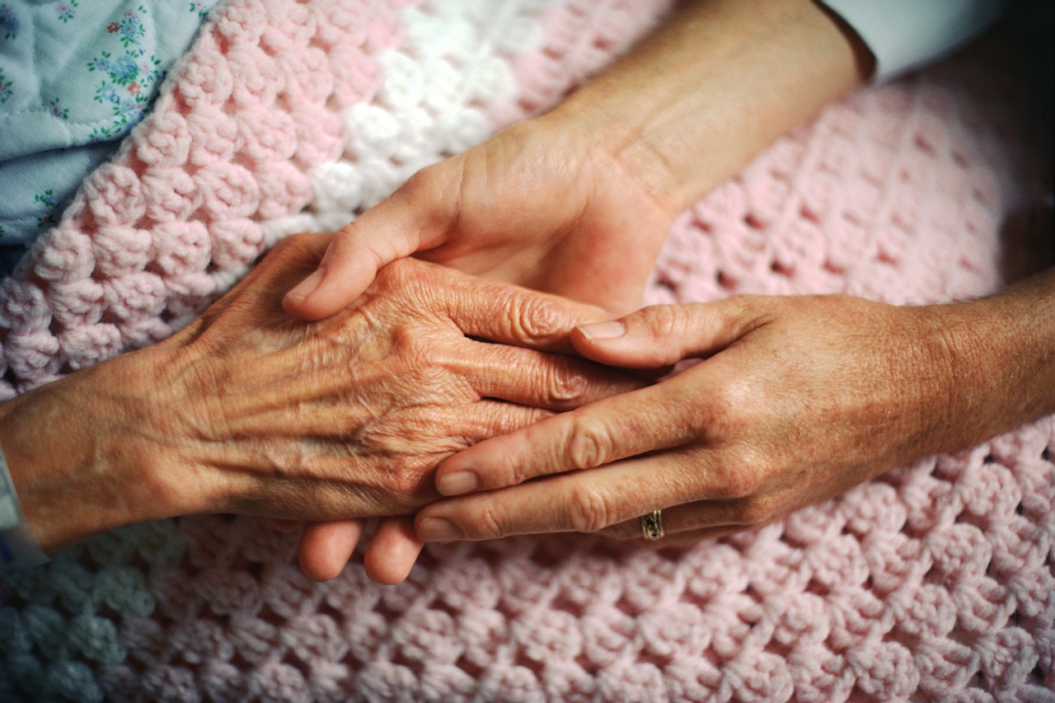
Adelman, et al. Caregiver Burden: a Clinical Review, JAMA 2014
Notes:
Mrs D, at 84 years of age, was the primary caregiver for her functionally impaired 86-year-old husband and shot herself 3 times in a suicide attempt. Mrs D’s family did not perceive the severity of the caregiver burden as a family picnic was planned for the day of her attempted suicide. Mrs D did not leave a note and later stated she fully intended to kill herself. While recovering in the hospital, she expressed relief at not having caregiving responsibilities. Two months later, her husband died, which Mrs D described as a release for her.
Mrs D did not have a primary care physician or attend any medical appointments for her own health needs, but she often accompanied Mr D to his appointments. Her 2 adult daughters lived nearby with their families. Reflecting on her caregiving experience, Mrs D stated, “it didn’t seem like there was anything that anybody could do for him,... I was doing all the house and yard work and taking care of him. …This was very hard for me, physically.”
Mrs D’s daughter: We tried to help where we could, but she was reluctant to accept it….
Mr D would not accept nonfamily home health care.
Mrs D: I could not stand another 24 hours. …I asked my husband more than once, wouldn’t he like some of those people to come in and help him? At least bathe and things like that. … He said no.
Mrs D’s daughter: … [S]he thought she was responsible to… do just about all of the caretaking. …[T]hey did the parent thing of don’t worry the kids about how bad off maybe Dad is, or how she was feeling…
Adelman, et al. Caregiver Burden: a Clinical Review, JAMA 2014

Slide 6
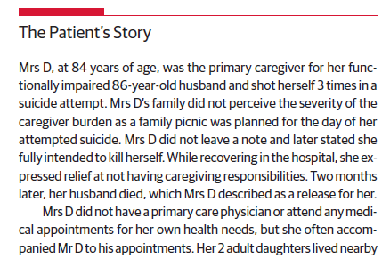
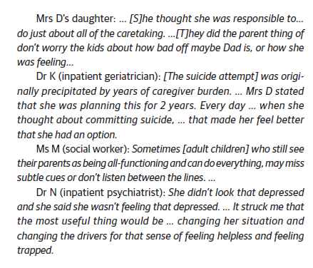
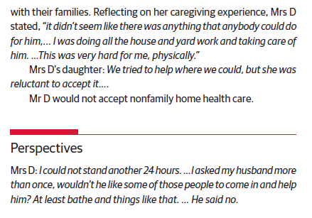

Slide 7
Definitions
Informal Caregiver/caregiving | provides unpaid care to a person with special needs
Caregiver burden | The extent to which caregivers perceive that caregiving has had an adverse effect on their emotional, social, financial, physical, and spiritual functioning
Adelman, et al. Caregiver Burden: a Clinical Review, JAMA 2014
National Alliance for Caregiving and AARP. Caregiving in the US, 2009
Easter Seals, Caregiving in Rural America, 2006
Notes:
Sidney Nebraska. In my mind there are more areas that are rural than counted by the US census bureau given that there are areas with 2,500 to 10000 people that we would all probably consider rural. Other studies have different definitions for what they consider to be rural….thus making it harder to compare studies.

Slide 8
https://www.ruralhealth.va.gov/vets/caregivers-module3.asp

Slide 9
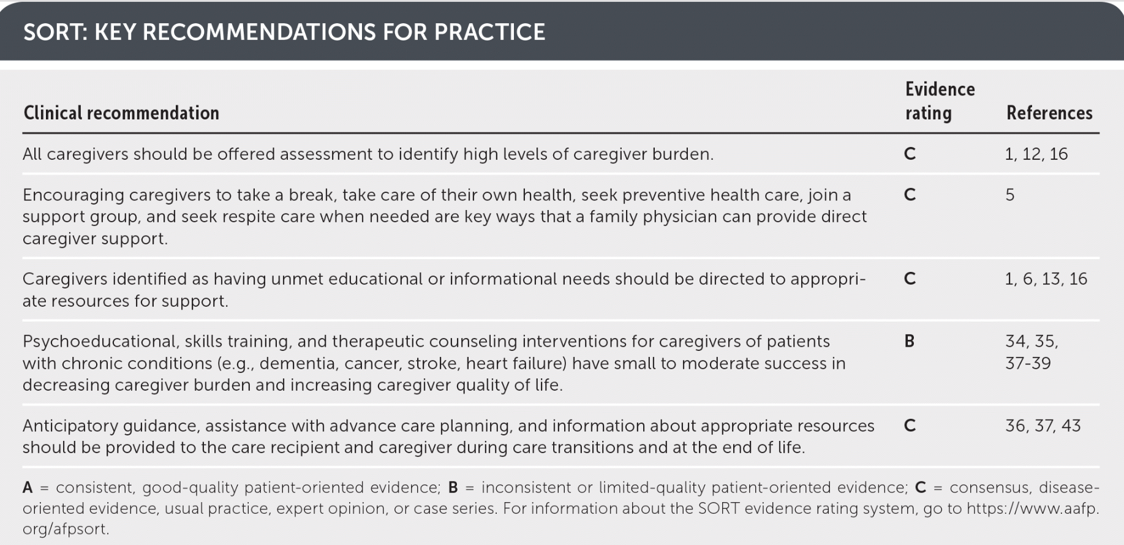
Typically Zarit burden scale
Swartz K & Collins L. “Caregiver Care” AFP 2019 Jun 1; 99(11):699-706

Slide 10
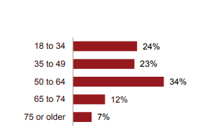
Caregiving
43.5 million adults in the United States (18.2%) have provided unpaid care to an adult or a child in the prior 12 months.
Care Recipient
Gender
Caregiver
Gender
Care Recipient
Age
Caregiver Age
For comparison, 12% of Adults aged 18 and older in the US have Diabetes
https://www.aarp.org/content/dam/aarp/ppi/2015/caregiving-in-the-united-states-2015-report-revised.pdf
https://www.cdc.gov/diabetes/pdfs/data/statistics/national-diabetes-statistics-report.pdf
Notes:
Mostly female caregivers, mostly older care recipients, mostly older caregivers if the care recipient is older
Spousal caregivers are the oldest, at 62.3 years of age, on average.

Slide 11
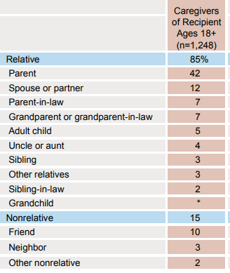
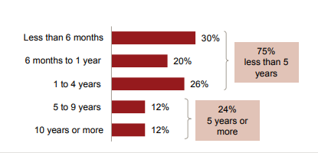
Care Recipient Relationship to Caregiver
Duration of care for the Care Recipient
½ of people felt like they had a choice in being
the caregiver
https://www.aarp.org/content/dam/aarp/ppi/2015/caregiving-in-the-united-states-2015-report-revised.pdf

Slide 12
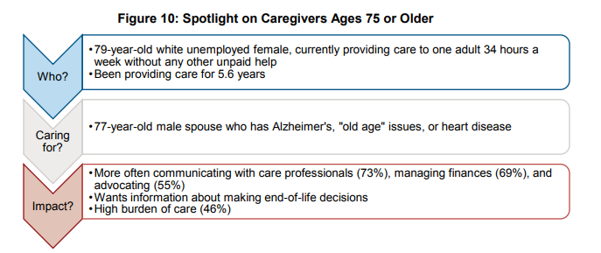
https://www.aarp.org/content/dam/aarp/ppi/2015/caregiving-in-the-united-states-2015-report-revised.pdf
Notes:
Most of the reasons for caregiving based on combined study done in 2009 by National alliance for caregiving AARP survey of 1400 patients was “old age” and dementia. The percentage of caregivers reporting caregiving for dementia has doubled between the 2004 survey and the 2009 survey from 6 to 12 percent

Slide 13
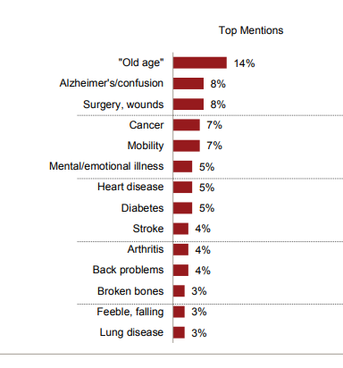
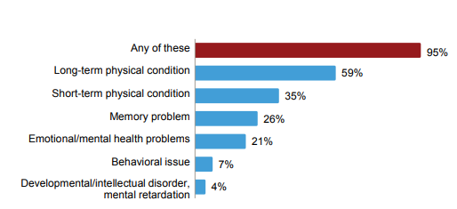
Main Health Problem of Care Recipient
Identified by Caregiver
Types of Care Recipient Conditions
https://www.aarp.org/content/dam/aarp/ppi/2015/caregiving-in-the-united-states-2015-report-revised.pdf

Slide 14
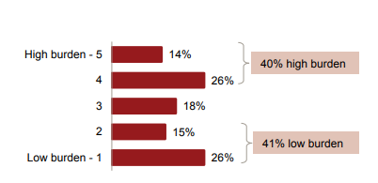
Burden of Caregiving
How has caregiving affected your health?
Based on hours of caregiving, number of ADLs and IADLs performed
Level of Emotional Stress that Caregiving
has caused the caregiver
Physical Strain that Caregiving puts on the
Caregiver
https://www.aarp.org/content/dam/aarp/ppi/2015/caregiving-in-the-united-states-2015-report-revised.pdf

Slide 15
Caregiver Burden and Health Impacts
Increased morbidity and mortality
Worse mental health (depression, anxiety, social isolation, suicide)
Worse health behaviors (sleep, exercise, healthy diet, refilling meds, keeping medical appointments, getting vaccinations, smoking)
Adelman, et al. Caregiver Burden: a Clinical Review, JAMA 2014
Burton, L. et al. Preventive health behaviors among spousal caregivers. Prev Med. 1997.
Talley, R. and Crews, J. Framing the Public Health of Caregiving. American Journal of Public Health. 2007.
Hoffman, G. et al., Health Behaviors among baby boomer informal caregivers. Gerontologist. 2012
Bejjani, C. et al. Characteristics of Depressed Caregivers of Veterans with Dementia. American Journal of Alzheimer’s Disease and Other Dementias. 2012
Noyes, et al. The Role of Grief in Dementia Caregiving. American Journal of Alzheimer’s Disease and Other Dementias. 2010
Varela, G. et al., Alzheimer’s Care at Home: a Focus on Caregivers Strain. Prof Inferm. 2011

Slide 16
Caregiver Burden and Health Impacts
Mortality
CG burden: independent predictor of CG mortality
63% increased risk of death
Adelman, et al. Caregiver Burden: a Clinical Review, JAMA 2014

Slide 17
Caregiver Burden and Health Impacts
Weight loss and poor nutrition
21-37% of caregivers for those with dementia have poor nutritional status
“Living in rural areas could increase the nutritional deficiencies because of limited accessibility to food shops and lack of public transportation”
Rullier, L., et. al. International Psychogeriatrics. 2014
Torres, S, et al. Journal of Nutrition Health and Aging. 2010
Notes:
This problem is surmised to be a greater problem in rural areas due to limited accessiblity to food shops and lack of public transport.

Slide 18
Caregiver Burden and Health Impacts
Poor self care
Spousal caregivers less likely to “engage in preventive health behaviors:”
Sleep and rest
Exercise
Eating regular meals
Keeping medical appointments
Getting vaccinations
Refilling medications
Burton, L. et al. Preventive health behaviors among spousal caregivers. Prev Med. 1997.
Talley, R. and Crews, J. Framing the Public Health of Caregiving. American Journal of Public Health. 2007.
Notes:
This is in addition to the worse healthy people 2010 status that rural patients already enjoy.

Slide 19
Caregiver Burden and Health Impacts
Poor self care
Baby boomer caregivers greater odds than non-caregivers of
overall negative health behavior
smoking
regular soda
fast-food consumption.
Hoffman, G. et al., Health Behaviors among baby boomer informal caregivers. Gerontologist. 2012

Slide 20
Caregiver Burden and Health Impacts
Sleep Deprivation
Especially in caregivers of those with disruption of the sleep-wake cycle
Adelman, et al. Caregiver Burden: a Clinical Review, JAMA 2014
Varela, G. et al., Alzheimer’s Care at Home: a Focus on Caregivers Strain. Prof Inferm. 2011.

Slide 21
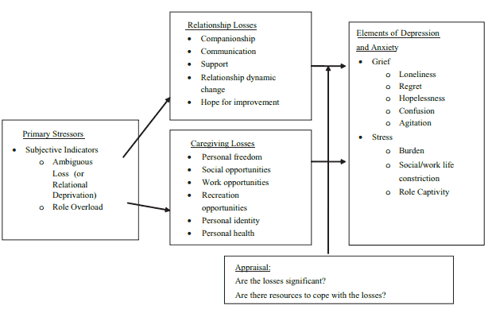
Caregiver Burden and Mental Health Impacts
Depression
Anxiety
Grief
Social Isolation
Suicide
Adelman, et al. Caregiver Burden: a Clinical Review, JAMA 2014
Bejjani, C. et al. Characteristics of Depressed Caregivers of Veterans with Dementia. American Journal of Alzheimer’s Disease and Other Dementias. 2012
Noyes, et al. The Role of Grief in Dementia Caregiving. American Journal of Alzheimer’s Disease and Other Dementias. 2010
Notes:
In people with caregiving responsibilities.

Slide 22
https://www.aarp.org/content/dam/aarp/ppi/2015/caregiving-in-the-united-states-2015-report-revised.pdf
Notes:
Highest burden of caregiving associated with dementia caregiving.

Slide 23
Estimated economic value of unpaid caregiver contributions 2009
Medicare
$509 billion
Caregiving
$450 billion
Medicaid
$361 billion
Toyota+ Ford+ Daimler 439 billion
Walmart
$408 billion
Suehs, B. et al. Household Members of Persons with Alzheimer’s Disease: Health Conditions, Healthcare Resource Use, and Healthcare Costs. JAGS. 2014

Slide 24
Caregiver burden and financial impacts
Inability to continue regular employment
69% make work accommodations
Greater healthcare resource use and health care costs for caregivers compared to non caregivers
More likely to have ED visits and hospitalizations
Feinberg, L. et al. Valuing the Invaluable: 2011 Update the Growing Contributions and Costs of Family Caregiving. AARP. 2011.
Suehs, B. et al. Household Members of Persons with Alzheimer’s Disease: Health Conditions, Healthcare Resource Use, and Healthcare Costs. JAGS. 2014
Notes:
Not spending time or money on preventative care

Slide 25
Impact of Caregiver Burden on Society
Workplace
Lost productivity
Estimated productivity loss for US businesses
33.6 billion per year from full-time caregiving employees
$ 2,110 per year for each full time employed caregiver
Health care costs:
Employers paid 8% more for health care of employees with eldercare responsibilities compared to non-caregiving employees (up to 13.4 billion in annual costs for US businesses)
Feinberg, L. et al. Valuing the Invaluable: 2011 Update the Growing Contributions and Costs of Family Caregiving. AARP. 2011.

Slide 26
Manley NA, Hicken BL, Rupper RW. Veterans as Caregivers: Those Who Continue to Serve. Fed Pract. 2017;34(4):28–34.

Slide 27
Other Difficulties
Have to learn
medical information
&/or procedures
ADLs
Memory
problems
“feel helpless”
Don’t know what
to do or how to help
Isolation
Recipient
Psychiatric issues
IADLs
(especially cooking
and cleaning)
Transportation
Manley NA, Hicken BL, Rupper RW. Veterans as Caregivers: Those Who Continue to Serve. Fed Pract. 2017;34(4):28–34.
Notes:
http://www.dreamstime.com/stock-image-elderly-man-umbrella-looking-up-sky-his-hand-to-see-if-to-rain-image36994481

Slide 28
What’s this got to do with me?
In your experience as a caregiver, have you ever had: a doctor, nurse, or social worker ask you what you need/needed…
Which of the following do you think would be/have been helpful to you: require a doctor, nurse, or social worker to ask you about what you need/needed…
“A Need Gap”

Slide 29
Manley NA, Hicken BL, Rupper RW. Veterans as Caregivers: Those Who Continue to Serve. Fed Pract. 2017;34(4):28–34.

Slide 30
Other: lack of desire, didn’t try, lazy, fighting with recipient lately

Slide 31
A sampling of resources to help caregivers:

Slide 32
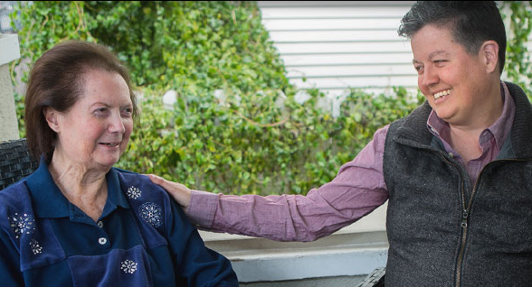
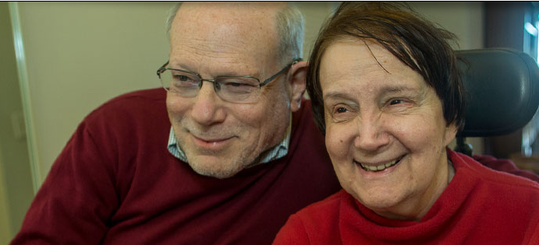
Great website: caregiver.org

Slide 33
Caregiver fact sheets: https://www.caregiver.org/fact-sheets

Slide 35
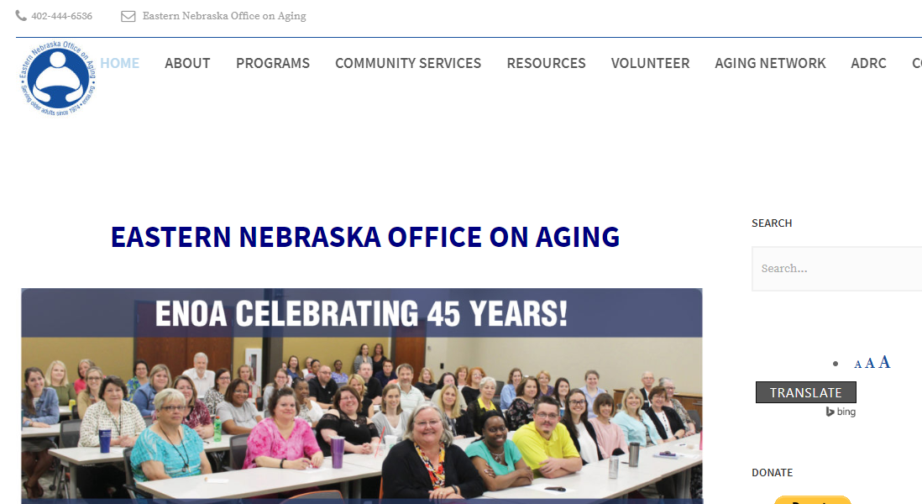

Slide 36
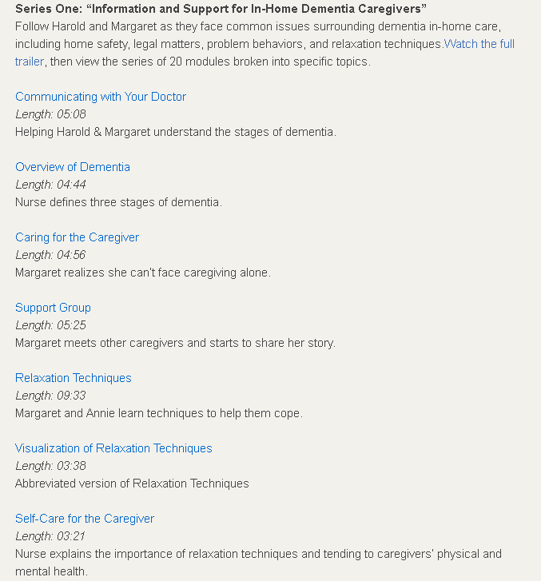
Caregiving video series produce by VA
https://www.ruralhealth.va.gov/vets/resources.asp

Slide 37
https://www.ruralhealth.va.gov/vets/comm_selfcare_assemb.asp

Slide 38
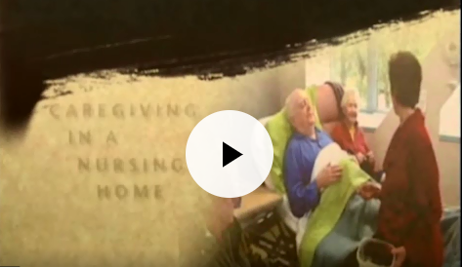
https://www.ruralhealth.va.gov/vets/caregivers-module20.asp

Slide 39
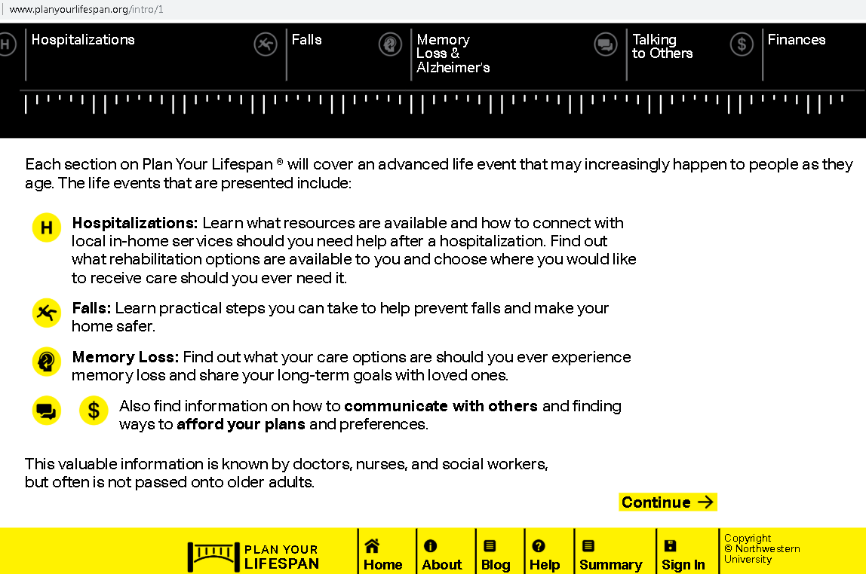

Slide 42
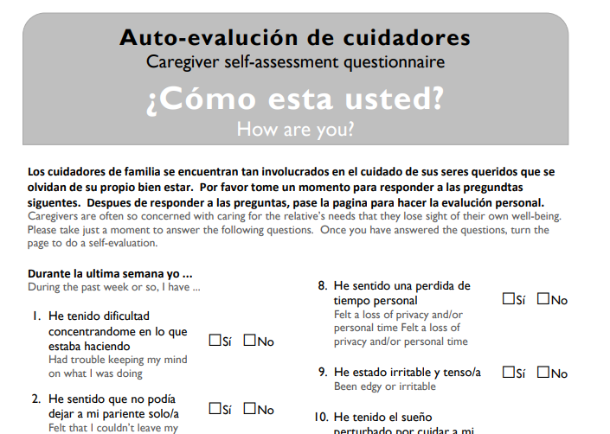
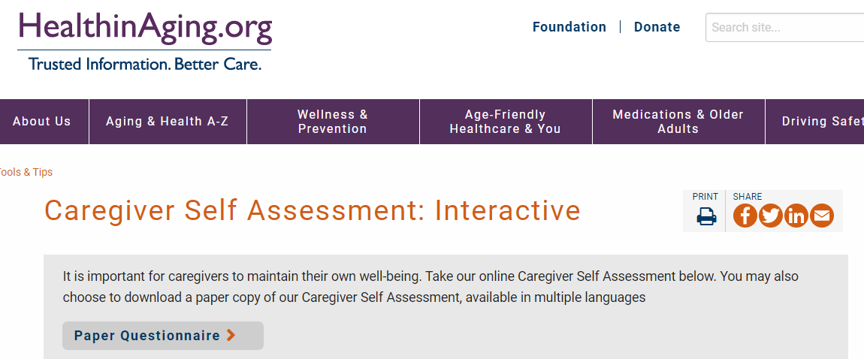

Slide 43
RAISE
Recognize, Assist, Include, Support, and Engage Family Caregivers Act of 2017 https://www.congress.gov/bill/115th-congress/senate-bill/1028.
Also known as the RAISE Family Caregivers Act, this act aims to address the stated “diverse needs” of family caregivers through 3 major provisions: 1) The act “directs the Department of Health and Human Services (HHS) to develop and make publicly available a National Family Caregiving Strategy that identifies recommended actions for recognizing and supporting family caregivers in a manner that reflects their diverse needs.” 2) HHS must then “convene a Family Caregiving Advisory Council to advise the department on recognizing and supporting family caregivers.” 3) The council is limited in duration to 5 years, after which time it dissolves. The effects of this groundbreaking legislation are, as yet, unclear.
From Geriatric Review Syllabus 10th ed

Slide 44
Questions?

