Slide 1
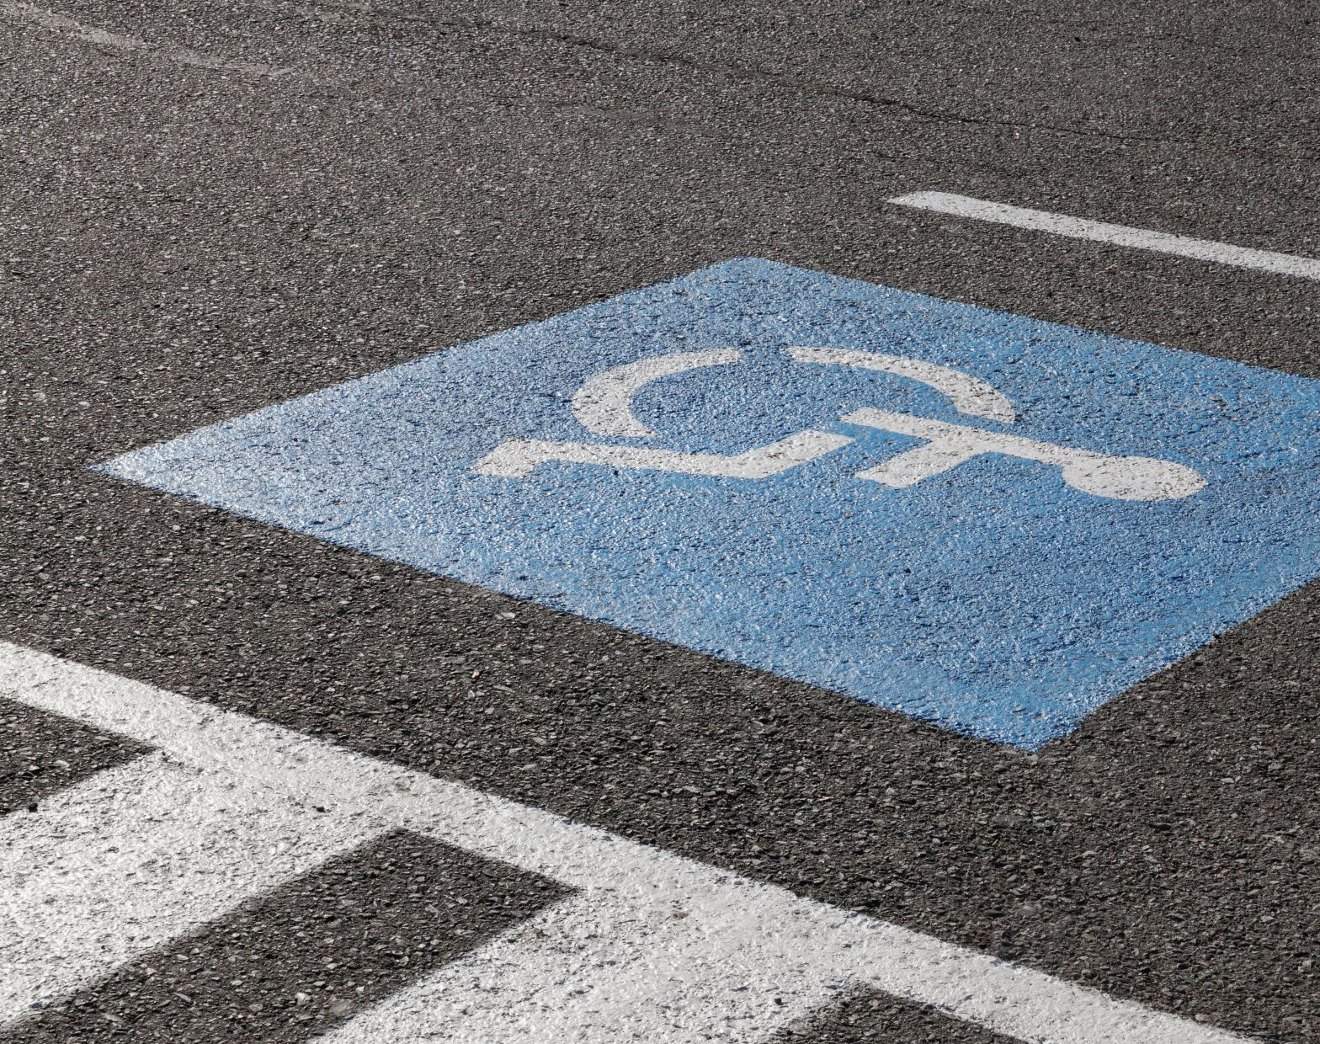
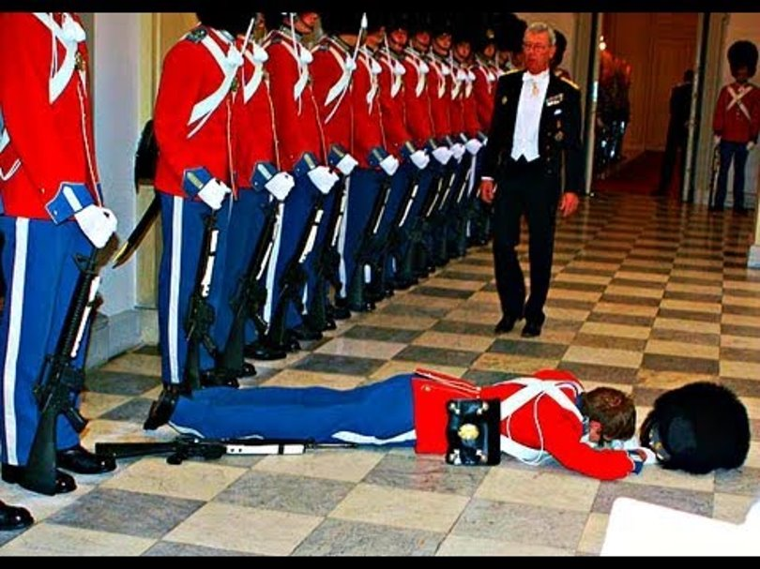
Falls and Mobility
GWEP 4M discussion
J Hejkal
02/4/2020

Slide 2
This program is supported by the Health Resources and Services Administration (HRSA) of the U.S. Department of Health and Human Services (HHS) as part of an award totaling 749,926.00 with 0% financed with non-governmental sources. The contents are those of the author(s) and do not necessarily represent the official views of, nor an endorsement, by HRSA, HHS, or the U.S. Government. For more information, please visit HRSA.gov.

Slide 3
Falls
25% of elderly population fall each year. Half tell their doctor.
One in five falls causes serious injury
Serious injury risk
Hip fracture with 25% 1-year mortality
SDH leads to >50% mortality or severe disability at 3 months
Notes:
More prevalent than diabetes (about 18% of older adults).

Slide 4
Hartholt K, Lee R, Burns E, van Beeck E. Mortality From Falls Among US Adults Aged 75 Years or Older, 2000-2016. JAMA 2019
Notes:
Fall-associated mortality has increased (about 30% relative increase over the past 10 years) in older adults, including after adjustment for age

Slide 5
Mobility
1/3 of older adults have mobility limitation.
Major determinant of well-being
Affects perceived quality of life more than falls
Notes:
Mobility disability is technically defined as the ability to walk ¼ mile without a walker; associated with ability to safely walk in community.

Slide 7
Exercise
Cornerstone of fall prevention and mobility improvement
Arthritic disease
Strength
Balance
Neurological disorders (e.g., Parkinsons)
Bone density
Cardiopulmonary disease

Slide 8
But Insufficient…

Slide 9
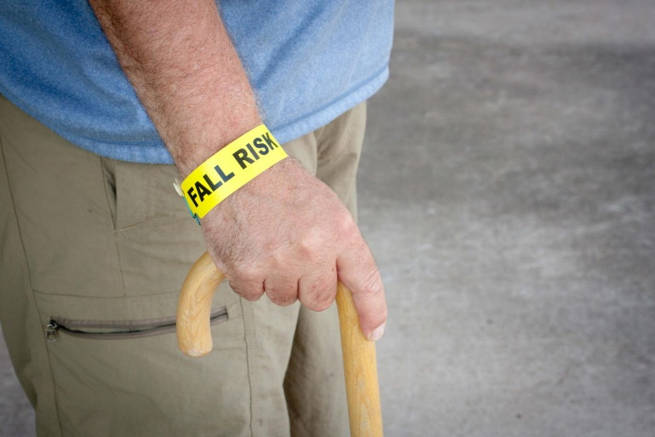
Geriatric Syndrome
Symptoms that are common in the elderly and result from additive, small deficits from multiple systems.
Notes:
I would argue that one of the reasons that exercise is so helpful is that it affects more than one domain and system.

Slide 10
What keeps us mobile?
The entire neurologic system
Proprioception system
Afferent nerves
Efferent nerves
CNS
Vestibular system
Vision
Muscles
Bones
CV system
Pulmonary

Slide 11
With contributions of every other system, too
Rushing to the toilet due to overactive bladder
Poor nutrition from GI problems.
And non-medical issues (cluttered floors, for example)
MEDICATIONS
Notes:
Needing to use the toilet is the primary cause of falls in institutional and hospital settings.

Slide 12
STEADI
CDC’s Stopping Elderly Accidents, Deaths, and Injuries initiative
Meant to help promote mobility and prevent falls in primary care settings.

Slide 13
Detection
When patients bring it up (more common if pain or multiple falls)
Screening (AWV)

Slide 14
Patients with low risk
Notes:
Vitamin D less important than we thought, unless truly deficient (e.g., in nursing homes)

Slide 15
Notes:
Good basics. There’s more you can do (i.e., thorough neurological exam and of course taking a thorough history). TUG (arise, walk 10 feet, turn around and sit down) . 30-se
4 Stage balance test is involves feet together, half tandem, tandem, and then stand on 1 foot for 10 seconds. If the patient can’t do the tandem stance for 10 seconds, fall risk is higher.

Slide 16
Notes:
There are many different proven fall-

Slide 17
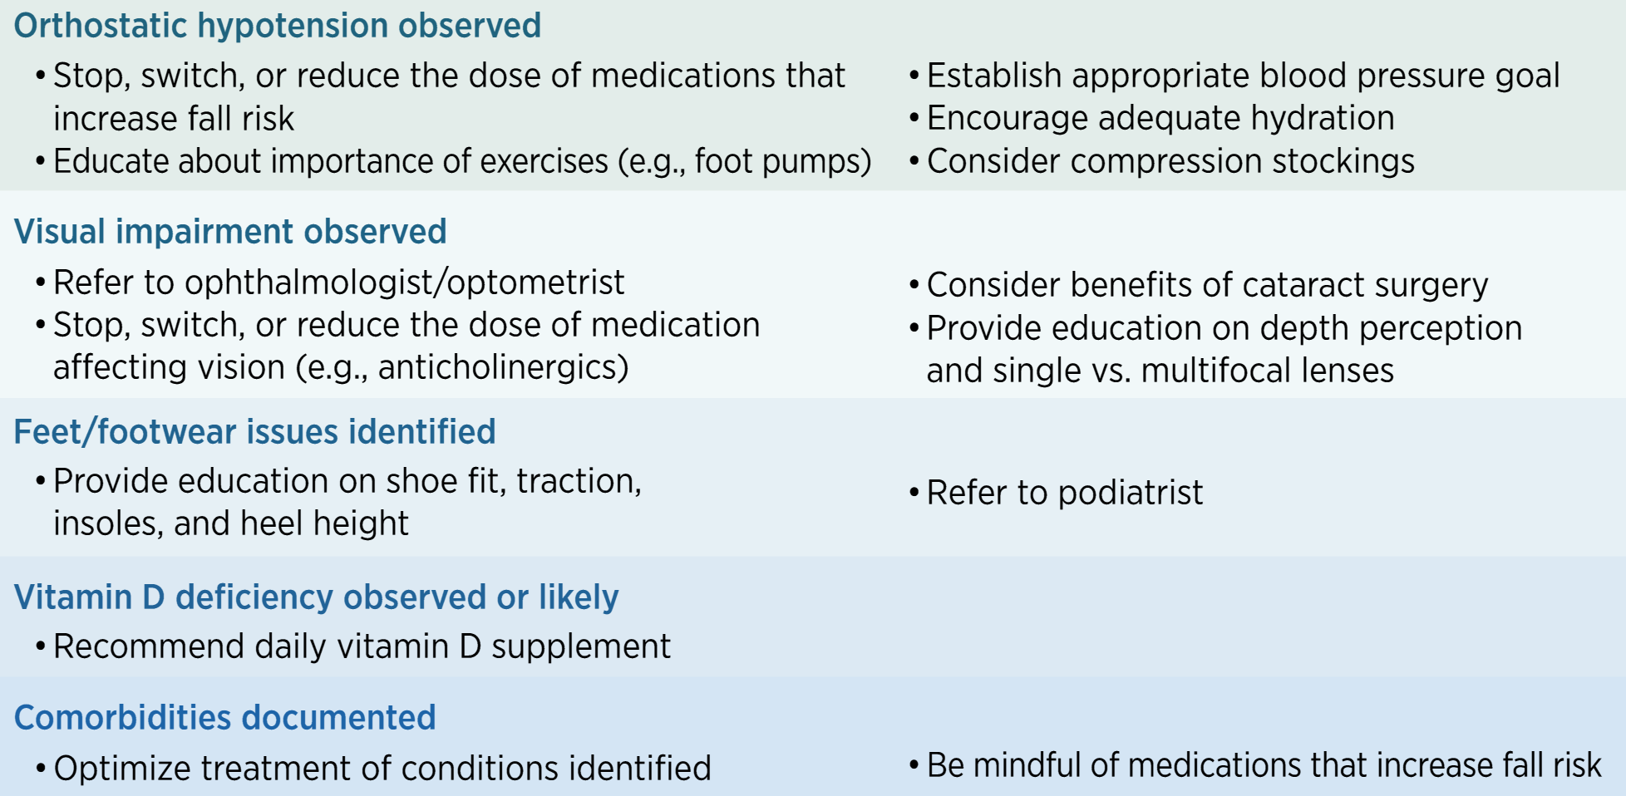
Notes:
Addressing orthostatic hypotension
Vision impairment: bifocals actually are associated with increased fall risk. Cataract surgery helps prevent them.
Vitamin D deficiency: really only helps to treat if there is a deficiency (unless in long-term care)

Slide 18
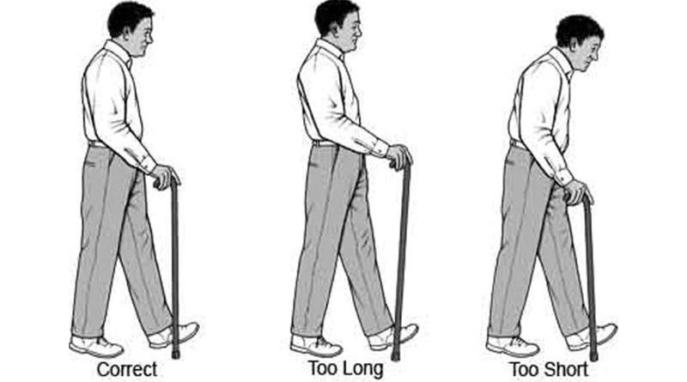
Other things to manage
Neurological disease
Imaging may be helpful
Referral to movement disorder clinic if indicated
Assistive devices
Emergency response systems
ENT for vertigo
http://www.elderlyaidsadvice.com/measure-your-walking-stick/

Slide 19
Other
Urinary urgency or incontinence
Pain
Cognitive impairment

Slide 20
Selective references
CDC STEADI website. http://cdc.gov/steadi/index.html
National Council on Aging (ncoa.org)
Hartholt K, Lee R, Burns E, van Beeck E. Mortality From Falls Among US Adults Aged 75 Years or Older, 2000-2016. JAMA 2019
Xu G. et al. Prevalence of diagnosed type 1 and type 2 diabetes among US adults in 2016 and 2017: population based study. BMJ 2018.

