Slide 1
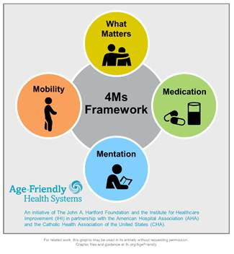
Age Friendly Primary Care: a Partnership between Fontenelle and UNMC’s Geriatrics Workforce Enhancement Program
Notes:
What Matters: Know and align care with each older adult’s specific health outcome goals and care preferences including, but not limited to end-of-life care, and across settings of care (document ACPs)
Medication: If medication is necessary, use Age-Friendly medications that do not interfere with What Matters to the older adult, Mobility, or Mentation across settings of care (Pharmacy protocols for med review in evaluating cognitive dysfunction, mobility and falls etc)
Mentation: Prevent, identify, treat, and manage dementia, depression, and delirium across settings of care
Mobility: Ensure that older adults move safely every day to maintain function and do What Matter

Slide 2
This program is supported by the Health Resources and Services Administration (HRSA) of the U.S. Department of Health and Human Services (HHS) as part of an award totaling 749,926.00 with 0% financed with non-governmental sources. The contents are those of the author(s) and do not necessarily represent the official views of, nor an endorsement, by HRSA, HHS, or the U.S. Government. For more information, please visit HRSA.gov.

Slide 3

The 4 M’s in Primary Care
Don’t try to fit a square peg in a round hole
Or
How to work with the reality in primary care

Slide 4
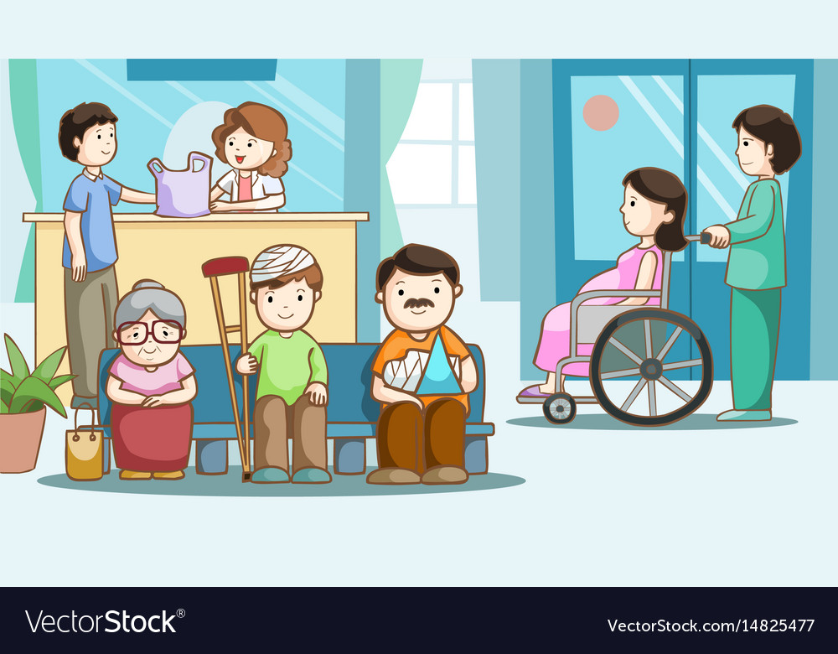
The Reality in Primary Care
Diverse populations
Wide range of ages
RVU targets/ mandates
Problems controlling “work pressure and pace”

Slide 5
Mentation
Delirium
Dementia
Depression

Slide 6
DEMENTIA:
History
Physical and
Social Networks

Slide 7
Objectives:
Understand essential elements of history in the diagnosis and differential diagnosis of dementia.
Describe how members of the interprofessional team work together in evaluation and management of dementia.
Recognize dementia as a geriatric syndrome with different factors contributing SOME of which can either be improved; and if not how to help patients/families compensate.

Slide 8
Etiology Pathogenesis Presenting
Symptoms
KNOWN
KNOWN
KNOWN, but variable presentation
Disease
Geriatric
Syndrome
Factor 1
Interacting
Factor 2
Interacting
Single Manifestation
Factor3
Interacting
Factor4
Interacting
Notes:
Disease- pneumonia: etiology-pneumococcal bacteria; pathogenesis multiplication in airways and lung parenchyma, presenting symptoms often but not always include: cough, fever, sputum, SOB
Geriatric syndrome: e.g. dementia/cognitive dysfunction common factors include ADEs, (including alcohol) , vascular risk factors, uncontrolled medical problems like DM, HF. The factors in yellow are those that are fixable or treatable. These are the things that general and family medicine can address.

Slide 9
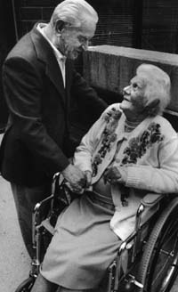
DEMENTIA
The most common cause of disability in later life
A focus for providers of health care to older adults

Slide 10
Dementia
(DSM-5 Major Neurocognitive Disorder)
Chronic acquired decline in one or more cognitive domains (learning and memory, complex attention, language, visual-spatial, executive) sufficient to affect daily life
Etiology: Any disorder causing damage to brain systems involved in memory. Alzheimer’s disease is the most common cause in later life

Slide 11
DEMENTIA
AD
Other
Vascular
Lewy BD
An umbrella term there are many causes.

Slide 12
Dementia:
Evaluation
History/physical
Neurologic
Medications
Mood
Abilities
Social

Slide 13
Diagnostic Pathway
History
Not AD
Physical Exam
Not AD
Neurological Exam
Not AD
Alzheimer’s Ds.

Slide 14

HISTORY OF SYMPTOMS
From a caregiver or someone close to the patient

Slide 15
The Dementia Evaluation
History
Collateral Source
Onset, Course, Progression, Risk Factors
Characteristic Course of Alzheimer’s Disease

Slide 16

HISTORY OF SYMPTOMS
What were the first symptoms?
How have things changed?
Is this typical
for AD?
We use a semi-structured interview done by social work and they also describe the social network, caregivers and who needs help

Slide 17
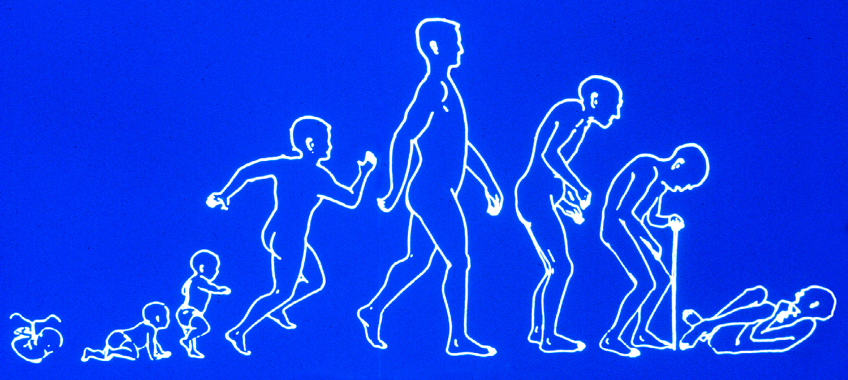
TYPICAL SYMPTOMS OF ALZHEIMER’S DISEASE
Functional loss in reverse order to
which skills were gained

Slide 18
Loss of Function in AD
IADLs (things that we do for children) are lost first in Alzheimer Disease
ADLs (everything it took you to get out of the house this AM) lost after all IADLs are impaired.

Slide 19
Case : Is This AD?
An 83 year old widower is evaluated because his family is concerned that he is cognitively slowed. He is still successfully maintaining homes in Arizona and Iowa. He describes a 9 month history of decline in his golf game, a 6 month history of unexplained falls, and a 1 month history of urinary incontinence. His.

Slide 20
Dementia Diagnostic Pathway
History
Not AD
Neurological Exam
Not AD
Physical Exam
Not AD
Alzheimer’s Ds.

Slide 21
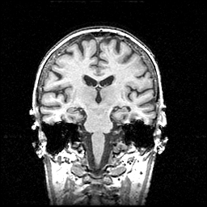
Dementias Arise From Cell Loss in the Cortex or Subcortex
Cortex- frontal, parietal, temporal, occipital lobes
Sub-cortex- basal ganglia, internal capsule, thalamus

Slide 22
Neuro Changes by Dementia Type
Neuro exam | Alzheimer’s | Subcortical
Cranial NN | Anosmia | Gaze changes
Strength, Reflexes &Sensation | Intact | Intact
Motor Tone * | Intact | Altered
Movement * | Intact | Altered
Gait * | Intact | Altered
*= Motor System Changes

Slide 23
Dementia Diagnostic Pathway
History
Not AD
Physical Exam
Not AD
Neurological Exam
Not AD
Alzheimer’s Ds.

Slide 24
The Dementia Evaluation
Physical
Essentially look for conditions that produce delirium
Delirium is frequently superimposed on dementia
Disease in major organ systems affect the brain, especially when advanced age or dementia is present

Slide 25
Case 2: What’s wrong here?
A 75 year old widow is evaluated at the request of her family for progressive cognitive impairment over the last 9 months. She is not taking meds correctly, not eating regularly and loosing weight. Her MMSE is 18. During the interview she admits to exertional fatigue, and lack of energy. On exam she has diffuse expiratory wheezing in all lung fields.

Slide 26
Geriatric Exam: not only the patient!!
Examine the environment. In cognitive impairment look at the drugs!!

Slide 27
Sutton’s Law:
“Gee, Willy, why do you rob banks?
“BECAUSE
THAT’S
WHERE THE
MONEY IS”

Slide 28



Geriatrician’s Law:
Go for the MEDS
Because that’s where the money is

Slide 29
Drugs and Dementia
Many drugs make patients worse, e.g. Sedatives, anxiolytics, anticholinergics, H2-blockers, centrally acting antihypertensives (clonidine, alpha-methyl dopa) antiarhythmics, beta blockers, digoxin, Sinemet, selegeline.
Don’t forget herbals and OTCs
Check all for CNS S.E.s
Try a “Drug Holiday”

Slide 30
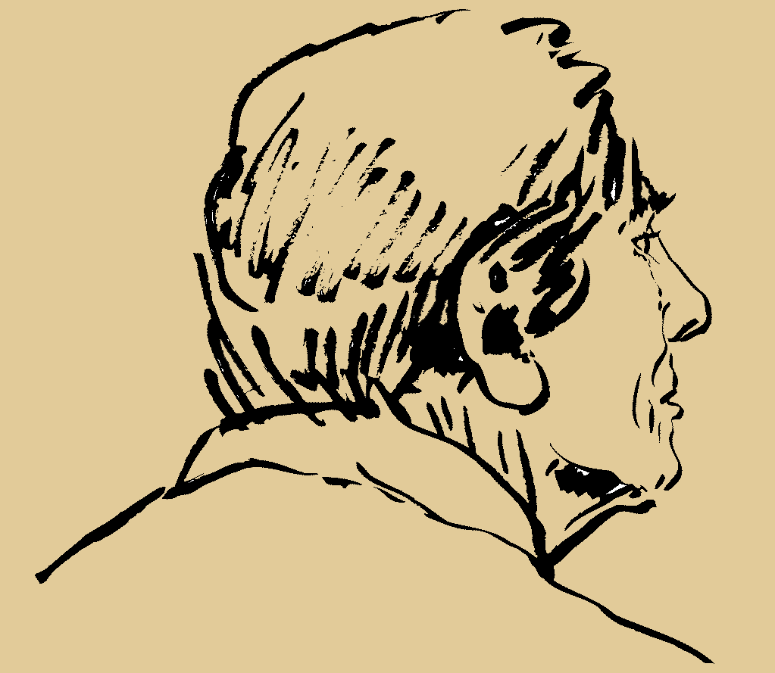
Alcohol and Dementia
Volume of distribution for ETOH with age
No more than one/day after age 65; stop all if cognition impaired

Slide 31
Case 3: What’s wrong here?
An 83 year old widow presents with a history of progressive cognitive failure. During interview she admits to a long term pattern of one drink before dinner. On questioning, her daughter feels that she likely exceeds one drink per day. Her MMSE is 18/30. She is having problems taking meds, fixing meals, paying bills.

Slide 32
The Dementia Evaluation
Laboratory/ Diagnostics
B-12, Folate, TSH
Chem profile, UA, ?O₂ sat
CBC
Other as indicated –most often drug levels
Brain Imaging (once, not multiple)

Slide 33
Things that Cause the Brain to Fail
(whether or not an underlying dementia is present)
D
E
M
E
N
T
I
A
Drugs
Emotional Illness (including depression)
Metabolic/endocrine disorders
Eye/ear/environment
Nutritional/neurological
Tumors/trauma
Infection
Alcoholism/anemia/ atherosclerosis

Slide 34
Diagnostic Criteria for AD
NIA ADRDA
Dementia (cognitive or behavioral symptoms) that: interfere with function; represent a decline; not explained by delirium or psych ds; and cognitive deficits in 2 or more domains.
Insidious onset and progressive course.
Presentations: amnestic (memory); nonamnestic

Slide 35
Therapy for AD
Cholinesterase inhibitors
Vitamin E
NMDA inhibitor- memantine for moderate stage, i.e. ADL dependent
RESEARCH: early identification of high risk patients, clinical trials to reduce accumulation of BAPP

Slide 36
Caregiver Support: core services offered by the Alzheimer’s Association
Information and Referral
Care Consultation
Safety Services
Early-Stage Engagement Programs
Support Groups
Monthly Educational Programs
Brain Health Awareness
Clinical Trials

Slide 37
Delirium Adapted from DSM-5
• Core symptom: disturbed consciousness (ie, decreased attention, environmental awareness)
• Cognitive change (eg, memory deficit, disorientation, language disturbance) or perceptual disturbance (eg, visual illusions, hallucinations)
• Three motoric subtypes: hyperactive, hypoactive, and normal/mild
• Rapid onset (hours to days) and fluctuating daily course
• Evidence of a causal physical condition

Slide 38
Assessing Cognitive Change
First and most sensitive is history from someone close to the patient
Standard instruments are essential
  MMSE (<24/30) ↓ sensitivity with high ed level
  MOCA (<26/30) better for detecting mild ∆
  Min-cog: really quick! About as sensitive as MMSE

Slide 39
Evaluation: Confusion Assessment Method (CAM)
Delirium is a:
Change in cognition that has both:
  Acute onset and fluctuating course
  AND Inattention
And either
  Disorganized thinking
  OR altered level of consciousness

Slide 40

Acute Onset AND Fluctuation
Symptoms develop over hours to days
(need a reliable informant; if not observed may present late) AND
Symptoms vary through out the day; characteristic lucid interval (e.g. she was really bad this AM but now better this afternoon)

Slide 41

AND Inattention
Difficulty focusing, sustaining, and shifting attention
Difficulty maintaining conversation or following commands
How to quickly test?

Slide 42


AND Either: Disorganized Thinking
E.G. disorganized or incoherent thinking
E.G. Rambling or irrelevant conversation (unpredictable switching subjects?)

Slide 43
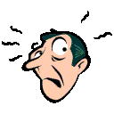

OR: Altered Level of Consciousness
Vigilant (hyperalert, very easily startled)
Lethargic (drowsy, easily aroused)
Stupor (difficult to arouse)
Coma (unarousable)

Slide 44
Delirium: PREDISPOSING (RISK) FACTORS
Advanced age
Dementia
Functional impairment in ADLs
Medical comorbidity
History of alcohol abuse
Male sex
Sensory impairment (↓ vision, ↓ hearing)

Slide 45
Who Gets Delirious? Why?
PRECIPITATING
VULNERABLE PATIENT
# of RISK FACTORS

Slide 46
PRECIPITATING FACTORS (INSULTS)
Acute cardiac events
Acute pulmonary events
Bed rest
Drug withdrawal (sedatives, alcohol)
Fecal impaction
Fluid or electrolyte disturbances
Indwelling devices
Infections (esp. respiratory, urinary)
Medications
Restraints
Severe anemia
Uncontrolled pain
Urinary retention

Slide 47
PRECIPITATING FACTORS (INSULTS)
Acute cardiac events
Acute pulmonary events
Bed rest
Drug withdrawal (sedatives, alcohol)
Fecal impaction
Fluid or electrolyte disturbances
Indwelling devices
Infections (esp. respiratory, urinary)
Medications
Restraints
Severe anemia
Uncontrolled pain
Urinary retention

Slide 48

Depression as Brain Dysfunction
Emotional illness slows cognitive function

Slide 49
Depression as a Cause of Brain Dysfunction
Dementia
Insidious onset
Long duration
No psychiatric history
Conceals disability (often unaware of memory loss)
“Near-miss” answers
Day-to-day fluctuation in mood
Depression
Abrupt onset
Short duration
Previous psychiatric history
Highlights disabilities (may complain of the memory loss)
“Don’t know” answers
Diurnal variation in mood, but generally more consistent

Slide 50
Mentation
Delirium
Dementia
Depression

