Slide 1
Geriatrics Case Conference
March 5, 2020

Slide 2
HOLDING A GOALS-OF-CARE DISCUSSION
Bill Lyons, MD
Division of Geriatrics, UNMC

Slide 3
This program is supported by the Health Resources and Services Administration (HRSA) of the U.S. Department of Health and Human Services (HHS) as part of an award totaling 749,926.00 with 0% financed with non-governmental sources. The contents are those of the author(s) and do not necessarily represent the official views of, nor an endorsement, by HRSA, HHS, or the U.S. Government. For more information, please visit HRSA.gov.

Slide 4
WHY, WHO, WHEN?
Sometimes obvious
80 yo with new cancer diagnosis, possible big surgery or course of chemo, maybe Hospice
75 yo on ventilator, discouraging O2 sat, can’t wean off pressors
More broadly, for older adults who have multiple conditions, navigating multiple clinicians

Slide 5
COUPLE OF GREAT RESOURCES
ariadnelabs.org
Brigham & Women’s Hospital
Harvard School of Public Health
Serious Illness Conversation Guide
patientprioritiescare.org
Academics Tinetti, Blaum, Naik, Didno
John A. Hartford Foundation, Robert Wood Johnson Foundation, and others

Slide 6
SET UP THE CONVERSATION
Thinking in advance – hope for the best, prepare for the worst
Benefit for patient and family
No decisions necessary today
Is this OK?

Slide 7
UNDERSTANDING
What is your understanding now of where we are with your illness?
“I know we doctors may not always do the best job of communicating about these things”
Calibrate their understanding as needed

Slide 8
INFORMATION PREFERENCES
How much information about what is likely to be ahead with your illness would you like from me?
Some patients like to know about time, others about what to expect…
How much would you like to involve your family or loved ones? What do they understand now?

Slide 9
PROGNOSIS
Share prognosis as a range, tailored to information preferences
How to estimate?
Experience
Contact consultant if a prominent disease
eprognosis.ucsf.edu

Slide 10
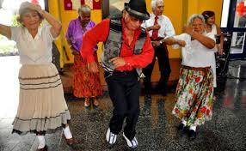
GOALS
If your health situation worsens, what are your most important goals?
Examples:
Function and independence
Longevity
Social connection
Symptom relief
What would you be doing more of if your [ailment] were not so burdensome?

Slide 11
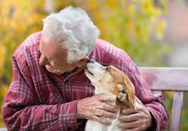
GOALS, cont.
Describe what a good day would look like
Which relationships or connections are most important to you?
What brings you the most enjoyment or pleasure?
What do you hope your health care can do for you?

Slide 12
BURDENS
Are these aspects of your health care making it difficult to meet your goals
Medicines (pills, shots, drops, inhalers)
Self-care tasks (diet, FSBG checks…)
Blood tests and x-rays, etc.
Medical visits
Dialysis…
What are you willing/able to do, and what NOT?

Slide 13
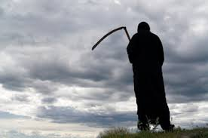
FEARS AND WORRIES
What are your biggest fears and worries about the future with your health?

Slide 14
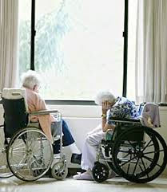
FUNCTION
What abilities are so critical to your life that you can’t imaging living without them?

Slide 15
TRADE-OFFS
If you became sicker, how much are you willing to go through for the possibility of gaining more time?
“I’ve had some patients who have told me, “Doc, I want you to do anything you can to have me live as long as possible – surgery, breathing machines, you name it….”
“And I’ve had other patients….”

Slide 16
MAKE RECOMMENDATIONS FOR NEXT STEPS
Acknowledge medical realities in clear, direct language
Summarize key goals and priorities
Describe treatment options that reflect both
Document the conversation
Hallenbeck’s ‘G O O D’

Slide 17
WHY “WHAT MATTERS” CARE MAY BE HELPFUL
Care for many older adults with multiple conditions may…
Be of uncertain benefit
Be burdensome
Inflict unintended harm
Be frustrating

Slide 18
WHY UNCERTAIN BENEFIT?
Few older adults in RCT’s, and those that are don’t look like our multimorbid patients
These persons may have less benefit from treatment than those in the research studies!

Slide 19
Questions / Discussion

