Slide 1
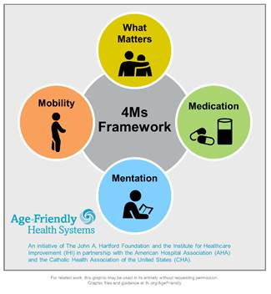
Age Friendly Primary Care: a Partnership between OneWorld and UNMC’s Geriatrics Workforce Enhancement Program

Slide 2
This program is supported by the Health Resources and Services Administration (HRSA) of the U.S. Department of Health and Human Services (HHS) as part of an award totaling 749,926.00 with 0% financed with non-governmental sources. The contents are those of the author(s) and do not necessarily represent the official views of, nor an endorsement, by HRSA, HHS, or the U.S. Government. For more information, please visit HRSA.gov.

Slide 3
Objectives:
Understand essential elements of history in the diagnosis and differential diagnosis of dementia.
Describe how members of the interprofessional team work together in evaluation and management of dementia.
Recognize dementia as a geriatric syndrome with different factors contributing SOME of which can either be improved or where we can go to help patients compensate.

Slide 4
DEMENTIA:
History
Physical and
Social Networks

Slide 5
Etiology Pathogenesis Presenting
Symptoms
KNOWN
KNOWN
KNOWN, but variable presentation
Disease
Geriatric
Syndrome
Factor 1
Interacting
Factor 2
Interacting
Single Manifestation
Factor3
Interacting
Factor4
Interacting
Notes:
Disease- pneumonia: etiology-pneumococcal bacteria; pathogenesis multiplication in airways and lung parenchyma, presenting symptoms often but not always include: cough, fever, sputum, SOB
Geriatric syndrome: e.g. falls common factors include ADEs, reduced functional reserve in 1 or more organs e.g. HF, arthritis etc, cognitive impairment with reduced judgment and problem solving, the factors in red are those that are fixable or treatable

Slide 6
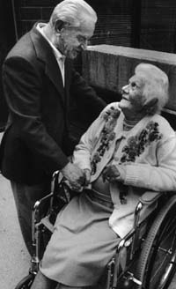
DEMENTIA
The most common cause of disability in later life
A focus for providers of health care to older adults

Slide 7
Dementia
Definition: A syndrome of acquired impairment of memory and other cognitive domains sufficient to affect daily life
Etiology: Any disorder causing damage to brain systems involved in memory. Alzheimer’s disease is the most common cause in later life

Slide 8
DEMENTIA
AD
Other
Vascular
Lewy BD
An umbrella term there are many causes.

Slide 9
Dementia:
Evaluation
History/physical
Neurologic
Medications
Mood
Abilities
Social

Slide 10
Diagnostic Pathway
History
Not AD
Physical Exam
Not AD
Neurological Exam
Not AD
Alzheimer’s Ds.

Slide 11
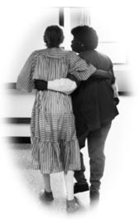
HISTORY OF SYMPTOMS
From a caregiver or someone close to the patient

Slide 12
The Dementia Evaluation
History
Collateral Source
Onset, Course, Progression, Risk Factors
Characteristic Course of Alzheimer’s Disease

Slide 13

HISTORY OF SYMPTOMS
What were the first symptoms?
How have things changed?
Is this typical
for AD?
We use a semi-structured interview done by social work and they also describe the social network, caregivers and who needs help

Slide 14
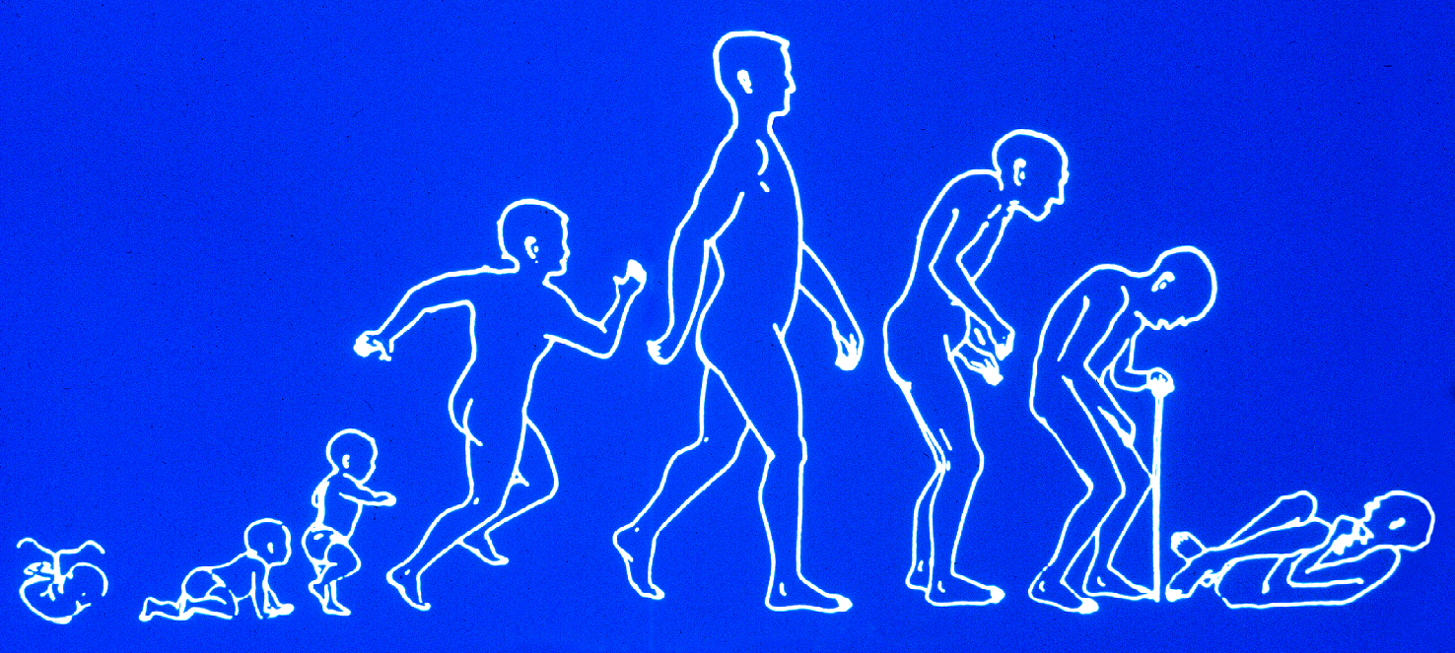
TYPICAL SYMPTOMS OF ALZHEIMER’S DISEASE
Functional loss in reverse order to
which skills were gained

Slide 15
Dementia Diagnostic Pathway
History
Not AD
Physical Exam
Not AD
Neurological Exam
Not AD
Alzheimer’s Ds.

Slide 16
Geriatric Exam: not only the patient!!
Examine the environment

Slide 17
Sutton’s Law:
“Gee, Willy, why do you rob banks?
“BECAUSE
THAT’S
WHERE THE
MONEY IS”

Slide 18
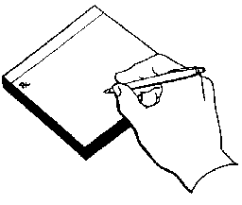

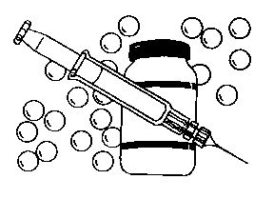
Geriatrician’s Law:
Go for the MEDS
Because that’s where the money is

Slide 19

Inspect the Drug Bag
Three or more drugs increase the likelihood of an adverse effect or drug interaction

Slide 20
Drugs and Dementia
Many drugs make patients worse, e.g. Sedatives, anxiolytics, anticholinergics, H2-blockers, centrally acting antihypertensives (clonidine, alpha-methyl dopa) antiarhythmics, beta blockers, digoxin, sinemet, selegeline.
Don’t forget herbals and OTCs
Check all for CNS S.E.s
Try a “Drug Holiday”

Slide 21
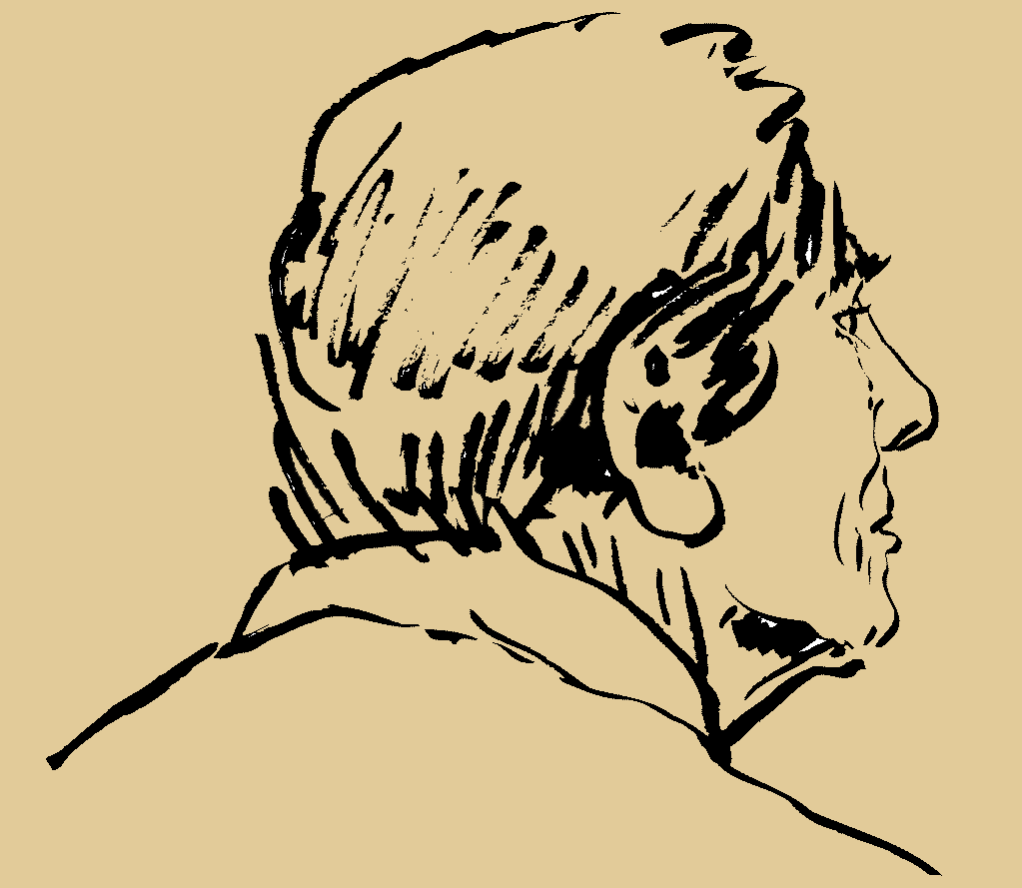
Alcohol and Dementia
Volume of distribution for ETOH with age
No more than one/day after age 65; stop all if cognition impaired

Slide 22
The Dementia Evaluation
Laboratory
B-12, Folate, TSH
Chem profile, UA, ?O₂ sat
CBC
Other as indicated –most often drug levels

Slide 23

The Dementia Evaluation
Radiology & Other
Head CT, ? Head MRI
Chest X-ray
EKG, EEG

Slide 24
Things that Cause the Brain to Fail
(whether or not an underlying dementia is present)
D
E
M
E
N
T
I
A
Drugs
Emotional Illness (including depression)
Metabolic/endocrine disorders
Eye/ear/environment
Nutritional/neurological
Tumors/trauma
Infection
Alcoholism/anemia/ atherosclerosis

Slide 25
Caregiver Support: core services offered by the Alzheimer’s Association
Information and Referral
Care Consultation
Safety Services
Early-Stage Engagement Programs
Support Groups
Monthly Educational Programs
Brain Health Awareness
Clinical Trials

Slide 26
N-648 Medical Certification for Disability Exception to the English & civics test requirements for naturalization because of physical disability or mental impairment
History of cognitive disability: use AD-8 to document a decline in function during adult life
Cognitive measure: Short Blessed or low-literacy MOCA
ICD 10 for presumed diagnosis

