Slide 1

Geriatrics Case Conference
December 5, 2019

Slide 2
Deprescribing in Older Adults
Linda Sobeski, PharmD, BCPS
Clinical Assistant Professor, UNMC COP
December 5, 2019

Slide 3
This program is supported by the Health Resources and Services Administration (HRSA) of the U.S. Department of Health and Human Services (HHS) as part of an award totaling 749,926.00 with 0% financed with non-governmental sources. The contents are those of the author(s) and do not necessarily represent the official views of, nor an endorsement, by HRSA, HHS, or the U.S. Government. For more information, please visit HRSA.gov.

Slide 4
Objectives
Define deprescribing and list common triggers for deprescribing.
Describe the barriers to deprescribing.
Explain the steps in deprescribing.
Discuss the rationale for deprescribing common drug categories.
Describe the enablers for deprescribing.
Become familiar with tools to assist with deprescribing.

Slide 5
Introduction
Polypharmacy:
  Administration of more medications than are clinically indicated
  Rate is 55-58% of older outpatients
Problems associated with polypharmacy:
  Adverse drug events
  Drug/drug and drug/disease interactions
  Impaired functional capacity
  Geriatric syndromes
  Medication non-adherence
  Increased mortality
  Increased cost

Slide 6
Introduction
Deprescribing:
  Planned, supervised process of dose reduction or discontinuation of medications that are:
    Unnecessary
    Ineffective
    Inappropriate
    Harmful
  Component of “good” prescribing
    Collaborative process
    In context with patient care goals, levels of functioning, life-expectancy, values & preferences
    Can bring about benefits and reduce harms

Slide 7
Benefits of Medication Reduction
Fewer falls and fractures
Reduced referral for acute services
Improved cognition
Better quality of life
Fewer medication errors and improved adherence

Slide 8
Triggers for Deprescribing
No indication
No longer aligns with goals of care or life expectancy
Inappropriate medication for geriatric patient
Adverse drug events
Prescribing cascades
Non-adherence
Patient preference
Palliative care/end of life

Slide 9
Prescribing Cascade
Drug 1
ADE interpreted as new medical condition
Drug 2
ADE interpreted as new medical condition
Drug 3
Rochon PA, Gurwitz JH. Optimizing drug treatment in elderly people: the prescribing cascade. BMJ 1997;315:1097.

Slide 10
Barriers to Deprescribing
Medical culture of prescribing
Clinical inertia (despite awareness)
  Provider/patient fear of adverse outcome
  Pressure to prescribe
  Multiple providers
Low self-efficacy
  Perceived lack of knowledge or skills
  Perceived barriers to success
Low feasibility
  Time and workload constraints
  Lack of longitudinal support

Slide 11
Steps for Deprescribing
Step 1: Review and reconcile medications
  All prescribed and OTC medications
  Assess indication
  Assess adherence
Step 2: Risk vs. benefit assessment for each medication
  Patient-centered approach
  ADEs, drug interactions, drug-disease interactions
  Use explicit tools (Beers criteria, STOPP criteria)

Slide 12
Steps for Deprescribing
Step 3: Assess eligibility for discontinuation
  Ineffective
  No current indication or symptoms have resolved
  Unacceptable risk
  Prescribing cascade
  Unacceptable treatment burden (administration or monitoring)
  Unlikely to confer benefit over patient’s lifespan
Step 4: Prioritize drug discontinuation
  Risk vs. benefit
  Ease of discontinuation
  Risk for adverse drug withdrawal events
  Patient preferences

Slide 13
Steps for Deprescribing
Step 5: Discontinue medications and implement monitoring protocol
  Step-wise approach based on priority
  Taper using practice guidelines, if available
  Monitor for return of symptoms, worsening of disease
  Monitor for physiological withdrawal

Slide 14
Categories of Drugs for Deprescribing
Inappropriate medication (2019 Beers criteria)
  Risk outweighs benefit for most elderly patients
  Anticholinergics, benzodiazepines/BZRAs, NSAIDs (high-risk patients)
  Alternatives: https://www.ncbi.nlm.nih.gov/pmc/articles/PMC4890629/pdf/nihms789464.pdf
Proton pump inhibitors
  Increased risk of fractures, C difficile, pneumonia, interstitial nephritis
  Often started without clear indication
  Often continued, despite symptom resolution
  Initial trial should be ~8 weeks for most common indications
  Taper higher doses
  Abrupt d/c without management of rebound symptoms increases risk of failure
  Continue if used for NSAID-induced ulcer prophylaxis

Slide 15
Categories of Drugs for Deprescribing
Benzodiazepines/BZRAs
  High risk of psychomotor impairment, falls, and cognitive impairment
  Not first line for anxiety or insomnia
  KEY is patient education and slow taper to avoid withdrawal: 25% every 2 weeks (~12.5% toward end)
  EMPOWER tool: http://www.criugm.qc.ca/fichier/pdf/BENZOeng.pdf
  Alternatives: SSRIs, SNRIs, CBT, sleep hygiene, melatonin
Antimuscarinics
  Highly anticholinergic
  Often continued despite limited or no benefit
  Non-pharmacologic interventions are first-line: behavioral tileting interventions

Slide 16
Categories of Drugs for Deprescribing
Statins for 1~ prevention
  Carryover from older treatment guidelines
  Older patients more likely to experience myopathy
  Unclear benefit of primary prevention in patients >75y, unless 1~ LDL > 190
  Unclear benefit in patients 40-75y, unless diabetes or >7.5% 10y ASCVD risk
  Consider time to benefit and life expectancy
ASA for 1~ prevention
  Limited evidence for primary prevention of CVD (especially older adults)
  Increased risk of gastrointestinal bleeding
  Not recommended for patients with 5y CV risk <15%
  Not recommended for patients >70y

Slide 17
Categories of Drugs for Deprescribing
Antipsychotics for BPSD
  No clear evidence for benefit and increased risk of mortality, EPS, falls
  Unlikely to benefit “agitated” behaviors
  Taper: 25-50% every 1-2 weeks
  Behavioral and environmental interventions are first-line
  Alternatives: cholinesterase inhibitors, SSRIs
  Reserve for patients with problematic psychosis
Cholinesterase inhibitors
  Only indicated for dementia
  Very modest benefit for cognition and functional status
  ADES: bradycardia, diarrhea, anorexia/weight loss, urinary incontinence, nightmares
  Deprescribe if: significant decline while on treatment, severe/end-stage dementia, ADEs

Slide 18
Categories of Drugs for Deprescribing
NSAIDs
  Increased BP, peripheral edema, CHF exacerbation
  GI bleed in high risk patients: >75y or concomitant use of steroids, antiplatelet agents, anticoagulants
  Risk of AKI or progression of CKD
  Alternatives: scheduled APAP, topical NSAIDs, counterirritants, TENS, PT, weight loss (OA), INJ steroids
Opioids
  Little evidence to support use in OA or chronic low back pain
  Risk of constipation, delirium, sedation, falls, unintentional overdose
  Deprescribe if no improvement in pain or function, SUD, or ADEs
  Decrease by 10% per week
  Alternatives: scheduled APAP, topical NSAIDs, counterirritants, TENS, PT, weight loss (OA), INJ steroids

Slide 19
Categories of Drugs for Deprescribing
Antihyperglycemics
  Higher A1c targets in older adults: 7-8% or higher
  Consider time to benefit for tight control and risk of hypoglycemia
  Deprescribe starting with:
    Drugs most likely to cause hypoglycemia
    Drugs with lowest HGA1c lowering potential

Slide 20
5M Model
Mind
Mobility
Medications
Multimorbidity
Matters Most
Model requires consideration of contributing factors outside the index condition
  Frailty
  Functional status
  Cognition
  Quality of life

Slide 21
Enablers of Deprescribing
Increased experience, skills, training
Access to specialists
Poor patient prognosis
Duty to do what is right for patient
Healthcare team-patient goal concordance
Patient-provider relationship
Teamwork: pharmacist-led polypharmacy/deprescribing clinics (D-PRESCRIBE)

Slide 22
Tips for Rational Prescribing
Are there underlying causes for problems or symptoms (including medications)?
Is the treatment necessary?
Are there non-pharmacologic options?
What are the risks of the treatment?
What are the patient’s goals of therapy?
What is the patient’s life expectancy based on age and comorbidity?
Is the patient adherent to current therapy? Will the patient be able to adhere to this treatment?
Can the patient afford the medication?
Have I participated in shared-decision making with the patient?

Slide 23
Resources & Tools
Deprescribing.org:
  PPIs, antihyperglycemics, antipsychotics, BZRAs, cholinesterase inhibitors
  https://deprescribing.org/resources/deprescribing-guidelines-algorithms/
Deprescribing BZRAs: AFP Practice Guideline
  https://www.aafp.org/afp/2019/0101/p57.html
Deprescribing Antipsychotics: AFP Practice Guideline
  https://www.aafp.org/afp/2018/0915/p394.html
2019Beers criteria: https://onlinelibrary.wiley.com/doi/epdf/10.1111/jgs.15767
  Alternatives for Beers Medications: https://www.ncbi.nlm.nih.gov/pmc/articles/PMC4890629/pdf/nihms789464.pdf
  https://globalrph.com/medcalcs/beers-criteria-patient-specific-reporting-available/

Slide 24
Resources & Tools
ARMOR Tool: https://www.managedhealthcareconnect.com/content/armor-a-tool-evaluate-polypharmacy-elderly-persons
Medstopper: http://medstopper.com
Hanlon JT, et al. A method for assessing drug therapy appropriateness. J Clin Epidemiol 1992;45(10):1045-1051.
TRIM: Tool to Reduce Inappropriate Medications
  https://www.ncbi.nlm.nih.gov/pmc/articles/PMC4919149/
OMahony D, et al. STOPP/START criteria for potentially inappropriate prescribing in older people: version 2. Age Ageing 2015;44:213-218.

Slide 25
Resources & Tools
Anticholinergic burden calculator: http://www.acbcalc.com/
Garfinkel D, et al. The war against polypharmacy: a new cost-effective geriatric-palliative approach for improving drug therapy in disabled elderly people. Isr Med Assoc J 2007;9:430-4.
Tannenbaum C, et al. Reduction of inappropriate benzodiazepine prescriptions among older adults through direct patient education: the EMPOWER cluster randomized trial. JAMA Intern Med 2014;174(6):890-898.

Slide 26

Questions

Slide 27
References
Krishnaswami A, et al. Deprescribing in older adults with cardiovascular disease. J AM Coll Cardiol 2019;73:2584-95.
McGrath K, et al. Deprescribing: a simple method for reducing polypharmacy. J Fam Pract 2017;66(7):436-445.
Martin P, et al. Effect of a pharmacist-led educational intervention on inappropriate medication prescriptions in older adults: the D-PRESCRIBE randomized clinical trial. JAMA 2018;320(18):1889-1898.
Halli-Tierney AD, et al. Polypharmacy: evaluating risks and deprescribing. Am Fam Physician 2019;100(1):32-38.
Frank C, Weir E. Deprescribing for older patients. CMAJ 2014;186(18):1369-1376.

Slide 28
Case Discussion
December 5, 2019

Slide 29
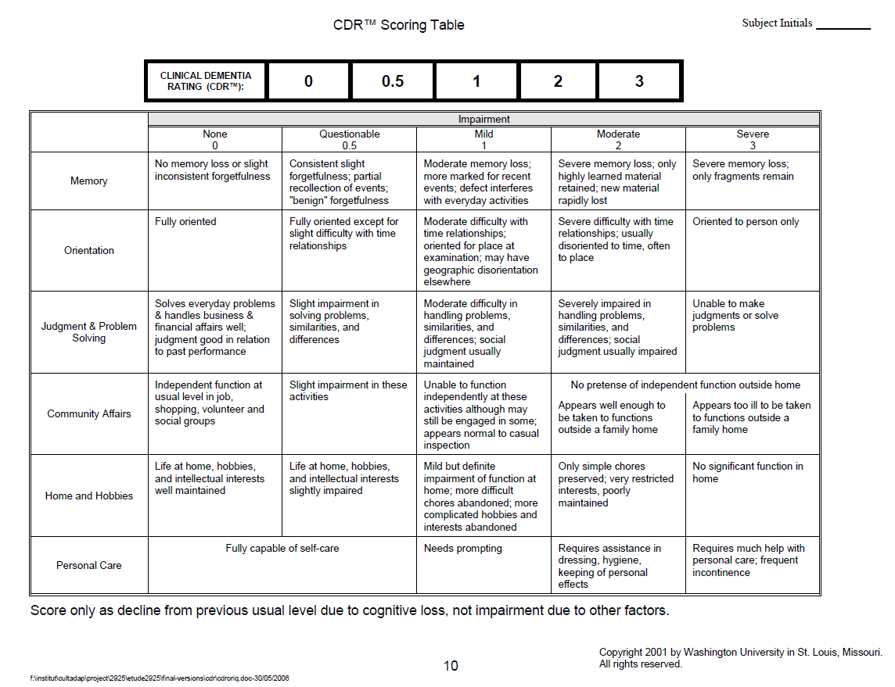

Slide 30
Article
Practice Parameter update: Evaluation and
management of driving risk in dementia
AAN Driving - Dementia Guidelines.pdf

Slide 31
Resources for Discussion:
DMV : https://dmv.nebraska.gov/forms
Statement of Physician https://dmv.nebraska.gov/sites/dmv.nebraska.gov/files/doc/dls/forms/statementofphysician.pdf
Vision statement https://dmv.nebraska.gov/sites/dmv.nebraska.gov/files/doc/dls/forms/visionstatement.pdf
Citizen Reexamination report https://dmv.nebraska.gov/sites/dmv.nebraska.gov/files/doc/dls/forms/CitizenReexaminationReport.pdf
ENOA Rural Transportation brochure: https://enoa.org/wp-content/uploads/2019/10/RTP-Bro-2.pdf
Community Transportation resources https://enoa.org/wp-content/uploads/2019/11/COMMUNITY-TRANSPORTATION-RESOURCES-11.19.pdf
Older drivers:
https://www.cdc.gov/motorvehiclesafety/older_adult_drivers/index.html?deliveryName=DM14138
Dementia and Driving:
https://alz.org/help-support/caregiving/safety/dementia-driving

Slide 32
Thank you for your participation in today’s conference.
We appreciate your attendance and value feedback provided in follow-up survey.
If you would like to submit a case for an upcoming conference, please send to Dr. Dworak.

