Slide 1
Geriatrics Case Conference
February 6, 2020

Slide 2
Mobility
Joe Hejkal, MD
Assistant Professor, UNMC
February 6, 2020

Slide 3
This program is supported by the Health Resources and Services Administration (HRSA) of the U.S. Department of Health and Human Services (HHS) as part of an award totaling 749,926.00 with 0% financed with non-governmental sources. The contents are those of the author(s) and do not necessarily represent the official views of, nor an endorsement, by HRSA, HHS, or the U.S. Government. For more information, please visit HRSA.gov.

Slide 4
Frequent Fallers
25% of elderly population fall each year
1/3 have other mobility limitation
Serious injury risk
Hip fracture with 25% 1-year mortality
SDH leads to >50% mortality or severe disability at 3 months

Slide 5
Screening
Less than half of patients who fall tell their doctor.
Stopping Elderly Accidents, Deaths and Injuries (STEADI) initiative from CDC provides guidance for screening and interventions.

Slide 7
STEADI initial screening guidelines
Stay independent brochure (12-question tool that patient fills out
OR
Ask
- Do you feel unsteady when standing or walking
- Do you worry about falling?
- Have you fallen in the past year?

Slide 8
For low risk individuals

Slide 9
If positive screen:

Slide 10
Other things to look at
Neuro exam is often appropriate
Focal weakness or motor abnormalities
Sensory deficits
Coordination problems
Parkinsonism
Look for nystagmus if symptoms

Slide 11
Develop care plan

Slide 12
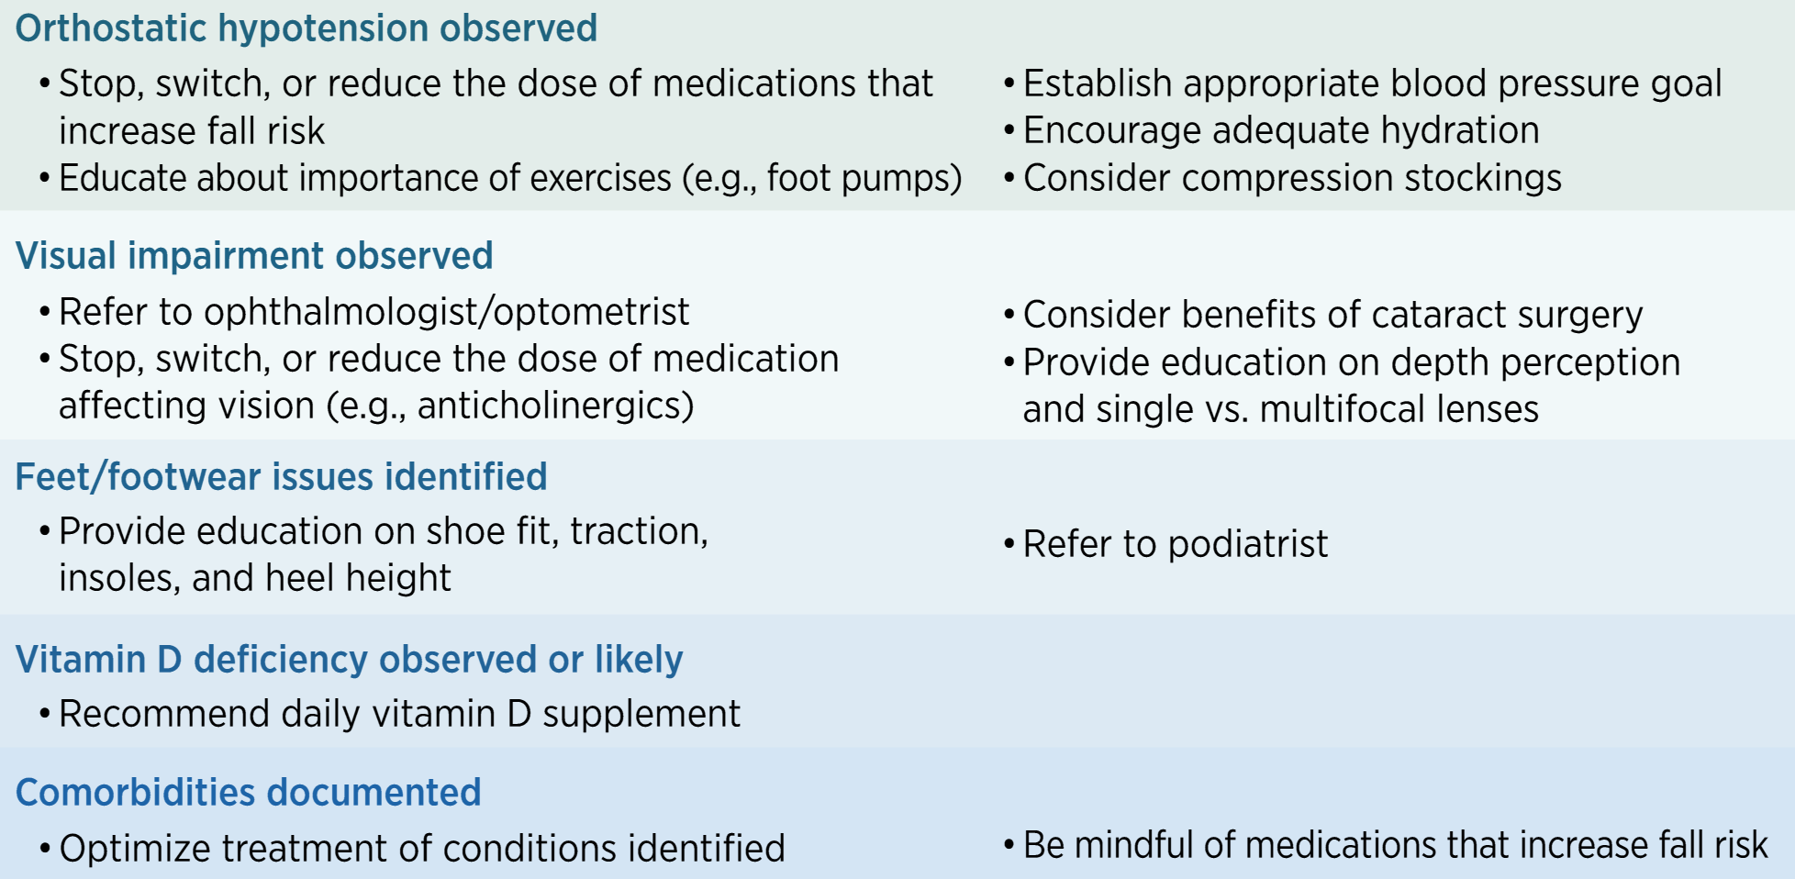

Slide 13
Other helpful interventions
Assistive devices
Emergency response systems
Other referral if appropriate (neurology, ENT, for example)

Slide 14
Questions?

