Slide 1
Advance Care Planning
In the time of Covid-19
Jane F. Potter

Slide 2
Funding This program is supported by the Health Resources and Services Administration (HRSA) of the U.S. Department of Health and Human Services (HHS) as part of an award totaling $751,695.00 with 0% financed with non-governmental sources. The contents are those of the author(s) and do not necessarily represent the official views of, nor an endorsement, by HRSA, HHS, or the U.S. Government. For more information, please visit HRSA.gov.

Slide 3
Objective Learn about a tool that incorporates 'patient priorities’ and goals of care with advance care planning
and one that has achieved world wide use during the pandemic.

Slide 4
Stressors on Providers During Covid
Lack of designated surrogates
Misunderstanding of care goals
Allocation of life saving resources- is this even something this patient would want?
Notes:
Provide advanced supportive care, run ventilators etc.
What is often harder for providers, what is more challenging:

Slide 5
Address those Stressors for Us and Patients
Identity surrogate decision makers
Assist in identifying “patient priorities” now and priorities for care during serious illness
Provide the right care during health emergencies

Slide 6
Making Advance Care Planning Easier for Diverse Populations During & after the COVID-19 Crisis

Slide 7
Topics
The goal of advance care planning (ACP)
ACP during COVID-19 crisis
Easy-to-use tools to help

Slide 8
What is Advance Care Planning (ACP)?
Definition: ACP is a process that supports adults at any age or stage of health in understanding and sharing their personal values, life goals, and preferences regarding current or future medical care.
Goal: The goal of ACP is to help ensure that people receive medical care that is consistent with their values, goals and preferences during serious and chronic illness.”

Slide 9
Move ACP Upstream
First Steps
Next Steps
Advanced Steps
Readiness to Engage
Life Course

Slide 10
Why is ACP Important?
Improved patient satisfaction with care
Improved quality of life
Less unwanted medical care aligned with wishes
Less stress for the surrogate decision maker
Detering KM et al. BMJ. 2010; Silveira MJ, et al. N Engl J Med. 2010;362(13):1211-1218; Houben CH, et al. J Am Med Dir Assoc. 2014; Bischoff et al. J Am Geriatr Soc. 2013; Bond WF, et al. J Palliat Med. 2018

Slide 11
Advance Care Planning Realities
• Advance care planning ~ 33% for the past 10 years
Lower among minority populations, ~ 15-20%
~ 10-20% discussed wishes with medical provider
Among ICU decedents, ~ 20% no ACP before death
Silveira et al. N Engl J Med. 2010; Yadav et al. Health Aff (Millwood). 2017; Harrison et al. JAMA Intern Med, 2016; Block BL, et al. JAMA Intern Med. 2020

Slide 12
COVID-19 Clinical Realities
Serious illness affecting both young and old (median 56 yrs)
Clinical picture can worsen very quickly
Families, surrogates not able to visit ER/hospital
Older patients not bringing hearing aids, glasses, or cell phones or chargers
Frontline providers are DESPERATE to know any information about the person and family contacts

Slide 13
ACP: Health Literacy Considerations
Average reading level in the US = 8th grade
Medicaid and older people = 5th grade
Most advance directive documents written beyond the 12th grade (post-graduate) level.

Slide 14
ACP: Language Considerations
61 million people in U.S. (~20%) speak language other than English at home
US 41 (13.5%)million Spanish; Nebraska 129,000 (7.4%)
US 3.4 million Chinese; Nebraska next most common
Vietnamese, Arabic, then Chinese
Lack of linguistically-appropriate materials

Slide 15
ACP: Cultural Considerations
Non-Western views on autonomy & decision making
– ~20% do not want to make own medical decisions
Mistrust and experiential racism
– Minorities given less information by clinicians and less time for discussion → mistrust forms
Crawley L, et al.,. JAMA. 2000; Kwak J, et al., Gerontologist. 2005; Singh JA,et al. Am J Manag Care. 2010; Smith AK, et al. JAMA. 2009 ; Gordon HS, et al. Cancer. 2006; Rhodes R, Teno JM. J Clin Oncol. 2009

Slide 16
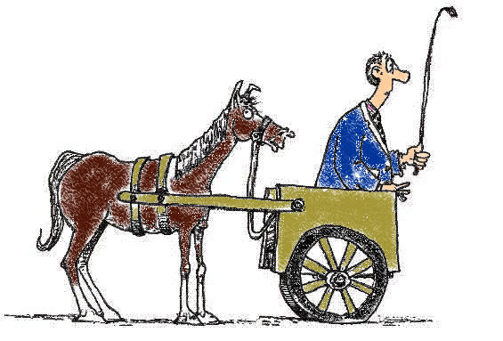
What Matters Most→ the Outcome
What matters most is not the treatment BUT the outcome of treatment
Not intubation or CPR (the cart)
But how their life will be after treatment (the horse)

Slide 18
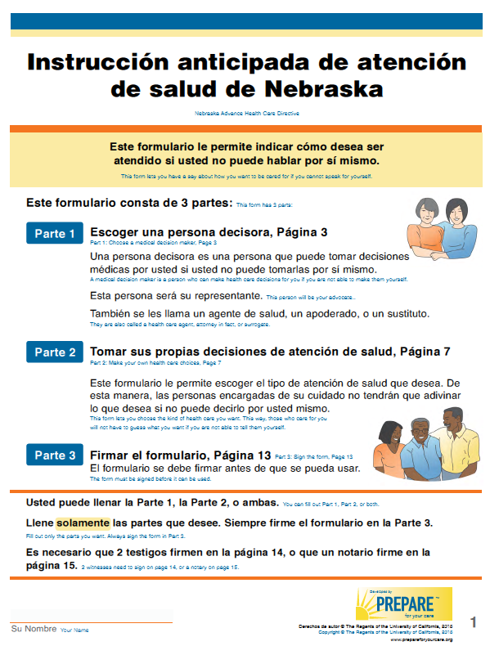
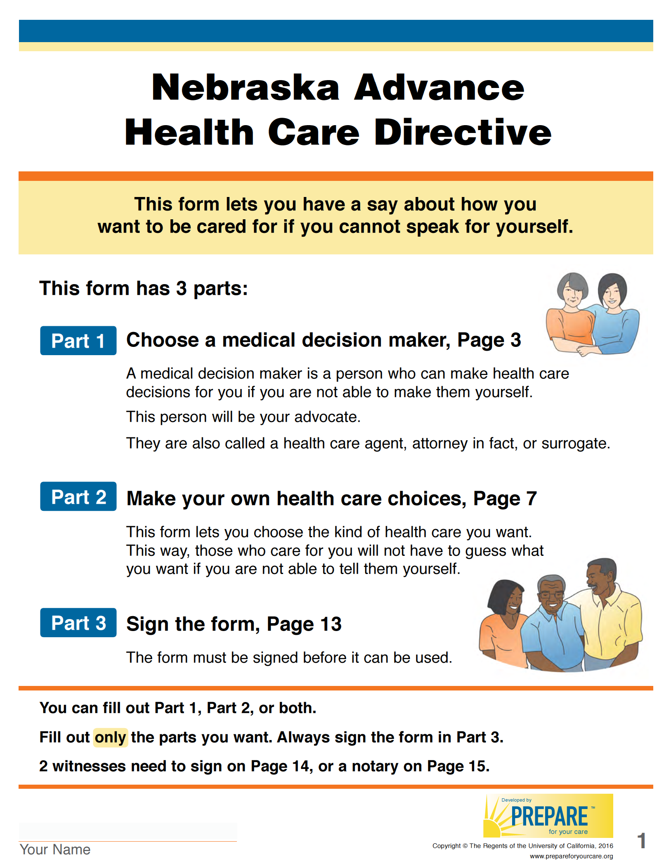
Easy-to-Read Advance Directive (AD)
RCT:
Doubled completion rates
Overwhelmingly preferred regardless of literacy/ language
10 languages
www.PrepareForYourCare.org
Sudore RL et. al., Patient Educ Couns 2007

Slide 19
Are Advance Directives Enough? NO Missing Puzzle Piece
PREPARE people with skills to:
– identify what is most important and how they want to live
– talk with family and friends
– talk with medical providers
– make informed decisions
– get the care that is right for them
Sudore RL. & Fried TR. Ann Intern Med, 2010

Slide 21
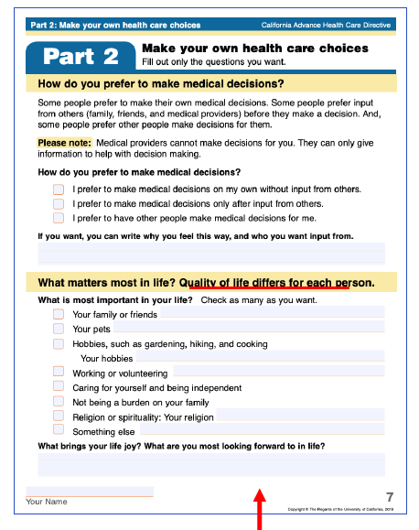
What’s Important Now ?

Slide 22
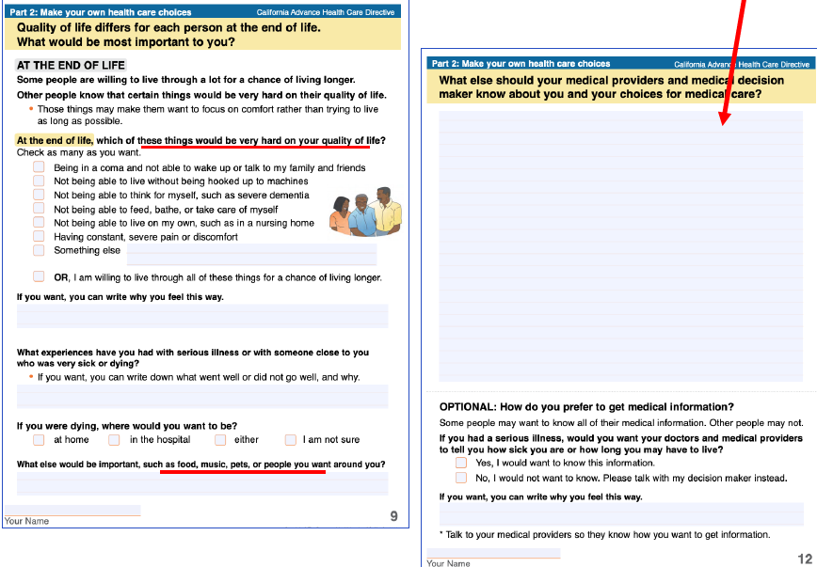
Values at End of Life, write “Why” in Covid or other

Slide 26
Why is ACP Important?
Improved patient satisfaction with care
Improved quality of life
Less unwanted medical care aligned with wishes
Less stress for the surrogate decision maker
Detering KM et al. BMJ. 2010; Silveira MJ, et al. N Engl J Med. 2010;362(13):1211-1218; Houben CH, et al. J Am Med Dir Assoc. 2014; Bischoff et al. J Am Geriatr Soc. 2013; Bond WF, et al. J Palliat Med. 2018

Slide 27
Summary : Prepareforyourcare
A tool that incorporates 'patient priorities’ and goals of care with ACP.
All forms and materials available for free
In a patient facing format
Bilingual ACP forms at the right literacy level, culturally appropriate and in 10 different languages.
Complete programs available for use with community groups in English and Spanish and on the web.

Slide 28
Questions/Discussion
Please remember to enter your attendance for today’s conference in the CHAT, including your name, role and clinic.
We value your feedback and truly appreciate your responses to the evaluation survey sent out following today’s conference.

Slide 29
Thank you for attending today’s
Geriatrics Case Conference!
Please complete the emailed evaluation!

