Slide 1
Geriatrics Case Conference
August 6th, 2020

Slide 2
This program is supported by the Health Resources and Services Administration (HRSA) of the U.S. Department of Health and Human Services (HHS) as part of an award totaling 751,695.00 with 0% financed with non-governmental sources. The contents are those of the author(s) and do not necessarily represent the official views of, nor an endorsement, by HRSA, HHS, or the U.S. Government. For more information, please visit HRSA.gov.

Slide 3
Introduction
Please welcome our
Primary Care Liaison
and today’s presenter
April Recher

Slide 4
Social Determinants of Health
Presented by April Recher

Slide 5
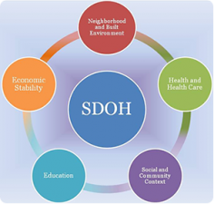
Social Determinants of Health (SDoH)
According to CDC, SDoH are :
The conditions in the places where people live, learn and work can affect a wide range of health risks and outcomes.
Poverty limits access to healthy food and safer neighborhoods and limits the level and quality of education available.

Slide 6
What does good health look like?
But, it is also social and economic opportunities:
Available resources to meet daily needs
Access to quality education and jobs and health care services
Available community-based resources for recreational and leisure-time activities
Reliable transportation
Positive social norms and attitudes
Public safety
Language/Literacy
Culture
Eat well
Staying active
Not smoking
Enough sleep
Receiving routine health care visits

Slide 7
Susan
Vignette
Susan is 58 years young and attending a clinic visit for her constant stomach pains and migraines.
She tells her provider how often she is in pain, how the migraines cause her to feel fatigued. She answers questions regarding when the symptoms started, how long they last and what methods she has used for relief thus far.
Susan mentions that she does not eat at regular times and often in a hurry because she is busy. No further questions were asked about her home life.
She is sent home with a higher dose of medication for migraines and told if her stomach pain doesn’t subside in a couple of weeks, to return for an abdominal ultrasound.
Her visit ends.

Slide 8
Susan
Vignette version 2
Susan is 58 years young and attending a clinic visit for her stomachaches and migraines. She is asked about her diet, activity level, stress at work and home, employment, transportation and home responsibilities.
During the discussion, she reveals:
She cares for her mother with dementia and a 4-year old grandchild because her son is working long hours.
She has her own vehicle but it has broken down a few times. She works overnight shifts because her husband works days and they need someone home at all hours for her mother and grandchild.
She often picks up fast food for the family and naps after work and right before she goes in to work.
Her provider team connects her with services for an in-home caregiver & support, local food pantries and informs her about the YMCA and SNAP benefits collaboration and providers her with lists of low income childcare services. They discuss healthy diet, stress relief tactics and importance of getting enough sleep.
The visit ends with Susan feeling supported and motivated.

Slide 9
Our Goal
Apply what we know about SDoH to improve individual and population health.
The Robert Wood Johnson Foundation’s Health Rankings Model estimates that only 20% of health outcomes can be attributed to clinical care. Nonmedical factors account for the other 80%—including social and economic factors (40%), physical environment (10%), health behaviors (20%).
“By working to establish policies that positively influence social and economic conditions and those that support changes in individual behavior, we can improve health for large numbers of people in ways that can be sustained over time. Improving the conditions in which we live, learn, work, and play and the quality of our relationships will create a healthier population, society, and workforce.” (healthypeople.gov)

Slide 10
What it is
A person’s health is influenced by a range of factors
Who they are; Age, Sex, Genetic factors.
What they do; Smoking, physical activity, alcohol & diet
Conditions; in which people are born, grow, live and work.
including; networks, socio-economics, cultural, environmental and health systems

Slide 11
Framework
Structural determinants
The unequal distribution of material and monetary resources shapes a persons place in society, such as their exposure, vulnerability and outcome to conditions that have an impact on their health.
Socioeconomics and political context that a person is born into and lives.
Governance, how society organizes itself to make and implement decisions.
Policies, social and public
Values, social and cultural beliefs that communities place on health

Slide 12
Framework
Intermediary Determinants
Material circumstances, like quality housing, financial means to buy healthy food and clothing.
Psychosocial factor, like stressful living circumstances, relationships and social support.
Behavior and Biological factors

Slide 13
How does it affect health?
Health systems
The type of and quality of healthcare available to the community
How easy it is for people to access these services and the healthcare they need.

Slide 14
The National Academies of Sciences, Engineering, and Medicine define access to health care as the “timely use of personal health services to achieve the best possible health outcomes.”
barriers = increased risk of poor health outcomes and health disparities.
barriers = limited health care resources.

Slide 15
Bridge
Social Cohesion and Social Capital are factors that bridge the structural and intermediary determinants. They describe the willingness of people living in a community for a wider benefit.
Intermediary determinants influence health and health inequities.
Structural Determinants
Intermediary Determinants
Health & Health Inequities
Social Cohesion & Social Capital

Slide 16
Not always linear
complex
Education Health
Socioeconomics
and political context

Slide 17
How to help
Hospitals and Community Services work together by focusing on a small patient population.
Hospitals will screen patients on their SDoH needs and refer them to their PCL.
The PCL will contact the patient after discharge and connect them with community services in their area based on their SDoH needs identified.
This process would be tracked and progress will be shared with each other.

Slide 18
Nebraska Medicine

Slide 19
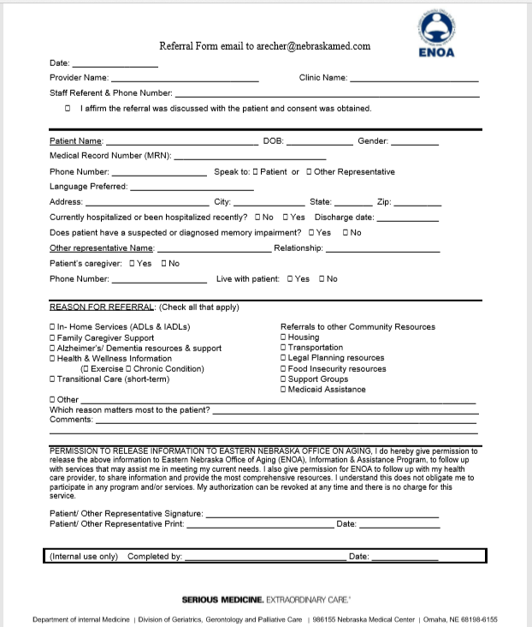
One World

Slide 20
Community Resources
In the Omaha area
ALZHEIMER'S ASSOCIATION, NEBRASKA CHAPTER 572-3010
EASTERN NEBRASKA OFFICE ON AGING www.enoa.org 444-6444
HEARTLAND FAMILY SERVICE www.heartlandfamilyservice.org 553-3000
NEBRASKA DEPT. OF HEALTH AND HUMAN SERVICES www.hhs.state.ne.us Info/referral; Financial/medical assistance; Food stamps 595-3400 Emergency/Energy Assistance

Slide 21
Resources
For more information
http://www.who.int/social_determinant... http://www.who.int/social_determinant... https://www.cdc.gov/socialdeterminants/ http://www.ucl.ac.uk/whitehallII
http://medicare.qualishealth.org/projects/caring-beyond-healthcare
https://www.cdc.gov/socialdeterminants/
https://www.healthypeople.gov/2020/topics-objectives/topic/social-determinants-health/interventions-resources/access-to-health

