Slide 1
Geriatrics Case Conference
September 3rd, 2020

Slide 2
This program is supported by the Health Resources and Services Administration (HRSA) of the U.S. Department of Health and Human Services (HHS) as part of an award totaling 751,695.00 with 0% financed with non-governmental sources. The contents are those of the author(s) and do not necessarily represent the official views of, nor an endorsement, by HRSA, HHS, or the U.S. Government. For more information, please visit HRSA.gov.

Slide 3
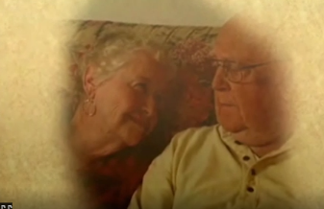
Finding the Right Housing Option for Patients with Dementia.
Natalie Manley, MD, MPH

Slide 4
Hospice
Home Health
Home
ILF
ALF with or without dementia care unit
Also includes Residential care homes (e.g. “Beehive homes”
SNF/LTC with or without dementia care unit
Independent Living Facility = ILF
Assisted Living Facility = ALF
Continuing Care Retirement Community = CCRC
Skilled Nursing Facility = SNF
Long Term Care = LTC
Continuing Care Retirement Community
Notes:
Increasing levels of supervision and services

Slide 5
ROOM and BOARD FINANCING
Home
ILF
ALF
SNF/LTC
Private pay,
Sometimes
Medicaid
Waiver
Private pay
Medicaid
PRIVATE PAY

Slide 6
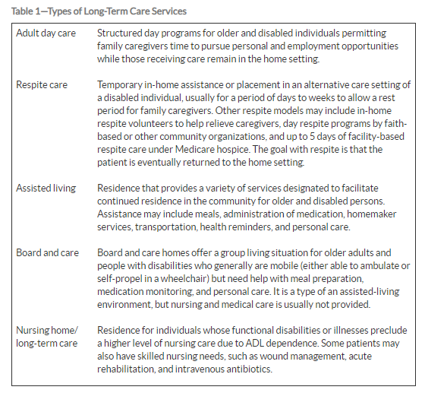
Geriatric Review Syllabus: 10th ed.

Slide 7
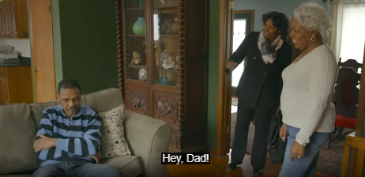
Home/Aging in Place
There’s no place like home!
https://www.ruralhealth.va.gov/vets/comm_selfcare_assemb.asp

Slide 8
Home-Service options
Friends/Family
Area Agency on Aging
Aging and Disability Resource Center
Home Health Services
Private services-ie housekeeping, lawn services
Meals on Wheels
Senior Center
Adult Day Services
Clinic Case Managers/Social workers
Medical/non-medical transport

Slide 9
Home-service resources
https://homemods.org/directory-state/ne/
Finding government benefits:
https://www.benefitscheckup.org/
Energy Assistance:
https://liheapch.acf.hhs.gov/help
VA’s Caregiver Support Line at 1-855-260-3274
https://www.ruralhealth.va.gov/vets/caregivers-module19.asp
Eldercare Locator
https://eldercare.acl.gov/Public/Index.aspx

Slide 10
Adult Day Services
http://www.carenebraska.org/list06_nebraska_adult_day_care.htm

Slide 11
Companionship care/Home Care Services
Provide:
Companionship/supervision
Medication Reminders
May provide some hands-on assistance
Housekeeping/cooking
May provide transportation

Slide 12
Home-service payment
Often private pay
Medicare
Medicaid
Veteran Affairs
Free Local community services
Long Term Care insurance

Slide 13
Home Health regulations
http://dhhs.ne.gov/licensure/Pages/Home-Health-Agencies.aspx
HOME HEALTH-per Nebraska DHHS
A home health agency provides skilled nursing care or a minimum of one other therapeutic service which includes physical therapy, speech pathology, occupational therapy, respiratory care services, home health aide services, social work services, intravenous therapy or dialysis services to a person in their permanent or temporary residence, other than a hospital or nursing home.
Any HHA seeking Medicare certification is required to meet the Medicare Conditions of Participation (CoP) prior to certification. This includes compliance with the OASIS (Outcome and Assessment Information Set) collection and transmission requirements.
Person must meet “Home-bound” criteria if Medicare is the payer
Only lasts as long as the continued services can be justified.
Does not provide 24/7 hands-on care

Slide 14
Geriatric Review Syllabus-ed. 10

Slide 15
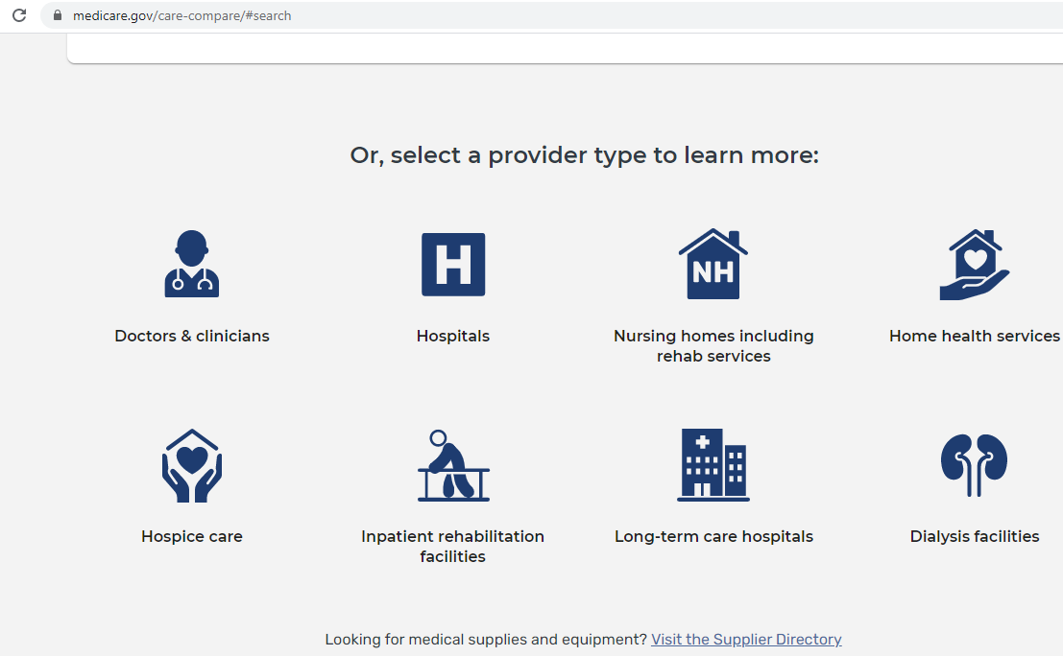

Slide 16
PACE: Program for All Inclusive Care of the Elderly
Interdisciplinary Primary care for frail elders with aim to help them age in place.
The average PACE enrollee is 80 years old and has an average of 8 medical conditions and 3 ADL limitations; half of PACE participants have dementia.
provides all inpatient, outpatient, and long-term care services to population that meets the level of needing long term care services.
Mostly funded by medicare and Medicaid, rarely paid for by private insurance
This team includes a physician (often a geriatrician), nurse practitioner, clinic and home-health nurses, social workers, physical therapist, pharmacist, dietician, and transportation workers.
The hub of care is the PACE center, which provides adult day health care. Other care includes respite, transportation, medication coverage, rehabilitation (including maintenance physical and occupational therapy), hearing aids, eyeglasses, and a variety of other benefits. The program, at the discretion of the interprofessional team, has the flexibility to pay for nonmedical costs in unusual circumstances (eg, paying a person’s electric or gas bill).

Slide 17
Health team goes to patient home to provide care and includes:
Physician
Nurse
Nurse Practitioner
Social work
Psychology
Pharmacist
Therapy
can be used in combination with other Home and Community Based Services.
https://www.va.gov/GERIATRICS/pages/Home_Based_Primary_Care.asp

Slide 18
Hospice—wherever you are
If less than 6 month prognosis, hospice services may be enough to keep a person home.
Outpatient Hospice provides a nurse a couple times a week, an aid a few times a week, social work, chaplain, bereavement, but does not provide 24/7 care

Slide 19
Independent Living Facility
AKA: Senior apartments, retirement community, 55+ community
Apartments with
- full kitchen in apartment
- various services depending on the
facility/community (eg dining, light house keeping, laundry, maintenance)
- common areas and social activities
Typically No staffing for assistance with Activities of Daily Living
Additional care likely will come from home health or other services listed in prior slides

Slide 20
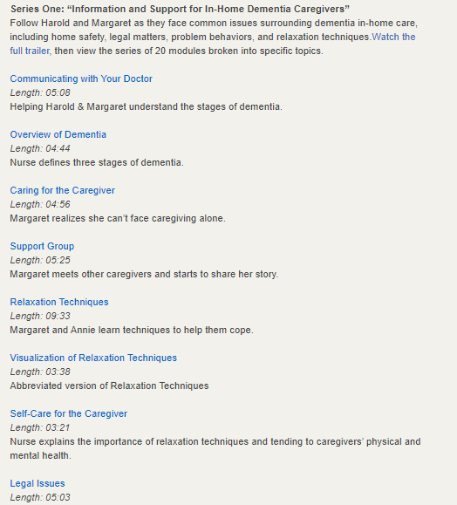
https://www.ruralhealth.va.gov/vets/resources.asp#dem
https://www.ruralhealth.va.gov/vets/caregivers-module19.asp

Slide 21
Thinking about transitioning to a facility?
Autonomy
Safety/Well Being
Capacity
Caregiver/ Surrogate

Slide 22
ALF-services/capabilities
Apartment, often without a full kitchen
Services depend on the facility
Can expect some hands-on assistance with ADLs (eg bathing)
Help with medication administration
During covid, they potentially have fewer visitor restrictions than LTC.

Slide 23
ALF-payment
Room and Board:
Private pay
Medicaid waiver
Long Term Care insurance
Medical Care-via provider visits, home health, hospice, etc
Medicare
Private insurance
Medicaid

Slide 24
ALF-regulations
Depends on the state
Much fewer regulations than long term care
http://dhhs.ne.gov/licensure/Pages/Assisted-Living-Facilities.aspx

Slide 25
ALF-Memory Care
An assisted-living facility which is an Alzheimer’s special care unit may apply for a memory care endorsement as provided in the Health Care Facility Licensure Act but shall not advertise itself as an endorsed memory care unit without such endorsement.
http://dhhs.ne.gov/licensure/Documents/Facilities-HealthCareFacilities.pdf

Slide 26
Memory Care—Can be ALF or LTC
Things to consider
ALF memory care can not manage skilled needs like catheters, wound care
LTC memory care can handle skilled needs
Many ALFs can not provide hands on assistance with eating
Therefore ALF memory care sometimes ends up not working out as a forever home

Slide 27
Memory Care—Can be ALF or LTC
More things to consider
Beautiful premises is nice…but….that doesn’t tell you about the quality of care
People with dementia need ability to wander around
Access/REAL actual available access to the outdoors
Single occupancy room is optimal
Lots of activities…with staff who are motivated to involve the less interested residents
What is the antipsychotic, hypnotic, and anxiolytic use

Slide 28
Memory Care—Can be ALF or LTC
Even more things to consider
The staff working there will effectively be their new family…What is the turnover in CNA staff?
Those are the staff members who spend the most time/energy with the residents
What dementia specific training does the staff get
When touring, don’t look at the pretty marble floors…look to see if the care staff are engaged with the residents, do the care staff seem happy, are they sitting their looking at their cell phones?
Can the care staff tell you how they manage behaviors?
ABC’s of behavior management

Slide 29
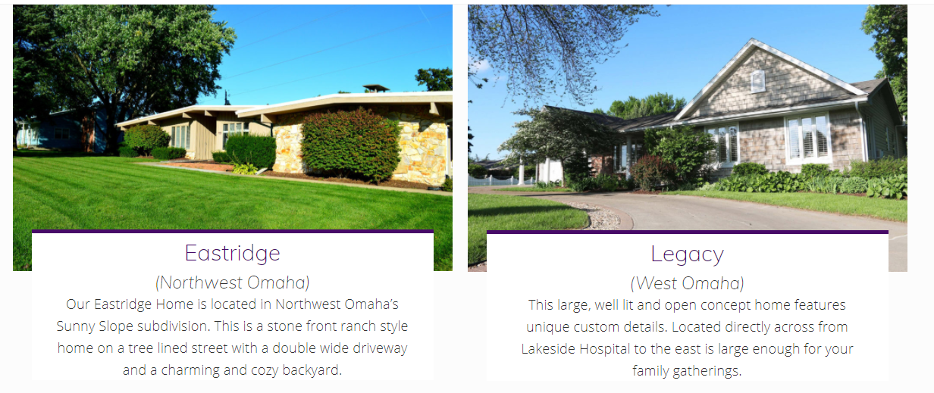
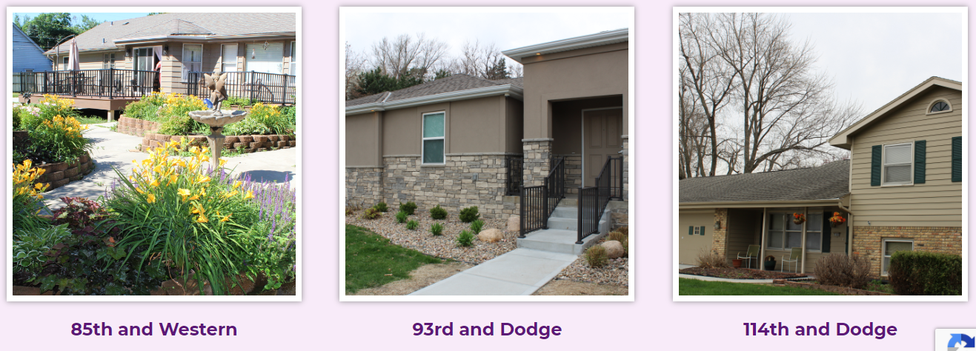
Residential Memory Care-ALF

Slide 30
Long term care-services
Day to day supervision, medication management, ADL and IADL no or minimal assistance to full assistance, skilled nursing care and various levels of rehabilitation services (depending on the facility)
https://www.medicare.gov/nursinghomecompare

Slide 31
Long Term Care
Things to consider
Single occupancy room is typically best
Is there a separate locked memory care unit to allow for wandering?
Does the separate locked area have easy/actual access to the outdoors?
Consider all the factors mentioned in memory care slides

Slide 32
LTC-payment
Room and board:
Private pay
Medicaid
Medical care:
Medicare
Private insurance
Medicaid
Hospice

Slide 33
LTC-regulations
Highly Highly regulated

Slide 34
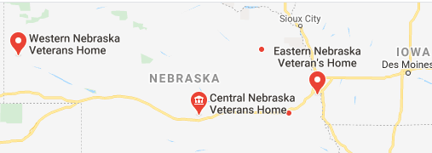
Veteran communities

Slide 35
A word on COVID
Food for Thought
Imagine you have moderate dementia…you live in this nice nursing home, you’ve adjusted to your caregivers and you’ve made some friends. You enjoy roaming the halls, playing card games, singing during chapel time, and sitting on the front patio. You LOVE when your grandkids come to visit and when they take you out to your favorite restaurant.
Now, suddenly, you don’t exactly know why…but you’re not supposed to come out of your room anymore, your favorite activities have stopped, the people who help you have been replaced with people without a face and muffled voices. Those replacements are always in a hurry…they keep saying something about “staffing.” Your family comes and taps on your window, but they don’t come in. You miss seeing your friends at the lunch table…you would love to have a hug…you just don’t feel like eating…
When you come out of your room the faceless people keep asking you to put this thing over your face…

Slide 36
COVID continued…
Now…You just got back from the hospital….It was wonderful…your family came to see you there…
You’re in a new empty room you don’t recognize. All your stuff is gone… They say your in the “grey zone” and you have to stay there for two weeks.
The faceless people have been replaced with strange people with muffled voices and foggy faces.
You see on your TV that lots of people are protesting…
Maybe you should try yelling out too…

Slide 37
Questions?

