Slide 1
Geriatrics Case Conference
November 5th, 2020

Slide 2
This program is supported by the Health Resources and Services Administration (HRSA) of the U.S. Department of Health and Human Services (HHS) as part of an award totaling 751,695.00 with 0% financed with non-governmental sources. The contents are those of the author(s) and do not necessarily represent the official views of, nor an endorsement, by HRSA, HHS, or the U.S. Government. For more information, please visit HRSA.gov.

Slide 3
Collaboration helps us all achieve more
To collaborate:
Attend, Participate, and Provide Feedback
Note your attendance in the CHAT by entering Name, Role, E-mail address and Clinic
During discussion: Please unmute yourself to contribute and ask questions.
Following each session, complete surveys and provide feedback

Slide 4
Adverse Drug Events and High-Risk Medications
Linda Sobeski, PharmD

Slide 5
Objectives
Review the epidemiology and risk factors for ADEs in older adults
Recognize common signs and symptoms of ADEs
Identify high-risk drugs
Explore alternative strategies to use of high-risk drugs
Discuss strategies and prescribing approaches to reduce risk of ADEs

Slide 6
Why are the Elderly More Vulnerable?
Physiologic changes
Decreased drug clearance
Increased sensitivity to drugs
Altered homeostasis
Drug-drug and drug-disease interactions

Slide 7
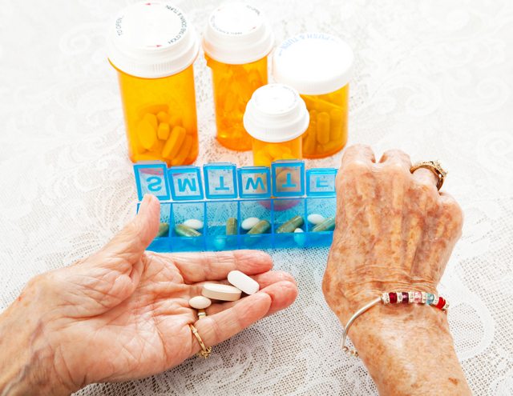
Background
Adverse drug events: unintended, harmful events attributed to the use of medications
Risk factors:
Polypharmacy
Multimorbidity
Age >85
Low body weight or BMI
CrCl <50 mL/min
Previous ADE
Multiple prescribers

Slide 8
Epidemiology of ADEs
1/6 elderly hospital admissions is due to ADE
Increases to 1/3 for age 75+
While hospitalized, 1/6 will experience at least one ADE
1/5 elderly are taking a potentially inappropriate medication
Significant economic and health burden
Notes:
Admission rate for ADEs is 4x higher in elderly vs. Younger population.

Slide 9
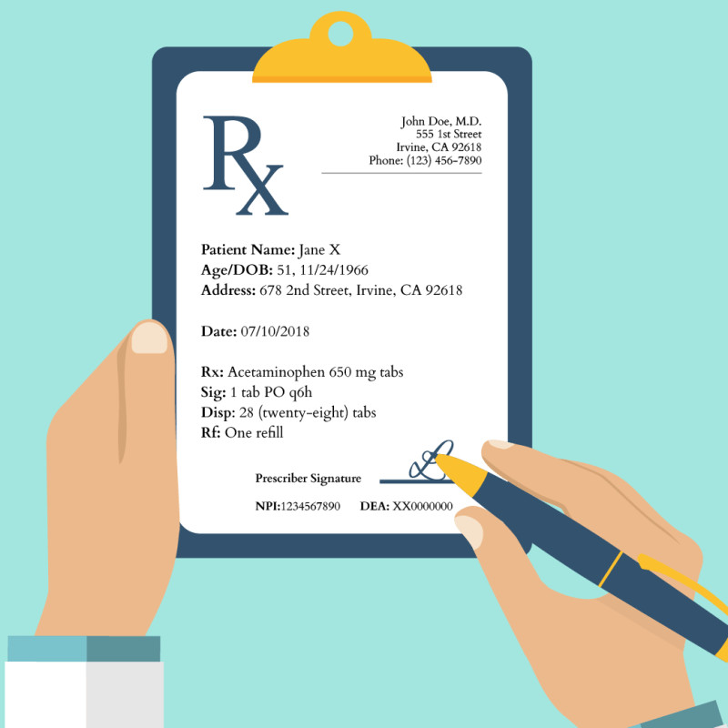
Epidemiology of ADEs
Type 1 ADEs: predictable
Type 2 ADEs: idiosyncratic
ADES occur in all phases of medication utilization process
Assessment
Prescribing
Dispensing
Administration
Monitoring
30-60% of ADEs are preventable

Slide 10
Recognizing Signs and Symptoms of ADEs
Poor appetite and/or GI complaints
Altered bowel or bladder patterns
Skin changes
Mental status changes
Behavior changes
Functional status changes
Altered sleep patterns
Neurological changes
Abnormal laboratory parameters
Abnormal vital signs

Slide 11
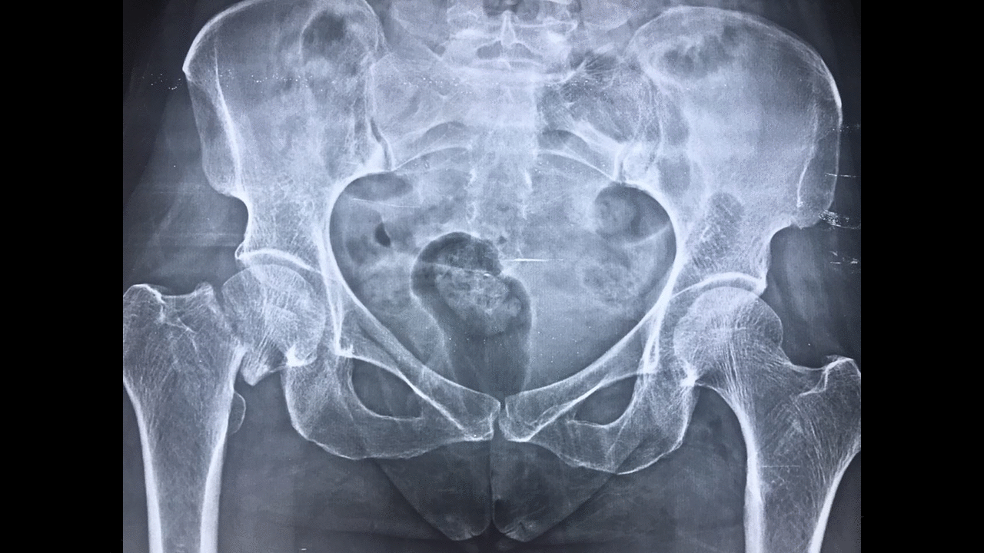
Common ADEs
Adverse GI events
Confusion
Sedation
Delirium
Bleeding
Orthostasis
Falls/fractures

Slide 12
Select High-Risk Drug Classes
NSAIDs
Benzodiazepines and BZRAs
Antipsychotics
Anticholinergics
NSAIDs + benzodiazepines are the classes causing the most potential ADEs in the community
Antipsychotics (and anticoagulants) most frequently associated with preventable ADEs in LTC
Notes:
Anticholinergics: first gen antihistamines, TCAs, antispasmodics, antimuscarinics

Slide 13
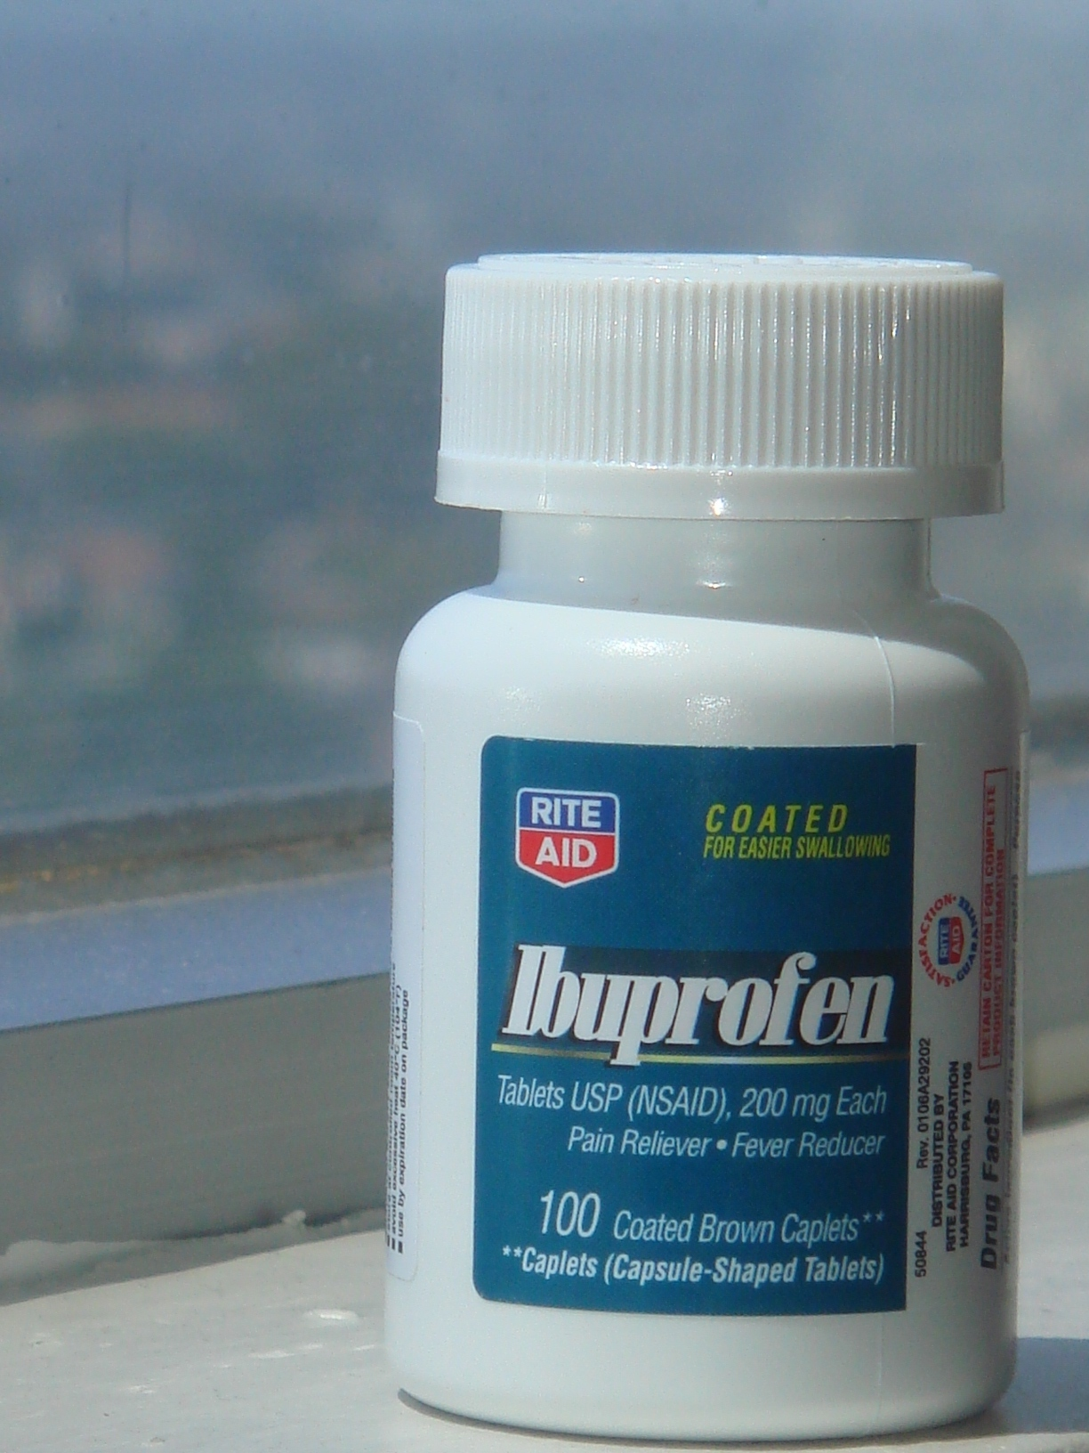
NSAIDs
Gastrointestinal bleeding
High risk = >75y, corticosteroids, anticoagulants, antiplatelets
Major GI events:
1% of patients treated 3-6 months
2-4% of patients treated 12 months
Trend continues rise with longer duration
Use PPI --> reduces risk
Renal impairment
Fluid retention → increased BP, peripheral edema, CHF exacerbation
Avoid unless failure of safer alternatives
Avoid long-term use (>3 months)
Pain: non-pharmacologic (e.g. heat/ice, PT, topical counterirritants, topical NSAIDs, topical lidocaine, ?tramadol

Slide 14
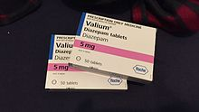
Benzodiazepines + BZRAs
Risk of cognitive impairment, delirium, falls, fractures, MVAs
D/C in patients with 1 or more falls in past 3 months
Avoid long-acting agents AND long-term use
Avoid for insomnia, agitation, delirium
Lorazepam preferred (if must be used)
BZRAs: minimal improvement in sleep latency
Avoid use >90d
Anxiety: SSRIs, SNRIs, buspirone
Sleep: sleep hygiene, melatonin
Use lowest dose, limited duration

Slide 15
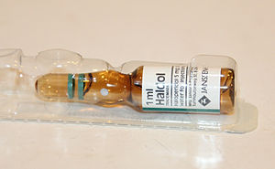
Antipsychotics
Increased risk of CVA mortality in older adults with dementia
Confusion, sedation, falls, EPS
Not very helpful for agitated behaviors
Not all BPSD symptoms require treatment
Threat to patient or caregiver safety
Threat to patients health or functional status
Alternatives: environment, behavioral interventions
Cholinesterase inhibitors, antidepressants

Slide 16
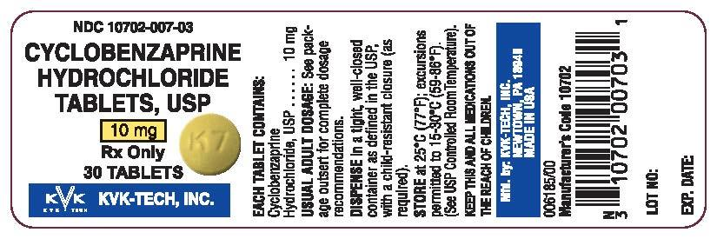
Skeletal Muscle Relaxants
Poorly tolerated due to:
Sedation
Weakness
Risk of falls and fractures
Anticholinergic effects (esp.cyclobenzaprine)
Questionable effectiveness
Potential for misuse
Musculoskeletal pain: topical NSAIDs, APAP

Slide 17
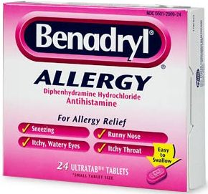
Anticholinergics
Sedation
Constipation, urinary retention, dry mouth
Cognitive impairment
Consider anticholinergic burden
Allergies: non-sedating antihistamines, steroid nasal sprays
Depression: any non-TCA
Neuropathy: duloxetine, gabapentin, pregabalin
Nausea: ondansetron

Slide 18
The List is LONG
Strong
First-generation antihistamines
Moderate
H2 blockers
Weak
Benzodiazepines
GI antispasmodics
TCAs
Antimuscarinics
Antipsychotics
Loperamide
Baclofen
Muscle relaxants
Digoxin
Trazodone
Mirtazapine
Quinidine
Tramadol
Diuretics
Isosorbide
Opiates

Slide 19
Antipsychotics --> antiparkinson drugs
Cholinesterase inhibitors --> antimuscarinics
Calcium channel blocker --> diuretics
Examples of the Prescribing Cascade
Notes:
Patients receiving antipsychotic drug in past 90 days 5.4x more likely to be prescribed antiparkinson's therapy
Risk of treatment with anticholinergic medication for greater for patients who received cholinesterase inhibitor (HR 1.53)
1.4 % of patients prescribed CCB for HTN were subsequently prescribed a loop diuretic within 90 days compared to 0.7% of patients prescribed a different antihypertensive. Peripheral edema from CCB due to fluid redistribution rather than fluid overload, therefore treatment with diuretic is not indicated and can lead to additional adverse outcomes.

Slide 20
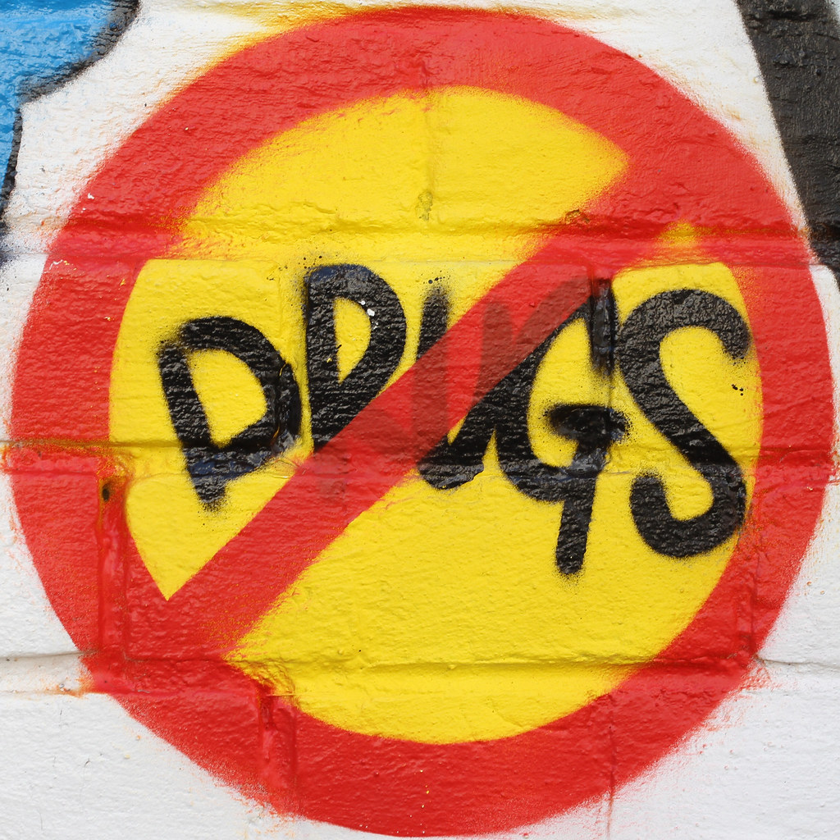
Approach to Prescribing
Step 1: Identify patients at risk
Step 2: Modify treatment accordingly
Review current drug therapy
Change in patient status
Indication no longer exists
Safer agent available
Drug interactions
Drug adverse effects
Simplification
Discontinue unnecessary therapy
Consider ADE as cause of any new symptom
Use high-risk drugs with caution
Consider non-pharmacologic approaches
Notes:
Pharmacists trained in systematic medication review
Providers often reluctant to stop medications, especially if they did not initiate the treatment and patient seems to be tolerating. SOmetimes this exposes patient to risk without therapeutic benefit.
Treatment goals may not may not be appropriate for older adults. Life expectancy/prognosis may influence goals. E.g. BP, HgA1c

Slide 21
Strategies to Prevent ADE Risk
Medication reconciliation
Reduce number of medications
Exercise pharmacovigilance
"Any new symptom in an older adult is drug-related until proven otherwise."
Use team approach
Physician, nurse, pharmacist, other HC professionals, patient, family
Increase awareness of high-risk medications
Reduce inappropriate prescribing
Reduce number or prescribers
Shared-decision making with patient/caregivers

Slide 22
Questions

