Slide 1
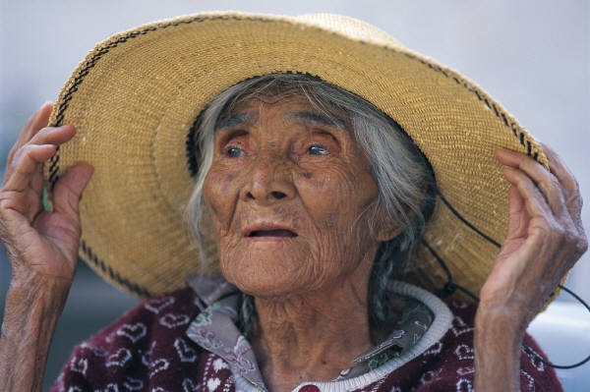
ELDER MISTREATMENT
Deb Mostek
June 2020

Slide 2

Objectives
Identify a vulnerable adult and risk factors associated with elder mistreatment (Obj 4.1)
Discuss how to differentiate between age-related disease and signs of elder mistreatment (Obj 4.2 and 4.3)
Describe how to report suspected elder mistreatment

Slide 3
One Definition of Elder Mistreatment
“(a) Intentional actions that cause harm or create a serious risk of harm (whether or not harm is intended) to a vulnerable elder by a caregiver or other person who stands in a trust relationship to the elder or
(b) Failure by a caregiver to satisfy the elder’s basic needs or to protect the elder from harm.”
National Research Council
Geriatric Review Syllabus,9th ed. 2016

Slide 4
Case #1
A 72-year-old woman comes to the office for her annual wellness visit. She is an established patient who lived alone until recently, when her grandson and great grandchild moved in with her. History includes hypertension, which is managed well with medication; she is wheel-chair bound and was recently diagnosed with breast cancer, and is currently receiving chemo therapy. She is dependent on the grandson for transportation to her medical appointments.
On physical examination, blood pressure is 166/90. All other findings are normal, and cognition is intact. When asked about her adherence to the medication regimen, she starts to cry. She states that she can no longer afford her antihypertensive medication, because her grandson constantly asks for money, threatening to leave and not let her see her great grand daughter if she does not comply.
GRS Teaching Slides 2019

Slide 5
case #1 continued
Which of the following aspects of the grandson’s behavior could be considered an example of financial exploitation?
A. Moving in with his grandmother
B. Asking her to give him money
C. Threatening to keep her from seeing her great-grand child
D. No financial exploitation because she was not forced to sign any documents
GRS Teaching Slides 2019

Slide 6
Types of Elder Mistreatment
Physical abuse
Psychological abuse
Abandonment
Neglect
  By others (intentional or unintentional)
  Self-neglect (accounts for 50 - 75%
  of all reported elder mistreatment)
Financial exploitation
Sexual abuse
Notes:
There are 6 types of elder mistreatment. The first is physical abuse which may include pushing, striking, kicking, intentionally burning or inappropriately restraining the elder. Psychological abuse includes humiliation, verbal abuse, or purposely isolating the elder from his or her usual social contacts. Abandonment occurs when the individual who has responsibility for care of the elder leaves without notice and without arranging for the elder’s basic care.
There are 2 different types of neglect. The first involves failure of a caregiver to provide for basic needs of the elder. Neglect can either be intentional or unintentional. Unintentional neglect occurs when a caregiver is simply unable to provide appropriate care. Intentional neglect consists of the caregiver refusing to provide necessary shelter, food, and/or medical care. The second category of neglect involves self neglect, which accounts for the majority of cases reported to Adult Protective Service. Self neglect is very different from the other types of elder mistreatment that involve a perpetrator. Self neglect involves the inability or refusal of the elder to adequately provide for his or her own needs.
Financial exploitation is on the rise and is the most rapidly increasing form of elder abuse. This is more likely to be reported by family members or personal bankers that detect misappropriation of the elder’s assets. Sexual abuse involves any non-consensual sexual contact with an elder.
In reviewing the vast diversity of elder mistreatment, it becomes more and more obvious why it is so difficult to define elder abuse and compile statistics on elder mistreatment.

Slide 7
EPIDEMIOLOGY OF
ELDER MISTREATMENT
Prevalence:
Up to 10% of community-dwelling older adults
≥20% of nursing home residents
Up to 50% of low-income older adults (because of fewer resources to meet caregiving demands)
Mistreatment exacerbates chronic illness and depression and is associated with significantly higher mortality
As few as 1 in 24 cases are reported to authorities
Notes:
In a pooled logistic regression analysis that adjusted for demographics, chronic disease, functional status, social networks, cognitive status, and depressive symptoms, the risk of death remained higher for cohort members experiencing mistreatment or self-neglect (SOE=A).

Slide 8
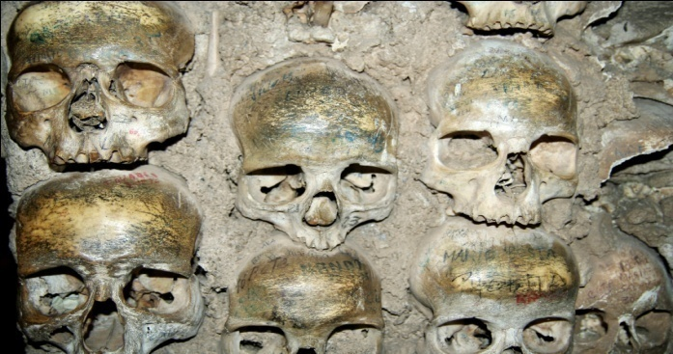
Medical Implications of elder mistreatment
Functional decline; Psychological decline
Sensory impairments in 50%
Malnutrition
Increased risk of medical morbidity
Increased risk of institutionalization
Increased risk of rehospitalization in
first 30 days
Decreased life expectancy
Poythress et al., J Elder abuse and Neglect, 2006
Notes:
Increased mortality
Individuals never reported to APS 17.3%
Physical abuse or caregiver neglect 53.2%
Self-neglect 40.3%
Lachs et al
Self-neglect is independent risk factor for death
50% higher mortality within 3 years than persons reported to APS for other types of elder mistreatment
untreated medical conditions

Slide 9
Risk factors related to elder mistreatment for becoming a victim
Functional dependence or disability*
Cognitive impairment/dementia,* particularly with disturbing behaviors
Poor physical health
Poor mental health
Low income/socioeconomic status
Social isolation/low social support
Previous history of family violence *Strongest risk factors
Previous traumatic event exposure
Substance abuse
GRS Teaching Slides 2019

Slide 10
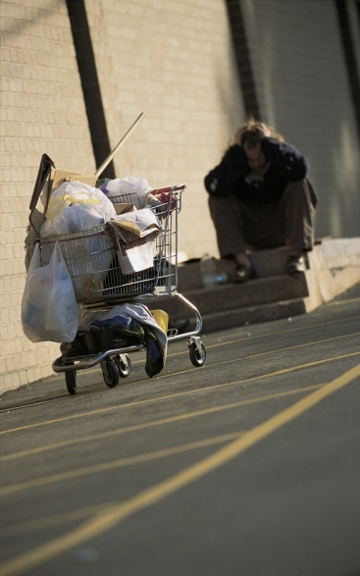
Risk factors related to elder mistreatment for becoming a perpetrator
Mental Illness
Substance abuse
Caregiver Stress
Previous history of family violence
Financial dependence on older adult
GRS Teaching Slides 2019

Slide 11

Evaluation
Complete history and physical
Functional assessment, sensory assessment
Social assessment
Cognitive assessment
Collateral history
Interview both patient and caregiver separately
Laboratory and radiographic exams as indicated
Environmental assessment (home health care, house call)

Slide 12
MEDICAL AND SOCIAL HISTORY
  Interview patients with dementia in the same way as others;
  If collateral information could affect clinical decision-making or immediate safety, consider interviewing other family, neighbors, visiting nurses, etc.
  Stress, isolation, or depression of the caregiver is relevant to the health of the older adult
  Consider interviewing the caregiver even if he or she is not your patient
  Counsel and offer resources to overwhelmed or stressed caregivers
GRS Teaching slides 2019
Notes:
Effective assessment detects mistreatment without placing undue suspicion on well-meaning caregivers or undermining a family’s ability to care for an older adult with support and counseling
Some caregivers are both well-meaning and abusive/neglectful
Research has shown that older adults with dementia who are victims of crime have the ability, in certain circumstances, to provide testimony about criminal events, such as the etiology of bruises or other injuries (SOE=B).

Slide 13
“RED FLAGS” THAT SHOULD RAISE
CONCERN ABOUT ELDER MISTREATMENT
Older adult and caregiver provide conflicting accounts of events
Caregiver interrupts/answers for the older adult
Older adult seems fearful of or hostile toward caregiver
Caregiver appears unengaged/inattentive or frustrated/burdened by caring for older adult
Caregiver appears overwhelmed by older adult
Caregiver appears to lack knowledge of older adult’s care needs
Evidence that caregiver and/or older adult may be abusing alcohol or illicit drugs
Sudden onset of depression/social withdrawal
GRS Teaching slides 2019

Slide 14
INDICATORS FROM THE HISTORY
THAT RAISE SUSPICION OF MISTREATMENT
Unexplained injuries
Past history of frequent injuries
Caregiver calls older adult “accident prone”
Delay between onset of medical illness or injury and seeking medical attention
Recurrent visits to the emergency department (ED) for similar injuries
Using multiple clinicians or EDs rather than one primary care provider
Noncompliance with medications, appointments, or clinician directions

Slide 15
EXAM FINDINGS SUSPICIOUS
FOR PHYSICAL ABUSE
Bruising in atypical locations (not over bony prominences, or on lateral arms, back, face, ears, or neck)
Patterned injuries (bite marks or injury consistent with the shape of a belt buckle, fingertip, or other object)
Wrist or ankle lesions or scars (suggesting use of restraints)
Burns (particularly stocking/glove pattern suggesting forced immersion, or cigarette pattern)
Multiple fractures or bruises of different ages
GRS Teaching Slides 2019
Notes:
Traumatic alopecia or scalp hematomas
Subconjunctival, vitreous, or retinal ophthalmic hemorrhage
Intraoral soft-tissue injuries
SOURCES:
Chang AL, Wong JW, Endo JO, et al. Geriatric dermatology: Part II. Risk factors and cutaneous signs of elder mistreatment for the dermatologist. J Am Acad Dermatol. 2013;68:533 e1–10.
Collins KA. Elder maltreatment: a review. Arch Pathol Lab Med. 2006;130:1290–1296.
Gibbs LM. Understanding the medical markers of elder abuse and neglect: physical examination findings. Clin Geriatr Med. 2014;30:687–712.
Palmer M, Brodell RT, Mostow EN. Elder abuse: dermatologic clues and critical solutions. J Am Acad Dermatol. 2013;68:e37–42.

Slide 16
ASSESSMENT
Distinguish abuse from accidents (SOE=B)
In one study, bruises from physical abuse were often large (>5 cm) and on the face, lateral right arm, or posterior torso
In other studies, abuse-related injuries were most common on the head, neck, and upper extremities
Injuries to the left cheek/zygoma, neck, and ulnar forearm may be much more common in abuse than accidents
GRS Teaching slides 2019
Notes:
When sexual abuse is reported or suspected, consider sending the patient to the ED for comprehensive sexual assault evaluation
Work with ED personnel to identify cases in which patients should not be released to an unsafe residence

Slide 17
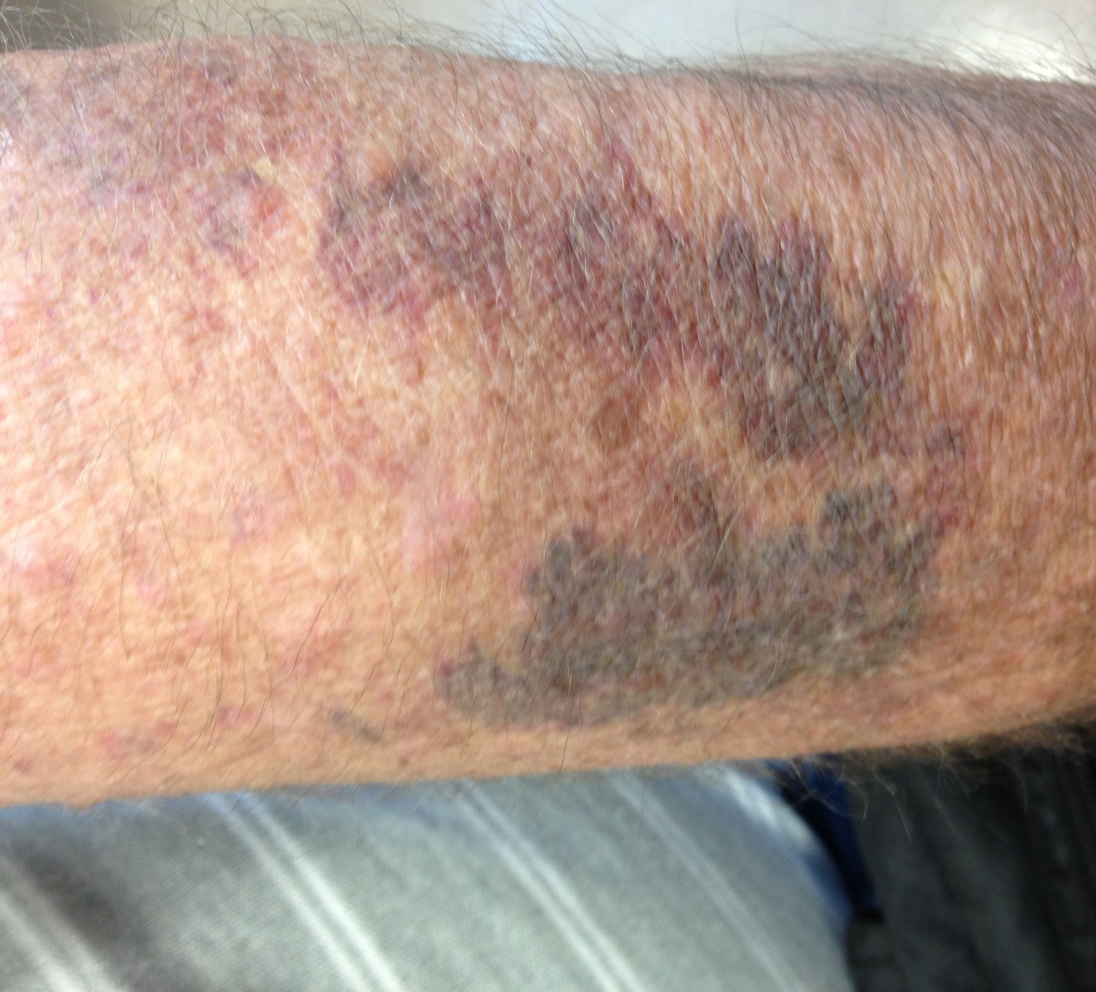

Slide 18

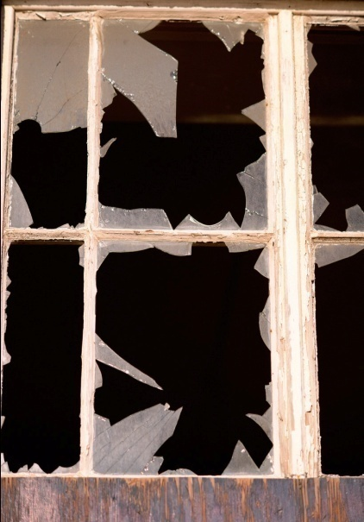
Common signs/symptoms of self neglect
Clinical signs
Missed med refills or physician appointments
Decline in cognitive function
Frequent exacerbations of chronic illnesses & untreated medical illnesses
Poor hygiene, long nails, dehydration, malnutrition, decubiti
Proxy reports
Dangerous or unkempt home
Unpaid bills and debts or evidence of exploitation
Functional decline in ADLs
Naik AD, Lai J, Kunik ME, Dyer CB. Geriatrics February 2008; 63(2)

Slide 19


Slide 20
Barriers to identifying self-neglecters
Self-neglecters:
Extreme social isolation
Suspicious of others
Lack of insight
Surrounding community:
Lack of awareness
Neighbors’ reluctance to “get involved”

Slide 21
CASE #2
An 86-year-old retired professor lives alone and is being prepared for discharge after hospitalization for an open leg wound and cellulitis that followed a fall at home. He denies any difficulties with ambulation, Activities of Daily Living, or Instrumental Activities of Daily Living. Notes from the EMS personnel indicate that they had difficulty getting access to the patient’s apartment because of clutter, and they noted the smell of urine and visible cockroaches. The patient denies any past medical history and takes no prescription medications.
Geriatric Review Syllabus

Slide 22
Case #2
When he presented to the emergency room, patient’s temperature was 38.3°C, blood pressure was 180/90; heart rate was 110; BMI was 18. Blood glucose by fingerstick was 350. He was disheveled and clothes were stained and malodorous. He had several bags of papers with him. On his right medial malleolus there was a 4 cm, open ulcer with clean base and surrounding erythema and warmth. He had erythematous patches in his intertriginous areas and long dystrophic nails. Score on the MoCA was 27 (he was only able to recall 3 of 5 words and was unable to draw parallelogram.) He was able to recite the months of the year backwards. He denied depressed ideation, difficulty with concentration or sleep disturbance. WBC was 13,000 with 90% neutrophils; BUN was 32; creatinine was 1.6; and hemoglobin A-1 C was 9%.
Geriatric Review Syllabus

Slide 23
Case #2 continued
He was treated with IV antibiotics, an antihypertensive agent, and long-acting insulin. At discharge he refuses home care services, home delivered meals, and all prescription medications, insisting that he can take care of himself.
Which of the following is the most likely explanation for these findings?
A. Dementia
B. Delirium
C. Depression
D. Self-neglect
E. Delusional disorder
Geriatric Review Syllabus

Slide 24
Case #3
A 75 year-old woman who lives alone and requires a home visit for medical care. It is winter and her home is cold. She states that her furnace does not work but that her son brought over a new kerosene heater last night. The heater has not been filled or started. She cannot afford repairs to her furnace, and she declines help from the Area Agency on aging for home repair. The telephone numbers she provides for her family contacts are disconnected. She refuses to leave her home. History includes moderate dementia, hypertension, arthritis, and chronic obstructive lung disease. Current medications are acetaminophen 500 mg twice daily, hydrochlorothiazide 25 mg/day, and tiotropium inhaler 5 mcg/day. She smokes 1 ppd and refuses to stop; does not drink alcohol.

Slide 25
Case #3 Continued
On exam her temperature is 37°C; BP: 135/78; HR: 68; RR: 12; O2 sat: 95% on RA. Her extremities are cool. Breath sounds are distant. There is mild bilateral pedal edema. Score on MoCA is 18/30 which is unchanged from her score 3 mos ago.
Which one of the following organizations can assist in assuring the safety of this patient?
A. Adult Protective Services
B. Home health care agency
C. Police department
D. Fire Department

Slide 26

Reporting to APS
Health care providers are mandatory reporters in Nebraska
1-800-652-1999 (Abuse hotline for all ages)

Slide 27
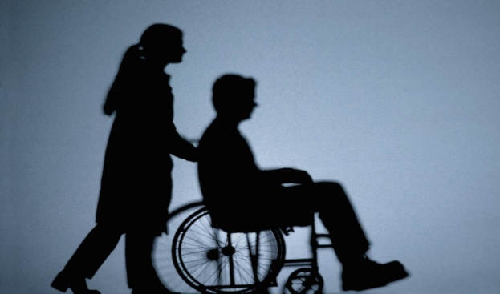
The health care provider’s role
Assess decision making capacity
Treat medical illness
Educate patient (and caregiver)
Treat psychiatric symptoms that are interfering with elder’s function/safety
Substance abuse treatment
Cooperate with other disciplines, social agencies
Notes:
Interdisciplinary approach
Consider serving on a community elder abuse task force
Participate in continuing education on elder mistreatment
Treat medical conditions such as wound care, depression, physical therapy to improve function
Fractures
Depression
Malnutrition
Educate pt regarding the health effects of abuse, alternative options for services, living situation
Provide home visits to patients who refuse to come in for medical care.
Collaborative process takes longer

Slide 28

Considerations when intervening
Capacity evaluation
  Older adults cannot be compelled to engage with APS if patient has capacity
Patient’s culture and previous standards
Risk assessment
Availability of social workers, case managers
Will individual accept help in the home?
Health department can sometimes help
  Gunstone S. J Psych and Mental Health Nursing, 2003. 10:287-296
Notes:
“MH workers displayed strong resistance to intervening unnecessarily…
“Local opinion also influences decisions and workers are conscious of way media and local communities affect them: “…it’s one of those things where you feel you are going to get incredibly criticized at some point, if somebody were to go into that flat and see it and say, ‘what on earth are you doing letting this man live here…?”, and all over the news of the world.” Gunstone S. J Psych and Mental Health Nursing, 2003. 10:287-296

Slide 29

Community resources for “at risk” patients
Consult Home Health Care Agency
Office on Aging (ENOA)
In-home services
  Meals on Wheels
  Housekeeping services
  Home health aide, bath aide
  Automated medication dispensers
  Respite care to lessen caregiver burden
Notes:
House calls
The at-risk patient who threatens to leave the hospital “AMA”

Slide 30
Case #4
An 89-year-old woman comes to the office For a follow up visit. She is accompanied by her 91-year-old husband. At her last appointment one month ago, weight loss was noted. She has a six-year history of Alzheimer’s disease with behavioral disturbance. She depends on her husband for all instrumental activities of daily living, as well as assistance with bathing and toileting. She often forgets her husbands name and at times believes he is trying to sell her for rent money. At today’s appointment her husband appears thin and disheveled. He has forgotten to bring his wife’s medication, and he admits that he can manage to make only one meal each day for himself and his wife. He states that he promised his wife to keep her at home “no matter what.“ He becomes tearful and asks for help, saying “I have nobody.“

Slide 31
Case #4 Continued
On examination the wife has lost another 2.3 kg (5 lbs) and appears thin. BMI is 22. She is just disheveled but there is no malodor. She appears to be in no acute distress.
Which one of the following would be a reasonable intervention in this scenario?
A. Report husband to the local district attorney’s office.
B. Refer the wife to adult protective services for legal guardianship.
C. Hospitalize the wife immediately for failure to thrive.
D. Refer the wife to a certified home health agency

Slide 32
Case #5
A 72-year-old woman has bruising that was not present at her previous assessment.
She resides in a nursing facility.
She cannot recall how she sustained the bruising, and there is no documentation of trauma.
History: stroke with left upper-extremity hemiplegia; mild vascular dementia
Dementia was diagnosed during a recent hospitalization for atrial fibrillation.

Slide 33
case #5 continued
Which one of the following patterns of bruising is most consistent with abuse?
A. Large, irregularly shaped bruises on the extensor surface of her right forearm
B. Skin tears on dorsum of her hands
C. Bilateral bruises on elbows
D. Bruises on her buttocks
GRS Teaching Slides 2019

Slide 34
Pearls
For screening; interview patient alone; “Is there any difficult behavior in your family or at home you would like to tell me about?”
Are the needs of this older individual being met?
Is this individual safe?
Health Care Providers are mandatory reporters
Report if you suspect elder mistreatment
Try to provide services in patient’s own home environment if possible
Although some presentations of elder mistreatment are dramatic, many types of mistreatment require a high index of suspicion and careful assessment

Slide 35
REsources
Harper GM, Lyons WL, Potter JF, eds. Geriatrics Review Syllabus: A Core Curriculum in Geriatric Medicine. 10th ed. New York: American Geriatrics Society; 2019. Chapter 15—Mistreatment; 133-141.
On Line Resources:
The Center of Excellence on Elder Abuse & Neglect; www.centeronelderabuse.org
Elder Justice Roadmap; www.justice.gov/elderjustice/research/roadmap.html
National Center on Elder Abuse; www.ncea.aoa.gov
Notes:
Each state’s Adult Protective Services can provide relevant information as well as direct assistance
This essential service has limitations, given the older adult’s willingness to participate in the system and the constraints on available resources

Slide 36
