Slide 1
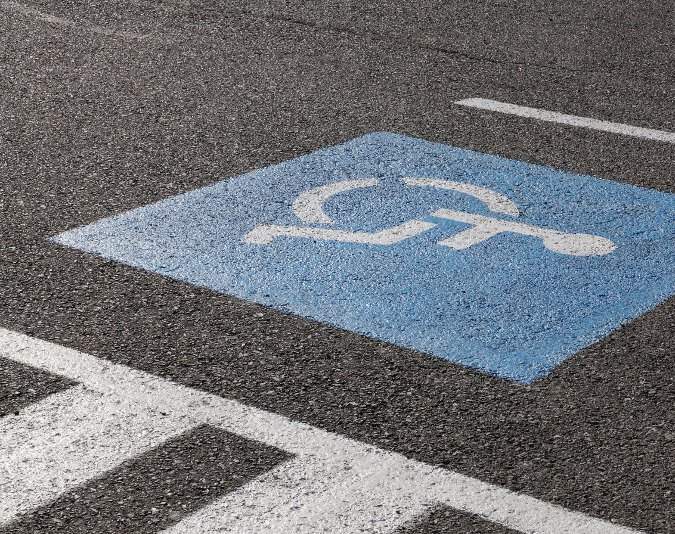
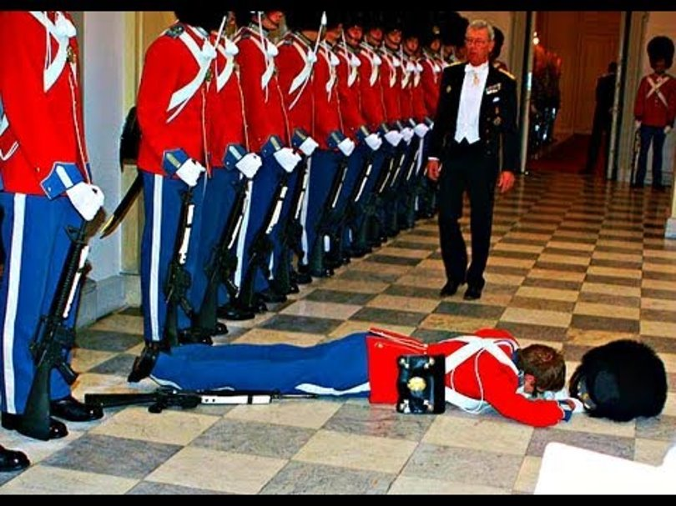
Falls and Mobility
GWEP 4M discussion
J Hejkal
10/19/2020

Slide 2
This program is supported by the Health Resources and Services Administration (HRSA) of the U.S. Department of Health and Human Services (HHS) as part of an award totaling $751,695.00 with 0% financed with non-governmental sources. The contents are those of the author(s) and do not necessarily represent the official views of, nor an endorsement, by HRSA, HHS, or the U.S. Government. For more information, please visit HRSA.gov.

Slide 3
Collaboration helps us all achieve more
Methods to collaborate:
Attend, Participate, Provide Feedback
Please note your attendance in the CHAT by entering Name, Role, E-mail address
During discussion: Please unmute yourself to contribute and ask questions.
Following each session, complete surveys and provide feedback

Slide 4
Falls
25% of elderly population fall each year. Half tell their doctor.
One in five falls causes serious injury
Serious injury risk
  Hip fracture with 25% 1-year mortality
  SDH leads to >50% mortality or severe disability at 3 months
Notes:
More prevalent than diabetes (about 18% of older adults).

Slide 5
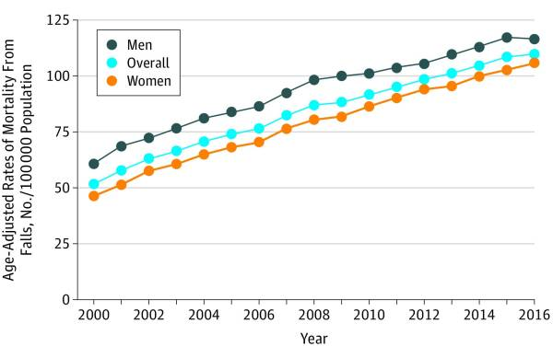
Hartholt K, Lee R, Burns E, van Beeck E. Mortality From Falls Among US Adults Aged 75 Years or Older, 2000-2016. JAMA 2019
Notes:
Fall-associated mortality has increased (about 30% relative increase over the past 10 years) in older adults, including after adjustment for age

Slide 6
Mobility
1/3 of older adults have mobility limitation.
Major determinant of well-being
More important to patients than falling
Notes:
Mobility disability is technically defined as the ability to walk ¼ mile without a walker; associated with ability to safely walk in community.

Slide 7
How to prevent falls and improve mobility
What is the intervention with the largest impact?

Slide 8
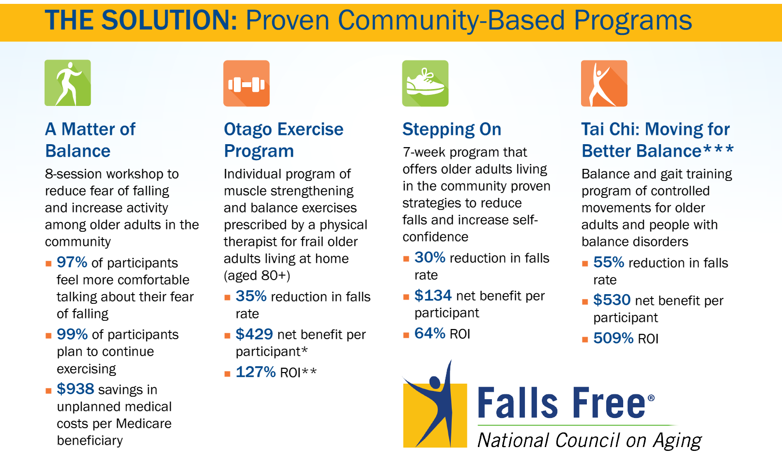

Slide 9

Exercise
Cornerstone of fall prevention and mobility improvement
  Arthritic disease
  Strength
  Balance
  Neurological disorders (e.g., Parkinsons)
  Bone density
  Cardiopulmonary disease

Slide 10
But Insufficient…

Slide 11
What keeps us mobile?
The entire neurologic system
  Proprioception system
  Afferent nerves
  Efferent nerves
  CNS
  Vestibular system
Vision
Muscles
Bones
CV system
Pulmonary

Slide 12
Other systems contribute to falls, too
Rushing to the toilet due to overactive bladder
Poor nutrition from GI problems.
And non-medical issues (cluttered floors, for example)
MEDICATIONS
Notes:
Needing to use the toilet is the primary cause of falls in institutional and hospital settings.

Slide 13
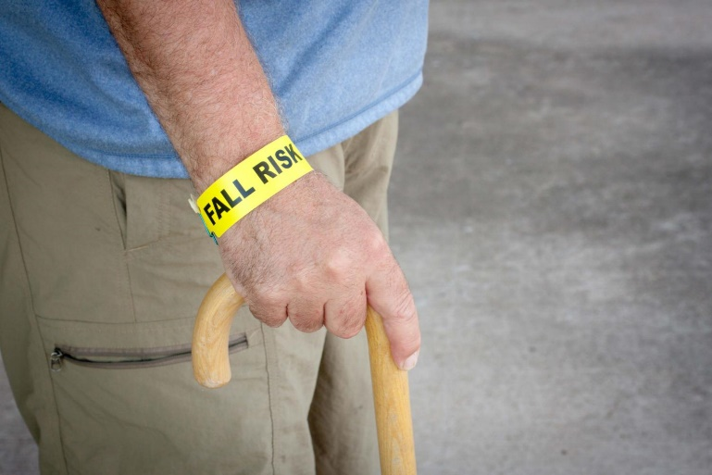
Geriatric Syndrome
Syndrome that is common in the elderly and results from additive, small deficits from multiple systems.
Notes:
I would argue that one of the reasons that exercise is so helpful is that it affects more than one domain and system.

Slide 14

STEADI
CDC’s Stopping Elderly Accidents, Deaths, and Injuries initiative
Meant to help promote mobility and prevent falls in primary care settings.
Notes:
This is really intended as a framework for developing a fall prevention PROGRAM at an institution or healthcare practice. As always in geriatrics, interventions work best when they are done by the entire team. But it also provides a great framework for just looking at falls in a clinical setting.
This is based on the 2011 AGS/BGS Fall Prevention Guidelines, with some minor updates since then based on the small amount of practice-changing literature that’s been published in the interim.

Slide 15
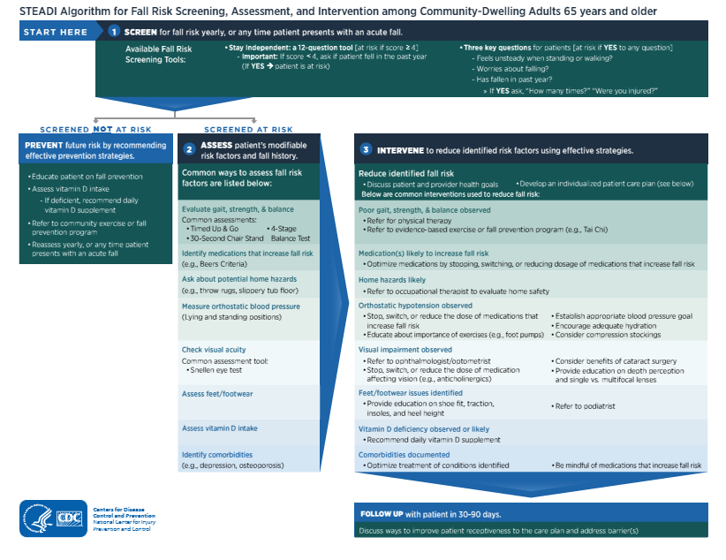
Notes:
This is the STEADI algorithm. Don’t try to read it; we’ll break it down into its components over the next few slides.

Slide 16
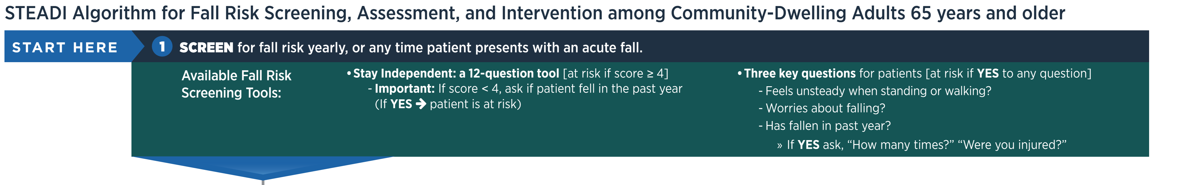
Detection
When patients bring it up
Yearly screening (AWV)
Notes:
Screen patients every year, or when they bring it up. If you do annual wellness visits, this is a good time (because it’s already baked into the AWV).

Slide 17
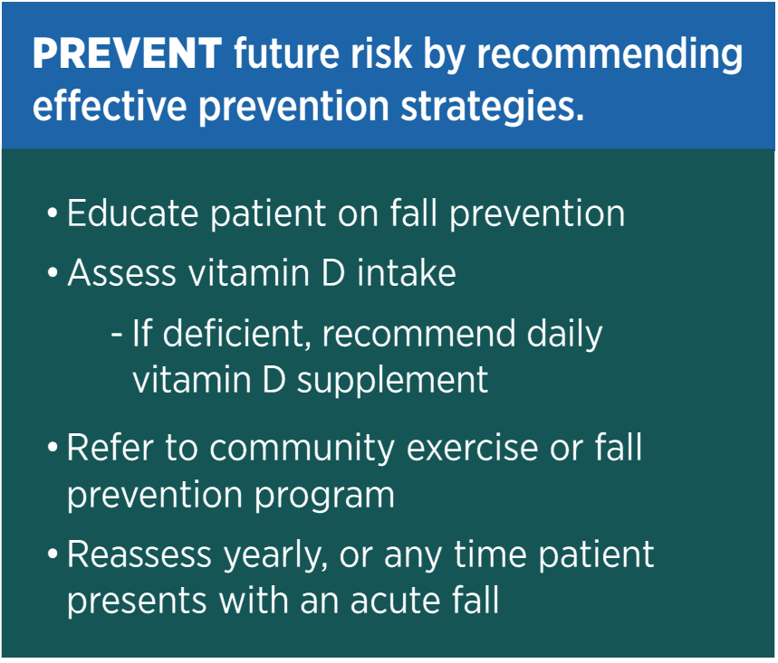
Patients with low risk
Notes:
Vitamin D less important than we thought, unless truly deficient (e.g., in nursing homes)

Slide 18
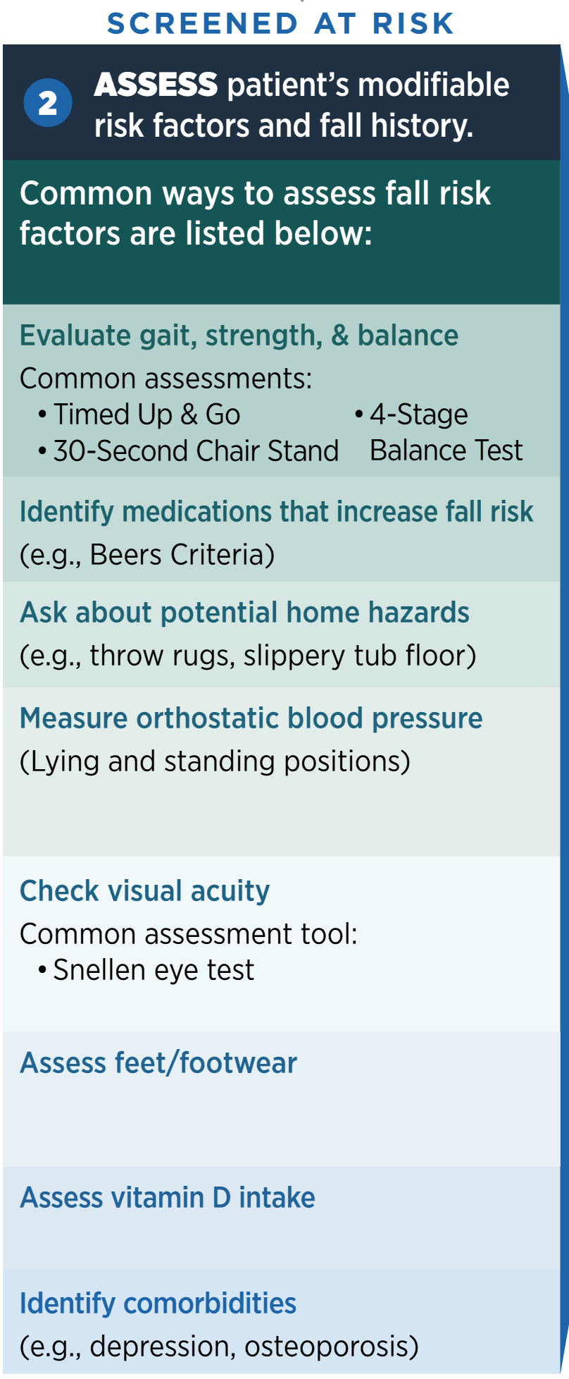
Notes:
Good basics. TUG (arise, walk 10 feet, turn around and sit down), if >12 seconds, then they’re at high risk. 30-sec chair stand: standardized for age and sex.
4 Stage balance test is involves feet together, half tandem, tandem, and then stand on 1 foot for 10 seconds. If the patient can’t do the tandem stance for 10 seconds, fall risk is higher.

Slide 19
Other things to look at
Neuro exam is often appropriate
  Focal weakness or motor abnormalities
  Sensory deficits
  Coordination problems
  Parkinsonism
Look for nystagmus if symptoms
Notes:
A few things that I think are helpful that are not really included in the algorithm: a neurological exam (sensation, motor abnormalities, ataxia, parkinsonism) and if the patient is dizzy, looking for nystagmus. A good gait exam can help identify some of these, too.

Slide 20
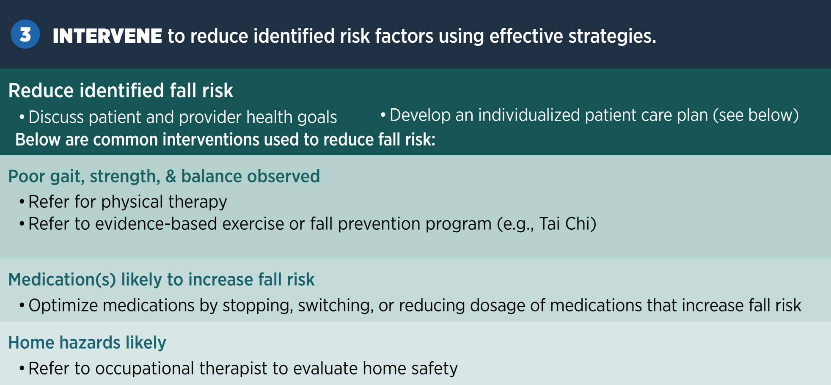
Notes:
There are many different proven fall-reduction programs (see previous slide)
Medications, such as benzodiazepines, anticholinergic meds

Slide 21
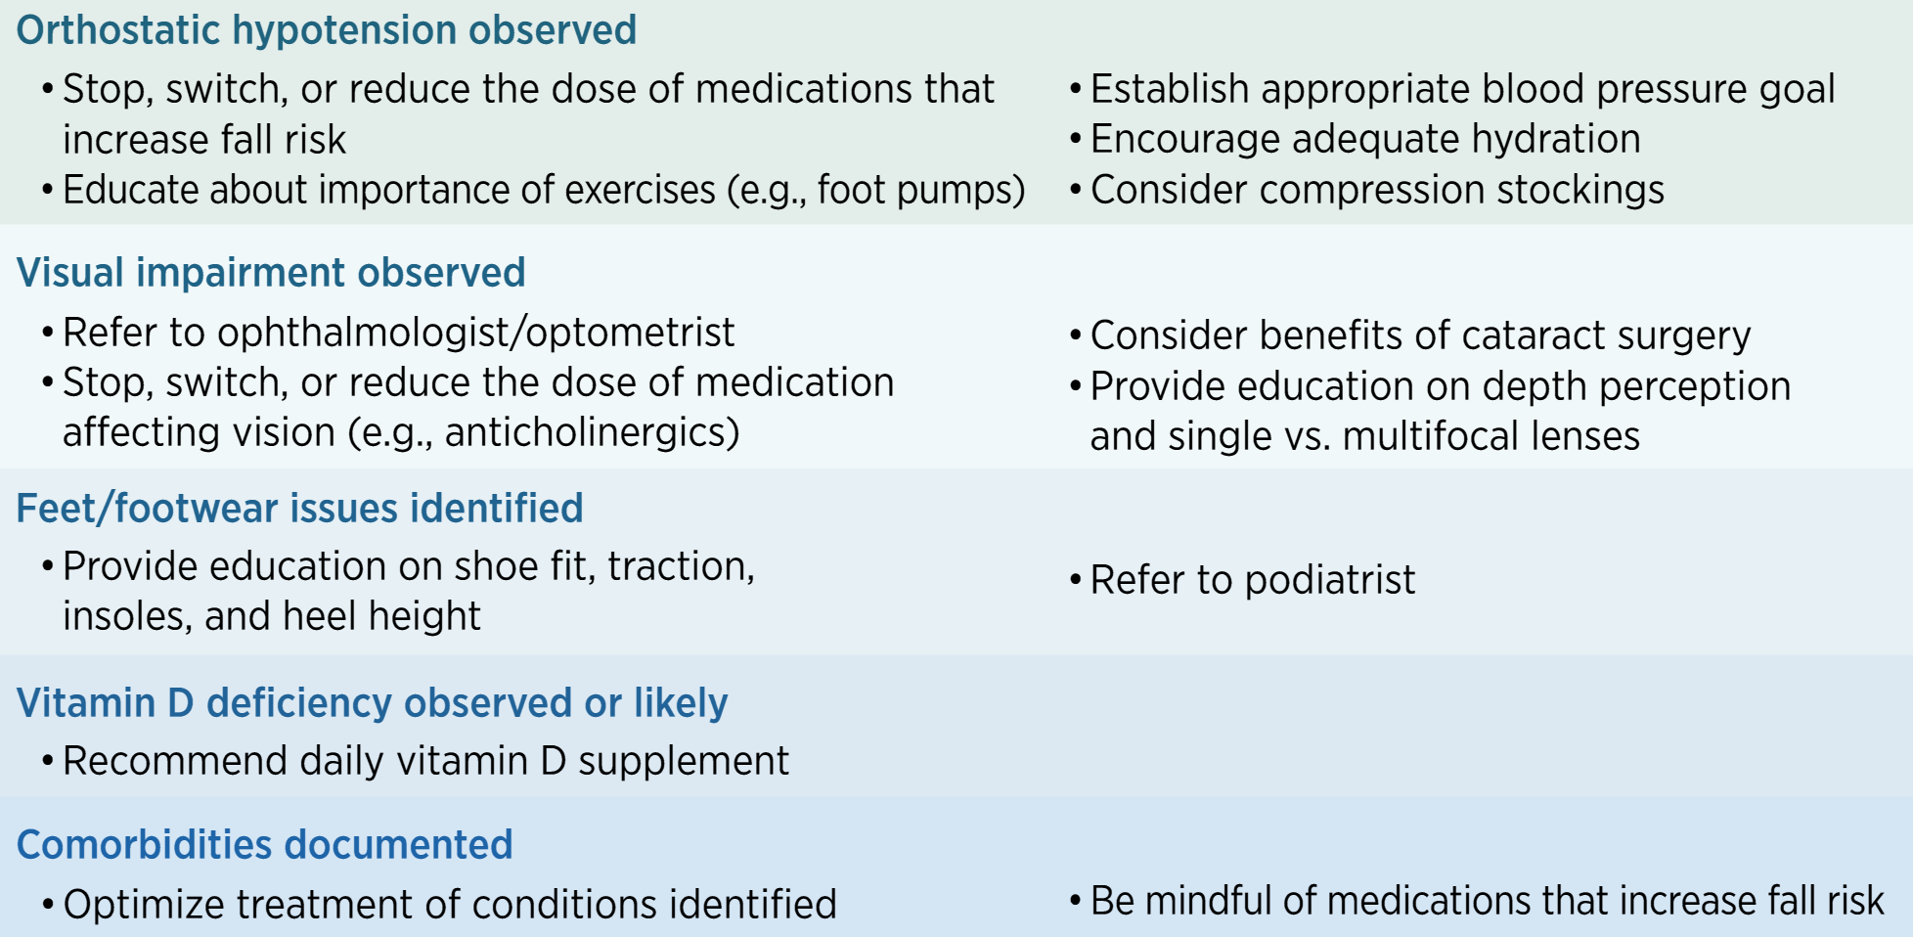
Notes:
Addressing orthostatic hypotension
Vision impairment: bifocals actually are associated with increased fall risk. Cataract surgery helps prevent falls.
Vitamin D deficiency: really only helps to treat if there is a deficiency (unless in long-term care)

Slide 22
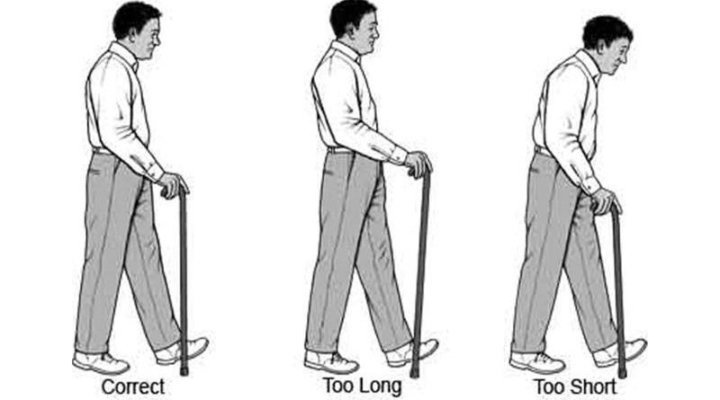
Other things to manage
Neurological disease
  Imaging may be helpful
  Referral to movement disorder clinic if indicated
Assistive devices
Emergency response systems
ENT for vertigo
http://www.elderlyaidsadvice.com/measure-your-walking-stick/
Notes:
Assistive devices: often people use a relatives old device, for example, and it’s not fitted correctly.

Slide 23
Other things to manage
Urinary urgency or incontinence
Pain
Cognitive impairment
Notes:
If a person has OAB, then anticholinergics used for that might also increase fall risk, so be careful.
Pain reduction methods: scheduled Tylenol, topical NSAIDs, sometimes gabapentinoids, pain management clinics, PT
Cognitive impairment: Separate lecture on this, but will need to really establish supportive milieu that helps prevent falls as much as possible.

Slide 24
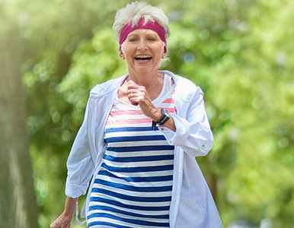
In sum…
Falls and mobility impairment are common
Many contributing factors
Exercise is best prevention, but often
other interventions are needed too.
Questions?

Slide 25
Selected references
CDC STEADI website. http://cdc.gov/steadi/index.html
National Council on Aging (ncoa.org)
Hartholt K, Lee R, Burns E, van Beeck E. Mortality From Falls Among US Adults Aged 75 Years or Older, 2000-2016. JAMA 2019
Xu G. et al. Prevalence of diagnosed type 1 and type 2 diabetes among US adults in 2016 and 2017: population based study. BMJ 2018.

