Slide 1
Telehealth
September 28, 2020

Slide 2
This program is supported by the Health Resources and Services Administration (HRSA) of the U.S. Department of Health and Human Services (HHS) as part of an award totaling $90,625.00 with 0% financed with non-governmental sources. The contents are those of the author(s) and do not necessarily represent the official views of, nor an endorsement, by HRSA, HHS, or the U.S. Government. For more information, please visit HRSA.gov.

Slide 3
Collaboration helps us all achieve more
Methods to collaborate:
Attend, Participate, Provide Feedback
Please note your attendance in the CHAT by entering Name, Role, E-mail address
During discussion: Please unmute yourself to contribute and ask questions.
Following each session, complete surveys and provide feedback

Slide 4
Objectives
Review
Types of available telehealth
Telehealth billing
Patient encounters that telehealth is useful for
Interdisciplinary aspects and pearls
Scheduling
Documentation

Slide 5
Survey results
Most thought telehealth useful.
Concerns about
Tech availability
Ease of use
Loss of the important elements of physical presence
Estimates around 40% of patients have webcam/smartphone
Fewer have BP cuffs
Providers thought telehealth adequate for about half of visits.
Notes:
I appreciated everyone’s responses to the survey, which helped me try to tailor this presentation. Of those who responded, most thought that telehealth is a useful tool, but there were concerns brought up regarding the technology or ease of use, and of course the significant element that’s lost when you don’t have a person physically present. Estimates varied, but overall estimates were that about 40% of patients had some kind of webcam or smartphone. And providers estimated that about half of their visits could be adequately completed with telemedicine.

Slide 6
Telehealth options
Video visits:
Telephone visits
Notes:
Providers can see patients through video chat apps or just by talking to patients over the phone. Both of these options, and payment for them, have been widely expanded during the coronavirus pandemic, including things that are not necessarily HIPAA-compliant.

Slide 7
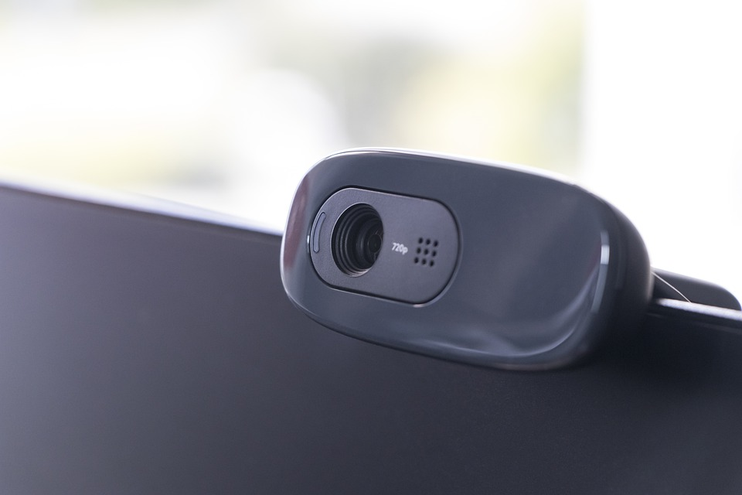
Billing - Video
Equivalence
Video visits: Payment and coding is the same as for in-person clinic visits
99211-99215 for established patients
99202-99205 for new patients
- Physical exams are limited over video
- So use History + MDM or bill by time
- Consent required
Notes:
Billing and reimbursement usually drive what we do, since we have to “do medicine” in a way that we get paid for it. Video visits have been made equivalent to in-person office visits.

Slide 8
Billing - Telephone
Different CPT codes; equivalent wRVU
- Telephone service must not be related to an other service provided in the 7 days prior or the 24 hours following the phone call.
- Consent needed
- Time-based equivalence to office E&M codes
99441 5-10 minutes. 0.48 wRVU
99442 11-20 minutes 0.97 wRVU
99443 21-30 minutes 1.50 wRVU
Notes:
Telephone visits are similar, but they have their own separate codes. Nonetheless, these codes provide reimbursement equivalent to established office patient visits.
Consent is required for all of this.
CMS did not previously reimburse for these at all. In May, they started to reimburse for telephone visits and made payment equal to an office visit. So they have become much more viable as an option for our patients who don’t have access to a webcam, or who can’t manage that technology on their own. Video visits are nicer (you get the nonverbal parts of communication, and you get a window into your patient’s living environment), but often not practical.

Slide 9
Other services
Behavioral health, Nutrition
- Many of you already use telehealth
- Many codes can also be used for audio-only visits
PT/OT/SLP
- Able to provide some services via telehealth now.
Notes:
CMS expanded what providers can provide telehealth now, too, and I understand that some of you in behavioral health and nutrition are already using it. CMS expanded many of these codes to “count” even when it’s an audio-only visit. I don’t know the specific codes you use, but I have CMS’s spreadsheet of the approx. 250 codes that they cover for telehealth, including what can be done as audio-only, and I’d be happy to send it to you if that would be helpful.

Slide 10
Other Visit types
Transitional Care Management – Video visit
Annual Wellness Visit (but NOT Welcome to Medicare)
- Video OR telephone visit
Face-to-face for certifications – Video visit
Notes:
TCM can be done by video visits. AWV can be done by either video or by telephone visits. Here, when doing a telephone visit, you do NOT use the telephone codes, but the AWV codes themselves.

Slide 11
When to use
When some physical exam components are less important
Chronic care management for many conditions
- Diabetes
- Hypertension
- Dementia
- Pain (except for chronic opiates)
Acute visits (sometimes)
Annual Wellness visits
Notes:
Many chronic conditions can be evaluated well over video or audio technology. Patients who take their blood sugars at home, for example, might have insulin adjusted through a visit like this. It is of course helpful if they can send you their BG logs. Notably, they discourage providers from doing opiate management by telehealth.
Acute visits may be appropriate for some concerns (such as URI’s), but obviously this does not apply for all.

Slide 12
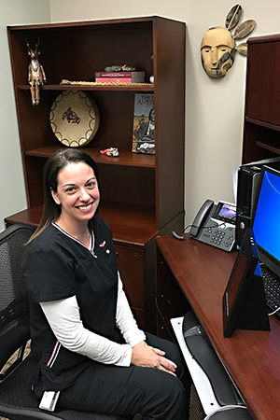
Teamwork
Essential for effective telemedicine
Scheduling staff
- Can review how to use platform (Zoom) with patient
- Obtain consent at the time of scheduling
Rooming staff should call in advance of appointment
- Pre-visit planning (med review, vital sign collection)
- Help troubleshoot when problems arise
- Can also assist with AWV questionnaire
IHS Telehealth in Oregon, 2016
Notes:
If possible, the scheduling staff can be in charge of collecting consent (once yearly).
Rooming staff should call the patient and review some pertinent info. This also ensures that nothing has changed (such as if a family member had planned to help set up the video but no longer is available).

Slide 13
Scheduling
Rooming time for a telehealth visit takes 0 minutes.
- Schedule accordingly
- Blocking time for telehealth can alleviate this
- Cluster appointments at beginning of clinic if possible.
- Rooming staff can help by calling patient to alert if provider running behind.
Notes:
If telehealth visits are interspersed with other visits, it can throw a schedule off: there’s no need for extra time for rooming in a telehealth visit, so patients will expect you to show up right at the scheduled time. There also are not obvious opportunities for staff to tell the patient that you’re running behind. So communicating with clinical staff can be essential. Blocking time at the beginning of clinic especially can help (if you have enough telehealth patients to do this).

Slide 14
Tips
Difficult to use these platforms with patients who have hearing impairment
Avoid bright backlighting if
possible
Post a sign on your office door to avoid interruptions.
If technical problems prevent video: switch to telephone quickly.
Notes:
In my personal experience, trying to do a visit like this with someone who has severe hearing impairment is fruitless.
There are good ways to set up your office for telehealth. Bright lights or a window in the background can wash out the image on a webcam.
Some people will post a sign on the door to avoid interruptions; it’s important to still keep encounters confidential.
Finally, don’t be afraid to switch to a telephone visit if the tech isn’t working: it’s easy to waste too much time trying to get a video conference to work right.

Slide 15
Documentation
Use templates!
Templated notes help so that needed documentation items are included.
- Consent
- Location of patient
- Location of provider
- Verification of patient ID
Templates can also guide billing (e.g., can remind of time cut-offs for telephone codes).
Notes:
I try to keep track of when the call started and stopped for billing purposes, since time-based billing is often the best way to do this.

Slide 16
Template
TELEPHONE VISIT
This visit was done by telephone in place of a face-to-face visit due to the COVID-19 pandemic. The patient gave verbal consent for today's visit.
Start time:
End Time:
Total Time:
I spent *** minutes communicating with the patient
Notes:
Telephone visits don’t need much: since they’re time-based, you just need documentation of your conversation and actions taken, along with something similar to this phrase.

Slide 17
Template
Video Visit
Physical Exam:
GEN:: Well-appearing in NAD; Questions answered appropriately
EYES: EOM intact. No icterus. No injection
LUNGS: Breathing comfortably on room air, normal effort
CV: no lower extremity edema
Skin: no rashes or lesions noted, no skin discoloration
Neuro: normal gait, normal range of motion, no focal deficits
Notes:
Here’s a sample PE for a video visit. The templates for these is very similar to what you use for any other office visit, but the exam is more limited. There also needs to be a similar piece documenting why telehealth was used (i.e., pandemic), and where the patient was located.

