Slide 1
Welcome! Let’s Collaborate
Please tell us who you are!
Put your Name, Role and E-mail address in the Chat
During discussion: Please unmute yourself to comment and ask questions.
Following each session, complete a survey and provide feedback

Slide 2
This program is supported by the Health Resources and Services Administration (HRSA) of the U.S. Department of Health and Human Services (HHS) as part of an award totaling 751,695.00 with 0% financed with non-governmental sources. The contents are those of the author(s) and do not necessarily represent the official views of, nor an endorsement, by HRSA, HHS, or the U.S. Government. For more information, please visit HRSA.gov.

Slide 3





NGWEP the Nebraska Geriatrics Workforce Enhancement Program
A Partnership between Ponca Health, UNMC , Community Based Organizations and other Primary Care Sites

Slide 4
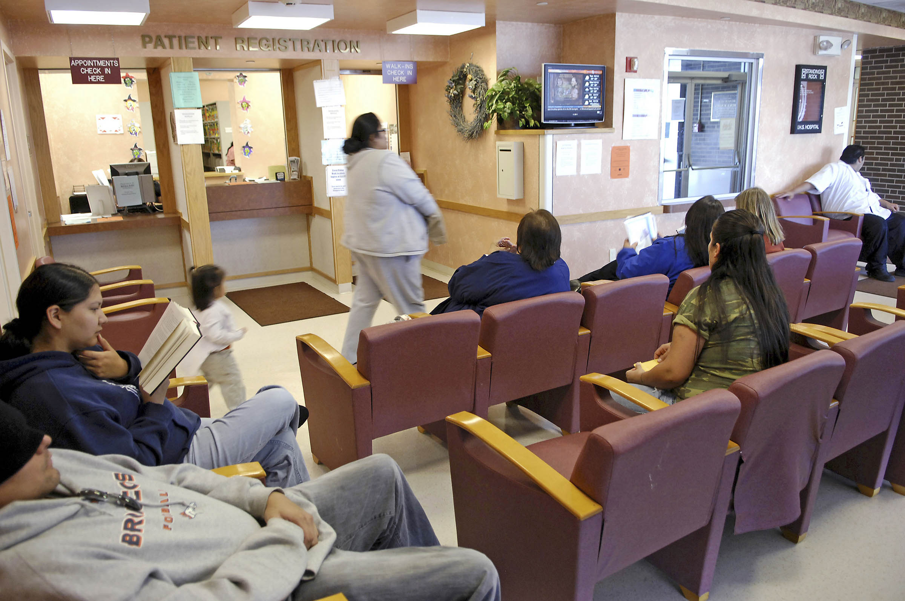
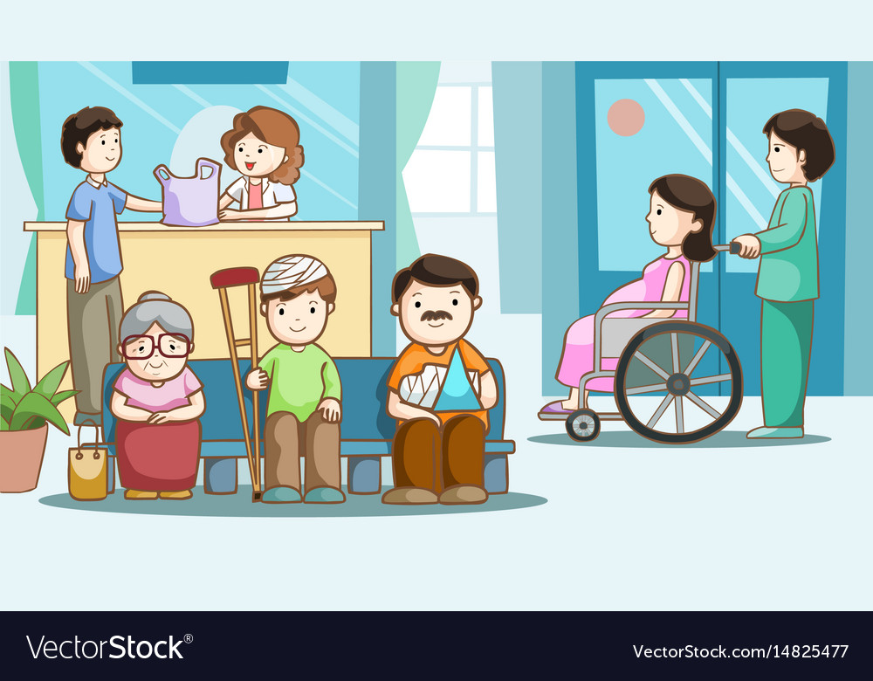
Your Job in Primary Care: a big one
Diverse populations
Wide range of ages
Desire to provide good care to all including elders

Slide 5

Why enhance the geriatrics skills in the primary care workforce?
Most elders are seen and cared for by PC providers
Many HCPs were trained before geriatrics was an important part of training
We now know what 4 things are important to health and quality of life for older people

Slide 6
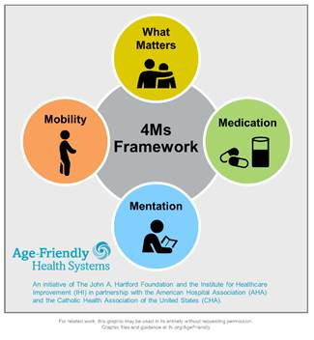
Age Friendly Primary Care:
These are the 4 important things
Notes:
We all care for elders, we want to do the important things. The 4 Ms are the important things
What Matters: Know and align care with each older adult’s specific health outcome goals and care preferences including, but not limited to end-of-life care, and across settings of care (document ACPs)
Medication: If medication is necessary, use Age-Friendly medications that do not interfere with What Matters to the older adult, Mobility, or Mentation across settings of care (Pharmacy protocols for med review in evaluating cognitive dysfunction, mobility and falls etc)
Mentation: Prevent, identify, treat, and manage dementia, depression, and delirium across settings of care
Mobility: Ensure that older adults move safely every day to maintain function and do What Matter

Slide 7

NGWEP is a Collaboration-teach/learn together
Discuss the 4 Ms September/October
Monthly Case conferences- bring cases to discuss with a panel trained in geriatrics (medicine, psychiatry, social work, pharmacy). Two other clinics also present cases.
Use Annual Wellness Visits to screen for the 4Ms- we will help you set up an efficient workflow

Slide 8
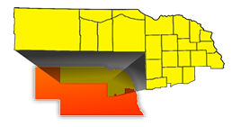
What Matters often home and care not cure
Northeast Nebraska
Area Agency on Aging

Slide 9

Who in the NGWEP will work most closely with your team?
Photos of Joe and Sara
Joe Hejkal, MD
Sara Wolfson, DNP

Slide 10
Mentation
The first of the 4Ms

Slide 11
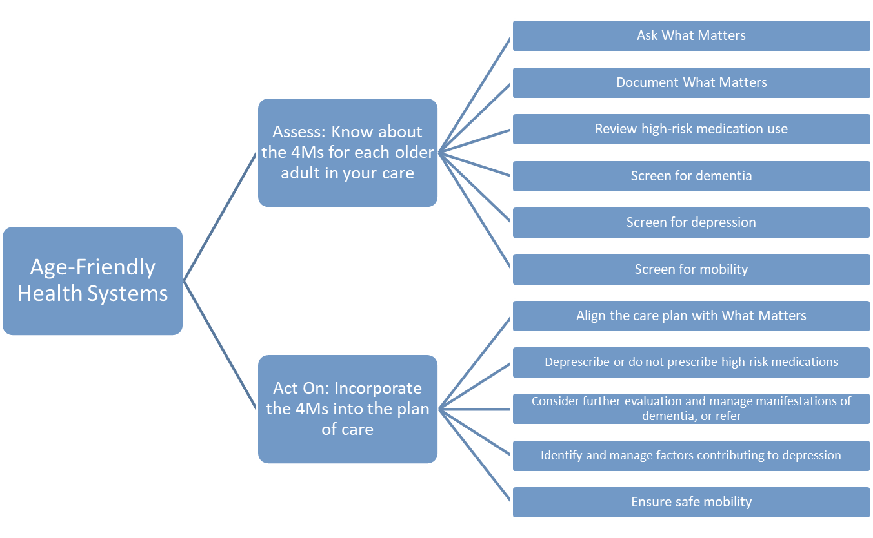
Guide to Using the 4Ms in Care of Older Adults: Ambulatory Patients
Screen for dementia
Screen for delirium
Screen for depression
Notes:
For talking points, please review the Guide: http://www.ihi.org/Engage/Initiatives/Age-Friendly-Health-Systems/Documents/IHIAgeFriendlyHealthSystems_GuidetoUsing4MsCare.pdf

Slide 12
Mentation
Delirium
Dementia
Depression

Slide 13

DEMENTIA
The most common cause of disability in later life
A focus for providers of health care to older adults

Slide 14
Dementia
(DSM-5 Major Neurocognitive Disorder)
Chronic acquired decline in one or more cognitive domains (learning and memory, complex attention, language, visual-spatial, executive) sufficient to affect daily life
Etiology: Any disorder causing damage to brain systems involved in memory. Alzheimer’s disease is the most common cause in later life

Slide 15
DEMENTIA
AD
Other
Vascular
Lewy BD
An umbrella term there are many causes.

Slide 16

Mentation: Tips
Normalize cognitive screening for patients. For example, say “I’m going to assess your cognitive health like we check your blood pressure, or your heart and lungs.”
Emphasize an older adult’s strengths when screening and document it so that all providers have a baseline.
Screening for cognitive impairment is part of Welcome to Medicare and Medicare Annual Wellness Visits

Slide 17
Screen during Annual Wellness with the Mini-cog
I am going to name 3 objects and I want you to repeat those after me
“Apple, Table Penny” (2 tries to get it right)
“Now I want you to remember those 3 things because I will ask you to repeat them in a couple of minutes.”
Clock draw: “please draw the face of a clock and set the hands to read (e.g.) 10 min after 11:00.

Slide 18
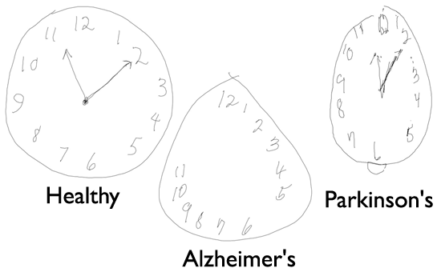
Mini Cog Interpretation
Each of the 3 items correct earns a point (0- 3 points)
Correct clock draw earns 2 pts; 1 point for getting the 12,3,6,9 in the correct anchor positions, no duplicate or missing numbers; 1 pt for the hands pointing correctly (0-2 points)
Total score <3 points, worry about dementia

Slide 19

If I am worried about dementia, what’s next?
AD8- a close friend/relative answers 8 questions any answer yes means we need to do more.
Some PC clinics will refer the patient if abnormal mini-cog and changes on AD-8
If AD8 is normal, but you are still worried do a second cognitive test and recheck the patient with the same test next year

Slide 20
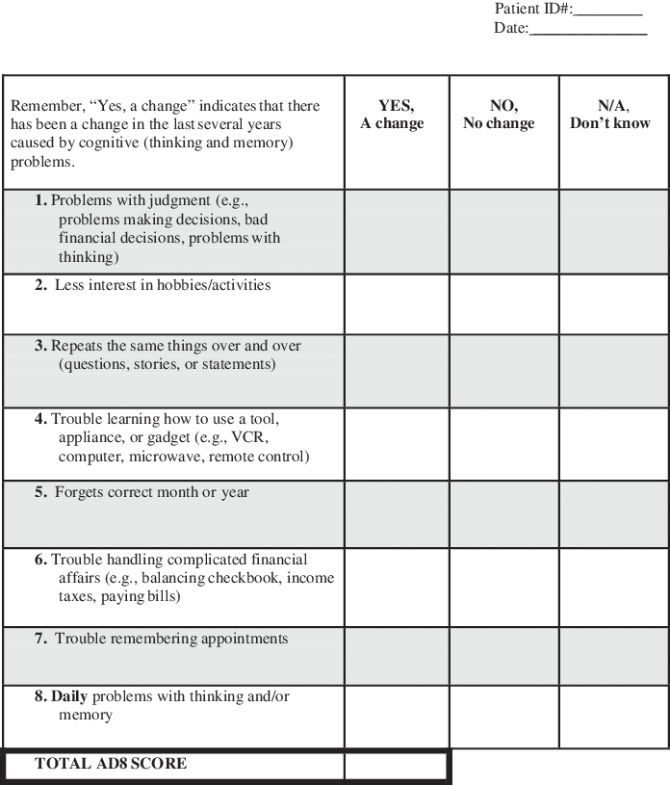
AD8
Alzheimer’s
Disease 8

Slide 21

If You want to do a Second Test: Which One?
  SLUMS- public domain
  MOCA- training required
  MMSE- requires purchase
  Any test needs to work in your population

Slide 22
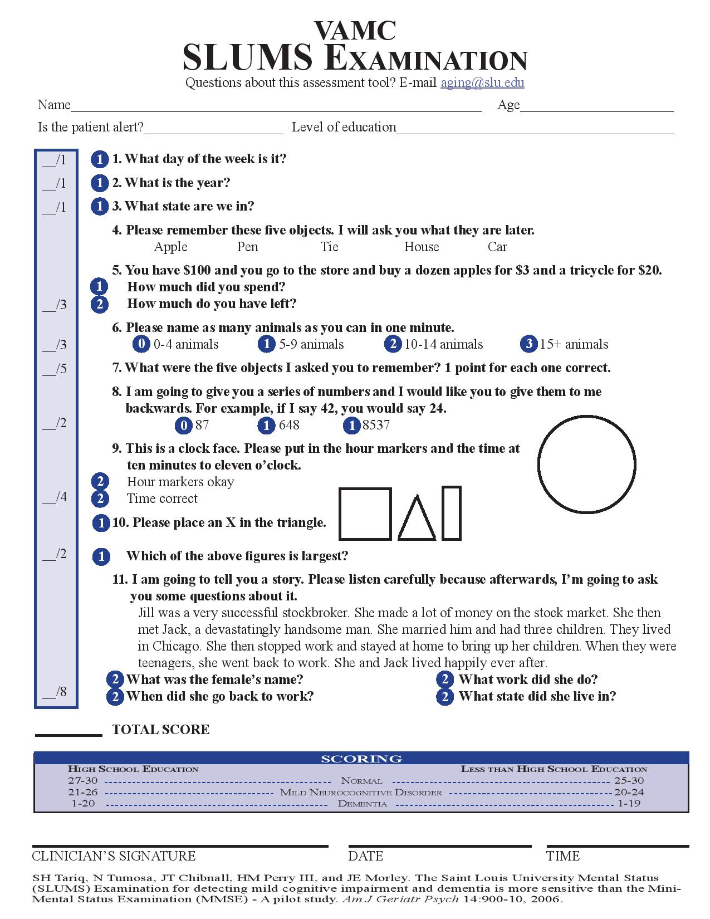
SLUMS
Saint Louis
University
Mental Status
Exam

Slide 23


Improving Memory in Primary Care
Take a look at the prescription medications
Look for substance misuse
Check labs for things you don’t want to miss

Slide 24
Prescription Drugs and Dementia
Many drugs make patients worse, e.g. Sedatives, anxiolytics, anticholinergics, H2-blockers, centrally acting antihypertensives (clonidine, alpha-methyl dopa) antiarhythmics, beta blockers, digoxin, Sinemet, selegeline.
Don’t forget herbals and OTCs
Check all meds for CNS side effects
Ask Pharmacy for help

Slide 25

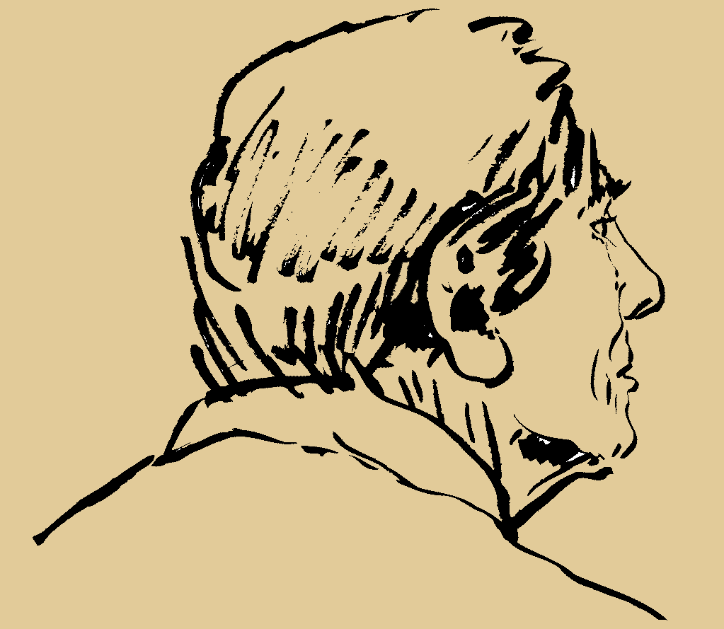
Alcohol and Dementia
Volume of distribution for ETOH with age
No more than one/day after age 65; stop all if memory is impaired

Slide 26
The Dementia Evaluation: don’t miss these
Laboratory/ Diagnostics
B-12, Folate, TSH
Chem profile, UA, ?O₂ sat
CBC
Other as indicated –most often drug levels
Brain Imaging (once, not multiple)

Slide 27

Caregiver Support: services offered by the Alzheimer’s Association
Information and Referral
Care Consultation
Safety Services
Early-Stage Engagement Programs
Support Groups
Monthly Educational Programs
Brain Health Awareness
Clinical Trials

Slide 28

Mentation Part 2: Depression
Depression is common in elders with other health problems
Can be hard to detect
Screening is recommended

Slide 29

Screen during Annual Wellness
Personal Health Questionnaire 2 (PHQ-2)
PHQ-9 or Geriatric Depression Scale
Depressed older people may not have all the symptoms

Slide 30
Depression: can look like dementia
Dementia
Insidious onset
Long duration
No psychiatric history
Conceals disability (often unaware of memory loss)
“Near-miss” answers
Day-to-day fluctuation in mood
Depression
Abrupt onset
Short duration
Previous psychiatric history
Highlights disabilities (may complain of the memory loss)
“Don’t know” answers
Diurnal variation in mood, but generally more consistent

Slide 31
Mentation Part 3. Delirium (Acute Confusion)
• Symptom: decreased attention, environmental awareness
• Cognitive change (eg, memory deficit, disorientation, language disturbance) or perceptual disturbance (eg, visual hallucinations
• Three motor subtypes: hyperactive, hypoactive, and normal/mild
• Rapid onset (hours to days) and fluctuates daily
• Evidence of a physical cause

Slide 32
Mentation: Delirium in Outpatients
Is UNDERRECOGNIZED
Has an underlying cause; is preventable and often treatable. Primary Care teams need to:
  Remove or treat underlying cause e.g. medication ADEs
  Restore/maintain function & mobility; recommend exercise
  Understand delirium behaviors
  Prevent complications- falls and adding high risk meds
Screen for delirium using the Ultra-Brief 2-Item Screener (UB-2)
Notes:
Talking Points from the What Matters Toolkit can be found here: http://www.ihi.org/Engage/Initiatives/Age-Friendly-Health-Systems/Documents/IHI_Age_Friendly_What_Matters_to_Older_Adults_Toolkit.pdf

Slide 33
Delirium Screening: UB-2
  1: Please tell me the day of the week
    Try to sit at eye level
    Be sure sensory aides (glasses, hearing) are in place patient can check anywhere (e.g., white board, newspaper, etc.), but cannot ask for help
  2: Please tell me the months of the year backward, say December as your first month

Slide 34
UB-2 Instructions
If participant finished reciting months but missed one or more, it is incorrect and no prompting is allowed.
Prompt only with: “what month comes before __________ (last month they said)?” Prompt up to two times
If patient does not follow the instruction re-read the instructions once
Fick et al, Journal of Hospital Medicine, 2015

Slide 35
UB-2 Does not make a diagnosis
It picks up >90% of delirium, but it really is delirium only 60% of the time.
If the patient passes the UB-2 he/she does NOT have delirium
If the patient fails the UB-2 you need a second test to know if they have delirium
The 3D CAM is the best next test

Slide 36
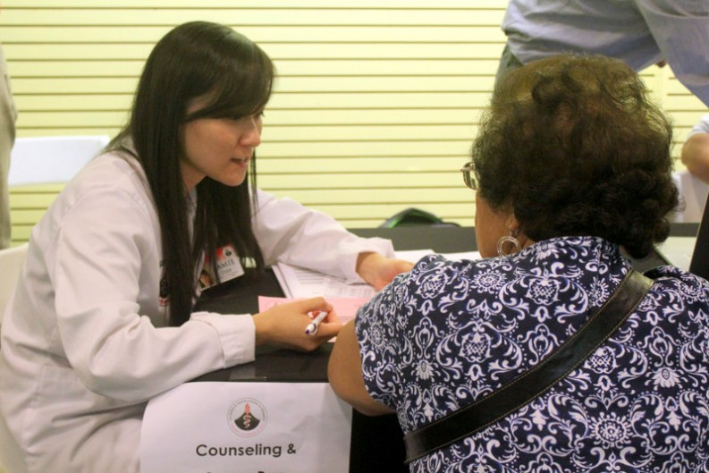
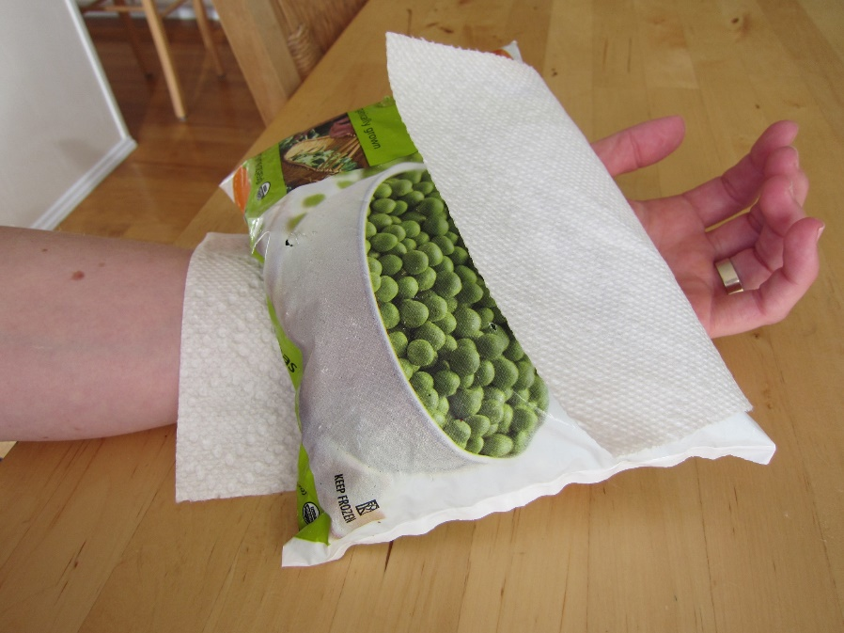
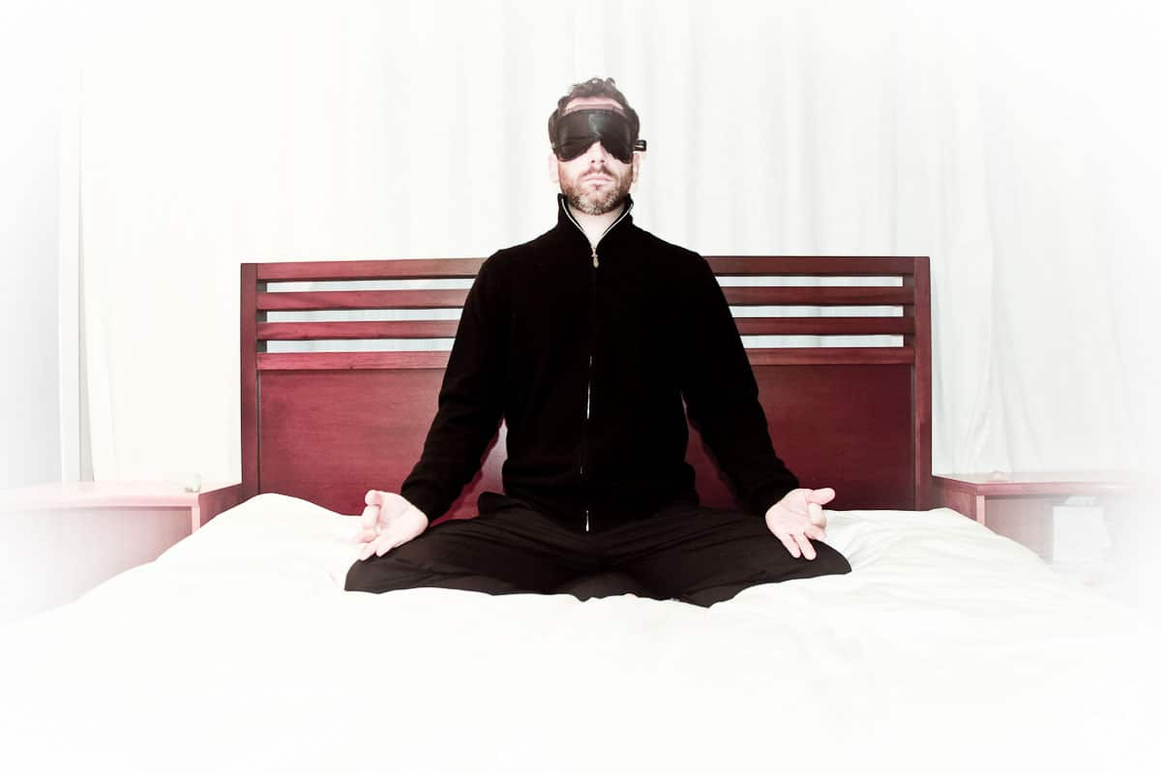
Mentation: Keeping the patient’s brain healthy
Offer non-pharmacological options for
MOOD
Pain
Sleep

Slide 37
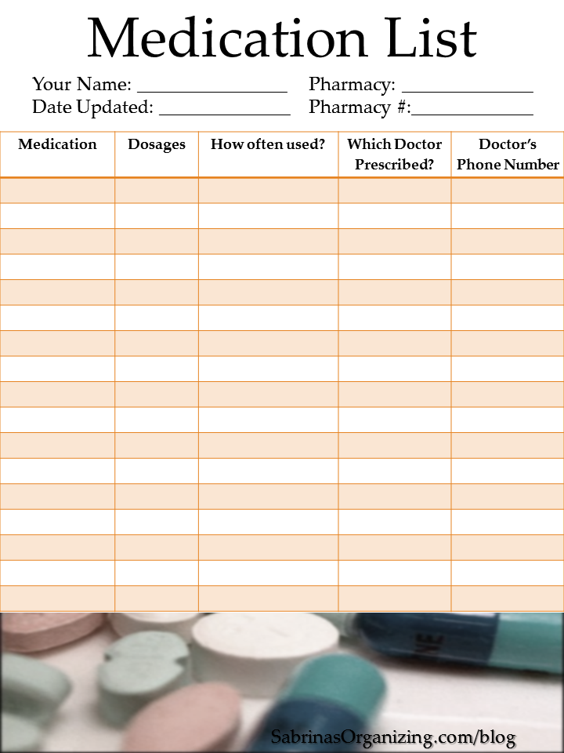
Mentation: Keeping the patient’s brain healthy
Make a medication list printout part of standard check-out
Ensure that the older adult and family caregivers understand:
  What their medications are for
  How to take them
  Why they are taking them
  How to know if they are helping or possibly causing adverse side effects.

Slide 38


Mentation: Tips
Decide on tools that best fits your care team culture.
Use all tools only as instructed and provide training to make sure it is used correctly.
Document mental status in the chart to measure change over time.
Until ruled out, consider a change in mental status to be delirium and raise awareness among care team and family caregivers about the risk of delirium superimposed on dementia

Slide 39
Annual Wellness Visit
Requires screening for dementia and depression
Ensures there is a time to look for these problems each year
You get a baseline for patients
It is easier to find changes when they come up

Slide 40
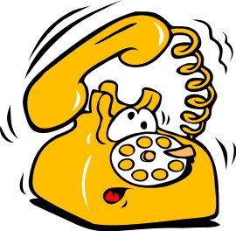
Telehealth: COVID Cares Act
Telehealth increasing use and importance
Great way to reach older patients and those far from the clinics
Answer a brief survey on telehealth
Dr. Hejkal discuss this with you September 28

Slide 41
Mentation
Delirium
Dementia
Depression

