Slide 1
Nebraska GWEP Geriatrics Case Conference ECHO will begin at 12:15
As you join, please utilize the SIGN-IN LINK shared to enter your name and e-mail address for attendance.
The didactic portion of today's conference will be recorded and available for viewing on our website following at: https://www.unmc.edu/NebraskaGWEP/
If you do not consent to recording, please disconnect at this time.

Slide 2
Welcome
Nebraska Geriatrics Workforce Enhancement Program welcomes you to our monthly Geriatrics Case Conference ECHO, held on the first Thursday of every month
Introductions of facilitators, presenters and new attendees
All attendees, please use SIGN-IN LINK to note attendance
Please mute during presentations and unmute yourself to speak during discussion
Share your feedback and ideas in follow-up surveys
Project ECHO® collects registration, participation, questions/answers, chat comments, and poll responses for some teleECHO® programs. Your individual data will be kept confidential. These data may be used for reports, maps, communications, surveys, quality assurance, evaluation, research, and to inform new initiatives.

Slide 5
Eye problems in the elderly for the Primary Care Provider
Natalie Manley, MD, MPH
4/1/21

Slide 6
Disclosure
This program is supported by the Health Resources and Services Administration (HRSA) of the U.S. Department of Health and Human Services (HHS) as part of an award totaling 751,695.00 with 0% financed with non-governmental sources. The contents are those of the author(s) and do not necessarily represent the official views of, nor an endorsement, by HRSA, HHS, or the U.S. Government. For more information, please visit HRSA.gov.

Slide 7
Objectives
At the end of this lecture the learner should be able to
List common geriatric eye concerns
Identify and manage common geriatric eye concerns
Know how to provide primary prevention of vision loss
Recognize ophthalmologic side effects of systemic medications
Recognize systemic side effects of ophthalmologic eye medications
We will not have time to discuss management of red eye
Ham’s Primary Care Geriatrics, 7th Ed. Chpt 26

Slide 8
www.aao.org/basicvideo
Another great site for physical exam of the eye: https://meded.ucsd.edu/clinicalmed/eyes.html

Slide 9
Physiologic Changes with aging
The lens hardens → ability to change shape (accommodation)→ ability to focus on near objects (presbyopia)
Lens opacification (cataract) → amount of light reaching the retina → longer for eyes to adjust to changes in light
sensitivity to glare
pupillary size
ability to adjust pupillary size to light
Ham’s Primary Care Geriatrics, 7th Ed. Chpt 26

Slide 10
Common Geriatric eye problems

Slide 11
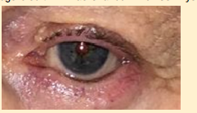
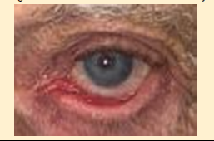
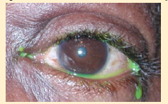
Common Pathologic external anatomic eye changes in older adults
Brow Ptosis
Ptosis
Entropion
Ectropion
Tearing (epiphora)
Image Credits: Dr. Rao Chanduri
Ham’s Primary Care Geriatrics, 7th Ed. Chpt 26

Slide 12
Dry Eye
prevalence increases with age
Women > Men
Symptoms: dryness, eye discomfort, burning, stinging, grittiness, tearing, ocular fatigue or a foreign body sensation.
Associations: poor sleep, depression, anxiety, stress, decreased quality of life
Can damage the ocular surface
can be episodic or chronic
Nonmodifiable risk factors: female sex, age, Sjögren syndrome,
Ham’s Primary Care Geriatrics, 7th Ed. Chpt 26

Slide 13
Dry Eye-modifiable risk factors
Dry environment
Medications
some topical ocular medications (artificial tears with preservatives, OTC antiredness drops with naphazoline or pheniramine)
Blepharitis
Smoking
alcohol use
long-term contact lens use,
LASIK surgery
Pollution
activities with decreased blinking (computer use)
poorly fitting sleep apnea masks
decreased blink from Parkinson’s
peripheral neuropathy
lid abnormalities—ectropion, lagophthalmos (incomplete lid closure during sleep)
thyroid disease
Sleep deprivation → decreases tear secretion and osmolality→ worsens tear film break up time.
Ham’s Primary Care Geriatrics, 7th Ed. Chpt 26

Slide 14
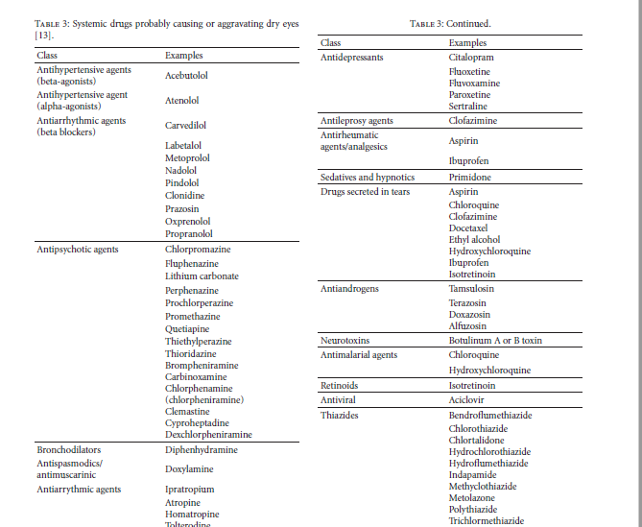
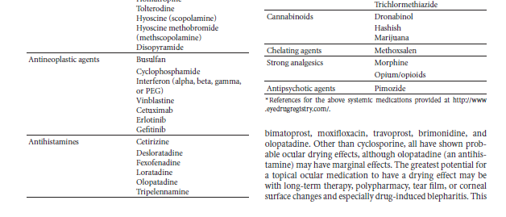
Medications that cause dry eye
Journal of Ophthalmology
Volume 2012, Article ID 285851, 8 pages
doi:10.1155/2012/285851
Review Article
The Role of Medications in Causing Dry Eye
Frederick T. Fraunfelder, James J. Sciubba, and William D.Mathers

Slide 15
Dry eye Management
The most important treatment for dry eye is identifying exacerbating factors and minimizing contributing medications
Warm compresses
Preservative free artificial tears (using artificial tears with preservatives more than 3 to 4 times a day will worsen DED)
Nighttime lubricating ointments
Optimize sleep, mood, and Parkinson’s
Refer to an eye provider when symptoms are not well controlled with above management
Ham’s Primary Care Geriatrics, 7th Ed. Chpt 26

Slide 16
Chronic Vision loss
Risk for decreased quality of life, functional loss, depression, falls, and social isolation.
Most common causes of vision loss in older adults:
uncorrected refractive error, cataracts, age-related macular degeneration (AMD), Diabetic retinopathy, glaucoma.
A comprehensive eye evaluation necessary every 1 to 2 years or more often as recommended by their eye specialist (e.g, those with DM should have annual eye examination)
* Will not be discussing acute vision loss today
Ham’s Primary Care Geriatrics, 7th Ed. Chpt 26

Slide 17
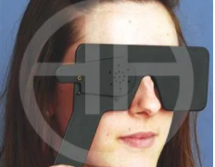
Refractive error
Up to 62% of low vision and 4% of blindness was caused by refractive error!
Older adults are at risk for uncorrected refractive error because of
financial constraints
Transportation
Cognition
Communication issues.
One nursing home study found that refractive correction led to immediate improvements in reading, psychological distress, activities and hobbies, and social interaction.
The pinhole test is a rapid method to detect refractive error
https://www.aao.org/image/pinhole-visual-acuity
Ham’s Primary Care Geriatrics, 7th Ed. Chpt 26

Slide 18
Age Related Macular degeneration (AMD)
Nonneovascular AMD(dry) causes 80%of cases BUT
Neovascular (wet) AMD causes ~90%of severe vision loss in AMD
Nonmodifiable risk factors: age, European decent, genetics, female sex
Primary modifiable risk factor: smoking.
The pathognomonic sign of AMD are drusen (yellow deposits on the macula from death of retinal cells).
Vision loss begins centrally and extends peripherally.
Ham’s Primary Care Geriatrics, 7th Ed. Chpt 26
https://www.aao.org/eye-health/diseases/amd-vision-simulator

Slide 19
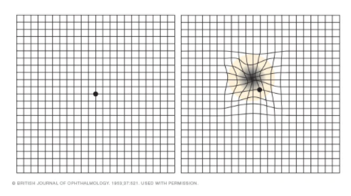
Age Related Macular degeneration (AMD)
Staging (early, intermediate, and late/advanced) drives treatment
Early: usually asymptomatic; identified during dilated eye exams
Early detection important to prevent worsening and improve overall outcomes
Progression from early or intermediate AMD to late AMD, can occur in a matter of days
loss of far and near vision, sudden visual distortion (e.g., straight lines or edges appear wavy), central vision loss, and change in color vision.
Encourage patients to do home monitoring with an Amsler Grid and to immediately alert eye care provider of changes.
Ham’s Primary Care Geriatrics, 7th Ed. Chpt 26
https://www.mayoclinic.org/diseases-conditions/dry-macular-degeneration/multimedia/amsler-grid/img-20008096

Slide 20
AMD treatment
Early disease: stop smoking
Intermediate or advanced AMD: AREDS2 vitamin and mineral supplement
Wet AMD: intravitreal injection with anti-VEGF agents (aflibercept, bevacizumab, and ranibizumab)
brolukizamab (a newer therapy) requires fewer injections
Ham’s Primary Care Geriatrics, 7th Ed. Chpt 26

Slide 21
Cataract
All people age 70 years and over have some degree of cataract.
Only clinically relevant if they impact ADLs, IADLs
Reduce illumination and contrast sensitivity, increase glare, and degrade color vision.
Risk factors: age, eye trauma, inflammation, metabolic or nutritional defects, smoking, alcohol consumption, ultraviolet radiation, and steroid use.
Ham’s Primary Care Geriatrics, 7th Ed. Chpt 26
https://www.aao.org/eye-health/diseases/cataracts-vision-simulator

Slide 22
Cataract
Symptoms:
blurring,
decreased vision
star bursts around light
Difficulty with night driving
Yellowed or brownish hue discoloration to vision
“second site” in which cataracts created a denser nucleus and they no longer need glasses
Diagnosis: dilated eye exam with slit lamp biomicroscope
https://www.nuffieldhealth.com/article/4-signs-you-may-have-cataracts
Ham’s Primary Care Geriatrics, 7th Ed. Chpt 26

Slide 23
Cataract treatment
Treatment: surgical
Extracapsular cataract extraction with posterior chamber intraocular lens implantation is standard.
No medications prevent or abolish cataracts.
The criterion for surgery is functional visual impairment and not a specific VA or maturity.
Visually impairing cataracts are associated with falls and first-eye cataract surgery appears to reduce falls, however, in the initial period after the surgery, special attention should be paid to prevent falls as patients adjust to their new refraction and depth perception.
Cataract surgery is also associated with improved cognition and reduced visual hallucinations.
Ham’s Primary Care Geriatrics, 7th Ed. Chpt 26

Slide 24
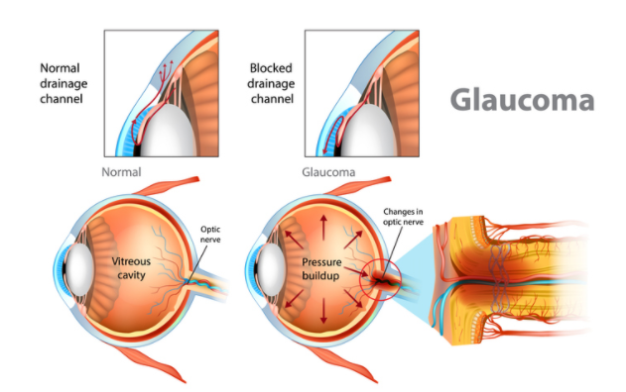
Glaucoma
POAG = primary open angle glaucoma
Destroys peripheral vision first and central vision in late stages.
Limited field of view makes mobility and driving difficult and increases fall risk.
Associated with depression and decreased quality of life
Low socioeconomic status is a risk for late detection of glaucoma and for progression (healthcare access; therapy adherence)
https://www.health.harvard.edu/staying-healthy/the-facts-about-glaucoma
Ham’s Primary Care Geriatrics, 7th Ed. Chpt 26

Slide 25
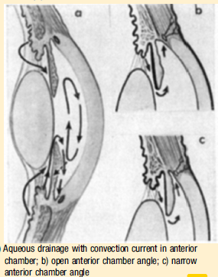
Glaucoma
POAG Risk Factors:
High intraocular pressure
Age
Enlarged optic nerve cup
Sub-Saharan African ethnicity
Family history
High myopia (near sighted -6.00 or higher)
Male sex
Risk factors for closed angle glaucoma
Age
Hyperopia (far sightedness)
Female sex
East Asian ethnic origin
Ham’s Primary Care Geriatrics, 7th Ed. Chpt 26

Slide 26
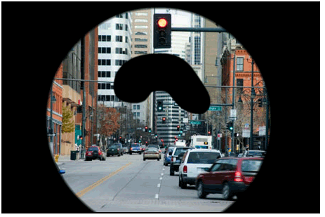
Glaucoma vision simulator
https://www.aao.org/eye-health/diseases/glaucoma-vision-simulator

Slide 27
Glaucoma
50% of patients with glaucoma are undiagnosed
Because damage to the optic nerve fibers can occur at normal IOP, these measurements have low sensitivity.
The most reliable and sensitive method for detection is direct visualization of the optic nerve head and retinal nerve fiber layer.
IOP measurement is vital for monitoring treatment and progression of disease
Visual field tests are most sensitive in later stage disease as a diagnostic and tracking tool
Treatment
Topical meds to decrease IOP (gently occlude the lower lacrimal duct, or close eyes after instilling the drops to decrease systemic absorption)
Laser trabeculoplasty and surgery are increasing in use.
Management of acute angle closure glaucoma is urgent.
Firstline therapy is lowering IOP using topical medications followed by immediate or urgent laser iridotomy
Ham’s Primary Care Geriatrics, 7th Ed. Chpt 26

Slide 28
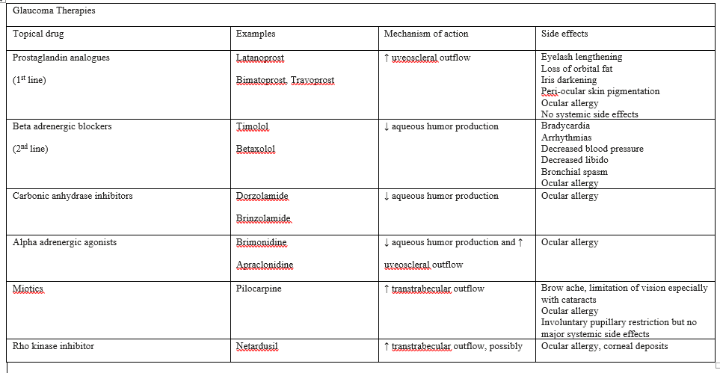
(From Jonas JB, Aung T, Bourne RR, Bron AM, Ritch R, Panda-Jonas S. Glaucoma. Lancet. 2017;390(10108):21832193.)
Ham’s Primary Care Geriatrics, 7th Ed. Chpt 26

Slide 29
Diabetic retinopathy (DR)
Risk factors for development and progression of DR:
Uncontrolled hyperglycemia
Duration of hyperglycemia
Hypertension
Ethnicity (African American, Hispanic, south Asian)
Dyslipidemia
Cataract surgery
Two stages: Nonproliferative DR = early stage; proliferative DR = severe stage
Nonproliferative--often asymptomatic
Proliferative (neovascularization of the retina) can lead to vitreous hemorrhage and tractional retinal detachment.
The primary cause of moderate vision loss in patients with DR is macular edema that occurs at any stage
Ham’s Primary Care Geriatrics, 7th Ed. Chpt 26

Slide 30
Diabetic retinopathy
Symptoms
visual distortion
decreased VA
Regular eye screening by eye specialist is important
Diagnosis made with slit lamp biomicroscopy and indirect ophthalmoscopy.
Ham’s Primary Care Geriatrics, 7th Ed. Chpt 26

Slide 31
Diabetic retinopathy treatment
Management of the microvascular complications using anti-VEGF intravitreal therapy and laser treatment for diabetic macular edema and proliferative retinopathy.
Other treatments include intravitreal anti-inflammatories, steroids, IL-6 inhibitors, and integrilin.
Ham’s Primary Care Geriatrics, 7th Ed. Chpt 26

Slide 32
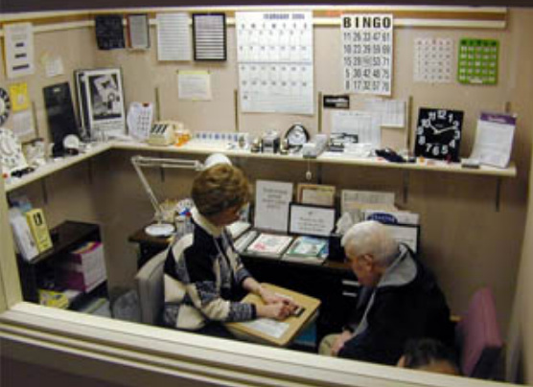
Low vision rehab
https://www.3newsnow.com/news/local-news/unmc-low-vision-center-has-been-offering-hope-and-healing-for-10-years
(402) 559-2463
https://www.unmc.edu/media/lowvision/LowVisionClinic.pdf

