Slide 1
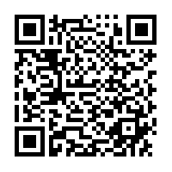
Nebraska GWEP Geriatrics Case Conference ECHO will begin at 12:15
As you join, please utilize the SIGN-IN LINK shared in Chat or QR link to enter your name and e-mail address for attendance.
The didactic portion of today's conference will be recorded and available for viewing on our website following at: https://www.unmc.edu/NebraskaGWEP/
If you do not consent to recording, please disconnect at this time.

Slide 2
Welcome
Nebraska Geriatrics Workforce Enhancement Program welcomes you to our monthly Geriatrics Case Conference ECHO, held on the first Thursday of every month
All attendees, please use SIGN-IN LINK to note attendance
Please mute during presentations and unmute yourself to speak during discussion
Share your feedback and ideas in follow-up surveys
Project ECHO® collects registration, participation, questions/answers, chat comments, and poll responses for some teleECHO® programs. Your individual data will be kept confidential. These data may be used for reports, maps, communications, surveys, quality assurance, evaluation, research, and to inform new initiatives.

Slide 3
This program is supported by the Health Resources and Services Administration (HRSA) of the U.S. Department of Health and Human Services (HHS) as part of an award totaling 751,695.00 with 0% financed with non-governmental sources. The contents are those of the author(s) and do not necessarily represent the official views of, nor an endorsement, by HRSA, HHS, or the U.S. Government. For more information, please visit HRSA.gov.

Slide 6
Nebraska GWEP Geriatrics Case Conference ECHO
Problems in Foot Care
John Weremy, DPM
June 3rd, 2021

Slide 7
Foot Problems with Geriatric Patients
By John Weremy

Slide 8
Dr. John Weremy
University of Nebraska-Lincoln
College of Podiatric Medicine Des Moines, Iowa
Two years of residency department of Veteran Affairs Denver, Colorado
Diplomat American College of Podiatric Medicine
Ehrling Bergquist Clinic
Offutt Air Force Base

Slide 9
Foot Pain
Approximately one in four older people
Impairs mobility and balance
Independent risk factor in falling
Can be effectively managed in older people with conservative intervention
Routine foot care
Footwear advice
Wearing orthotics

Slide 10
Risk Factors
Female more prone than males
Bunions
Hammertoes
Shoe gear
Obesity
Depression
Diabetes
Osteoarthritis

Slide 11
Most Common Problems
Corns and calluses
Nail disorders (fungal, ingrown, thickening, etc.)
Bunions
Hammertoes
Systemic Diseases
Diabetes
Osteoarthritis
Rheumatoid arthritis
PAD
Neuropathy

Slide 12
Impact of Foot Pain
Reduced walking
Difficulty with daily activities
Impaired balance
Increased falls
Poor health
Weight gain
Joint pain
Cardiovascular function
Impaired functional status

Slide 13
Management of Foot Pain
Regular podiatric care (once a year)
Debride nails (UK study showed 100 patients hospitalized 89% cannot trim nails)
Debride corns and calluses
Shoe gear advice
50% wear wrong size shoes
Problems include → being fashionable, not measured, and availability of proper shoes
Foot orthotics
Reduce pressure
Improve balance

Slide 14
Patient #1 (72 year old female)
History of Rheumatoid arthritis
Psoriatic arthritis
Lumbar Radiculopathy

Slide 15
Physical Exam
Diminished pedal pulses
CFT more than 3 seconds
Skin thin and shiny
Decreased sensation to monofilament test
Charcot foot right
HAV bilaterally
Hammertoes bilaterally
Ingrown dystrophic nails
Calluses
Sub metatarsal head left second, medial aspect
Left first metatarsal head, plantar aspect right second toe and medial aspect right second toe

Slide 16
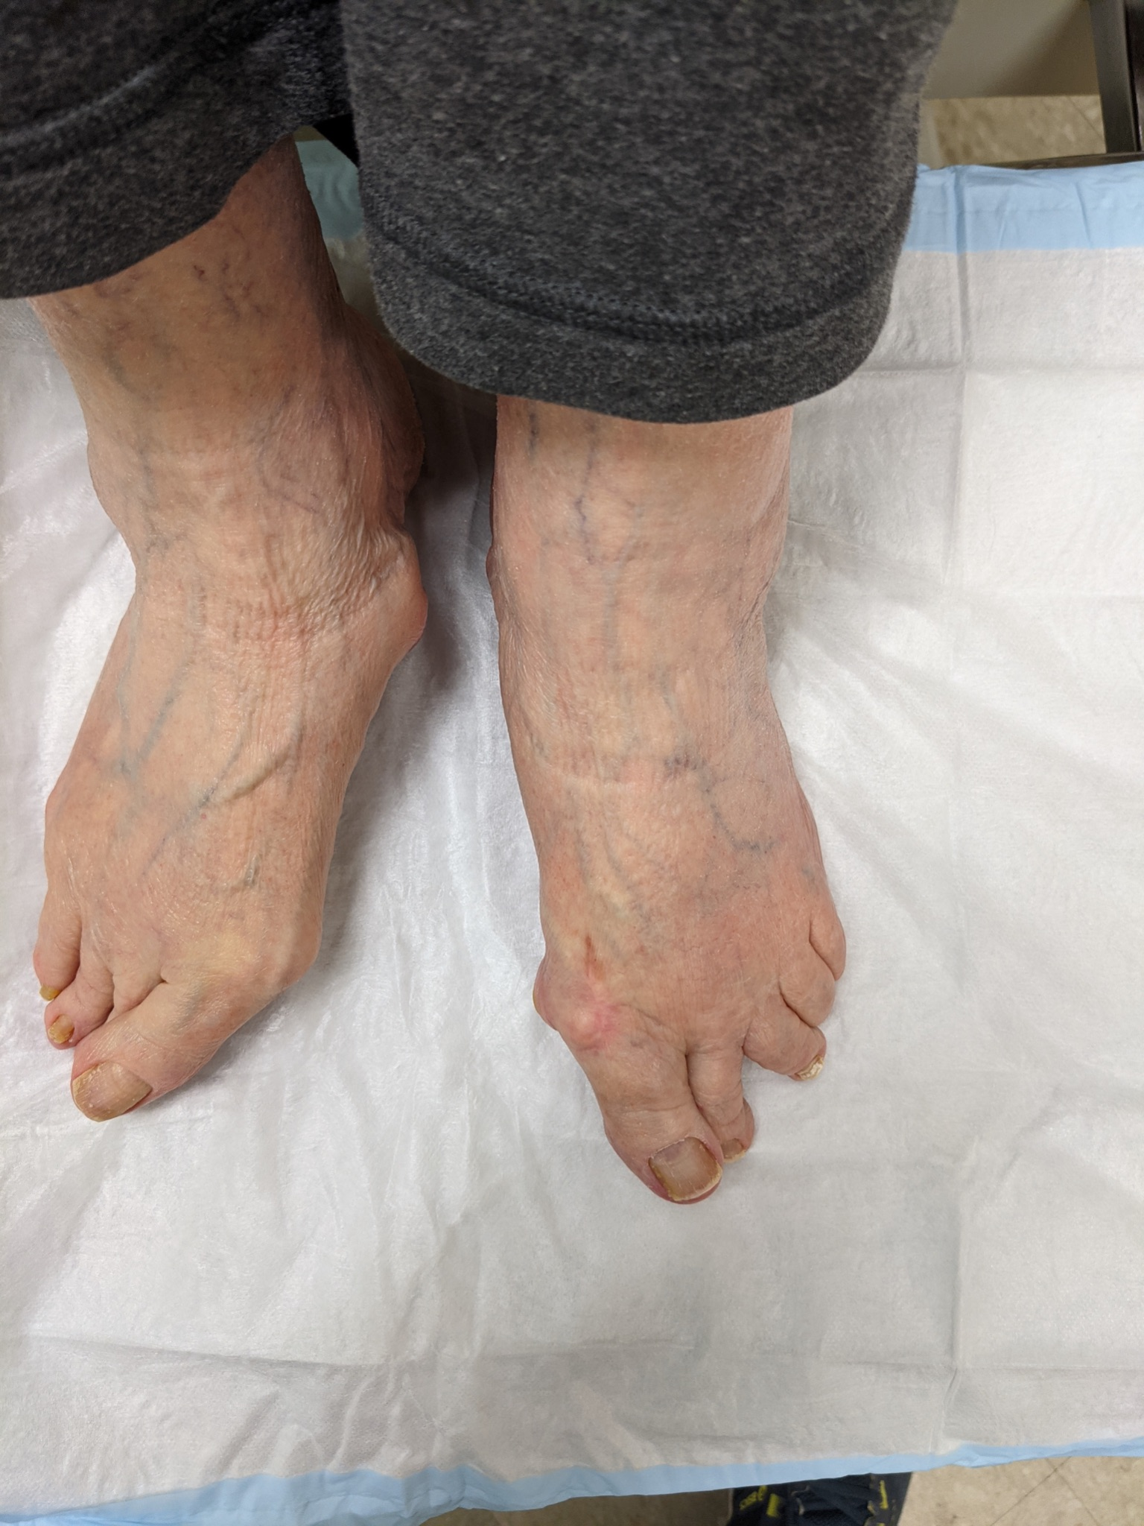
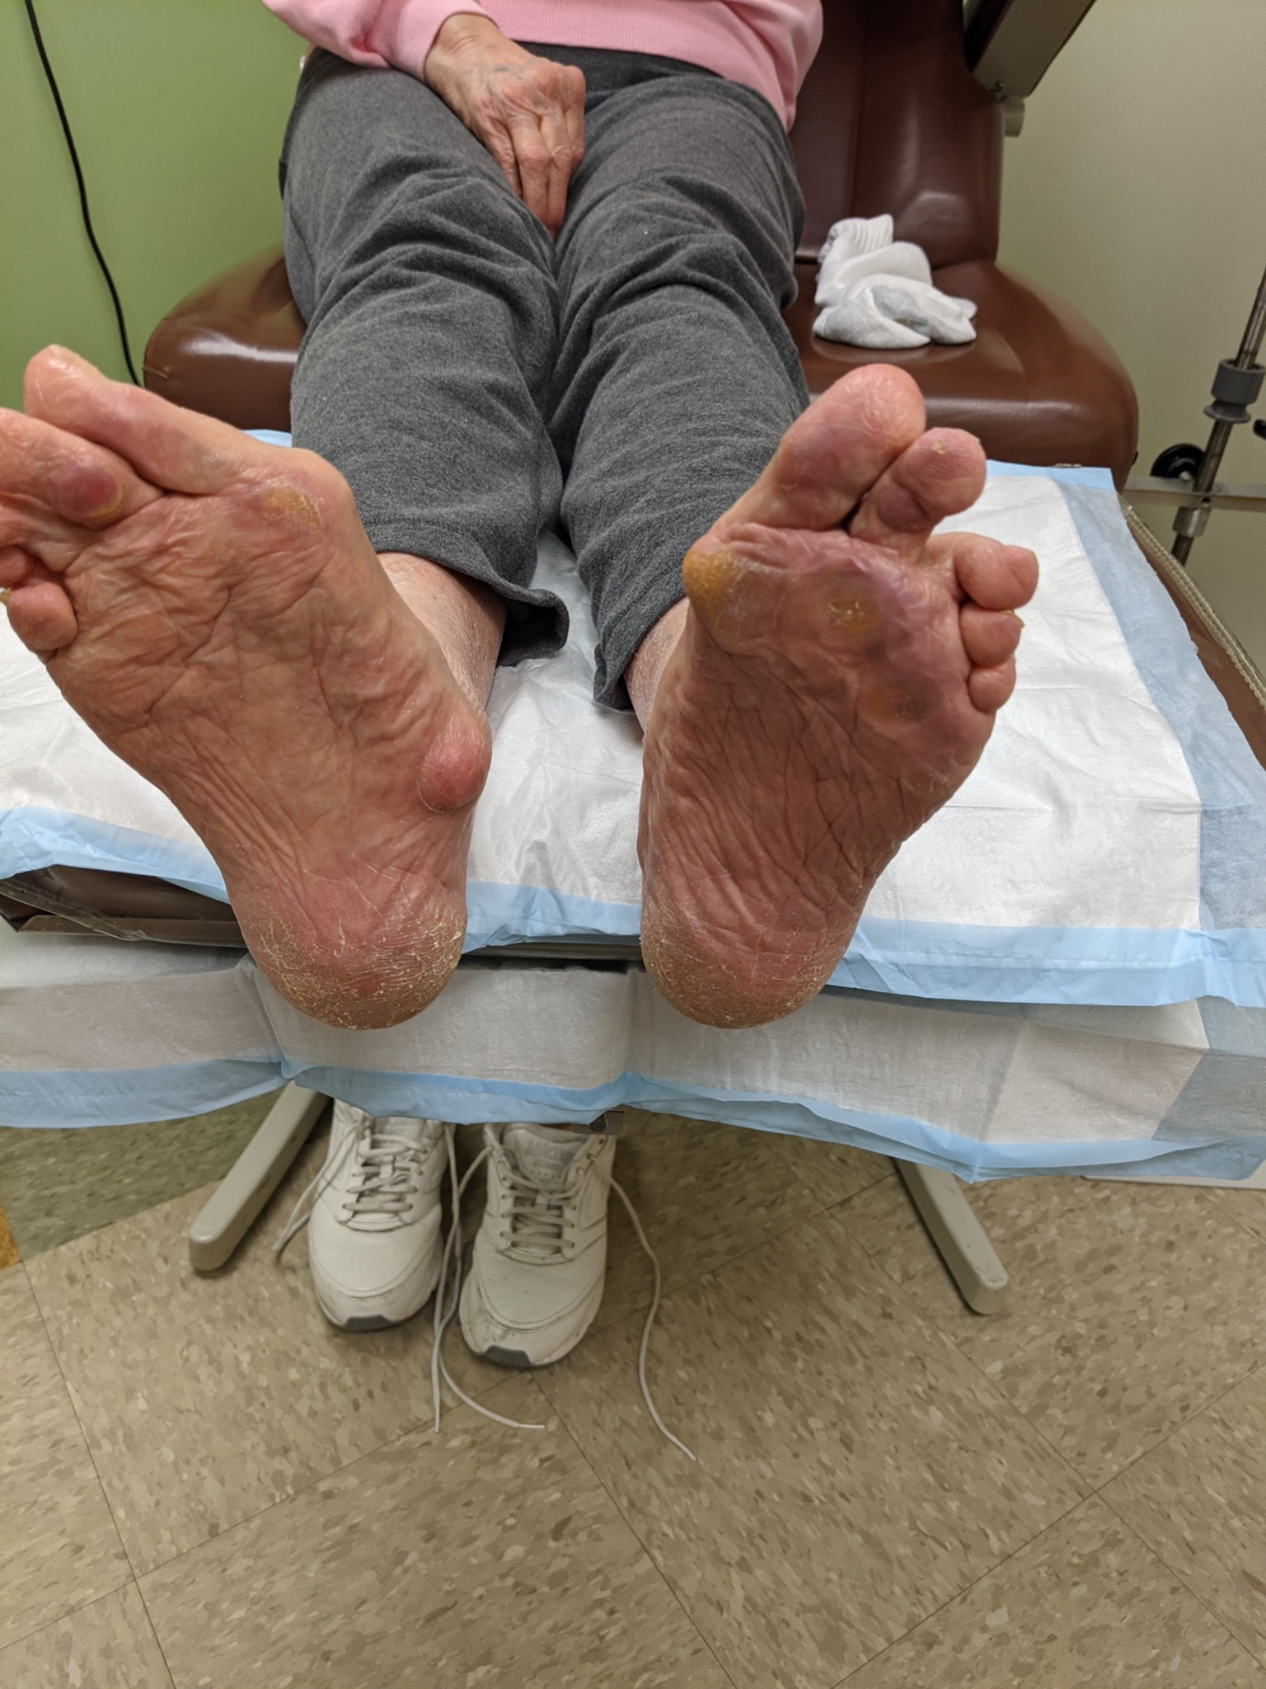

Slide 17
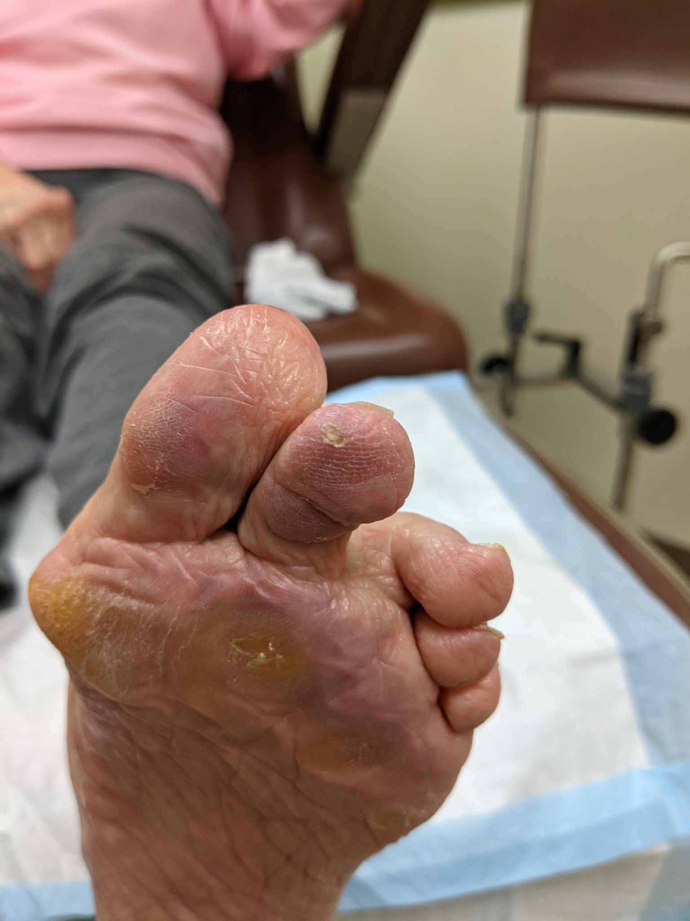
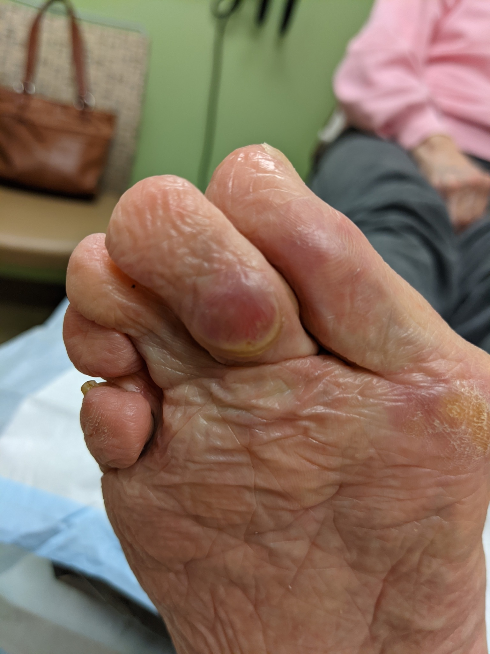

Slide 18
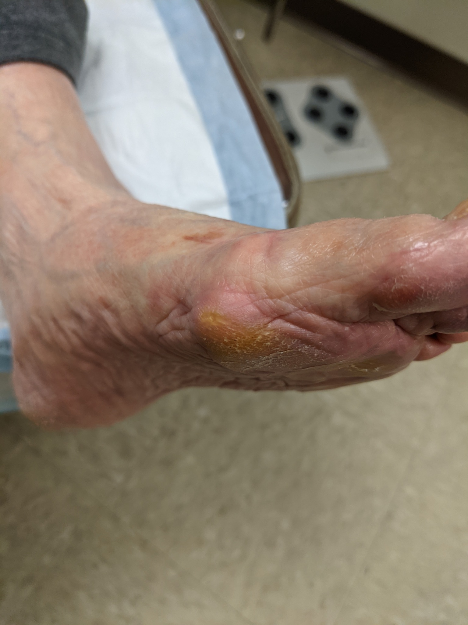
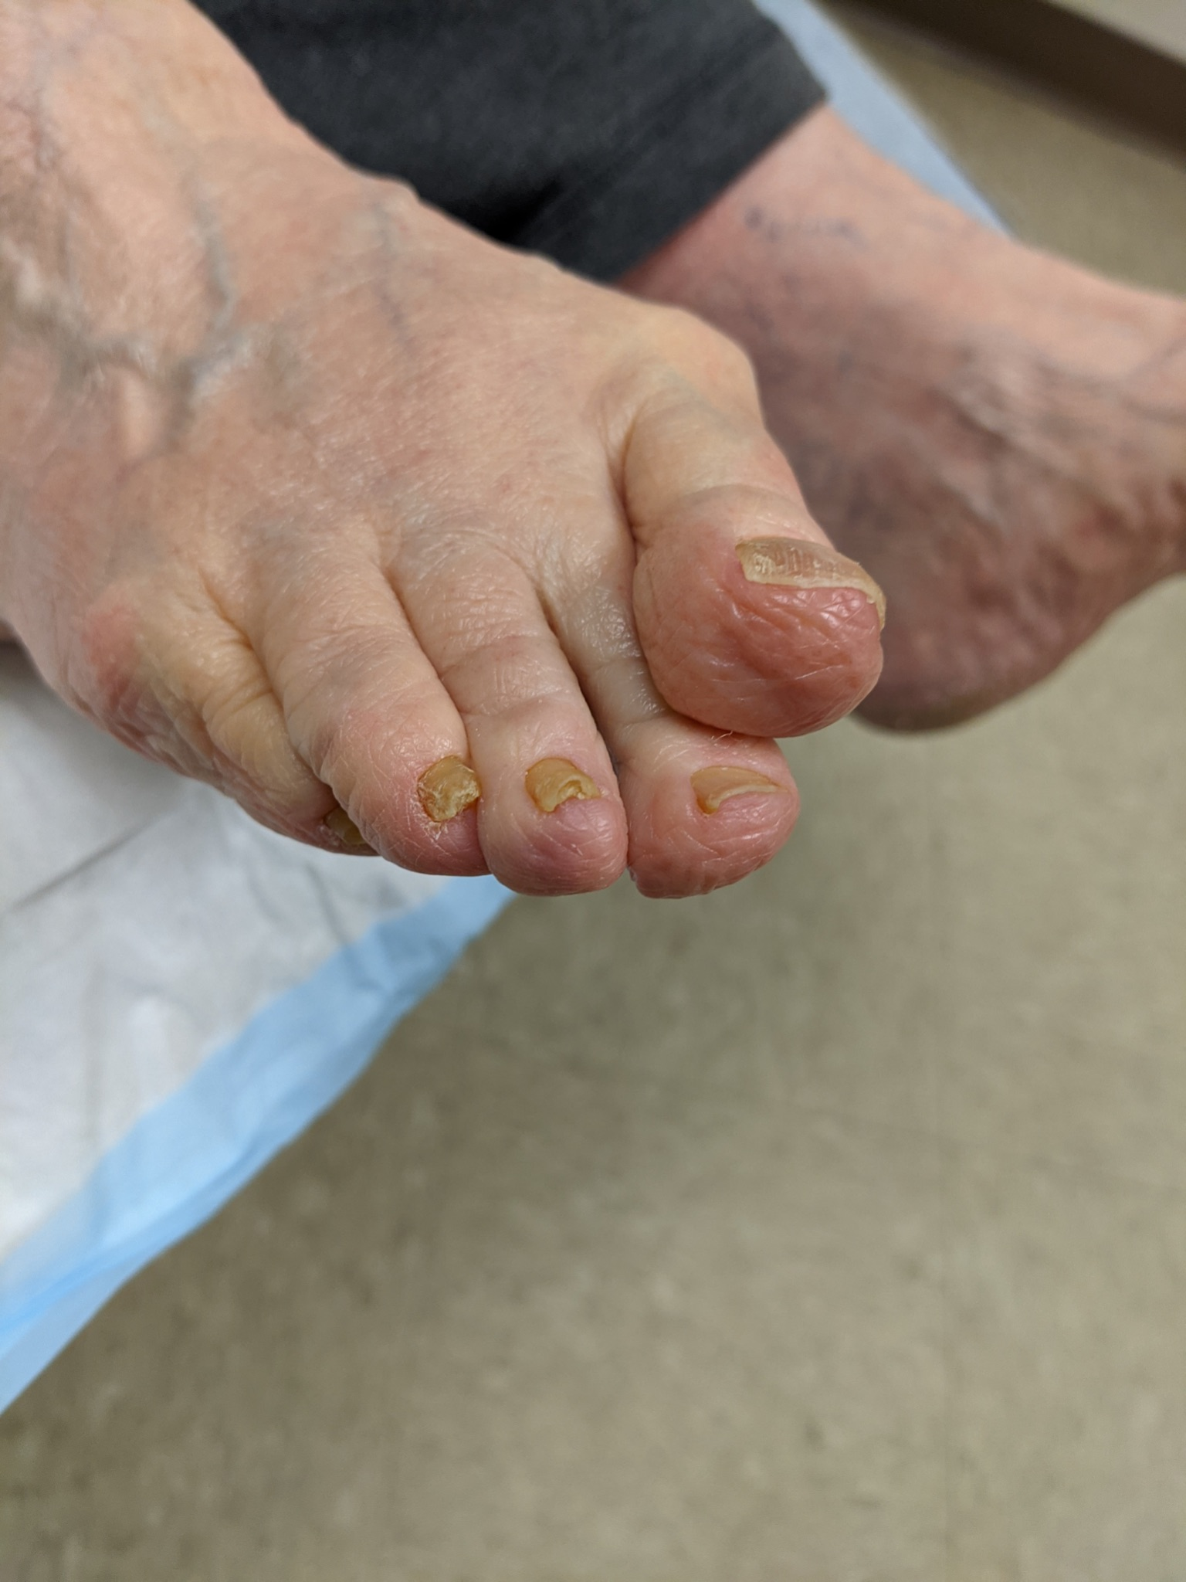

Slide 19
