Slide 1
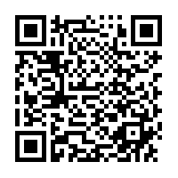
Nebraska GWEP Geriatrics Case Conference ECHO will begin at 12:15
As you join, please utilize the SIGN-IN LINK shared in
Chat to enter your name and e-mail address for
attendance or use this QR link
The didactic portion of today's conference will be recorded and available for viewing on our website following at: https://www.unmc.edu/NebraskaGWEP/
If you do not consent to recording, please disconnect at this time.

Slide 2
Welcome
Nebraska Geriatrics Workforce Enhancement Program welcomes you to our monthly Geriatrics Case Conference ECHO, held on the first Thursday of every month
All attendees, please use SIGN-IN LINK to note attendance or use this QR Link
Please mute during presentations and unmute yourself to speak during discussion
Share your feedback and ideas in follow-up surveys
Project ECHO® collects registration, participation, questions/answers, chat comments, and poll responses for some teleECHO® programs. Your individual data will be kept confidential. These data may be used for reports, maps, communications, surveys, quality assurance, evaluation, research, and to inform new initiatives.

Slide 3
This program is supported by the Health Resources and Services Administration (HRSA) of the U.S. Department of Health and Human Services (HHS) as part of an award totaling $749,813.00 with 0% financed with non-governmental sources. The contents are those of the author(s) and do not necessarily represent the official views of, nor an endorsement, by HRSA, HHS, or the U.S. Government. For more information, please visit HRSA.gov.
Attendance
QR Link

Slide 4
Attendance
QR Link

Slide 5
“In support of improving patient care, this activity has been planned and implemented by the University of Nebraska Medical Center and Project ECHO®. Project ECHO® is jointly accredited by the Accreditation Council for Continuing Medical Education (ACCME), the Accreditation Council for Pharmacy Education (ACPE), and the American Nurses Credentialing Center (ANCC), to provide continuing education for the healthcare team.”

Slide 6
Nebraska GWEP Geriatrics Case Conference ECHO
“Partnering for Age Friendly Care at the Nebraska GWEP: Progress Report”
Jane F. Potter, MD
August 5th , 2021

Slide 7
Partnering for Age Friendly Care, the Nebraska GWEP:
progress report

Slide 8
Why Enhance the PC Workforce?
Most care for people over 65 yrs is done in primary care
Research in geriatrics shows there are 4 high yield areas that improve care and outcomes
Collaboration within the IP team and with CBOs is key to 4Ms care

Slide 9
The 4 Ms
What Matters
Mentation
Mobility
Medications

Slide 10
Timeline
Melissa Kitto, Jason Gillespie
Alex Dworak, Jeremy Howe
Carrie Hoarty
OneWorld
Ponca Health
Midtown
Federally Qualified Health Center (FQHC)
Indian Health Services
NM PCMH clinic
July 2020
July 2021
July 2019
01
03
2019
2020
2021
Q1
Q2
Q3
Q4
Q1
Q2
Q3
Q4
Q1
Q2
Q3
Q4
02
04
Fontenelle
IM DOC
Nebraska Medicine
PCMH clinic
Nebraska Medicine
PCMH clinic
January 2020
January 2021
Dan Jeffrey
Stephen Mohring
Notes:
Here is our timeline for multiple primary care site to join the project. Different sites joined our project every 6 months. First was our FQHC partner OW, which joined in 2019 July, and then our PCMH partner Fontenelle clinic in January 2020. Ponca Indian Health services joined in another 6 month, and then two more PCMH clinics joining in 2021.
Thank you to those who have been geriatric champions for their clinics

Slide 11
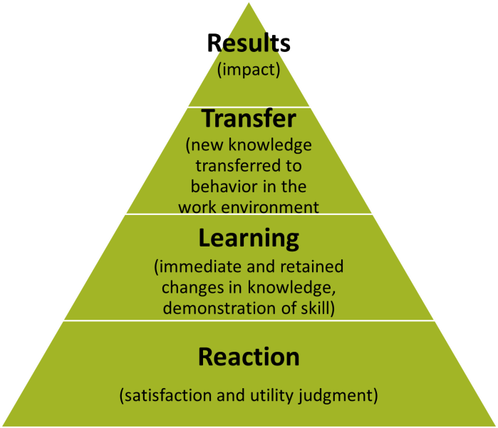
How Do We know if 4-Ms Education is Effective
Level 4: Patient Outcomes
(EMR data)
Level 3: Behavior/structure change (Survey, EMR data, Internal service tracking document)
Level 2: Knowledge and Skills
(Survey)
Level 1: Satisfaction & perceived
usefulness (Survey)
Notes:
Alright, let me start with our evaluation framework. We use Kirkpatrick’s 4 level model. The model has 4 different levels of outcomes. The first level is reaction of the training including satisfaction and perceived usefulness. Level 2 outcome is immediate and retained changes in knowledge or skills. Level 3 outcome is transfer of new knowledge into behavior. Level 4 outcome is impact or patient outcomes improved due to the program. The underlying rationale of this model is that success in level 1 to 3 will lead to success in level 4, which is the ultimate impact of the training intervention.

Slide 12
4Ms Education for "Age Friendly Clinics”
Attendance 9/5/19 - 5/6/21
 | HICSA | One World | Fontenelle | Ponca | IM DOC | Oth. | Total
4Ms Geriatric Sessions | 10 | 49 | 25 | 97 | 43 | 7 | 231
ECHO Case Conferences | 75 | 135 | 41 | 26 | 17 | 86 | 380
Total | 85 | 184 | 66 | 123 | 60 | 93 | 611
Notes:
Out first 4Ms session started on September 2019, and since then we provided a total of 611 training hours to interprofessional health care professionals in various primary care clinics and community organizations.

Slide 13
4Ms Education for "Age Friendly Clinics”
Who we are: Participants by Profession
82% female
Non-Hispanic Whites (73%) Hispanics (12%), Asian (7%), African American (2%), and Other (6%)
About 50% aged 20-39

Slide 14
Educational Outcomes
You reported significant increase in knowledge and confidence treating older adults
> 90% of you agreed or strongly agreed that the 4Ms training and case conferences:​
were effective
enhance clinical practice​
would recommend
sessions to their peers

Slide 15
Transfer of Knowledge-in EMR Data
What Matters- Advance Care Plans
Mentation: Referral of Caregivers for Patients with Dementia
Mobility: Fall Risk Assessment
Medication: Counseling on Opioid Risk
Notes:
All of these are part of the AWV

Slide 16
Knowledge Transfer
New Knowledge transferred to behavior in the work environment
What Matters- Proportion of people over the age of 65 years who have an advance care plan in the EMR or decline to have one

Slide 17
Patients > 65 years with an Advanced Care Plan in EMR
Notes:
Quiz question 1 what proportion of people in the US have any documentation for an ACP
A. <5% B. 5-20% C. 21-30-% D. 31-40%
70 percent of older Americans complete ADs prior to their death [9,14,25].
This is similar to an Australian study which showed that approximately 30 percent of older Australians have an ACP document available at the point of care [26].
Some underrepresented ethnic groups have low rates of ACP [39] and AD completion [37,38], with evidence that many AD documents are not culturally acceptable to them [4,37,40]. Many people, including those identifying with non-Western cultures, consider family and community as the source for treatment decisions, rather than the individual.
Advance directives (ADs) promote patient autonomy in the event of decisional incapacity and are associated with greater likelihood of treatment decisions and endpoints consistent with patient preferences and values.
Efforts to promote the completion of advance directives implicitly assume that completion rates of these documents, which help ensure care consistent with people's preferences in the event of incapacity, are undesirably low. However, data regarding completion of advance directives in the United States are inconsistent and of variable quality. We systematically reviewed studies published in the period 2011-16 to determine the proportion of US adults with a completed living will, health care power of attorney, or both. Among the 795,909 people in the 150 studies we analyzed, 36.7 percent had completed an advance directive, including 29.3 percent with living wills. These proportions were similar across the years reviewed. Similar proportions of patients with chronic illnesses (38.2 percent) and healthy adults (32.7 percent) had completed advance directives. The findings provide benchmarks for gauging future policies and practices designed to motivate completion of advance directives, particularly among those people most likely to benefit from having these documents on record.

Slide 18
Quiz Question 1
What proportion of people in the US have any documentation for an ACP?
<5%
5-20%
21-30-%
31-40%

Slide 19
Patients > 65 years with an Advanced Care Plan in EMR
Estimated US rate for any ACP
Notes:
70 percent of older Americans complete ADs prior to their death [9,14,25].
This is similar to an Australian study which showed that approximately 30 percent of older Australians have an ACP document available at the point of care [26].
Some underrepresented ethnic groups have low rates of ACP [39] and AD completion [37,38], with evidence that many AD documents are not culturally acceptable to them [4,37,40]. Many people, including those identifying with non-Western cultures, consider family and community as the source for treatment decisions, rather than the individual.
Advance directives (ADs) promote patient autonomy in the event of decisional incapacity and are associated with greater likelihood of treatment decisions and endpoints consistent with patient preferences and values.
Efforts to promote the completion of advance directives implicitly assume that completion rates of these documents, which help ensure care consistent with people's preferences in the event of incapacity, are undesirably low. However, data regarding completion of advance directives in the United States are inconsistent and of variable quality. We systematically reviewed studies published in the period 2011-16 to determine the proportion of US adults with a completed living will, health care power of attorney, or both. Among the 795,909 people in the 150 studies we analyzed, 36.7 percent had completed an advance directive, including 29.3 percent with living wills. These proportions were similar across the years reviewed. Similar proportions of patients with chronic illnesses (38.2 percent) and healthy adults (32.7 percent) had completed advance directives. The findings provide benchmarks for gauging future policies and practices designed to motivate completion of advance directives, particularly among those people most likely to benefit from having these documents on record.

Slide 20
How Can We Increase proportion of people with an ACP?
Discussion with provider during Annual Wellness Visits
Small group education sessions for patients
On-line Prepare for your Care website (Spanish and English)
Availability of Nebraska approved forms (in native languages) and notaries to witness completion
Notes:
Available in English, Spanish, draft of one in Karen (ca-rin)

Slide 21
Knowledge Transfer
New Knowledge transferred to behavior in the work environment
Mentation- Proportion of people over 18 years with dementia who are referred for additional caregiver education and support.
Notes:
What proportion of the population over age 65 years have dementia

Slide 22
Quiz Question 2
What proportion of people over age 65 years in the US suffer from dementia?
5%
10%
15%
20%
Notes:
One in 10 people (10%) age 65 and older has Alzheimer's dementia.
The percentage of people with Alzheimer's dementia increases with age: 3% of people age 65-74, 17% of people age 75-84, and 32% of people age 85 and older have Alzheimer's dementia.⁶² People younger than 65 can also develop Alzheimer's dementia, but it is much less common and prevalence is uncertain.
The estimated number of people age 65 and older with Alzheimer's dementia comes from a study using the latest data from the 2010 U.S. Census and the Chicago Health and Aging Project (CHAP), a population-based study of chronic health conditions of older people.⁶²

Slide 23
Age Distribution of People in the US with Dementia
3%
17%
32%

Slide 24
Why Make Referrals for Dementia Education in Primary Care?
PCPs are the first to hear about cognitive concerns
Trusted source of information
Referrals need to be part of normal workflow.
How to ‘catch-up’ on existing patients potentially benefiting from referral?

Slide 25
How to Refer from Primary Care
At NM structured order faxed to AANC-enter in ‘orders’
OneWorld and Ponca Health fax a referral- using AANC form

Slide 26
Referral for Caregiver Education and Support
AANC Referral through NM EMR
Staff Education on Alzheimer’s Assoc. of NE Chapter (AANC) Referral
Date | Session Title | Session Type | # of Attendees/ Recipients
1/11/21 | Tip Sheet to make AANC referral (for EMR resource trainers) | In-person/ online staff meeting; email | 31 attendees (101 received email)
1/21/20 | Services offered by & referral to AANC (Fontenelle Clinic) | In-person | 6 attendees
11/5/20 | Announcing partnership with AANC to NM PCMH Clinics | Email (Newsletter) | 262 received email
Notes:
Approach 2: give providers easy way to refer pts once they are newly identified, or as the patient’s condition changes
To encourage dementia education and referral, we trained clinic providers/staff regarding how to increase AANC referrals. Overall, 37 clinic providers/staff attended in-person educational session on how to refer patients to AANC including instructions on how to use EMR tools, more than 300 staff received information via email through PCMH newsletter and regular staff meeting.
Since September 2019, a total of 32 individuals (16 dyads) participated and completed more than 80% of the Early-Stage Support Group (ESSG) for Dementia hosted by AANC.

Slide 27
Programming by AANC
Recuring on-line Programs in Spanish and English
Support groups: virtual but resuming in-person
Early Stage Support Groups (ESSG) next scheduled in September

Slide 28
Identify Existing Patients
EMR search for ICD-10
Dementia Diagnosis Codes
Identify patients at baseline and every 6-12 month to conduct outreach with information from the Alzheimer’s Association.
Notes:
First approach; catch up. Identify pts

Slide 29
Identification of Patients with Dementia and Referral
For caregiver Education and Support
Notes:
Add to the graph when Fontenelle decides their approach

Slide 30
Knowledge Transfer
New Knowledge transferred to behavior in the work environment
Mobility- Proportion of people over the age of 65 years who are screened for risk of falls

Slide 31
Quiz Question 3
What proportion of people over age 65 years fall each year?
5-10%
11-24%
25-30%
31-40%
Notes:
Answer 1 in 4 in other sources 30%

Slide 32
Mobility
How You Screen for Risk of Falls
Timed Up and Go
1 Question: Have you fallen in the last year?
3 Questions from STEADI
Have you fallen in the last year?
Fear of falling?
Feel unsteady walking?
Notes:
Falls are a common and serious health threat to adults 65 and older. Every year, more than 1 in 4 older adults falls, but more than half of those who fall don’t tell their healthcare provider. The Stopping Elderly Accidents, Deaths, and Injuries (STEADI) initiative was developed in response to this growing health threat.

Slide 33
Percent Patients Screened for Fall Risk Using 3 questions: Clinic 2
Pandemic
1/2019-12/31/19
1/2020-12/31/20
Baseline (Jan 19 - Dec 19) | 12mths (Jan 20 – Dec 20)
619 | 627
557 | 492
Notes:
Only 10% of fall screening completion among “Telehealth” patients

Slide 34
Percent Patients Screened for Fall Risk Using TUG: Clinic 1
Baseline (Jul 18 - Jun 19) | 6mths (Jul 19 – Dec 19) | 12mths (Jan 20 – Jun 20) | 18mths (Jun 20 – Dec 20)
1753 | 1508 | 1222 | 1353
114 | 118 | 120 | 124
Notes:
% people completed Timed-Up and Go test

Slide 35
Knowledge Transfer
New Knowledge transferred to behavior in the work environment
Medications- Screen for possible opioid abuse prior to prescription
(Nebraska Medicine only)

Slide 36
Interview for Risk of Opioid Misuse Before prescribing (NM clinic only)
Pandemic
Baseline (Jan 19 - Jun 19) | Baseline (Jul 19 – Dec 19) | 6mths (Jan 20 – Jun 20) | 12mths (Jun 20 – Dec 20)
80 | 88 | 80 | 89
76 | 83 | 71 | 84
Notes:
[6 month interval]
Here we demonstrate the MIPS measure 2 which is based on Fontenelle clinic only.
We have two sets for histograms based on age groups. We have all patients older than 18 years and patients older than 65 years. We see slight decrease in the percentages in the post-training from the baseline which can be attributable to multiple cause that Dr. Kim will talk about in the later sections.
If questions arise:
Briefly mention about NE mandate.
At the baseline, out of 535 patients 18+ prescribed opioid, 512 (95.7%) patients interviewed with clinicians regarding the risk of opioids misuse.
Post-training, out of 512 patients 18+ prescribed opioid,454 (completed the interview.
For 65+ population,
At the baseline, out of 146 patients prescribed opioid, 140 (95.9%) patients interviewed with clinicians regarding the risk of opioids misuse.
Post-training, out of 140 patients prescribed opioid, 126 (90%) completed the interview.
We can talk more about this in the later sections:
Even though percentage went down slightly, we think this minimal decrease might be due to the impact of COVID-19 during the first 6 month of 2020.
There is also a potential ceiling effect of this measure as it is mandated by Nebraska Law.

Slide 37
Level 4: Results (Impact)
30-day Hospital
Re-admission

Slide 38
Will Addressing SDoH Reduce Readmissions?
How can we address SDoH?
Multiple CBOs provide a patchwork of services.
Services available vary over time
Hypothesis: A resources specialist integrating a HC system with CBOs will address unmet social needs after discharge and reduce readmissions

Slide 39
Patient Outcomes
New Knowledge transferred to behavior in the work environment
30-day Readmission- The proportion of people over age 65 y readmitted will decline when SDoH are addressed.
(Nebraska Medicine only)

Slide 40
Quiz Question 4
What Proportion of Health Outcomes are attributed to Social Determinants of Health?
A. 20%
B. 40%
C. 60%
D. 80%

Slide 41
Address Social Determinants of Health
Social Determinants of Health Educational Sessions by April Recher, Patient Care Liaison
Date | Number of Attendees
8/6/2020 | 25 (Geriatrics Case Conference, FT, OW)
6/15/2020 | Midtown Nurse Care Coordinators
4/20/2021 | 31 total (IM DOC), via zoom meeting and/or email
Notes:
56 PCMH clinic providers/staff received education on how to identify and address social determinants of health by the Patient Care Liaison.

Slide 42
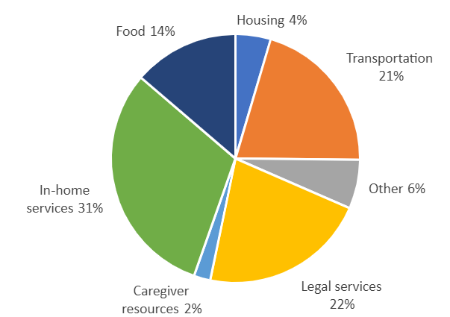
Progress on Addressing Social Determinants of Health after Hospitalizations
Patient Counseling by PCL
 | HICSA | Fontenelle | Midtown | Total
Patient contact attempted | 181 | 196 | 458 | 835
Patient reached (%) | 147 (81.2) | 139 (70.9) | 314 (68.6) | 600 (71.9)
Services Recommended | 14 | 29 | 50 | 93
Services
Recommended
Notes:
Overall, PCL attempted to call more than 800 patients from June 2020 to March, 2021 (10 months). Out of those attempted, 600 patients received counseling services by PCL, and 93 services were arranged by working with Area of Aging Services.
In-home services were recommended the most, followed by legal services (22%) and transportation services (21%).
Patients’ providers were also receiving notes (close the loops)

Slide 43
30-Day All-Cause Hospital Readmission Age 65+
Emphasis on Transitional Care Svcs
Pandemic & PCL
Notes:
The graph shows 30-day readmission due to all causes at Fontenelle for patients over 65 years broken down by every 6-month intervals. Compared to the first and second 6 months in 2019 (9 and 12%, respectively), readmission rates were lower in the first and second 6 months in 2020 (9 and 5%).
Now I would like to hand over the slides to Dr. Kim for further explanations of these advancements.
If questions arise:
Given that PCL intervention started in the second half of the year 2020, it may show some potential impacts of interventions.

Slide 44
30-Day All-Cause Hospital Readmission Age 18-64
Emphasis on Transitional Care Svcs
Pandemic & PCL
Notes:
The graph shows 30-day readmission due to all causes at Fontenelle for patients over 65 years broken down by every 6-month intervals. Compared to the first and second 6 months in 2019 (9 and 12%, respectively), readmission rates were lower in the first and second 6 months in 2020 (9 and 5%).
Now I would like to hand over the slides to Dr. Kim for further explanations of these advancements.
If questions arise:
Given that PCL intervention started in the second half of the year 2020, it may show some potential impacts of interventions.

Slide 45
Recognizing Age Friendly Primary Care
You are recognized by the Institute for Health Improvement for addressing the 4Ms as part of Annual Wellness Visits
AFHS level 1: NM PCMH clinics led by Fontenelle, Dan Jeffrey and Shelley Baldwin
AFHS level 1: OneWorld, Inc led by Jessica Winter and Kris McVea.
AFHS Level 2: Requires reporting data for 3 months.

Slide 46
Follow-up Case Discussions
Comments welcome as presenters ready for the updates

