Slide 1
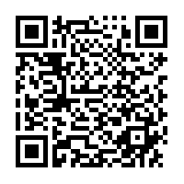
Nebraska GWEP Geriatrics Case Conference ECHO will begin at 12:15
As you join, please utilize the SIGN-IN LINK shared in
Chat to enter your name and e-mail address for
attendance or use this QR link
The didactic portion of today's conference will be recorded and available for viewing on our website following at: https://www.unmc.edu/NebraskaGWEP/
If you do not consent to recording, please disconnect at this time.

Slide 2
Welcome
Nebraska Geriatrics Workforce Enhancement Program welcomes you to our monthly Geriatrics Case Conference ECHO, held on the first Thursday of every month
All attendees, please use SIGN-IN LINK to note attendance or use this QR Link
Please mute during presentations and unmute yourself to speak during discussion
Share your feedback and ideas in follow-up surveys
Project ECHO® collects registration, participation, questions/answers, chat comments, and poll responses for some teleECHO® programs. Your individual data will be kept confidential. These data may be used for reports, maps, communications, surveys, quality assurance, evaluation, research, and to inform new initiatives.

Slide 3
This program is supported by the Health Resources and Services Administration (HRSA) of the U.S. Department of Health and Human Services (HHS) as part of an award totaling $749,813.00 with 0% financed with non-governmental sources. The contents are those of the author(s) and do not necessarily represent the official views of, nor an endorsement, by HRSA, HHS, or the U.S. Government. For more information, please visit HRSA.gov.
Attendance
QR Link

Slide 4
Nebraska GWEP Geriatrics Case Conference ECHO® Agenda
Thursday, Sept 2, 2021 12:15pm-1:15pm | Palliative and Hospice Care: What the PC Provider Needs to Know
Clinical Medical Director(s): | Jane F. Potter, MD, GWEP Program Director
Didactic Speaker(s): | Melissa Teply, MD
Case Submitted by: | Nebraska Medicine
Case Review Facilitator(s): | Melissa Teply, MD, Jane F. Potter, MD
Target Audience: | Physicians, Advanced Practice Providers, Pharmacists, RNs, Medical Assistants, Psychologists, Direct Care Workers, other healthcare providers
Clinical Objectives: | To educate community and rural healthcare providers in patient care, treatment and management of care for older patients. To expand access to specialty care in Nebraska.
Attendance
QR Link
Time | Didactic(s) / Case Based Discussion(s) | Speaker(s)
12:15pm - 12:20pm | Announcements and Introductions | Jane F. Potter, MD, GWEP Program Director
12:20pm – 12:40pm | Palliative Medicine: What the Primary Care Provider Needs to Know | Melissa Teply, MD
12:40pm – 1:15pm | Case Presentation and Discussion | Melissa Teply, MD
1:15pm | Closing Announcements | Jane F. Potter, MD, GWEP Program Director

Slide 5
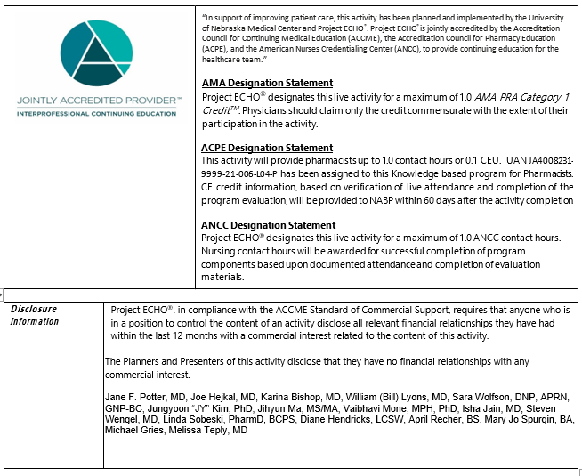

Slide 6
Nebraska GWEP Geriatrics Case Conference ECHO
“Palliative and Hospice Care: What the Primary Care Provider Needs to Know”
Melissa Teply, MD
September 2 , 2021

Slide 7
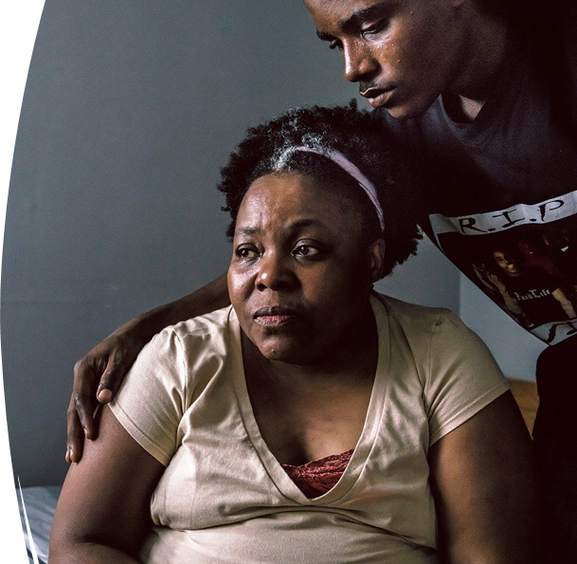
Geriatrics Workforce Enhancement Program (GWEP) 'Geriatrics Case Conferences'
Hospice and Palliative Medicine
Melissa Teply, MD
UNMC/Nebraska Medicine

Slide 8
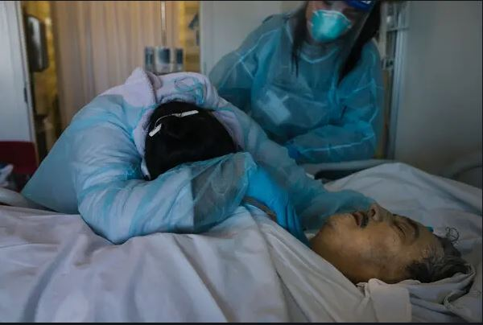
Serious Illness:
a health condition that carries a high risk of mortality

Slide 9
How do I bring up palliative care or hospice? When should I refer? (...To be honest, I still get the two confused at times...)

Slide 10
You mean hospice?
Palliative care?

Slide 11
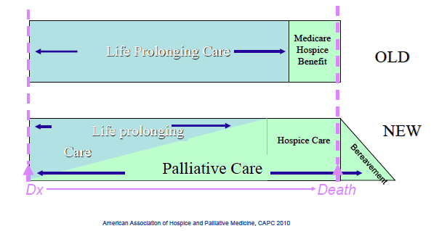

Slide 12
Palliative care
Both
Interdisciplinary team
Focus on quality of life
The “patient” is both the person with the illness and their family
Hospice

Slide 13
Palliative care
Both
Symptoms
Coping
Advance care planning
Legacy work
Hospice

Slide 14
Palliative care
Any stage of illness
Both
Symptoms
Coping
Advance care planning
Legacy work
Hospice
Less than 6 months to live

Slide 15
Palliative care
Any stage of illness
Can be delivered with curative or disease directed therapies
Both
Symptoms
Coping
Advance care planning
Legacy work
Hospice
Less than 6 months to live
No other disease directed treatments available or forego disease directed treatments

Slide 17
Patterson, Kerry. Crucial Conversations: Tools for Talking When Stakes Are High. New York: McGraw-Hill, 2012.

Slide 18
Key Themes
Control (opposing opinions)
Uncertainty (high stakes)
Trust (strong emotions)

Slide 19
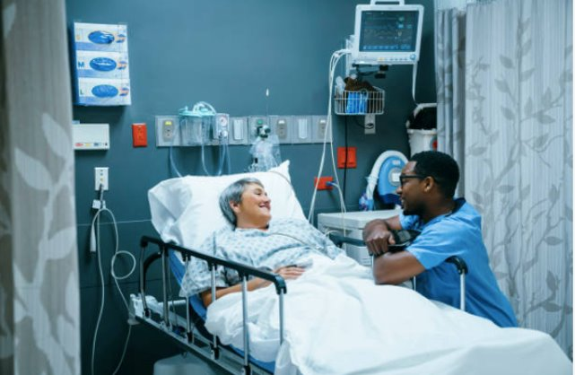
How do we typically handle
crucial conversations?​
We can avoid them.​
We can face them and handle them poorly.​
We can face them and handle them well.
Emotions tend to rule
Our bodies physically react
We are under pressure
We are stumped
Patterson, Kerry. Crucial Conversations: Tools for Talking When Stakes Are High. New York: McGraw-Hill, 2012.

Slide 20
Key Skills in Communication about Serious Illness
The Challenge | The Approach
I said the same thing to two patients, and they reacted completely differently | Meet the patient and family where they are at
Things are changing. I'm worried. The patient hasn't been ready to talk | Asking permission
I need to be honest, but I don't want to take away hope | Dose your language about bad news based on medical certainty
I'm not sure what to do next | Figure out what matters most & Make recommendations when it matters most

Slide 21
The Challenge: I said the same thing to two patients, and they reacted completely differently

Slide 22
If we could choose, what is the least bad way to die?

Slide 23
Die at home
Free from pain
In our sleep
Without being a burden
Notes:
We want to live until we die and skip the dying part or make it as short as possible

Slide 25
CANCER

Slide 26
“I’m not dying, and I only want to talk about the positive.”
Notes:
From the patient, or the family, or both

Slide 27
“I know I'm dying,
I don't know how to live
until then.”

Slide 28
“My pastor keeps praying for a miracle,
but I need help with reality.”

Slide 29
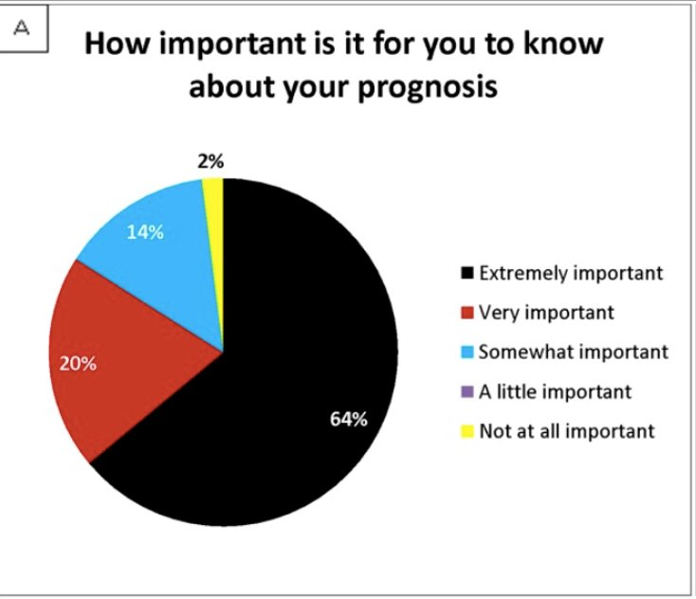
El-Jawahri. Associations among prognostic understanding, quality of life, and mood in patients with advanced cancer. Cancer 2013.
Photo credit: https://www.patientpop.com/blog/running-a-practice/patient-experience/5-strategies-for-dealing-with-problem-patients-and-when-you-should-let-them-go/

Slide 30
Wants to know prognosis (71%)
Does not want to know prognosis (29%)
Prognostic disclosure
(17.6%)
Communication need met
Potential for conflict
No prognostic disclosure
Unmet communication need
Potential distress for medical team
Enzinger. Outcomes of prognostic disclosure: associations with prognostic understanding, distress, and relationship with physician among patients with advanced cancer. J Clin Onc, 2015.
Gattellari. When the treatment goal is not cure: are cancer patients equipped to make informed decisions? J Clin Oncol, 2002.
Notes:
71% wanted to know life expectancy→67% of patients who had not reported disclosure of prognosis 17.6% reported a prognostic estimate
How do we avoid not making them depressed or sad or not liking us
Rhonda Cox here

Slide 31
General coping categories
Violence:
Resistance or Unrealistic Optimism
Silence:
Ambivalence
Ready to discuss
"Denial"
"I'm going to beat this"
"I only want to talk about the positive"
Shock
"Why me?"
Fixation on if things could have been different
Double back on previously agreed upon plans
Accepting/Realistic
"It is what it is"
"Tell me what I need to plan for"
Patterson, Kerry et al.. Crucial Conversations: Tools for Talking When Stakes Are High. New York: McGraw-Hill, 2012.
Notes:
And > But
Hope and worry

Slide 32
Son
Silent/Focused on dad
Wife
Tearful/Overwhelmed
Patient
Ambivalent
Intermittently open
Daughter
Ready to discuss
Most verbal in conversation
Daughter
Tearful/Avoidant
Notes:
Resistant
Avoidant
Ambivalent
Ready to discuss

Slide 33
Anxiety
Show curiosity about the patient and their inner thoughts
Anger
Shock
Frustration
Fear
Build a safe space for emotional expression
Fear and anxiety about the uncertain future
&
Grief over all the losses along the way
Overwhelmed
Recognize and name the emotions
Loss of control
Acknowledge the core experience driving the emotion
Shame around emotions
Prior trauma
Grief
Coping strategies and ongoing support

Slide 34
You can't force the conversation: Allow space for the patient and family to grieve
Disease Course | Emotional Course
Diagnosis | Shock & uncertainty about the future Loss of the expected future (travel, kids, what could have been)
Telling friends & family about the diagnosis | Loss of being treated "normal"
Starting disease directed treatments | Loss of routine; Inability to plan
Progression of symptoms/disease | Loss of health Loss of normal appearance
Further progression in later stages | Loss of function Loss of independence
Terminal stage | Fear of dying Fear of being dead (missing out on life)
Life isn't normal anymore
Parkes, CM. Coping with loss: the dying adult. BMJ. 1998 Apr 25; 316(7140): 1313–1315.

Slide 35
The Approach:
Meet the patient and family where they are at
Notes:
And > But
Hope and worry

Slide 36
You can’t force a conversation that a person isn’t ready to have
Notes:
And > But
Hope and worry

Slide 37
You can't force the conversation
Resistance
Ambivalence
Ready to discuss
Build trust
Consistent information
Resist the righting reflex
Roll with resistance
Pollak. Applying motivational interviewing techniques to palliative care communication. J Pall Med, 2011.
Notes:
And > But
Hope and worry

Slide 38
The Challenge: Things are changing. My patient is getting sicker. I'm worried. The patient hasn't been ready to talk.

Slide 39
EMOTIONAL
Cherry, Kendra. Emotions and Types of Emotional Responses: The 3 Key Elements That Make Up Emotion. https://www.verywellmind.com/what-are-emotions-2795178. Last updated July 17, 2019.

Slide 40
The Approach:
Asking permission
Notes:
And > But
Hope and worry

Slide 41
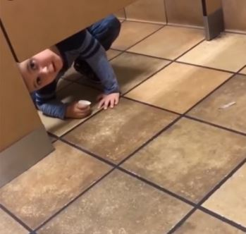
Would it be okay if I share how I am thinking through this?
Gives the patient the chance to say no
If they don't want to talk, then you can ask who we should talk to or when to follow up
Allows you to speak more plainly

Slide 42
When they’re not ready to talk…
How urgent is the conversation?

Slide 43
When they’re not ready to talk…
How urgent is the conversation?
Not urgent
Somewhat urgent but not critical
Emergent, patient is declining quickly

Slide 44
When they’re not ready to talk…
How urgent is the conversation?
Not urgent
Set a time for follow up

Slide 45
When they’re not ready to talk…
How urgent is the conversation?
Somewhat urgent but not critical

Slide 46
When they’re not ready to talk…
How urgent is the conversation?
Somewhat urgent but not critical
I’m worried about how things are going. Could we talk about the bigger picture?

Slide 47
When they’re not ready to talk…
How urgent is the conversation?
Somewhat urgent but not critical
I’m worried about how things are going. Could we talk about the bigger picture?
Yes
Discuss necessary information

Slide 48
When they’re not ready to talk…
How urgent is the conversation?
Somewhat urgent but not critical
I’m worried about how things are going. Could we talk about the bigger picture?
No, I just can’t right now
Set a time for follow up

Slide 49
When they’re not ready to talk…
How urgent is the conversation?
Emergent, patient is declining quickly

Slide 50
When they’re not ready to talk…
How urgent is the conversation?
Emergent, patient is declining quickly
I’m very worried about you/your loved one. I need to speak as plainly as possible. Is that okay?

Slide 51
When they’re not ready to talk…
How urgent is the conversation?
Emergent, patient is declining quickly
I’m very worried about you/your loved one. I need to speak as plainly as possible. Is that okay?
Discuss necessary information

Slide 52
When they’re not ready to talk…
How urgent is the conversation?
Not urgent
Somewhat urgent but not critical
Emergent, patient is declining quickly
Set a time for follow up
I’m worried about how things are going. Could we talk about the bigger picture?
I’m very worried about you/your loved one. I need to speak as plainly as possible. Is that okay?
Yes
No, I just can’t right now
Discuss necessary information
Discuss necessary information
Set a time for follow up

Slide 53
You Can't Force the Conversation
Resistance or Unrealistic Optimism
Ambivalence
Ready to discuss
Asking permission
Exploring possibilities
Pollak. Applying motivational interviewing techniques to palliative care communication. J Pall Med, 2011.
Notes:
And > But
Hope and worry

Slide 54
The Approach:
Asking permission
Can we talk about the big picture and what I'm worried about?
Can we talk about a plan B if things don't go as hoped?
Notes:
And > But
Hope and worry

Slide 55
The Challenge: I want to be honest, but I don't want to take away hope.

Slide 56
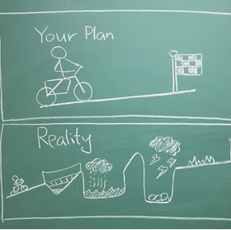
What patients expect from us:
Fix it (cure)
Be honest if you can't fix it
Listen to their concerns (partner with them)
Be ready to make a recommendation (and also be understanding if they don't take your recommendation)
Do the best you can for their comfort throughout the illness
https://nrchealth.com/10-things-patients-want-from-their-doctors/. April 14, 2016.​
Stone, M. What patients want from their doctors. BMJ 2003.​
https://chironhealth.com/blog/patients-really-want-doctors/. February 19, 2018.

Slide 57
The Approach:
Dose your language about bad news based on medical certainty and timing in the disease course
Notes:
And > But
Hope and worry

Slide 58
Where are we in the disease course? | Medical Certainty | News to the patient and family
Notes:
And > But
Hope and worry

Slide 59
The Approach:​
Dose your language about bad news based on medical certainty and disease course
Where are we in the disease course? | Medical Certainty | News to the patient and family
Early |  | At some point, this will likely take your life.
Middle OR Super rough start |  | I'm worried you are nearing the end of your life.
Late |  | I'm worried that time is short no matter what we try to do/in spite of our best efforts.
Notes:
And > But
Hope and worry

Slide 60
The Approach:​
Dose your language about bad news based on medical certainty and disease course
Where are we in the disease course? | Medical Certainty | News to the patient and family
Early | I'm worried your loved one might not survive this illness.
Middle OR Super rough start | In spite of our best efforts, I'm worried that things aren't working as hoped and we are running out of options to fix this.
Late | I'm worried your loved one is dying no matter what we do.
Notes:
And > But
Hope and worry

Slide 61
The Challenge: I'm not sure what to do next.

Slide 62
History of medical decision making
Notes:
And > But
Hope and worry

Slide 63
Here are the options. Let me know what you want to do.

Slide 64
History of medical decision making
Notes:
And > But
Hope and worry

Slide 65
The Approach:
Figure out what matters most
&
Make recommendations when it matters most
Notes:
And > But
Hope and worry

Slide 66
Given what we have talked about, what is most important to you about how we move forward from here?

Slide 67
“We never stop hoping, we just change what we hope for.”
Cure
More time
Comfort
Peaceful death
Drews, MF. The evolution of hope in patients with terminal illness. Nursing 2019: January 2017 - Volume 47 - Issue 1 - p 13–14

Slide 68
Given what you just told me, can I make some recommendations?

Slide 69
Where are we in the disease course? | Medical Certainty | Course of Action
Notes:
And > But
Hope and worry

Slide 70
Where are we in the disease course? | Medical Certainty | Course of Action
Early disease course | Disease directed medical intervention is likely to help | Pursue the medical intervention
Notes:
And > But
Hope and worry

Slide 71
Where are we in the disease course? | Medical Certainty | Course of Action
Early | Disease directed medical intervention is likely to help | Pursue the medical intervention
Middle | Unclear if disease directed intervention is likely or unlikely to help | Pursue disease directed interventions until it's clear all options have been exhausted or stop at any point that the interventions are not in line with the patient's wishes
Notes:
And > But
Hope and worry

Slide 72
Where are we in the disease course? | Medical Certainty | Course of Action
Early | Disease directed medical intervention is likely to help | Pursue the medical intervention
Middle | Unclear if disease directed intervention is likely or unlikely to help | Pursue disease directed interventions until it's clear all options have been exhausted or stop at any point that the interventions are not in line with the patient's wishes
Late | No further disease directed or life prolonging intervention is likely to help | Recommendation to focus entirely on comfort
Notes:
And > But
Hope and worry

Slide 73
It's about connection, not perfection.
- Dr. Keri Brenner
​Be a connectionist, not a perfectionist.​
- Mel Teply
​ "It's about connection, ​ not perfection"​ ​ - Dr. Keri Brenner​

