Slide 1
Nebraska GWEP Geriatrics Case Conference ECHO
“Diabetes and your older patients”
Natalie Manley, MD
October 7, 2021

Slide 2
This program is supported by the Health Resources and Services Administration (HRSA) of the U.S. Department of Health and Human Services (HHS) as part of an award totaling $757,483.00 with 0% financed with non-governmental sources. The contents are those of the author(s) and do not necessarily represent the official views of, nor an endorsement, by HRSA, HHS, or the U.S. Government. For more information, please visit HRSA.gov.

Slide 3
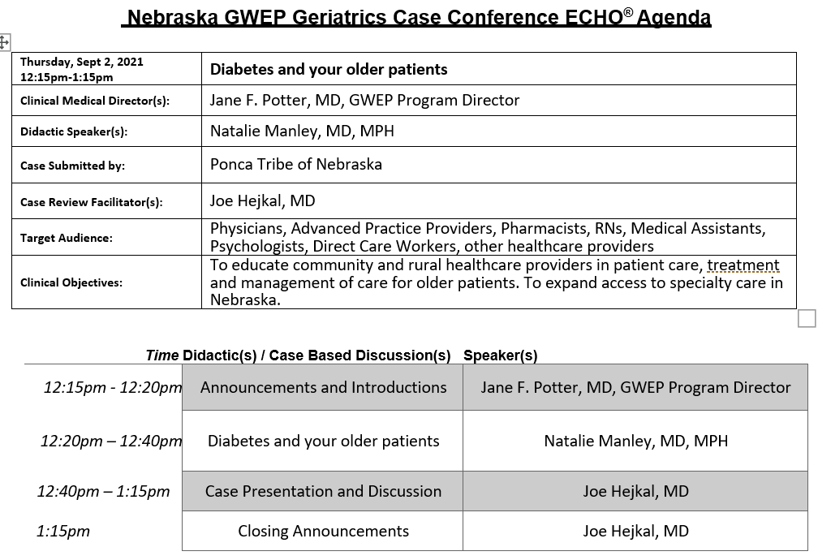

Slide 4
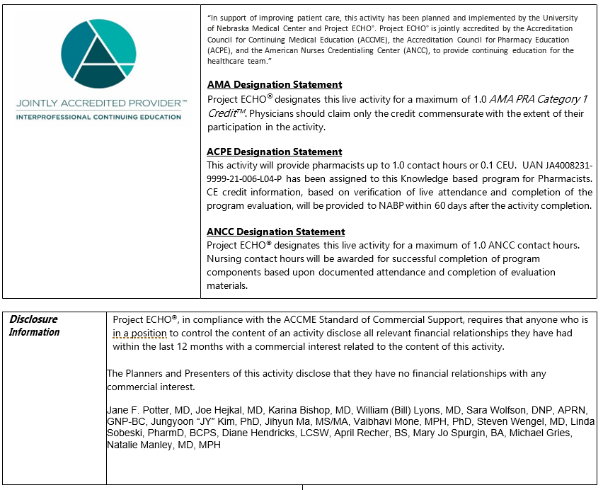

Slide 5
Diabetes Management in Older Adults— A Review of American Geriatrics Society Recommendations
Natalie Manley, MD, MPH

Slide 6
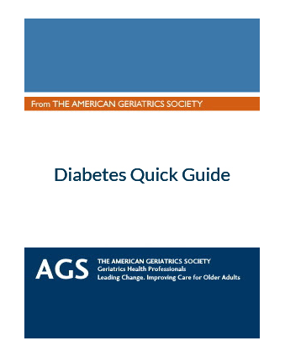
adapted from Finding the Sweet Spot: an interactive workshop on diabetes management in older adults (Triantafylidis LK, Phillips SC, Hawley CE, Schwartz AW. Finding the Sweet Spot: An Interactive Workshop on Diabetes Management in Older Adults. MedEdPORTAL. 2019;15:10845. Published 2019 Oct 18. doi:10.15766/mep_2374-8265.10845).
Triantafylidis LK, Phillips SC, Hawley CE, Schwartz AW. AGS Quick Guide to Diabetes Management in Older Adults. New York, NY: American Geriatrics Society. Available at: http://geriatricscareonline.org

Slide 7
Goals
• Develop individualized glycemic goals for the treatment of older adults with diabetes
• List safety and efficacy characteristics of antihyperglycemic agents in older adults
• Implement geriatric prescribing and deprescribing principles for antihyperglycemic agents

Slide 8
Introduction—Look for the “sweet spot”
Diabetes is very common among older adults
Intensive glucose lowering can lead to excessive risk for hypoglycemia and potentially falls
Many older adults do not have enough remaining life expectancy to benefit from microvascular risk reduction
Therefore, for many older adults, the harms of intensive glucose lowering may outweigh the benefits.
The “sweet spot” of safe management of diabetes in older adults should consider hemoglobin A1c (A1c) goals that are individualized based on age, comorbid conditions, and remaining life expectancy.

Slide 9
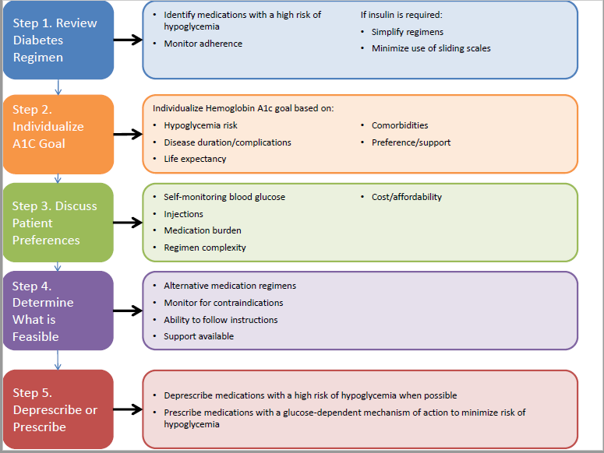

Slide 11
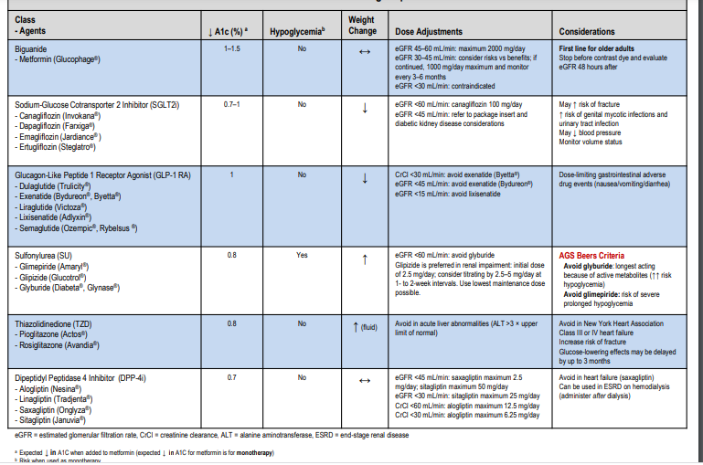

Slide 12
Insulin Pearls
• Lower insulin doses are required with decreased eGFR (titrate to effect).
• Insulins with higher risk of hypoglycemia:
o Insulin NPH
o Insulin regular
o Mixed formulations (i.e., insulin NPH and regular 70/30)
• Consider insulin if A1C ≥10%
• Educate patients on the importance of a consistent diet while on insulin and the dangers of skipping a meal
• AGS Beers Criteria: Avoid sliding-scale insulin because of a higher risk of hypoglycemia without improvement in hyperglycemia management regardless of care setting
• Strategies to minimize hypoglycemic risk:
o Patient education
o Frequent self-monitoring of blood glucose
o Flexible and rational insulin regimens
o Individualized glycemic goals
o Ongoing monitoring and support

Slide 14
Quick points
• Individualized A1c goals will help to guide both blood glucose goals and medication choices
• A1c may not be an accurate measure of glycemic control in frail older adults with multiple comorbidities1
• Higher A1c goals do not protect against hypoglycemia for older adults on insulin therapy
• When the A1c goal is less stringent, fasting, prandial, and nocturnal glucose targets should also be relaxed

Slide 15
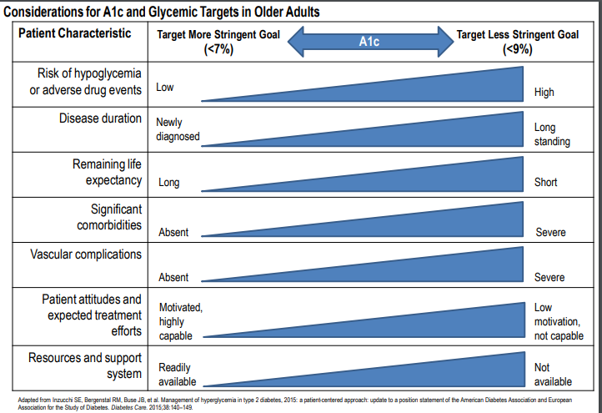

Slide 16
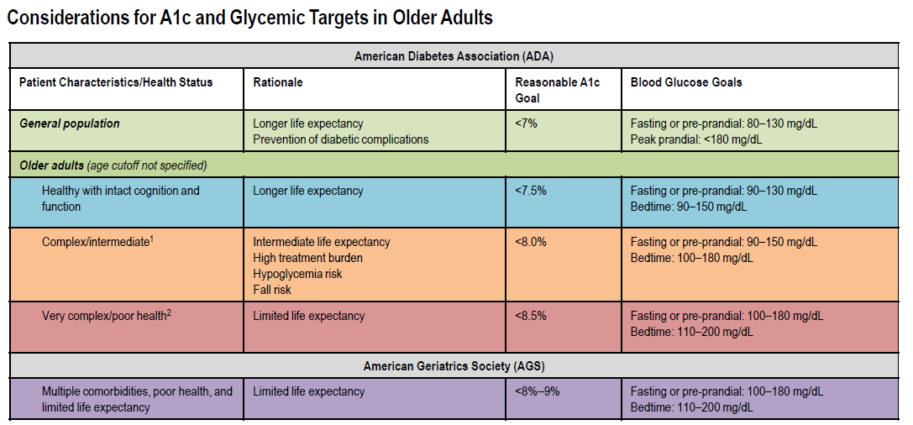
NOTE: The patient characteristic categories are general concepts; not every patient will clearly fall into a particular category. Patient and caregiver preference should be considered for individualized glycemic goal setting. The ADA does not recommend A1c targets >8.5% because they may expose the patient to more frequent higher glucose values and subsequently acute risks (glycosuria, dehydration, hyperglycemia hyperosmolar syndrome, or poor wound healing). 1. At least 3 coexisting chronic illnesses (conditions serious enough to require medications or lifestyle management and may include arthritis, cancer, congestive heart failure, depression, emphysema, falls, hypertension, incontinence, stage 3 or worse chronic kidney disease, myocardial infarction and stroke) or 2+ instrumental ADL impairments or mild-to-moderate cognitive impairment; 2 LTC or the presence of a single end-stage chronic disease illness (stage 3-4 congestive heart failure or oxygen dependent lung disease, chronic kidney disease requiring dialysis, or uncontrolled metastatic cancer) or moderate-to-severe cognitive impairment or 2+ ADL dependencies.

Slide 18
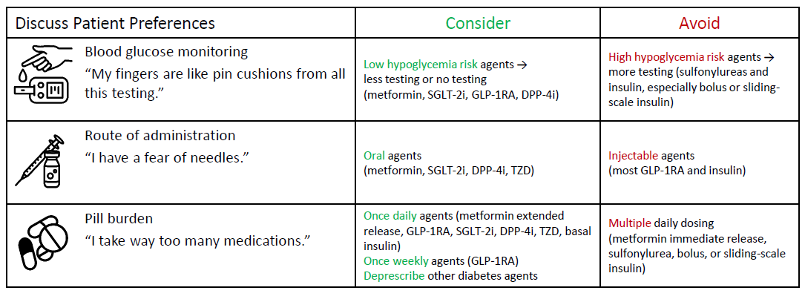

Slide 20
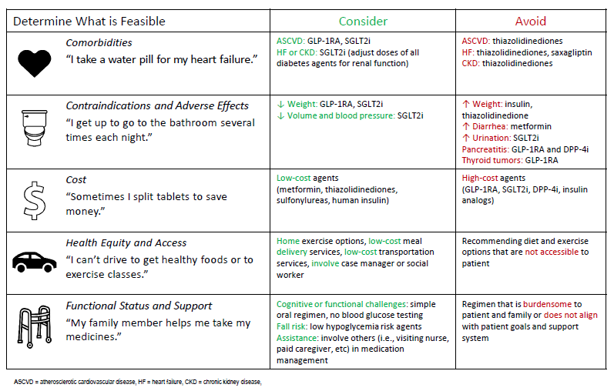

Slide 22
