Slide 1
Geriatric considerations in thyroid disease
Mandy Byers MD, CMD

Slide 2
Objectives
Brief review of the thyroid gland and normal changes with age
Evaluation and management of thyroid disease in the elderly
Hypothyroidism
Hyperthyroidism
Nodular Thyroid Disease

Slide 3
Thyroid anatomy
The thyroid is usually a butterfly shaped endocrine gland located at the front of the neck below the laryngeal prominence (Adam’s apple).
It is composed of two lobes connected by a band of tissue referred to as the isthmus. Pyramidal lobe variation occurs.
It is covered by a thin fibrous capsule with two layers.
The inner layer extrudes into the gland and forms septae which divide the thyroid into nodules.
The outer layer attaches the gland to the cricoid and thyroid cartilages which cause the thyroid to move up and down with swallowing.

Slide 4
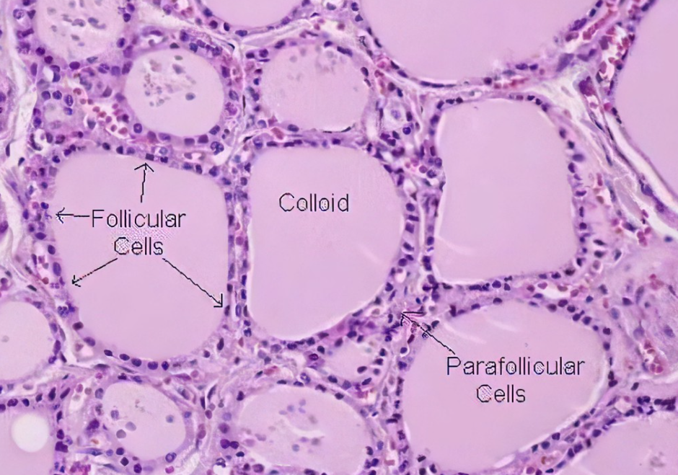
Thyroid Histology
Thyroid Follicle
Main functional unit of the thyroid
Made up of a rim of follicular cells with vascular, nerve and lymphatic supply surrounding a core of colloid
Colloid is made up of the thyroid hormone precursor protein called THYROGLOBULIN (an iodinated glycoprotein)
Parafollicular Cells (C Cells) are interspersed among the follicles
secrete Calcitonin which opposes parathyroid hormone in regulation of calcium homeostasis

Slide 5
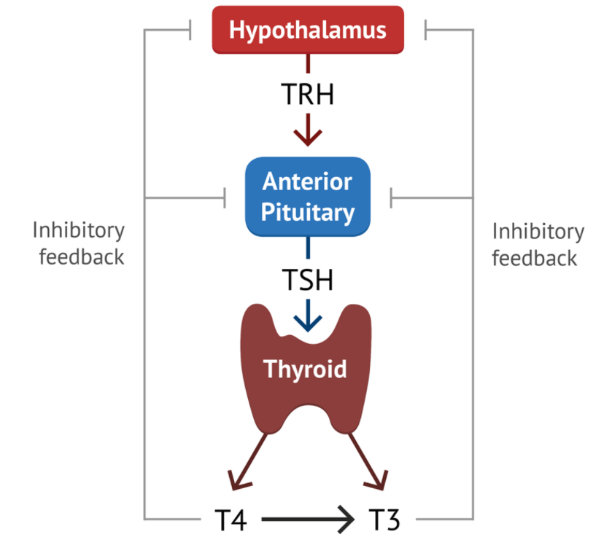
Thyroid Hormone Regulation
The hypothalamus produces Thyrotropin Releasing Hormone (TRH) which signals the anterior pituitary to release Thyrotropin also known as Thyroid Stimulating Hormone (TSH)
TSH circulates in the blood and signals the Thyroid follicular cells to metabolize thyroglobulin within the colloid and secrete Thyronine (T4) and Triiodothyroinine (T3)
T3 and T4 act as inhibitory feedback to both the hypothalamus and the anterior pituitary in hormone regulation.

Slide 6
T3 & T4 physiological effects
Neuro: nervous system development and function, myelinization
Pituitary: TSH production, growth hormone regulation
Heart/vascular: cardiac output, heart rate, peripheral vasodilation
Muscle: protein catabolism, energy expenditure
GI/Liver: mitosis, gluconeogenesis, fatty acid/cholesterol synthesis, cholesterol metabolism, part of appetite and gastric motility regulation
Skeletal System: growth and maturation, bone resorption
Respiratory: Rate and depth of respirations, lung development and surfactant production
Adipose tissue: lipolysis (metabolizing fat)
Metabolic: oxidative metabolism regulation
Skin: growth and maturation of the epidermis and hair follicles

Slide 7
The normal aging Thyroid
T4 levels remain effectively unchanged
Decreased T4 secretion is balanced by decreased clearance
T3 levels are unchanged until extreme old age
Distribution of TSH concentration shifts toward a higher baseline level
Screening for thyroid disease in the elderly is recommended

Slide 8
Diagnostic challenges
Older adults often present with nonspecific, muted or atypical symptoms and many have no complaints at all
Lab evaluation is often complicated by coexisting illness and medications
“Normal” ranges do not necessarily reflect what is normal for the elderly
Higher prevalence of biochemical hypothyroidism in older persons.

Slide 9
Hypothyroidism
Overt hypothyroidism occurs in 0.5% to 5% of older adults
Most cases are due to chronic autoimmune thyroiditis
Symptoms are often atypical with an insidious onset and slow rate of progression and can overlap with other pathology
Dry skin, decreased skin turgor, slowed mentation, weakness, constipation, anemia, hyponatremia, arthritis, paresthesia, gait disturbances.

Slide 10
Hypothyroidism
Mild hypothyroidism in an acutely ill elder can quickly progress to severe hypothyroidism increasing susceptibility to myxedema
Lab testing necessary as symptoms are often atypical with an insidious onset and slow rate of progression and can overlap with other pathology in multimorbid individuals

Slide 11
Subclinical Hypothyroidism
Elevated TSH, normal free T4 levels
Occurs in 15% of people age 65+, more common in women
T4 supplementation (levothyroxine) in older adults with mildly elevated TSH has limited clinical benefit and may be harmful
May follow clinically monitoring TSH and Free T4 q 6 months until stable
TSH levels persistently ≥ 10mIU/L are at increased risk of congestive heart failure and cardiovascular mortality regardless of age and may be treated though unknown if treatment reverses risks

Slide 12
T4 replacement
Mild hypothyroidism (usually ambulatory/LTC setting)
Start at low dose (25mcg/day) increase q 4-6 weeks
In patient with significant ASCVD begin at lower dose (12.5mcg/day)
Severe hypothyroidism / Myxedema (inpatient)
Stress dose steroids
50-200 mcg/day IV daily until patients can tolerate PO
Target TSH level 4-7mIU/L
Monitor for necessary dose adjustments of other meds – anticonvulsants, digoxin, opiate analgesics

Slide 13
Hypothyroidism in nonthyroidal illness
Increased TSH is usually due to primary hypothyroidism but can be transiently increased during recovery from acute illness
Sick Euthyroid occurs in persons without pre-existing hypothalamic-pituitary and thyroid gland dysfunction
Confirm Hypothyroidism over time with TFTs
Low T4 Syndrome: low total T4, Free T4 normal, normal TSH in patients with severe nonthyroidal illness – Euthyroid
Low T3 Syndrome: Most common alteration in TFTs in even mild nonthyroidal illness
Secondary hypothyroidism: occurs in hypopituitarism (normal or low TSH and low free T4)

Slide 14
hyperthyroidism
Graves disease is the most common etiology among older adults
Triples the risk of developing Atrial Fibrillation within 10 years, and present in 13-30% of older people with Afib
Causes secondary osteoporosis and should be suspected in patient with low bone mineral density

Slide 15
hyperthyroidism
Common features on presentation in the elderly
Afib, heart failure, weight loss, muscle atrophy, weakness
Apathetic thyrotoxicosis
Depression, inactivity, lethargy, withdrawn behavior
Anorexia, weight loss, constipation, muscle weakness, cardiac symptoms

Slide 16
Subclinical hyperthyroidism
Low TSH with normal Free T4 and T3 (2% of older adults without known thyroid disease)
Low TSH shown to be associated with cognitive impairment and dementia, unknown whether treatment can prevent cognitive decline
Associated with A Fib
Accelerated BMD loss

Slide 17
Hyperthyroidism treatment
Treatment recommended if TSH < 0.1mIU/L and considered in older adults with TSH levels 0.1-0.45 mIU/L
May reduce risk of a fib and mortality risk
Radioactive Iodine (RAI) is the treatment of choice for Graves or toxic nodular thyroid disease, high or repeated doses may be necessary in older persons
Antithyroid drugs may be given before RAI to control symptoms
Post RAI measure TSH levels regularly to monitor for eventual development of hypothyroidism or recurrence of hyperthyroidism

Slide 18
Nodular thyroid disease
Incidence of multinodular goiter increases with age
Nodules present in approx. 90% of women ≥ 70 & 60% of men ≥ 80
Most are benign, but solitary nodules more likely to be malignant in the older patients, Males > Females
Exogenous suppression of hot nodules may cause iatrogenic hyperthyroidism
Be aware of risk of iodine-induced thyrotoxicosis in older persons with multinodular goiter so caution with contrast/amiodarone

Slide 19
summary
Screening TSH appropriate for asymptomatic older adults
Must follow up abnormal TSH with TFTs – Free T4
Measure TSH and Free T4 for symptomatic elderly
Recognizing that symptoms may be vague and insidious, so low threshold to test
Be cautious with initiation of hormone replacement
Shoot for a target TSH in the 4-7 mIU/L in older patients

Slide 20
Thank you

