Slide 1
What is Telemedicine?
Abigale Miller
Medical Student
Emily Jezewski
Medical Student
ENOA and GWEP – UNMC

Slide 2
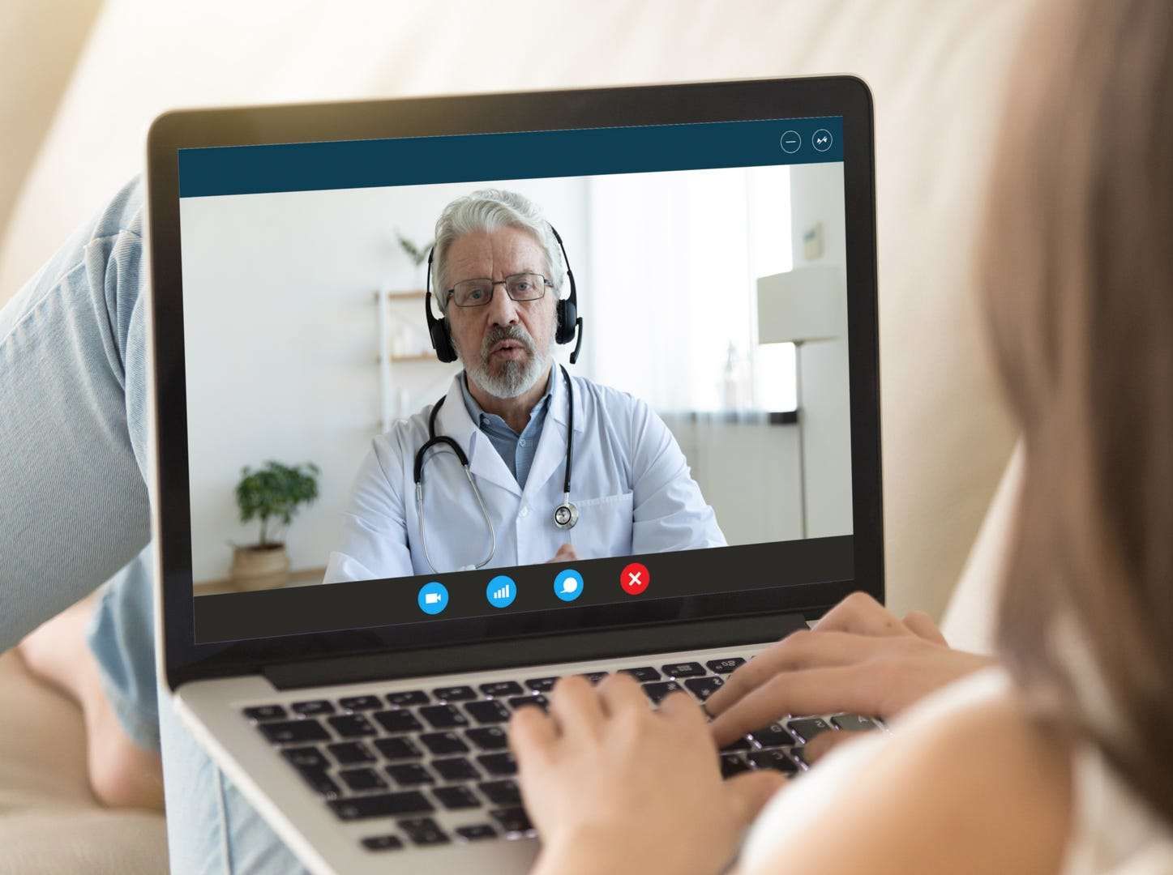
Are you confused about Telemedicine?
What even is telemedicine?
A way to connect with you doctor from your home via
PHONE
COMPUTER/LAPTOP
TABLET

Slide 3
Can I use telemedicine for a...
Sore throat?
Feeling blue?
Prescription renewal?
Annual Physical?
Sinus Infection?
Earache?
Allergies?
YES!
You can use telemedicine for all of this and MORE!

Slide 4
Who Can I See?
Primary Care!
Mental Health Providers
Psychiatry
Counseling
Specialists
Dermatology
Cardiology
Geriatricians
Allergists

Slide 5
How does telemedicine work?
Different at all doctor's offices, but still simple to use!
First – Call your doctor
Tell them what you need to be seen for. Tell them you do not feel comfortable going to clinic and want to be seen at home.
Your doctor's office will schedule you an appointment and give you directions

Slide 6
How do I prepare for my telemedicine visit?
What Device do you have?

Slide 7
If you have a computer or laptop...
1. Does your computer or laptop have a camera?
You will likely need to download zoom! -- more information to come later
No camera
You may need to use a cell phone or a landline!

Slide 8
Do you have a smart phone? Such as an iPhone or an Android?
You will likely need to download zoom!
More directions soon!
If you have an iPhone, your doctor may suggest FaceTime
In this instance, they will call you on your iPhone at your scheduled appointment time
This will be a video call and you will be able to see your provider!

Slide 9
Do you have a tablet? Such as an iPad
You will likely need to download Zoom!
Your provider may call you over FaceTime, if they prefer that

Slide 10
Do you have a cellphone or landline?
Your doctor will call you at your scheduled appointment time!

Slide 11
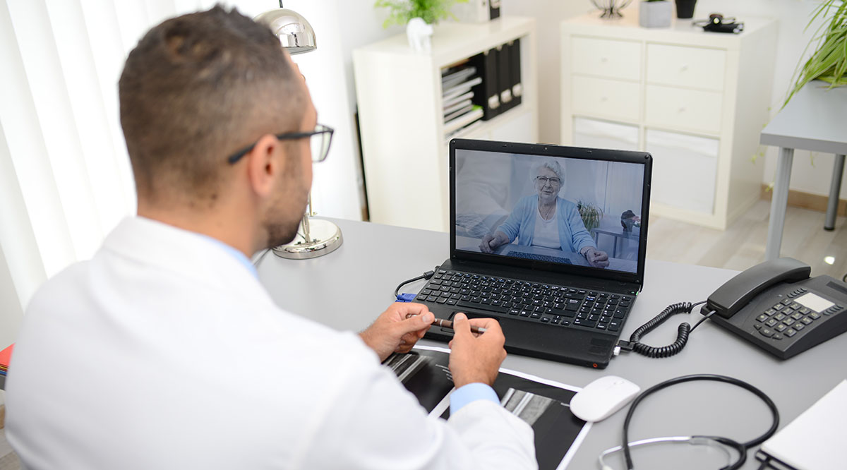
What is Zoom?
Zoom is an application that can be used on a computer or a smartphone/tablet
Zoom allows you talk face to face with your doctor through video chat.
Note: While many doctors and hospitals use zoom for telehealth visits, it is not the only application used. Others used include: Teladoc, MDLIVE, Skype, and Google Hangouts

Slide 12
Do telemedicine visits cost money?
Yes
Almost all visits are covered by Medicare and Medicaid
If you have specific questions about coverage, you should contact your doctor or insurance provider
You may also contact Senior Health Information Insurance Program (SHIIP) 1-800-234-7119

Slide 13
Is Telemedicine Safe?
Telemedicine is VERY SAFE.
The only people who will see your health information is the doctor and their staff.
All the communication methods use SECURE, SAFE, networks and phone lines that allow you to talk to your doctor.

Slide 14
Is Telemedicine private?
Your information will NEVER be shared.
Your visits are PRIVATE!
The only people who have access to your doctor's visit is the you, the doctor, and whoever YOU choose to be there.
Yes – All visits are HIPPA compliant.

Slide 15
Thank you!
Feel free to reach out to use via email: Emily.Jezewski@unmc.edu
Abigale.miller@unmc.edu
This publication is supported by the Health Resources and Services Administration (HRSA) of the U.S. Department of Health and Human Services (HHS) as part of an award totaling $90,625 with 0% percentage financed with non--governmental sources. The contents of those of the authors and do not necessarily represent the official views of nor an endorsement, by HRSA, HHS, or the U.S. Government

