Slide 1
Things that go UP and
Things that go DOWN
Common lab tests where age makes a difference in how we diagnose disease
J Potter
2/3/2022
No conflicts
Do NOT blame HRSA for any errors

Slide 2
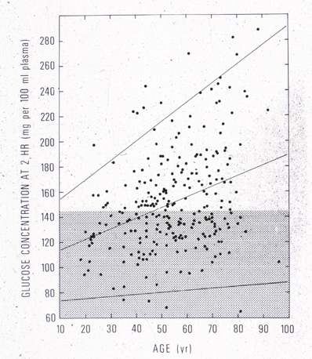
Background
2-Hour Post Prandial glucose levels
We are most like each other when we are young
We become more different as we age.
Heterogeneity is the rule
We can only speak about average or usual changes
+ 2 SD
- 2 SD

Slide 3
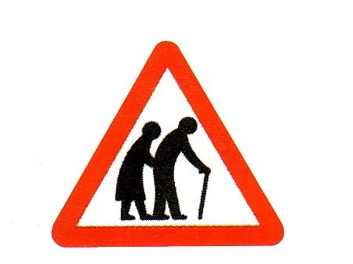
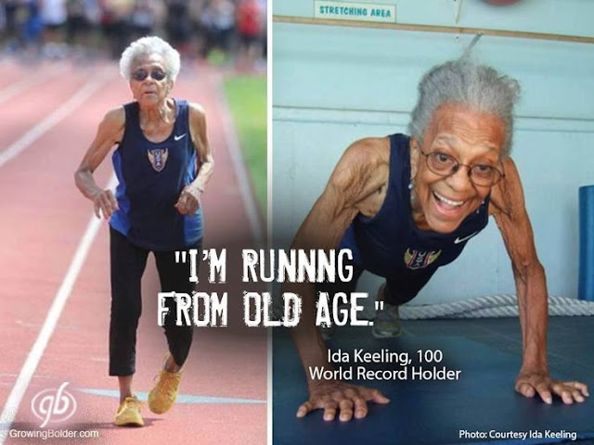
Variability with AGE and with FRAILTY
Notes:
Some of this variability is explained by frailty. For many lab values, frail vs robust/healthy older people is quite different. Frail have more abnormalities.

Slide 4
Which of the following goes UP with age?
A. Serum B-12
B. Post-prandial Insulin
C. Inflammatory markers
D. Serum creatinine
Notes:
Serum B-12 goes down with age, as soes post prandial insulin, while serum Cr does not change with age.
Today we focus on common clinical measures where age influences how we interpret a given test in diagnosis of a disease and avoid diagnosing a problem when none exist

Slide 5
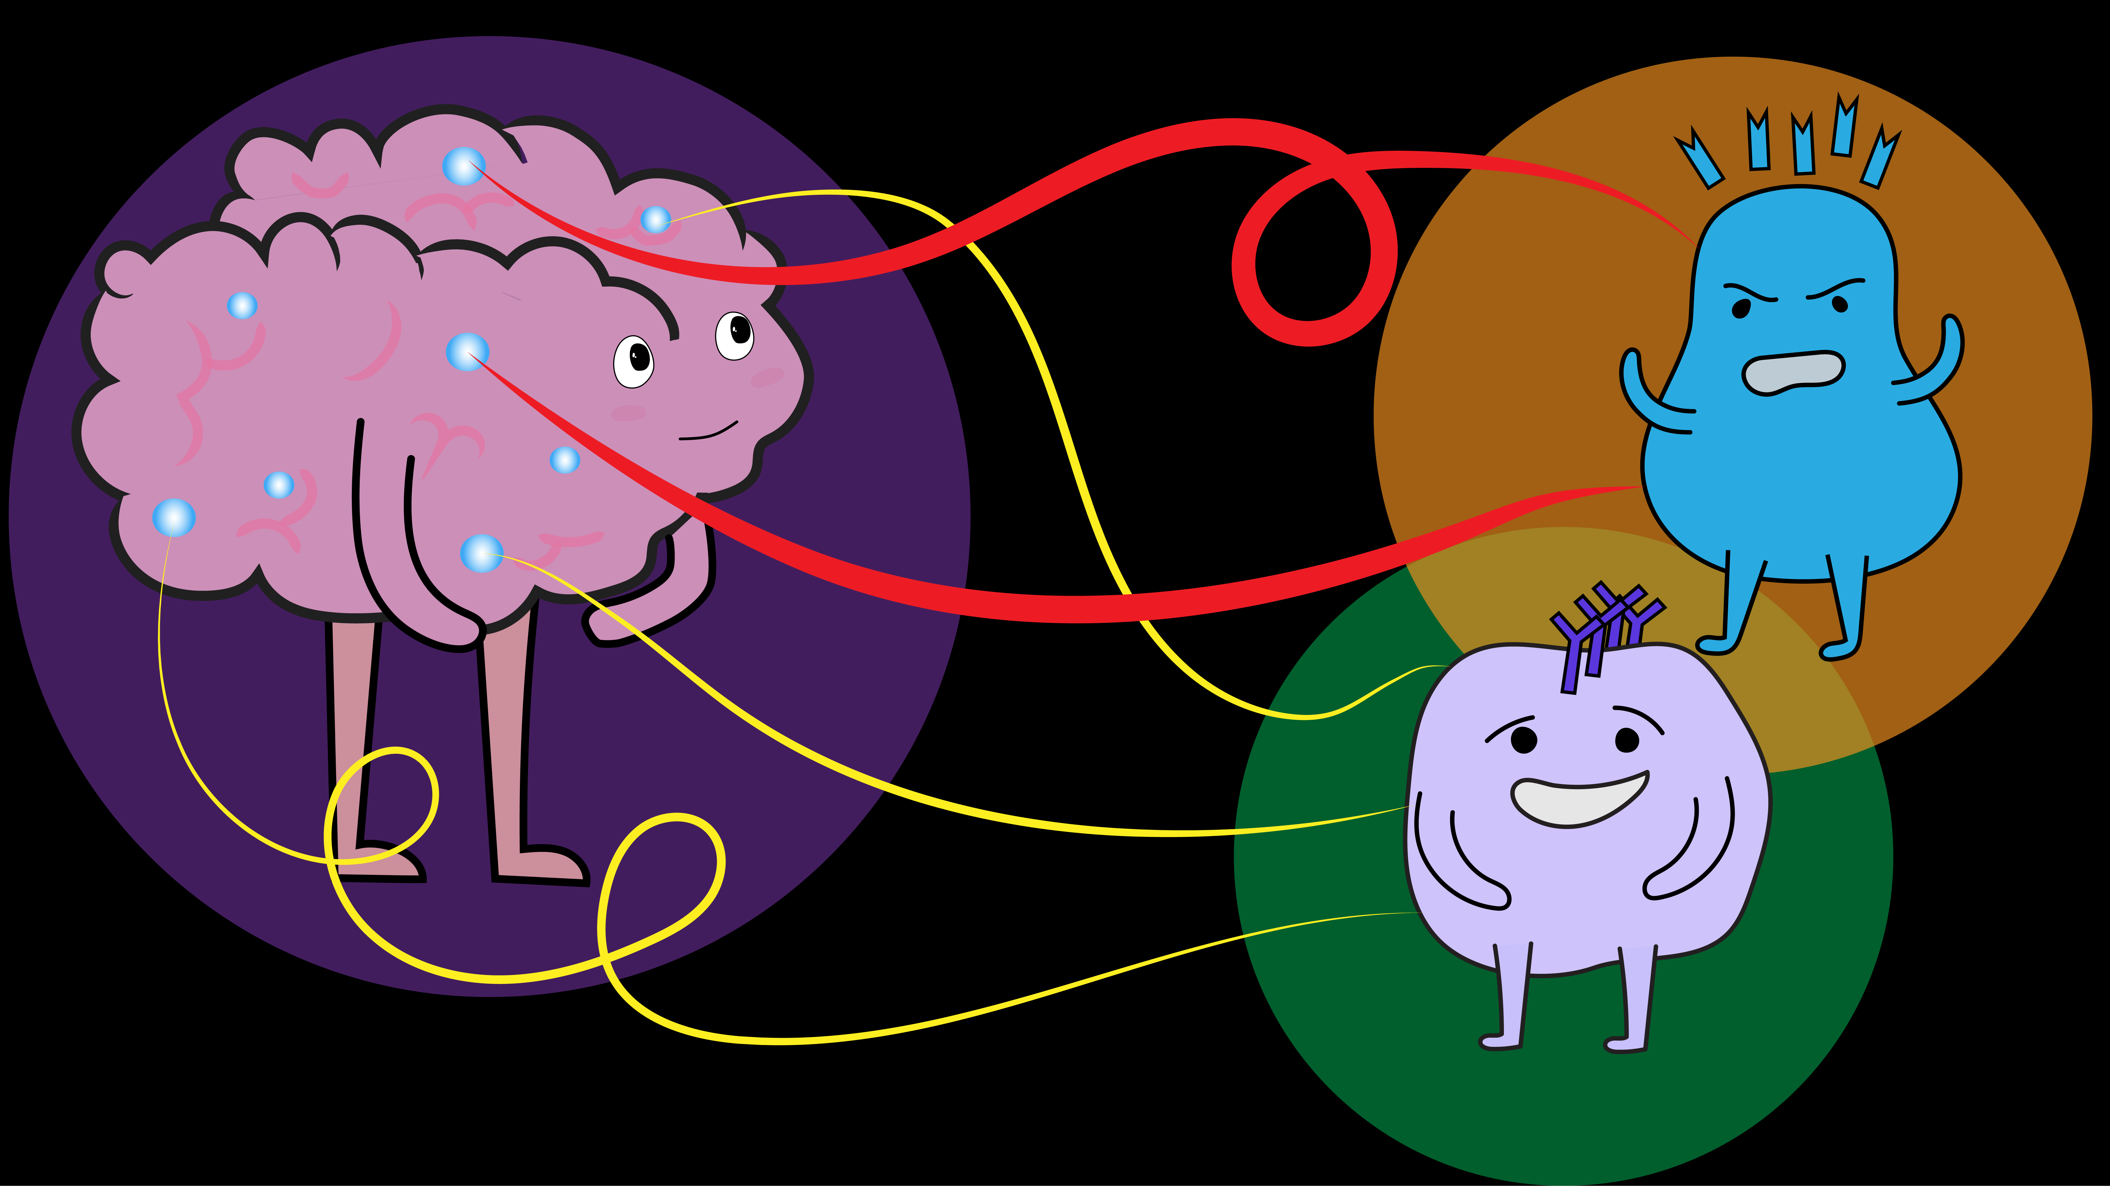
Effects of Increased Inflammation on Lab Studies
  Increase ESR*
  upper limit of normal for age:
  ♀ (age+10)/2 ; ⚨ age/2
  Increase CRP
  NOT out of the usual lab limits but in the upper normal range
  Increase D-Dimer
  upper limit = age x10
  Increase Alkaline phosphatase
  Not more than twice normal
Notes:
ESR PMR
CRP CV risk
D Dimer PE

Slide 6
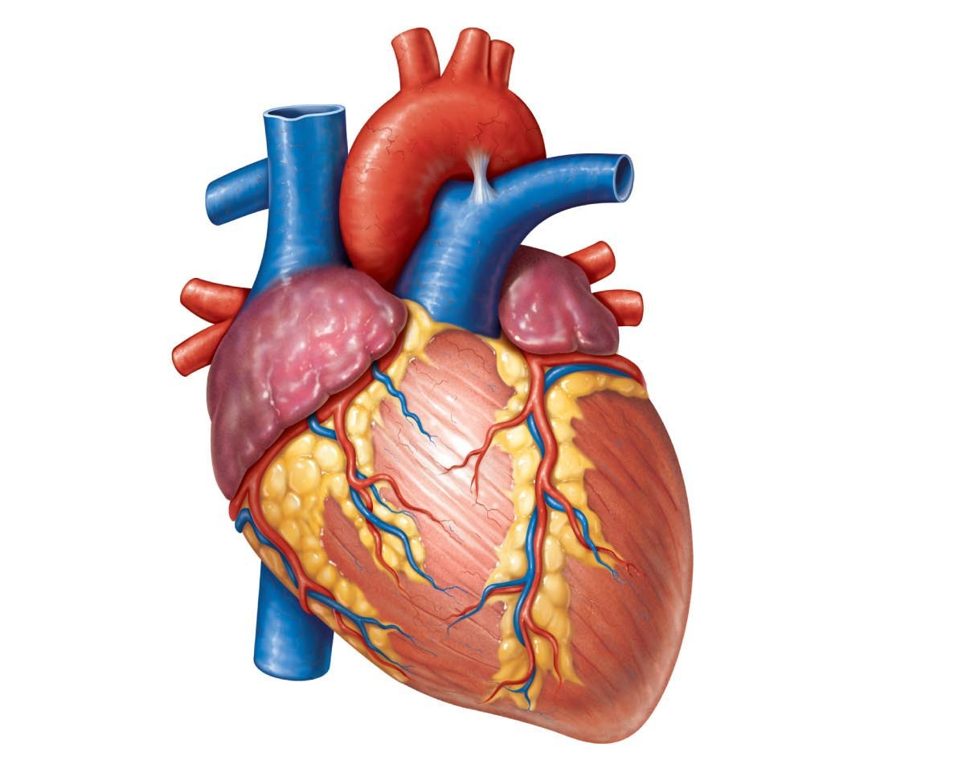
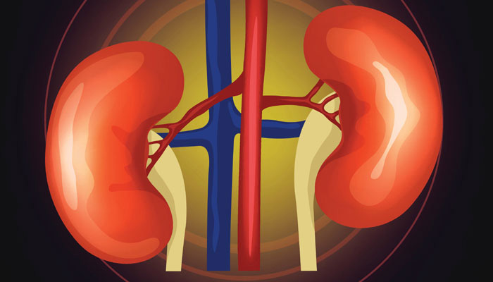
What else goes UP?
HF peptide (due to change in renal function and age-related LV hypertrophy).
Patients >70 years
  HF very unlikely if BNP<125pg/ml or NT-proBNP <35 pg/ml
  HF very likely if BNP >500 pg/ml or NT-proBNP >1200 pg/ml

Slide 7
Your patient is 70; you check her TSH and T4. What threshold of TSH* would prompt you to start thyroid replacement when the patient has a normal T4?
A. 6 mU/L
B. 8 mU/L
C. 10 mU/L
D. 12 mU/L
* Lab normal range 0.5-5.0 mU/L
Notes:
Today we focus on common clinical measures where age influences how we interpret a given test in diagnosis of a disease and avoid diagnosing a problem when none exist

Slide 8
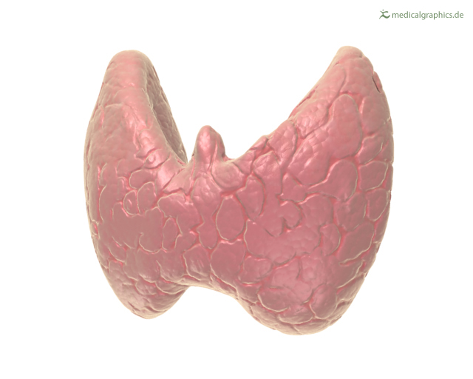
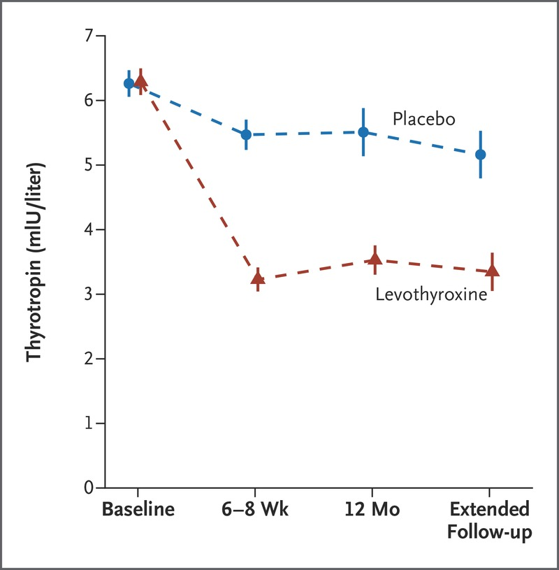
What else goes UP?
TSH
TSH up to 20 with a normal T-4 is subclinical hypothyroidism; TX does not improve symptoms.
Ignore mild TSH elevation unless ≥10¹
Reduce replacement dose with age (decline in lean body mass)
¹ NEJM
Notes:
PMID: 28402245
DOI: 10.1056/NEJMoa1603825
Free article
Participants were identified from clinical laboratory and general practice databases and records. The inclusion criteria were an age of 65 years or more and persistent subclinical hypothyroidism, defined as an elevated thyrotropin level (4.60 to 19.99 mIU per liter) that was measured on at least two occasions that were 3 months to 3 years apart, with the free thyroxine level within the reference range.
Abstract
Background: The use of levothyroxine to treat subclinical hypothyroidism is controversial. We aimed to determine whether levothyroxine provided clinical benefits in older persons with this condition.
Methods: We conducted a double-blind, randomized, placebo-controlled, parallel-group trial involving 737 adults who were at least 65 years of age and who had persisting subclinical hypothyroidism (thyrotropin level, 4.60 to 19.99 mIU per liter; free thyroxine level within the reference range). A total of 368 patients were assigned to receive levothyroxine (at a starting dose of 50 μg daily, or 25 μg if the body weight was <50 kg or the patient had coronary heart disease), with dose adjustment according to the thyrotropin level; 369 patients were assigned to receive placebo with mock dose adjustment. The two primary outcomes were the change in the Hypothyroid Symptoms score and Tiredness score on a thyroid-related quality-of-life questionnaire at 1 year (range of each scale is 0 to 100, with higher scores indicating more symptoms or tiredness, respectively; minimum clinically important difference, 9 points).
Results: The mean age of the patients was 74.4 years, and 396 patients (53.7%) were women. The mean (±SD) thyrotropin level was 6.40±2.01 mIU per liter at baseline; at 1 year, this level had decreased to 5.48 mIU per liter in the placebo group, as compared with 3.63 mIU per liter in the levothyroxine group (P<0.001), at a median dose of 50 μg. We found no differences in the mean change at 1 year in the Hypothyroid Symptoms score (0.2±15.3 in the placebo group and 0.2±14.4 in the levothyroxine group; between-group difference, 0.0; 95% confidence interval [CI], -2.0 to 2.1) or the Tiredness score (3.2±17.7 and 3.8±18.4, respectively; between-group difference, 0.4; 95% CI, -2.1 to 2.9). No beneficial effects of levothyroxine were seen on secondary-outcome measures. There was no significant excess of serious adverse events prespecified as being of special interest.
Conclusions: Levothyroxine provided no apparent benefits in older persons with subclinical hypothyroidism. (Funded by European Union FP7 and others; TRUST ClinicalTrials.gov number, NCT01660126 .).

Slide 9
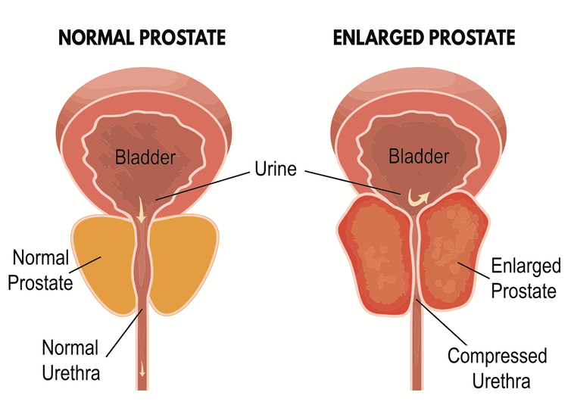
What else Goes up?
PSA
Prostate size increases with age.
Age-adjust upper limits of normal in men
  40-59 yrs ≤ 2.5 ng/ml
  60-69 yrs ≤ 4.5 ng/ml
  70-79 yrs ≤ 6.5 ng/ml

Slide 10
Things that go DOWN
Renal function
  CrCl goes down but serum Cr does not*;
  eGFR not reliable without age adjustment²
  Drug dosing often based on CrCL (e.g. bisphosphonates).
Age-adjust doses of renally excreted drugs
* Frail/malnourished Cr is falsely low
Glomeruli are Lost with Age
Age 20
Age 90
- 50 %
² Annals Int Med, 2021
Notes:
Newer formula adds age and sex and significantly changes classification of renal impairment in kids and older people Annals Int Med 2021

Slide 11
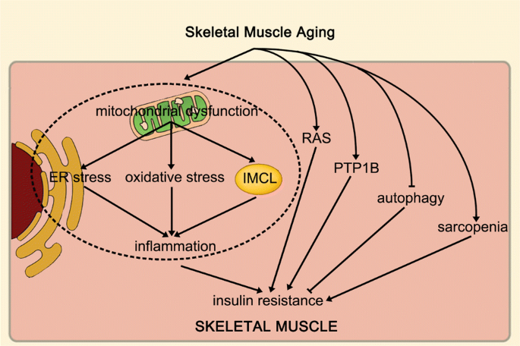
Things that go DOWN
Insulin release to a glucose challenge; and insulin sensitivity
Expect higher random glucose levels;
May increase HbA1c to “prediabetic” levels
Prediabetes as an important entity is in question in older people³
³ JAMA Int Med
Notes:
Journal club article- FU Of of 3142 community-based cohort study of older adults, the prevalence of prediabetes was high; however, during the study period, regression to normoglycemia or death was more frequent than progression to diabetes. These findings suggest that prediabetes may not be a robust diagnostic entity in older age.
JAMA Intern Med. 2021;181(4):511-519. doi:10.1001/jamainternmed.2020.8774 Published online February 8, 2021.

Slide 12
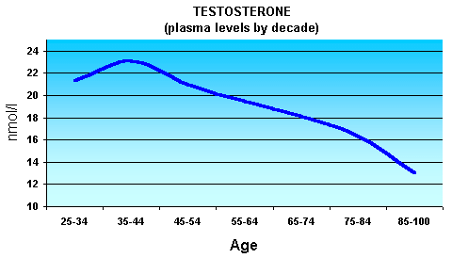
Things that go DOWN
Testosterone (and many other hormones)
Do not diagnose hypogonadism in older men based on low T-level without
  Repeated and unequivocally low levels and
  Symptoms (low libido is most reliable see GAYF)

Slide 13
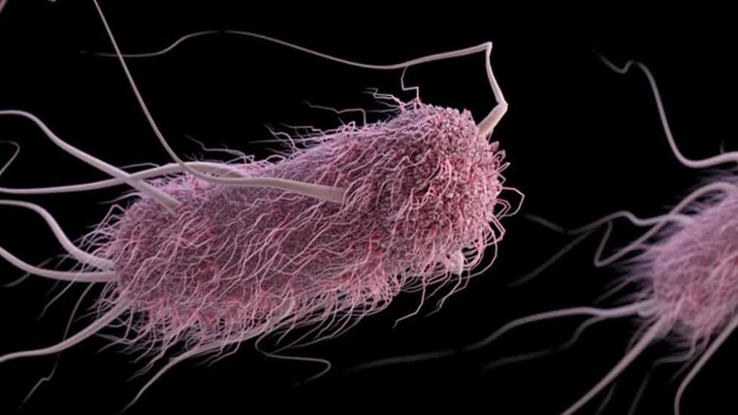
Things that go DOWN
Immune function-Aging Reduces Immune Function: T Cells
Antibody formation by B cells, may also be altered with aging
Colonization of the bladder without infection is common (asymptomatic bacteriuria)
Notes:
Current Paradigm Concerning How Aging Impacts Immune Function
Both experimental and clinical studies have indicated that older people are more susceptible to microbial infection due to declining immune responses.⁹ The generation of a primary immune response is the result of a carefully orchestrated interaction of the innate and adaptive immune systems.^{10,11} The majority of studies on aging and immune function have focused on adaptive T cell function, with several reports showing that aging impairs T cell IL-2, IFN-γ production, and Th1 immunity,^{12–14} one of the critical immune defenses to infection from intracellular pathogens such as viruses. Aging also impairs T-cell CD28 signaling¹⁵ and immune synapse formation.¹⁶ Furthermore, aging reduces T cell thymic output, leading to reduced numbers of naïve T cells, cells that are essential for eradicating infections from new pathogens. In addition, aging leads to an accumulation of memory T cells,¹⁷ which are critical for prevention of re-infection and are the basis for vaccination therapies. In addition, aging leads to defective CD4⁺ and CD8⁺memory T cell function.^{18,19} Other components of the adaptive immune system, including antibody formation by B cells, may also be altered with aging.^{20,21}
Less is known about the role of aging in innate immunity, which is the first line of host defense against infections.^{22–25} Some studies in this area have found no alteration in the innate system with aging¹⁴ and one study found that cytokine responses were elevated in aged human dendritic cells (DCs).²⁶ Other experimental and clinical reports have documented that aging impairs the innate immune system, including inflammatory cytokine production by human DCs.^{27,28} In sum, the field of aging and immune function is dominated by the paradigm that aging reduces immune function, thus providing an explanation for why older people are more susceptible to microbial infection.

Slide 14
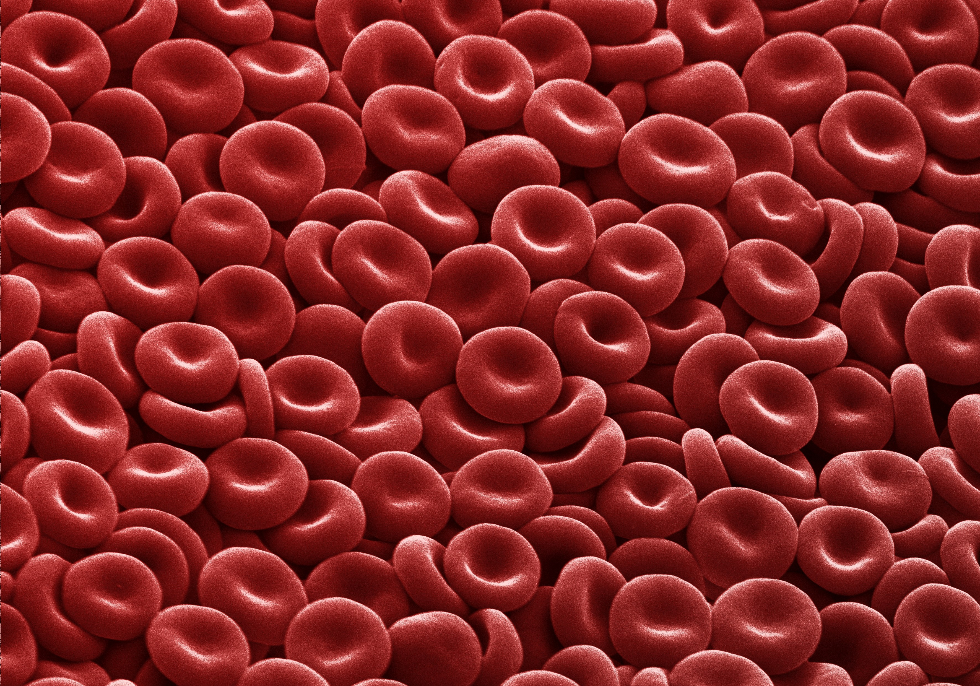
Things that go DOWN but not much
Hemoglobin
evaluate men when Hb<13
and women <12
OR if Hb drops >=1 gm in a year.
Significance
Lower hemoglobin is associated with more severe disability, poorer mobility and cognition, frailty, and falls

Slide 15
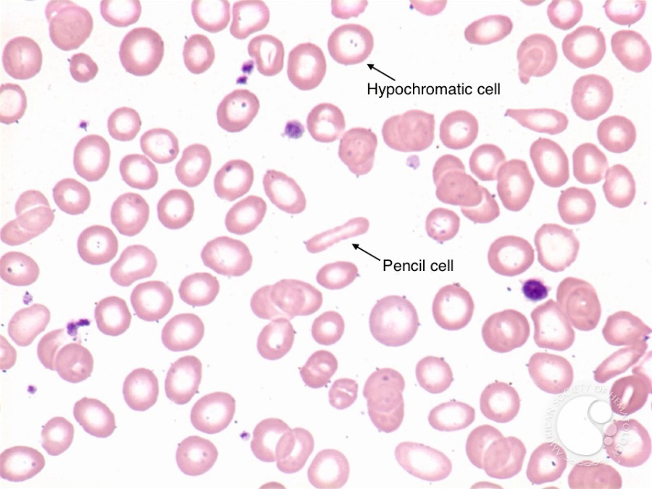
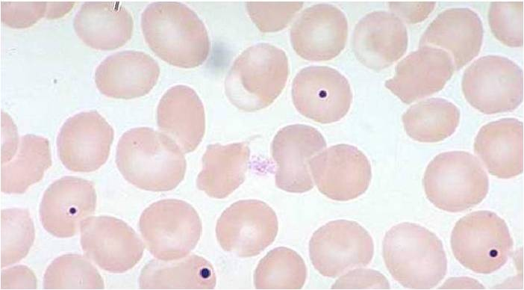
How to think about Anemia in Later Life
Combined deficiencies are common in older adults;
Reasonable to check B₁₂, folate, and iron in all cases.
MCV is not reliable in combined deficiency states.

Slide 16
Notes:
MMA and homocysteine up= B-12 deficiency, possible folate deficiency
MMA normal, homocysteine up-NO B-12 deficiency, possible folate deficiency

Slide 17
*
* eGFR: <30, 9% anemic; < 60, 1% anemic

Slide 18
What is the Most Common Cause of Anemia in Late Life?
Iron deficiency anemia
Anemia of chronic kidney disease
Anemia of chronic inflammation
Unexplained anemia of the elderly

Slide 19
Differentiating Anemias of Chronic Inflammation, Chronic Kidney Disease, UAE, MDS, Iron Deficiency, and Mixed ACI/Iron Deficiency
Anemia Type | Ferritin, ng/mL | TSAT, % | ESR/CRP | Other Labs | % of All Late-Life Anemias
Anemia of chronic inflammation (ACI) | >100 | >20 | Elevated¹ | Hb not<10; CrCl >30 | 6–26
Anemia of CKD | >100 | >20 | WNL | CrCl <30² | 4–11
Unexplained Anemia of the Elderly (UAE) | WNL | WNL | WNL | B₁₂ and folate WNL; Hb not <10 | 25–40
Myelodysplastic Syndrome (MDS) | WNL | WNL | WNL | Hb <10, +/- other cytopenias | ?
Iron Deficiency | <30 | Low | WNL | TSAT <20 | 15–30
Mixed Iron Deficiency and ACI | 30–100 | Low | Elevated | TSAT <20 | ?

Slide 20
Conclusions
Things that go UP and DOWN
Anemia
Age adjust what is normal for your older patients when rules exist
  -ESR; BNP, TSH, D-Dimer, PSA, HF peptide
Caution in interpreting low testosterone levels
Don’t treat asymptomatic bacteriuria
Don’t chase borderline alk. phos. levels
Anemia is common and increases morbidity
Evaluate anemia in ♀ when Hb <12 and in ♂when Hb <13 or a drop of 1 gm/1-year
The most common causes are UAE, followed by ACI, and iron deficiency

Slide 21
Thank You
Questions and Comments

Slide 22
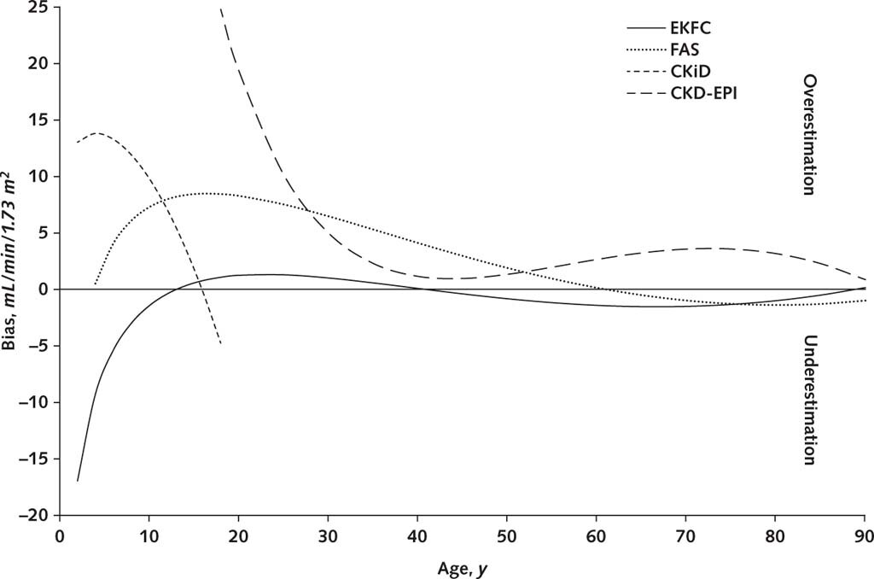
From: Development and Validation of a Modified Full Age Spectrum Creatinine-Based Equation to Estimate Glomerular Filtration Rate [A Cross-sectional Analysis of Pooled Data]
Ann Intern Med. 2021; 174(2):183-191. doi:10.7326/M20-4366
Figure Legend:
Positive bias indicates overestimation; negative bias indicates underestimation. CKD-EPI = Chronic Kidney Disease Epidemiology Collaboration; CKiD = Chronic Kidney Disease in Children Study; EKFC = European Kidney Function Consortium; eGFR = estimated glomerular filtration rate; FAS = full age spectrum; mGFR = measured GFR.
Date of Download: 01/19/2022
https://www.acponline.org

Slide 23
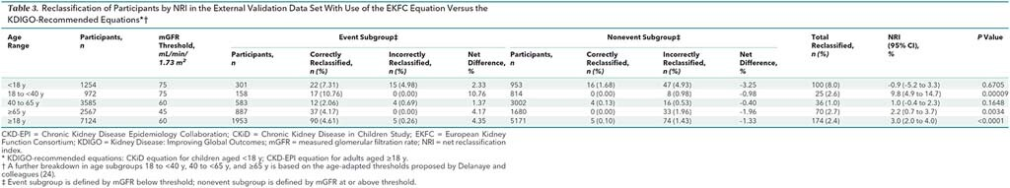
Table 3. Reclassification of Participants by NRI in the External Validation Data Set With Use of the EKFC Equation Versus the KDIGO-Recommended Equations*†
The gain in reclassifying participants was significant in the young adult (P < 0.001) and older adult (P = 0.003) subgroups.

