Slide 1
Therapy for COPD: Can They Afford It? Can They Use It?
Linda Sobeski, PharmD, BCPS
Clinical Associate Professor
Department of Pharmacy Practice and Science
UNMC College of Pharmacy

Slide 2
Objectives:
Describe
Describe common errors in inhaler device technique in the elderly
Discuss
Discuss the key considerations for selecting inhalers and optimizing inhaler use in the elderly
Describe
Describe the factors influencing cost of inhalers
Discuss
Discuss potential strategies for minimizing cost of inhalers

Slide 3
Introduction
Errors related to device mishandling are common in COPD
Meta-analysis (Chrystyn, 2017)
Overall error rates: 50-100%
pMDIs: at least one error = 86.8%
DPIs: at least one error = 60.9%
Handling errors => compromised drug delivery => reduced efficacy
Lack of device training is a key factor in handling errors
Older adults: physical or cognitive factors
Chrystyn, et al. Device errors in asthma and COPD: systematic literature review and meta-analysis. MPJ Prim Care Respir Med;2017:27(1):22.
Bonini, et al. The importance of inhaler devices in the treatment of COPD. COPD Res Pract 2015;1(1):9.
Notes:
HC professional: correct use only 15-69% of the time

Slide 4
Reasons for Inhaler Errors
Device: active vs. passive dose
Formulation: solution vs. powder
Dose preparation: DPIs
Patient:
Physical skill, dexterity
Hand strength
Lung capacity
Hand/breath coordination
Notes:
Often it is the very young or very old who experience physical difficulties and at increased risk of inhaler errors if consideration not given to individual abilities

Slide 5
4 Types of Inhaler Devices
Metered-dose inhalers (MDI)
Pressurized (pMDI)
Breath-actuated
Dry powder inhaler (DPI)
Multi-dose
Single-dose
Soft mist inhaler (SMI)
Nebulizer

Slide 6
MDIs
Limitations:
Requires coordination between actuation and inhalation
Actuation at beginning of slow deep breath
Consider spacers
Some breath-actuated devices (Respiclick™, RediHaler™)
Advantages:
Less expensive
Portability
Multi-dose device
Some have dose counters
Pressurized metered-dose inhaler (pMDI)

Slide 7
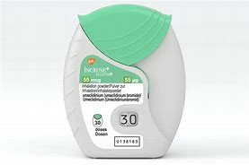
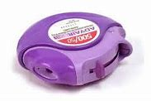
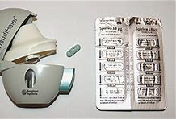
DPIs
Limitations:
Dependent on peak inspiratory flow (PIF) rate
Minimum = 30 L/min
Optimal = >60 L/min
Must protect from humidity
Dose-preparation required for single-dose
Advantages:
Breath-actuated
High portability
Some multidose
HandiHaler™
Ellipta™
Diskus™
Notes:
BA MDIs require lower PIF for activation than DPI
Risk factors for low PIF include: age >60y, female gender, shorter height, and lower FVC and IC as % of predicted
COPD patients can have temporarily reduced PIF after acute exacerbation

Slide 8
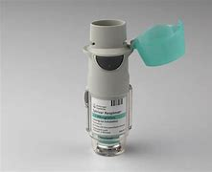
SMIs
Limitations:
Requires coordination between actuation and inhalation
Assembly required
Advantages:
Fine-slow velocity mist (>1s) facilitates coordination
Independent of PIF
Portability
Respimat™
Notes:
BA MDIs require lower PIF for activation than DPI
Risk factors for low PIF include: age >60y, female gender, shorter height, and lower FVC and IC as % of predicted
COPD patients can have temporarily reduced PIF after acute exacerbation

Slide 9
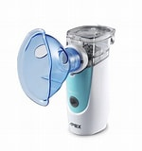
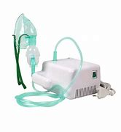
Nebulizers
Limitations:
Delivery time ~10minutes (pneumatic devices)
Low portability (pneumatic devices)
Some medication lost to atmosphere
Limited drug availability
Advantages:
Fine-mist aerosol
Eliminates coordination issues
Eliminates PIF issues
Medicare B coverage
Notes:
BA MDIs require lower PIF for activation than DPI
Risk factors for low PIF include: age >60y, female gender, shorter height, and lower FVC and IC as % of predicted
COPD patients can have temporarily reduced PIF after acute exacerbation

Slide 10
Critical Inhaler Errors
Device | Error
pMDI | Actuation after the end of inhalation Stopping inhalation immediately after actuation Inhaling too fast or forcefully Inhaling through nose
DPI | Failure to insert capsule (single-dose) or load dose (multi-dose) Not holding device in correct position during/after loading Not inhaling deeply or forcefully enough
SMI | Not rotating base to activate drug Not holding device upright during dose activation Not maintaining inhalation with drug spray

Slide 11
KEY Considerations for Device Selection
Devices available for desired drug
Patient able to use device correctly
Manual dexterity + strength
PIF rate
Cognitive impairment
Ease of use
Convenience and portability
Patient preference
Prescriber familiarity
Cost

Slide 12
Optimizing Inhaler Use
Check natural inhaler technique: fast vs. slow
Demonstrate correct usage at outset of treatment and over time
Education on condition and treatment
Keep devices consistent
Use multi-drug devices
Consider patient preference
Notes:
If patient tends to breathe slowly use MDI or fast + hard, use DPI
If patient has errors related to coordination of actuation and inhalation use breath-actuated (BAI) or small particle formulation
Device continuity has been shown to improve disease control in asthmatics

Slide 13
Inhaler Education
Verbal instruction + demonstration
Face-to-face
Trained healthcare providers (up to 67% of MDs, nurses, and RPs unable to describe/perform critical steps)
Regular review and repeated instruction
“Teach back” method
Include education about why inhaler is necessary
Video demonstrations (online)
Notes:
Training can help achieve PIF for DPIs and slow inhalation rate for MDIs.

Slide 14
Cost of Inhalers
2015: >$8 billion spent on 4 leading COPD medications
Many are brand name only, patent protected
Delivery systems are patented
Difficult to create generics even when drugs are old
Phasing out of chlorofluourocarbons (2008)
Unlikely that prices will decrease
Patients reach “doughnut hole” quicker
Cost identified as a factor in inhaler non-adherence

Slide 15
Ways to Lower Cost
Use formulary products
Use generics, if available
Appeal insurance coverage
Mail order
Compare pharmacy prices
Online coupons
Patient assistance programs (eligibility varies)
Manufacturers
Non-profits
https://www.aafa.org/patient-assistance-medicine-drug-programs
Federally qualified health centers
Notes:
PAPs: US citizen, no insurance or drug not covered, income eligibility
Discount programs often exclude federal programs (Medicare, Medicaid, Tricare)

Slide 16
PCMH Medication Access Coordinator
Haydon Lira
hlira@nebraskamed.com

Slide 17
Questions

