Slide 1
Hospice- What the PCP needs to know
Natalie Manley, MD, MPH, CMD, HMDCB

Slide 2
You are caring for Mr. Jones, an 87 year old retired math professor, widower, and father of 4. He lives at home with his daughter who is his POA and primary caregiver. He has stage 7C Alzheimer’s dementia and he has lost 10 pounds in the last 3 months due to decreasing oral intake. It is becoming very difficult to get him into the clinic for appointments. He is no longer able to safely ambulate and speaks fewer than 1 word during your appointment. You are discussing goals and prognosis with his 4 children who have all come to the appointment. You tell them that hospice is a reasonable option. His family asks you to tell them what hospice is. What do you tell them?

Slide 3
Definition of Hospice
“to relieve the pain and suffering of patients with serious, advanced, or life-threatening illnesses” (Beresford, aahpm quarterly vol 19, no 2)
as defined by the National Hospice and Palliative Care Organization
Quality compassionate care for people facing a life limiting illness or injury
Team-oriented approach to expert medical care, pain management, and emotional and spiritual support expressly tailored to the person’s needs and wishes. And to the person’s loved ones as well
Based on the belief that each of us has the right to die pain free and with dignity, and that our loved one’s will receive the necessary support to allow us to do so
Focus on “caring, not curing”
Can be provided in any location, any age, religion, race, illness
Covered under Medicare, Medicaid, most private insurance plans, HMOs and other managed care organizations

Slide 4
Simple definition
Hospice is a program that people are entitled to receive through Medicare, Medicaid (and most insurances) when their prognosis is 6 months or less.
It is a program that people choose/elect to enroll in
https://www.medicare.gov/coverage/hospice-care

Slide 5
Hospice benefit
Covered under Medicare part A (the same thing that pays for the hospital)
A person can revoke hospice whenever they want
Team comes to the home (wherever that is)
RN, SW, Home health aide, chaplain, MD/NP/PA if needed
Covers (some/most) meds, (some/most) equipment (DME), visits by the hospice team
DOES NOT cover room and board
DOES NOT cover medications that are UNRELATED to the life limiting illness or that are no longer appropriate
Bereavement support for family for 13 months after death

Slide 6
Hospice
Copyright 2013 by Morrison S. from AAHPM primer of palliative care, 6th E. page 7.
Notes:
http://slideplayer.com/slide/4341651/

Slide 7
Another short definition
Hospice is all about working as a team to provide TLC with heaping doses of love; enabling people to live their best lives with the time left, achieve unfinished business; supporting their caregivers to provide the best possible care and guide the caregivers through the dying/grieving process; and to have as much fun/enjoyment as possible

Slide 8
Often times, by the time it is time a person qualifies for hospice, hospice is simply an add on to what you are already doing.

Slide 9
After explaining hospice to your patient’s family, the patient’s son asks “so if dad starts hospice, does that mean that he will just lay in bed until he dies? My daughter’s wedding is in 2 weeks…I really wanted him to be able to come to the wedding…

Slide 10
What do hospice patients look like?
Dreamweaver foundation website

Slide 11
Dreamweaver foundation website

Slide 12
The family is interested in pursuing hospice, but they have some additional questions that you don’t have answers for…Now what?

Slide 13
Options to introduce hospice
Hospice informational
Hospice evaluation
Hospice eval/admit

Slide 14
Mr. Jones is going to be admitting to hospice today, what should the family expect as part of the admission process and for the days, weeks, months to come?

Slide 15
Start of care/Admission process
Admit takes a couple hours
Admission nurse evaluates patient, does a hands-on assessment, reviews medications with patient/family
The patient/family gets to choose who they want for their primary care provider
Hospice works with the patient and family and PCP to determine which medications might need to be de-prescribed.
Hospice pays for medications that are related to the terminal illness and that are still necessary and also for medications that are for symptom management
Hospice does not pay for medications unrelated to the terminal diagnosis.

Slide 16
Start of Care/Admission
Social worker does admission packet for signatures to enroll in hospice, code status, assess any social needs such as living arrangements, caregiver needs, assess spiritual needs. Provide options regarding which team members the patient wants to have as a part of the care.

Slide 17
Hospice Team
Counseling:
Chaplain
Bereavement (for at least a year after death)
Dietary counseling
Social work
Nurse
Physician/Medical Director
Aide
Volunteers
Often times an APRN
PT, OT and Speech as needed
Music therapy
Consultant pharmacist

Slide 18
Team member visits
Nursing once-twice a week, bare minimum every other week—and more often as death draws near or as symptoms arise
In hospice nurses play a role similar to resident physicians. They are out in the field assessing the patients and take “first call” –taking calls from facility staff, family members, patients.
CNA once or twice a week
Social work, chaplain, bereavement once a week to once a month and more often if needed
Volunteers as needed/desired/available
Medical director/physician available to answer questions by phone at all times and for visits as needed
Other awesome but not required team members: music therapy, eastern medicine practitioners, etc.

Slide 19
Case 2
You are seeing a patient in clinic with NYHA class 4 CHF with recent hospital admission for atrial fibrillation with RVR. They tell you that they don’t ever want to be hospitalized again. The patient asks you if you think he/she qualifies for hospice. How do you know?

Slide 20
Q: How do you know if your patient qualifies for hospice?
Answer:
If you think a person might qualify for hospice, then they probably do.
You do not have to know for sure and you do not have to decide. It is up to the hospice to decide whether the person qualifies.
If the person is interested in hospice, then you will never be wrong to make a referral.

Slide 21
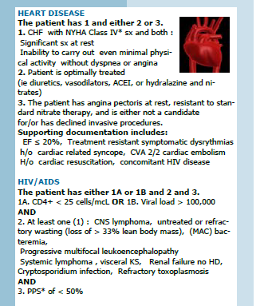
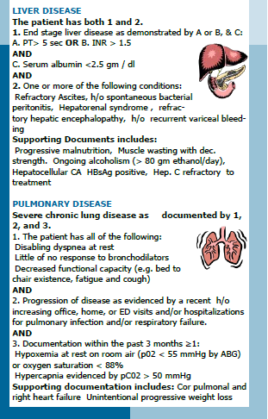
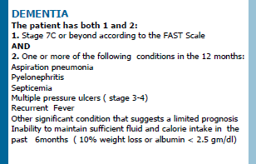
Hospice Eligibility Criteria
http://geriatrics.uthscsa.edu/tools/Hospice_elegibility_card__Ross_and_Sanchez_Reilly_2008.pdf

Slide 22
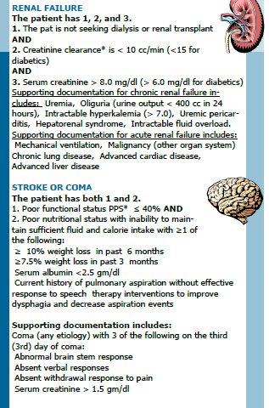
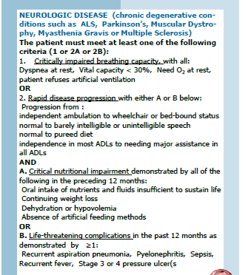

Slide 23
Frailty Syndrome:
Geriatric Review Syllabus 10th ed

Slide 24
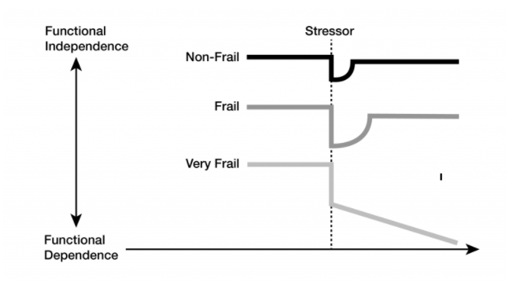
Failure to thrive/Frailty Syndrome
A chronic, progressive condition with a spectrum of severity.
In earlier phases may respond to treatment
The most severely frail older adults appear to be in an irreversible, pre-death phase with high risk of mortality over 6–12 months.
Geriatric Review Syllabus 10th ed

Slide 25
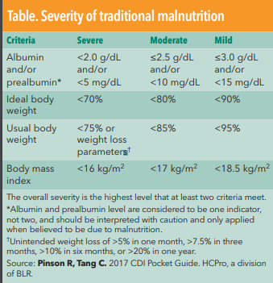
Signs of Malnutrition
https://med.virginia.edu/ginutrition/wp-content/uploads/sites/199/2014/06/Parrish-Sept-14.pdf
https://www.acphospitalist.org/archives/2017/01/acph-201701-coding-malnutrition-revisited_t1.pdf
Albumin is not required for diagnosis of malnutrition

Slide 26
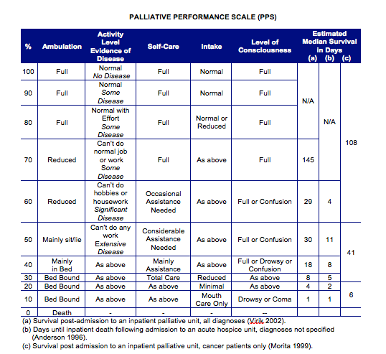
Palliative Performance Scale
https://www.mypcnow.org/blank-irr0h

Slide 27
FAST Score for Alzheimer’s
Dementia as a primary hospice dx—has to be a defined type of dementia, e.g. cerebrovascular disease, Alzheimer’s, frontotemporal, lewy body, etc
http://geriatrics.uthscsa.edu/tools/Hospice_elegibility_card__Ross_and_Sanchez_Reilly_2008.pdf

Slide 28
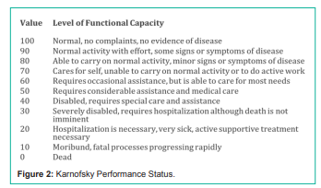
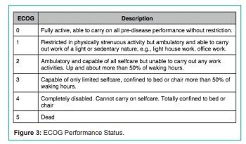
Karnofsky Performance Status and ECOG Performance Status
http://austinpublishinggroup.com/family-medicine/fulltext/jfm-v3-id1050.php

Slide 29
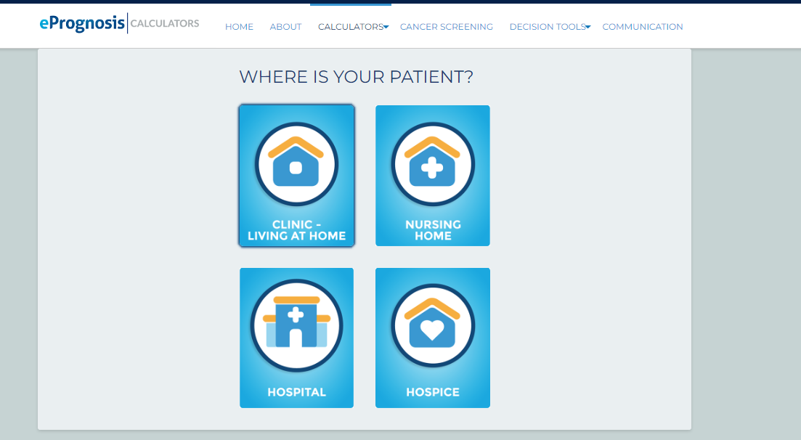

Slide 30
Mrs Smith is a 67 year old dog lover with metastatic lung cancer. She is on your hospital service with a diagnosis of respiratory failure related to malignant pleural effusions. She has decided she would like to return home on hospice for the remainder of her life so that she can be with her beloved pets. She has caregivers at home. She is currently on 5 liters of O2 NC, is drowsy but wakes for care providers and can take pills. You are preparing her discharge orders. What should you order for her discharge?

Slide 31
Deprescribing at start of hospice
Depends on the patient’s ability to swallow and proximity to death
Remove meds that are likely causing more harm than good (this is completely individualized)
Common Examples of meds that need weaning (especially in people with poor appetite and weight loss):
Amiodarone
Statins
Diuretics, anti-hypertensives
Diabetes meds (e.g. Metformin)
Anticholinergics
Medications we typically keep
Levothyroxine
If the person has heart failure, then we keep the heart failure meds
If the person has COPD, then we keep the COPD meds—unless they no longer have the inspiratory capacity to inhale, then we switch
If the person needs insulin, we keep the insulin (but the blood sugar goals are much more relaxed.

Slide 32
Comfort pack
Typically includes morphine and Ativan to have on hand for discomfort. It is good to spell out exactly what you want them used for.
Morphine for pain, air hunger, dyspnea
Ativan for agitation/anxiety not responsive to other measures
Don’t forget the chaplain, comforting touch
No evidence to support regular use of atropine
Sometimes Haldol is a necessary add on
Don’t forget the bowels and bladder!

Slide 33
Death Rattle
Comparison With Placebo. No drugs tested against placebo
(scopolamine hydrobromide and atropine) were
found to be superior to placebo. A placebo-controlled
RCT from the U.S. comparing sublingual atropine to
sublingual saline in 160 patients found no difference
in noise score and heart rate at baseline, after
two hours (P ¼ 0.73) and four hours (P ¼ 0.21).40 A
smaller placebo-controlled study from Germany
compared intravenous (i.v.) or subcutaneous (s.c.)
scopolamine hydrobromide to saline in 31 patients
and likewise found no significant difference in death
rattle scores (P value not reported).32

Slide 34
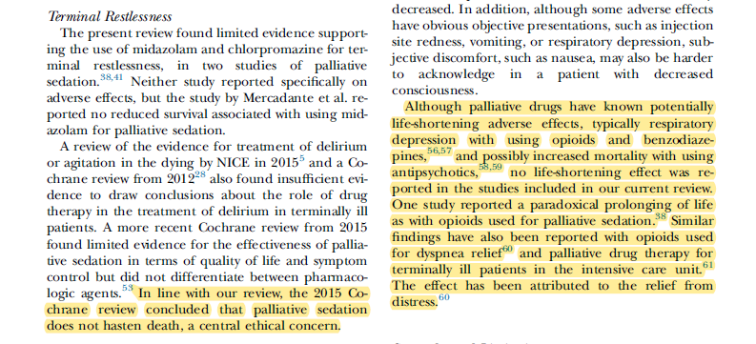

Slide 35
This Photo by Unknown Author is licensed under CC BY-SA
Your hospitalized patient with cancer metastatic to the spine has decided to transfer to a nursing facility with hospice and you are preparing the discharge. The patient has had difficult to control back pain during the hospital. What do you need to do to make sure the transition in care goes well?

Slide 36
This Photo by Unknown Author is licensed under CC BY-SA
Make sure the patient gets a dose of pain medicine prior to leaving so that the patient isn’t in severe pain by the time the transport has gotten him/her to the new location.

Slide 37
Locations for Hospice
Home
Nursing home
Assisted living
Independent Living
Inpatient hospice (GIP)
Continuous care (home care)
SIA—service intensity add on
Respite care
Therefore, have to be able to work
Within the rules and regulations of the
Facility where the person lives and incorporate
teams

Slide 38
In care facilities
Nursing home staff keep doing all of their normal work for the nursing home resident(patient)
Hospice nurse comes a couple times a week to check in on the needs of the patient
Social work and chaplain come every other week or month (If the patient/family accepts their services) to check on the needs of the patient and will provide a social presence
Room and board coverage for the nursing home continues to be paid for by the same source (private pay, VA pay, Medicaid)
Hospice is added on to the day to day care that is provided.

Slide 39
In the home
Patient may continue to live independently in their home
Needs a back up plan for when no-longer able to live independently
Patient may live at home with family caregivers or paid caregivers
Hospice comes and supports the person

Slide 40
Respite Care
care in an approved facility on a short‐term basis for respite”
Designed to provide respite for family members or other caregivers
Medicare certified SNF or acute care hospital
Limited to no more than five (5) consecutive days
Otherwise, no limit to number of times respite can be provided
Crosno, 2019

Slide 41
Continuous Care
during brief periods of crisis . . . As necessary to maintain the terminally ill patient at home
Must have a skilled care need
Minimum of 8h of direct care in a 24h period
>50% of care must be provided by licensed nurse (RN or LVN/LPN)
<50% of care may be provided by hospice aide
Crosno, 2019

Slide 42
Service Intensity Add‐on (SIA)
provided in the last 7 days of life
• Up to 4 hours per day of nursing care provided by Registered Nurse (RN)
Crosno, 2019

Slide 43
General Inpatient (GIP)
inpatient care in an inpatient facility for pain control or acute or chronic symptom management which cannot be managed in other settings”
Based on:
Uncontrolled symptoms managed only in facility (hospital or SNF with 24h RN)
Having a skilled need to manage uncontrolled symptoms or monitor treatment
No specified number of days, but best practice suggests daily evaluation of ongoing necessity
Crosno, 2019

Slide 44
Wound care
Mnemonic “SPECIAL”:
Stabilize the wound;
Prevent new wounds;
Eliminate odor;
Control pain;
Infection prophylaxis;
Absorbent wound dressings;
Lessen or reduce dressing changes

Slide 45
Other points
It’s ok to interview hospices to ensure that their philosophies align with yours. For example, use of antibiotics, desprescribing, etc.

Slide 46
Billing pointers
GV modifier—if you are the PCP elected by the patient (meticulously tracked by the hospice company) and you do not have a financial relationship/contract with the hospice company and the patient is seeing you for a hospice related reason
GW code-provider seeing the patient for a purpose not related to their hospice diagnosis (for example an ophthomologist sees a patient with dementia who develops a new eye problem)

Slide 47
Questions?

