Slide 1
NGWEP the Nebraska Geriatrics Workforce Enhancement Program
A Partnership between Nebraska Medicine, UNMC , Community Based Organizations and Primary Care Sites

Slide 2
This program is supported by the Health Resources and Services Administration (HRSA) of the U.S. Department of Health and Human Services (HHS) as part of an award totaling 751,695.00 with 0% financed with non-governmental sources. The contents are those of the author(s) and do not necessarily represent the official views of, nor an endorsement, by HRSA, HHS, or the U.S. Government. For more information, please visit HRSA.gov.

Slide 3
Why enhance the geriatrics skills in the primary care workforce?
Most elders are seen and cared for in PC clinics
Many HCPs received limited training in geriatrics
EB review and expert consensus¹ identified 4 things important to health & QOL for older people.
¹ References available on request (JAHF, IHI)

Slide 4
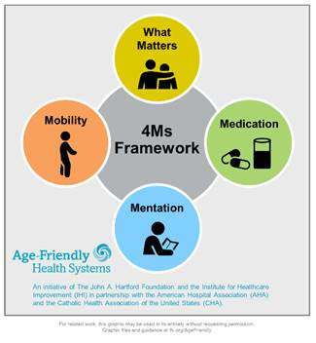
Age Friendly Primary Care:
These are the 4 important things
Notes:
We all care for elders, we want to do the important things. The 4 Ms are the important things
What Matters: Know and align care with each older adult’s specific health outcome goals and care preferences including, but not limited to end-of-life care, and across settings of care (document ACPs)
Medication: If medication is necessary, use Age-Friendly medications that do not interfere with What Matters to the older adult, Mobility, or Mentation across settings of care (Pharmacy protocols for med review in evaluating cognitive dysfunction, mobility and falls etc)
Mentation: Prevent, identify, treat, and manage dementia, depression, and delirium across settings of care
Mobility: Ensure that older adults move safely every day to maintain function and do What Matters

Slide 5
NGWEP is a Collaboration-teach/learn together
Dedicated introductions to 4 Ms
Monthly Case conferences- bring cases to discuss with 6 other clinics and a panel trained in geriatrics (medicine, psychiatry, social work, pharmacy) and community service specialists.
Annual Wellness Visits screen for the 4Ms

Slide 6
ASKING ABOUT SERIOUS THINGS: WHAT MATTERS
Bill Lyons, MD
Division of Geriatrics, UNMC

Slide 7
COUPLE OF GREAT RESOURCES
prepareforyourcare.org
Rebecca Sudore et al
Advance Care Planning
patientprioritiescare.org
Tinetti, Blaum, Naik, et al
Priority setting in multimorbidity, good for ACP as well

Slide 8
ACP AND ELICITING WHAT MATTERS
Similar and related activities
ACP, by definition, is about planning for the future
ACP entails
Identification of surrogates
Elicitation of What Matters
Yet eliciting What Matters is helpful in the here and now of managing multimorbid patients

Slide 9
MEET RENEE
40 yo woman is an elementary school art teacher with hyperlipidemia and hypothyroidism.
Recently remarried, she has an 8-month old son and 5-year-old daughter.
A chest film incidentally discovers a 2-cm RUL mass; pathology shows adenocarcinoma.
What are your next steps in her care?

Slide 10
MEET MILDRED
85 yo woman is a retired elementary school art teacher with advanced parkinson disease, related dementia, HFrEF (last EF 20%), frailty.
Widowed, her son and daughter reside out of state with their families. Resides in an ALF.
A chest film incidentally discovers a 2-cm RUL mass; pathology shows adenocarcinoma.
What are your next steps in her care?

Slide 11
CARE FOR MANY OLDER ADULTS WITH MULTIPLE CONDITIONS MAY…
Be of uncertain benefit
Few older adults in RCT’s
Those who are don’t look like Mildred
These persons have less benefit from treatment than those in the studies
Be burdensome
Inflict unintended harm
Be frustrating
Hence the need for determining What Matters

Slide 12
WHEN MIGHT YOU HAVE A WHAT MATTERS CONVERSATION?
Annual Wellness Visit
New diagnosis, or change in health status
Change in life stage or circumstances
As part of chronic disease management discussions
Visit to patient in inpatient setting (hospital, nursing home)
Or first clinic visit following hospitalization

Slide 13
WHO CAN HAVE THE WHAT MATTERS CONVERSATION?
Any member of the care team can initiate and document the conversation
Can also be elicited by self-report (write in free text on a form)

Slide 14
CHECK THEIR UNDERSTANDING
(Not always necessary)
What is your understanding now of where we are with your illness?
“I know we doctors may not always do the best job of communicating about these things”
Calibrate their understanding as needed

Slide 15
PROGNOSIS
(Not always necessary)
(May provide rationale for: Why now?)
Share prognosis as a range, tailored to information preferences
How to estimate?
Experience
Contact consultant if a prominent disease
eprognosis.ucsf.edu

Slide 16
WHAT MATTERS: GOALS
What things are most important in your life?
What makes life worth living?
Examples:
Function and independence – living on your own, caring for yourself
Longevity
Social connection – friends, family, religion
Symptom relief
Have you changed your mind about what matters in your life? (Say more…)

Slide 17
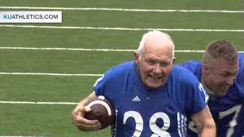
GOALS, cont.
What would you be doing more of if your [ailment] were not so burdensome?
What activities are particularly important or meaningful?
Is there something you want or need to do before, say, your next birthday?

Slide 18
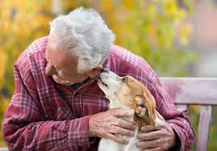
GOALS, cont.
Describe what a good day would look like
Which relationships or connections are most important to you?
What brings you the most enjoyment or pleasure?
What do you hope your health care can do for you?

Slide 19
WHAT MATTERS: BURDENS
Are there things about your healthcare that you think aren’t helping, or you find bothersome or difficult? (Possible examples:)
Medicines (pills, shots, drops, inhalers)
Self-care tasks (diet, FSBG checks…)
Blood tests and x-rays, etc.
Medical visits
Dialysis…
What are you willing/able to do, and what NOT?

Slide 20
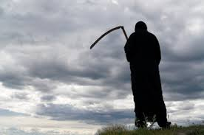
WHAT MATTERS: FEARS AND WORRIES
What are your biggest fears and worries about the future with your health?
What experience have you had with serious illness?
What went well? What didn’t? Why?
In the same situation, what would you want?

Slide 21
FEARS AND WORRIES, cont.
Can you imagine anything that would be worse than death? Or,
Can you think of any health situations that would be hard on your quality of life?
Some people might say
Not being able to live w/o machines
Not being able to think for oneself
Not being able to live on one’s own
Constant pain…

Slide 22
SCENARIO TO CONSIDER
Sudden event has left you unable to communicate
You’re receiving all care needed to keep you alive
Doctors believe little chance you’ll recover ability to know who you are or who you’re with
Would you want
Medical treatment to keep you alive, or
To stop the medical treatment
(You’d be kept comfortable in any case)

Slide 23
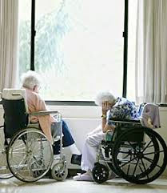
WHAT MATTERS: FUNCTION
What abilities are so critical to your life that you can’t imaging living without them?

Slide 24
WHAT MATTERS: TRADE-OFFS
If you became sicker, how much are you willing to go through for the possibility of gaining more time?
“I’ve had some patients who have told me, “Doc, I want you to do anything you can to have me live as long as possible – surgery, breathing machines, you name it….”
“And I’ve had other patients….”

Slide 25
HAVING AND DOCUMENTING THE CONVERSATION
“I want to be sure we are working on the things in your health that you think are most valuable. Can we step back and talk about that for a couple of minutes?”
Probably best to do in a meeting room across a table, not in exam room with patient in a gown
Try to record in EHR in patient’s own words
“Be able to walk around block with my grandson,” not
Increase mobility
Share with interdisciplinary team

Slide 26
COMMENTS & QUESTIONS?

