Slide 1

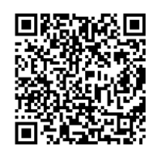
Nebraska GWEP Chalco, and SCC Collaboration
Discovering the 4Ms
“Mobility” will begin at Noon
Passcode: 2022
As you join, if you have not submitted a GWEP registration
previously, please use the QR code to complete one, or utilize link
that will be shared in the Chat.
Following registration, please enter your name and role
in the Chat to note your Attendance.
This presentation will be recorded and available for viewing on our website following at: https://www.unmc.edu/NebraskaGWEP/ If you do not consent to recording,
please disconnect at this time.

Slide 2
This program is supported by the Health Resources and Services Administration (HRSA) of the U.S. Department of Health and Human Services (HHS) as part of an award totaling $749,836 with 0% financed with non-governmental sources. The contents are those of the author(s) and do not necessarily represent the official views of, nor an endorsement, by HRSA, HHS, or the U.S. Government. For more information, please visit HRSA.gov.

Slide 3
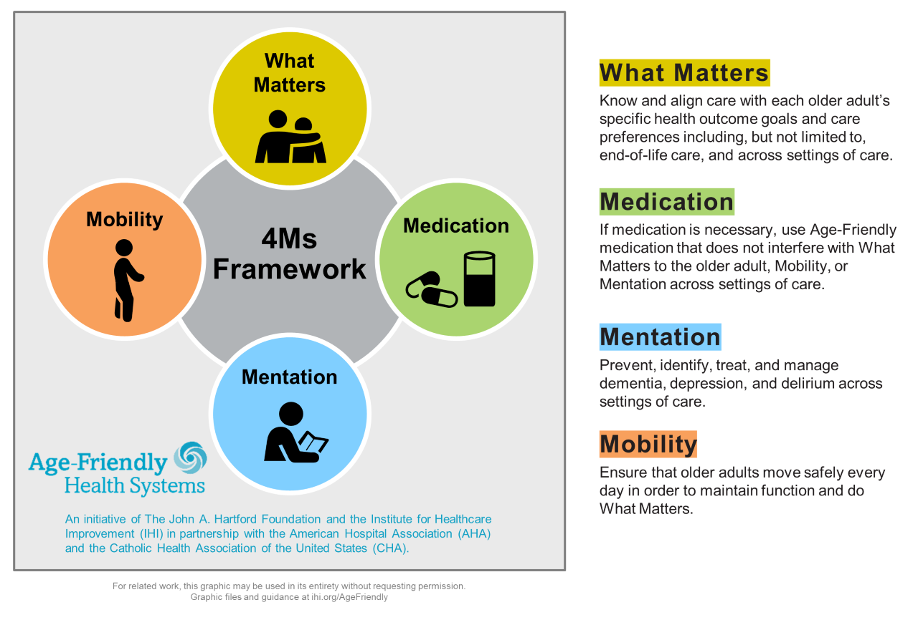

Slide 4





“Mobility”
By Joe Hejkal, MD
August 23, 2022

Slide 5
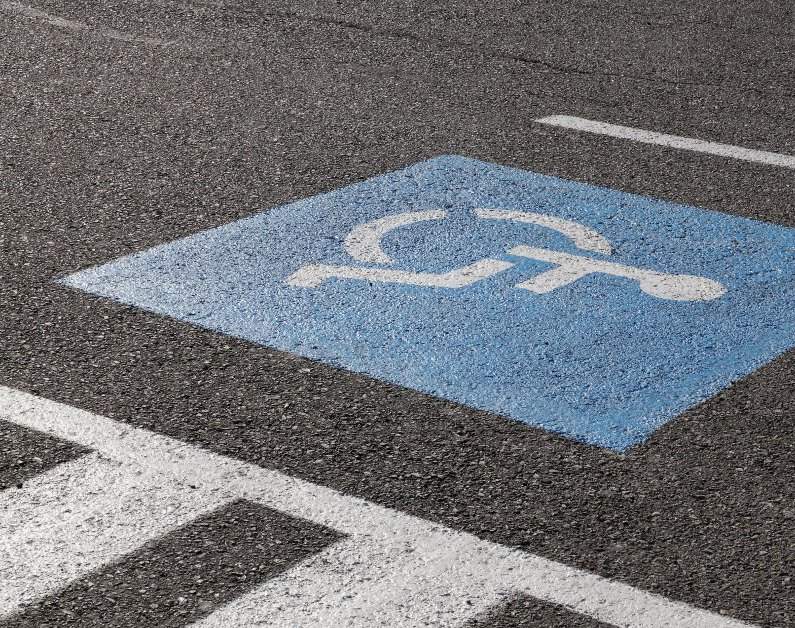
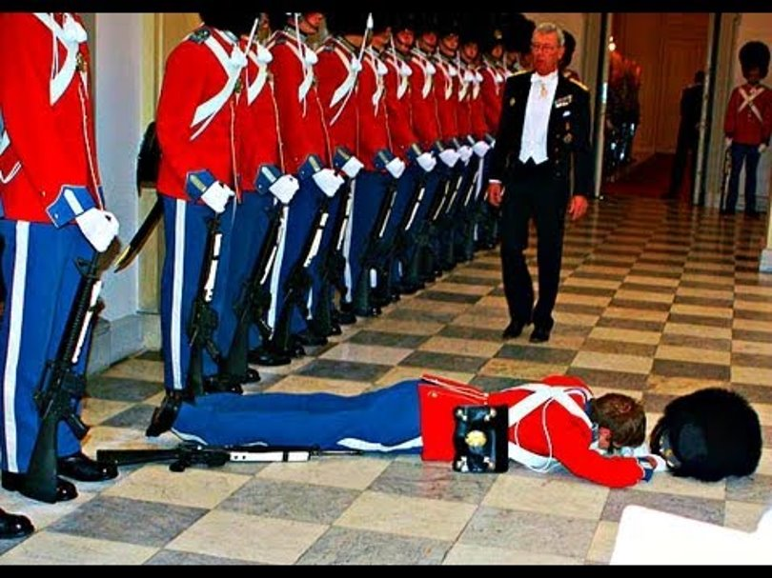
Falls and Mobility
GWEP 4M discussion
J Hejkal
8/23/2022

Slide 6
Collaboration helps us all achieve more
Methods to collaborate:
Attend, Participate, Provide Feedback
Please note your attendance in the CHAT by entering Name, Role, E-mail address
During discussion: Please unmute yourself to contribute and ask questions.
Following each session, complete surveys and provide feedback

Slide 7
Falls
25% of elderly population fall each year. Half tell their doctor.
One in five falls causes serious injury
Serious injury risk
  Hip fracture with 25% 1-year mortality
  SDH leads to >50% mortality or severe disability at 3 months
Notes:
More prevalent than diabetes (about 18% of older adults).

Slide 8
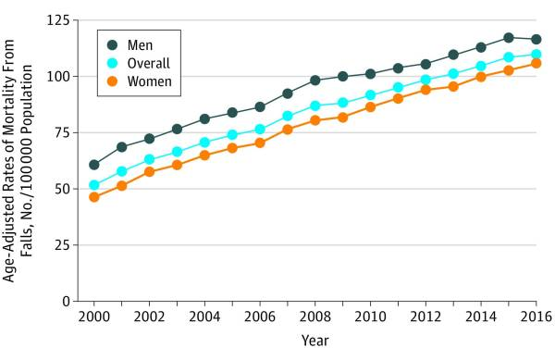
Hartholt K, Lee R, Burns E, van Beeck E. Mortality From Falls Among US Adults Aged 75 Years or Older, 2000-2016. JAMA 2019
Notes:
Fall-associated mortality has increased (about 30% relative increase over the past 10 years) in older adults, including after adjustment for aging population

Slide 9
Mobility
1/3 of older adults have mobility limitation.
Major determinant of well-being
More important to patients than falling
Notes:
Mobility disability is technically defined as the ability to walk ¼ mile without a walker; associated with ability to safely walk in community.

Slide 10
How to prevent falls and improve mobility
What is the intervention with the largest impact?

Slide 11
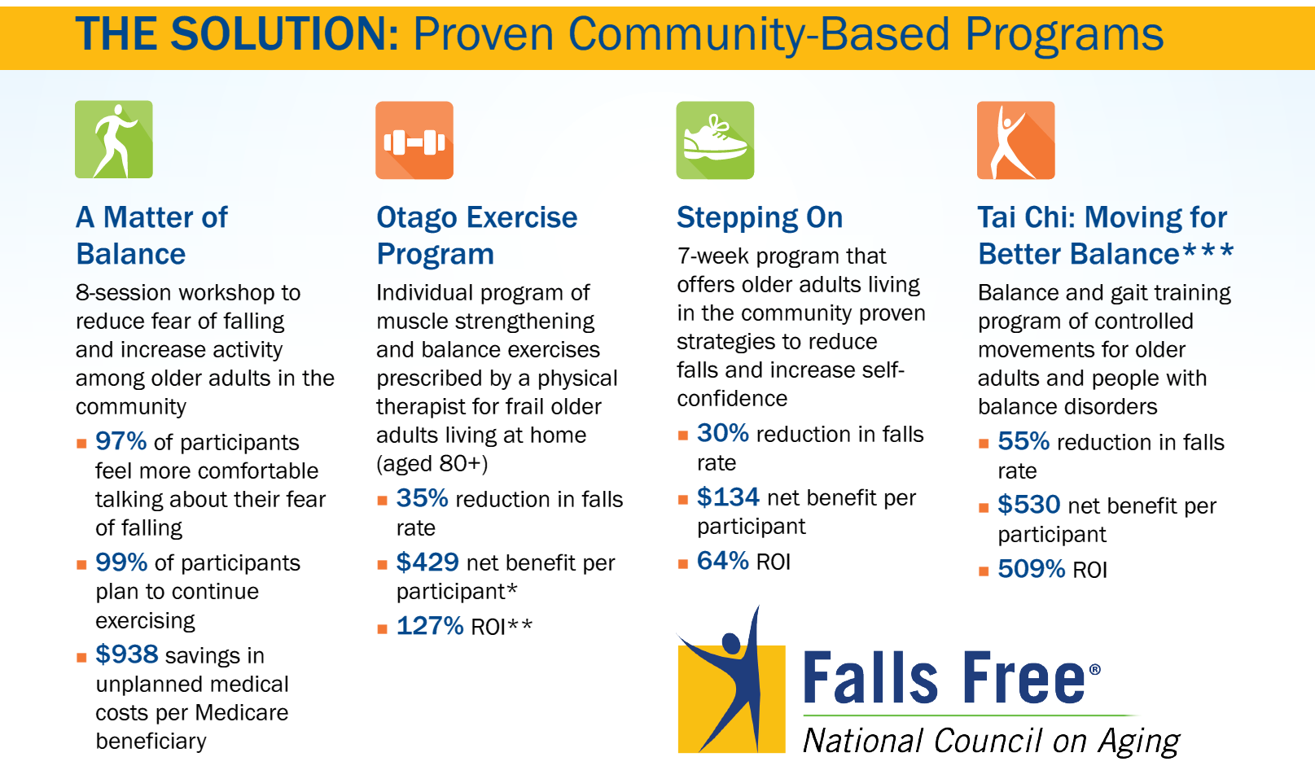

Slide 12

Exercise
Cornerstone of fall prevention and mobility improvement
  Arthritic disease
  Strength
  Balance
  Neurological disorders (e.g., Parkinsons)
  Bone density
  Cardiopulmonary disease
Notes:
We could stop here, right? Getting patients to exercise benefits almost every body system and helps to improve fall risk – it affects strength, balance, arthritis; can help retrain the CNS, improves bone density, etc., etc., etc.

Slide 13
But Insufficient…
Notes:
Exercise is great. But there’s more to it.

Slide 14
What keeps us mobile?
The entire neurologic system
  Proprioception system
  Afferent nerves
  Efferent nerves
  CNS
  Vestibular system
Vision
Muscles
Bones
CV system
Pulmonary
Notes:
What systems keep us mobile? Thoughts?

Slide 15
Other systems contribute to falls, too
Rushing to the toilet due to overactive bladder
Poor nutrition from GI problems.
And non-medical issues (cluttered floors, for example)
MEDICATIONS
Notes:
Needing to use the toilet is the primary cause of falls in institutional and hospital settings.

Slide 16
Falls and injury
Muscle weakness
Neurological deficits
Poor vision
Cluttered
Environment
Malnutrition
Medications
Orthostatic hypotension
Osteoporosis
Urinary urgency
Notes:
Falls are a typical “geriatric syndrome:” a problem that results in additive deficits from multiple contributing systems, including external domains. This complexity is a reason why geriatric syndromes are difficult to treat. I would argue that one of the reasons that exercise is so helpful is that it affects more than one domain and system.

Slide 17

STEADI
CDC’s Stopping Elderly Accidents, Deaths, and Injuries initiative
Meant to help promote mobility and prevent falls in primary care settings.
Notes:
This is really intended as a framework for developing a fall prevention PROGRAM at an institution or healthcare practice. As always in geriatrics, interventions work best when they are done by the entire team. But it also provides a great framework for just looking at falls in a clinical setting.
This is based on the 2011 AGS/BGS Fall Prevention Guidelines, with some minor updates since then based on the small amount of practice-changing literature that’s been published in the interim.

Slide 18
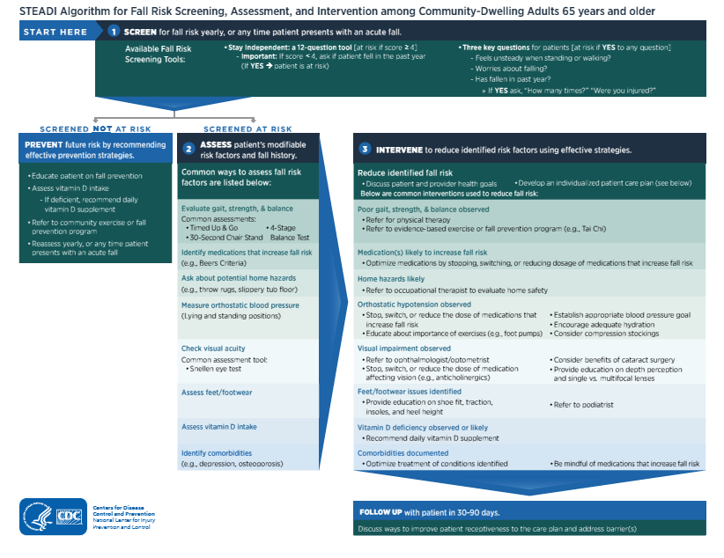
Notes:
This is the STEADI algorithm. Don’t try to read it; we’ll break it down into its components over the next few slides.

Slide 19
Detection
When patients bring it up
Yearly screening (AWV): Choose one
  (1) Stay Independent Brochure
    If fell in last year, high-risk, even if negative screen
  (2) Ask 3 key questions
      Do you feel unsteady when standing or walking
      Do you worry about falling?
      Have you fallen in the past year?
Notes:
Screen patients every year, or when they bring it up. If you do annual wellness visits, this is a good time (because it’s already baked into the AWV).

Slide 20
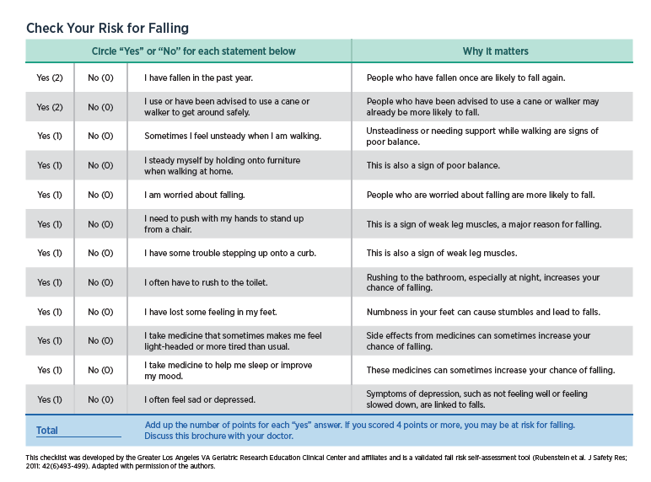
Notes:
Stay Independent Brochure – contains a 12-item questionnaire

Slide 21
Patients with low risk
Primary prevention:
  Education on fall prevention
  Assess vitamin D intake and recommend supplement if deficient
  Refer to community exercise/fall prevention program
  Reassess yearly or after a fall
Notes:
Vitamin D less important than we thought, unless truly deficient (e.g., in nursing homes)

Slide 22
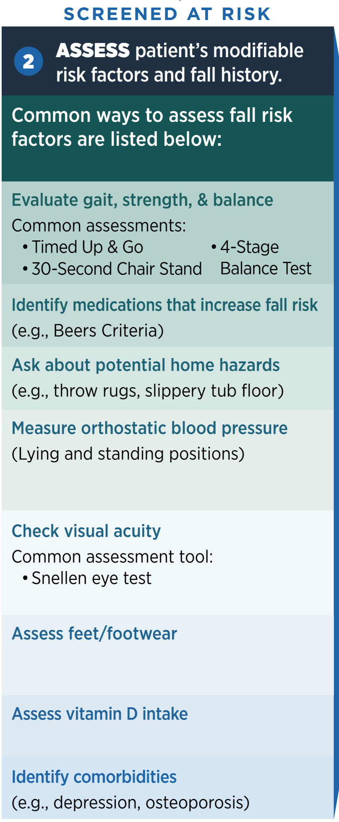

Notes:
Good basics. TUG (arise, walk 10 feet, turn around and sit down), if >12 seconds, then they’re at high risk. 30-sec chair stand: standardized for age and sex.
4 Stage balance test involves feet together, half tandem, tandem, and then stand on 1 foot for 10 seconds. If the patient can’t do the tandem stance for 10 seconds, fall risk is higher.

Slide 23
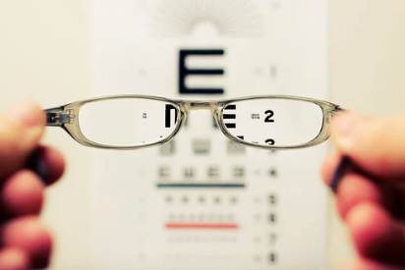

Slide 24
Other things to look at
Neuro exam is often appropriate
  Focal weakness or motor abnormalities
  Sensory deficits
  Coordination problems
  Parkinsonism
Look for nystagmus if symptoms
Notes:
A few things that I think are helpful that are not really included in the algorithm: a neurological exam (sensation, motor abnormalities, ataxia, parkinsonism) and if the patient is dizzy, looking for nystagmus. A good gait exam can help identify some of these, too.

Slide 25
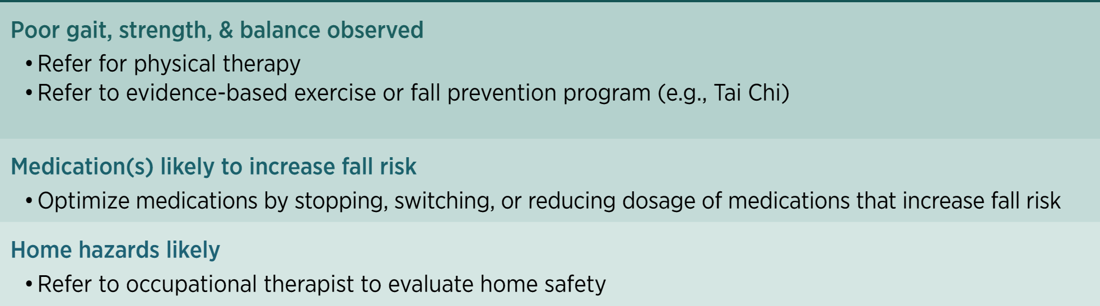
Notes:
After making this patient-centered (i.e., discussing health goals):
There are many different proven fall-reduction programs (see previous slide), includes Tai Chi (e.g., through local YMCA’s), UNMC’s EngAge FallProof,
Medications, such as benzodiazepines, anticholinergic meds

Slide 26
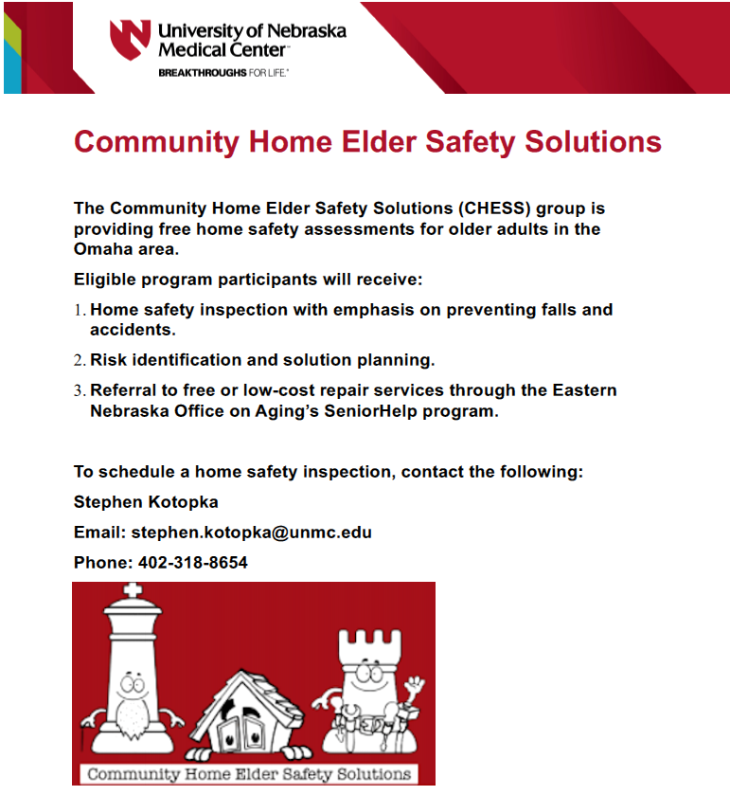

Slide 27
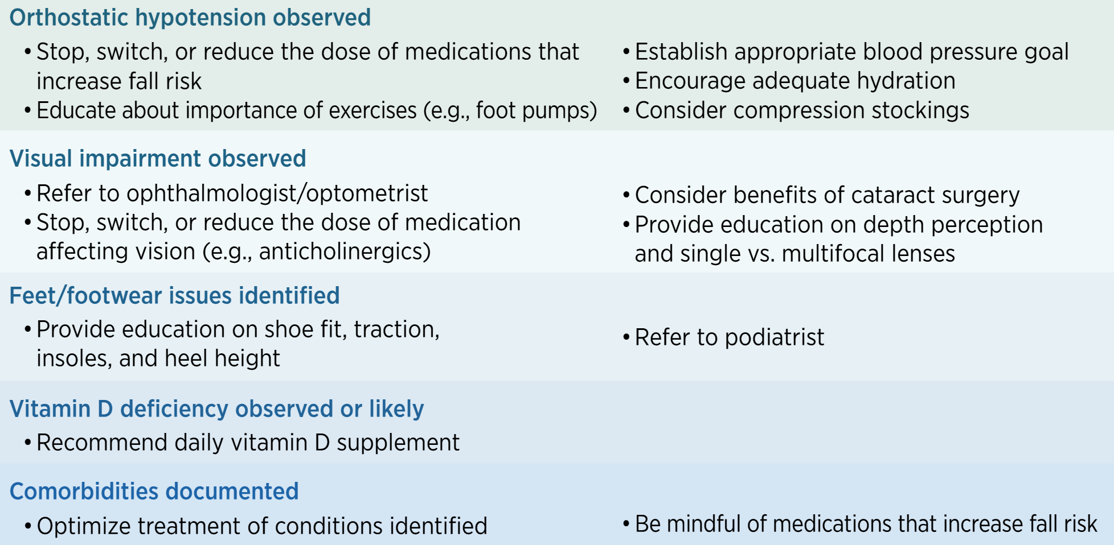
Notes:
Addressing orthostatic hypotension
Vision impairment: bifocals actually are associated with increased fall risk. Cataract surgery helps prevent falls.
Vitamin D deficiency: really only helps to treat if there is a deficiency (unless in long-term care)

Slide 28
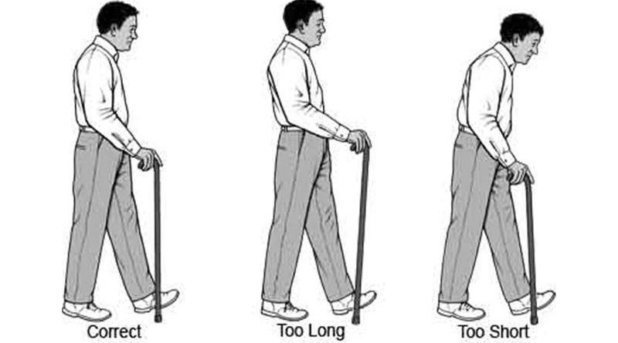
Other things to manage
Neurological disease
  Imaging may be helpful
  Referral to movement disorder clinic if indicated
Assistive devices
Emergency response systems
ENT for vertigo
http://www.elderlyaidsadvice.com/measure-your-walking-stick/
Notes:
Assistive devices: often people use a relatives old device, for example, and it’s not fitted correctly.
What kind of devices to use?
Canes: esp for people with maybe a proprioceptive deficit, someone who needs another point of contact for stability.
FWW: for those with worse mobility trouble, LE weakness
4WW: for those with easy fatigability who need a seat, would benefit from having something to carry things.

Slide 29
Other things to manage
Urinary urgency or incontinence
Pain
Cognitive impairment
Notes:
If a person has OAB, then anticholinergics used for that might also increase fall risk, so be careful.
Pain reduction methods: scheduled Tylenol, topical NSAIDs, sometimes gabapentinoids, pain management clinics, PT
Cognitive impairment: Separate lecture on this, but will need to really establish supportive milieu that helps prevent falls as much as possible.

Slide 30
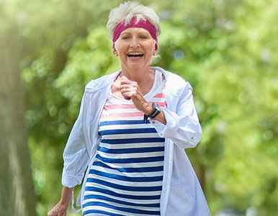
In sum…
Falls and mobility impairment are common
Many contributing factors
Exercise is best prevention, but often
other interventions are needed too.
Questions?

Slide 31
Selected references
CDC STEADI website. http://cdc.gov/steadi/index.html
National Council on Aging (ncoa.org)
Hartholt K, Lee R, Burns E, van Beeck E. Mortality From Falls Among US Adults Aged 75 Years or Older, 2000-2016. JAMA 2019
Xu G. et al. Prevalence of diagnosed type 1 and type 2 diabetes among US adults in 2016 and 2017: population based study. BMJ 2018.

