Slide 1
Welcome! Let’s Collaborate
Please tell us who you are!
Put your Name, and role/profession in the Chat
During discussion: Please unmute yourself or raise your hand to comment or ask a question.

Slide 2
This program is supported by the Health Resources and Services Administration (HRSA) of the U.S. Department of Health and Human Services (HHS) as part of an award totaling 749,836.00 with 0% financed with non-governmental sources. The contents are those of the author(s) and do not necessarily represent the official views of, nor an endorsement, by HRSA, HHS, or the U.S. Government. For more information, please visit HRSA.gov.

Slide 3

Your Roles in Primary Care:
To serve:
  Diverse populations
  Wide range of ages
  Desire to provide
  optimal care to all,
  including older people
This Photo by Unknown Author is licensed under CC BY

Slide 4
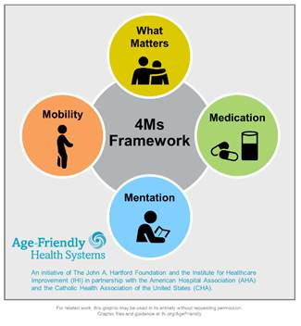
Age Friendly Primary Care:
These are the 4 important things
Notes:
The 4 things to enhance the health and quality of life for older people are. What we call the 4MsMs are the important things
What Matters: Know and align care with each older adult’s specific health outcome goals and care preferences including, but not limited to end-of-life care, and across settings of care (document what is important)
Medication: If medication is necessary, use Age-Friendly medications that do not interfere with What Matters to the older adult, Mobility, or Mentation across settings of care (Pharmacy protocols for med review in evaluating cognitive dysfunction, mobility and falls etc)
Mentation: Prevent, identify, treat, and manage dementia, depression, and delirium across settings of care
Mobility: Ensure that older adults move safely every day to maintain function and do What Matters

Slide 5

NGWEP is a Collaboration-teach/learn together
Monthly Case conferences- bring cases to discuss with 8 other clinics and a panel trained in geriatrics (medicine, psychiatry, social work, pharmacy) and community service specialists.
Annual Wellness Visits screen for the 4Ms- what are the next steps when issues are identified? EMR tools in EPIC to address mentation

Slide 6
Mentation
One of the 4Ms

Slide 7
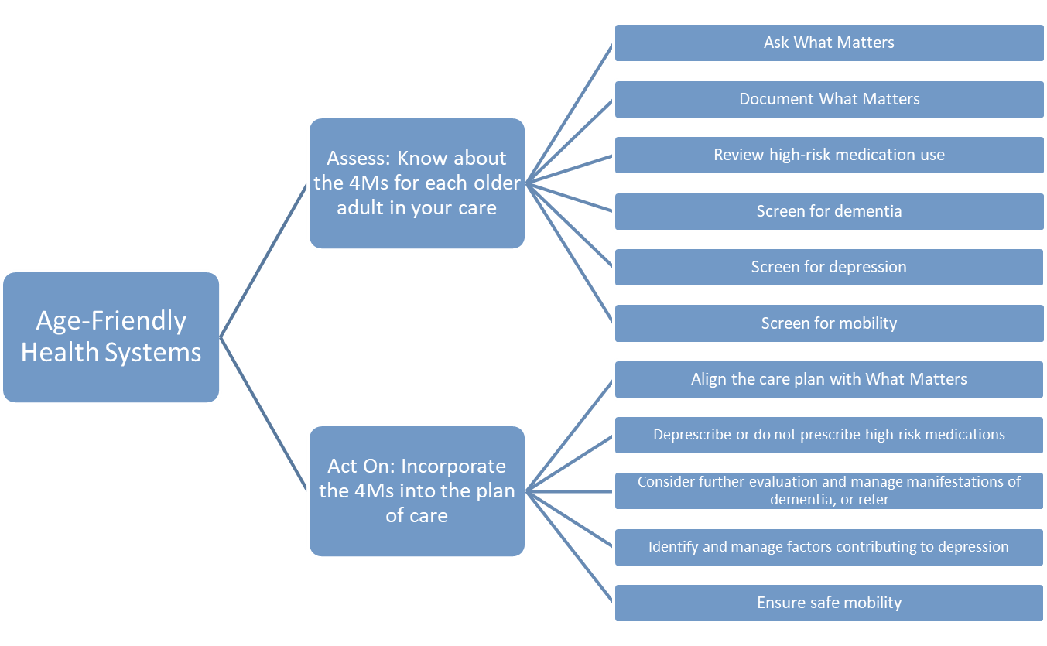
Using the 4Ms in Care of Older Ambulatory Patients
Know the 4Ms for every patient in your care
Screen for dementia, delirium and depression
Incorporate the 4 Ms in Plan of Care
Evaluate/refer for dementia
Manage depression
Manage delirium
Notes:
For talking points, please review the Guide: http://www.ihi.org/Engage/Initiatives/Age-Friendly-Health-Systems/Documents/IHIAgeFriendlyHealthSystems_GuidetoUsing4MsCare.pdf

Slide 8
Mentation: Objective: Screening & Next Steps
Delirium
Dementia
Depression

Slide 9

DEMENTIA
The most common cause of disability in later life¹
A focus for providers of health care to older adults
¹Reference available on request

Slide 10
Dementia
(DSM-5 Major Neurocognitive Disorder)
Chronic acquired decline in one or more cognitive domains (learning and memory, complex attention, language, visual-spatial, executive) sufficient to affect daily life
Etiology: Any disorder causing damage to brain systems involved in memory. Alzheimer’s disease is the most common cause in later life

Slide 11
DEMENTIA
AD
Other
Vascular
Lewy BD
An umbrella term there are many causes.

Slide 12

Mentation: Tips
Normalize cognitive screening for patients. For example, say “I’m going to assess your cognitive health like we check your blood pressure, or your heart and lungs.”
Emphasize an older adult’s strengths when screening and document it so that all providers have a baseline (in EPIC .MOCA5).
Screening for cognitive impairment is part of Welcome to Medicare and Medicare Annual Wellness Visits

Slide 13
Screen during Annual Wellness with the Mini-cog
I am going to name 3 objects and I want you to repeat those after me
“Apple, Table Penny” (2 tries to get it right)
“Now I want you to remember those 3 things because I will ask you to repeat them in a couple of minutes.”
Clock draw: “please draw the face of a clock and set the hands to read (e.g.) 10 min after 11:00.

Slide 14
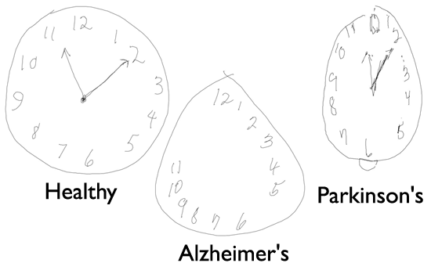
Mini Cog Interpretation
Each of the 3 items correct earns a point (0- 3 points)
Correct clock draw earns 2 pts; 1 point for getting the 12,3,6,9 in the correct anchor positions, no duplicate or missing numbers; 1 pt for the hands pointing correctly
Total score <3 points, worry about dementia

Slide 15

If I am worried about dementia, what’s next?
AD8- a close friend/relative answers 8 questions an answer yes to 2 or more means likely a problem.
Some PC clinics will refer the patient if abnormal mini-cog/MOCA and changes on AD-8
If AD8 is normal, but you are still worried do a MOCA and recheck the MOCA/AD-8 next year

Slide 16
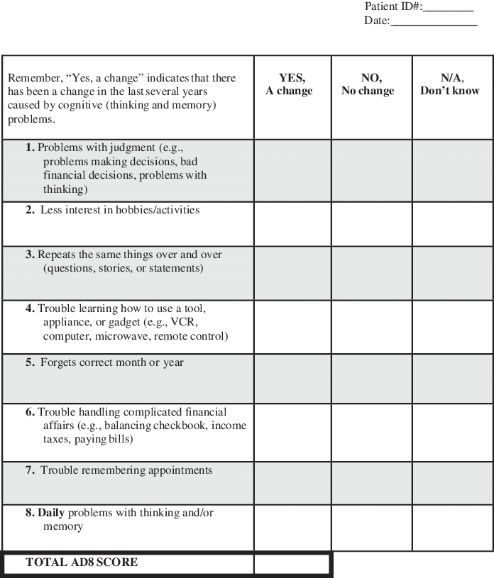
AD8
Alzheimer’s
Disease 8

Slide 17
Initial and FU Dementia Evaluation
99483, wRVU value= 3.44, not more often than every 180 days
Other general E &M codes cannot be used on the same day of service; elements overlap
Codes that can be used: prolonged service codes (99358/99359) transitional care codes (99495/99496 ).

Slide 18
EPIC documentation for 99483
Note Type: NM AMB Cognitive Impairment Care Plan Note covers the required elements of history, exam, functional assessment, caregiver and safety issues.
  A formatted HPI structures history of cognitive loss
  Exam block prompts for a neuro exam gait, symmetry, and strength
  Last PHQ-2 and MOCA are imported
Smart set: Geriatric Cognitive Impairment
  Lab and imaging, referrals and treatment of cognition (ACHE inhibitor etc);
  Treatment for behavior (if any), caregiver needs (AA referral)

Slide 19


Improving Memory in Primary Care
Take a look at the prescription medications
Look for substance misuse
Check labs for things you don’t want to miss

Slide 20
Prescription Drugs and Dementia
Many drugs make patients worse, e.g. Sedatives, anxiolytics, anticholinergics, H2-blockers, centrally acting antihypertensives (clonidine) antiarhythmics, beta blockers, digoxin, Sinemet, selegeline.
Don’t forget herbals and OTCs
Check all meds for CNS side effects
Ask Pharmacy to review (ref: PCMH pharmacy)

Slide 21

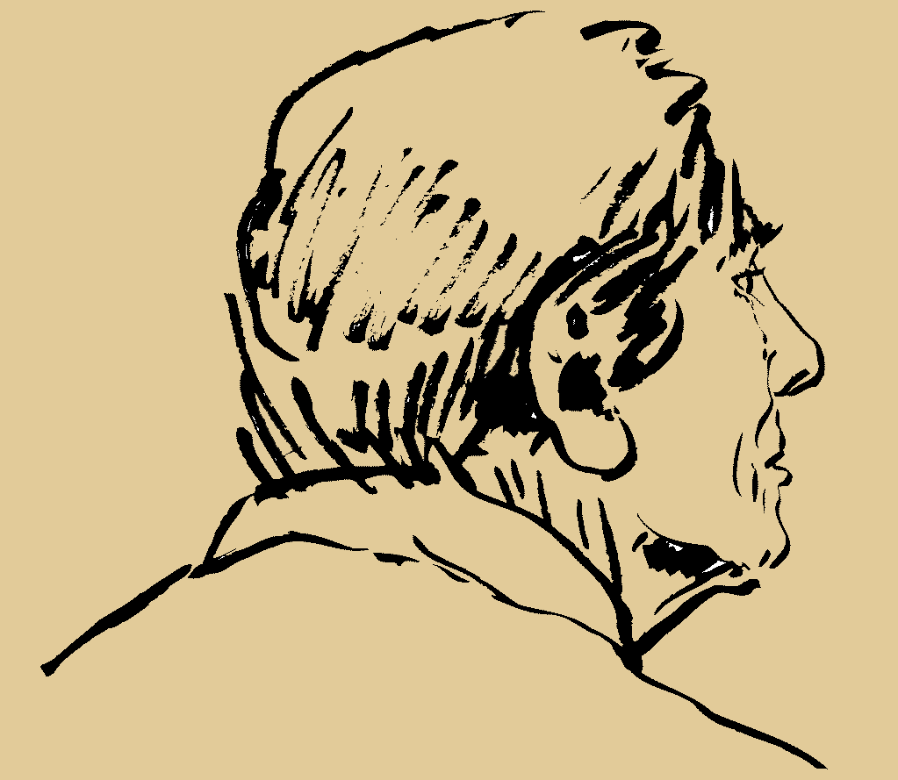
Alcohol and Dementia
Volume of distribution for ETOH with age
No more than one/day after age 65; stop all if memory is impaired

Slide 22
The Dementia Evaluation: don’t miss these
Laboratory/ Diagnostics
B-12, Folate, TSH
Chem profile, UA, ?O₂ sat
CBC
Other as indicated –most often drug levels
Brain Imaging (once, not multiple)

Slide 23
Caregiver Support: services offered by the Alzheimer’s Association
Information and Referral
Care Consultation
Safety Services
Support Groups
Monthly Educational Programs-webinars
Brain Health Awareness
Clinical Trials
Place EPIC referral “ Alzheimer’s”
prints info about the referral in the AVS

Slide 24

Mentation Part 2: Depression
Depression is common in elders with other health problems
Positive PHQ-2 triggers a PHQ-9 in most NM PCMH clinics-what is the workflow at CFM?

Slide 25
Subsyndromal Depression
Does not meet criteria for MDD; but may need pharm- or non-pharmacologic treatment
Can be serious and associated with functional decline
May complain of poor energy or somatic symptoms
May include adjustment disorder or mild depression with anxiety

Slide 26
Depression: can look like dementia
Dementia
Insidious onset
Long duration
No psychiatric history
Conceals disability (often unaware of memory loss)
“Near-miss” answers
Day-to-day fluctuation in mood
Pseudo-dementia
Abrupt onset
Short duration
Previous psychiatric history
Highlights disabilities (may complain of the memory loss)
“Don’t know” answers
Diurnal variation in mood, but generally more consistent

Slide 27
Mentation Part 3. Delirium (Acute Confusion)
• Symptom: decreased attention, environmental awareness
• Cognitive change (eg, memory deficit, disorientation, language disturbance) or perceptual disturbance (eg, visual hallucinations
• Three motor subtypes: hyperactive, hypoactive, and normal/mild change
• Rapid onset (hours to days) and fluctuates daily
• Evidence of a physical cause

Slide 28
Mentation: Delirium in Outpatients
Is UNDERRECOGNIZED
Has an underlying cause; is preventable and often treatable. Primary Care teams need to:
  Remove or treat underlying cause e.g. medication ADEs
  Restore/maintain function & mobility; recommend exercise
  Understand delirium behaviors
  Prevent complications- falls and adding high risk meds
Screen for delirium using the Ultra-Brief 2-Item Screener (UB-2)
Notes:
Talking Points from the What Matters Toolkit can be found here: http://www.ihi.org/Engage/Initiatives/Age-Friendly-Health-Systems/Documents/IHI_Age_Friendly_What_Matters_to_Older_Adults_Toolkit.pdf

Slide 29
Delirium Screening: Ultra Brief-2 (UB-2)
  1: Please tell me the day of the week
    Try to sit at eye level
    Be sure sensory aides (glasses, hearing aids) are in place patient can check anywhere (e.g., calendar, newspaper, etc.), but cannot ask for help
  2: Please tell me the months of the year backward, say December as your first month

Slide 30
UB-2 Instructions
If participant finished reciting months but missed one or more, it is incorrect and no prompting is allowed.
Prompt only with: “what month comes before __________ (last month they said)?” Prompt up to two times
If patient does not follow the instruction re-read the instructions once
Fick et al, Journal of Hospital Medicine, 2015

Slide 31
UB-2 Does not make a diagnosis
Sensitivity>90% of delirium, but specificity only 60%.
If the patient passes the UB-2 he/she does NOT have delirium
If the patient fails the UB-2 you need a second test to know if the cognitive problem is delirium
The 3D CAM is the best next test

Slide 32
Google: The 3D CAM (Marcantonio Annals 2014)
3D Confusion Assessment Methodology
CAM FEATURE
1 | Acute Change/Fluctuating Course
2 | Inattention
3 | Disorganized thinking
4 | Altered Level of Consciousness
Delirium Diagnosis Requires 1 & 2 and either 3 or 4
Sensitivity 95% (C.I. 84%, 99%], specificity 94% C.I. [90%, 97%]

Slide 33

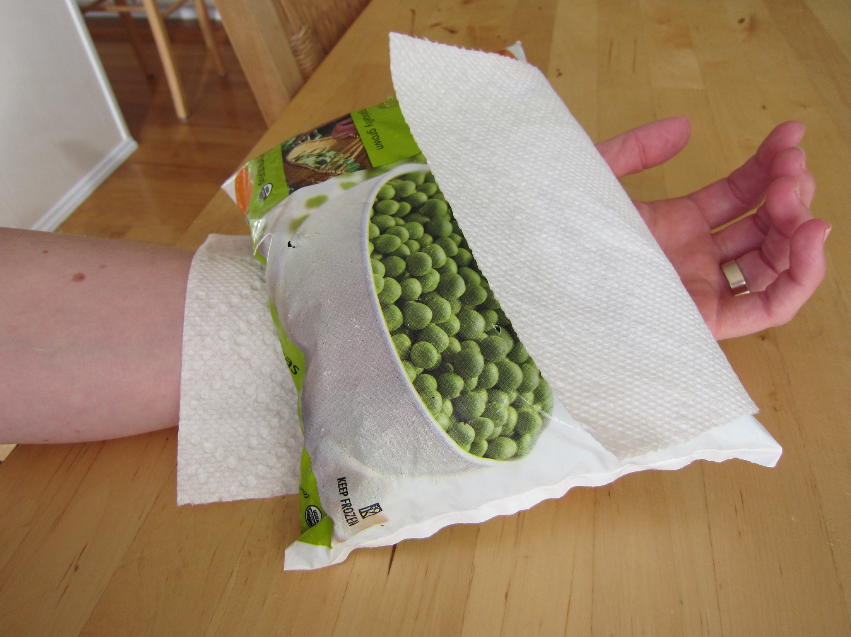
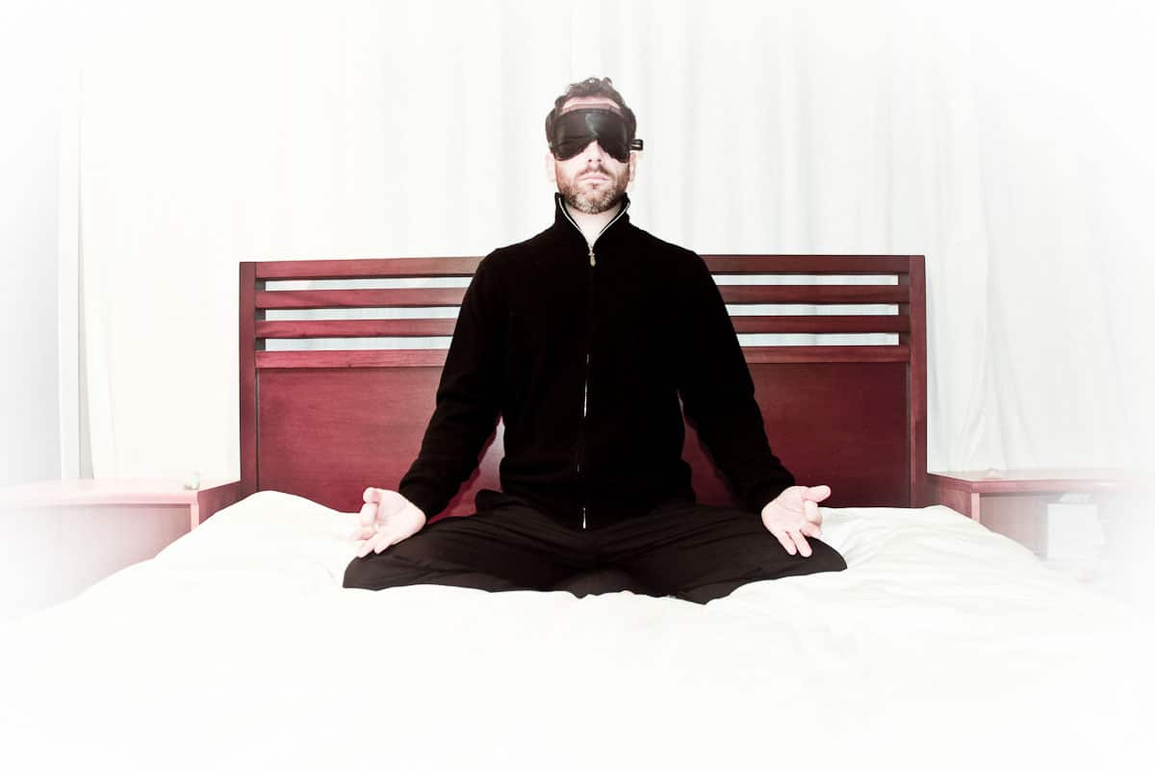
Mentation: Keeping the patient’s brain healthy
Offer non-pharmacological options for
MOOD
Pain
Sleep

Slide 34
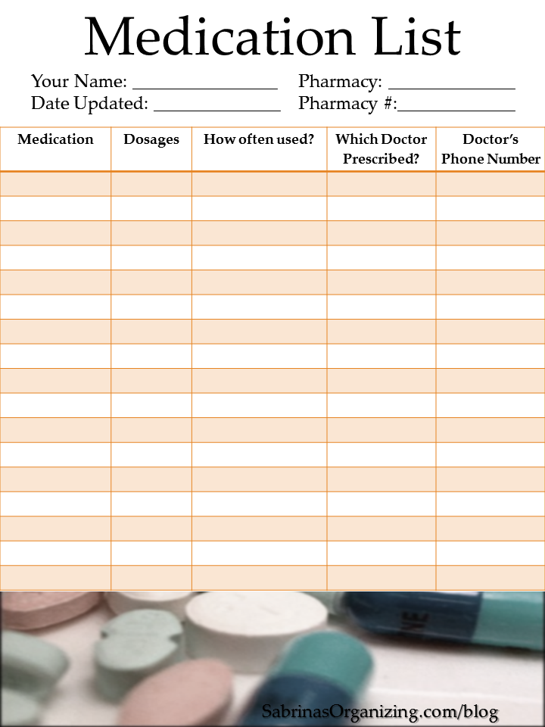
Mentation: Keeping the patient’s brain healthy
Ensure that the older adult and family caregivers understand:
  What medications are for
  How to take them
  How to know if they are helping or possibly causing adverse side effects.

Slide 35


Mentation: More Tips
NM selected the MOCA as our tool
Use tools only as instructed and provide training.
Document mental status in the chart to measure change over time (EPIC review flow sheet .moca5)
Until ruled out, consider a change in mental status to be delirium and raise awareness among care team and family caregivers about the risk of delirium superimposed on dementia

Slide 36
Annual Wellness Visit
Requires screening for dementia and depression
Ensures there is a time to look for these problems each year
You get a baseline for patients
It is easier to find changes when you know the baseline

Slide 37
Mentation: screen for problems & take next steps
Delirium
Dementia
Depression

Slide 38
THANK YOU!!
Before you leave click the link in the chat to complete the session evaluation with passcode 0830

