Slide 1
Mental health Issues in Long Term Care
Thomas Magnuson, M. D.
Associate Professor
Division of Geriatric Psychiatry
UNMC

Slide 2
This program/project is supported by the Health Resources and Services Administration (HRSA) of the U.S. Department of Health and Human Services (HHS) as part of an award totaling $749,836.00 with 0% financed with non-governmental sources. The contents are those of the author(s) and do not necessarily represent the official views of, nor an endorsement, by HRSA, HHS, or the U.S. Government. For more information, please visit HRSA.gov.

Slide 3
Objectives
Cognition
Mood
Anxiety
Psychosis

Slide 4
cognition

Slide 5
Cognition
Delirium
Dementia

Slide 10
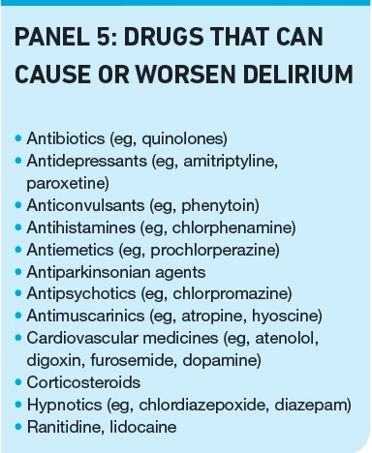
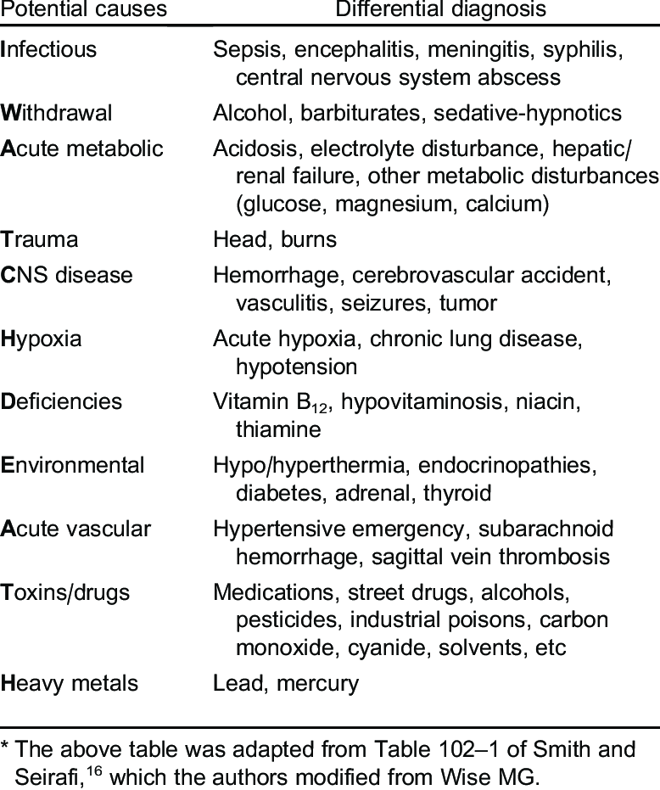

Slide 12
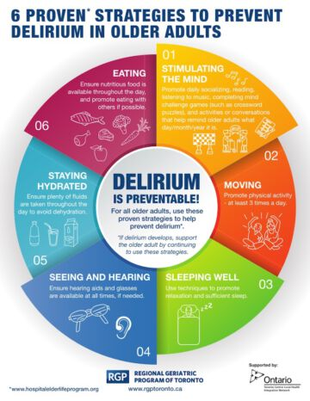

Slide 15
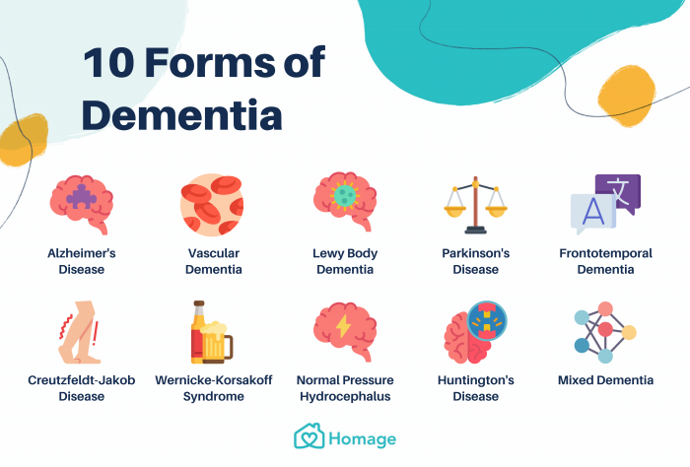

Slide 17
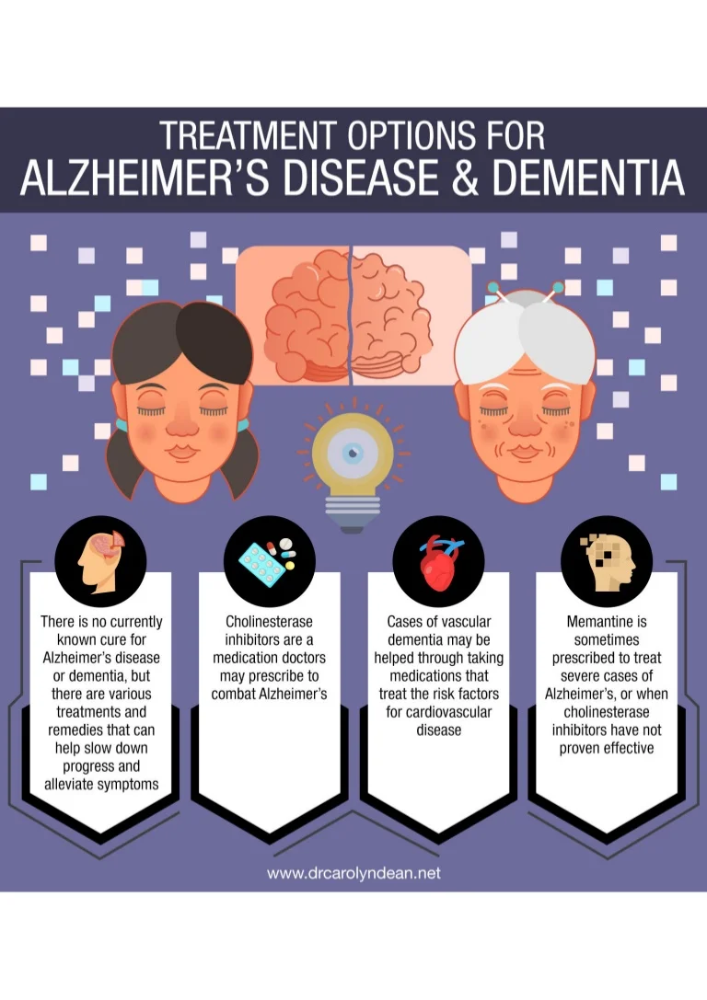

Slide 18
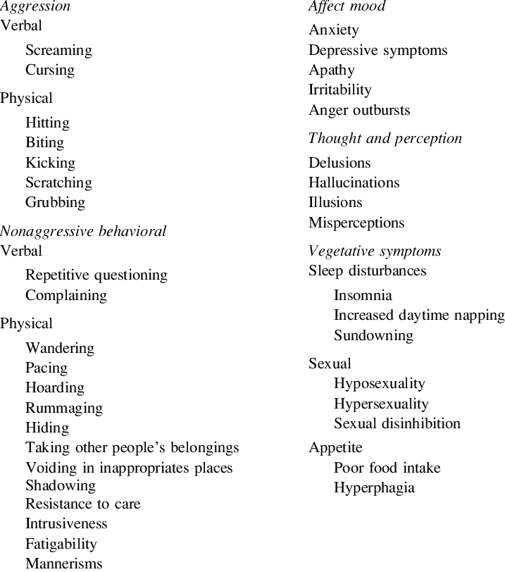

Slide 20
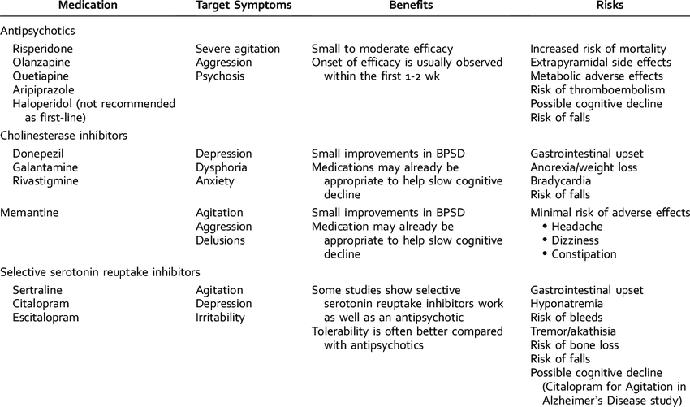

Slide 21
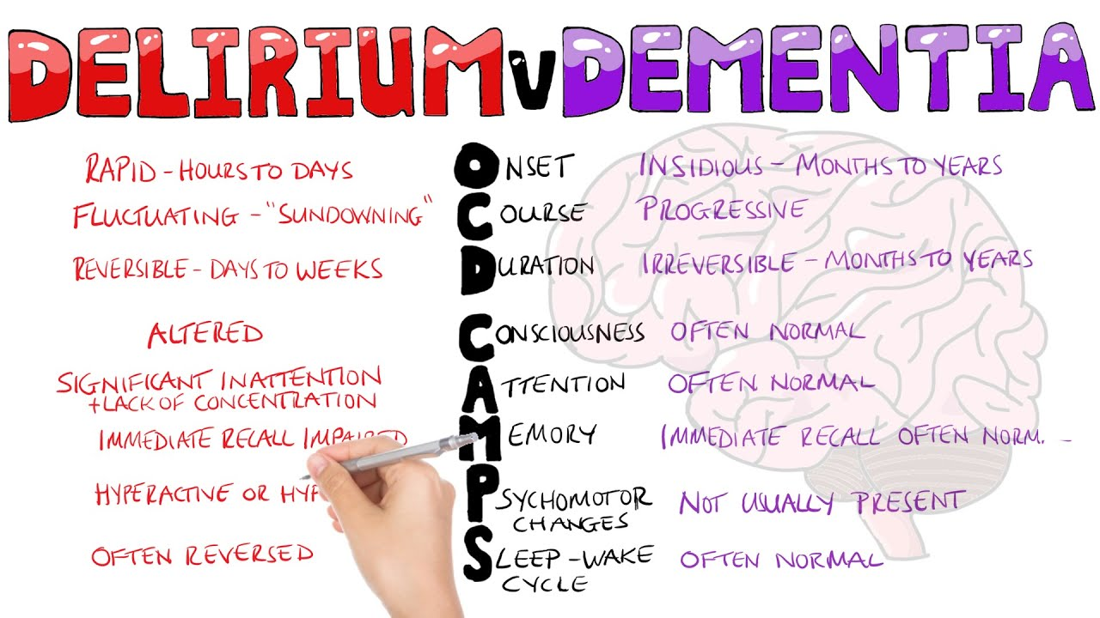

Slide 22
Mood

Slide 23
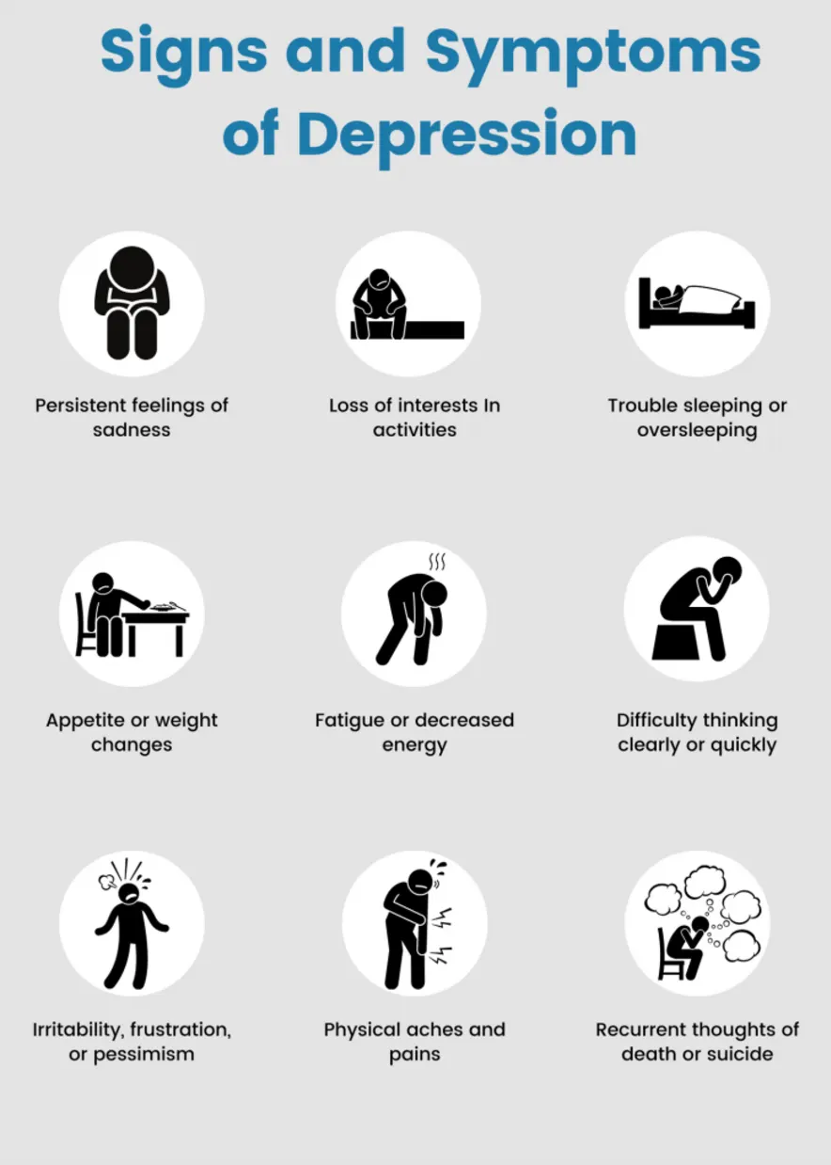

Slide 27
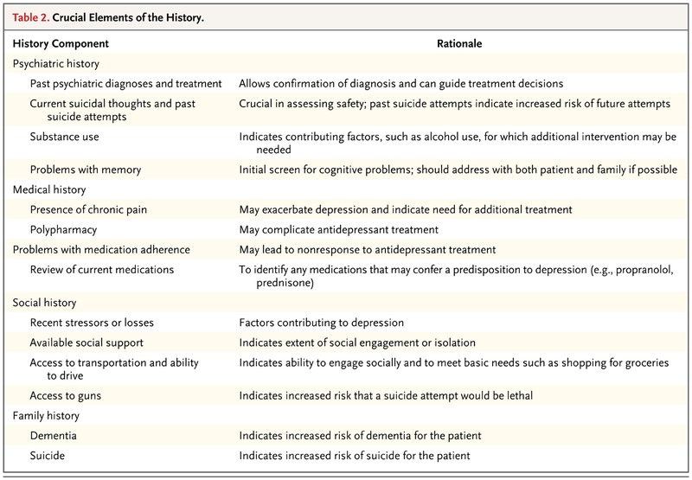

Slide 28
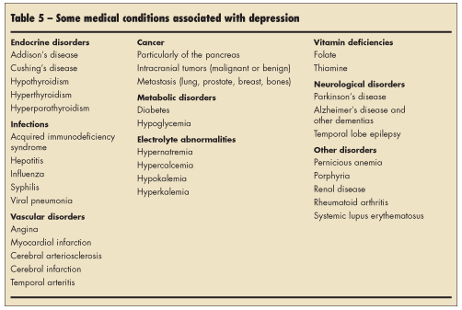

Slide 32
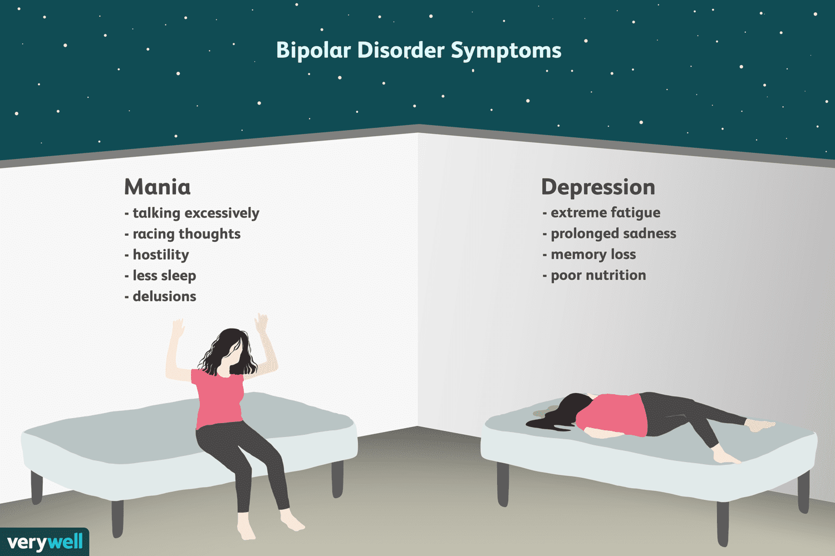

Slide 34
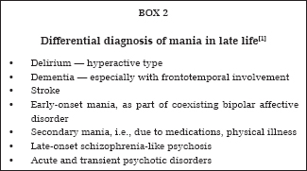

Slide 35
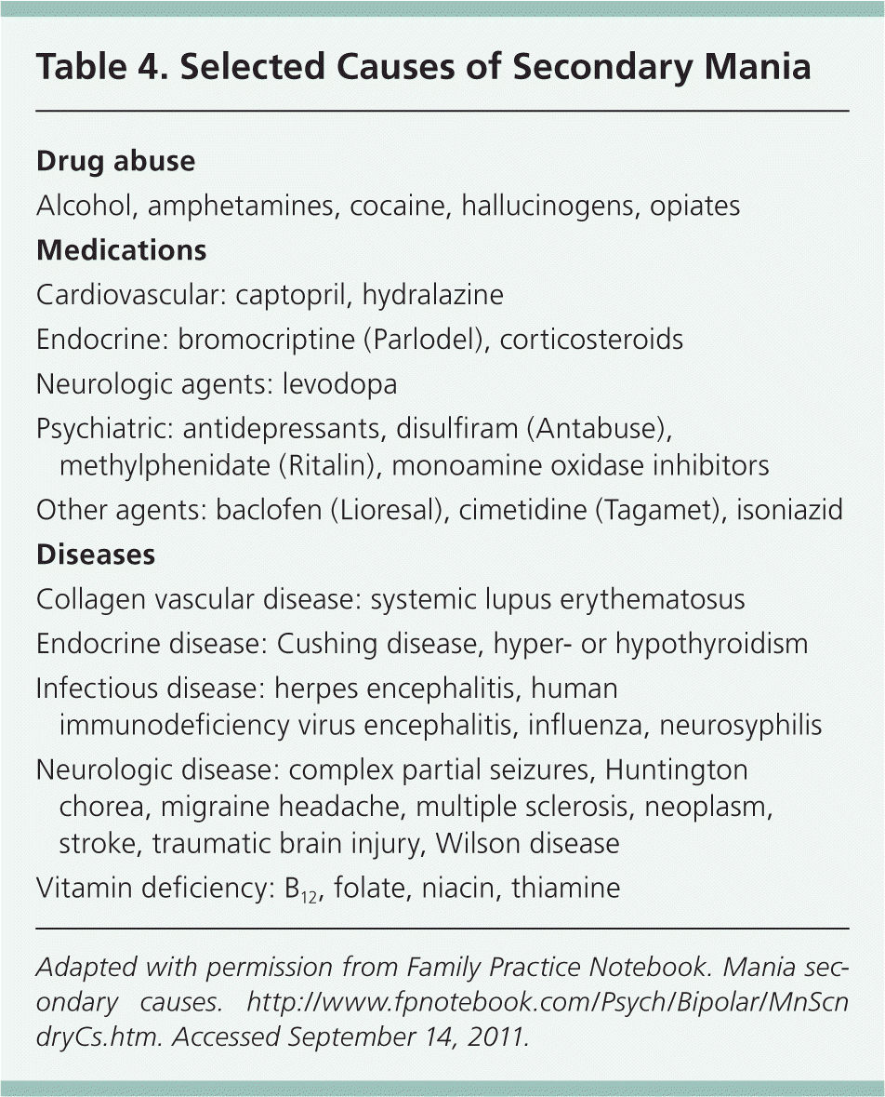

Slide 38
anxiety

Slide 40
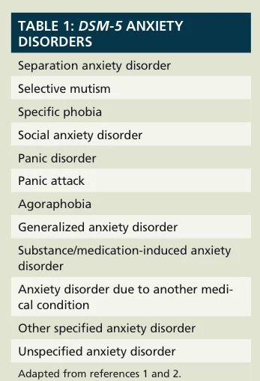

Slide 41
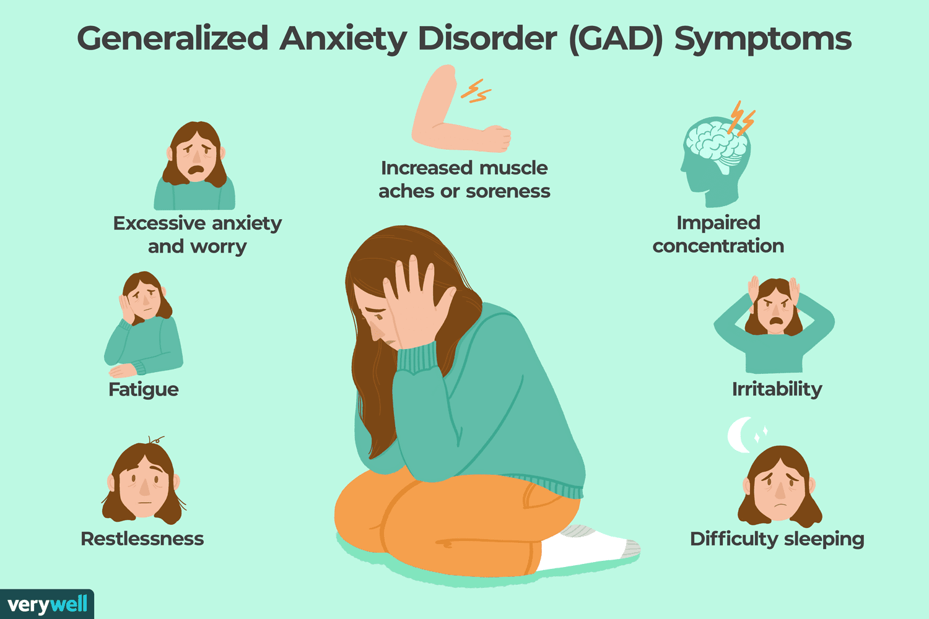

Slide 44
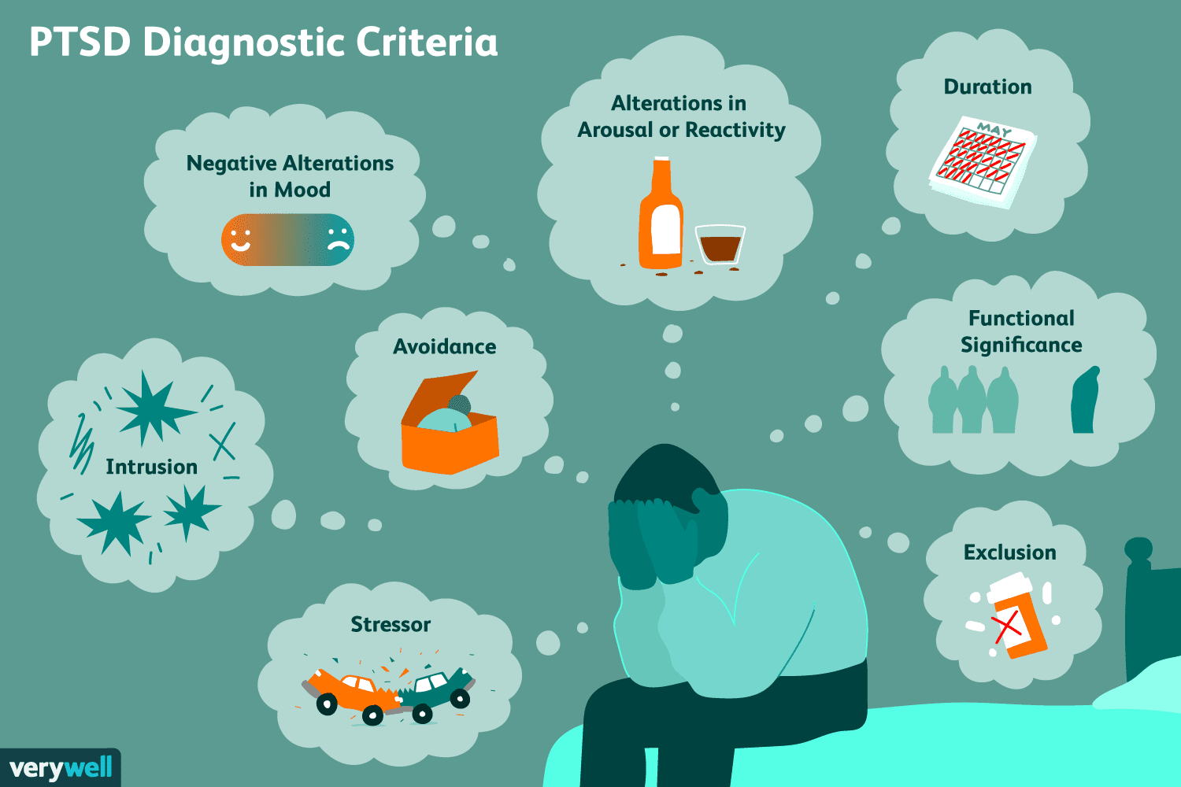

Slide 46
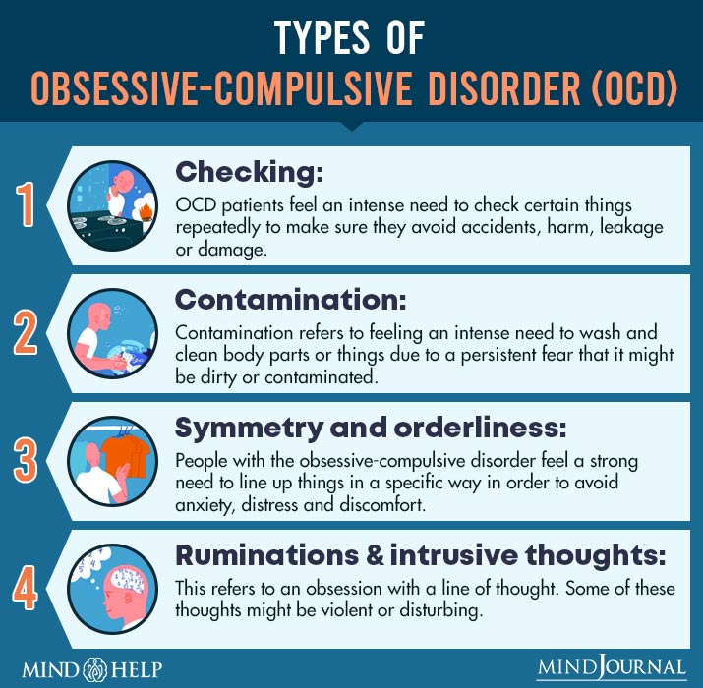

Slide 47
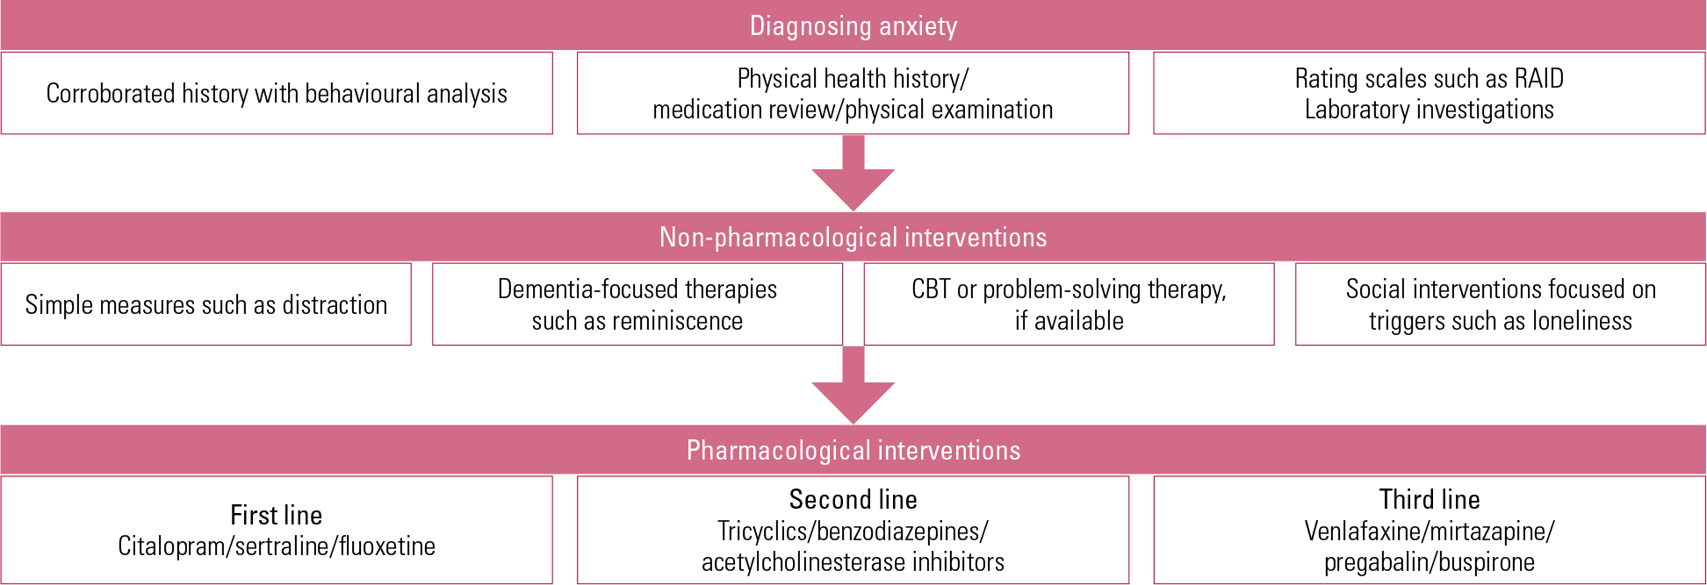

Slide 48
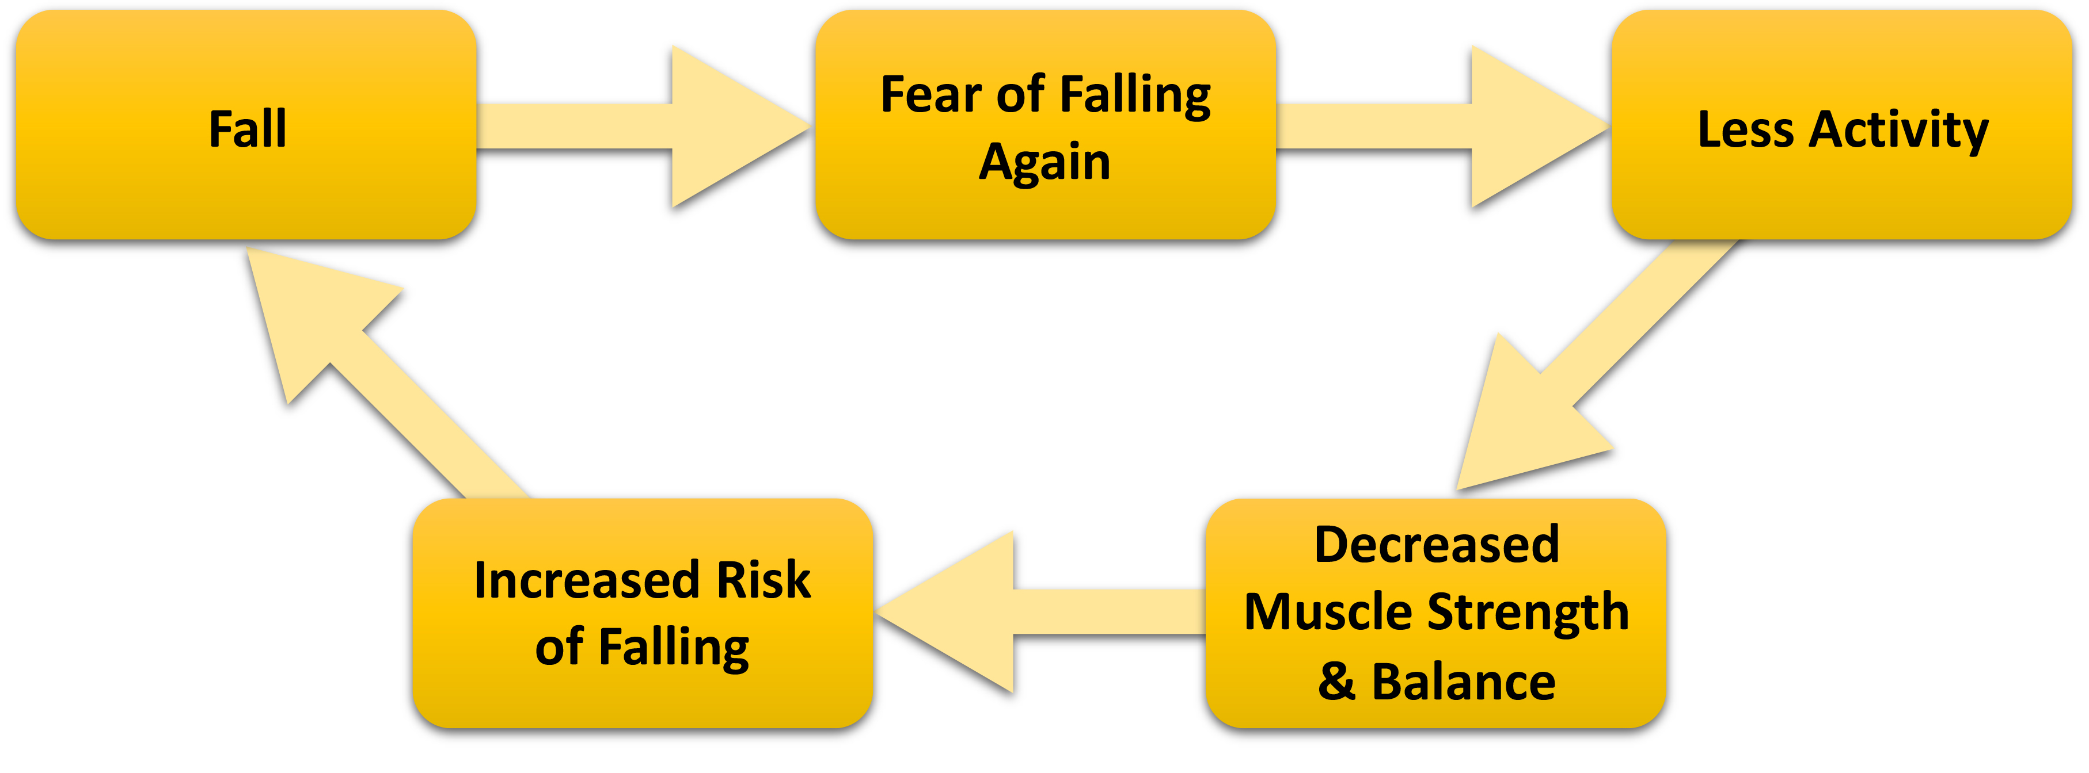

Slide 51
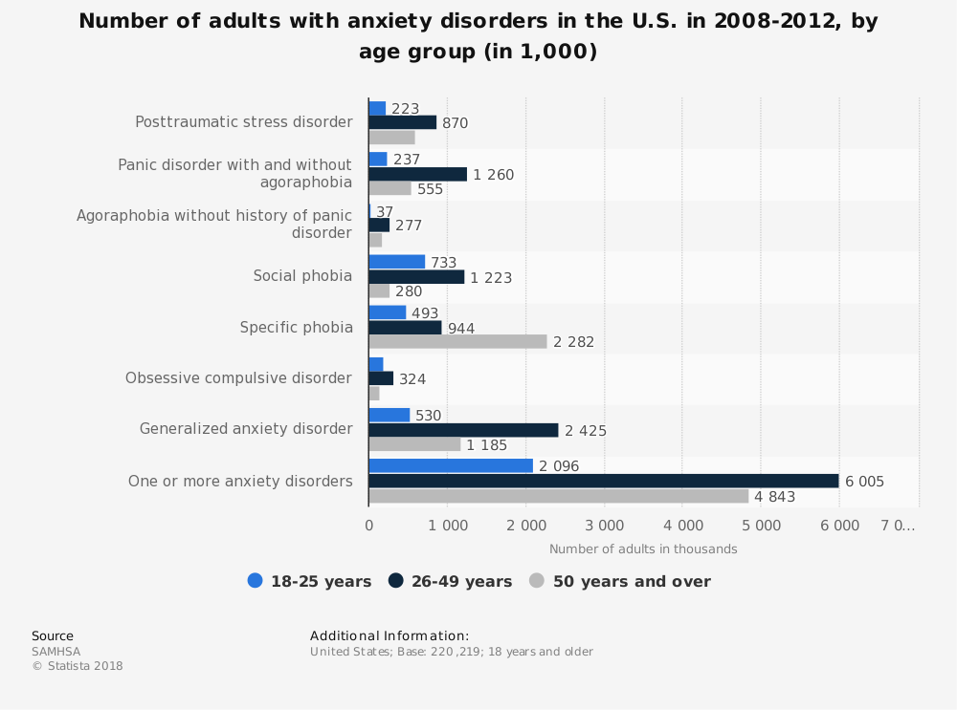

Slide 52
psychosis

Slide 54
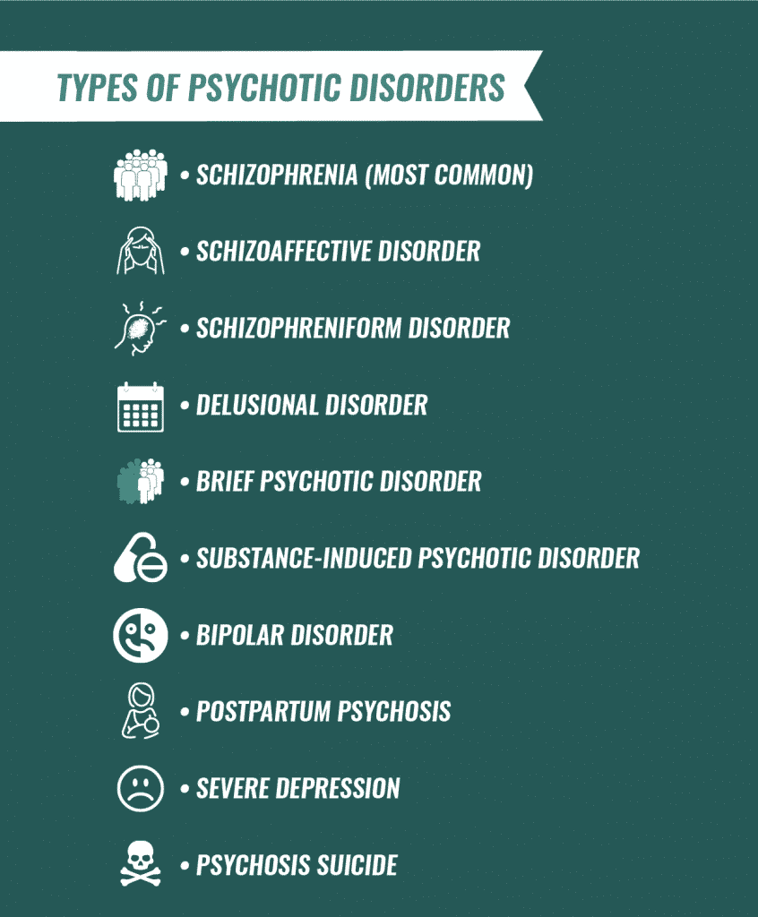

Slide 55
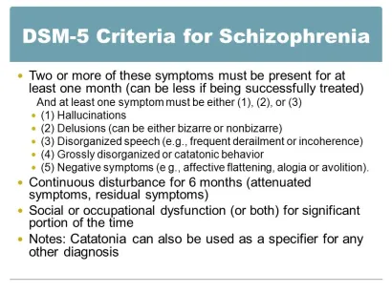

Slide 56
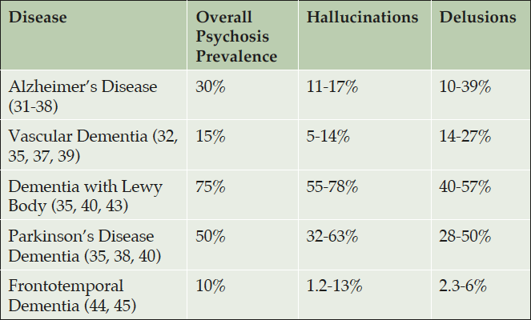

Slide 58
