Slide 1
Physical activity in older adults
Alex Dworak MD
OneWorld CHC
GWEP collaborative 11/03/2022

Slide 2
Exercise and physical activity
Numerous benefits at all ages beyond infancy
Generally de-prioritized for multiple reasons including social determinants of health
Time due to work and family care responsibilities
Mental health challenges
Cost of gym membership or home equipment
Toxic fitness culture which may not be inclusive
Erroneous ideas about injury rates or physical effects
Lack of familiarity with training modalities/intimidation of seeking assistance
Prioritization of automobiles/lack of safe areas in the built environment

Slide 3
Patient presentation
Your patient is a 71 year old with a history of a severe bicep tear and cervical neck strain recently.
Northern European ancestry, generally healthy.
Doesn’t really do any walking for exercise; used to do bodybuilding and strongman exercises like yoke walks and stone carries back in Europe. Now lives in the city, still working part time.
Height: 6’4”. Weight: 300 lbs. BMI 36.5.
No medications, up to date on age appropriate cancer screening.
How would you counsel this patient on injury prevention?

Slide 4
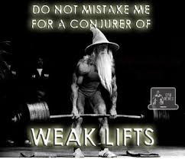
DYEL?
Do any of your patients engage in resistance training (that you know of)?
Do any of your patients engage in regular aerobic exercise (that you know of)?
Do you personally train in cardio? In strength training?
Do you feel comfortable advising patients on devising an exercise regimen?
Do you have time during your visits?
Do you have someone you can refer to for this purpose?

Slide 5
Exercise at 65 and beyond
ACSM recommendations: 2018 guidelines
27% of elders meet the recommendations
Worksheet for elderly/handout in English: https://www.acsm.org/all-blog-posts/acsm-blog/acsm-blog/2019/09/10/physical-activity-function-older-age
Physical activity reduces the risk of fall-related injuries in older people by 32-40%, and this includes severe falls requiring medical care or hospitalization

Slide 6
Exercise at 65 and beyond
There is strong evidence that physical activity improves physical function and reduces the risk of age-related loss of physical function in a dose-response manner among the general aging population and improves physical function in older people with frailty and with Parkinson’s disease
Moderate evidence indicates that for older adults who sustained a hip fracture or stroke, extended exercise programs and mobility-oriented physical activity improves physical function

Slide 7
Exercise at 65 and beyond
“I like to go walking.”
Type of physical activity: The physical activity programs that effectively reduced the risk of fall-related injuries and bone fractures contained a variety of group- and home-based activities.
Most programs were multicomponent and included various combinations of moderate-intensity balance, strength, endurance, gait, and physical function training, as well as recreational activities (e.g., dancing, cycling, gardening, sports).
Although the research is limited, it does not support the use of low-intensity walking as a primary mode of physical activity to reduce the risk of fall-related injuries and fractures among older adults, although walking may be included in multicomponent physical activity regimens.

Slide 8
“Whoa! Don’t hurt yourself!”
It is a very common misconception that resistance training offers excessive injury risk.
Heavy powerlifting, with proper form, has an injury rate equal to or less than walking (including for things like getting hit by a car due to distracted driving—that doesn’t usually happen in a gym…)
I am unaware of any specific data in the elderly, but in general, starting slow and doing linear progression without rapid ramp up is recommended.

Slide 9
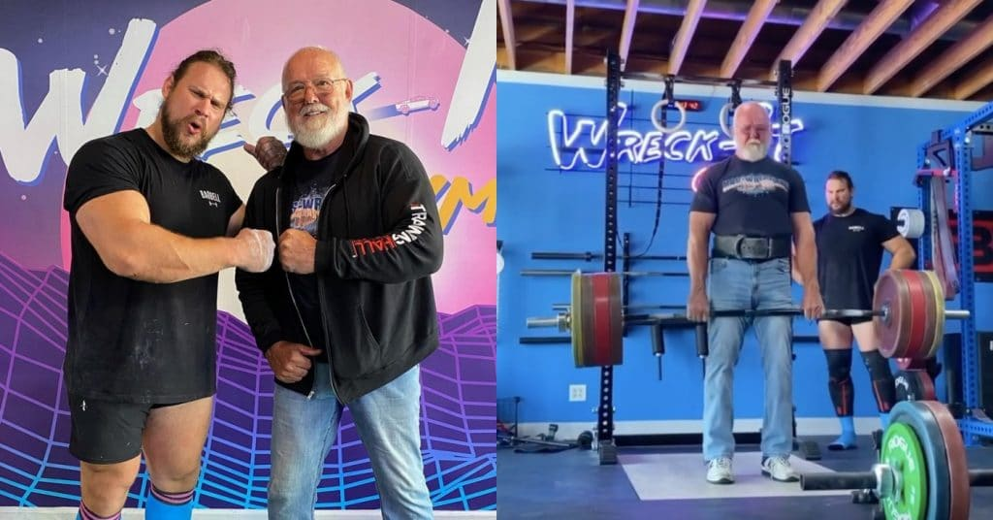
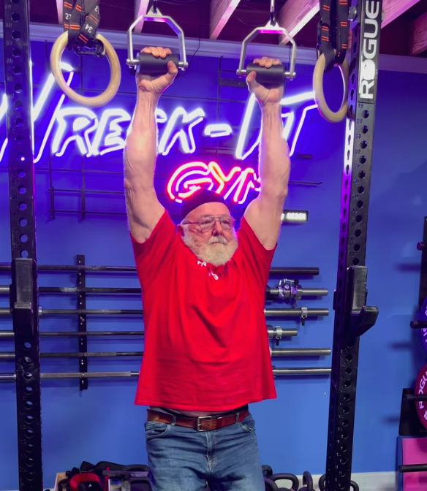
Returning to the case
The patient (not actually my patient—I wish!) is…
Odd Haugen, the Vise Grip Viking
Pictured: At the Arnold 2020, with WSM Martins Licis, deadlifting 451x3 with an axle, doing a 35 second dead hand on RGT

Slide 10
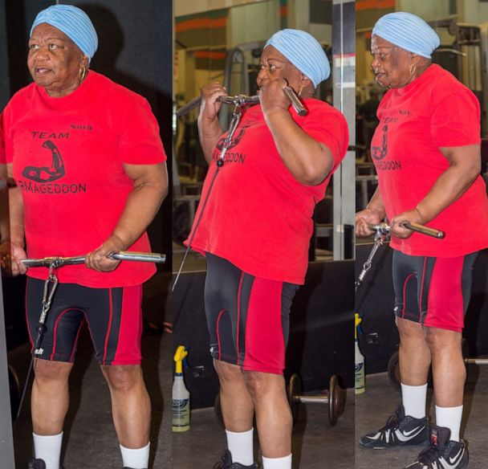
Another example
Nora Langdon, 78 years old
https://youtu.be/9J1geyFW0uY
Started going to the gym at 65

Slide 11
https://www.roguefitness.com/theindex/video/odd-haugen-and-the-world-record-thomas-inch-dumbbell-lift-2 (2016 at the age of 66)

Slide 13
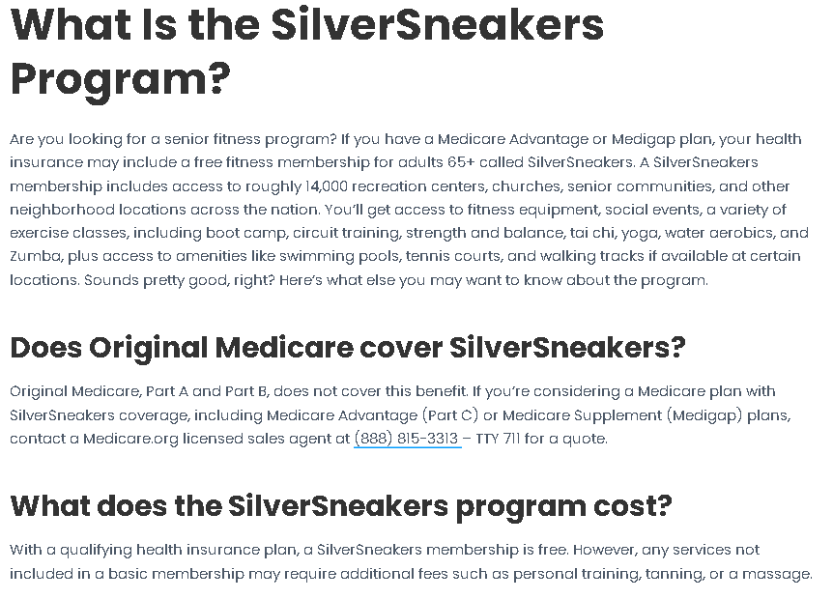

Slide 14
Discussion of strategies for exercise counseling in our patients
150 minutes of aerobic activity per week at moderate intensity
OR 60 minutes per week of vigorous activity
2 resistance training sessions per week
Balance, stretching activity 10 minutes twice a week
https://www.aafp.org/afp/2010/0101/p55.html

Slide 15
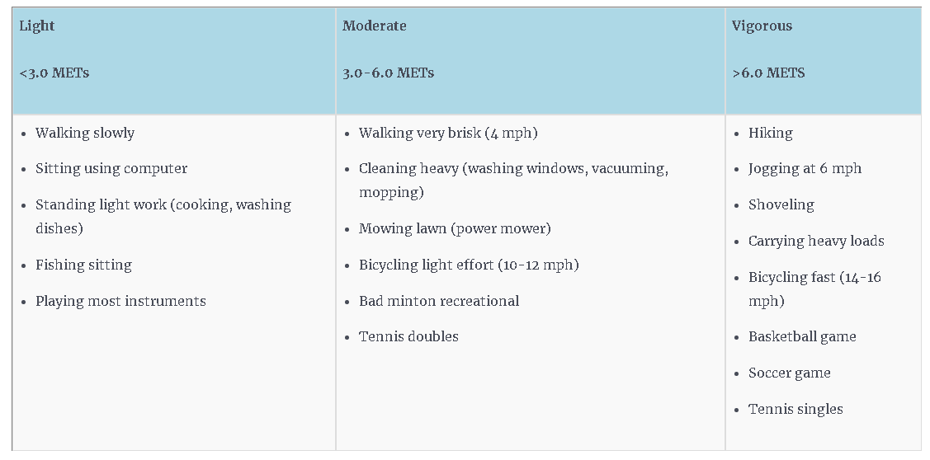

Slide 16
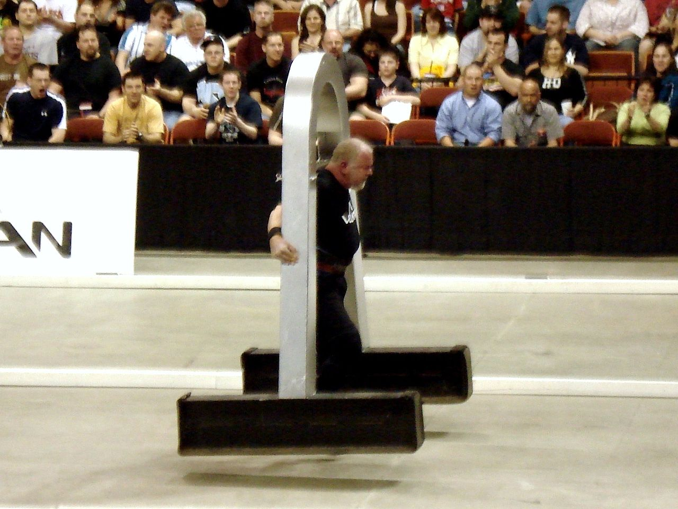

Slide 17
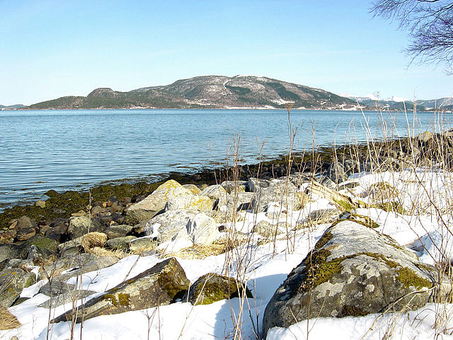
Thank you!

