Slide 1

What Matters
Bill Lyons, MD
November 9, 2022

Slide 2
This program is supported by the Health Resources and Services Administration (HRSA) of the U.S. Department of Health and Human Services (HHS) as part of an award totaling $749,836.00 with 0% financed with non-governmental sources. The contents are those of the author(s) and do not necessarily represent the official views of, nor an endorsement, by HRSA, HHS, or the U.S. Government. For more information, please visit HRSA.gov.

Slide 3
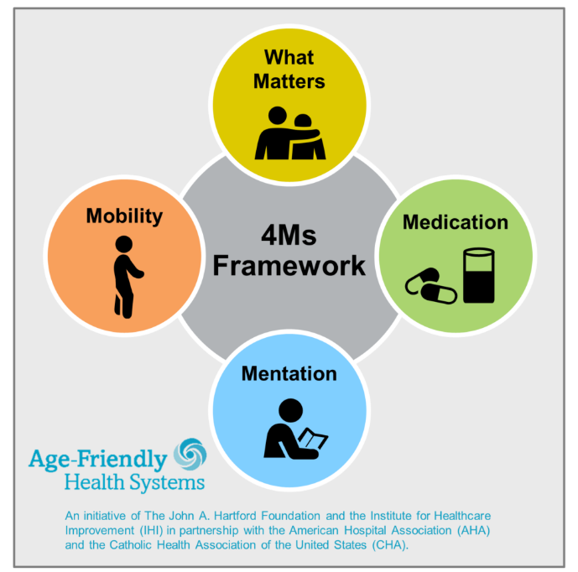
What Matters Focusing on What Matters Most means looking at the goals of our care, coordinating advance care planning, and making sure priorities and preferences that are important to us individually become part of our treatment plans.
Medications Focusing on Medications means raising awareness about potential side effects while also working to reduce the number of medications we take whenever we can.
Mobility is the term for being able to move freely on our own or with help. Mobility is linked to staying physically fit and being able to live on our own for as long as possible, which makes it one of the most important “Ms” of geriatrics for our health, safety, and independence. Focusing on Mobility means maintaining our ability to walk or stay balanced while also avoiding falls and other types of common injuries.
Mentation Staying mentally sharp and managing mental health can help us live longer and hopefully healthier lives. That’s why expert attention to the Mind—one of the “Ms” of geriatrics and age-friendly care—is such an important part of our well-being. Focusing on the Mind means supporting our brain health and managing unique conditions like dementia, delirium, and depression, which can affect our ability to think clearly and make decisions.

Slide 4
Collaboration helps us all achieve more
Methods to collaborate:
Attend, Participate, Provide Feedback
During discussion: Please unmute yourself to contribute and ask questions.
Following each session, complete surveys and provide feedback

Slide 5
COUPLE OF GREAT RESOURCES
prepareforyourcare.org
  Rebecca Sudore et al
  Advance Care Planning
patientprioritiescare.org
  Tinetti, Blaum, Naik, et al
  Priority setting in multimorbidity, good for ACP as well

Slide 6
ACP AND ELICITING WHAT MATTERS
Similar and related activities
ACP, by definition, is about planning for the future
ACP entails
  Identification of surrogates
  Elicitation of What Matters
Yet eliciting What Matters is helpful in the here and now of managing multimorbid patients

Slide 7
MEET RENEE
40 yo woman is an elementary school art teacher with hyperlipidemia and hypothyroidism.
Recently remarried, she has an 8-month old son and 5-year-old daughter.
A chest film incidentally discovers a 2-cm RUL mass; pathology shows adenocarcinoma.
What are your next steps in her care?

Slide 8
MEET MILDRED
85 yo woman is a retired elementary school art teacher with advanced parkinson disease, related dementia, HFrEF (last EF 20%), frailty.
Widowed, her son and daughter reside out of state with their families. Resides in an ALF.
A chest film incidentally discovers a 2-cm RUL mass; pathology shows adenocarcinoma.
What are your next steps in her care?

Slide 9
CARE FOR MANY OLDER ADULTS WITH MULTIPLE CONDITIONS MAY…
Be of uncertain benefit
  Few older adults in RCT’s
  Those who are don’t look like Mildred
  These persons have less benefit from treatment than those in the studies
Be burdensome
Inflict unintended harm
Be frustrating
Hence the need for determining What Matters

Slide 10


ADVANCE CARE PLANNING
Is a process, not just a form or document
Involves
  Reflection
  Sharing

Slide 11
KEY DECISIONS INVOLVED IN ACP
Choosing a surrogate
Articulating What Matters Most
(Maybe) Clarifying strong views about medical interventions
  CPR
  Intubation
  Dialysis
  Artificial nutrition and hydration
  Etc.

Slide 12

SET UP THE CONVERSATION
Thinking in advance – hope for the best, prepare for the worst
Benefit for patient and family
No decisions necessary today, but…
Is this OK?

Slide 13

CHECK THEIR UNDERSTANDING
(Not always necessary)
What is your understanding now of where we are with your illness?
“I know we doctors may not always do the best job of communicating about these things”
Calibrate their understanding as needed

Slide 14
PROGNOSIS
(Not always necessary)
(May provide rationale for: Why now?)
Share prognosis as a range, tailored to information preferences
How to estimate?
  Experience
  Contact consultant if a prominent disease
  eprognosis.ucsf.edu

Slide 15

REALISTIC EXPECTATIONS OF ACP
Can’t expect the process or document to cover every possible situation or decision
Better to spend time clarifying desired (vs undesired) way of living than…
Checking a selection of boxes on menu of possible interventions

Slide 16
CHARACTERISTICS OF A GOOD SURROGATE
Reasonably available
Can understand and represent patient’s particular goals, values, preferences…
…Even if they don’t agree with them!
Can make decisions in difficult moments

Slide 17
CHOOSING THE SURROGATE
Can’t just pick one – need to have a heart-to-heart talk
Patient should think about and clarify how much flexibility (if any) to grant the surrogate

Slide 18
WHAT MATTERS: GOALS
What things are most important in your life?
Examples:
  Function and independence – living on your own, caring for yourself
  Longevity
  Social connection – friends, family, religion
  Symptom relief
Have you changed your mind about what matters in your life? (Say more…)

Slide 19

GOALS, cont.
What would you be doing more of if your [ailment] were not so burdensome?
(Probably better for current multimorbid management than for ACP)
What activities are particularly important or meaningful?

Slide 20

GOALS, cont.
Describe what a good day would look like
Which relationships or connections are most important to you?
What brings you the most enjoyment or pleasure?
What do you hope your health care can do for you?

Slide 21
WHAT MATTERS: BURDENS
Are these aspects of your health care making it difficult to meet your goals
  Medicines (pills, shots, drops, inhalers)
  Self-care tasks (diet, FSBG checks…)
  Blood tests and x-rays, etc.
  Medical visits
  Dialysis…
What are you willing/able to do, and what NOT?

Slide 22

WHAT MATTERS: FEARS AND WORRIES
What are your biggest fears and worries about the future with your health?
What experience have you had with serious illness?
What went well? What didn’t? Why?
In the same situation, what would you want?

Slide 23
FEARS AND WORRIES, cont.
Can you imagine anything that would be worse than death? Or,
Can you think of any health situations that would be hard on your quality of life?
Some people might say
  Not being able to live w/o machines
  Not being able to think for oneself
  Not being able to live on one’s own
  Constant pain…

Slide 24
SCENARIO TO CONSIDER
Sudden event has left you unable to communicate
You’re receiving all care needed to keep you alive
Doctors believe little chance you’ll recover ability to know who you are or who you’re with
Would you want
  Medical treatment to keep you alive, or
  To stop the medical treatment
  (You’d be kept comfortable in any case)

Slide 25
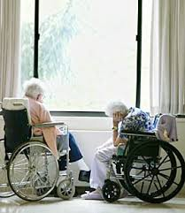
WHAT MATTERS: FUNCTION
What abilities are so critical to your life that you can’t imaging living without them?

Slide 26
WHAT MATTERS: TRADE-OFFS
If you became sicker, how much are you willing to go through for the possibility of gaining more time?
“I’ve had some patients who have told me, “Doc, I want you to do anything you can to have me live as long as possible – surgery, breathing machines, you name it….”
“And I’ve had other patients….”

Slide 27


QUESTIONS AND COMMENTS?

Slide 28
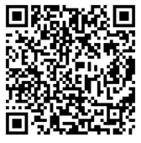
We value your feedback
Please take a moment to share yours with QR code or link below:
Passcode: 1109
Link: https://unmcredcap.unmc.edu/redcap/surveys/?s=44HA8NKX8C

