Slide 1
Colon Cancer Screening: age 50-75 age 45 to 75-85
Kathryn Hutchins, MD
Assistant Professor, Division of Gastroenterology & Hepatology
Program Directory, Gastroenterology Fellowship

Slide 2
Disclosures
None

Slide 3
What percentage of individuals in the United States are currently undergoing screening for CRC?
25%
45%
65%
85%

Slide 4
What percentage of individual in the United States are currently undergoing screening for CRC?
25%
45%
65%
85%

Slide 5
Setting: Annual exam with conversation to address health care maintenance:
Which of the following patients should you recommend colorectal cancer screening based on USPSTF guidelines?
43 y/o female with family history of “small benign” colon polyp in her mother at age 65.
38 y/o African American male without family history of CRC.
77 y/o Caucasian male with hypertension but otherwise healthy.
65 y/o Hispanic female with diarrhea and hematochezia

Slide 6
Setting: Annual exam with conversation to address health care maintenance:
Which of the following patients should you recommend colorectal cancer screening based on USPSTF guidelines?
43 y/o female with family history of “small benign” colon polyp in her mother at age 65.
38 y/o African American male without family history of CRC.
77 y/o Caucasian male with hypertension but otherwise healthy.
65 y/o Hispanic female with diarrhea and hematochezia

Slide 7
Objectives
Review CRC epidemiology and recommendations for screening
Discuss the stool-based screening tests and direct visualization screening tests for CRC
Discuss the pros / cons of the different screening tests

Slide 8
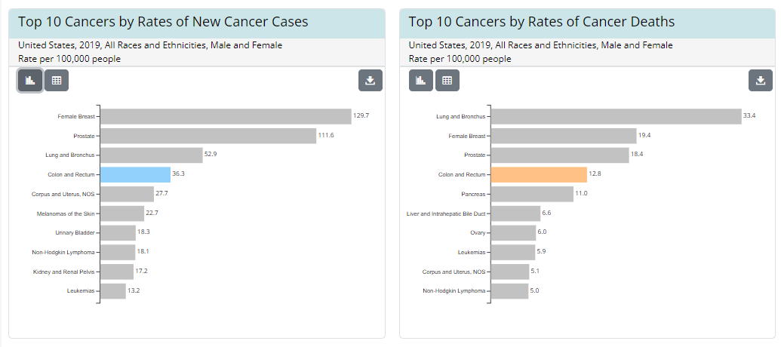
CRC Epidemiology: CRC is common
3rd most common cause of cancer in men and women
https://cdc.gov/cancer

Slide 9
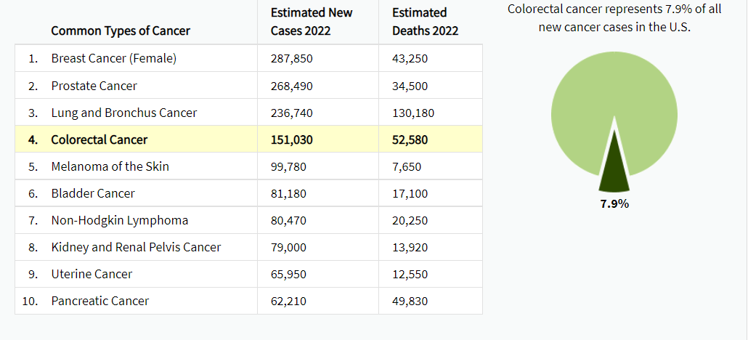
https://seer.cancer.gov

Slide 10
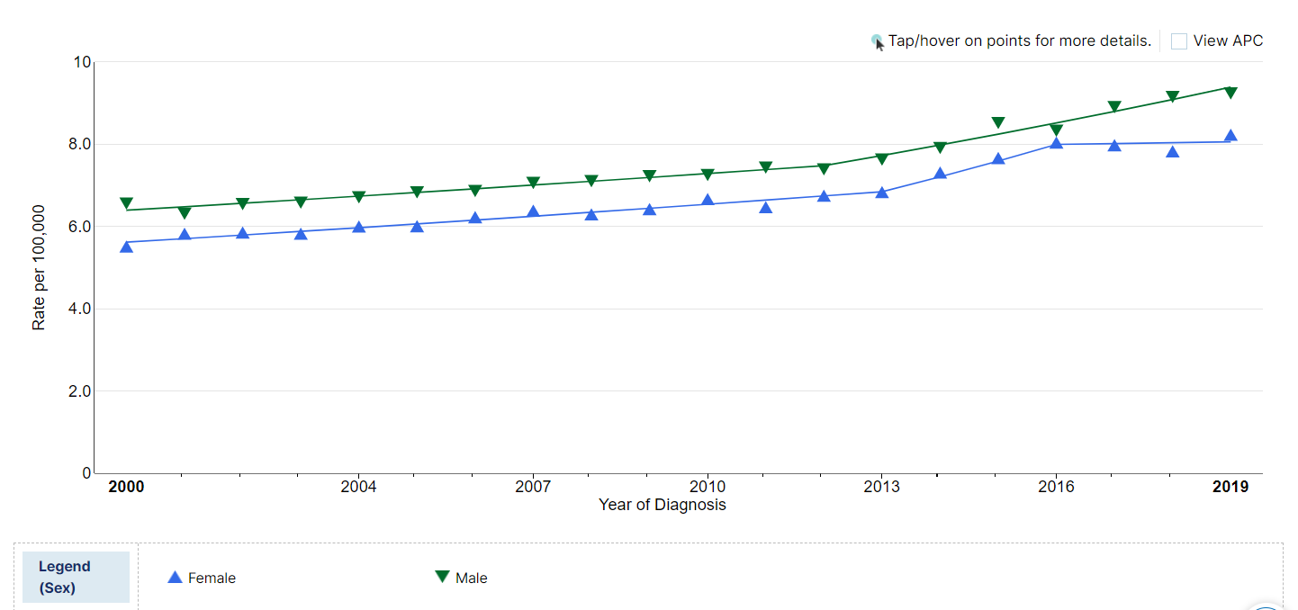
All Ages, Both Sexes
CRC Trends
Age <50, Both Sexes
https://seer.cancer.gov
Notes:
51% increase in CRC incidence in individuals age 20-49 since the early 1990s

Slide 11
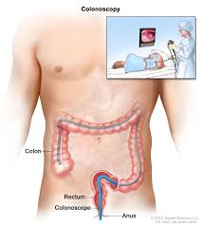
Characteristics in younger individuals
Siegel R et al. CA CANCER J CLIN 2020;70:145–164

Slide 12
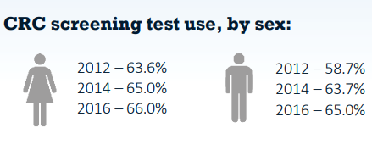
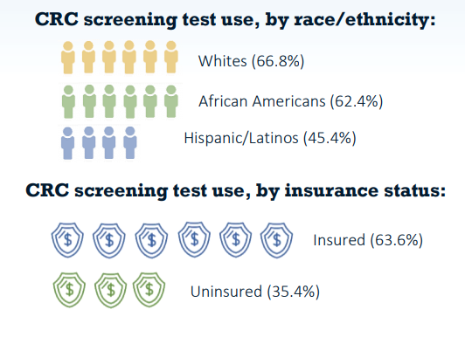
CRC Screening Rates
National Colorectal Cancer Roundtable (NCCRT) goal:
80% by 2018
CDC’s Behavioral Risk Factor Surveillance System, 2016
Wender R, et al. Gastrointest Endosc Clin N Am. 2020 Jul;30(3):499-509

Slide 13
Why screen?
Siegal R et al. CA CANCER J CLIN 2020;70:145–164

Slide 14
When should we begin screening?
Americal Association of Family Practice (AAFP):
CRC screening beginning age 50
American College of Physicians (ACP):
CRC screening beginning age 50
US Multi-Society Task Force of Colorectal Cancer (MSTF): panel of gastroenterologists (AGA, ACG and ASGE)
CRC screening beginning age 50
Sequential offers with first tier options suggested first
Physicians performing colonoscopy measure quality (ADR, cecal, withdrawal time)
Physician performing FIT monitor quality
But wait….we have newer guidelines to follow
Rex et al. Gastrointestinal Endoscopy. 2017.
Wilkins et al. Am Fam Physician. 2018 May 15;97(10):658-665
Qaseem et al. Annals of Internal Medicine. 2019 November

Slide 15
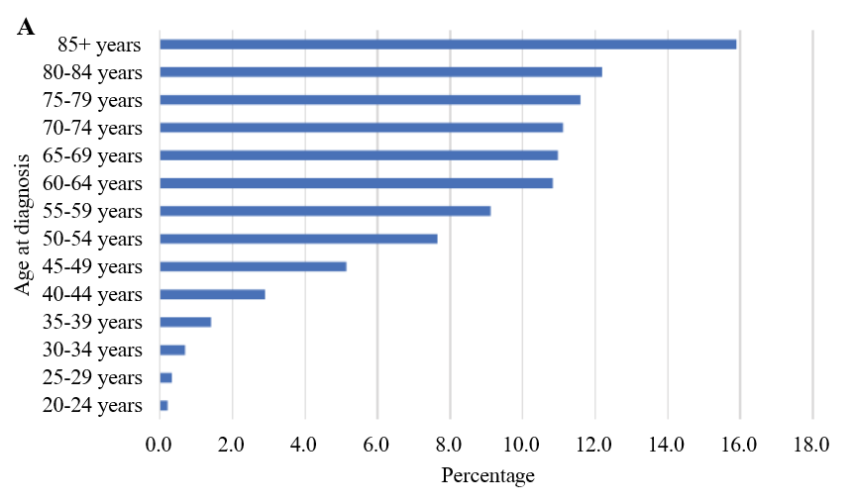
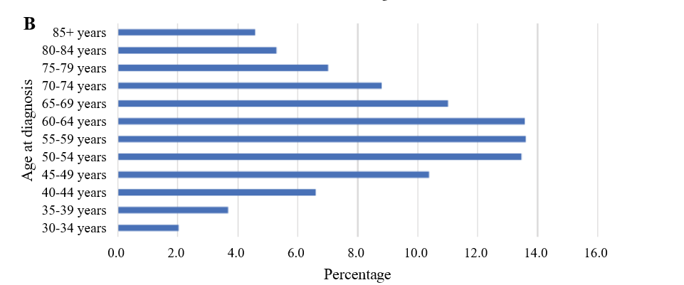
American Cancer Society (ACS)
New qualifited recommendations in 2018
Recommendation based on increase life-years gained modeling performed by the Cancer Intervention and Surveillance Modeling Network (CISNET)
Siegel RL, et al. Colorectal cancer incidence patterns in the United States, 1974-2013. J Natl Cancer Inst. 2017;109(8)
Wolf et al. CA CANCER J CLIN 2018;68:250–281

Slide 16
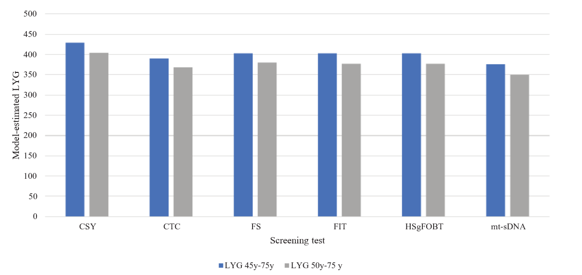
ACS continued
Model – estimate LYG
Model suggests that starting colorectal cancer screening at age 45 years can moderately increase life-years gained and decrease colorectal cancer cases and deaths compared to beginning screening at age 50 years
Siegel RL, et al. Colorectal cancer incidence patterns in the United States, 1974-2013. J Natl Cancer Inst. 2017;109(8)
Wolf et al. CA CANCER J CLIN 2018;68:250–281

Slide 17
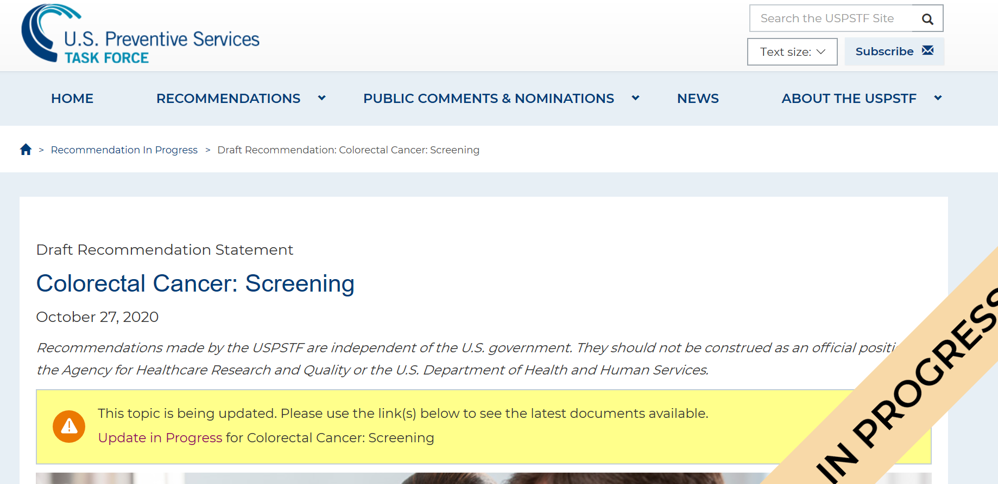
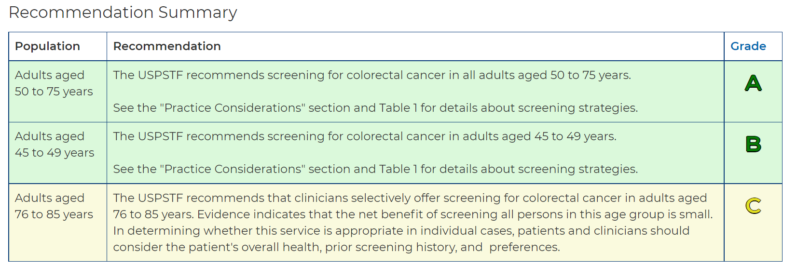
May 2021 – final recommendations released
Siegel RL, et al. Colorectal cancer incidence patterns in the United States, 1974-2013. J Natl Cancer Inst. 2017;109(8)
Davidson K, et al. JAMA. 2021;325(19):1965-1977
Notes:
Created in 1984 (oversight by AHRQ since 1998). • Independent, volunteer panel of national experts. • Provide grade-based preventive services recommendations based on rigorous review of existing peer-reviewed evidence. • Do not consider costs of the preventive service when determining a recommendation grade.
Replaces the 2016 guideline recommendations.
Screening: substantial net benefit
Moderate net benefit
Small net benefit
*Average risk: excludes individuals with a history of adenomas, colorectal cancer, family history of colorectal cancer, inflammatory bowel disease, and known genetic predisposition to CRC (e.g., Lynch, FAP)
Age to Stop Screening Selective offering of screening based on: • Overall health (life expectancy, comorbidity) • Prior screening history • Patient prefere

Slide 18
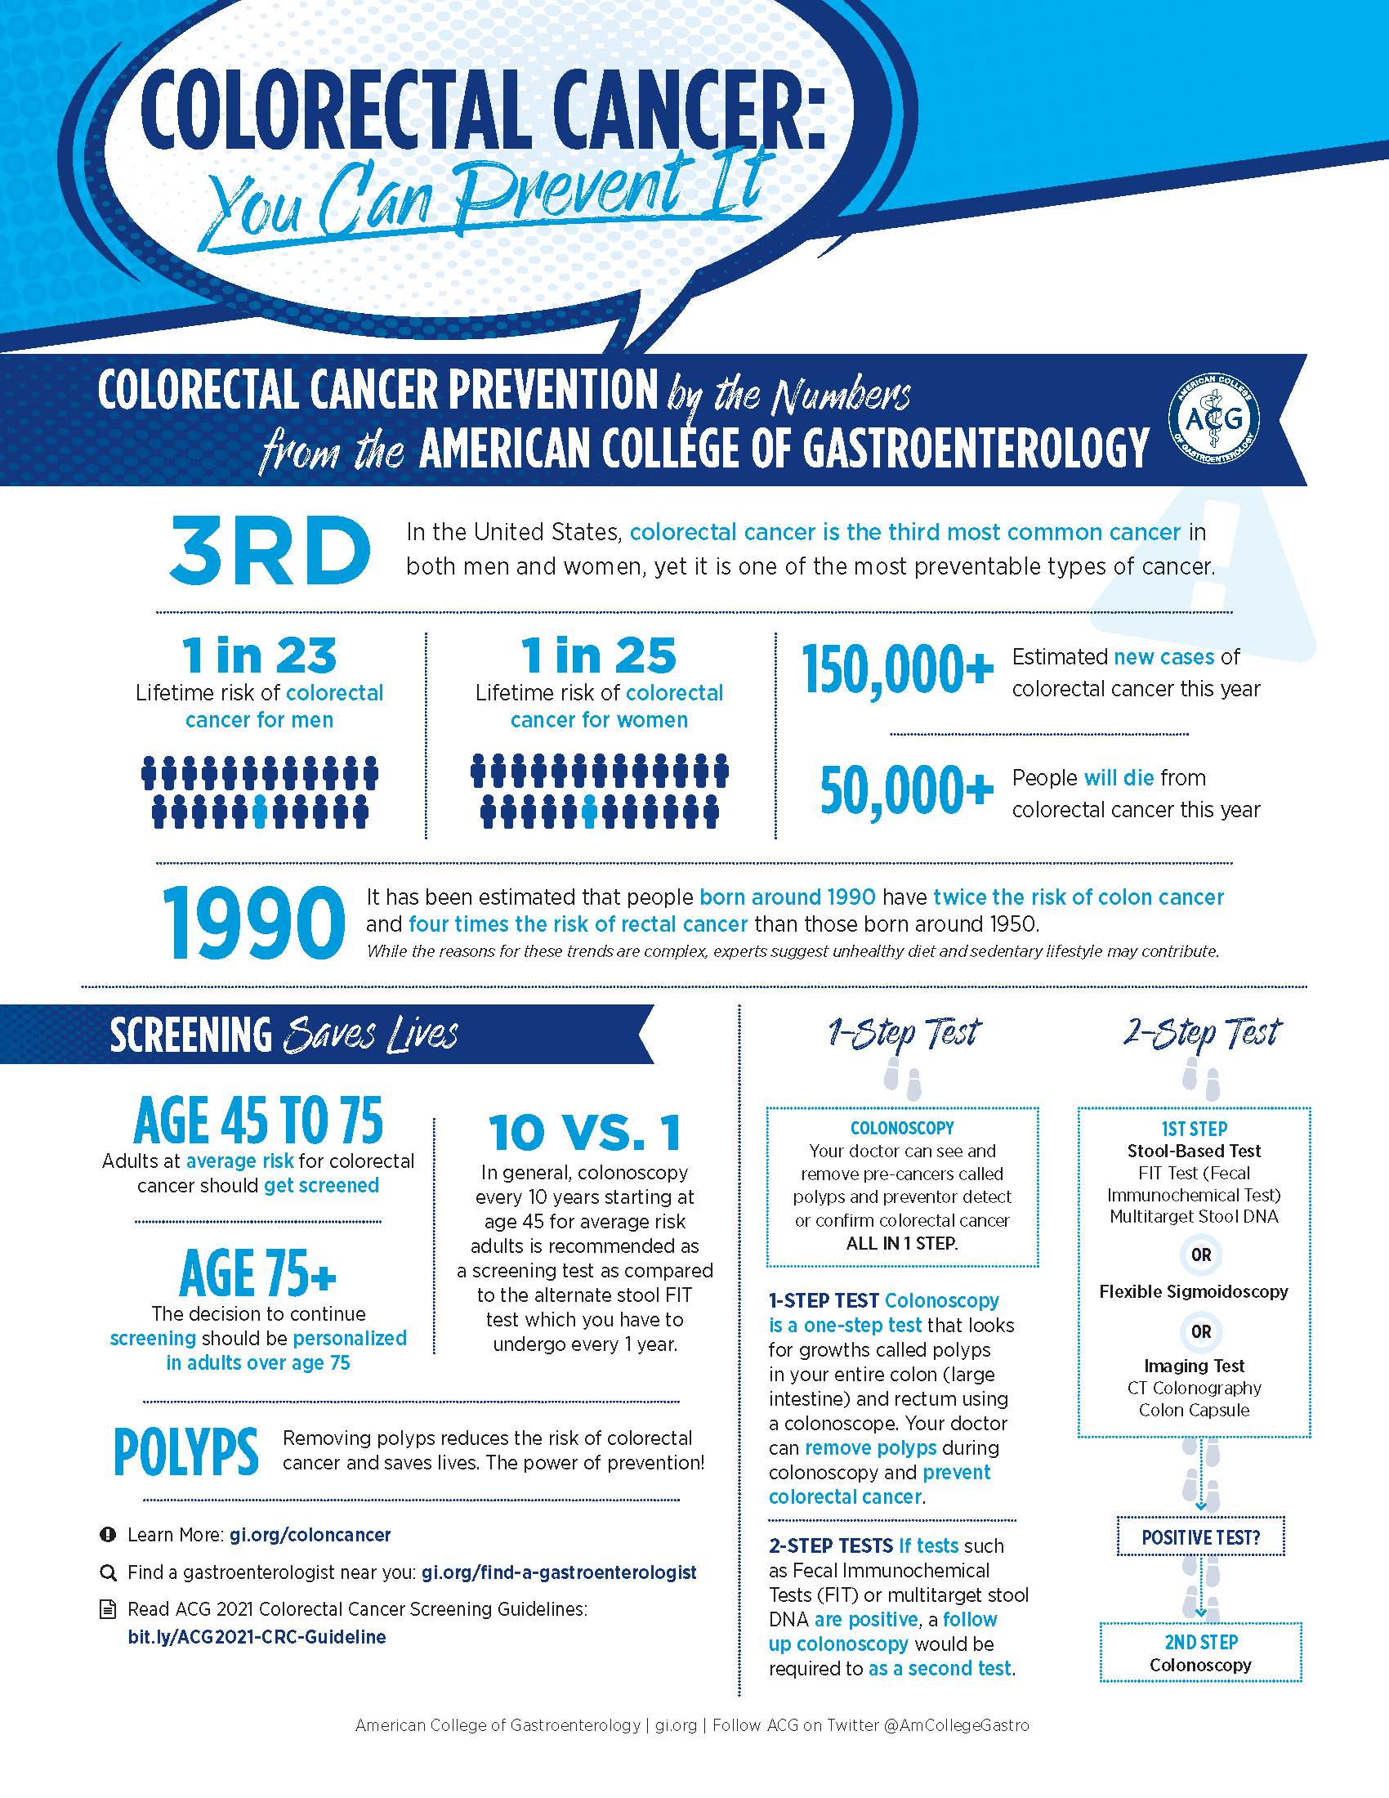
MARCH 2021
American College of Gastroenterology: www.gi.org
Notes:
*Average risk: excludes individuals with a history of adenomas, colorectal cancer, family history of colorectal cancer, inflammatory bowel disease, and known genetic predisposition to CRC (e.g., Lynch, FAP)

Slide 19
CRC screening at 45 could avert 29,400 CRC cases and 11,100 CRC deaths over the next 5 years but would require 10.7 million additional colonoscopies and cost an incremental $10.4 billion. Improving screening rates to 80% in persons who are 50–75 years old would avert nearly 3-fold more CRC deaths at one third the incremental cost.
Ladabaum et al. Gastroenterology. July 2019: 137-148
Notes:
Screening colonoscopy @ age 45 years in 1000 persons averted 4 CRCs and 2 CRC deaths, gained 14 quality-adjusted life-years (QALYs), cost $33,900/QALY gained, and required 758 additional colonoscopies. These alternatives averted 13–14 CRC cases and 6–7 CRC deaths and gained 27–28 discounted QALYs while saving $163,700–$445,800. Shifting current age-specific screening rates to 5 years earlier could avert 29,400 CRC cases and 11,100 CRC deaths over the next 5 years but would require 10.7 million additional colonoscopies and cost an incremental $10.4 billion. Improving screening rates to 80% in persons who are 50–75 years old would avert nearly 3-fold more CRC deaths at one third the incremental cost.

Slide 20
45 is the new 50

Slide 21
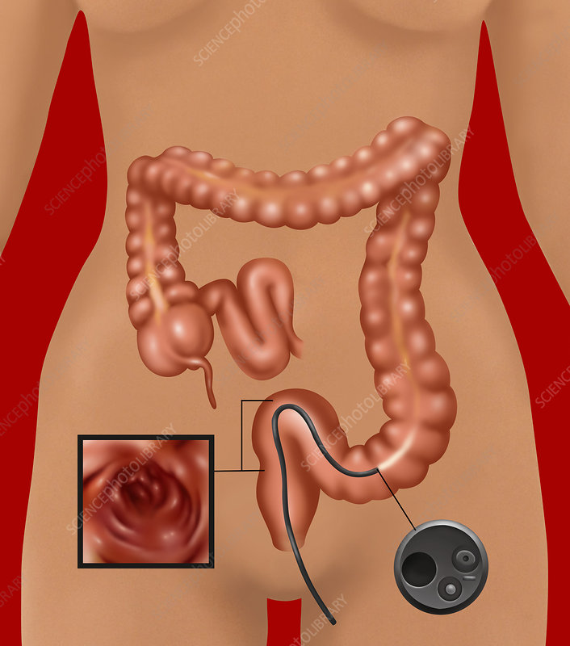
Colorectal Cancer Screening Tests
Stool Based Testing
Highly sensitive guaiac FOBT (HSgFOBT)
Fecal immunochemical Test (FIT)
FIT-fecal DNA
Direct Visualization Testing
CT colonography
Flexible Sigmoidoscopy
Colonoscopy
Sciencephoto.com
Aside from colonoscopy, above tests are a 2-step strategy if positive.
(+) FIT → colonoscopy (+) CT colonography → colonoscopy

Slide 22
Stool Based Screening Tests
Highly Sensitive guaiac FOBT (HSgFOBT)
Tests for occult blood in the stool
(+)Noninvasive, low cost
(+)Can be done at home
(-)Dietary restrictions needed prior to testing, Not ideal in the opportunistic approach setting
Recommend annually in the US
Fecal immunochemical test (FIT)
Tests for globin part of hemoglobin
(+)Noninvasive, low cost
(+)Can be done at home
(-)Not ideal in the opportunistic approach setting, fair sensitivity for advanced adenoma, no sensitivity for serrated lesions
Recommend annually in US
Rex et al. Gastrointestinal Endoscopy. 2017

Slide 23
Stool Based Screening Tests…continued
FIT-fecal DNA test (Cologuard)
FIT plus markers for abnormal DNA
(+) Large screening colonoscopy study: FIT, FIT-fecal DNA, colonoscopy
FIT-fecal DNA: 1 time sensitivity for CRC: 92%, FIT: 73.8%
FIT-fecal DNA test has the highest single time sensitivity for non-invasive, non-imaging screening
*** 40% sensitivity for SSP
(+) Can be done at home
(-) Low specificity and declines with increasing age
(-) $$$ (10x as much as annual FIT)
Recommend 3-year interval in US
Rex et al. Gastrointestinal Endoscopy. 2017

Slide 24
Direct Visualization Testing
High Quality Colonoscopy:
(+) single session diagnosis and treatment, long interval between exams, high sensitivity
(-) need for bowel cleanse, higher risk of perforation & other complications relative to other screening modalities, operator dependence affects performance
Recommend 10 year interval in US
Quality measures
Adenoma Detection Rate
Cecal Intubation Rate
Use of split prep
Withdrawal time
Documentation of Prep
Rex et al. Gastrointestinal Endoscopy. 2017

Slide 25
Measures defining High Quality Colonoscopy:
Rex et al. Gastrointestinal Endoscopy. 2017

Slide 26
CT colonography
Replaced barium enema. Better tolerated and more effective.
Compared to colonoscopy:
(+) Lower perforation rates
(-) Both need bowel preps
(-)Sensitivity for polyps less than 1 cm is less than colonoscopy
(-)Radiation exposure
Polyps 6mm or > → colonoscopy
Recommend 5 year interval in US
Flexible sigmoidoscopy
(+) Lower cost and reduced risk compared to colonoscopy, limited bowel prep, no need for sedation
(-) Limited R sided evaluation, lower patient satisfaction (no sedation)
Recommend 5 (or 10) yr interval in US
This modality has nearly disappeared from screening settings in the US
Rex et al. Gastrointestinal Endoscopy. 2017

Slide 27
Capsule colonoscopy
Approved by FDA for imaging the proximal colon in patients with previous incomplete colonoscopies AND patients needing colorectal imaging but not colonoscopy or sedation candidates
(-) Prep is required.
(-) If positive, patient will need repeat prep and colonoscopy.
Not approved for CRC screening
Septin9 assay
First FDA approved serum test for CRC screening
Sensitivity of 48% for CRC detection and no sensitivity for precancerous polyp detection
Relatively expensive compared to FIT
Not currently recommended in US for CRC screening
Rex et al. Gastrointestinal Endoscopy. 2017

Slide 28
Screening Test Characteristics
Test | Sensitivity CRC | Sensitivity advanced adenoma | Specificity for CRC
HSgFOBT | 62-79% | 7% | 87-96%
FIT | 76-95% | 27-47% | 89-96%
FIT-DNA (Cologuard) | 93% | 43% | 85%
CT Colonography | 96% | 67-94% (greater than 10mm) 73-98% (greater than 6mm) | 85-98% (greater than 10mm) 80-93% (greater than 6mm)
Flexible Sigmoidoscopy | 58-75% | 72-86% | 92%
Colonoscopy | 95% | 89-98% (greater than 10mm) 75-93% (greater than 6 mm) | 90%
Davidson K, et al. JAMA. 2021
Knudsen et al. JAMA. 2021

Slide 29
Summary
Colorectal cancer ranks in the top 5 for new cancers and cancer related death
Incidence is on a downward trend for all ages but there is an increasing trend in individuals under 50
Screening recommendations have been recently updated based on the increasing incidence.
Several screening options exist
The best test is the test that gets done

