Slide 1




NGWEP
The Nebraska Geriatrics Workforce Enhancement Program
A partnership between UNMC,
Community-Based Organizations,
Nebraska Medicine and Primary Care Sites

Slide 2
This program is supported by the Health Resources and Services Administration (HRSA) of the U.S. Department of Health and Human Services (HHS) as part of an award totaling $749,836.00 with 0% financed with non-governmental sources.
The contents are those of the author(s) and do not necessarily represent the official views of, nor an endorsement, by HRSA, HHS, or the U.S. Government. For more information, please visit www.HRSA.gov.

Slide 3
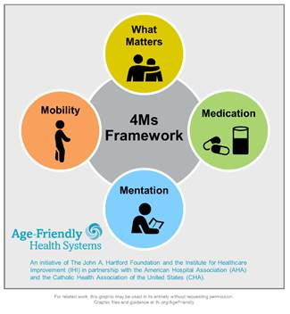
Age Friendly Primary Care:
These are the 4 important things
Notes:
We all care for elders, we want to do the important things. The 4 Ms are the important things
What Matters: Know and align care with each older adult’s specific health outcome goals and care preferences including, but not limited to end-of-life care, and across settings of care (document ACPs)
Medication: If medication is necessary, use Age-Friendly medications that do not interfere with What Matters to the older adult, Mobility, or Mentation across settings of care (Pharmacy protocols for med review in evaluating cognitive dysfunction, mobility and falls etc)
Mentation: Prevent, identify, treat, and manage dementia, depression, and delirium across settings of care
Mobility: Ensure that older adults move safely every day to maintain function and do What Matters

Slide 4
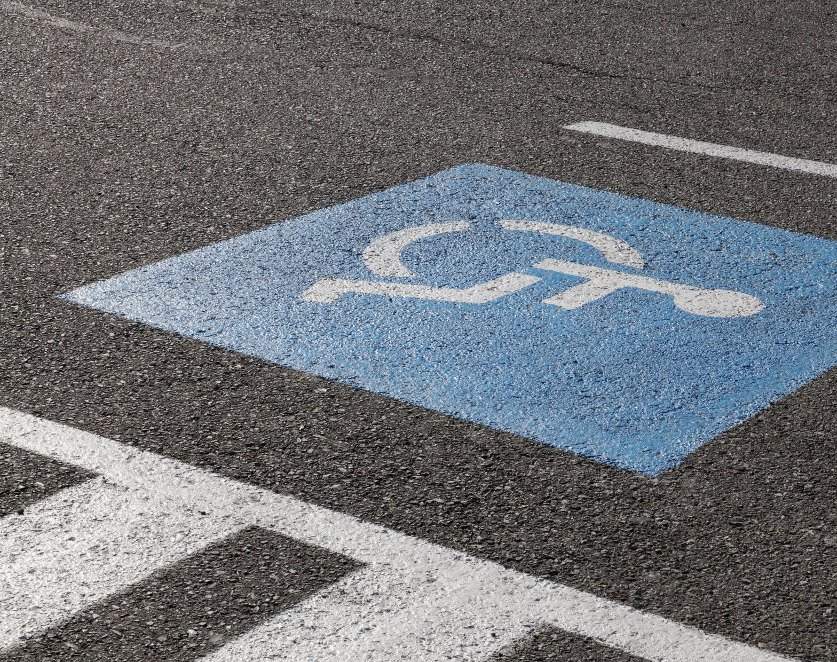
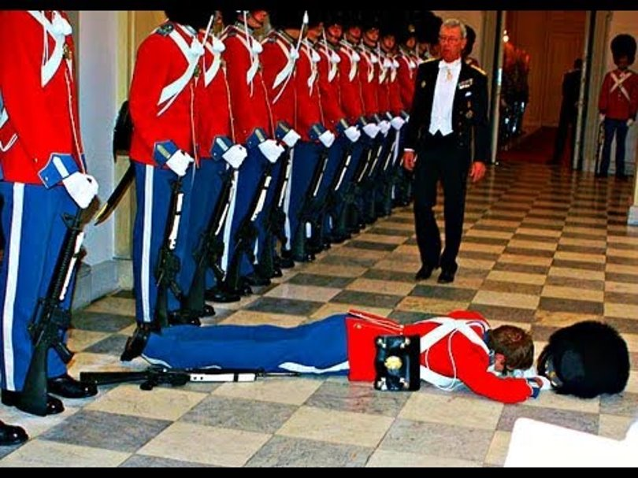
Falls and Mobility
J Hejkal
1/26/2023

Slide 5
Falls
25% of elderly population fall each year. Half tell their doctor.
One in five falls causes serious injury
Serious injury risk
  Hip fracture with 25% 1-year mortality
  SDH leads to >50% mortality or severe disability at 3 months
Notes:
More prevalent than diabetes (about 18% of older adults).
Rates in nursing homes, or in oldest old, are higher
Previous falls predict future falls: one fall indicates about 60% fall risk in next year.

Slide 6
Mobility
1/3 of older adults have mobility limitation.
Major determinant of well-being
More important to patients than falling
Notes:
Mobility disability is technically defined as the inability to walk ¼ mile without a walker; associated with ability to safely walk in community.

Slide 7
How to prevent falls and improve mobility
What is the intervention with the largest impact?

Slide 8
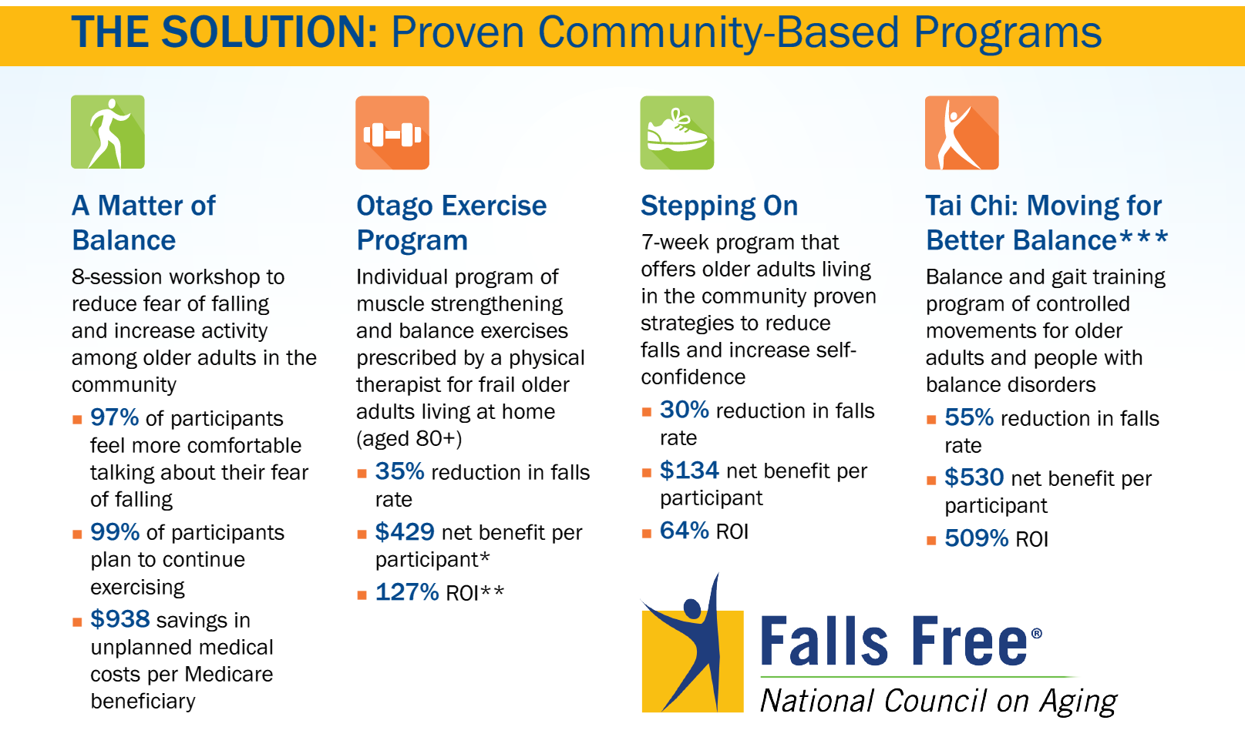

Slide 9
Exercise
Cornerstone of fall prevention and mobility improvement
  Arthritic disease
  Strength
  Balance
  Neurological disorders (e.g., Parkinsons)
  Bone density
  Cardiopulmonary disease
Notes:
We could stop here, right? Getting patients to exercise benefits almost every body system and helps to improve fall risk – it affects strength, balance, arthritis; can help retrain the CNS, improves bone density, etc., etc., etc.

Slide 10
But Insufficient…
Notes:
Exercise is great. But there’s more to it.

Slide 11
What keeps us mobile?
The entire neurologic system
  Proprioception system
  Afferent nerves
  Efferent nerves
  CNS
  Vestibular system
Vision
Muscles
Bones
CV system
Pulmonary
Notes:
What systems keep us mobile? Thoughts?

Slide 12
Other systems contribute to falls, too
Rushing to the toilet due to overactive bladder
Poor nutrition from GI problems.
And non-medical issues (cluttered floors, for example)
MEDICATIONS
Notes:
Needing to use the toilet is the primary cause of falls in institutional and hospital settings.

Slide 13
Falls and injury
Muscle weakness
Neurological deficits
Poor vision
Cluttered
Environment
Malnutrition
Medications
Orthostatic hypotension
Osteoporosis
Urinary urgency
Notes:
Falls are a typical “geriatric syndrome:” a problem that results in additive deficits from multiple contributing systems, including external domains. This complexity is a reason why geriatric syndromes are difficult to treat. I would argue that one of the reasons that exercise is so helpful is that it affects more than one domain and system.

Slide 14

STEADI
CDC’s Stopping Elderly Accidents, Deaths, and Injuries initiative
Meant to help promote mobility and prevent falls in primary care settings.
Notes:
This is really intended as a framework for developing a fall prevention PROGRAM at an institution or healthcare practice. As always in geriatrics, interventions work best when they are done by the entire team. But it also provides a great framework for just looking at falls in a clinical setting.
This is based on the 2011 AGS/BGS Fall Prevention Guidelines, with some minor updates since then based on the small amount of practice-changing literature that’s been published in the interim.

Slide 15
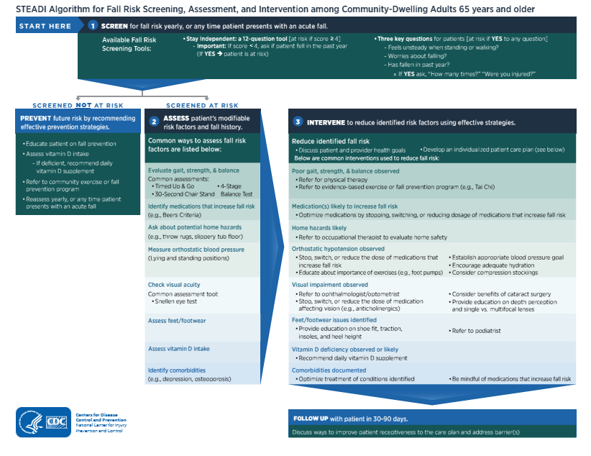
Notes:
This is the STEADI algorithm. Don’t try to read it; we’ll break it down into its components over the next few slides.

Slide 16
Detection
When patients bring it up
Yearly screening (AWV): Choose one
  (1) Stay Independent Brochure
    If fell in last year, high-risk, even if negative screen
  (2) Ask 3 key questions
      Do you feel unsteady when standing or walking
      Do you worry about falling?
      Have you fallen in the past year?
Notes:
Screen patients every year, or when they bring it up. If you do annual wellness visits, this is a good time (because it’s already baked into the AWV).

Slide 17
Patients with low risk
Primary prevention:
  Education on fall prevention
  Assess vitamin D intake and recommend supplement if deficient
  Refer to community exercise/fall prevention program
  Reassess yearly or after a fall
Notes:
Vitamin D less important than we thought, unless truly deficient (e.g., in nursing homes)

Slide 18
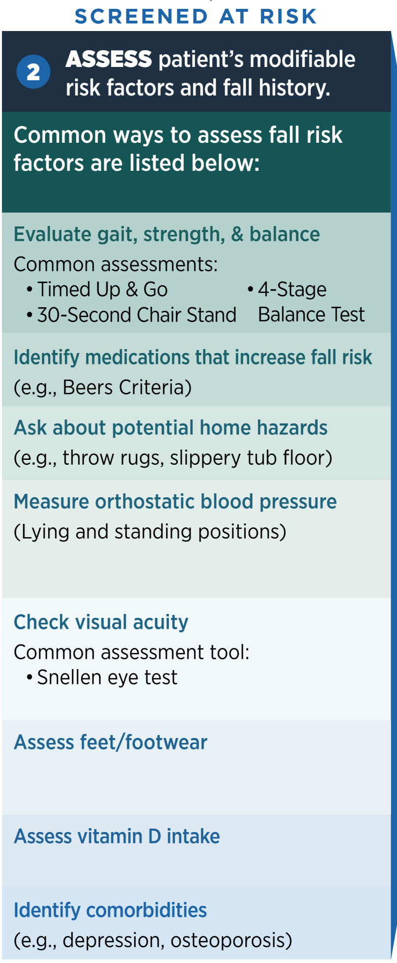
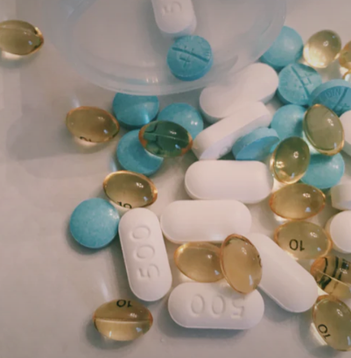
Notes:
Good basics. TUG (arise, walk 10 feet, turn around and sit down), if >12 seconds, then they’re at high risk. 30-sec chair stand: standardized for age and sex.
4 Stage balance test involves feet together, half tandem, tandem, and then stand on 1 foot for 10 seconds. If the patient can’t do the tandem stance for 10 seconds, fall risk is higher.

Slide 19
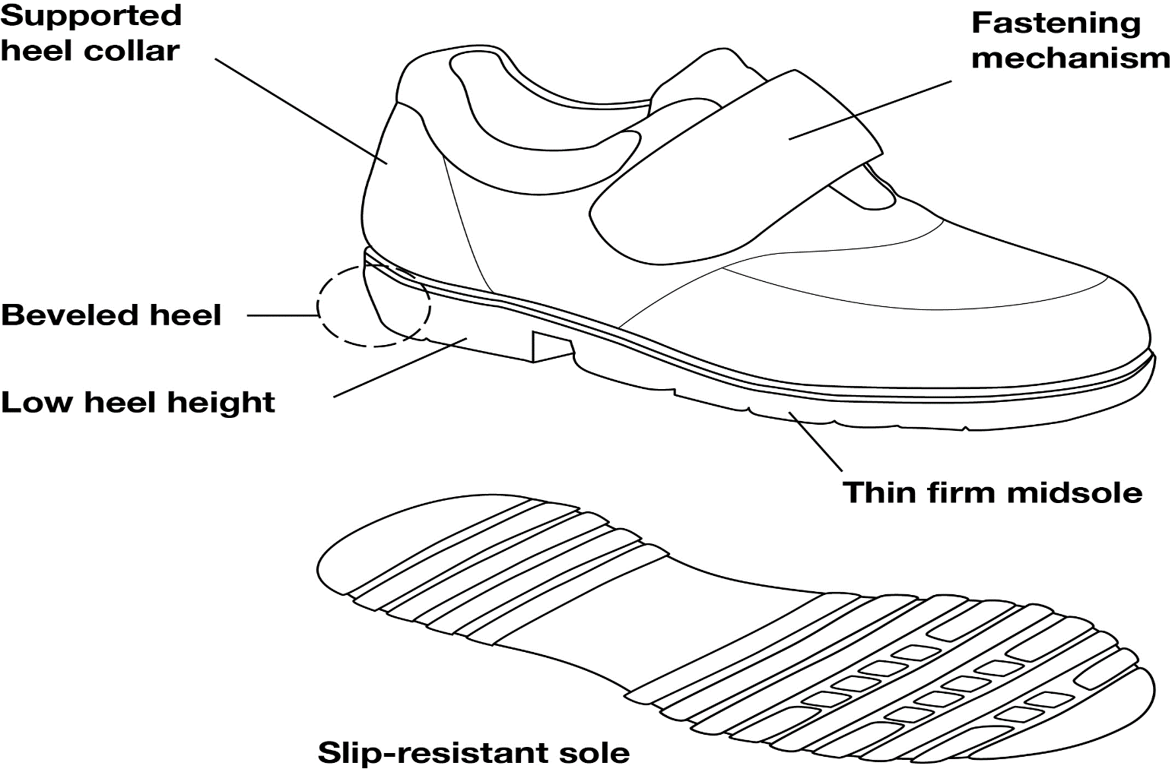
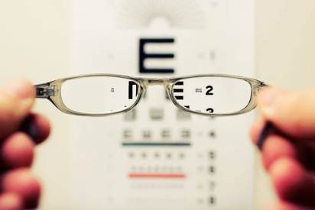
Source: Geriatric Review Syllabus 11th Ed. Teaching Slides

Slide 20
Other things to look at
Neuro exam is often appropriate
  Focal weakness or motor abnormalities
  Sensory deficits
  Coordination problems
  Parkinsonism
  Nystagmus
Notes:
A few things that I think are helpful that are not really included in the algorithm: a neurological exam (sensation, motor abnormalities, ataxia, parkinsonism) and if the patient is dizzy, looking for nystagmus. A good gait exam can help identify some of these, too.

Slide 21
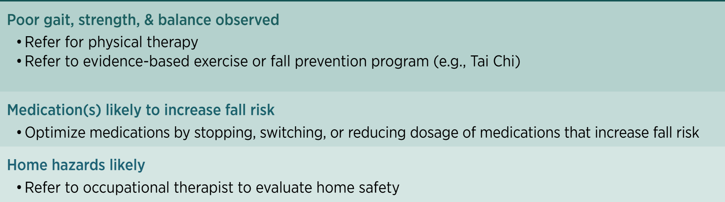
Notes:
After making this patient-centered (i.e., discussing health goals):
There are many different proven fall-reduction programs (see previous slide), includes Tai Chi (e.g., through local YMCA’s), UNMC’s EngAge FallProof,
Medications, such as benzodiazepines, anticholinergic meds

Slide 22
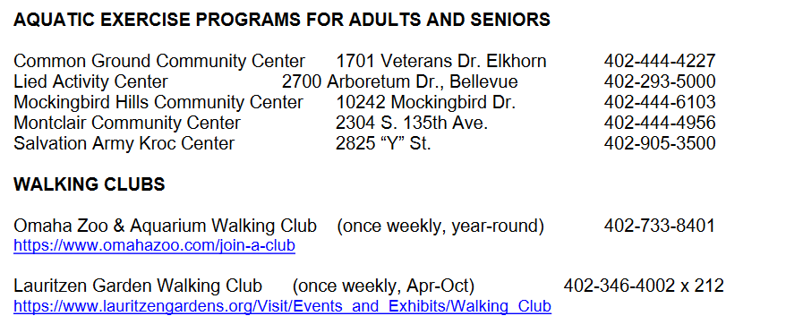

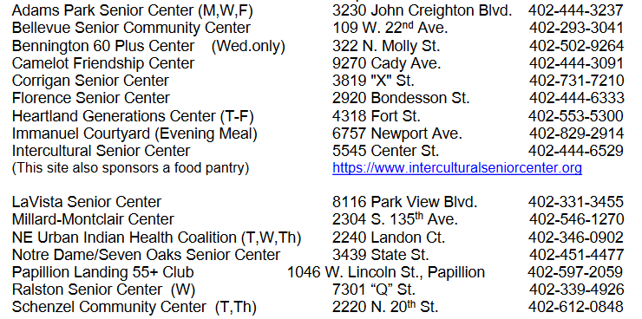

Notes:
Church
Libraries
Work part time at a gym
“Have you returned to your regular exercise routine?”
“Do you walk outside the house?”
“Are you feeling winded, fatigued, or dizzy?
“Are you back to your previous distances or time spent exercising?”
“Any trouble with steps or stairs?”

Slide 23
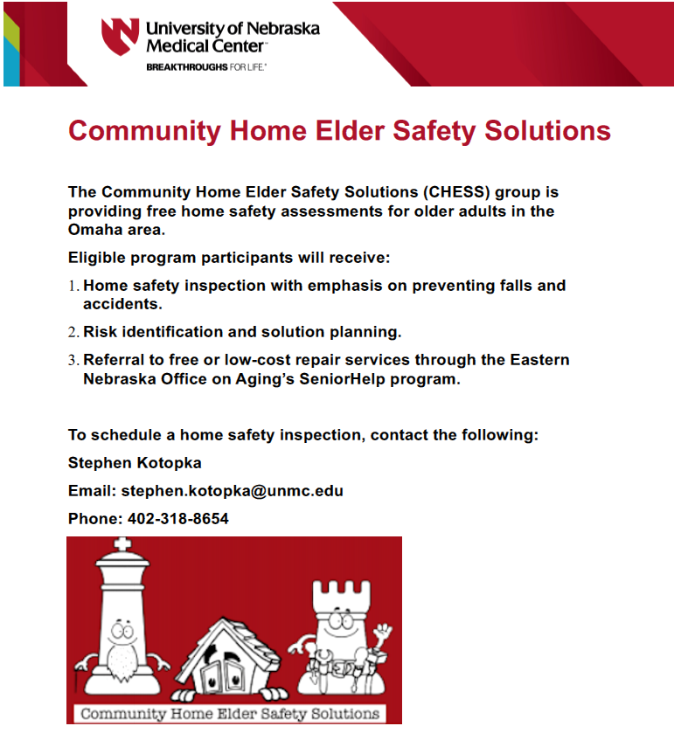

Slide 24
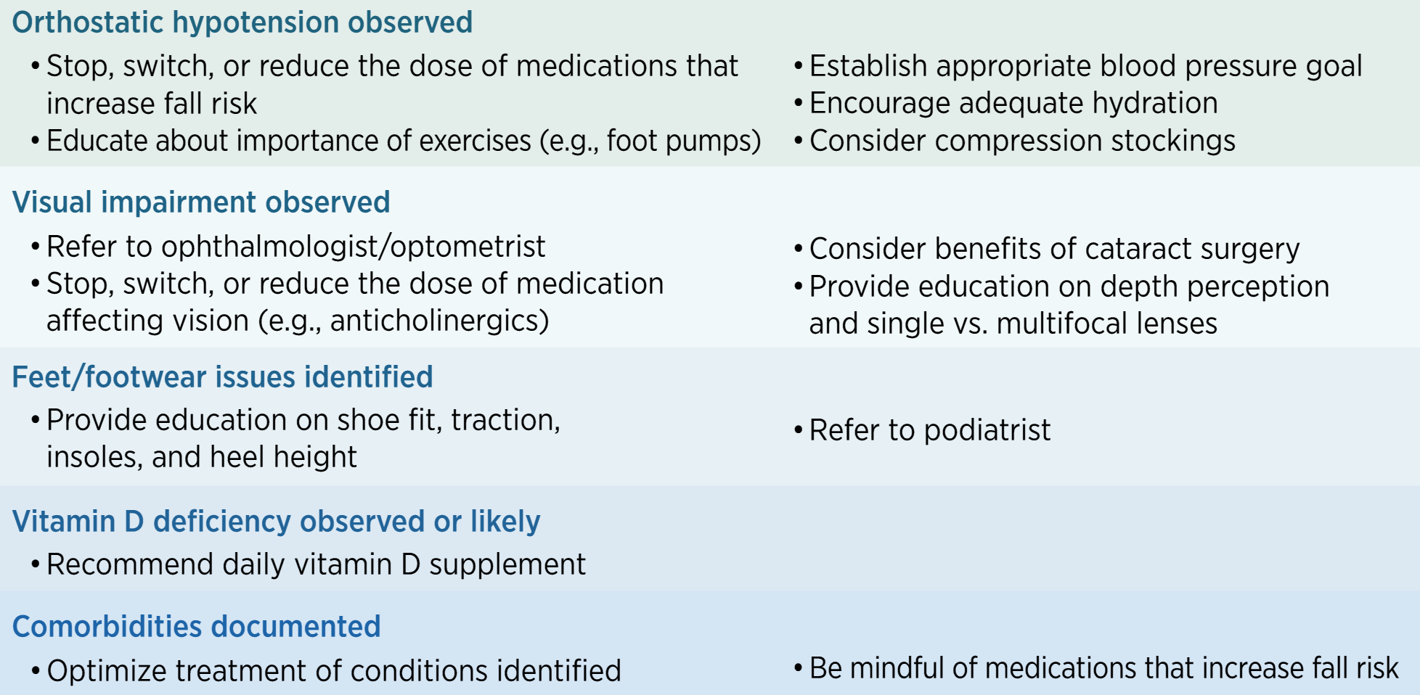
Notes:
Addressing orthostatic hypotension
Vision impairment: bifocals actually are associated with increased fall risk. Cataract surgery helps prevent falls.
Vitamin D deficiency: really only helps to treat if there is a deficiency (unless in long-term care)

Slide 25
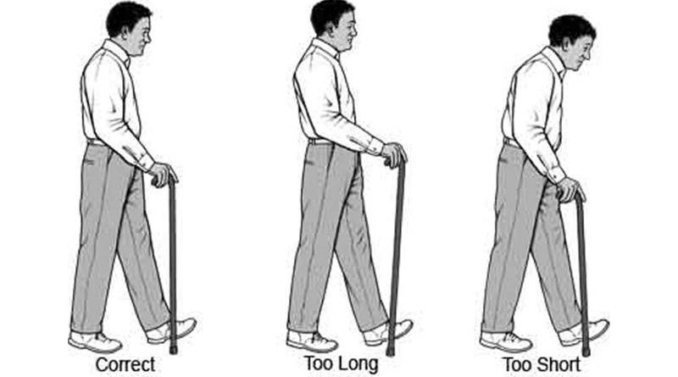
Other things to manage
Neurological disease
  Imaging may be helpful
  Referral to movement disorder clinic if indicated
Assistive devices
Emergency response systems
ENT for vertigo
http://www.elderlyaidsadvice.com/measure-your-walking-stick/
Notes:
Assistive devices: often people use a relatives old device, for example, and it’s not fitted correctly.
What kind of devices to use?
Canes: esp for people with maybe a proprioceptive deficit, someone who needs another point of contact for stability.
FWW: for those with worse mobility trouble, LE weakness
4WW: for those with easy fatigability who need a seat, would benefit from having something to carry things.

Slide 26
Other things to manage
Urinary urgency or incontinence
Pain
Cognitive impairment
Notes:
If a person has OAB, then anticholinergics used for that might also increase fall risk, so be careful.
Pain reduction methods: scheduled Tylenol, topical NSAIDs, sometimes gabapentinoids, pain management clinics, PT
Cognitive impairment: Separate lecture on this, but will need to really establish supportive milieu that helps prevent falls as much as possible.

Slide 27
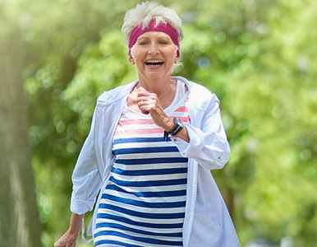
In sum…
Falls and mobility impairment are common
Many contributing factors
Exercise is best prevention, but often
other interventions are needed too.
Questions?

Slide 28
Selected references
CDC STEADI website. http://cdc.gov/steadi/
National Council on Aging (ncoa.org)
Hartholt K, Lee R, Burns E, van Beeck E. Mortality From Falls Among US Adults Aged 75 Years or Older, 2000-2016. JAMA 2019
Xu G. et al. Prevalence of diagnosed type 1 and type 2 diabetes among US adults in 2016 and 2017: population based study. BMJ 2018.

Slide 29
Age Friendly Primary Care:
These are the 4 important things
Notes:
We all care for elders, we want to do the important things. The 4 Ms are the important things
What Matters: Know and align care with each older adult’s specific health outcome goals and care preferences including, but not limited to end-of-life care, and across settings of care (document ACPs)
Medication: If medication is necessary, use Age-Friendly medications that do not interfere with What Matters to the older adult, Mobility, or Mentation across settings of care (Pharmacy protocols for med review in evaluating cognitive dysfunction, mobility and falls etc)
Mentation: Prevent, identify, treat, and manage dementia, depression, and delirium across settings of care
Mobility: Ensure that older adults move safely every day to maintain function and do What Matters

Slide 30
4Ms: Medications
Linda Sobeski, PharmD, BCPS
Clinical Associate Professor
UNMC College of Pharmacy
Updated: 7/2022
Updated: 4/2018
Notes:
We all care for elders, we want to do the important things. The 4 Ms are the important things
What Matters: Know and align care with each older adult’s specific health outcome goals and care preferences including, but not limited to end-of-life care, and across settings of care (document ACPs)
Medication: If medication is necessary, use Age-Friendly medications that do not interfere with What Matters to the older adult, Mobility, or Mentation across settings of care (Pharmacy protocols for med review in evaluating cognitive dysfunction, mobility and falls etc)
Mentation: Prevent, identify, treat, and manage dementia, depression, and delirium across settings of care
Mobility: Ensure that older adults move safely every day to maintain function and do What Matters

Slide 31
Objectives:
Describe
Describe the physiologic, pharmacokinetic, and pharmacodynamic factors which affect drug use in the elderly
Describe
Describe risk factors and identify drugs commonly associated with adverse drug events in the elderly
Recognize
Recognize potentially inappropriate drug use and recommend alternative therapy where appropriate
Discuss
Discuss principles of optimal prescribing for older patients

Slide 32
Challenges of Geriatric Pharmacotherapy
Changes in aging physiology
Pharmacokinetics
Pharmacodynamics
Polypharmacy
Inappropriate prescribing
(Beers and others)
Adverse drug events
Medication adherence

Slide 33
Effects of Aging on Drug PK
Absorption
No change in overall F for most drugs
Distribution
Decreased Vd for hydrophilic drugs = increased C
Metabolism
Elimination
Decreased F for some drugs:
Vitamins
Minerals
Ca2+ in setting of increased GI pH
Increased F for high extraction drugs
Increased Vd for lipophilic drugs = longer t1/2
Increased % free drug (unbound to albumin)
Decreased Phase I metabolism = increased t1/2 (active metabolites)
No change in Phase II metabolism (inactive metabolites)
Decreased GFR = longer t1/2 for renally eliminated drugs and metabolites

Slide 34
Pharmacodynamics and Aging
Increased sensitivity
Digoxin
Warfarin
Alpha-blockers
Diuretics
Vasodilators
Anticholinergics
Alcohol
Opioids
Benzodiazepines
Antipsychotics
Decreased sensitivity
Beta-blockers
Beta-agonists
CCB (cardiac conduction)

Slide 35
Adverse Drug Events (ADEs)
Rate of ADEs in older adults: 2.5-50.6%
Responsible for 5-28% of acute geriatric hospital admissions
106,000 deaths + $85 billion spent in 2000
>95% of ADEs are predictable
~50% of ADEs are preventable
Most errors occur at the ordering and monitoring stages
Notes:
Perspective: If ADE listed on death certificate, it would be the 5th leading cause of death.

Slide 36
Patient Risk Factors for ADEs
Polypharmacy
Inappropriate prescribing
Medication underuse
Medication non-adherence
Multi-morbidity
Prior ADEs
Low WT or BMI
Age > 85y
CrCl <50 mL/min

Slide 37
Inappropriate Prescribing
Definition: prescribing drugs that should be avoided because risk outweighs benefit
20% of home care patients
25% of long-term care residents
Explicit criteria:
Beers
Start/Stopp
FORTA-US
HEDIS
PRISCUS

Slide 38
The Beers Criteria (2019)
Drug | Concern | Alternatives
Anticholinergics: First-generation antihistamines e.g. diphenhydramine, hydroxyzine | Highly anticholinergic Exception: DPH in acute allergic reactions | Intranasal saline, intranasal steroids 2nd generation agents: fexofenadine, loratadine For itching: moisturizers
Gastrointestinal agents: PPIs | Risk of C. difficile infection, bone loss and fractures Avoid scheduled use for >8 weeks unless high-risk patient (chronic NSAID or steroid use, erosive esophagitis, Barrett’s esophagus, ZE, or demonstrated need for maintenance treatment) | Antacids PRN H2 blockers
AGS 2019 Beers Criteria Update Expert Panel. American Geriatrics Society 2019 Updated Beers Criteria for Potentially Inappropriate Medication Use in Older Adults. JAGS 2019.

Slide 39
The Beers Criteria (2019)
Drug | Concern | Alternatives
CNS agents Antidepressants: e.g. amitriptyline, doxepin | Highly anticholinergic Cause orthostatic hypotension | For depression: SSRIs (except paroxetine), SNRIs, bupropion For neuropathic pain: SNRIs, gabapentin, pregabalin, topical capsaicin, lidocaine patch
CNS agents: Antipsychotics Antiemetics e.g. promethazine, prochlorperazine | Increased risk of CVA and greater rate of cognitive decline and mortality in dementia. Avoid for BPSD unless failure of non-pharmacologic options AND substantial risk of harm to self or others. Exceptions: schizophrenia, BPAD, or short-term use as entiemetic during chemotherapy | Behavioral interventions For N/V: Ondansetron
AGS 2019 Beers Criteria Update Expert Panel. American Geriatrics Society 2019 Updated Beers Criteria for Potentially Inappropriate Medication Use in Older Adults. JAGS 2019.

Slide 40
The Beers Criteria (2019)
Drug | Concern | Alternatives
CNS agents: Benzodiazepines: alprazolam lorazepam clonazepam | Increased risk of cognitive impairment, delirium, falls, fractures, and MVAs Possible exceptions: seizure disorders, benzodiazepine/alcohol withdrawal, severe GAD, periprocedural anesthesia | For anxiety: SSRIs, SNRIs, buspirone
CNS agents: BZRA hypnotics: eszopiclone zolpidem zalpelon | ADEs similar to BZD: delirium, falls, fractures Increased ER visits, hospitalizations, MVAs Minimal improvement in sleep latency and duration | Sleep hygiene (preferred) Melatonin Low-dose trazodone Low-dose mirtazapine
AGS 2019 Beers Criteria Update Expert Panel. American Geriatrics Society 2019 Updated Beers Criteria for Potentially Inappropriate Medication Use in Older Adults. JAGS 2019.

Slide 41
The Beers Criteria (2019)
Drug | Concern | Alternatives
Pain medications: Non-COX II selective NSAIDs (PO): e.g. naproxen, ibuprofen, meloxicam, diclofenac, aspirin >325mg | Increased risk of GI bleeding + PUD in high-risk groups (>75y; concomitant corticosteroids, anticoagulants, antiplatelet agents) PPI or misoprostol reduces, but does not eliminate risk UGI ulcers, gross bleeding, or perforation = ~1% of patients treated for 3-6 months and ~2-4% of patient treated for 1 year; trend continues with longer duration Increased risk of elevated BP and AKI Avoid chronic use unless other alternatives not effective and patient can take gastroprotective agent | Scheduled APAP Tramadol Opioids Topical lidocaine Topical capsaicin Counter irritants Non-pharmacologic: TENS
AGS 2019 Beers Criteria Update Expert Panel. American Geriatrics Society 2019 Updated Beers Criteria for Potentially Inappropriate Medication Use in Older Adults. JAGS 2019.

Slide 42
The Beers Criteria (2019)
Drug | Concern | Alternatives
Pain medications: Skeletal muscle relaxants: methocarbamol carisoprodol chlorzoxazone metaxalone cyclobenzaprine | Poorly tolerated by elderly due to anticholinergic effects, sedation, and risk of fracture Questionable effectiveness at doses tolerated in older adults | For mild or moderate pain: APAP, salsalate, propionic acid derivatives (e.g. ibuprofen, naproxen)
AGS 2019 Beers Criteria Update Expert Panel. American Geriatrics Society 2019 Updated Beers Criteria for Potentially Inappropriate Medication Use in Older Adults. JAGS 2019.

Slide 43
Polypharmacy
Definition: administration of more medications than are clinically indicated
Rate is 55-59% of older outpatients
Use of dietary supplements adds to burden
46-59% use vitamin/mineral supplement
11-14% use herbal supplements

Slide 44
Prescribing Cascade
Drug 1
ADE interpreted as new medical condition
Drug 2
ADE interpreted as new medical condition
Drug 3
Rochon PA, Gurwitz JH. Optimizing drug treatment in elderly people: the prescribing cascase. BMJ 1997;315:1097.

Slide 45
Avoiding Polypharmacy
Avoid prescribing before evaluation
Not every complaint requires a medication
Consider non-pharmacologic therapy
Be reluctant to start drugs that will be hard to stop
Beware of the “prescribing cascade”

Slide 46
Deprescribing
Definition: systematic process of dose reduction or medication discontinuation
Medication risk > benefit
Expected benefit no longer consistent with patient care goals
Medication ineffective or no longer necessary
Conceptual benefit, but outcomes not well studied
Considerations:
Quality of evidence
Potential for harm
Patient values & preferences
Costs of deprescribing

Slide 47
Barriers to Deprescribing
Unknown indication
Little guidance on when or how to stop medications
Concern about adverse outcome due to stopping medication
Deviation from clinical guidelines

Slide 48
Clinical Factors for Deprescribing
Documentation of factors that warrant continued use
Engage patients in the process
Knowing when and how to taper medications
May need to increase monitoring
Plan for manage recurring symptoms
Guidelines by: https://deprescribing.org/resources/deprescribing-guidelines-algorithms/
  PPIs
  BZD and BDRAs
  Antipsychotics
  Antihyperglycemics
  AChEIs and memantine

Slide 49
Medication Non-Adherence
Prevalence in elderly is 40-80% (mean 50%)
Factors in non-adherence
Financial, cognitive, or functional status
Beliefs and understanding about disease and medications
Polypharmacy, adverse effects
Caregiver support
Non-adherence associated with increased ADEs and healthcare costs
Factor in ~10% of hospital admissions
Cause of 21% of preventable ADEs

Slide 50
Assessing Non-Adherence
Socioeconomic factors: cost, cultural beliefs
Provider-patient relationship
Condition-related factors
Therapy-related factors: e.g. complexity
Patient related factors: functional/cognitive impairment

Slide 51
Prescribing to Enhance Adherence
Least expensive alternative
01
Simplify the regimen
02
Clear written instructions
03
Use tools:
04
Educate patient on medication:
Purpose
Benefits
Potential risks/ADEs
05
Magnifiers
Tab splitters/ crushers
Adherence packaging
Dose measuring devices
Spacers
Large print
Pill boxes

Slide 52
Rational Medication Use in the Elderly
Consider
Consider risk vs. benefit for specific patient
Consider
Consider non-pharmacologic therapy
Start
Start with a low dose and titrate slowly
Reach
Reach max tolerated dose of single agent before adding 2nd
Use
Use one drug to treat two conditions

Slide 53
Rational Medication Use in the Elderly
Adjust
Adjust doses for renal and hepatic impairment
Avoid
Avoid the prescribing cascade
Plan
Plan for assessment
Take
Review
Take ownership of the patient’s drug list
Review medications regularly and keep accurate records

Slide 54
Rational Medication Use in the Elderly
Manage
Consider
Consider drug holidays or d/c trials
Stop
Stop medications the patient refuses to take
Stop
Stop medications of dubious benefit
Manage the patient, not the numbers

Slide 55
KEY POINTS
PK and PD changes generally result decreased clearance and increased sensitivity to medications in older adults
ADEs and drug-related problems are a common cause of increased morbidity and functional impairment in older adults
Tools (e.g. Beer’s Criteria) exist to help identify inappropriate prescribing in older adults
Optimizing drug therapy can play a major role in reducing drug-related problems and increasing quality of life

Slide 56
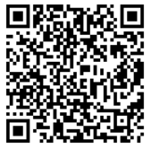
Program Survey
Link: https://unmcredcap.unmc.edu/redcap/surveys/?s=44HA8NKX8C
Passcode: 0126
QR code:

