Slide 1





NGWEP the Nebraska Geriatrics Workforce Enhancement Program
A Partnership between Nebraska Medicine, UNMC , Community Based Organizations and Primary Care Sites

Slide 2
This program is supported by the Health Resources and Services Administration (HRSA) of the U.S. Department of Health and Human Services (HHS) as part of an award totaling 749,836.00 with 0% financed with non-governmental sources. The contents are those of the author(s) and do not necessarily represent the official views of, nor an endorsement, by HRSA, HHS, or the U.S. Government. For more information, please visit HRSA.gov.

Slide 3
Why enhance the geriatrics skills in the primary care workforce?
Most elders are seen and cared for in PC clinics
Many HCPs received limited training in geriatrics
EB review and expert consensus¹ identified 4 things important to health & QOL for older people.
¹ References available on request

Slide 4
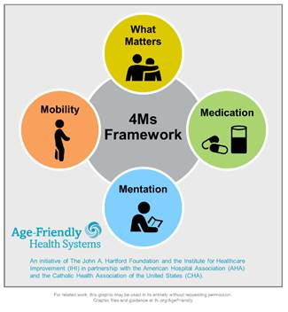
Age Friendly Primary Care:
These are the 4 important things
Notes:
We all care for elders, we want to do the important things. The 4 Ms are the important things
What Matters: Know and align care with each older adult’s specific health outcome goals and care preferences including, but not limited to end-of-life care, and across settings of care (document ACPs)
Medication: If medication is necessary, use Age-Friendly medications that do not interfere with What Matters to the older adult, Mobility, or Mentation across settings of care (Pharmacy protocols for med review in evaluating cognitive dysfunction, mobility and falls etc)
Mentation: Prevent, identify, treat, and manage dementia, depression, and delirium across settings of care
Mobility: Ensure that older adults move safely every day to maintain function and do What Matters

Slide 5

NGWEP is a Collaboration-teach/learn together
Discuss What Matters and Mentation today; Mobility & Medications on 1/26
Monthly Case conferences
  Bring cases to discuss with 8 other clinics and an IP geriatrics panel (med, psych, SW, pharm) and community services.
  Get a written summary after the conference.
Annual Wellness Visits screen for the 4Ms- what are the next steps when issues are identified? EMR tools in EPIC

Slide 6
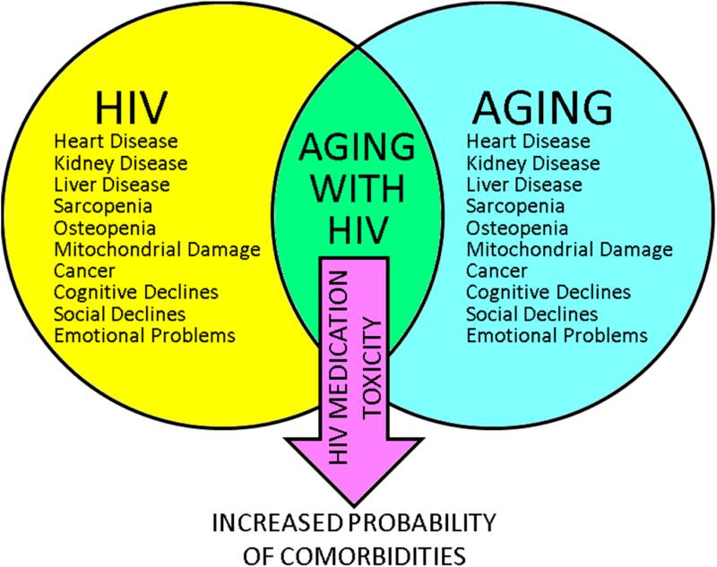
SCC: Primary Care for people living with HIV

Slide 7
Mentation
One of the 4Ms

Slide 8
Mentation: Screening & Next Steps
Delirium
Dementia
Depression

Slide 9

DEMENTIA
The most common cause of disability in later life¹
A focus for providers of health care to older adults
¹Reference available on request

Slide 10
Dementia
(DSM-5 Major Neurocognitive Disorder)
Chronic acquired decline in one or more cognitive domains (learning and memory, complex attention, language, visual-spatial, executive) sufficient to affect daily life
Etiology: Any disorder causing damage to brain systems involved in memory. Alzheimer’s disease is the most common cause in later life

Slide 11
DEMENTIA
AD
Other
Vascular
Lewy BD
An umbrella term there are many causes.

Slide 12

Mentation: Tips
Normalize cognitive screening for patients. For example, say “I’m going to assess your cognitive health like we check your blood pressure, or your heart and lungs.”
Emphasize an older adult’s strengths when screening and document it so that all providers have a baseline.
Screening for cognitive impairment is part of Welcome to Medicare and Medicare Annual Wellness Visits

Slide 13
Screen during Annual Wellness with the Mini-cog
I am going to name 3 objects and I want you to repeat those after me
“Apple, Table Penny” (2 tries to get it right)
“Now I want you to remember those 3 things because I will ask you to repeat them in a couple of minutes.”
Clock draw: “please draw the face of a clock and set the hands to read (e.g.) 10 min after 11:00.

Slide 14
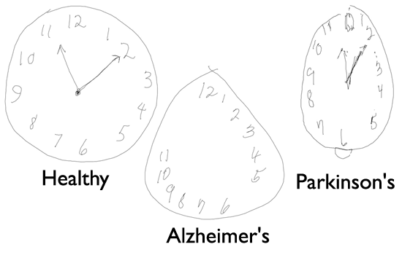
Mini Cog Interpretation
Each of the 3 items recalled earns a point (0- 3 points)
Correct clock draw earns 2 pts; 1 point for getting the 12,3,6,9 in the correct anchor positions, no duplicate or missing numbers; 1 pt for the hands pointing correctly
Total score <3 points, positive for dementia

Slide 15

If I am worried about dementia, what’s next?
AD8- a close friend/relative answers 8 questions an answer yes to 2 or more means likely a problem.
Some PC clinics will refer the patient if abnormal mini-cog/MOCA and changes on AD-8
If AD8 is normal, but you are still worried do a MOCA and recheck the MOCA/AD-8 next year

Slide 16
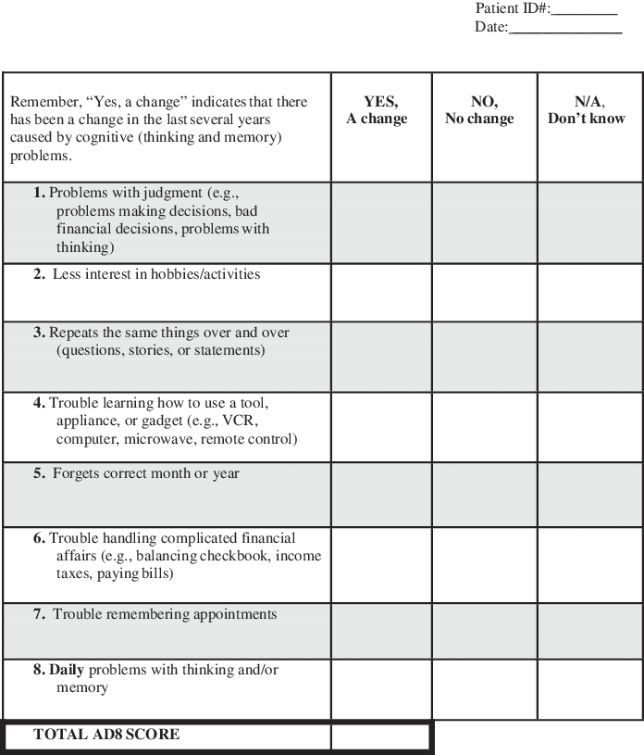
AD8
Alzheimer’s
Disease 8
Completed by someone who knows the patient

Slide 17
Initial and FU Dementia Evaluation
99483, wRVU value= 3.44, not more often than every 180 days
Other general E &M codes cannot be used on the same day of service; elements overlap
Codes that can be used: prolonged service codes (99358/99359) transitional care codes (99495/99496 ).

Slide 18
EPIC documentation for 99483
Note Type: NM AMB Cognitive Impairment Care Plan Note covers the required elements of history, exam, functional assessment, caregiver and safety issues.
  A formatted HPI structures history of cognitive loss
  Exam block prompts for a neuro exam gait, symmetry, and strength
  Last PHQ-2 and MOCA are imported
Smart set: Geriatric Cognitive Impairment
  Lab and imaging, referrals and treatment of cognition (ACHE inhibitor etc.);
  treatment for behavior (if any), caregiver needs (AA referral)

Slide 19


Improving Memory in Primary Care
Take a look at the prescription & OTC medications
Look for substance misuse

Slide 20
Prescription Drugs and Dementia
Many drugs make patients worse, e.g. Sedatives, anxiolytics, anticholinergics, H2-blockers, centrally acting antihypertensives (clonidine) antiarrhythmics, beta blockers, digoxin, Sinemet, selegiline.
Don’t forget herbals and OTCs
Check all meds for CNS side effects
Ask Pharmacy to review

Slide 21

Alcohol and Dementia
Volume of distribution for ETOH with age
No more than one/day after age 65; stop all if memory is impaired

Slide 22
The Dementia Evaluation: don’t miss these
Laboratory/ Diagnostics
B-12, Folate, TSH
Chem profile, UA, ?O₂ sat
CBC
Other as indicated –most often drug levels
Brain Imaging (once, not multiple)

Slide 23
Caregiver Support: services offered by the Alzheimer’s Association
Information and Referral
Care Consultation
Safety Services
Support Groups
Monthly Educational Programs-webinars
Brain Health Awareness
Clinical Trials
Place EPIC referral “ Alzheimer’s”
prints info about the referral in the AVS
Must fax referral to number on form

Slide 24

Mentation Part 2: Depression
Depression is common in elders with other health problems
Positive PHQ-2 should trigger a PHQ-9
Refer to mental health provider or/and pharmacotherapy

Slide 25
Subsyndromal Depression
Does not meet criteria for MDD; but may need pharm- or non-pharmacologic treatment
Can be serious and associated with functional decline
May complain of poor energy or somatic symptoms
May include adjustment disorder or mild depression with anxiety

Slide 26
Mentation Part 3. Delirium (Acute Confusion)
• Symptom: decreased attention, environmental awareness
• Cognitive change (eg, memory deficit, disorientation, language disturbance) or perceptual disturbance (eg, visual hallucinations
• Three motor subtypes: hyperactive, hypoactive, and normal/mild
• Rapid onset (hours to days) and fluctuates daily
• Evidence of a physical cause

Slide 27
Mentation: Delirium in Outpatients
Is UNDERRECOGNIZED
Has an underlying cause; is preventable and often treatable. Primary Care teams need to:
  Remove or treat underlying cause e.g. medication ADEs
  Restore/maintain function & mobility; recommend exercise
  Understand delirium behaviors
  Prevent complications- falls and adding high risk meds
Screen for delirium using the Ultra-Brief 2-Item Screener (UB-2)
Notes:
Talking Points from the What Matters Toolkit can be found here: http://www.ihi.org/Engage/Initiatives/Age-Friendly-Health-Systems/Documents/IHI_Age_Friendly_What_Matters_to_Older_Adults_Toolkit.pdf

Slide 28
Delirium Screening: Ultra Brief-2 (UB-2)
  1: Please tell me the day of the week
    Try to sit at eye level
    Be sure sensory aides (glasses, hearing) are in place patient can check anywhere (e.g., white board, newspaper, etc.), but cannot ask for help
  2: Please tell me the months of the year backward, say December as your first month
Fick et al, Journal of Hospital Medicine, 2015

Slide 29
UB-2 Does not make a diagnosis
Sensitivity>90% of delirium, but specificity only 60%.
If the patient passes the UB-2 he/she does NOT have delirium
If the patient fails the UB-2 you need a second test to know if the cognitive problem is delirium
The 3D CAM is the best next test- 8 more questions + observations you make while seeing the patient
Sensitivity 95% (C.I. 84%, 99%], specificity 94% C.I. [90%, 97%]
Marcantonio Annals 2014

Slide 30
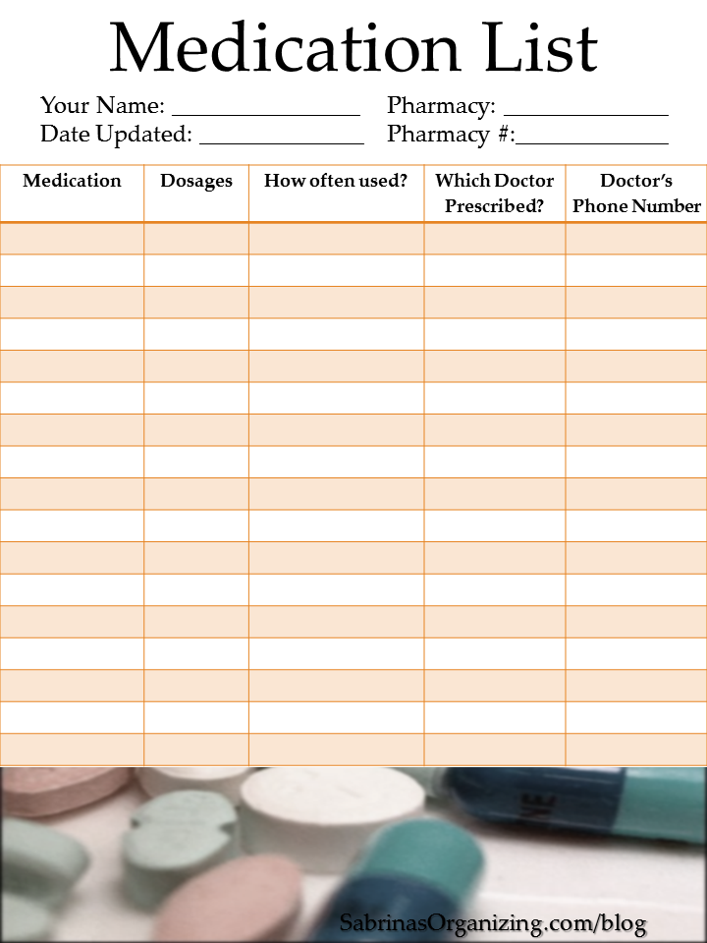
Mentation: Keeping the patient’s brain healthy
Ensure that the older adult and family caregivers understand:
  What medications are for
  How to take them
  How to know if they are helping or possibly causing adverse side effects.

Slide 31


Mentation: Tips
NM selected the MOCA as our tool
Document mental status in the chart to measure change over time (EPIC review flow sheet .moca5)
Until ruled out, consider a change in mental status to be delirium and raise awareness among care team and family caregivers about the risk of delirium superimposed on dementia

Slide 32
Mentation: screen for problems & take next steps
Delirium
Dementia
Depression

Slide 33
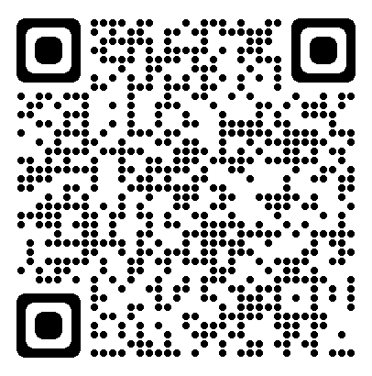
THANK YOU!!
Next up Dr. Bill Lyons
Before you sign off click the link in the chat (or QR code) and tell us how we did (evaluation)
Passcode: 0120

Slide 34
ASKING ABOUT SERIOUS THINGS: WHAT MATTERS
Bill Lyons, MD
Division of Geriatrics, UNMC

Slide 35
COUPLE OF GREAT RESOURCES
prepareforyourcare.org
  Rebecca Sudore et al
  Advance Care Planning
patientprioritiescare.org
  Tinetti, Blaum, Naik, et al
  Priority setting in multimorbidity, good for ACP as well

Slide 36
ACP AND ELICITING WHAT MATTERS
Similar and related activities
ACP, by definition, is about planning for the future
ACP entails
  Identification of surrogates
  Elicitation of What Matters
Yet eliciting What Matters is helpful in the here and now of managing multimorbid patients

Slide 37
MEET RENEE
40 yo woman is an elementary school art teacher with hyperlipidemia and hypothyroidism.
Recently remarried, she has an 8-month old son and 5-year-old daughter.
A chest film incidentally discovers a 2-cm RUL mass; pathology shows adenocarcinoma.
What are your next steps in her care?

Slide 38
MEET MILDRED
85 yo woman is a retired elementary school art teacher with advanced parkinson disease, related dementia, HFrEF (last EF 20%), frailty.
Widowed, her son and daughter reside out of state with their families. Resides in an ALF.
A chest film incidentally discovers a 2-cm RUL mass; pathology shows adenocarcinoma.
What are your next steps in her care?

Slide 39
CARE FOR MANY OLDER ADULTS WITH MULTIPLE CONDITIONS MAY…
Be of uncertain benefit
  Few older adults in RCT’s
  Those who are don’t look like Mildred
  These persons have less benefit from treatment than those in the studies
Be burdensome
Inflict unintended harm
Be frustrating
Hence the need for determining What Matters

Slide 40
WHEN MIGHT YOU HAVE A WHAT MATTERS CONVERSATION?
Annual Wellness Visit
New diagnosis, or change in health status
Change in life stage or circumstances
As part of chronic disease management discussions
Visit to patient in inpatient setting (hospital, nursing home)
Or first clinic visit following hospitalization

Slide 41
WHO CAN HAVE THE WHAT MATTERS CONVERSATION?
Any member of the care team can initiate and document the conversation
Can also be elicited by self-report (write in free text on a form)

Slide 42

CHECK THEIR UNDERSTANDING
(Not always necessary)
What is your understanding now of where we are with your illness?
“I know we doctors may not always do the best job of communicating about these things”
Calibrate their understanding as needed

Slide 43
PROGNOSIS
(Not always necessary)
(May provide rationale for: Why now?)
Share prognosis as a range, tailored to information preferences
How to estimate?
  Experience
  Contact consultant if a prominent disease
  eprognosis.ucsf.edu

Slide 44
WHAT MATTERS: GOALS
What things are most important in your life?
What makes life worth living?
Examples:
  Function and independence – living on your own, caring for yourself
  Longevity
  Social connection – friends, family, religion
  Symptom relief
Have you changed your mind about what matters in your life? (Say more…)

Slide 45
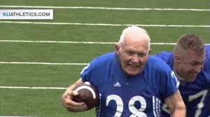
GOALS, cont.
What would you be doing more of if your [ailment] were not so burdensome?
What activities are particularly important or meaningful?
Is there something you want or need to do before, say, your next birthday?

Slide 46
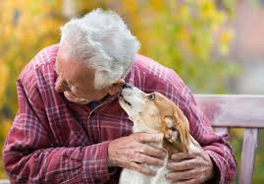
GOALS, cont.
Describe what a good day would look like
Which relationships or connections are most important to you?
What brings you the most enjoyment or pleasure?
What do you hope your health care can do for you?

Slide 47
WHAT MATTERS: BURDENS
Are there things about your healthcare that you think aren’t helping, or you find bothersome or difficult? (Possible examples:)
  Medicines (pills, shots, drops, inhalers)
  Self-care tasks (diet, FSBG checks…)
  Blood tests and x-rays, etc.
  Medical visits
  Dialysis…
What are you willing/able to do, and what NOT?

Slide 48

WHAT MATTERS: FEARS AND WORRIES
What are your biggest fears and worries about the future with your health?
What experience have you had with serious illness?
What went well? What didn’t? Why?
In the same situation, what would you want?

Slide 49
FEARS AND WORRIES, cont.
Can you imagine anything that would be worse than death? Or,
Can you think of any health situations that would be hard on your quality of life?
Some people might say
  Not being able to live w/o machines
  Not being able to think for oneself
  Not being able to live on one’s own
  Constant pain…

Slide 50
SCENARIO TO CONSIDER
Sudden event has left you unable to communicate
You’re receiving all care needed to keep you alive
Doctors believe little chance you’ll recover ability to know who you are or who you’re with
Would you want
  Medical treatment to keep you alive, or
  To stop the medical treatment
  (You’d be kept comfortable in any case)

Slide 51
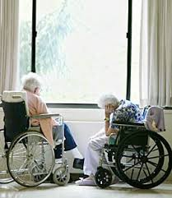
WHAT MATTERS: FUNCTION
What abilities are so critical to your life that you can’t imaging living without them?

Slide 52
WHAT MATTERS: TRADE-OFFS
If you became sicker, how much are you willing to go through for the possibility of gaining more time?
“I’ve had some patients who have told me, “Doc, I want you to do anything you can to have me live as long as possible – surgery, breathing machines, you name it….”
“And I’ve had other patients….”

Slide 53
HAVING AND DOCUMENTING THE CONVERSATION
“I want to be sure we are working on the things in your health that you think are most valuable. Can we step back and talk about that for a couple of minutes?”
Probably best to do in a meeting room across a table, not in exam room with patient in a gown
Try to record in EHR in patient’s own words
  “Be able to walk around block with my grandson,” not
  Increase mobility
Share with interdisciplinary team

Slide 54

COMMENTS & QUESTIONS?

Slide 55
We truly value your feedback
Passcode: 0120

