Slide 1
Overview and definition of service dogs, therapy dogs and emotional support animals and benefits
Cathy Guinane
Director of Community Training at the Nebraska Humane Society

Slide 2
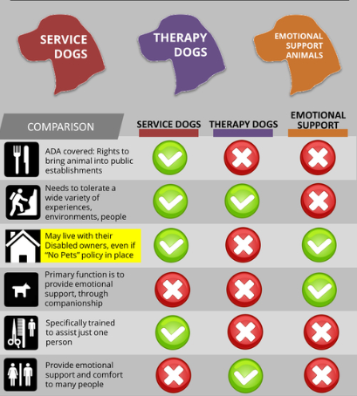

Slide 3
Ann C. Mangiameli, JD
Service Animals and Housing Rights

Slide 4
NEB. REV STATUTE §20-131-01
It is the intent of the Legislature that persons with disabilities shall be entitled to full and equal access to all housing accommodations offered for rent, lease or compensation in this state.

Slide 5
Neb Rev Statute §20-131-.04
Every person with a disability who has a service animal or obtains a service animal shall have full and equal access to all housing accommodations …..Such person shall not be required to pay extra compensation for such animal……

Slide 6
FAIR HOUSING ACT
Prohibits discrimination in the sale, rental, financing or advertising f housing.
Tenants with disabilities are entitled to a reasonable accommodations to allow equal opportunity for housing enjoyment.
A reasonable accommodation is a change, exception or adjustment to a rule, policy, practice or services such as an exception to a no animal policy.
This would include allowing a visitor with a service animal to bring their animal into the home.
Other reasonable accommodation examples..

Slide 7
FAIR HOUSING ACT REQUIREMENTS
The person must have a disability.
The animal must serve a function directly related to the person’s disability.
The request to have the service animal must be reasonable.

Slide 8
:
EXCEPTIONS
A landlord does not have to allow an assistive animal if it would pose an undue financial and administrative burden or would alter the nature of the provider’s operations (eg. could can’t have an emu as a service animal)
If the animal’s behavior poses a direct threat to the health or safety of others.
The risk must be significant and immediately identified no based on opinion or speculation. (i.e.. Denying a pit bull because it’s a pit bull)

Slide 9
Questions?
ann@mangiamelilaw.com
402-953-5766

