Slide 1
"Interventions and Intergenerational Programs on Addressing Social Isolation and Loneliness in Older Adults"
Jeremy Holloway
Professor & Director of Geriatric Education
University of North Dakota
Department of Geriatrics

Slide 2
Bio
JEREMY HOLLOWAY, PHD
Dr. Jeremy Holloway is a Geriatric Professor, Diversity, Equity & Inclusion leader and curriculum specialist with 20 years of professional and global experience. Dr. Holloway has led strategic planning, program design, and implementation for over 30 groups and organizations, in 10 countries for multiple organizations and sectors of healthcare, business, church ministries, and higher education. His intuitive skills in unifying by means of collaborative partnerships, unique understanding of visualization and mindfulness, and perspective in Social Determinants of Health build more inclusion that ultimately betters patients, associates, stakeholders, and community members as a whole.

Slide 3
WHAT IS THE NEED?
Social isolation is linked to increased rates of loneliness and suicide, hypertension and other physical health effects, and has been identified as a public health priority.
Loneliness and social isolation are cited as having negative health impacts equivalent to smoking 15 cigarettes a day.
$6.7 Billion
LONELINESS COSTS MEDICARE AN ESTIMATED $6.7 BILLION ANNUALLY
Source: Lynda Flowers, Ari Houser, Claire Noel-Miller, AARP Public Policy Institute, Jonathan Shaw, Jay Bhattacharya, Lena Schoemaker, Stanford University, Monica Farid, Harvard University, November 27, 2017.

Slide 4
Older Adult Population

Slide 5
The demographics of aging are shifting.
The baby boomers (people born between 1946 to 1964) first turned 65 beginning 2011.
Persons over aged 85 and over are the most rapidly growing segment of our population and their numbers will double over the first quarter of the century and more than quadruple over the first half the century (to over 19 million persons).
Notes:
He, Wan, Daniel Goodkind, and Paul R. Kowal. "An aging world: 2015." (2016): 09-1.

Slide 6
The older adult population is growing both in number and in diversity.
In 2000, 16% of population were non-whites (Blacks, Hispanics, Asians, Native Americans) or 5.8 million persons. In 2050, 36% of population will be non- white or 29.5 million persons.
Notes:
Byars-Winston, A., Fouad, N., & Wen, Y. (2015). Race/ethnicity and sex in US occupations, 1970–2010: Implications for research, practice, and policy. Journal of vocational behavior, 87, 54-70.

Slide 7
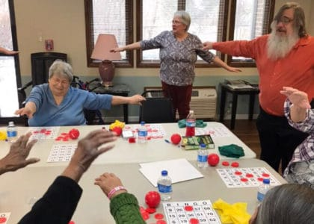
WKU’s Bingocize
Target audience: The program targets sedentary, older adults at all physical and mental ability levels in a variety of settings including certified nursing facilities, assisted living, independent living, and community senior centers.
Health outcomes:
Improved lower/upper body strength, gait, balance, and range of motion,
Improved aspects of cognition (executive function),
Increased social engagement,
Improved knowledge of falls risk reduction and nutrition
Improved patient activation.

Slide 8
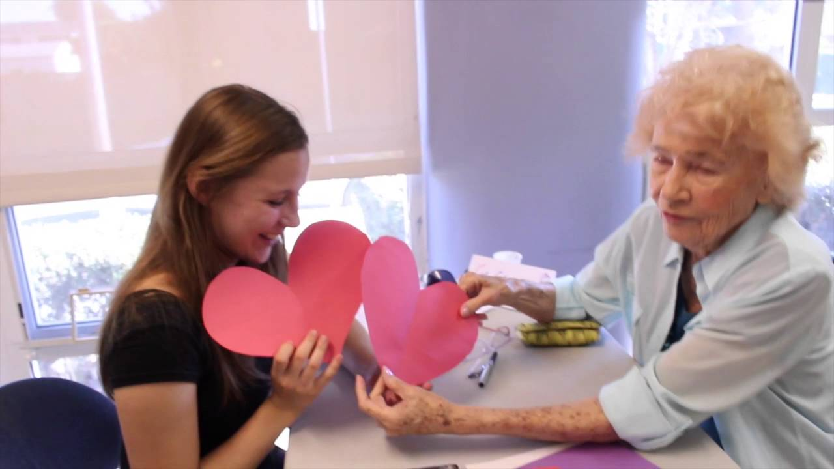
UCLA’s TimeOut
Aims:
1. Foster Intergenerational connections between college students and memory-impaired seniors
2. Provide needed respite to family/caregivers of older adults
3. Inspire college students to consider careers in aging

Slide 9
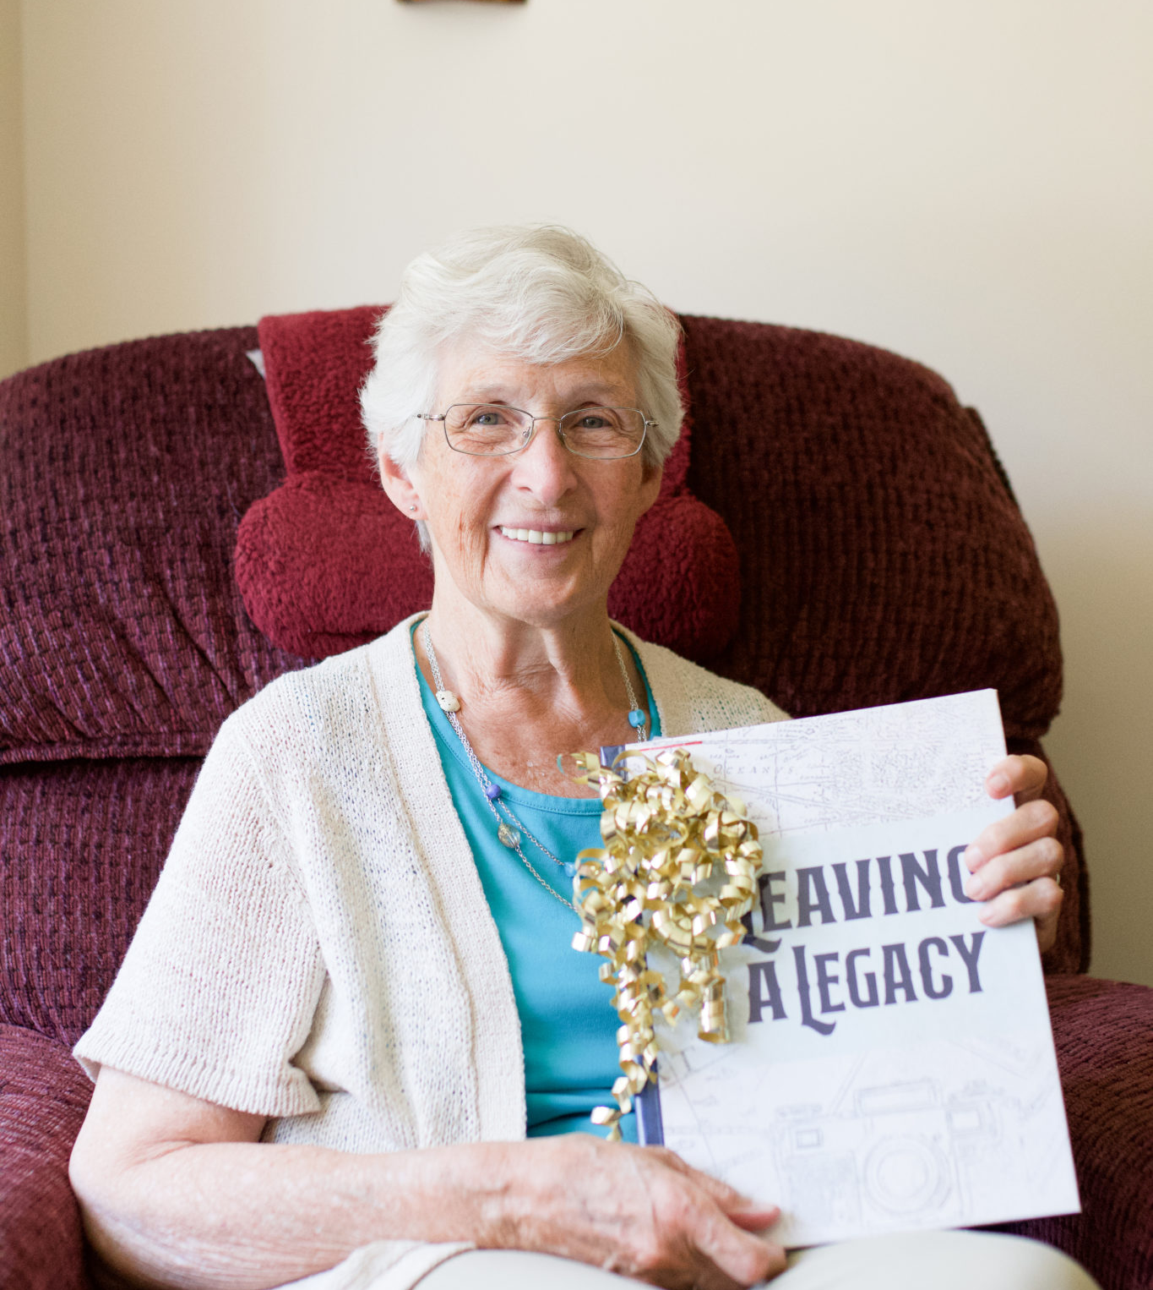
Tellegacy
Upon request, book provided for all that complete at least 5 sessions
Tangible result of conversations representing legacy and longevity
Printed copy presented to resident as a celebration
Encompasses stories from older adult and impressions from Legacy Builders
Reinforces all that was discussed
Opportunity to engage family members and caregivers

Slide 10
Tellegacy Program Description
Who: Intergenerational - University Students & Older Adults
Why: Decrease a sense of Isolation and Loneliness
What: Weekly sessions utilizing a strengths-based curriculum.
Where: In-person, phone, virtual meetings

Slide 11
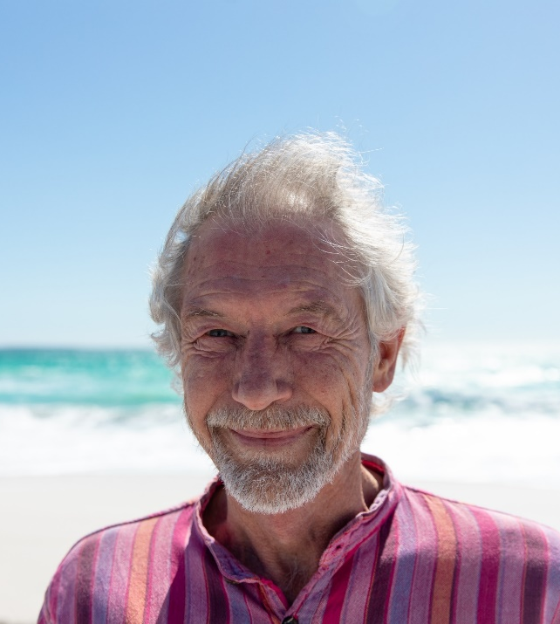
Evaluation Methods
UCLA Loneliness Scale
Satisfaction of Life Scale
Ambivalent Ageism Scale
Other considerable: PHQ9, Identity Scale, Student Belonging Scale, Goal-Setting Scale…

Slide 12
Thank you!
Discussion Points:
Potential assisting in…
Self-Efficacy
Quality of Life
Graduation rates
Decreasing isolation and loneliness
Jeremy Holloway, PhD
Email: Jeremy.Holloway@und.edu

