Slide 1
A Review of Opioid Safety in Older Adults
Alfred Fisher MD PhD
Professor and Chief
Division of Geriatrics, Gerontology, and Palliative Medicine
Department of Internal Medicine
University of Nebraska Medical Center
Alёna A. Balasanova, M.D., FAPA
Associate Professor
Director, Addiction Psychiatry Education
Co-Director, Addiction Psychiatry Consultation-Liaison Service
Department of Psychiatry
University of Nebraska Medical Center

Slide 2
Disclosures
This program is supported by the Health Resources and Services Administration (HRSA) of the U.S. Department of Health and Human Services (HHS) as part of an award totaling $749,836.00 with 0% financed with non-governmental sources. The contents are those of the author(s) and do not necessarily represent the official views of, nor an endorsement, by HRSA, HHS, or the U.S. Government. For more information, please visit HRSA.gov.
Nebraska GWEP (www.unmc.edu/NebraskaGWEP)

Slide 3
Older Patients are often prescribed and use opioids
Approximately 9% of outpatient clinic visits by older patients involve a prescription for an opioid medication
About 9% of patients over the age of 65 years take an opioid for chronic, non-cancer pain
A growing number of patients are presenting for the treatment of opioid use disorders
Naples, et. al. Clin. Ger. Med. (2016) 32:725-735 / Maree, et. al. Am. J. Ger. Psych. (2016) 24:949-963.

Slide 4
Evidence for the effectiveness of long-term opioids for chronic pain is weak
A clinical trial comparing dose escalation versus a fixed dose showed no improvement in pain levels.
There are no studies showing that opioids improve physical activity, function, sleep, mood, or quality of life in patients with chronic, non-cancer pain
Naliboff, et. al. J. Pain (2011) 12:288-96 / Sehgal, et. al. Expert Rev. Neurother. (2013) 13:1201-20.

Slide 5
Additional concerns with opioid use in Older Adults
Long-term opioid use is associated with cognitive decline and even short-term use is associated with the development of delirium
Use of opioids is not associated with increased falls, but is associated with an increased risk of fractures
Opioid use is also associated with increased risk of car accidents, cardiovascular events (MI or A.fib), and pneumonia
Puustinen, et. al. BMC Ger. (2011) 11:70 / Woolcott, et. al. Arch Int.. Med. (2009) 169:1952-1960 / Naples, et. al. Clin. Ger. Med. (2016) 32:725-735

Slide 6
Non-opioid options to treat common sources of pain
Low back pain
Self-care and education in all patients: advise patients to remain active and limit bedrest
Nonpharmacological treatments: physical therapy, exercise, cognitive behavioral therapy, interdisciplinary rehabilitation
Medications
  First-line: acetaminophen, non-steroidal anti-inflammatory drugs (NSAIDs) with caution
  Second-line: Serotonin and norepinephrine reuptake inhibitors (SNRIs) / tricyclic antidepressants (TCAs) with caution
Steroid injections
Neuropathic pain
Medications: SNRIs, topical lidocaine,
gabapentin/pregabalin, TCAs
CDC Opioid guidelines
Osteoarthritis
Nonpharmacological treatments: physical therapy, exercise, weight loss, patient education, evaluation for joint replacement surgery
Medications
  First-line: acetaminophen, topical NSAIDs, oral NSAIDs with caution
  Second-line: intra-articular hyaluronic acid, capsaicin, intra-articular glucocorticoid injections
Fibromyalgia
Patient education: Address diagnosis, treatment, and patient’s role in treatment
Nonpharmacologic treatments: low-impact aerobic exercise, cognitive behavioral therapy, biofeedback, interdisciplinary rehabilitation
Medications
  First-line: duloxetine, pregabalin
  Second-line: TCAs, gabapentin

Slide 7
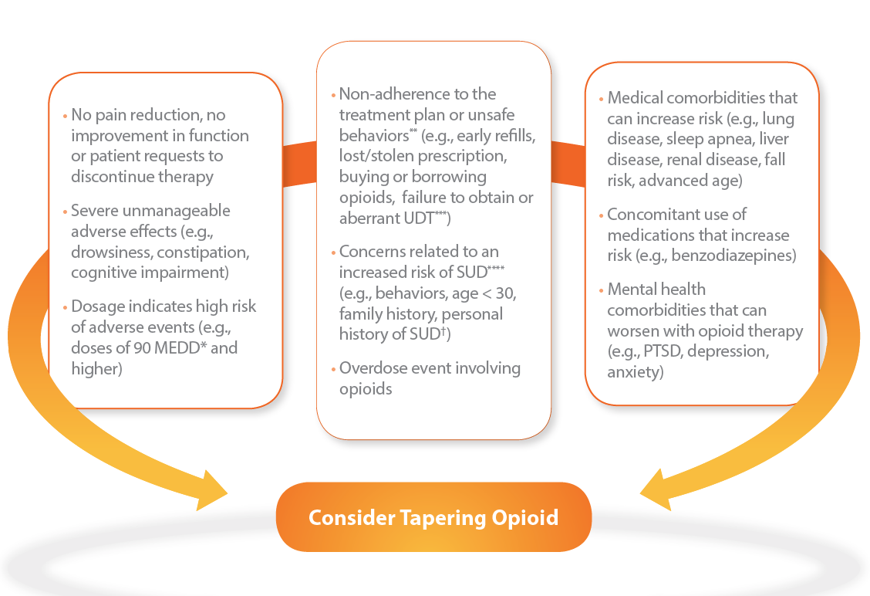
When to consider tapering opioids

Slide 8
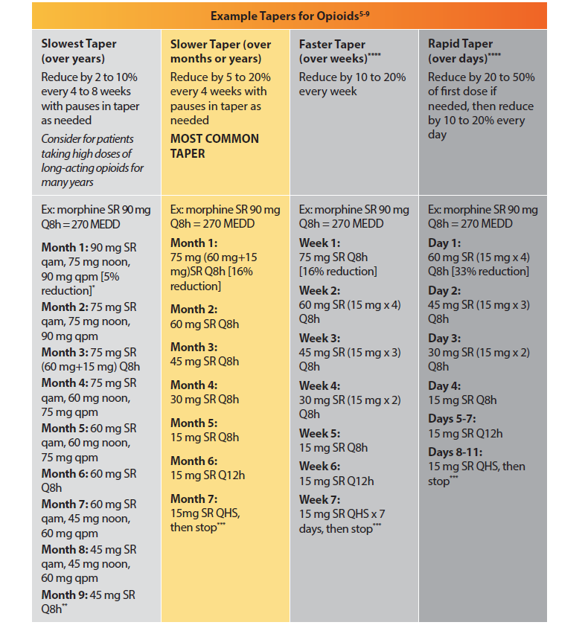

Slide 9
Screening for Opioid Use Disorders
Number of options available
  WHO developed ASSIST tool
  NIDA resources for assessing opioid use disorders in the pain management setting (https://www.drugabuse.gov/nidamed-medical-health-professionals/science-to-medicine/screening-substance-use/in-pain-management-setting)
  These largely focus on underlying risks for substance use disorders (prior history and family history) and patient report of using opioids for non-medical purposes
  Also utilize PDMP (prescription drug monitoring program) to check for prescriptions from multiple providers
  Rieb, et. al. Can Geriatr J. (2020) 23:123-134.

Slide 10
How to reduce patient harm from Opioids
Prescribe acute opioids for only short durations (7 days or less)
Encourage tapering and reduced use of opioids
Offer treatment (or referral) for buprenorphine treatment for patients unable or unwilling to consider opioid tapering
Avoid co-prescribing of opioids and benzodiazepines or other CNS depressants
Co-prescribe naloxone with opioid prescriptions

Slide 11
Available Tools

Slide 12
Provider Brochure

Slide 13
Patient Brochures

Slide 14
Summary
Opioids are frequently prescribed for older patients and chronic use is not uncommon
Opioid medications have additional potential harms in older individuals, such as cognitive decline and auto accidents
For older individuals using chronic opioid therapy, consider screening for opioid use disorder, offering deprescribing, and referral for buprenorphine treatment

Slide 15
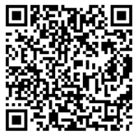
Program Survey
We truly value your feedback!
Please utilize link or QR code below –
Link: https://unmcredcap.unmc.edu/redcap/surveys/?s=44HA8NKX8C
Passcode: 042723

