Slide 1
Chronic Kidney Disease
Jennifer Fillaus, DO
Nebraska GWEP
May 4, 2023

Slide 2
Objectives
Kidney facts
Who is KDIGO
Who to screen
CKD Definition and classification
Estimating equations
Aging and CKD
Complications of CKD
Referral Guidelines
Suggested Reading

Slide 3
Kidney Disease Facts
Kidney disease kills more people each year than breast or prostate cancer.
The National Kidney Foundation recommends annual kidney disease screening for anyone over the age of 60.
Risk factors for kidney disease include: high blood pressure, diabetes, kidney stones, a family history of kidney failure, prolonged use of over-the-counter pain medications, and being over the age of 60.
More than 37 Million Americans - 1 in 7 adults- have chronic kidney disease and most don't know it.
Of the over 120,000 Americans on the national organ transplant waitlist, more than 98,000 await a life-saving kidney.
National Kidney Foundation: Kidney.org

Slide 4
Kidney Disease: Improving Global Outcomes (KDIGO)
Was established in 2003 with its stated mission to “improve the care and outcomes of patients with kidney disease worldwide through promoting coordination, collaboration, and integration of initiatives to develop and implement clinical practice guidelines.”
Since 2003, KDIGO has developed a catalog of clinical practice guidelines informing the care of patients with, or at risk of developing, kidney diseases.

Slide 5
WHO TO SCREEN
ACC / AHA Guidelines
  Patients with hypertension be screened with eGFR and urinary albumin
2019 KDIGO Guidelines
  Universal screening for persons with hypertension, diabetes, or cardiovascular disease
  An individualized approach to screening was recommended for persons with other clinical, environmental, or genetic risk factors for CKD
  CKD screening must include assessments of both eGFR and albuminuria

Slide 6
KDIGO: Criteria for Diagnosis of CKD
CKD is an abnormality in kidney structure or function for more than 3 months.
  This can include a sustained decrease in GFR to <60 ml/min per 1.73 m²
  Presence of albuminuria (defined as an urine albumin-creatinine ratio [ACR] ≥30 mg/g or albumin excretion rate ≥30 mg/24 hours)
  Abnormalities on urine sediment, histology, or imaging
  Electrolyte abnormalities due to tubular disorders
  Prior history of kidney transplantation
Kidney Disease: Improving Global Outcomes (KDIGO) CKD Work Group:
KDIGO 2012 clinical practice guideline for the evaluation and management of chronic kidney disease.

Slide 7
Classification of CKD
The KDIGO guidelines classify CKD on the following basis:
  Cause (“C”)
    (1) whether pathology arises from the kidney or is a consequence of systemic disease
    (2) the location(s) within the kidney where pathology is observed or presumed to be present.
      Examples of the latter include glomerular, tubulointerstitial, vascular, cystic, and genetic.
  GFR (“G”)
    G1 (≥90 ml/min per 1.73 m²),
    G2 (60–89 ml/min per 1.73 m²),
    G3a (45–59 ml/min per 1.73 m²),
    G3b (30–44 ml/min per 1.73 m²),
    G4 (15–29 ml/min per 1.73 m²), and
    G5 (<15 ml/min per 1.73 m²).
  Albuminuria (“A”)
    A1 (<30 mg/g), f
    A2 (30–300 mg/g), and
    A3 (>300 mg/g)
Kidney Disease: Improving Global Outcomes (KDIGO) CKD Work Group:
KDIGO 2012 clinical practice guideline for the evaluation and management of chronic kidney disease.

Slide 8
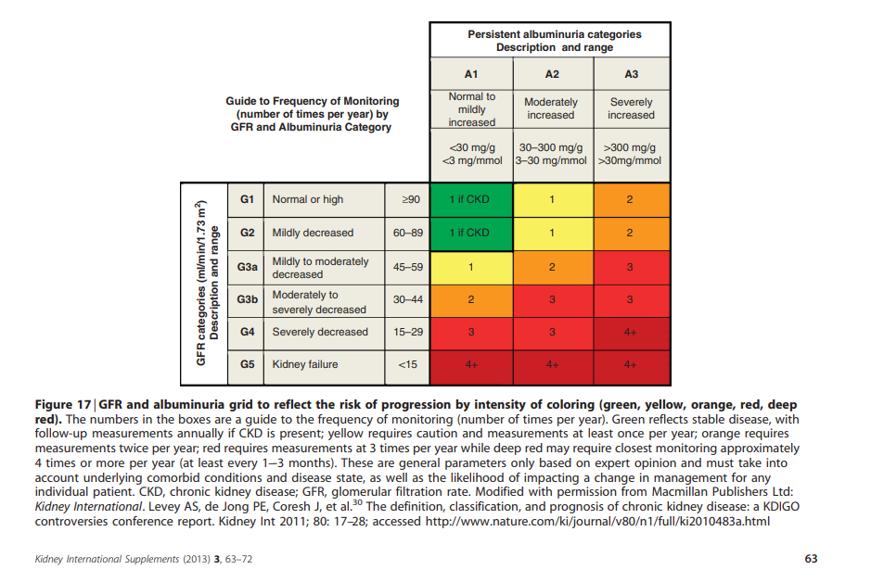

Slide 9
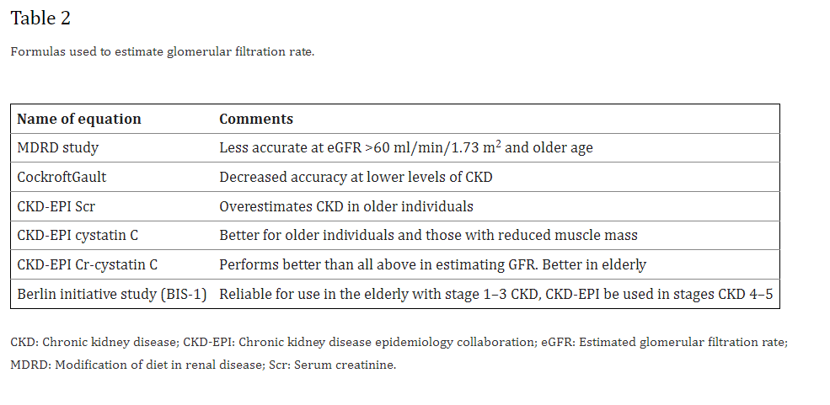
Mallappallil M, Friedman EA, Delano BG, McFarlane SI, Salifu MO. Chronic kidney disease in the elderly:
evaluation and management. Clin Pract (Lond). 2014;11(5):525-535.

Slide 10
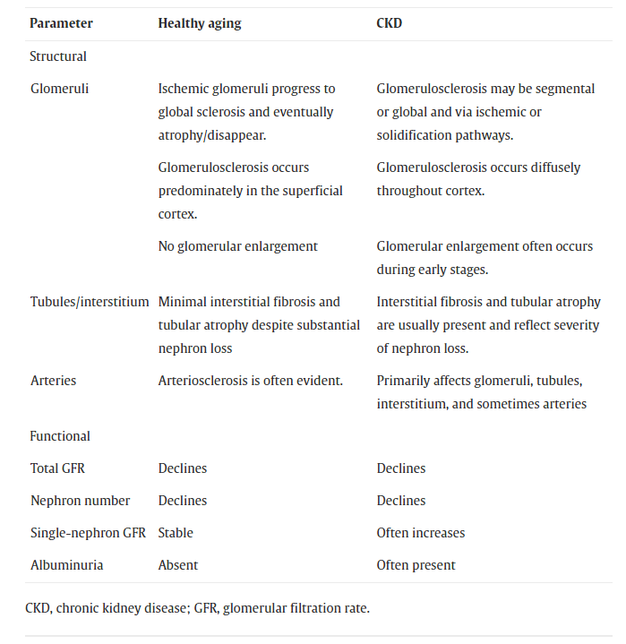
Richard J. Glassock, Pierre Delanaye, Andrew D. Rule: Should the definition of CKD be changed to include age-adapted GFR criteria? YES.
Kidney International: Volume 97, Issue 1, 2020, Pages 34-37.

Slide 11
Aging and CKD
The nephrology society is still divided about whether the decline in GFR noted with aging is part of the normal aging process versus CKD.
  Current nephrology guidelines recommend an age-neutral approach to chronic kidney disease (CKD) management based upon the level of estimated glomerular filtration rate (eGFR) and the presence of proteinuria
Nonetheless, preservation of the kidneys hormonal function, electrolyte and acid base balance as well as normal urinalysis in elderly patients with GFR <60 ml/min/1.73 m² is indicative of a kidney aging normally rather than a kidney with CKD.
Mallappallil M, Friedman EA, Delano BG, McFarlane SI, Salifu MO. Chronic kidney disease in the elderly:
evaluation and management. Clin Pract (Lond). 2014;11(5):525-535.

Slide 12
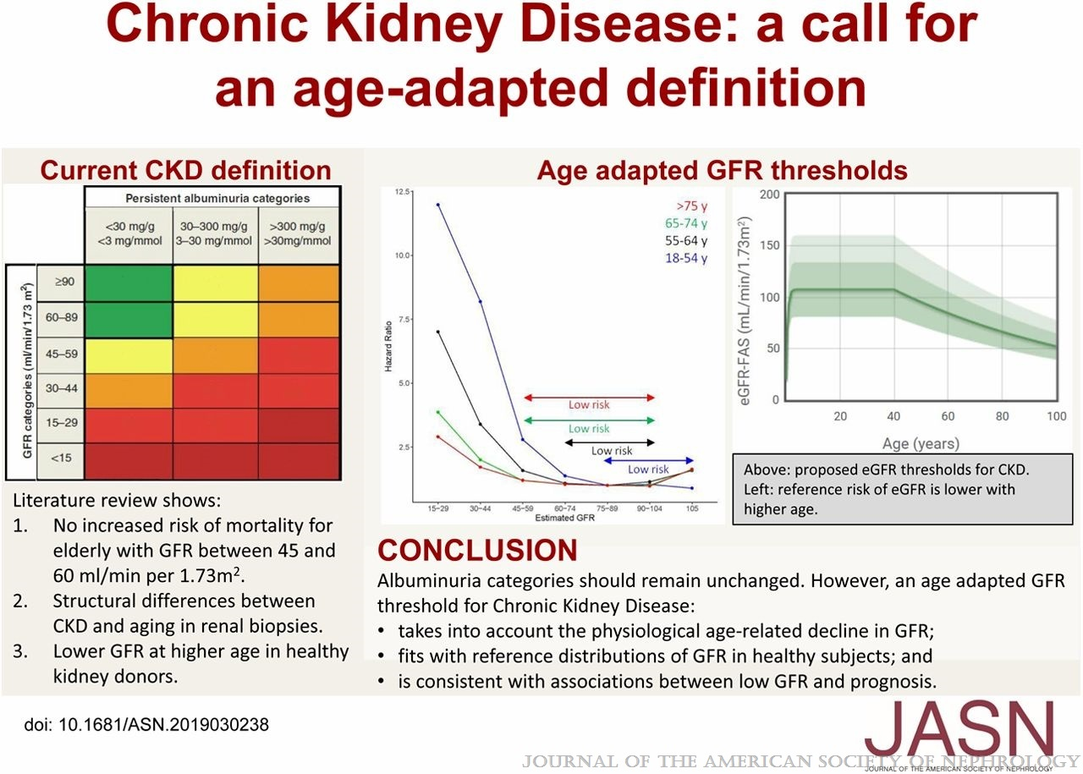
Delanaye, et al. CKD: A Call for an Age-Adapted Definition. JASN 30(10):p 1785-1805, October 2019.

Slide 13
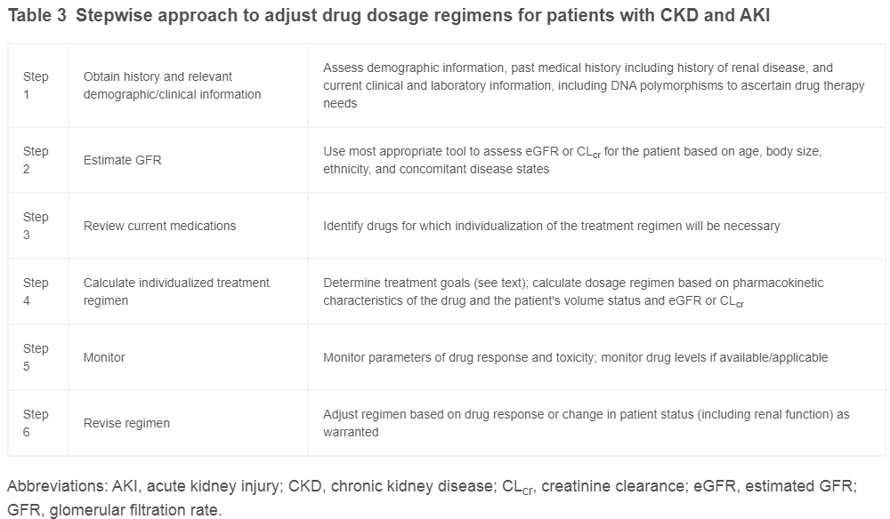
Gary R. Matzke et al. Drug dosing consideration in patients with acute and chronic kidney disease—a clinical update from Kidney Disease: Improving Global Outcomes (KDIGO): Kidney International (2011) 80, 1122–1137

Slide 14
Complications of CKD

Slide 15
2012 KDIGO NEPHROLOGY REFERRAL GUIDELINES
AKI or abrupt sustained fall in GFR
GFR < 30 ml/min/1.73 m2 (GFR categories G4-G5)
A consistent finding of significant albuminuria (See next slide)
Progression of CKD
  Rapid progression is defined as a sustained decline in eGFR of more than 5 ml/min/1.73 m2 /yr.
Urinary red cell casts, RBC > 20 per high power field sustained and not readily explained
CKD and hypertension refractory to treatment with 4 or more antihypertensive agents
Persistent abnormalities of serum potassium
Recurrent or extensive nephrolithiasis
Hereditary kidney disease
Kidney International Supplements (2013) 3, 5–14

Slide 16
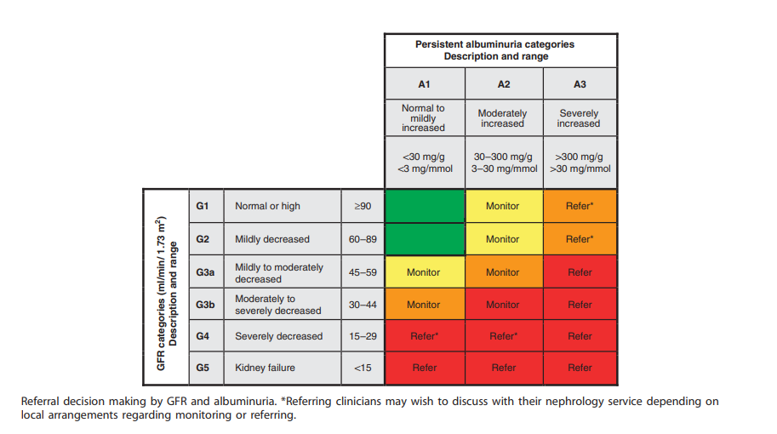
Kidney International Supplements (2013) 3, 5–14

Slide 17
Vascular Access Planning
KDIGO GUIDELINE
Clinical Practice Recommendations
We recommend timely referral for planning renal replacement therapy (RRT) in people with progressive CKD in whom the risk of kidney failure within 1 year is 10–20% or higher , as determined by validated risk prediction tools
CKD Stage 3 to 4
  Protect veins of UE
  Protect Non-Dominant UE
List of NOs
  No BPs
  No venipunctures, i.v. lines, PICCs
Kidney International Supplements (2013) 3, 5–14

Slide 18

Executive summary of the KDIGO 2022 Clinical Practice Guideline for Diabetes Management in Chronic Kidney Disease: an update based on rapidly emerging new evidence
Peter Rossing, M. Luiza Caramori, Juliana C.N. Chan, Hiddo J.L. Heerspink, Clint Hurst, Kamlesh Khunti, Adrian Liew, Erin D. Michos, Sankar D. Navaneethan, Wasiu A. Olowu, Tami Sadusky, Nikhil Tandon, Katherine R. Tuttle, Christoph Wanner, Katy G. Wilkens, Sophia Zoungas, Jonathan C. Craig, David J. Tunnicliffe, Marcello A. Tonelli, Michael Cheung, Amy Earley, Ian H. de Boer
Kidney International
Volume 102 Issue 5 Pages 990-999 (November 2022)
DOI: 10.1016/j.kint.2022.06.013
Copyright © 2022 International Society of Nephrology Terms and Conditions

Slide 19
References
Kidney Disease: Improving Global Outcomes (KDIGO) CKD Work Group: KDIGO 2012 clinical practice guideline for the evaluation and management of chronic kidney disease. Available at: https://kdigo.org/wp-content/uploads/2017/02/KDIGO_2012_CKD_GL.pdf. Accessed July 7, 2021
United States Renal Data System: 2020 USRDS Annual Data Report: Epidemiology of kidney disease in the United States, Bethesda, MD, National Institutes of Health, National Institute of Diabetes and Digestive and Kidney Diseases, 2020
Whelton PK, Carey RM, Aronow WS, Casey DE Jr, Collins KJ, Dennison Himmelfarb C, et al.: 2017 ACC/AHA/AAPA/ABC/ACPM/AGS/APhA/ASH/ASPC/NMA/PCNA guideline for the prevention, detection, evaluation, and management of high blood pressure in adults: A report of the American College of Cardiology/American Heart Association task force on clinical practice guidelines. Hypertension 71: e13–e115, 2018
Shlipak MG, Tummalapalli SL, Boulware LE, Grams ME, Ix JH, Jha V, et al.; Conference Participants: The case for early identification and intervention of chronic kidney disease: Conclusions from a Kidney Disease: Improving Global Outcomes (KDIGO) controversies conference Available at: https://kdigo.org/wp-content/uploads/2019/01/KDIGO-Early-CKD-ID-and-intervention-conf-report-FINAL.pdf. Accessed April 12, 2021
Powe NR: Black kidney function matters: Use or misuse of race? JAMA 324: 737–738, 2020
Inker LA, Titan S: Measurement and estimation of GFR for use in clinical practice: Core curriculum 2021. Am J Kidney Dis 78: 736–749, 2021
Gary R. Matzke et al. Drug dosing consideration in patients with acute and chronic kidney disease—a clinical update from Kidney Disease: Improving Global Outcomes (KDIGO): Kidney International (2011) 80, 1122–1137

Slide 20
References
Koye DN, Magliano DJ, Reid CM, Jepson C, Feldman HI, Herman WH, et al.: Risk of progression of nonalbuminuric CKD to end-stage kidney disease in people with diabetes: The CRIC (Chronic Renal Insufficiency Cohort) study. Am J Kidney Dis 72: 653–661, 2018
National Kidney Foundation: Kidney.org
KDOQI Clinical Practice Guidelines for Chronic Kidney Disease: Evaluation, Classification, and Stratification.
Mallappallil M, Friedman EA, Delano BG, McFarlane SI, Salifu MO. Chronic kidney disease in the elderly: evaluation and management. Clin Pract (Lond). 2014;11(5):525-535.
Rosansky SJ, Schell J, Shega J, Scherer J, Jacobs L, Couchoud C, Crews D, McNabney M. Treatment decisions for older adults with advanced chronic kidney disease. BMC Nephrol. 2017 Jun 19;18(1):200.
KDIGO EXECUTIVE CONCLUSIONS| VOLUME 102, ISSUE 5, P990-999, NOVEMBER 2022. Executive summary of the KDIGO 2022 Clinical Practice Guideline for Diabetes Management in Chronic Kidney Disease: an update based on rapidly emerging new evidence.
Zoungas S, de Boer IH. SGLT2 inhibitors in diabetic kidney disease. Clin J Am Soc Nephrol. 2021;16:631–633.
Hayashi et al. Kid Int 2006; 9: 504-513.
Richard J. Glassock, Andrew D. Rule: The implications of anatomical and functional changes of the aging kidney: with an emphasis on the glomeruli. Kidney International: Volume 82, Issue 3, 2012, Pages 270-277.
Richard J. Glassock, Pierre Delanaye, Andrew D. Rule: Should the definition of CKD be changed to include age-adapted GFR criteria? YES. Kidney International: Volume 97, Issue 1, 2020, Pages 34-37.
Delanaye, Pierre et al. CKD: A Call for an Age-Adapted Definition. JASN 30(10):p 1785-1805, October 2019.

