Slide 1

Cross-Cultural Communication
Jeremy Holloway PhD
UND Professor, Geriatric Education
Advocate for Diversity, Equity, & Inclusion

Slide 2
Objectives
Participates will be able to:
Describe what cross-cultural communication is.
Describe why cross-cultural communication is important.
Describe how one can implement cross-cultural communication inside or outside the work environment.

Slide 3
Research to note: Social Isolation and Loneliness
Social isolation is linked to increased rates of loneliness and suicide, hypertension and other physical health effects, and has been identified as a public health priority.
Loneliness and social isolation are cited as having negative health impacts equivalent to smoking 15 cigarettes a day.
Source: Lynda Flowers, Ari Houser, Claire Noel-Miller, AARP Public Policy Institute, Jonathan Shaw, Jay Bhattacharya, Lena Schoemaker, Stanford University, Monica Farid, Harvard University, November 27, 2017.

Slide 4
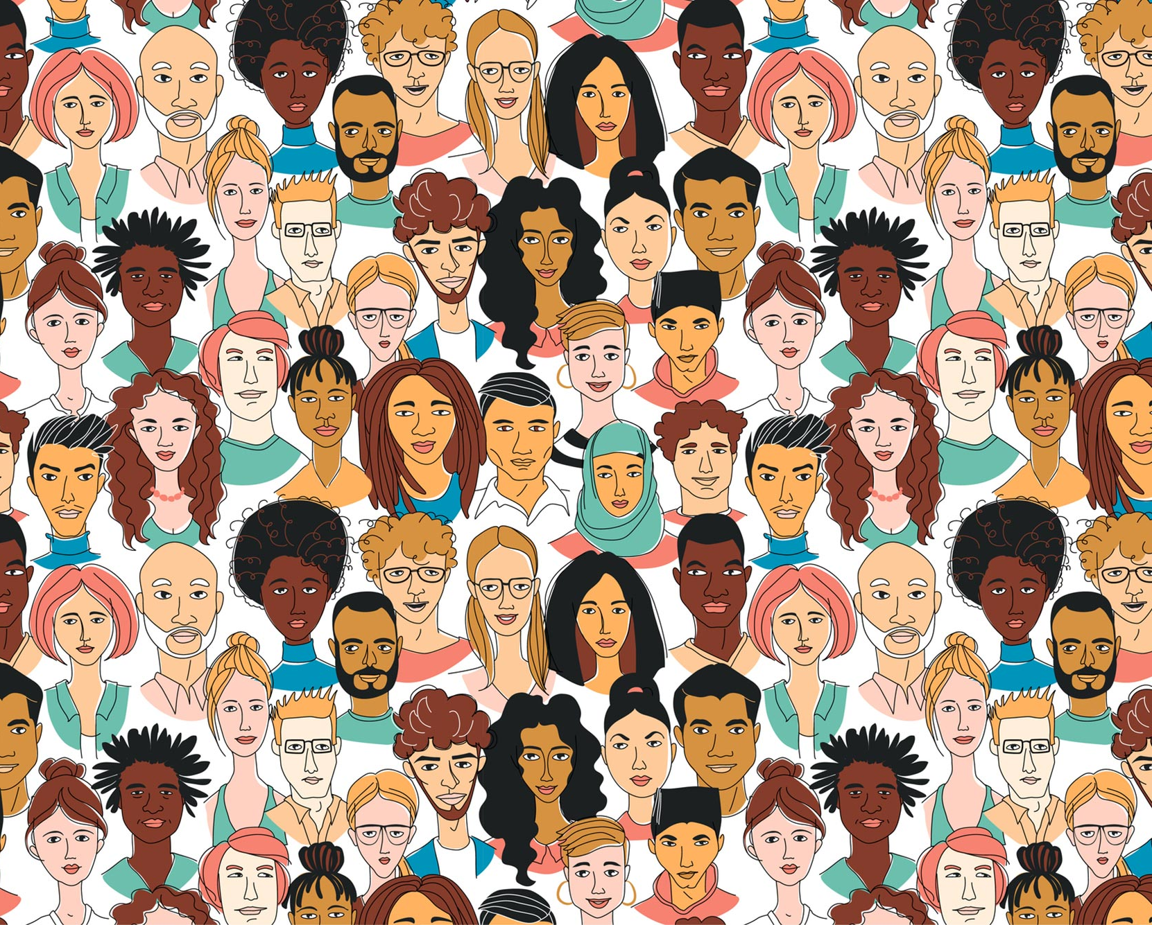
Cross-Cultural Communication From Intra Out
Much of how we communicate with others begins with how we interpret information and communicate with ourselves (intrapersonal communication).
Let’s start with understanding certain terms.

Slide 5

Defining & Understanding Terms
Nationality
  The status of belonging to a
  particular nation by origin,
  birth, or naturalization.
Ethnic group
  A sizable group of people
  sharing a common and
  distinctive racial, national,
  religious, linguistic, or cultural
  heritage

Slide 6
Defining & Understanding Terms
Race
A human population distinguished as a more or less distinct group by genetically transmitted physical characteristics.

Slide 7
What is Culture?

Slide 8
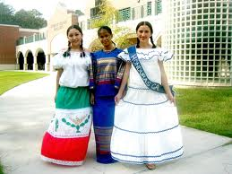
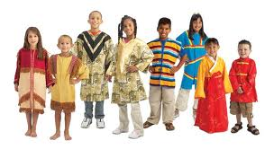
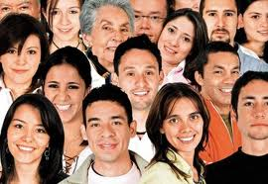
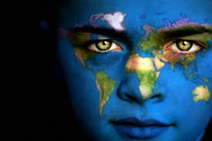
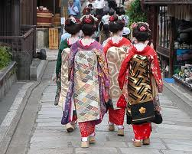
Culture is learned.

Slide 9
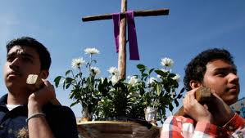
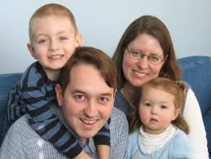
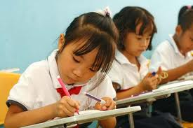
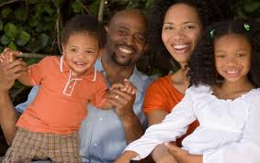
Culture is learned first in the family, then in school, then in the community and other social organizations such as the church.
Purnell, 2005; Lewis 2021
Lewis, D. C. (2021). CULTURE IS A PROCESS!. Respublica Literaria, 2(3), 153-163.
Purnell, L. (2005). The Purnell model for cultural competence. Journal of Multicultural Nursing & Health, 11(2), 7.

Slide 10
Cultures differ from one another in the ways they view the world—worldviews.
In the United States, the term “culture” or “ethnicity” is often only equated with race, yet…
Culture is learned.

Slide 11
Art

Slide 12
Is learned or taught
Art

Slide 13
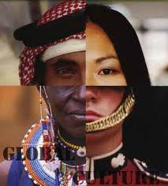
Cultural Diversity
Diversity constitutes differences in perspectives and ideas related to lived cultural experiences.

Slide 14
All Cultures Are On The Table Here

Slide 15
Why Learn Cross-Cultural Communication (CCC)?
CCC is the process of recognizing differences and similarities among cultural groups or individuals to more effectively engage within a given context.
Developing strong cross-cultural communication skills is the first step in creating a successful work environment that brings out the best in all of an organization’s team members.

Slide 16
Diversity Equity & Inclusion is not the problem, but a means to cross-cultural communication
The “problem” of Diversity matters emerges because we live in a world that encourages people disproportionately to use differences to include or exclude, reward or punish, credit or discredit, elevate, or oppress, value or devalue, leave alone or harass….
Johnson, 2006

Slide 17
Since “Culture” has been majorly viewed in the U.S. as being primarily related to race, ethnicity, and gender…
Effective diversity/inclusivity programs are emerging to communicate diversity matters in a way that combats marginalization and exclusion.
Making “Diversity” More Inclusive

Slide 18
Seven kinds of diversity
“ism”
Racism/ethnocentrism
Sexism
Religious oppression
Heterosexism
Classism
Ageism
Ableism
“Otherness”
Race/ethnicity
Gender
Religion
Sexual Orientation
Socio-economic status
Age
Physical/Mental Ability
Hamilton, P. (2021). Diversity and Marginalisation in Childhood: A Guide for Inclusive Thinking 0-11. Diversity and Marginalisation in Childhood, 1-272.
Johnson, A. P. (2006). Making connections in elementary and middle school social studies. Sage.

Slide 19
Example
Racial difference

Slide 20
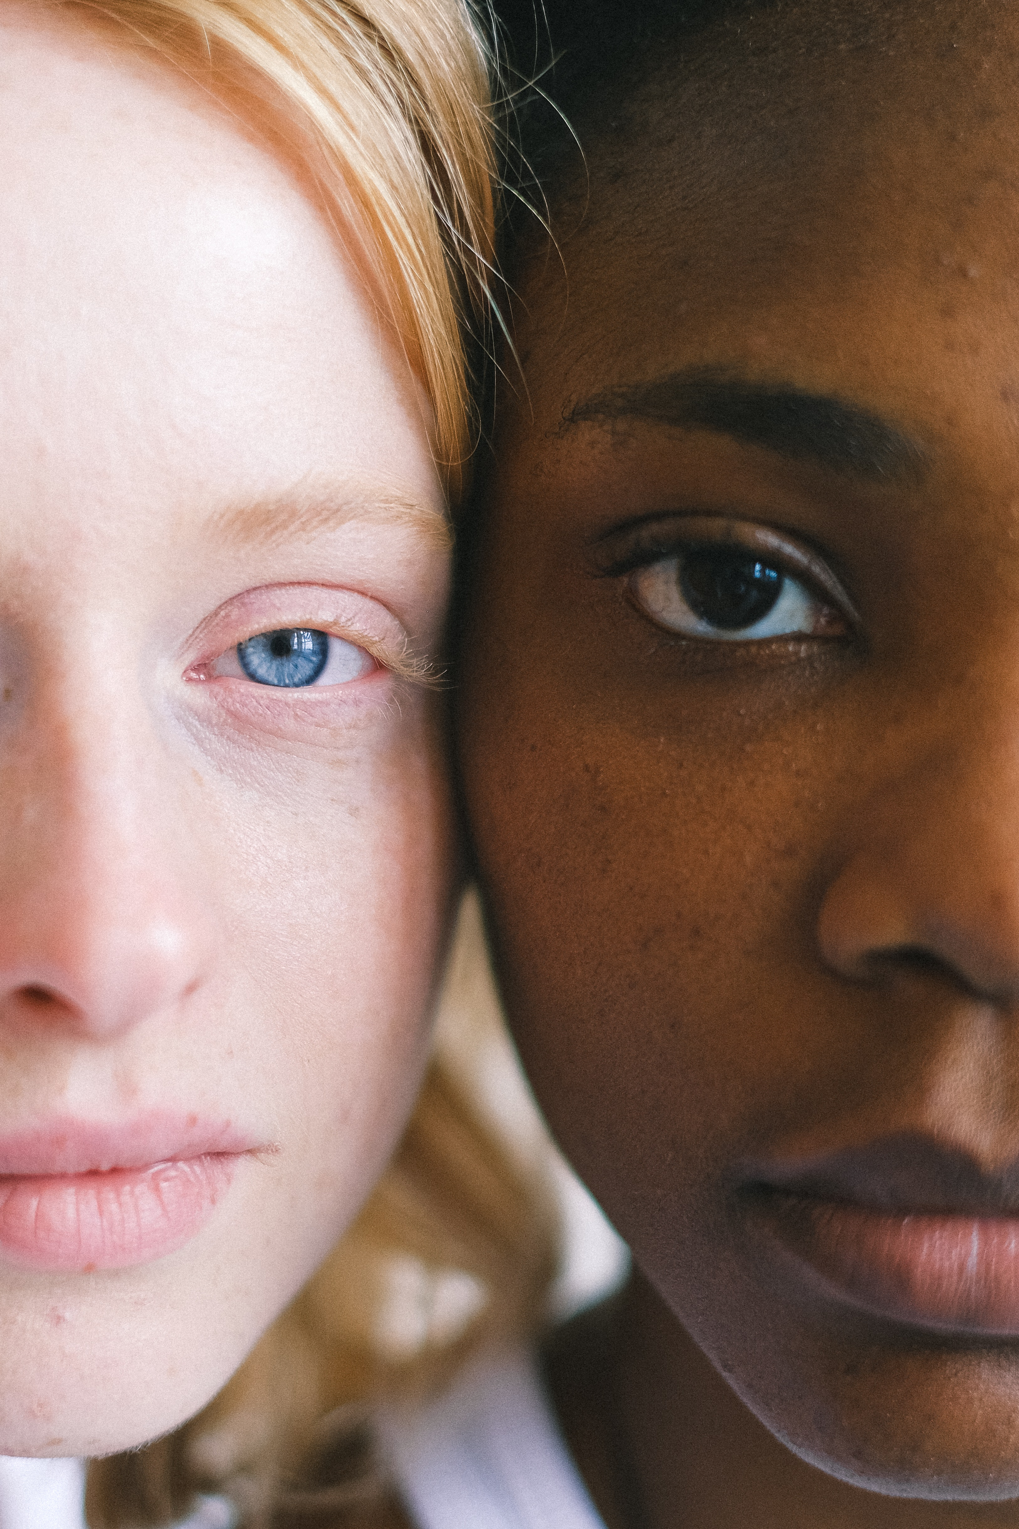
Racial characteristics are only minor variations among people groups.
Racial characteristics (e.g., skin color, eye shape, hair texture) account for 0.012 percent of human biological variation.
Susan Cameron & Susan Macias Wycoff Journal of Counseling & Development, 1998

Slide 21
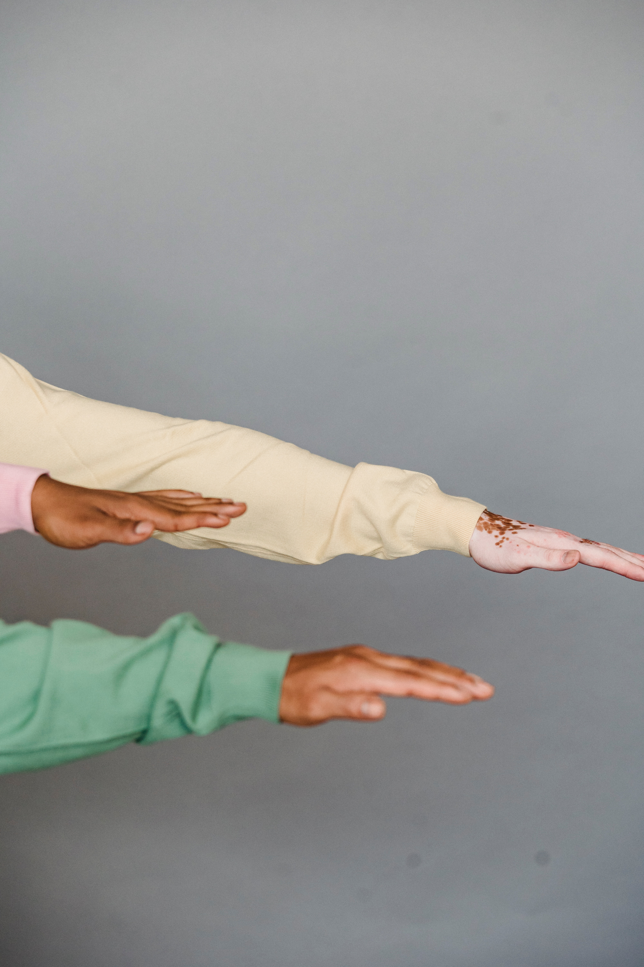
People from the same ethnic or racial group are also “diverse” in terms of socio-economic status, education, age, religion, sexual orientation, individual experiences, or disposition.
Note: these categories can strongly influence one’s dietary and general health decisions.
Diversity in Diversity

Slide 22
Given that racial characteristics (e.g., skin color, eye shape, hair texture) account for 0.012 percent of human biological variation, to issue a health condition based on race is at most about .012 accurate.
Health conditions would, therefore, be best issued, based on one’s immediate family history, cultural practices and life-decisions.
Issues with Generalized Health Statistics

Slide 23
Incorrect statement:
“African Americans are more than likely to be susceptible to XYZ…”
Correct statement:
An African American with XYZ dietary habits, and with family histories of XYZ can be susceptible to XYZ.”
Example:

Slide 24
The health condition of a race can not be generalized due to the insignificance of racial variation, yet instead can be assessed by mentioning, for example, an individual’s lived experiences, immediate family background, their own eating and exercising habits, life-styles and beliefs, mindsets, and economic climate.
Note:
Cross-cultural communication is not based on race alone, but by the lived experiences and learned cultural practices of the individual.
In Summary…

Slide 25
Personal/Professional Application
Learn about your own values and familial culture.
  How is it the same as the person to whom you are providing care? How is it different?
  What are the things the person values?
  What makes them smile? What makes you smile? How can we be more understanding of differences and values?
  Note:
  Even research can contain embedded confirmation or unconscious bias.

Slide 26
Keep in mind: Implicit Cultural Assumptions
North American
Egalitarian/equality
Can control the environment
Future oriented
Informal
Direct in communications
Youth valuing
“Friendliness”
Optimism
Action oriented: Change now
Ethnocentric: our way is the best way
“Contrast” Cultures
Hierarchy
Belief in fate
Present focus
Formal
Indirect (non-verbal cues)
Age valuing
More closed to “strangers”
Fatalism
Change takes time
Ethnocentric: our way is the only way

Slide 27
Tips:
Find out how you and your fellow staff identifies yourself/themselves. Do not presume or prescribe identity based on appearance or statistics. Engage with the human being and learn from them.
This approach is influences by patient/person-centered, holistic care, and self-efficacy related approaches.
In Summary…

Slide 28

Gaining Cultural Competence and Civility

Slide 29
Diversity and inclusivity are about understanding… not necessarily agreeing.

Slide 30
Solutions to Understanding Older Adults of Diverse Backgrounds from a Cross-Cultural Standpoint
Understanding terms
Exploring culture, cultural assumptions, and the development of bias
Creating inclusive environments and culturally competent training to professionals
Acknowledge and greet older persons first.
Generally, use formal term of address (Mr., Mrs.), at least initially.
Train office staff to do the same
Assess cultural competence
Diversity→Inclusivity→Civility

Slide 31

Civility involves acting with regard to other’s lived experiences and feelings.

Slide 32
Creating a culture of civility requires communication, interaction, and an appreciation for the interests each person brings to the relationship.
Abdel Aziz Abdel Naby, S., Hamido, S., Abdel Hameed, N., & Mahmoud, H. 2022.
Abdel Aziz Abdel Naby, S., Hamido, S., Abdel Hameed, N., & Mahmoud, H. (2022). Developing Civility Behavior Guideline among Maternity Nursing Students at Class Room and Practical Engagement. Egyptian Journal of Health Care, 13(4), 197-213.

Slide 33
Diversity→Inclusivity→Civility
Civility matters because treating one another with respect is necessary to effective communication, community building, and finding common ground.
The Dance of Incivility in Nursing
Dr. Cindy Clark, Boise State University

Slide 34
Diversity + Inclusivity + Civility =
Community
We Value:
A positive culture that fosters mutual respect and trust [and] promotes this atmosphere through open communication.
An environment that recognizes and respects cultural diversity by recognizing and being responsive to individual needs.
Elizabethtown Community & Technical College

Slide 35
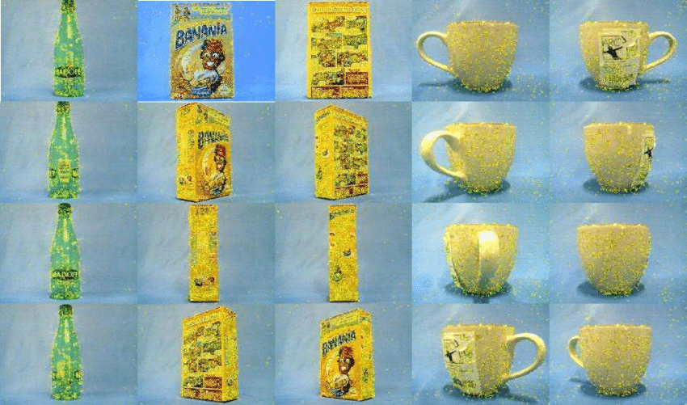
Without civility, we miss opportunities to really listen and understand others’ points of view. Center, D. L. (2010).
Researchgate.com
Center, D. L. (2010). Three As of civility: Acknowledgment, authentic conversations, and action. The Journal of Continuing Education in Nursing, 41(11), 488-489.

Slide 36
Recommendation for individuals to enhance cultural competence
For all:
Challenge racist, sexist, and homo-negative comments and jokes that demean others. Racism and other forms of discrimination may persevere in part because people who anticipate feeling upset and who believe that they will take action when faced with an act of intolerance may actually respond with indifference.

Slide 37
In Summary to Civility in professional environments
Be proactive: Include expectations for behavior, along with academic expectations in syllabi
Be a model: Behavior serves as a powerful representation in how staff treat follow staff and patients.
Ask why: seek to have staff explain their behavior and put it into context
Have a plan: to respond to the unexpected
Follow through on your plans for action
Document incidents and your response(s) thereto

Slide 38
.
In Summary…

Slide 39
Discussion
What is one thing that you desire to implement to improve your cross-cultural communication?

Slide 40

Discussion
Also, feel free to send comments and/or questions to Jeremy.Holloway@ndus.edu.

Slide 41
Thank you

