Slide 1
Prepare to Care for an Aging Population with HIV
Nikki Regan, APRN
Specialty Care Center Assistant Director of HIV Programs
Nebraska Medicine
May 18, 2023

Slide 2
Disclosures
I have no financial relationships to disclose

Slide 3
Objectives
Review key findings of the HealthHIV State of Aging National Surveys
Discuss necessity of culturally-competent care for people aging with HIV
Understand impact of aging population on the Nebraska Medicine Specialty Care Center

Slide 4
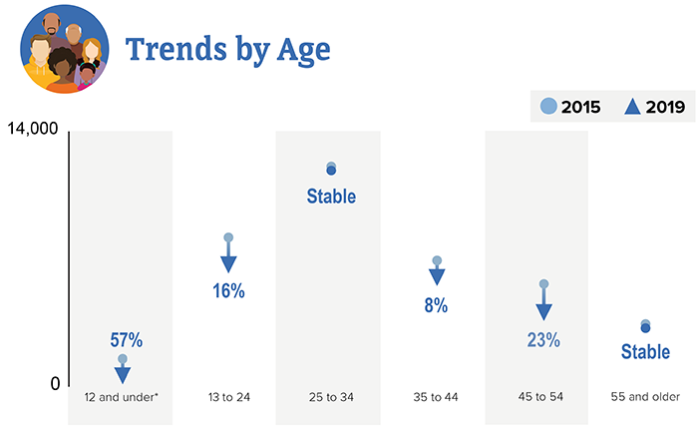
Why Does Aging with HIV Matter?
Number of people aging with HIV is rapidly increasing
Older people with HIV (OPHW) are the fastest growing group of all people with HIV (PWH). Two reasons:
BIRTHDAYS! For those diagnosed with HIV years or decades ago
New HIV diagnoses (incidence) in people 55+
3887/36801 new diagnoses in 2019 (10.6%)
particularly among women: 55+ account for 17% new diagnoses among women in 2019 (1156/6999)
Image and information from CDC website: HIV by Age: HIV Diagnoses. https://www.cdc.gov/hiv/group/age/diagnoses.html

Slide 5
Aging Matters More Each Day!
In 2020, 60% of PWH in the US were 50+ years old
By 2030, project this to increase to 73%
Many HIV risk factors are the same across the lifespan, but older people are less likely to be tested for HIV
OPWH face “usual” challenges of aging while also navigating challenges of HIV
Increased risk for comorbidities, mental health challenges, and social needs
HIV, even treated, is a chronic inflammatory state
PWH diagnosed prior to introduction of combination antiretroviral therapy are even more likely to have other co-occurring conditions
Health HIV 2nd Annual State of Aging with HIV: https://healthhiv.org/wp-content/uploads/2021/07/HealthHIV_Second_Annual_State_of_Aging_with_HIV.pdf

Slide 6
Never too old for a HIV test!
CDC recommends that everyone between ages of 13 and 64 get tested for HIV at least once as part of routine health care.
For people with certain risk factors, CDC recommends annual HIV screening
Clear benefits from to being diagnosed early and started on antiretroviral therapy right away
https://www.cdc.gov/hiv/testing
Notes:
You’re a man who has had sex with another man.
You’ve had anal or vaginal sex with someone who has HIV.
You’ve had more than one sex partner since your last HIV test.
You’ve shared needles, syringes, or other drug injection equipment (for example, cookers).
You’ve exchanged sex for drugs or money.
You’ve been diagnosed with or treated for another sexually transmitted disease.
You’ve been diagnosed with or treated for hepatitis or tuberculosis (TB).
You’ve had sex with someone who has done anything listed above or with someone whose sexual history you don’t know

Slide 7
Survey conducted July/August 2019
Online distribution (survey monkey)
76 qualitative and quantitative questions
No incentive
831 eligible participants age 50+ (out of 1086 total responses)
Survey questions addressed:
HIV Management
Interactions with Providers
Care Coordination
Healthcare Expenses
Pharmacy Usage
Aspects of Living with HIV, including mental health, isolation, substance use
Image and information from: Aging with HIV National Survey https://healthhiv.org/wp-content/uploads/2020/03/Aging-with-HIV-National-Survey2020_v6B.pdf

Slide 8
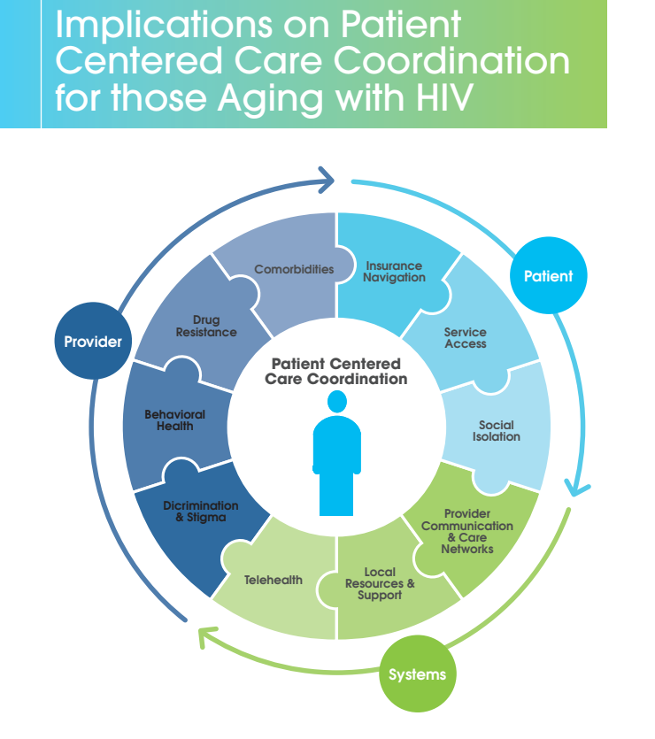
Inaugural Survey continued:
53% of respondents said they felt very satisfied with coordination of care
32% satisfied
6% dissatisfied
Respondents indicated negative responses in healthcare settings:
Stigma (50%)
Ageism (25%)
Homophobia (24%)
Image and information from: Aging with HIV National Survey https://healthhiv.org/wp-content/uploads/2020/03/Aging-with-HIV-National-Survey2020_v6B.pdf

Slide 9
THE SEQUEL (2021)
40th anniversary of the first reports of AIDS in the USA: “Pneumocystis Pneumonia—Los Angeles,” in Morbidity and Mortality Weekly Report, June 5, 1981. National Library of Medicine #7802429
102 questions reviewed, validated, piloted by external community advisory board
Online distribution March-June 2021
Expanded eligibility:
PWH 50+ years old
OR PWH <50 years old but diagnosed with HIV at least 15 years ago
479 eligible respondents
Image and information from: HealthHIV Second Annual State of Aging with HIV National Survey. https://healthhiv.org/wp-content/uploads/2021/07/HealthHIV_Second_Annual_State_of_Aging_with_HIV.pdf

Slide 10
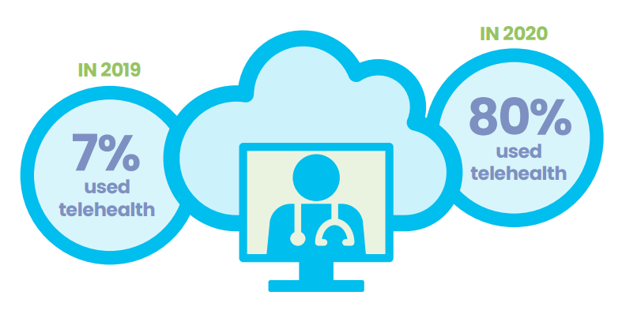
New Villain in Town: COVID-19
4 in 10 reported fewer visits to provider during COVID-19
Increased uptake of telehealth for OPWH!
Strong themes of isolation:
32% experienced 24 hours+ of isolation in last week
Decrease in service availability and uptake
Image and information from: HealthHIV Second Annual State of Aging with HIV National Survey. https://healthhiv.org/wp-content/uploads/2021/07/HealthHIV_Second_Annual_State_of_Aging_with_HIV.pdf

Slide 11
Third Annual State of Aging with HIV National Survey
October 2022-January 2023
Same eligibility as prior survey
673 eligible respondents
Key Findings:
Comorbidity is common (2 in 3 respondents with at least 2 comorbidities)
Near-universal polypharmacy (3 in 4 take at least 2 daily medications)
Mental health concerns rising (64% endorsed concerns compared to 40% on prior survey)
Financial insecurity (half with no retirement plan)
“Left out” (strong sentiment among respondents that OPWH are not part of HIV care conversations)
Image and information from the HealthHIV Third Annual State of Aging with HIV Survey. https://healthhiv.org/stateof/agingwithhiv/

Slide 12
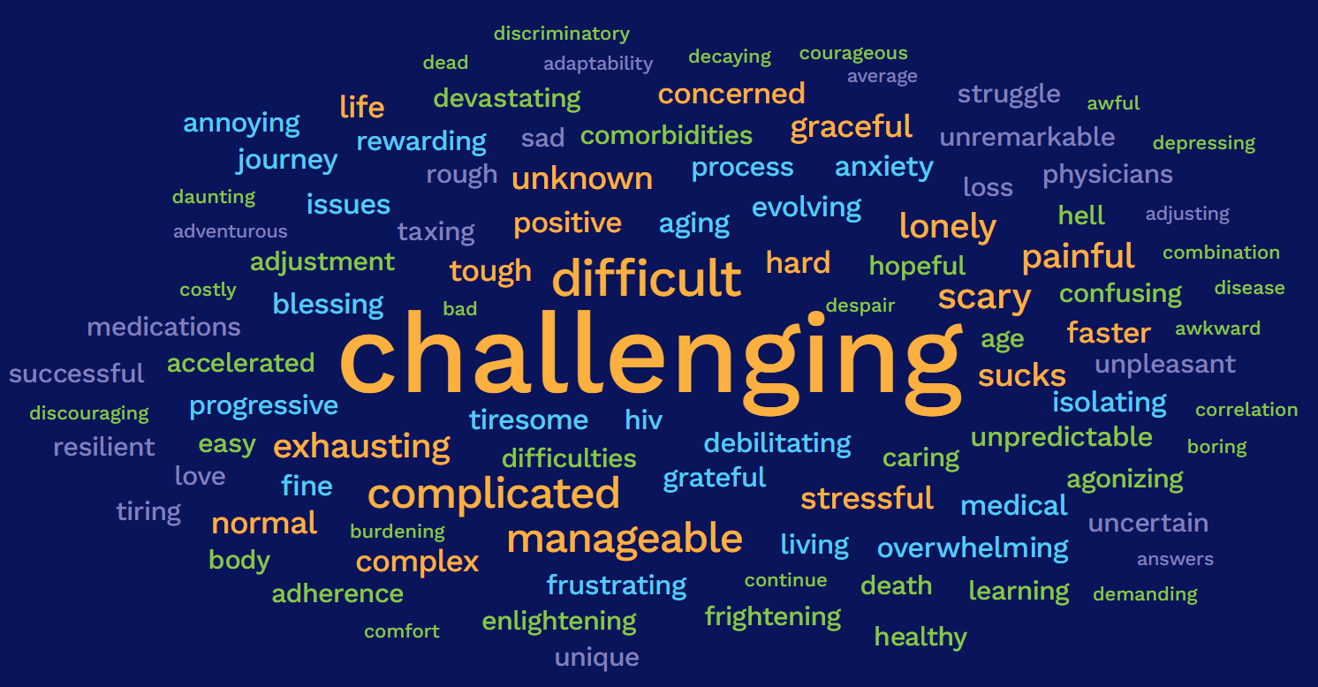
Image from the HealthHIV Third Annual State of Aging with HIV Survey. https://healthhiv.org/stateof/agingwithhiv/

Slide 13
Aging at the Specialty Care Center (SCC)
Total unique patients=1255
Age 51-55: 174 (14%)
Age 56-60: 183 (15%)
Age 61-70: 178 (14%)
Age 71+: 25 (2%)
Future trends:
Age 45-50: 183 (15%)

Slide 14
Next Steps
Specialty Care Center currently participating in UNMC Geriatric Workforce Enhancement Program (GWEP) ECHO Collaborative to address needs and improve care for aging population with HIV
Mentorship established with geriatric care specialist
Consumer Advisory Board
Task force formed and incorporating goals into Clinical Quality Management activities
Behavioral health (PHQ2)
Identifying patients without primary care medical home and taking ownership of age-appropriate screenings for these patients
Toured Home Instead Center for Successful Aging

Slide 15
Resources for OPWH in Nebraska
Nebraska Medicine Specialty Care Center
Medical care
Linkage to Ryan White program assistance (psychosocial support, food vouchers, insurance/Medicare assistance, etc)
Nebraska AIDS Project (NAP)

Slide 16
Ryan White 12/6/1971—4/8/1990
Diagnosed with HIV in 1984
Lived in Kokomo, IN
Hemophiliac, contacted HIV through contaminated blood transfusions
Faced stigma and discrimination in school and community, fought for his right to attend school
Became a national spokesperson and advocate for PWH and educated others
August 1990: Ryan White Comprehensive AIDS Resource Emergency (CARE) Act
WOULD BE 51 YEARS OLD TODAY, experiencing many of the same challenges and highlights of life as our aging population

Slide 17
Nikki Regan, APRN
Specialty Care Center
Assistant Director of HIV Programs
Nebraska Medicine
nregan@nebraskamed.com
402-559-8163

