Slide 1
Start, stop, or continue?: Statin treatment in individuals over age 75
Alfred Fisher MD PhD
Professor and Chief
Division of Geriatrics, Gerontology,
and Palliative Medicine
University of Nebraska Medical Center

Slide 2
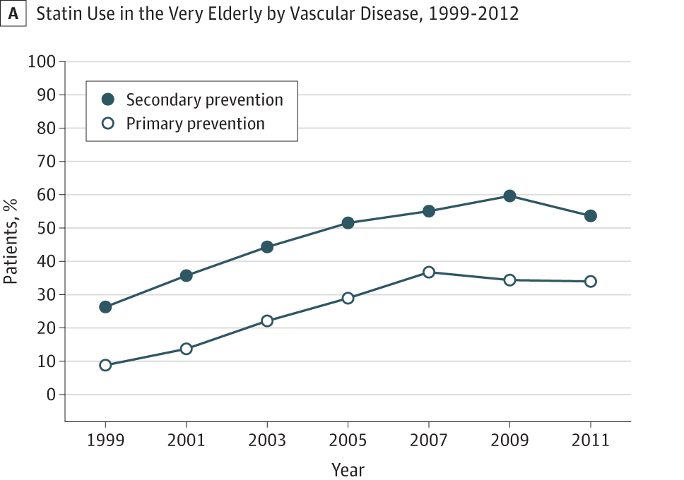
Older Patients in Primary Care often take Statins
Under-treatment?
Over-treatment?
Johansen, et. al. JAMA Intern Med. 2015;175(10):1715-1716
(Patients >79)

Slide 3
Why is this important?
Often statins have been started years/decades ago
Can contribute to polypharmacy
    Might decrease compliance with other meds
    Statins have drug-drug interactions
Cardiovascular events/mortality increase with age
Would like to know if/level of benefit
Might be missing out on a benefit for dementia (vascular and/or AD)

Slide 4
What is known from RCTs?
Individuals of all ages with vascular disease benefit from statin treatment for secondary prevention.
Individuals age <75 benefit from statin treatment for primary prevention
Insufficient patient numbers were enrolled to determine if there is a primary prevention benefit for those over 75 years of age.

Slide 5
What if we pool trials?
Meta-analysis conducted by Cholesterol Clinic Trialist’s Collaboration using 28 RCTs (Lancet 2019; 393: 407–15).
Include 186,804 individuals and 14,483 individuals over age 75.

Slide 6
What did they find?
For individuals with vascular disease history (MI, angina, CHF)

Slide 7
And for primary prevention?
Included specific CHF and dialysis trials
Excluded these studies

Slide 8
Are all outcomes improved?
Just “major events” was significant

Slide 9
Conclusions and Limitations
Individuals of all ages with vascular disease benefit from statin treatment for secondary prevention.
Individuals age >75 also benefit from statin treatment for primary prevention – at least for major cardiac events
These results might not be fully generalizable given inclusion/exclusion criteria of underlying studies (such as cognitive impairment)
Subject numbers are still a concern

Slide 10
Could we conduct a larger study?
Orkaby et. al. (JAMA. 2020;324(1):68-78.) turned to the VA to find 326,981 individuals over age 75, not taking a statin, and free of CV disease (myocardial infarction (MI), transient ischemic attack (TIA) or stroke, peripheral vascular disease, or coronary revascularization)
In this group, 57,178 individuals were started on statin (but not for treatment of CV disease)

Slide 11
What did they find?

Slide 12
Does this show similar results in disease/gender/ethnicity subgroups?

Slide 13
Conclusions and Limitations
Statin treatment in individuals over age 75 is associated with decreased all-cause and cardiac mortality, delay in cardiac events, and decrease in CABG and PCI treatment
Benefits are still seen in individuals with dementia and other conditions often excluded from RCTs
Results might not be that generalizable (97% men and 90% white) unless you practice at VA
Data is NOT an RCT. Prescribers chose to start statin and might have picked up of prognostic differences between the groups (aka improved all-cause mortality)

Slide 14
Take home message
Statins are effective and likely under-utilized for individuals over age 75 with CVD
Statin treatment might be beneficial and is reasonable to consider for primary prevention in individuals over age 75
Need to consider prognosis and patient preferences – benefits take 2-5 years to accrue and involves a daily medication
PREVENTABLE trial (sites at Omaha VA and UNMC) seeks to determine if benefits are seen in RCT and to determine if statin treatment reduces dementia

