Slide 1
Caregiving to the Karen Elders
Synthia Htoo (Elder Program Coordinator)
Hta Thi Yu Moo (Caregiver support Coordinator)
Clara Tunwin (Program Director)

Slide 2
Agenda
History of Karen People
Karen elder attitudes towards health care
Karen Caregivers of elders
Recommendations

Slide 3
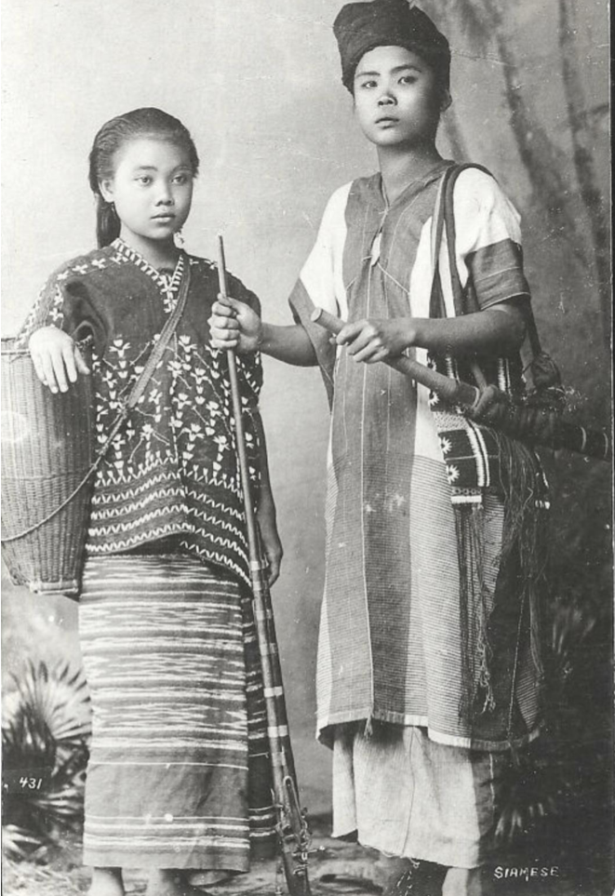
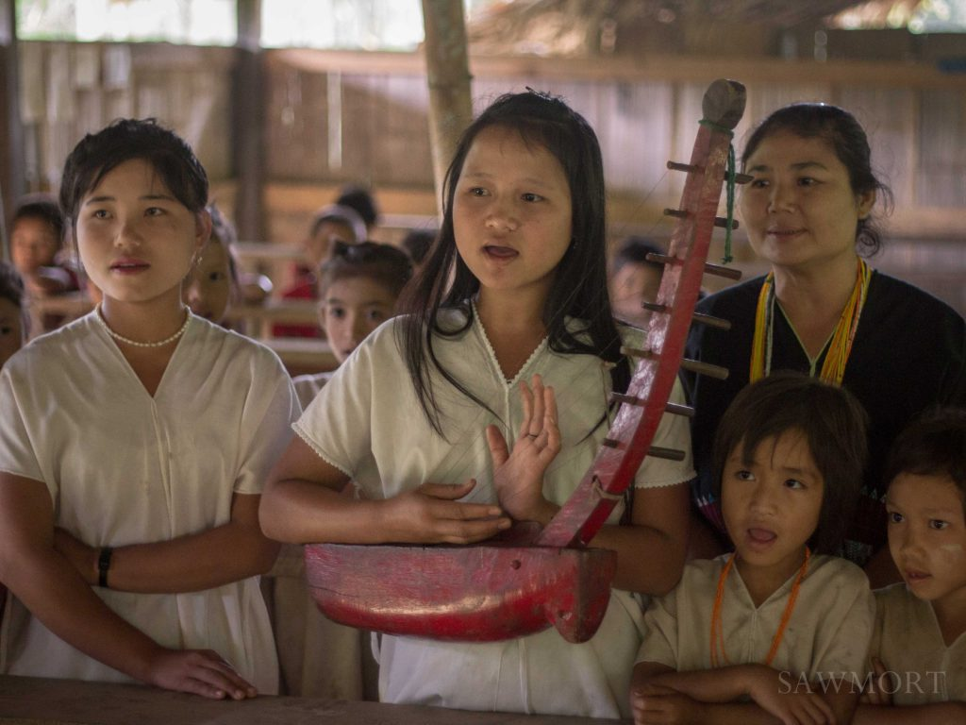
History of the Karen People
Traced origins to the Gobi Desert area in Mongolia
Settled in Myanmar (Burma) and Thailand
Approximately 7 million karens all over the world
Approximately 50,000-60,000 in USA

Slide 4
Karen Traditions
Multi-generation families live together and support each other
In Karen culture we do not have “First Name or Last name or Clan names”. Siblings can have different last names, parents and children can have different last names.
Not a culture that is expressive (verbal or emotions), problems are usually solved by non-confrontative manner or avoidance
Never address the elders by their names
Karens practice three main religions :
Animisim/Spirit worship, Buddhism, Christianity
Close ties to extended family members and neighbors and help each other with babysitting or caregiving of elderly

Slide 5
Decades of conflicts in Burma
WWII British (allied with Karen forces) vs Japanese (allied with Burmese forces) fought in Burma
Britain gave Burma independence to Burmese on January 4, 1948.
Ethnic groups of Burma have been struggling for ethnic and political rights to self-govern. Ongoing Burmese military dictatorship oppressed ethnic people and their rights.
Displaced people increased after 2021military coup by the Burmese military (approximately 600,000 people displaced in karen controlled regions)
Karen refugees must walk for weeks to reach the refugee camps

Slide 6
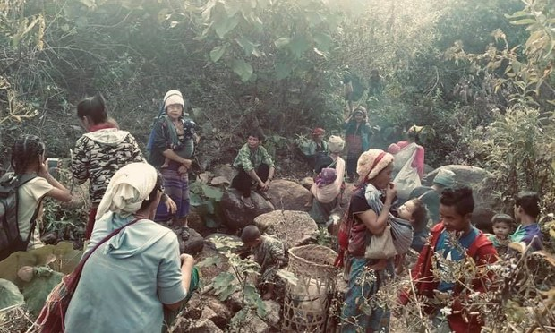
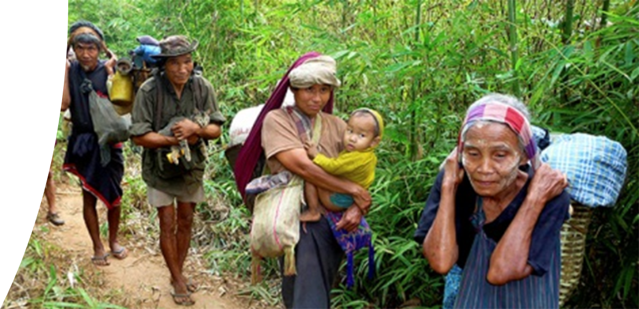
Life in Refugee Camps
No freedom to move around
Poverty
Lack of access to health care, education and employment opportunities
Average wait time 10-15 years to resettle in a third country

Slide 7
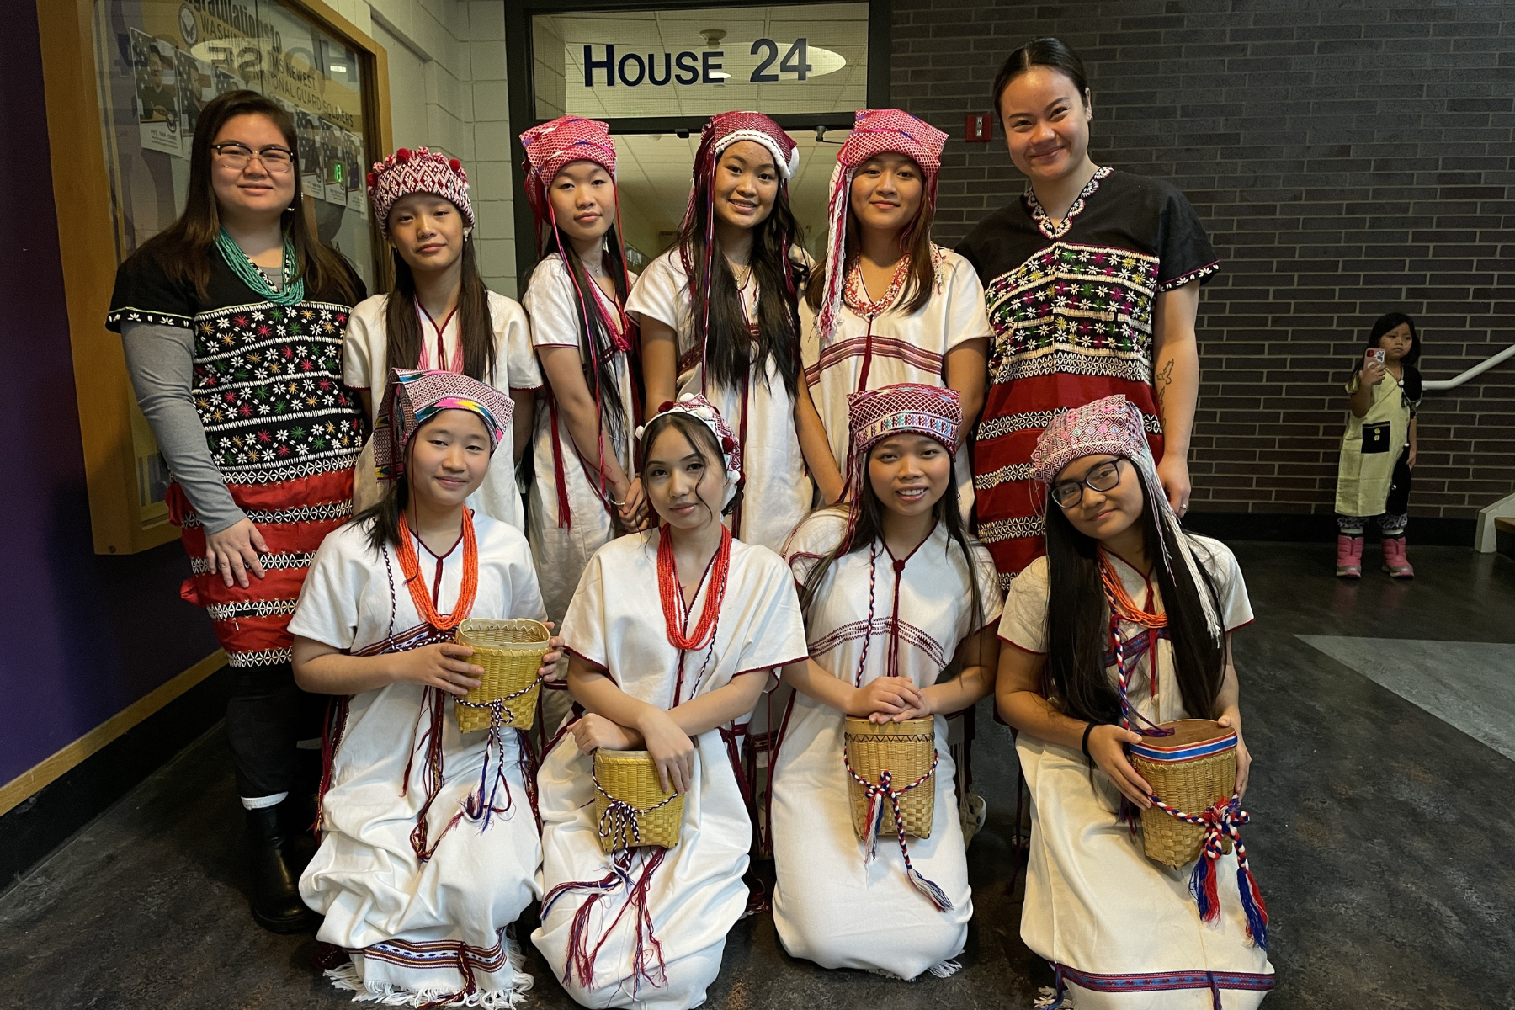
Life in the US
Issues and Barriers in the US
Language
Education & Jobs
Housing
Transportation
Accessing Healthcare
Navigating the System
Cultural Differences (communication, parenting etc..)
Substance Use and mental health issues

Slide 8
Karen elders' attitudes towards health care
Most Karen elder are not a generation that are familiar with western health care (prevention or treatment)
Lack of knowledge/education about different health systems
Don't know how to get health information or how to advocate for themselves
Can't choose provider that they wanted because of language barrier
Like to use natural herbs because they have been using for so long, passed down from generation to generation.
Don't like to use a lot of western medicine because of side affects

Slide 9
Karen elders' attitudes towards health care (continued)
Depend on family members to make decisions for them
Sensitive to “Health Care Directives” (worry if the provider is passively letting them know they will die soon, also a bad omen to think/talk about death before it happens)
It is important to explain the purpose of “Health Care Directives” and the different world view of western culture.
planning vs go with the flow
Karen elders that experienced war trauma, don’t like to discuss or talk about their experiences in the form of Therapy. We found that, they prefer social connections and gatherings to maintain their mental well being and having organic conversations.

Slide 10
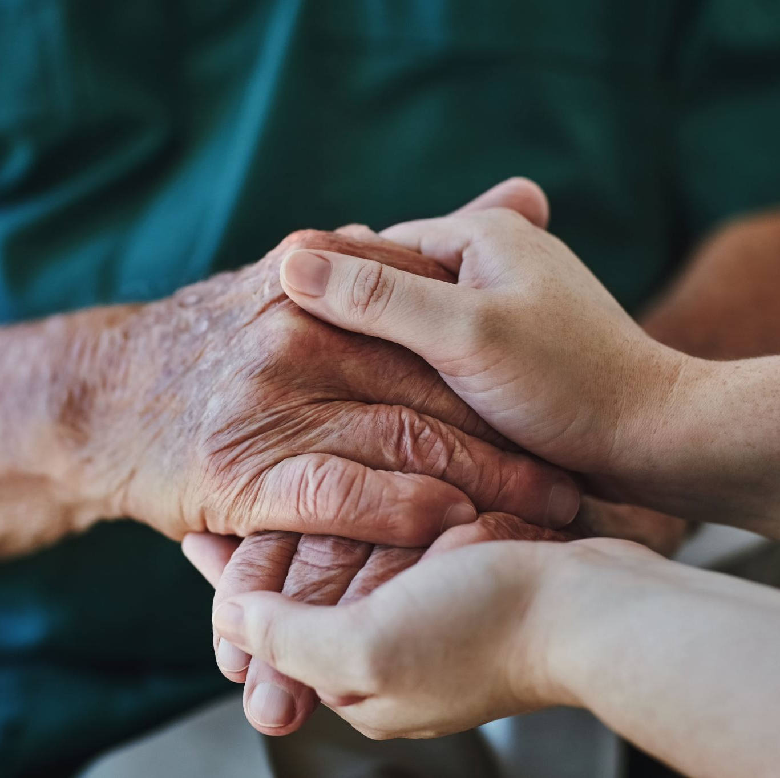
Karen Caregivers of elders
Take care of parents at home as a blessing. They took care of us when we were young and it is our turn to take care of them.
Avoid nursing home and assisted living because these resources were not available in homeland (trust issues, language and cultural barriers)
Some families would send their elderly family members to Adult Day Care if there is a karen speaking staff that they can depend on is present.
Caregivers experience a lot of stress and get burnout because they are working as well.

Slide 11
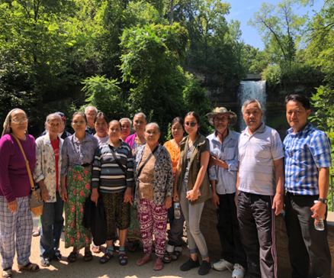
Karen Caregivers of elders
As a caregiver,
We speak on behalf of them
Made decision for them
Collective family decision making process vs individual decision making
Karens came from cultural backgrounds that are not legalistic – it’s important to educate about legal guardianship (for decision making)

Slide 12
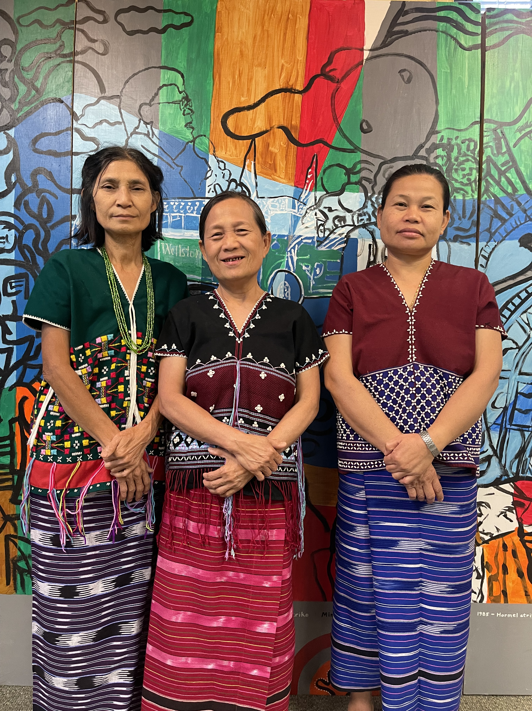
Karen Caregivers of elders
Health professionals can best support them by
Provide resources
Share tips about Western caregiving practice
Educate themselves about Karen culture/traditions
Training/Support group in Karen language
Notes:
language (we don’t usually use group discussion, seeing counseling or therapy)

Slide 13
Recommendations for Health Care Professionals
Encourage Karen elders for annual check ups.
Encourage Karen elders to see a dentist.
Encourage Karen elders to have regular eye exams.
Encourage Karen elders to be physically active (tips to stay active during Winter)
Educate Karen elders on good oral/dental hygiene practices (majority of them chew betel nut and tobacco)
Educate Karen elders to eat balanced meals (karen diet lacks dairy – high carb)
Create culturally appropriate programs (activities, trips and food) for elders in your community.
Hire Bi-lingual staff to assist with care coordination in hospitals and clinics
Fun Fact: our karen elder program participants love Bingo!

Slide 14
Thank you
Questions?

