Slide 1
ACCEPTANCE AND COMMITMENT THERAPY (ACT)
Cecilia Poon, PhD, ABPP
Licensed Psychologist

Slide 2
Disclosure and Disclaimer
I have no financial or other conflicts to declare
Case example(s), if any, are hypothetical

Slide 3
Objectives
Understand the basic features of ACT
Describe the evidence base of ACT
Discuss the application of ACT with older adults
(Cultivate an interest in ongoing professional development in ACT and related approaches)

Slide 4
ACT in Context
CBT
(Cognitive Behavioral Therapies)
Behavioral Activation
Cognitive Therapy
Rational Emotive Behavior Therapy (REBT)
Exposure and Response Prevention (ERP)
Cognitive Processing Therapy (CPT)
Prolonged Exposure (PE)
Integrated Behavioral Couples Therapy
Acceptance and Commitment Therapy (ACT)
Dialectical Behavior Therapy (DBT)
Functional Analytic Psychotherapy (FAP)
Mindfulness-Based Cognitive Therapy (MBCT)
Mindfulness-Based Stress Reduction (MBSR)
and more…etc.

Slide 5
Functional Contextualism
Any action or event cannot be separated from its historical and current context
Workability
Relational Frame Theory
Role of human language and cognition in suffering

Slide 6
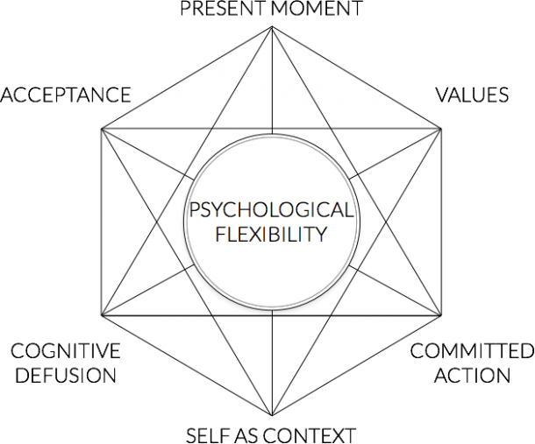
Hexaflex: 6 Core Processes
Adapted from Hayes et al., 1999

Slide 7
Psychological Inflexibility
DOMINANCE OF PAST AND FUTURE
EXPERIENTIAL
AVOIDANCE
LACK OF CLARITY OR CONTACT WITH VALUES
STUCK/
INFLEXIBLE
FUSION WITH THOUGHTS
INACTION, IMPULSIVITY, OR AVOIDANCE
ATTACHMENT TO CONCEPTUALIZED SELF

Slide 8
3 Pillars of Flexibility in FACT*
AWARE
OPEN
ENGAGED
*Focused Acceptance and Commitment Therapy (Strosahl et al., 2012 )

Slide 9
ACCEPTANCE
Experiential Avoidance
“I am afraid/ ashamed of my feelings”
“If I don’t do this or do less of this, I won’t feel bad”
Willingness to fully connect with our inner experiences
Let go of the tendency to control uncomfortable thoughts, feelings, and sensations
Non-judgmental

Slide 10
DEFUSION
Cognitive Fusion
“I think that, so it must be true!”
Getting “hooked” and "caught up" in thoughts
Confusing thought and reality
Look at thoughts, not from thoughts
See thoughts as what they are (i.e., thoughts!)
Not try to change the content, or eliminate/ distract from our thoughts
Reduce the influence of unhelpful cognitive processes on behavior; notice the language processes

Slide 11
PRESENT MOMENT
Dominance of Conceptualized Past and Feared Future
Ruminate about the past
Worry about the future
Notice accurately what is happening in the here and now
Engage fully in what we are doing
Take in important information about whether to change or persist in a behavior
Mindfulness

Slide 12
SELF AS CONTEXT
Self as Content
“I am my narrative and my story can’t change”
Rigid rule-following
A transcendent sense of self, i.e., the observing self
Self as context from where thoughts, feelings, and sensations unfold
Loosen up attachment to language of conceptualized self
Sky and weather metaphor

Slide 13
VALUES
Lack of Clarity or Contact with Values
Feels un-anchored or direction-less
Feels stuck
Existing not based on “what matters”
The person we want to be, things we want to do, what we want to stand for in this life
A direction that guides ongoing action; not a goal
A sense of meaning, abundance, vitality

Slide 14
COMMITTED ACTION
Inaction, Impulsivity, or Persistent Avoidance
Ineffective pattern of behavior, doing the same thing over and over expecting different (better) results
Going through the motions while feeling struck/ trapped
Take action and make decisions that are in line with our values, even when life is challenging

Slide 15
ACT: What It Is, What It Isn’t
Experiential > Didactic
Use of experiential exercise and metaphors
Not a specific set of coping skills, techniques, or protocols
May work on one or more core process, in any order
Number of sessions: 1- 20+
Therapeutic relationship, case conceptualization (e.g., life and problem context, goals, treatment plan), and practice ARE important
It is not passive

Slide 16
ACT: Overall Evidence Base
1,000+ RCTs on ACT and its components as of December 2022 (www.contextualscience.org)
Small sample size, don’t always have a strong comparison group
Its focus makes it difficult to compare outcome with diagnosis-specific approaches
APA Division 12 cited “strong” research support for using ACT to treat chronic pain; “modest” support for anxiety, depression, and OCD; pending support for psychosis
The VA listed ACT for depression as an EBT
SAMHSA recognized ACT as an EST

Slide 17
ACT with Older Adults
Has ~20 studies involving adults age 60 and older, in community and LTC settings across cultural-linguistic backgrounds
Effective in reducing distress (depression) in older adults
Less conclusive for enhancing physical functioning and psychological flexibility
Demonstrates acceptability and feasibility among older adults with chronic pain, depression, generalized anxiety, caregiving stress...etc.
Newer research focuses on alternative delivery methods, e.g., online modules to reduce loneliness

Slide 18
ACT with Older Adults: Why?
Transdiagnostic
Consistent with Baltes’ and Baltes’ Selective Optimization and Compensation (SOC) Model of Successful Aging (e.g., Acceptance, Present Moment; Workability of Committed Action)
May address ageism in older adults and those around them (e.g., Defusion, Self-As-Context)
Consistent with “What Matters Most” in the Geriatrics 5Ms (e.g., Values)
Supports older adults’ wisdom, resilience, and emotion regulation

Slide 19
Case Examples
(If there is time)

Slide 20
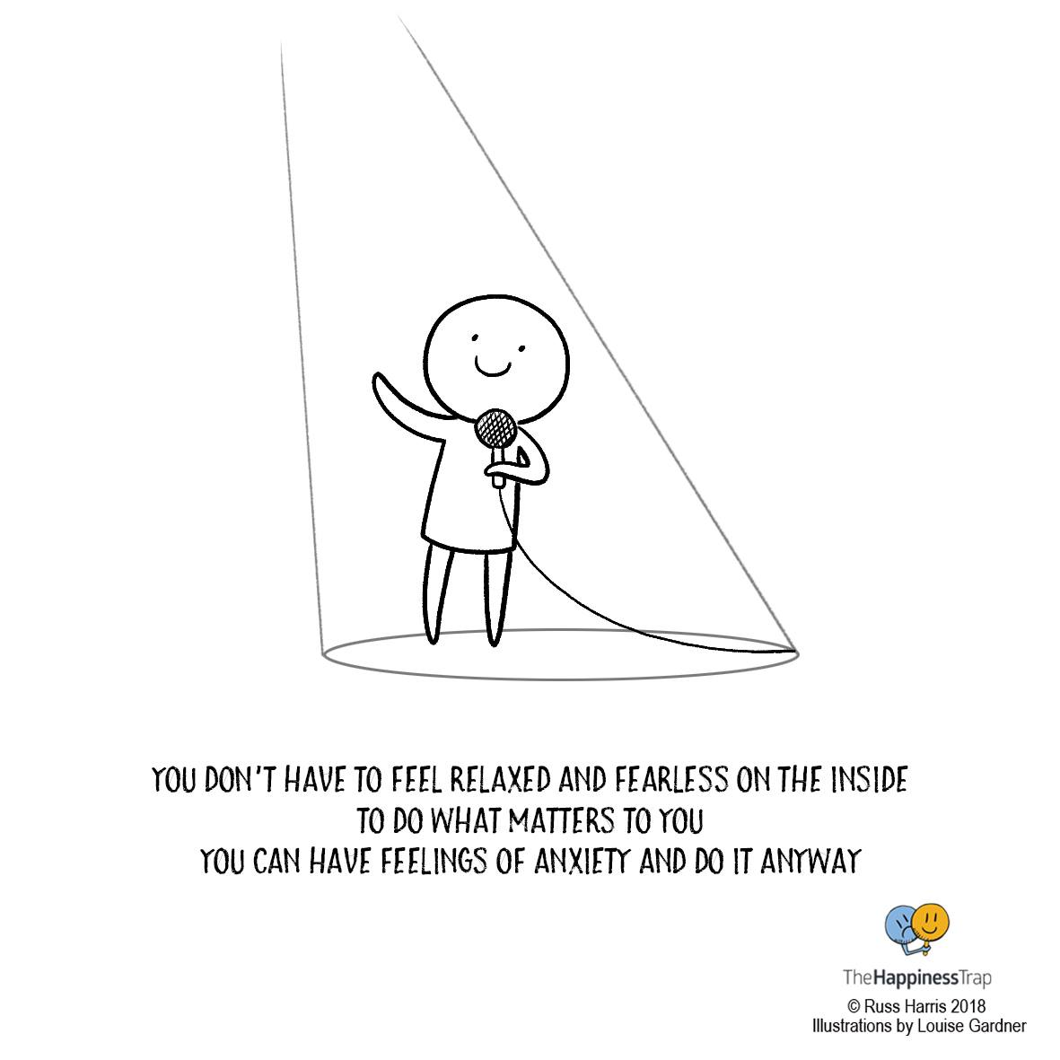
Questions?
Email cepoon@nebraskamed.com for references and resources
THANK YOU!

