Slide 1
Pharmacogenomics in Older People
Christopher L Shaffer, PharmD, PhD
Associate Professor
Colleges of Pharmacy and Medicine

Slide 2
Presenter Disclosures
Consultant/ Speakers bureaus | No Disclosures
Research funding | NIMH “Dose-response relationship and pharmacokinetics of intranasal oxytocin on the neural impact in youths with high levels of irritability.”
Stock ownership/Corporate boards-employment | No Disclosures
Off-label uses | No Disclosures

Slide 3
Objectives
To provide an overview of pharmacogenetics.
To describe the scientific rationale for pharmacogenetics.
To review opportunities and barriers related to implementation into clinical practice, especially the older patient population.

Slide 4
Introduction to Pharmacogenetics

Slide 5
The study of how genes influence individuals’ response to pharmacological treatments: Pharmacogenetics- The effect of a single gene variant with a large effect size on drug response Pharmacogenomics- The effect of many genetic variants on many drugs

Slide 6
Current Treatment Paradigm

Slide 7
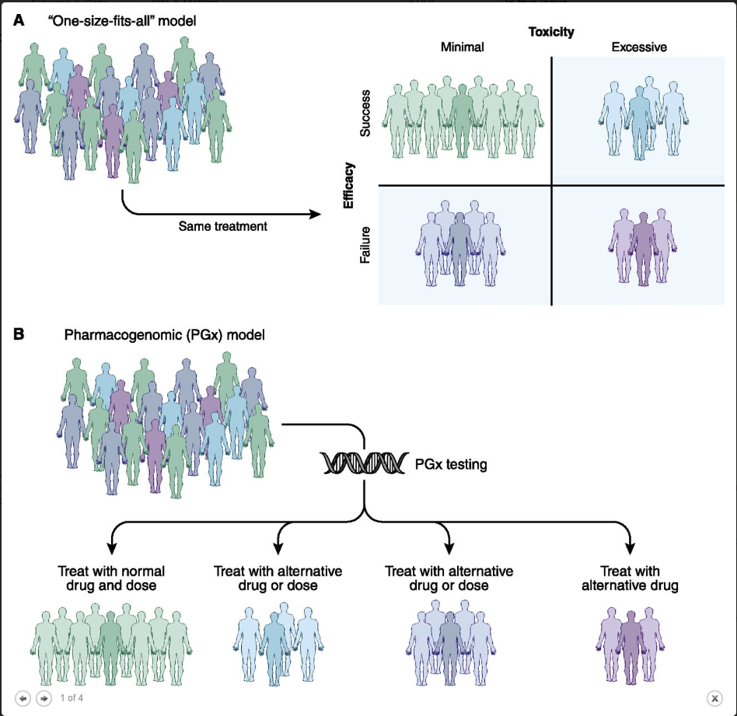

Slide 8
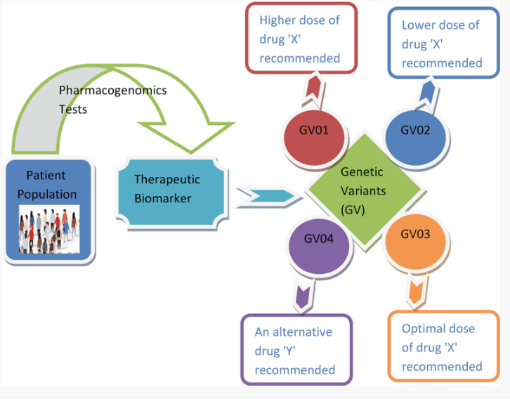
97% of individuals have an actionable genetic finding that can guide medication choice

Slide 10
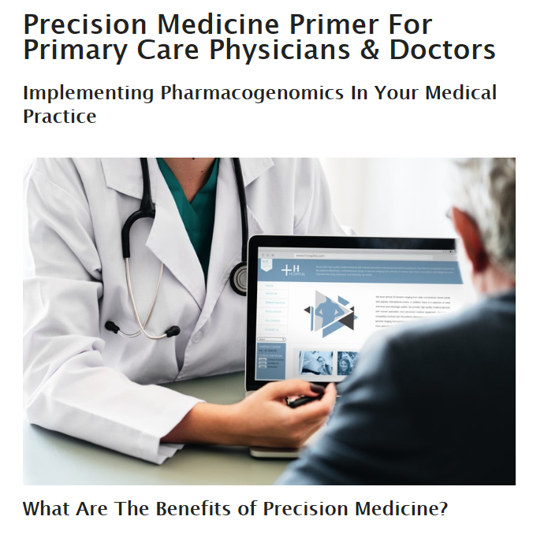
In one study, 65% of FP’s agreed that PGx is useful, but only 13% felt able to use a test in an informed fashion

Slide 11
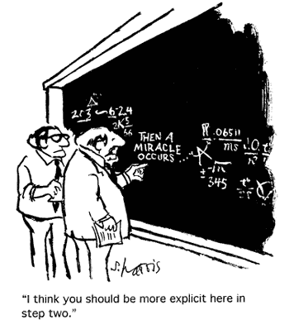
Translating Pharmacogenomics

Slide 12
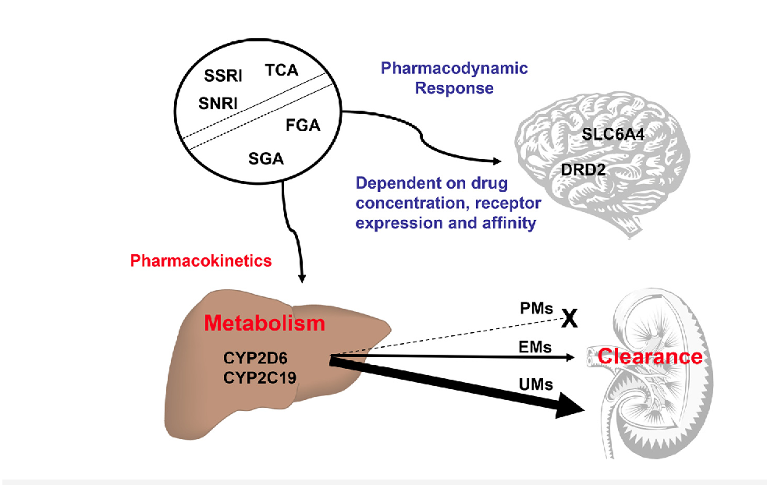
Impact of Pharmacokinetics and Pharmacodynamics
Pharmacokinetics: what the body does to the drug
Pharmacodynamics: what the drug does to the body

Slide 13
Pharmacokinetic Terms

Slide 14
Pharmacokinetic Terms

Slide 15
Examples of Polymorphisms…
Diplotype in Milli (Result) | Phenotype | Priority | EMR Flag (Color)
(*5/*5)0N | PM | Priority | Abnormal
(*1/*1)1N | EM | Routine | Normal
(*2/*2)1N | EM | Routine | Normal
(*1/*1,*1/*9,*9/*9)1N | EM or IM | Routine | Normal
(*41/*41)1N | IM | Routine | Normal
(*17/*17,*17/*40,*40/*40)1N | IM or PM | Indeterminate | Abnormal
(*4/*4)1N | PM | Priority | Abnormal
(*1/*1)2N | EM | Routine | Normal
(*1/*10)2N | EM | Routine | Normal
(*1/*17)2N | EM | Routine | Normal
(*1/*2)3N | UM | Priority | Abnormal
(*1/*3)2N | EM | Routine | Normal
(*1/*41)2N | EM | Routine | Normal
(*1/*6)2N | EM | Routine | Normal

Slide 16
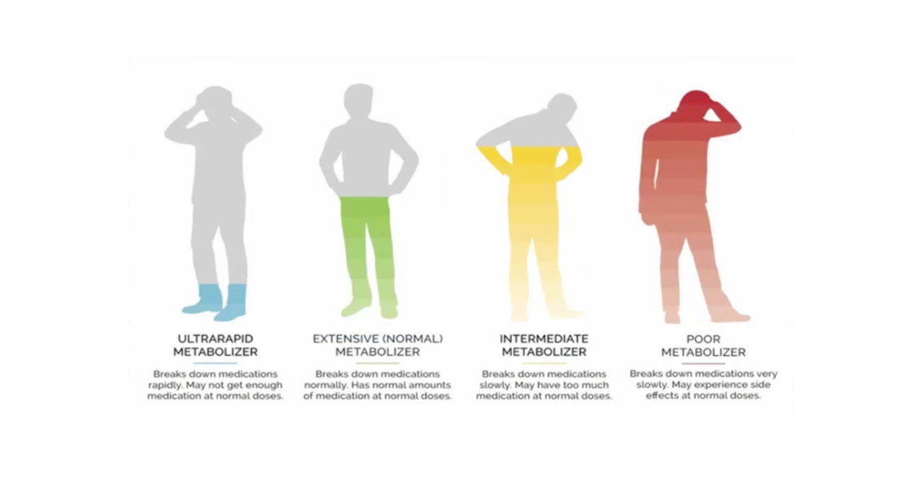
Definitions of Metabolic Status

Slide 23
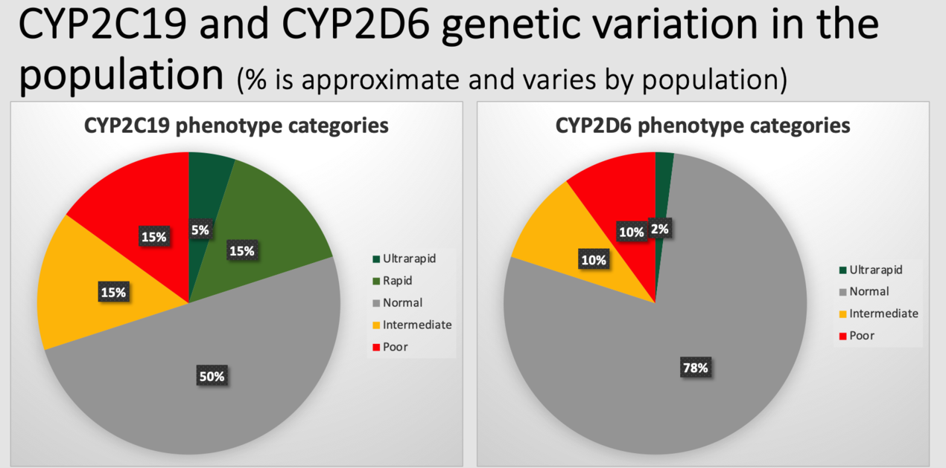

Slide 24
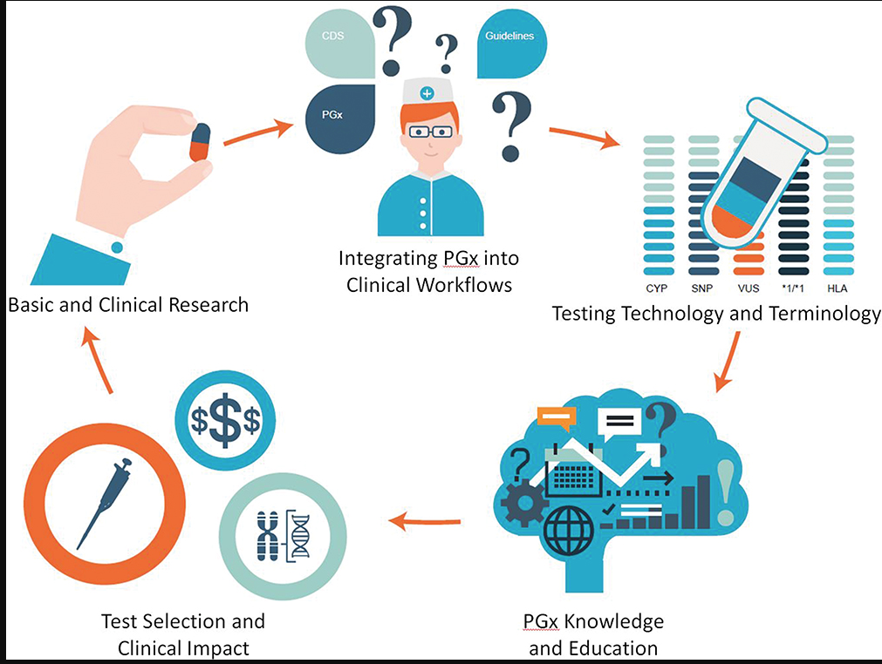

Slide 25
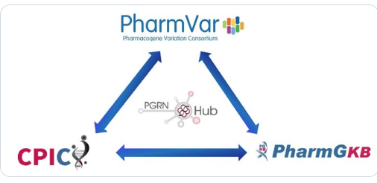

Slide 26
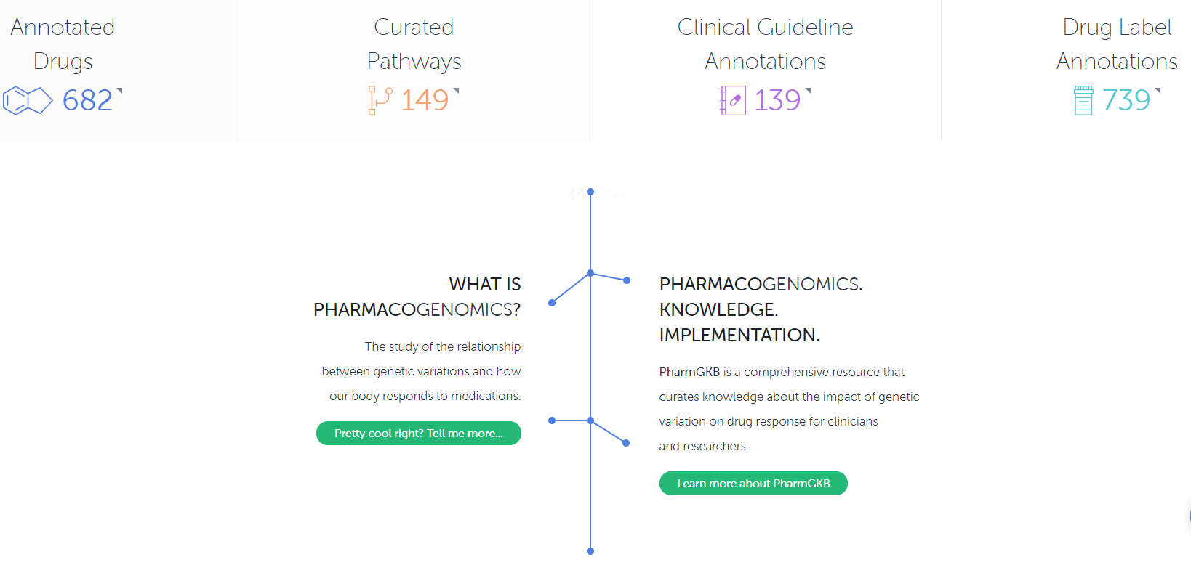
PharmGKB

Slide 28
Warfarin PharmGKB Info
Warfarin Sensitivity Genotyping:
CP450 2C9 and Vitamin K epoxide reductase complex (VKORC1) enzyme. The test simultaneously detects and genotypes 2 polymorphisms of the CYP2C9 gene, CYP29C*2 (3608C>T) and CYP2C9*3 (42614A>C), and a single point polymorphism of the VKORC1(1173C>T). Individuals who are heterozygous or homozygous variant for any of these alleles are generally more sensitive to standard doses of warfarin that similar individuals who lack these alleles, and are at an increased risk for bleeding.

Slide 29
Ranges are derived from multiple published clinical studies. Other clinical factors (e.g., age, race, body weight, sex, concomitant medications, and comorbidities) are generally accounted for along with genotype in the ranges expressed in the Table. VKORC1 –1639 G>A (rs9923231) variant is used in this table. Other co-inherited VKORC1 variants may also be important determinants of warfarin dose. Patients with CYP2C9 *1/*3, *2/*2, *2/*3 and *3/*3 may require more prolonged time (>2 to 4 weeks) to achieve maximum INR effect for a given dosage regimen.
FDA: Warfarin Package Insert
VKORC | *1/*1 CYP2C9 | *1/*2 CYP2C9 | *1/3 CYP2C9 | *2/*2 CYP2C9 | *2/*3 CYP2C9 | *3/*3 CYP2C9
GG | 5-7 mg | 5-7 mg | 3-4 mg | 3-4 mg | 3-4 mg | 0.5-2 mg
AG | 5-7 mg | 3-4 mg | 3-4 mg | 3-4 mg | 0.5-2 mg | 0.5-2 mg
AA | 3-4 mg | 3-4 mg | 0.5-2 mg | 0.5-2 mg | 0.5-2 mg | 0.5-2 mg

Slide 33
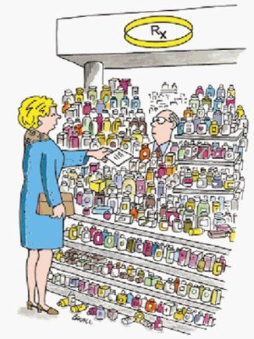
Implementing Pharmacogenomics Into Practice
Here is my DNA sequence...
New Yorker 2000

Slide 34
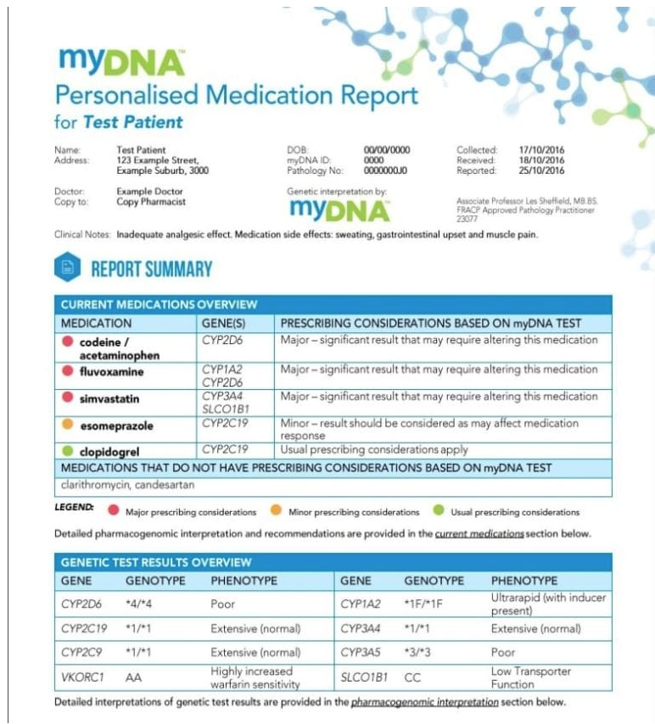
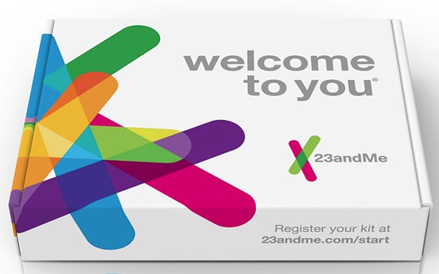
Pharmacogenetics & Direct To Consumer genetic testing

Slide 35
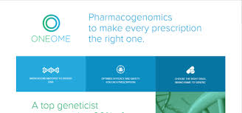
Pharmacogenetics & Clinical Laboratores

Slide 36
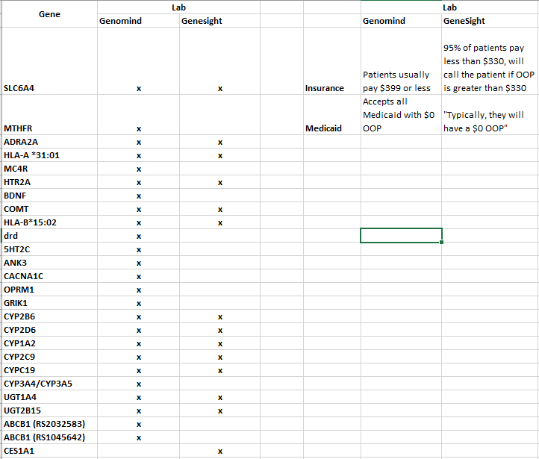
Genomind vs GeneSight

Slide 38
Implementation of PGX Testing in Clinical Setting

Slide 40
Implementation of PGX Testing in Clinical Setting

Slide 41
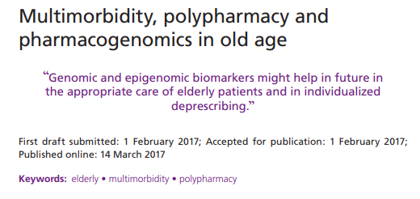
Implementation of PGX Testing in Older Patient Population

Slide 42
Pharmacogenomics in Older Patient Population
Polypharmacy (>5 medications) is common since many elderly suffer from >3 significant diseases.
Functional decline through environmental and genetic causes may exacerbate small genomic variations.
Higher fall rates with sedatives, anti-depressants, anti-psychotics, and anti-Parkinson medications
50% of these medications are impacted by polymorphisms in CYP2C19 or CYP2D6 isoenzymes
Higher rates of neuropsych and pain medications in this patient population.

Slide 45
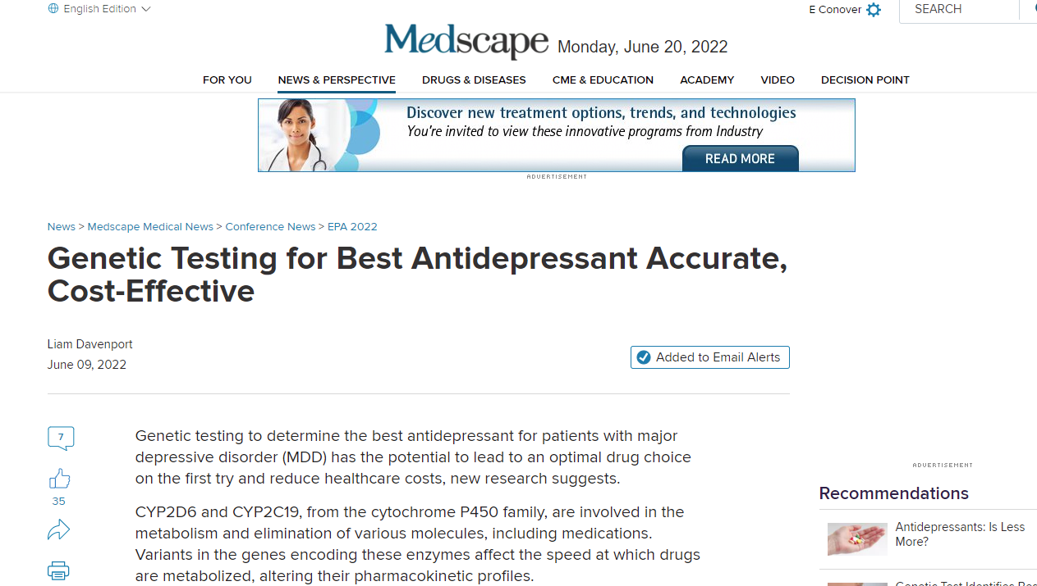

Slide 47
It’s not just the genes..
Personalized Medicine and Pharmacogenomics are just one piece of the puzzle.
Still have:
Drug-drug interactions
Drug-disease interactions
Drug-nutrient interactions
Drug-genetic interactions
An additional piece of data to assist the clinician for the best therapeutic plan for the patient!

Slide 48
Pharmacogenetics Clinic
Medical Geneticist
Genetic Counselor
Pharmacologist

Slide 49
Pharmacogenetics Clinic
Started at MMI Clinic in Fall 2018.
Partnership with Genetic Medicine
Patients with therapeutic toxicities or treatment failures.
Clinic has grown to monthly clinics, seeing adult and pediatric patients.
Results are shared with patients and medical providers
Dr. Omar Abdul-Rahman
Beth Conover, MS, APRN, LCGC

Slide 50
Pharmacogenetics clinic workflow
Referral from provider
Appointment usually within 4 weeks
First visit
Review medical history including adverse drug events and treatment failures
Pre-test counseling provided including limitations and cost
Second visit
In-depth review of test results
Report with treatment considerations generated and sent back to referring provider
Kit ordered to home address and sent back to lab for processing
Results usually within 10-14 days
All visits scheduled via telehealth, unless patient requests in-person
Accepts all ages

Slide 51
Example:
Mr. R, age 60, is referred to you by his primary care physician, who diagnosed him with depression approximately 2 years ago. When he was first diagnosed, Mr. R was prescribed sertraline, 100 mg/d, which was effective. He maintained this response for approximately 1 year, but then the sertraline 'stopped working'. During the last year, Mr. R received citalopram, 20 mg/d, and paroxetine, 20 mg/d. Neither medication was effective for his recurrent depressive symptoms and resulted in significant adverse effects.
Mr. R undergoes pharmacogenomics testing to help guide therapy. He is found to have the cytochrome P450 (CYP) 2C19 *2/*3 genotype and a CYP2D6*4/*5 genotype. Both are associated with a poor metabolism phenotype. How are these results used to guide therapy?

Slide 53
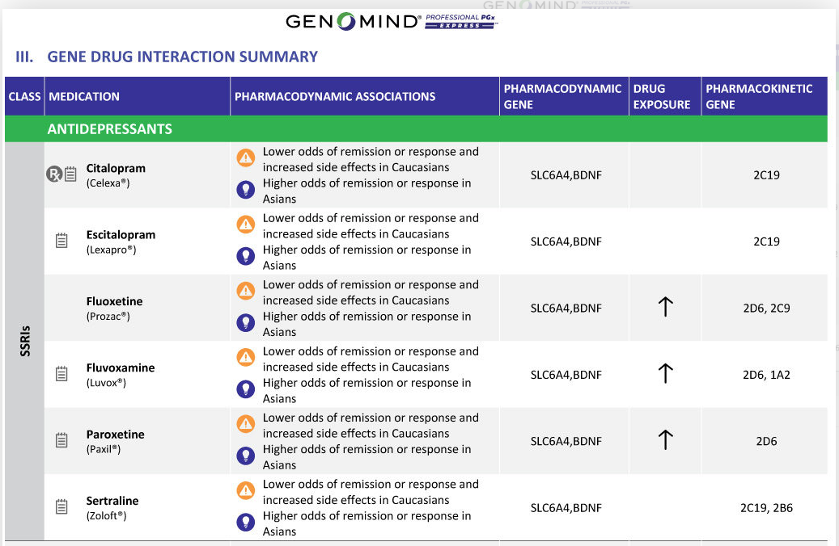

Slide 56
EPIC Request for Pharmacogenetics Consult

Slide 60
Conclusions
The adoption of pharmacogenomics into clinical practice provides another data element for clinicians in “personalizing” medication treatments.
Clinically relevant gene:drug relationships have been determined through national and international consortiums, but their application to the geriatric patient population has been inconsistent.
At this time, reactive pharmacogenomic testing pursuant to treatment failures or adverse events is most likely to be covered by insurance companies.
Local resources are available to assist in research or clinical implementation into clinical practice.

Slide 61
Thank you.

