Slide 1
Genitourinary Syndrome of Menopause (GUSM)
Dr. Sylvia Ziegenbein, MD
OB/GYN
3/7/2024

Slide 2
Objectives
What is genitourinary syndrome of menopause?
Discuss the natural physiology, clinical diagnosis and treatment options for GSM.
Present and discuss a case of GSM.

Slide 3
Disclosures
none

Slide 4
Postmenopausal women- Remember learning terms like...
Vaginal atrophy
Atrophic vaginitis
Vulvar itching
Vaginal dryness
Pain with intercourse bc of dryness
Vulvovaginal atrophy
Recurrent UTIs
Overactive bladder, urgency, urge incontinence

Slide 5
North American Menopause Society (NAMS) and International Society for the Study of Women's Sexual Health
Single syndrome!!!!
2014
GSM
All from lack of estrogen
Name change for providers to recognize this as a SYNDROME
Symptoms
Vaginal and/or vulvar - itching, burning, irritation, pain with intercourse from dryness and/or levator spasm. Sometimes vague pain/discomfort.
Bladder issues - urgency, urge incontinence and/or recurrent UTIs.
Can actually start perimenopausally (even before menopause.)
We are focusing on 65yoa and beyond

Slide 6
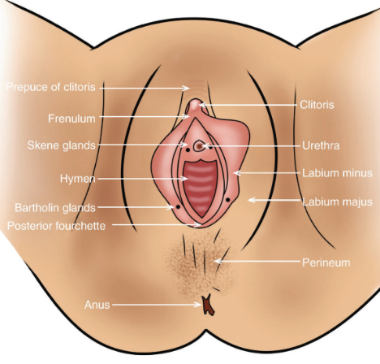
High Concentrations of Estrogen Receptors
Normal External Genitalia

Slide 7
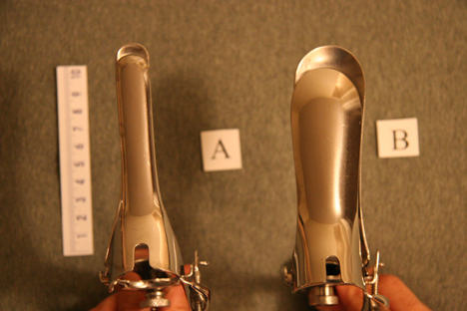
Lack of Estradiol

Slide 8
Differential diagnoses-usual suspects
Candida (positive vaginal pathogen or wet mount)
Lichen sclerosus (whitish skin changes with itching or pain)
Lichen simplex chronicus (normal architecture but thickened skin)
HSV (shallow ulceration)
Cancer (heaped up or ulceration, usually beefier red)
Allergic/contact dermatitis (pads, soap, fragrance)
Cystitis
Other skin conditions- psoriasis, eczema
A word about bacterial vaginosis
Anaerobes, higher pH, natural history

Slide 9
Genitourinary Syndrome of Menopause- Treatments
Vaginal estrogens - creams, tablets, ring
DHEA(prasterone/Intrarosa)-vaginal capsule that intracellularly changes to estrogen and androgens
Ospemifene-SERM-turns on the vaginal epithelium/neutral on breasts
OTC- vaginal moisturizers and lubricants

Slide 10
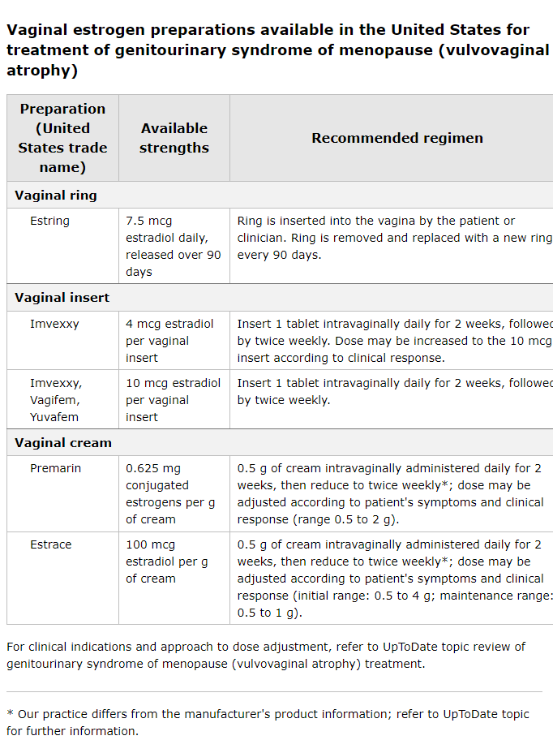
Treatments-Estrogens Vaginal, local
Physiology
Lack of Estrogen
Replace Estrogen
Estrace Cream(estradiol, full applicator is 4gms)
1/4th applicator per vagina 2-3x wkly qHS
(can substitute 1 inch of cream on a finger instead of applicator.)
TIPS: 1. Can rub dime size amount on ext. genitalia at same time
2. Can use more if no uterus
Premarin Cream(conjugated equine estrogens)
same Rx (full applicator is 2 gms)
Other options vaginally:
Ring, tablets, capsules
My preferred:
Natural, no interaction with other meds(bc it's topical and ultra low dose, will not increase one's risk of clots nor breast cancer)
It Works!!! Long history of use.

Slide 11
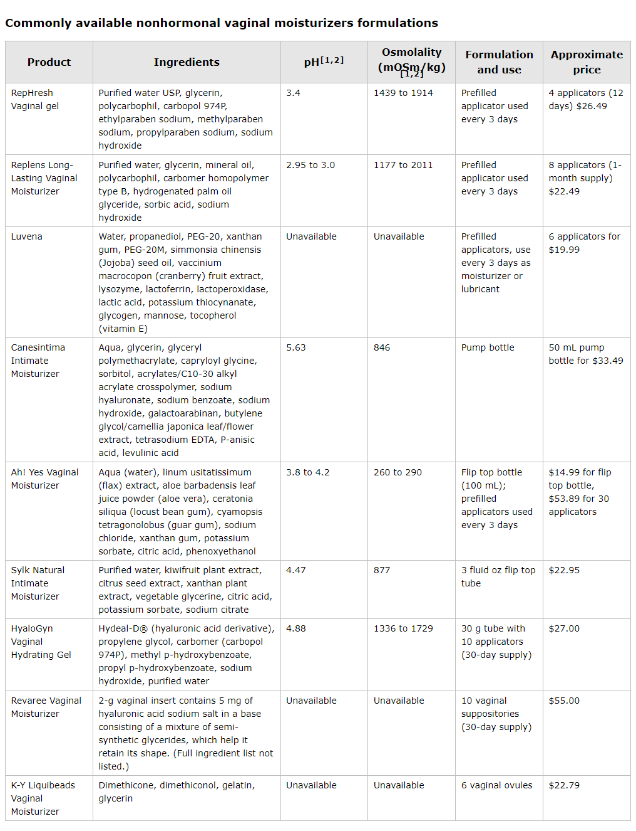
Vaginal Moisturizers
Choose one with hyaluronic acid
Not cheap
Not always natural
Additives-can make things worse
Coconut oil???

Slide 12
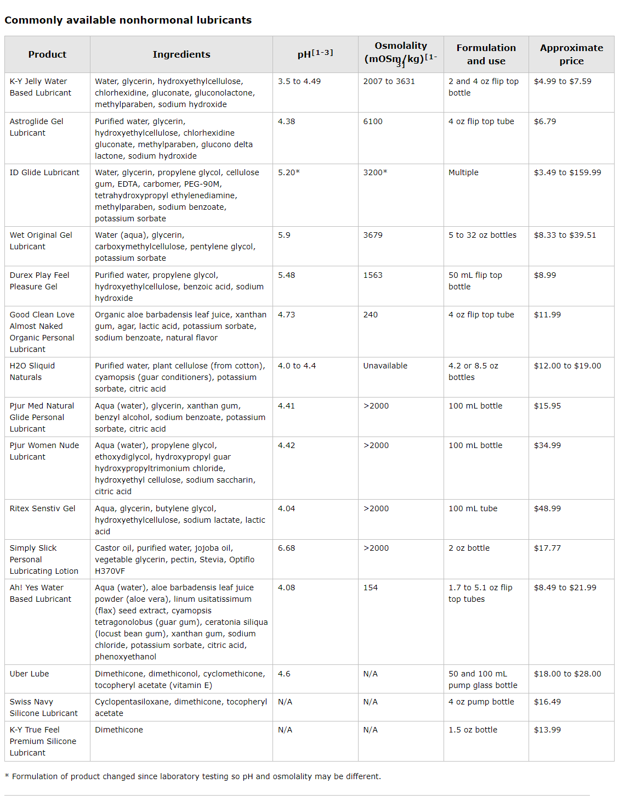
Non Hormonal Lubricants OTC
From a Women's Health Pelvic Floor PT
-Slippery Stuff
Must be aware of ingredients-
-alcohols can be drying
-can have allergies to components

Slide 13
Pain with Sex
Pain with deep thrusting
Vaginal dryness
Genitourinary Syndrome of Menopause
Lubricants
Silicone based are best
Moisturizers
Replens
HyaloGYN-hyaluronic acid
Vaginal estrogen
Creams, tablet, ring
Ultra low dose, 2-3x per week
Second line for
DHEA-vaginal(prasterone)
Ospemifene
Oral SERM-stimulates vaginal tissue
Neutral on breast tissue
Hot flashes, possible VTEs
Laser
Not FDA approved
Not as common in this population
Endometriosis
Endometritis
Pelvic mass

Slide 14
Case
75 yo pt brought in by her daughter.
Dementia
Recurrent UTIs

Slide 15
Actually known to me
Haven't seen her in 3 years
First started seeing her 14 years previously
Had been on vaginal estradiol and clobetasol
Hx of bx proven lichen sclerosus
Thoughts???

Slide 16
Exam
Classic whitish changes on the vulva of LS
Some petechiae externally
Introitus
Urethral caruncle
Mild erythema at the introitus
Smaller introitus
Vagina
Pale, absent rugae, with petechiae
No discharge
Can't see the cervix, too uncomfortable, not necessary
Thoughts?

Slide 17
Dementia and LS
Life expectancy about 5 yrs
No bx of LS areas
Not scratching
No clobetasol
Dementia and GSM
Removed and placed an Estring
Actually messaged her gerontologist 3 months previously to place an estring.
No UTI in the past 3 months
F/U in 3 months

Slide 18
Estring
Super convenient for pt and staff
Q 3 months
Insurance
Necessary vaginal caliber
Need a little cooperation from pt though
Can tie a piece of dental floss for ease of removal

Slide 19
Other thoughts
With LS
Can get scarring that somewhat blocks the urethral meatus-do an exam
2x increase risk of cancer-do an exam yearly if possible, can be just external
Vagifem/Yuvafem
Very thin applicator, next best option
2-3 x weekly, MTh, or MWF
Vaginal creams- Estrace or Premarin
1/4th applicator of cream inserted vaginally 2-3x weekly at night
Little messier, cream comes out in the morning
Anxiety? Moisture?
But, also nice with vulvar itching, can rub some on every morning if desired
Otherwise vaseline works well other times of the day for external dryness.

Slide 20
Questions???

