Slide 1
Sharing What Matters as patients complete Advance Care Planning
Nubia Quiros
Advance Care Planning Liaison
University of Nebraska Medical Center
Brandi Flagg, MD, MPH, CMD
Assistant Professor
Division of Geriatrics & Palliative Care
University of Nebraska Medical Center

Slide 2
Objectives
Define Advance Care Planning
Review ACP tools available for use in the clinic setting
Review ACP completion data at 2 NGWEP clinical sites
Hear from an Advance Care Planning Liaison on what works!

Slide 3
Quick Quiz
Can someone with dementia sign an advance directive?
Yes or no
To fill out an Advance Directive at your doctor’s office, the patient must have a complete understanding of intubation, feeding tubes, and dialysis. T or F
Notes:
To be used for audience polling questions:
Yes
False

Slide 4
Advance Care Planning-Defined
STEP 1: CHOOSING A HEALTH CARE POWER OF ATTORNEY
The first step is to pick someone you would trust to speak for you if you needed urgent health care and couldn’t speak for yourself. The best person for the job:
Lives close by, or at least is easily reached in a crisis.
Knows the health care system and health care matters well enough to take part in discussions with doctors, nurses and others involved in your care.
Agrees to make health care choices that are in line with your wishes.
STEP 2: DECIDING WHAT’S IMPORTANT TO YOU
The next step is to make a living will.
1
In this document, you might touch on these types of health care:
2
•Cardiopulmonary resuscitation or CPR, if you have no pulse and your heart is not pumping blood.
3
• Intubation and mechanical ventilation, if you cannot breathe on your own.
4
• Dialysis, if your kidneys have failed.
5
• A feeding tube, sometimes called a PEG tube, if you cannot safely swallow normal food or drink.
6
• A DNR/DNI order, short for “do not resuscitate, do not intubate.”
7
STEP 3: PUT YOUR WISHES IN WRITING. NOTARIZE. SCAN TO MEDICAL RECORD
Notes:
Advance care planning is a 2 step process.
It refers to putting together a written-legal document stating who you would want to make healthcare decisions for you if you were too ill or incapacitated to speak for yourself (ie naming a healthcare POA/surrogate decision maker/healthcare proxy). Best if this person is easily reached and knows the healthcare system (can talk with doctors and nurses). They need to make choices in line with your wishes.
It is also an opportunity to state what matters to you most regarding your healthcare. We call this part an advance directive or living will. It give an opportunity to spell out your wishes (it’s okay if your wish is to have your decision maker decide based on the information available at the time.
Patient needs to have capacity to name a decision maker at time of completion. Typically, still possible with mild dementia. To have capacity they need to understand what is being asked and demonstrate ability to make a choice and have some reasoning for that choice, and appreciate the consequences (outcomes) of that choice.
The final step is to put all of the above (POA and your wishes) into a legal recognized document. Having a notary saves time and allows for one signature. It can be difficult to find (or have in one place all at once) 2 witnesses with no conflicts (ie. Not the named durable POA or the physician/healthcare provider).

Slide 5
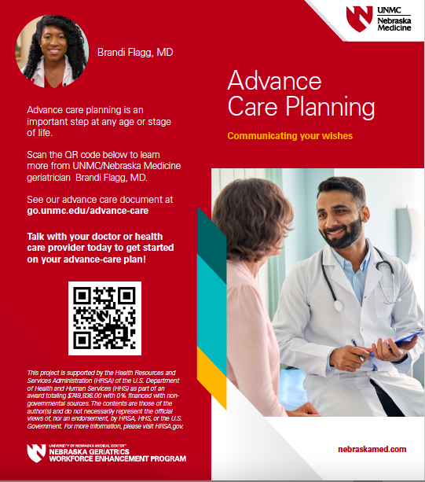
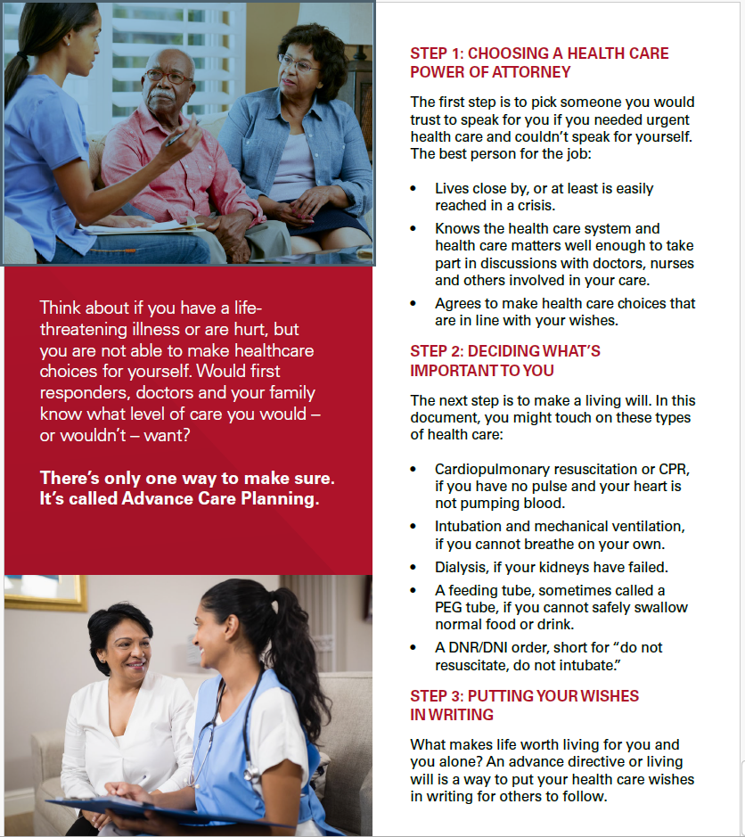
ACP Clinical Tools
Notes:
Nebraska Medicine brochure - English

Slide 6
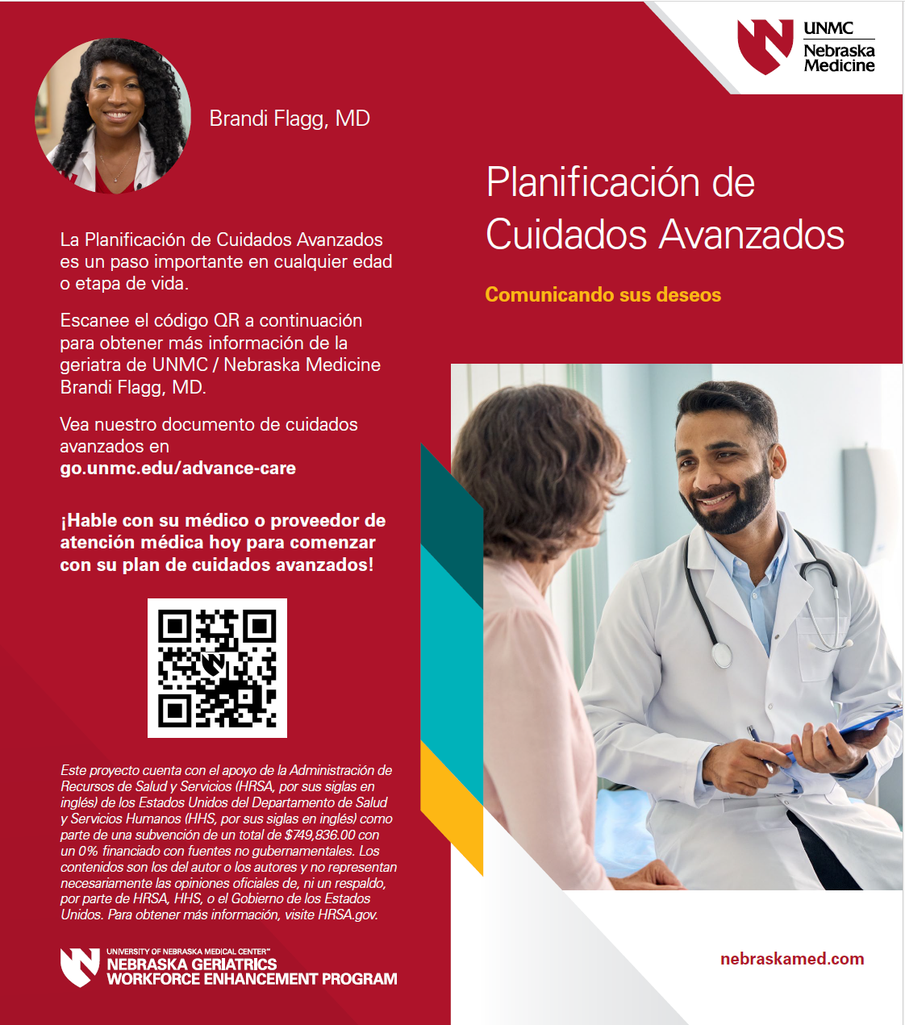
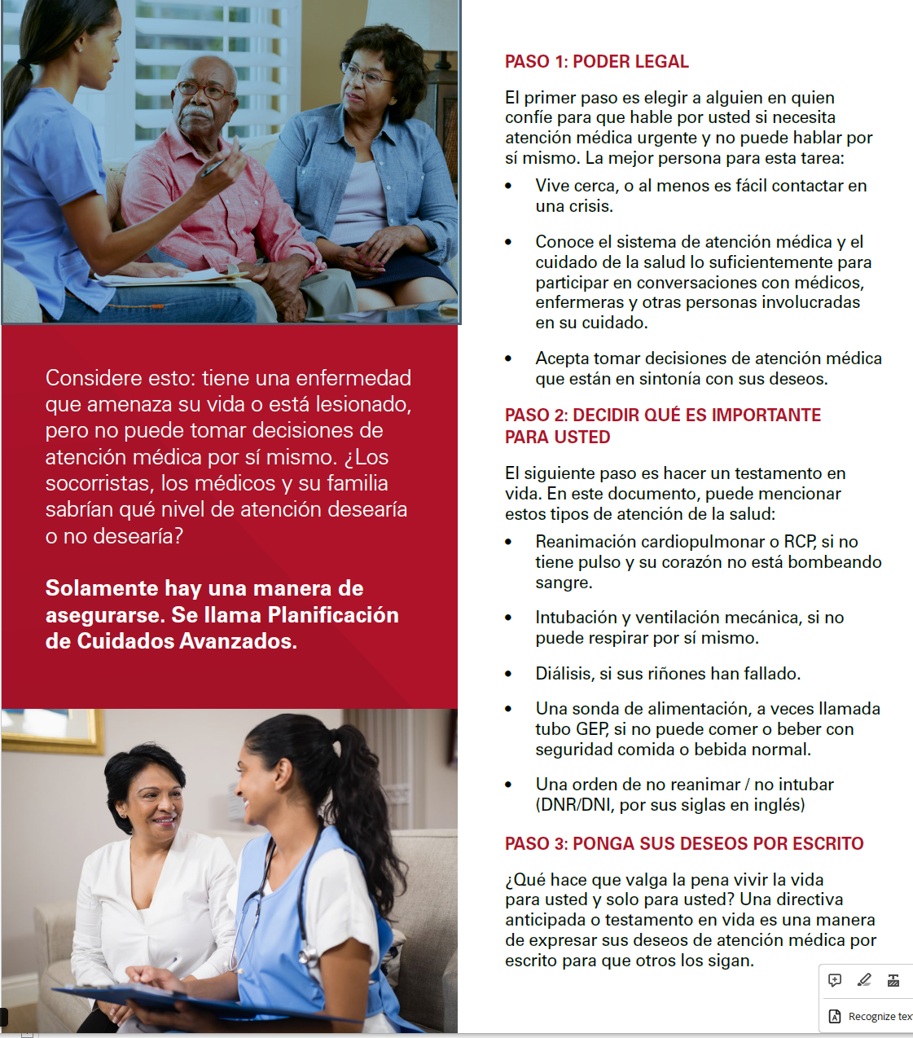
ACP Clinical Tools
Notes:
Nebraska Medicine brochure- Spanish

Slide 7
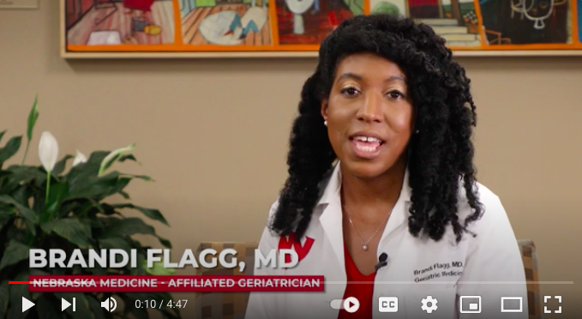
ACP Video
Notes:
Nebraska medicine ACP video available in both English and Spanish. Advance Directives: Your peace of mind (youtube.com)

Slide 8
ACP Clinical Tools
Notes:
Cost is $5 per booklet; speaks to medical, personal, emotional and spiritual needs, good for guiding the conversation in families. Universal form legal in 46 states including Nebraska (special steps in 4 states). Available in 30 languages.

Slide 9
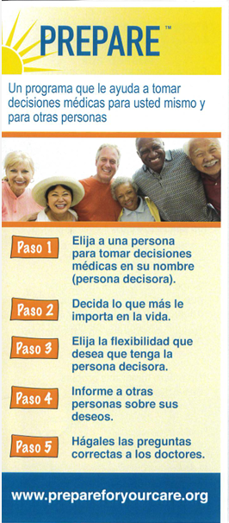
ACP Clinical Tools
PREPARE FOR YOUR CARE
Notes:
Similar step by step guide. Developed by UC San Francisco. Can be filled out online or in print. Free to the public for use, but licensing is required for use in QI/research projects, branding, data reporting, or making available on your institution web site . Available in Spanish and English digitally. Some other languages in printed form. Many communication aids on the website, videos, and toolkit for group “movie” events.

Slide 10
ACP Video

Slide 11
Advance Care Planning Liaison
Good Rapport
No healthcare background required
Cultural Awareness
Has access to the patient schedule
Advance Care Planning Knowledge
Availability thru encrypted platforms – Spruce
5 hours / 4 days a week
HIGHLY MOTIVATED
What do you do? “Raise awareness that you can make your own end of life decisions”
Notes:
So we know that Lack of ACP planning can lead to family feuds and distress among caregivers, patients enduring care other than what they would have wanted because of not having things in writing, or worst-case scenarios when there is limited next of kin and court guardianship is required to determine care.
Because ACP is a serious and sensitive topic, it can be helpful to have an ACP liaison who has more time to dedicate with patients to answer questions and assist completion (Move the ball from contemplation to completed document).
An ACP liaison is someone who can have ….

Slide 12
ACP Outcome Changes
Notes:
(Graphs credit to Jungyoon Kim, PhD (NGWEP program evaluator) who presented on the full scope of this project earlier in the year).
This chart shows the percentage of patients 65 and older who completed the ACP documentation in the medical record in the clinic A. Each year, we collected ACP measure twice for the 1st 6 months and 2nd 6 months.
As you can see, the numbers were pretty stable for the first 3 years, but in 2022 after we hired ACP coordinator, it increased by 8.8 percentage point from 18.6% to 27.4% in the next 6 months. The next period in 2023, the percentage went down slightly, but still about 6% higher than the previous year.

Slide 13
ACP Outcome Changes
Notes:
(Graphs credit to Jungyoon Kim, PhD ( NGWEP program evaluator) who presented on the full scope of this project earlier in the year).
Clinic B showed a dramatic increase of ACP documentation between baseline (1.8%) and post intervention (14.8%) in 2023. As you can see, before GWEP it was about 2% overall, but starting in 2022 the number increased up to 14.8%. We are in the process of getting our next round of MIPS data and expect that it will be around 20%.

Slide 14
Notes:
Having an ACP liaison provides the ripple effect that we want for more patients to complete ACP planning. Turn presentation to Nubia to discuss her experiences with ACP planning at One World and in the community.

Slide 15
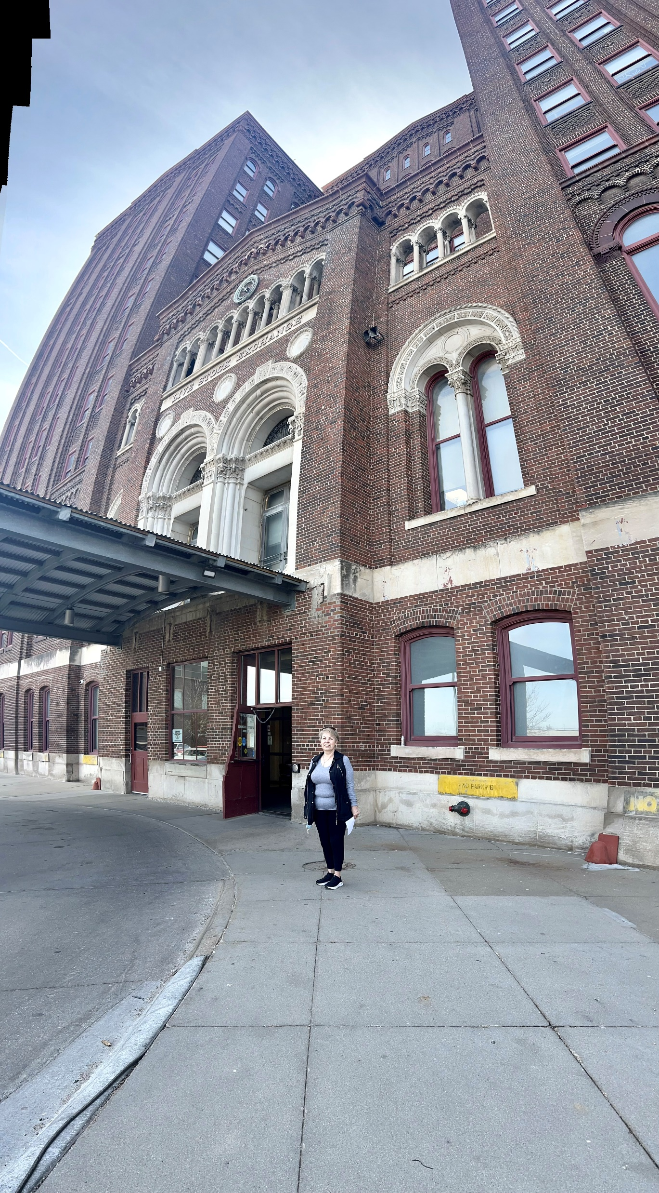
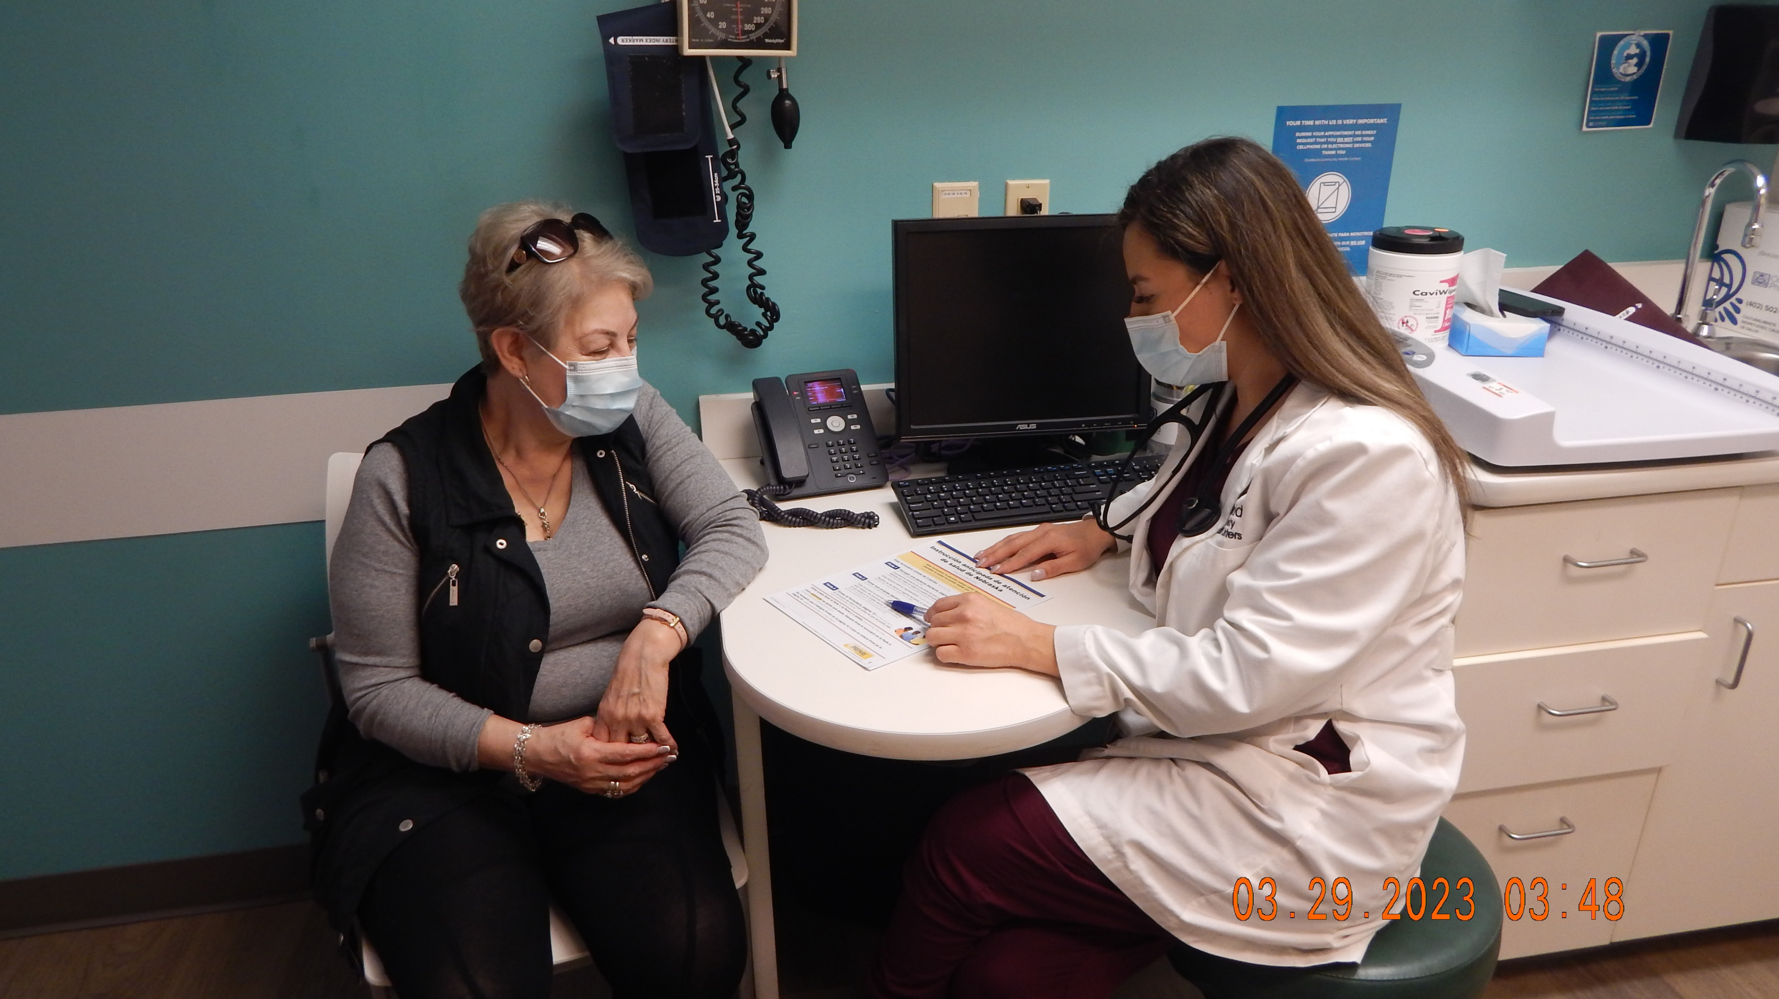
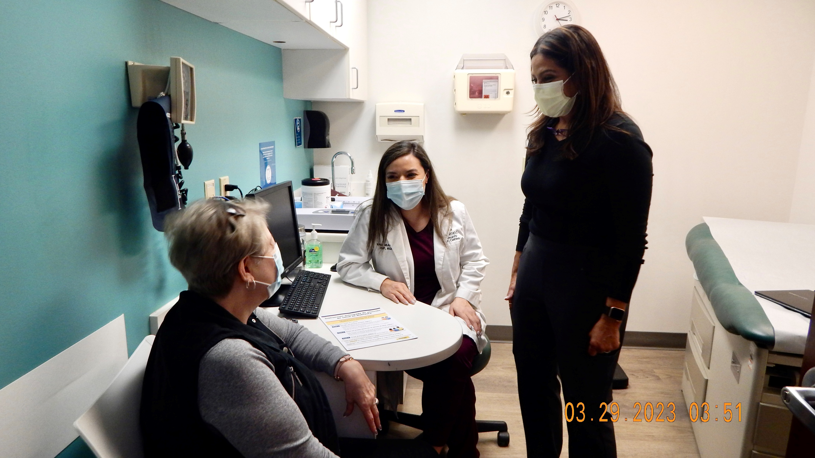
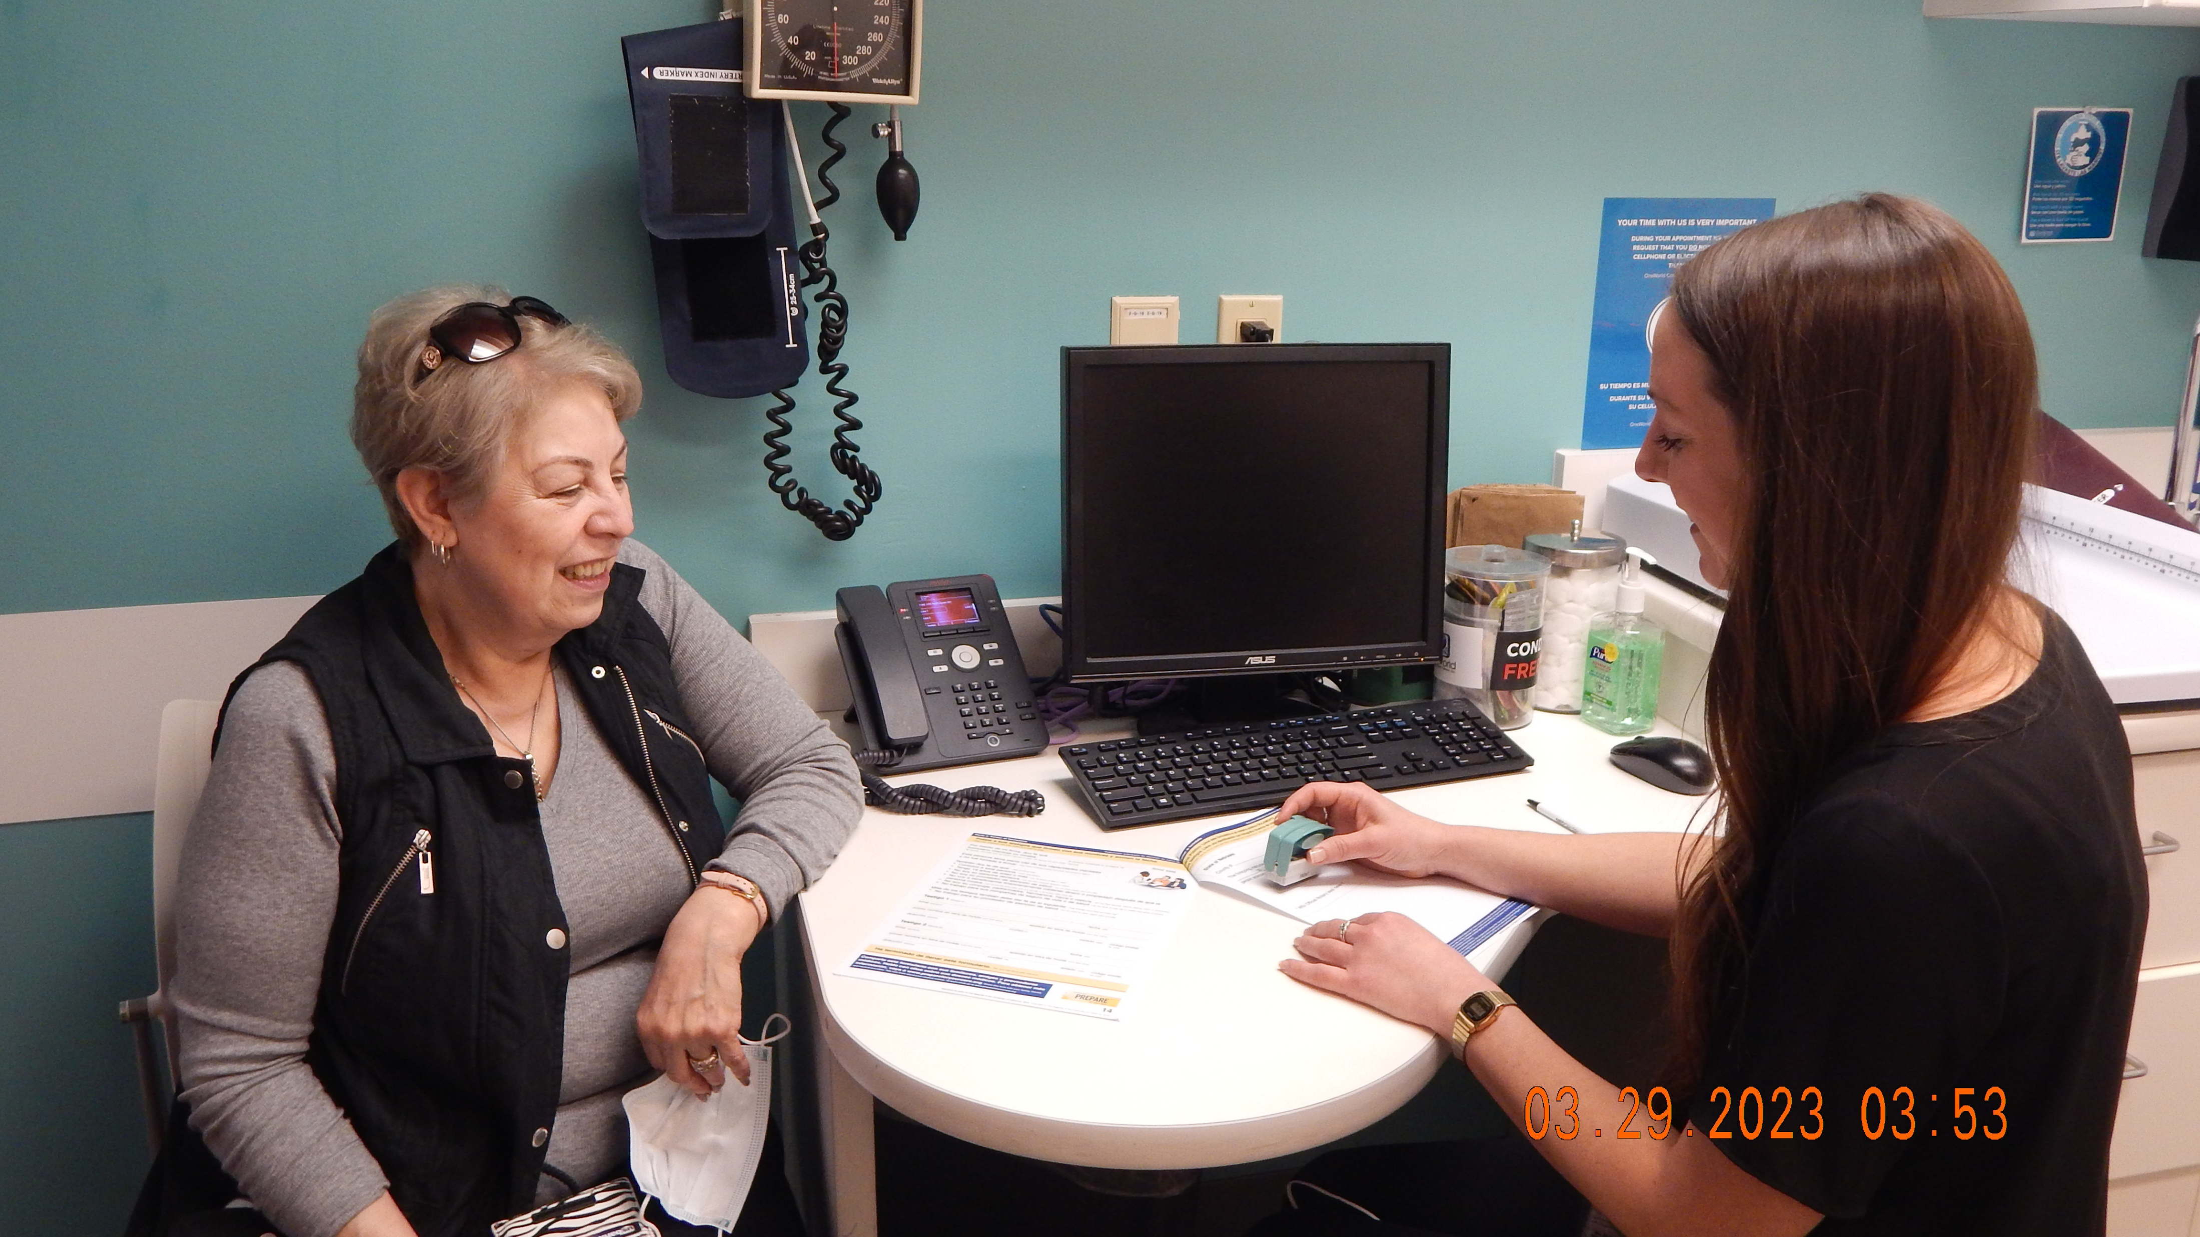
Notes:
Nubia to review process at One World: logistics, barriers, successes

Slide 16
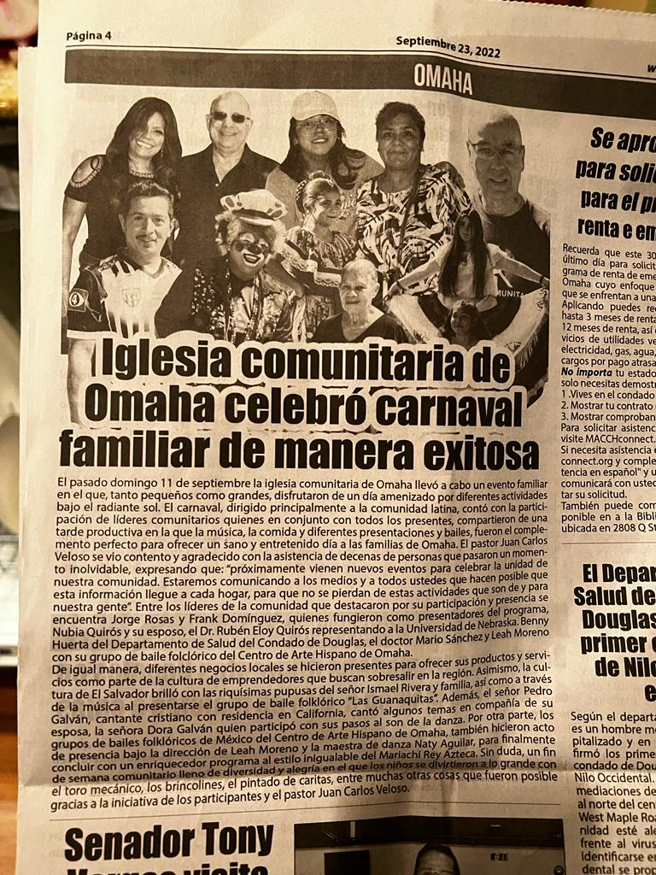
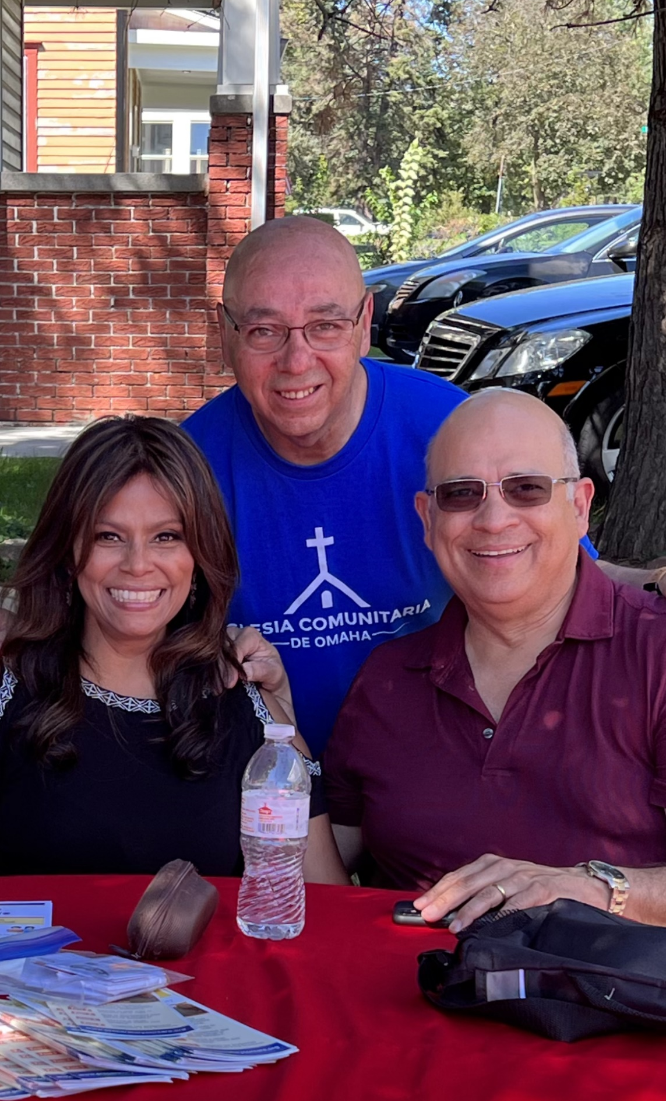
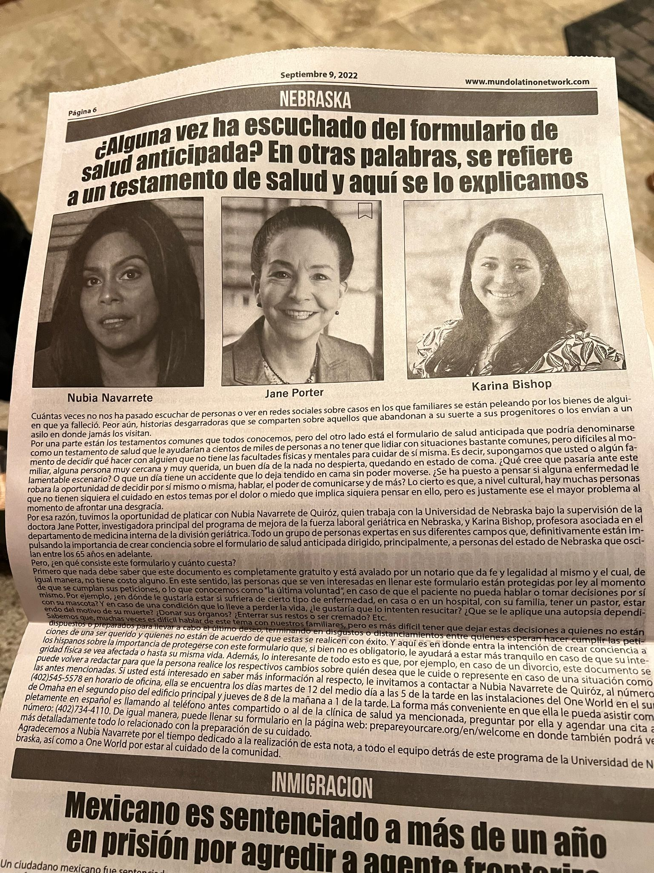
Notes:
Nubia to discuss related community efforts to get the word out about ACP planning.

Slide 17
Key Takeaways
Advance care planning is important for all ages, but especially for 65+.
There are many easy-to-use tools to assist completion of an advance directive.
The most important step of the process is to name a healthcare POA who will act based on your wishes.
A clinical ACP liaison is a huge asset to completion of advance directives in the clinical setting.
Notes:
Success depends highly on physicians referring to the ACP liaison

