Slide 1









Faculty Success End-User Training
Presented by: Meagan Crews
9/30/25

Slide 2
Introduction
What is Faculty Success?
Entering and Editing Activities
Faculty Success Reporting
Q&A
Resources

Slide 3
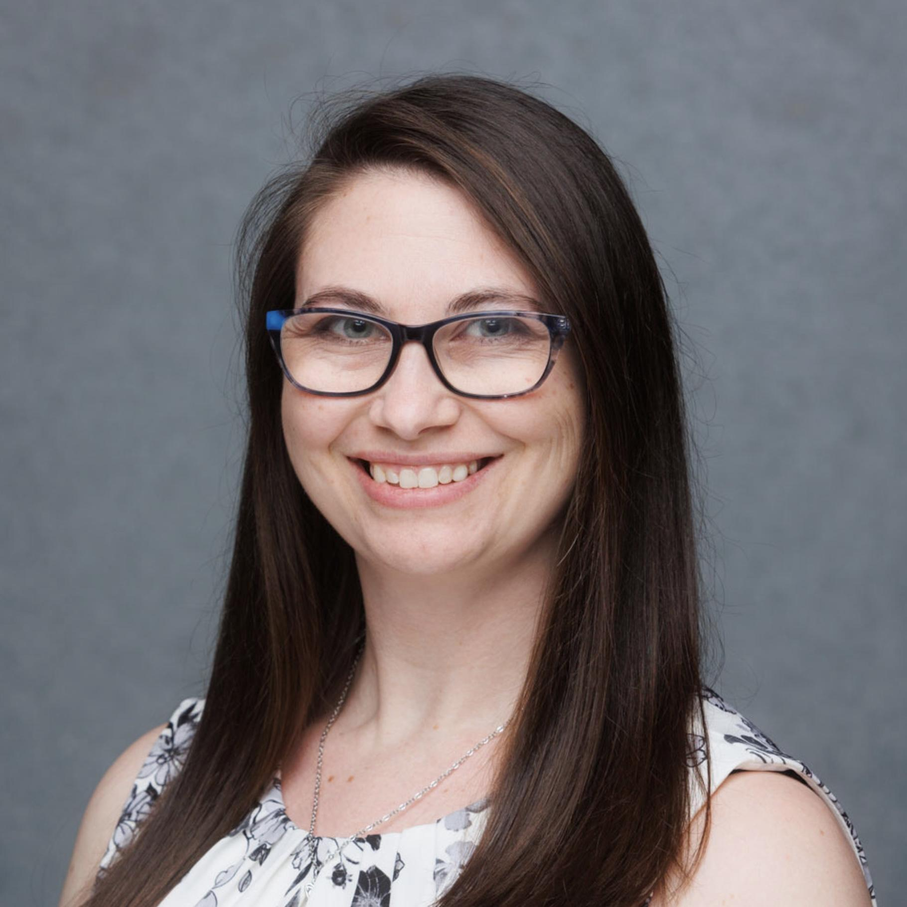
Introduction
Meagan Crews, She/Her/Hers Senior Product Consultant
Watermark Client Services
Prior Experience: Worked 7 years in higher education supporting faculty and academic leadership with curriculum, faculty qualifications, and more.
Experience at Watermark: 3 years as a consultant for Curriculum Strategy and Faculty Success
Location: I lived most of my life in Colorado but currently reside in Texas

Slide 4
Housekeeping and Expectations
You are encouraged to login and follow along - there will be specific activities during the session for you to try (login details provided on next slide).
To keep things moving, please hold your questions for Q&A segments or enter them into chat to be addressed during Q&A or by your system administrator.
If you’re having an immediate issue (like errors or issues seeing/hearing the presenter), please feel free to come off mute.
The presentation and recording will be shared with system administrators after the session for future reference materials.

Slide 5
UNMC Expectations
Roles and responsibilities
Administrator
Faculty
Proxy Users
UNMC resources and next steps
Questions? Contact your campus administrator
Ong Vang, ong.vang@unmc.edu

Slide 6
Learning Outcomes
By the end of this training session, you will be able to:
Navigate the Faculty Success system
Add new activities to your profile using a variety of methods
Revise activities over time
Create a self-service report
Run a report

Slide 7
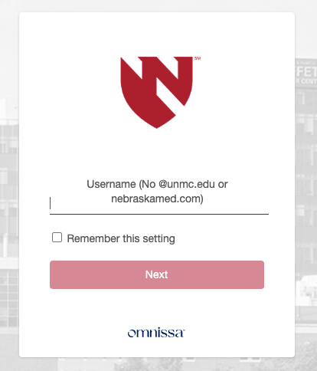
Login to Faculty Success
Bookmark the Direct URL: login.watermarkinsights.com/connect/ universityofnebraskamedicalcenter

Slide 8
Faculty Success Introduction and Overview

Slide 9


What is Faculty Success?
Faculty Success is a secure, web-based application designed to centralize, manage, and report on faculty activity data. It acts as a central hub where faculty can keep a continuous record of their academic careers and professional activities.
Centralized Profile: It serves as a single place to track and store all professional activities, creating a living professional portfolio.
Efficient Reporting: Faculty can easily generate tailored CVs and reuse data for various reports and reviews to reduce time spent preparing materials.
Streamlined Processes: The system supports efficient data entry, reporting, and reviews with dedicated features for each function.
Faculty data entered into structured fields
Structured reports display or aggregate faculty data
Reports included in faculty review and other processes

Slide 10
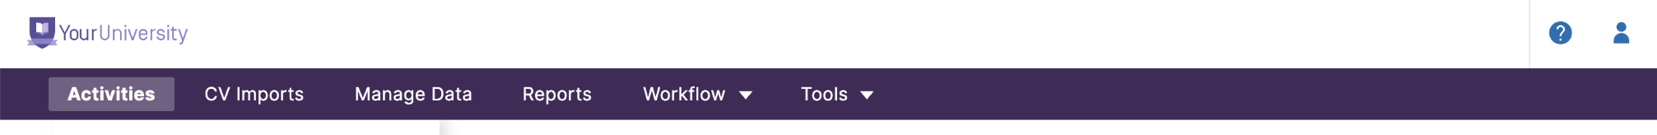
System Navigation (Original View - Proxy Users)
The utilities you see in navigation will be based on your Security Role(s) assigned. If you believe something is in error, please contact your system administrator.
Activities: Access to your activity database (users with tracking activities enabled)
CV Imports: CV Import Tool (only visible directly in navigation when tracking your own activities, manage data to access CV Imports for others).
Manage Data: Access to the activity database for other users (users with manage data access)
Reports: Access to create or run reports (all users, reports vary)
(Coming Soon) Workflow: Access to complete tasks related to reviews (all users)
Tools: Access to administrative tools such as users and security (system admins only)

Slide 11
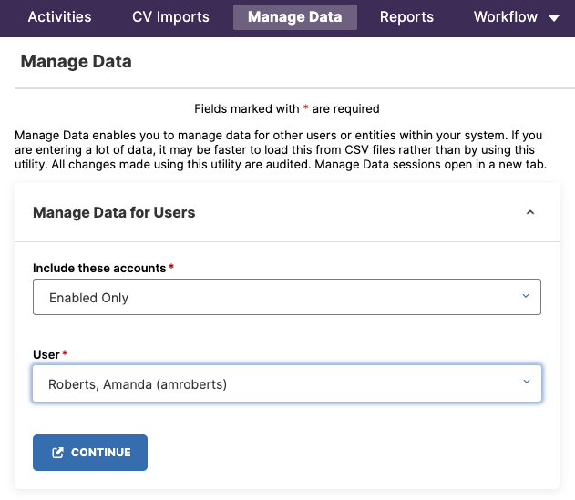
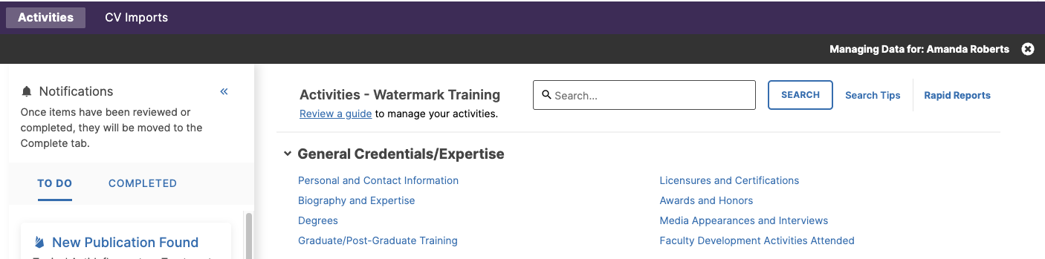
Manage Data (Proxy Users)

Slide 12
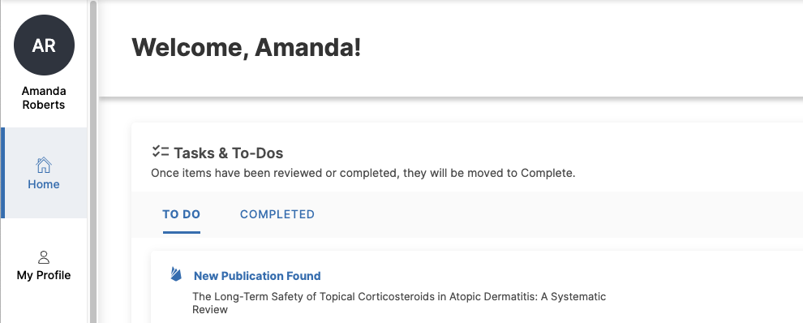
Faculty Home

Slide 13
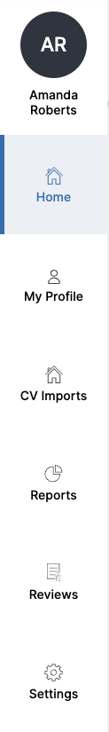
System Navigation (New View - Faculty Users)
Home: Your landing page. This is where you will see pending and completed tasks.
My Profile: Your professional record. Use this item to enter and update activities related to your teaching, scholarly publications, and service. The data you enter here supports reports and feeds into reviews.
CV Imports: This tool helps you quickly create records using your CV. Upload your CV file, highlight entries, and turn them into activities. CV Imports can save time when entering a large number of activities.
Reports: This feature allows you to create and generate reports based on the information in your profile.
(Coming Soon) Reviews: Where you can complete tasks related to your reviews.

Slide 14
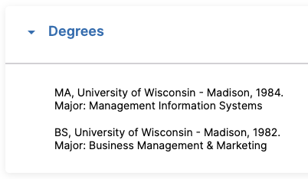
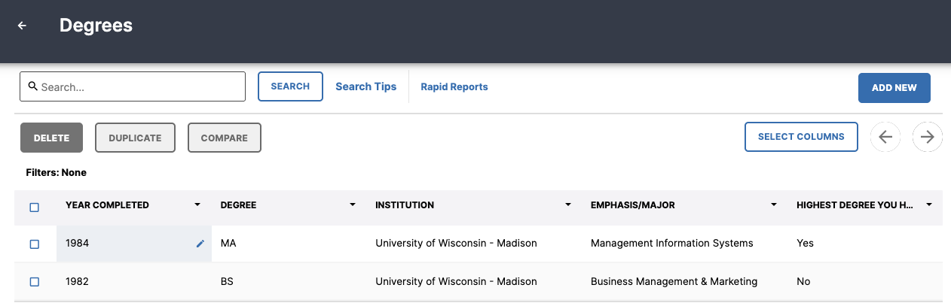
Faculty Success Glossary
Record: A single activity in the system, such as a publication, a service activity, or a degree.
Screen: Each record is housed within a screen - defined by type - such as Publications, Degrees, and Scheduled Teaching.
Field: A single point of data entry on a record, such as a publication title or date.
Summary Screen: A summary/list view of all records on a particular screen.
Report: The output of activity records. A report includes your CV, Annual Activity Report, or other report(s) you create or that are shared with you.
Screen
Record
Field
Summary Screen

Slide 15
Entering and Managing Activities

Slide 16
Overview of How To Get Data Into The System
Manual Data Entry
Enter new activities directly to a screen
Revising and deleting activities only done manually
Publication Imports
Proactive Search
Import from a third party like PubMed or Crossref (note: additional services may be available depending on institutional access)
Import from a BibTeX file from repositories like Google Scholar
CV Imports
Utilize highlighting technology to transfer activities from Word CV (note: access to tool determined by institutional administrators)

Slide 17
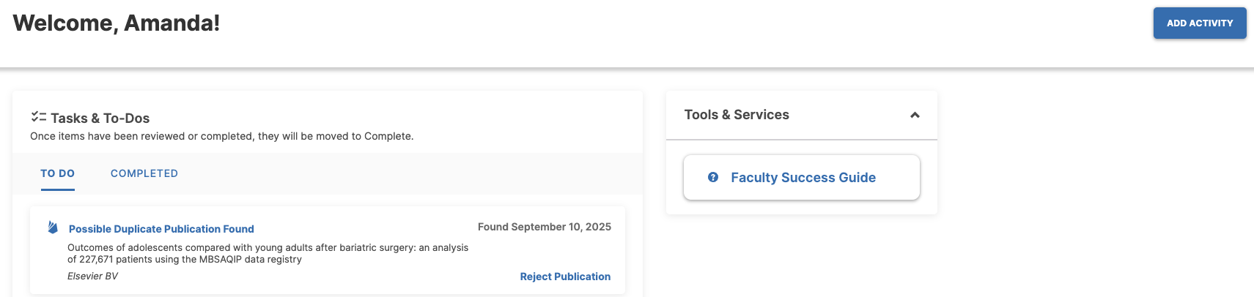
Home
Add Activity: Quickly add a new activity to your profile, such as publications, awards, or service.
Tasks & To-Dos: Manage matched publications and pending reviews.
Tools & Services: Access Watermark’s Faculty Success Guide for help

Slide 18
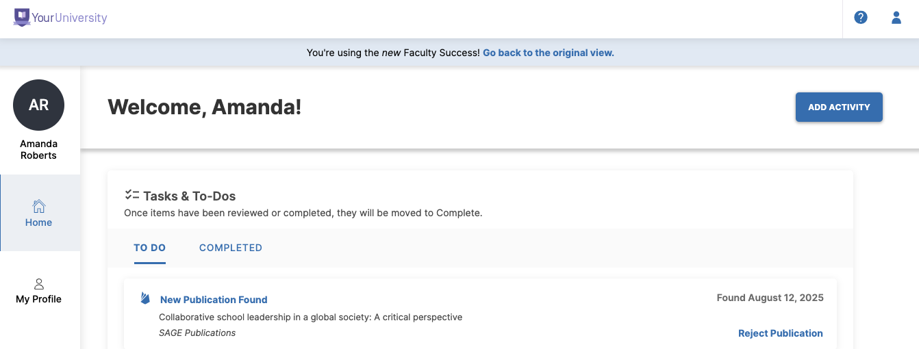
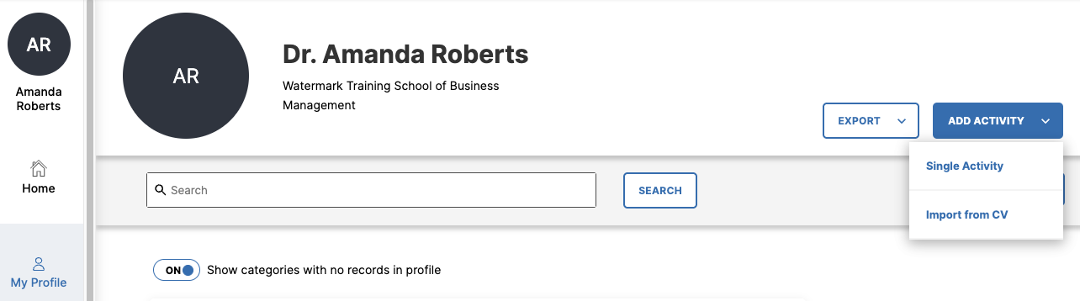
Home or My Profile: Add Activity

Slide 19
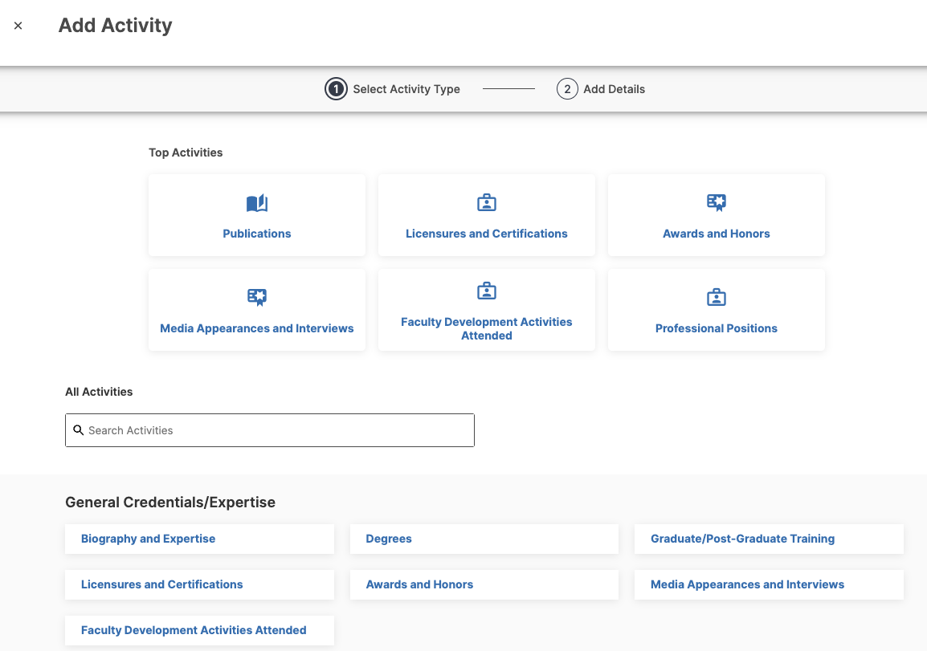
Add New Activity
Step 1: Select Activity Type
Top Activities represent most frequent and/or recent screens edited for quick entry
Search or browse below for all screen options

Slide 20
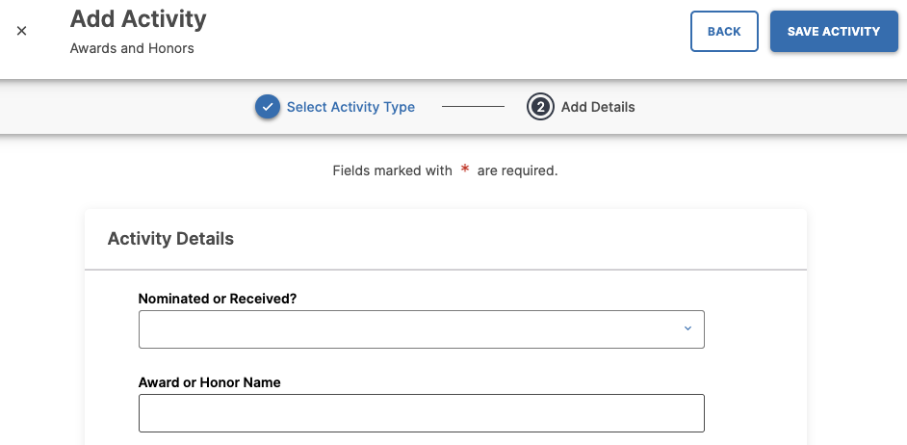
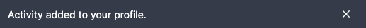
Add New Activity
Step 2: Add Details
Fill in relevant data fields for your activity
Click Save Activity (top right) when complete
Returns to Home or My Profile and “Activity added to your profile” message appears

Slide 21
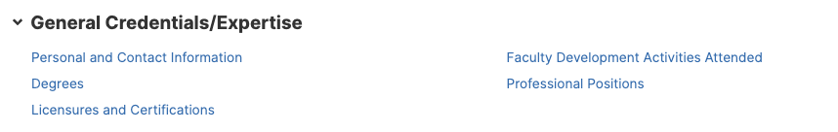
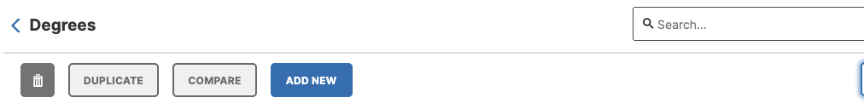
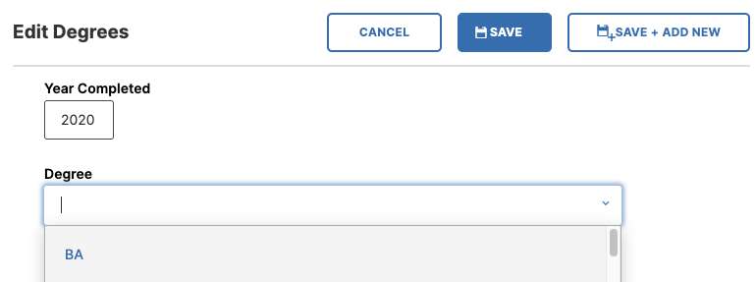
Add Activity (Original View)
Step 1: Manage Data
Manage Data and choose user to manage
Step 2: Select Screen
Click appropriate screen to begin
Step 3: Add New
Click blue “Add New” button and complete data fields
Save

Slide 22
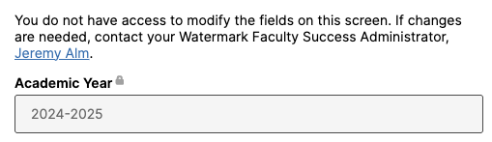
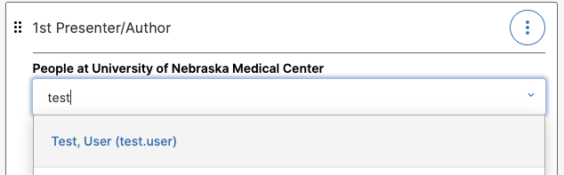
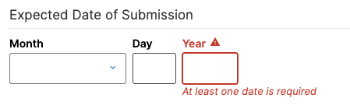
Data Entry Fields
Each screen is intended to capture specific types of activities and will include unique fields to capture data. Below are some special features to be aware of:
Locked Fields: Some fields will be locked with a padlock icon because they are managed by administrators or a collaborator. You can't edit these.
Required Fields: Look for fields marked as required. You won't be able to save the record until you fill them out.
User Reference Fields: When you see a field that allows you to select a user from your institution, selecting them will add the record to their profile (in our default configuration).
Dates: Always enter accurate dates. Reports use record dates to include or exclude activities within the timeframe. At least one date (often a year) is typically required.

Slide 23
Data Entry Best Practices and Tips
Enter only relevant information: Don't feel you have to fill out every field. For example, if you're entering a journal article, you would leave the "name of larger work" field blank.
Be complete and accurate: Fill out all relevant fields as completely as possible. The more thorough you are, the better.
Avoid placeholder data: Don’t use "N/A," "None," or other placeholders. This can cause problems when generating your CV.
Data entry matters for CVs: Your CV can only be generated correctly if the data is in the proper fields and formatted correctly. For example, you should not enter citation punctuation (like periods or quotation marks) as these are typically added in the report.
Review and clean up imported data: It's important to review and edit (or request revision) any data that was entered for you through system migration or other imports. You are responsible for ensuring its accuracy.

Slide 24
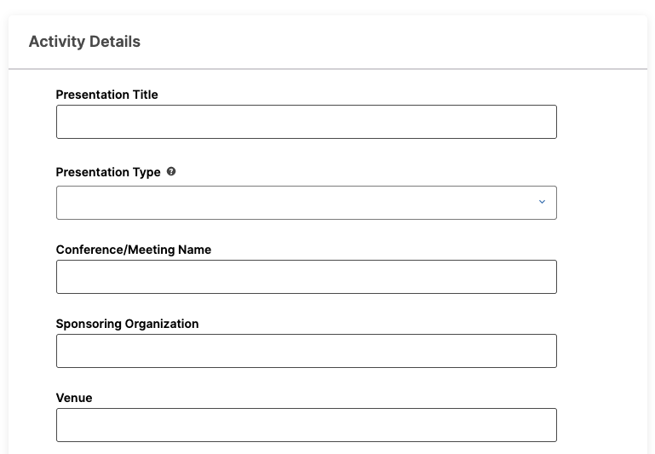
Activity: Create a Record
Manually create a record for a Presentation (or other activity of your choice).
Click Add Activity (new view)
Select Presentations
Complete data fields related to your most recent presentation
Click Save
Review your new activity
What questions do you have?

Slide 25
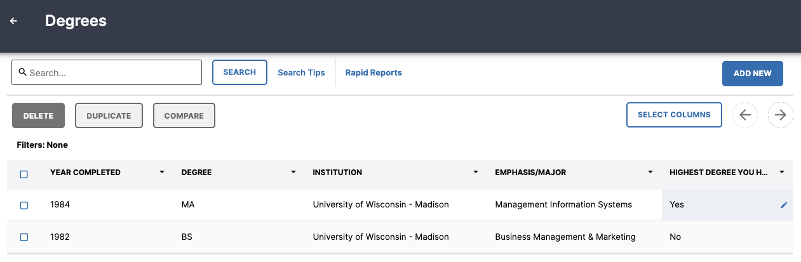
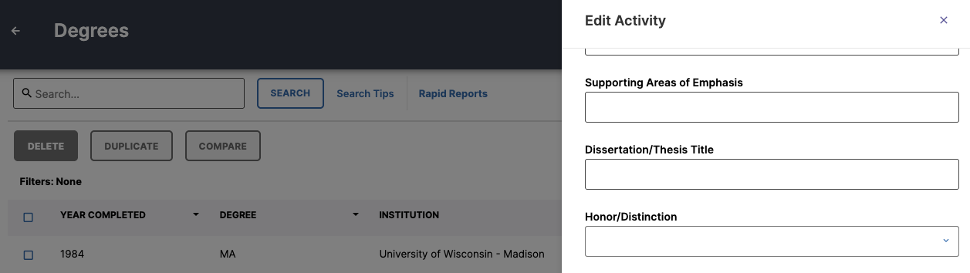
Revising Activity Data
From My Profile, select the screen name to review and edit existing records.
Review data entered on your behalf
Revisit activities regularly to update fields like status or dates
Check for duplicates, compare and merge or delete
Add missing activities if needed
Revise summary screen view with “Select Columns”

Slide 26
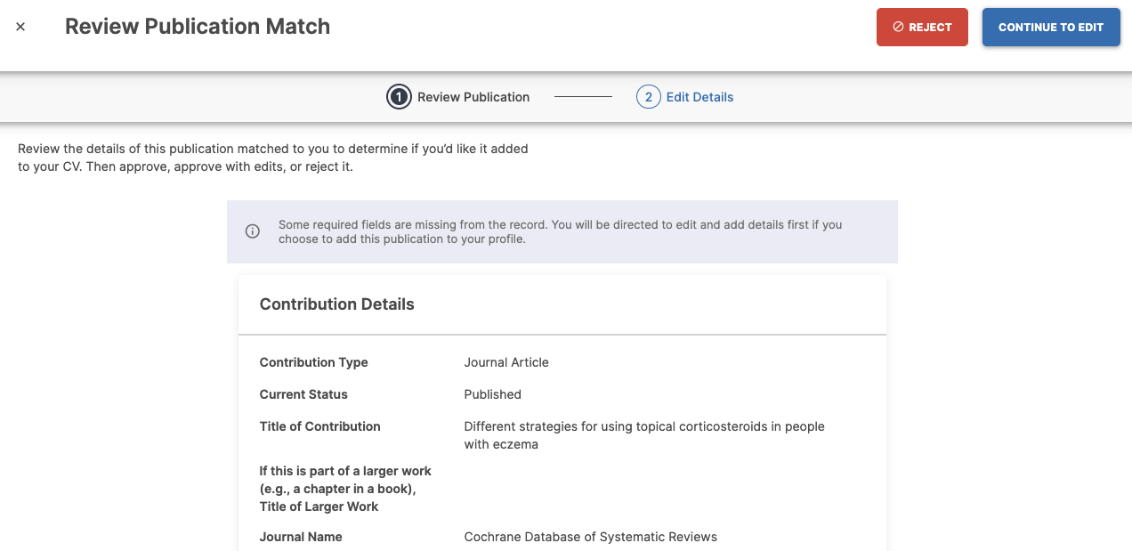
Importing Publications
From Home, use our Proactive Search feature to accept or reject publications found in Crossref that may match to you.
To accept publication, click “New Publication Found”
Click “Continue to Edit” to revise any publication details and save to your profile
To reject publication, click “Reject Publication”
You can also reject the publication after opening the record if you’re not sure
Once publication is accepted or rejected, notification will move to “Completed”

Slide 27
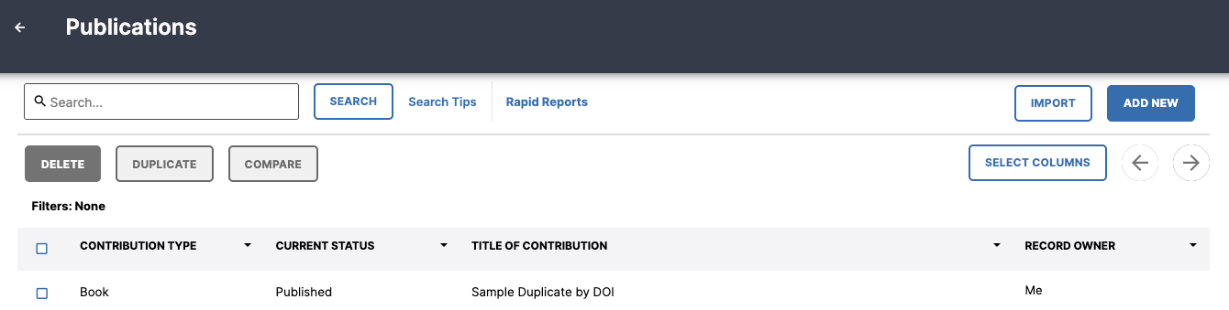
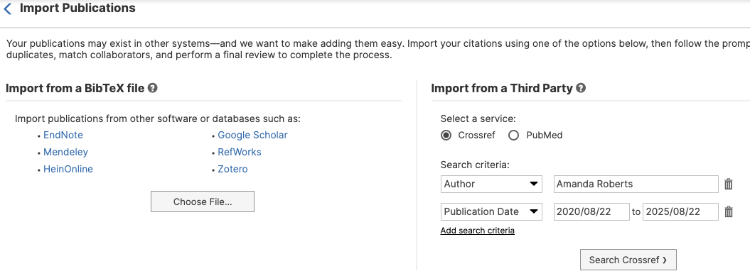
Importing Publications
From My Profile, click Publications and then the Import button for additional publication import options.
Learn more about Bibtex files and upload your file
Choose additional third party repositories that are available, or search with different parameters in Crossref, such as published work under another name

Slide 28
Activity: Import a Publication
Import a new Publication from Proactive Search, and/or
Reject a publication that doesn’t belong to you, and/or
Open Publications > Import and manually search and import a publication.
What method did you use, and why?

Slide 29

CV Import
From My Profile, click “Add Activity” and CV Import option or choose CV IMport from the left hand menu.
Upload your Word document CV
Follow detailed prompts to select activity type, highlight activities to add, and determine specific record details for each section
Import CV once complete to bulk create new records

Slide 30
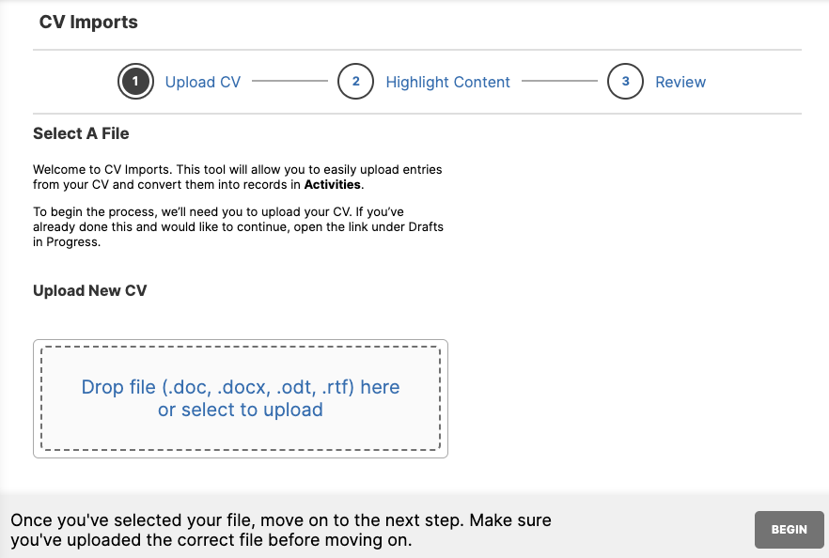
Activity: Import Service from CV
Click CV Imports
Upload your CV (must be a Word format)
Follow on-screen instructions carefully to select activities to import
Import records or save to continue importing later
Important note: Import tools can only add new activities, and should not be used to revise existing records.
What questions do you have?

Slide 31
Reports Quick CV, Self-Service Reports, Full Service Reports

Slide 32
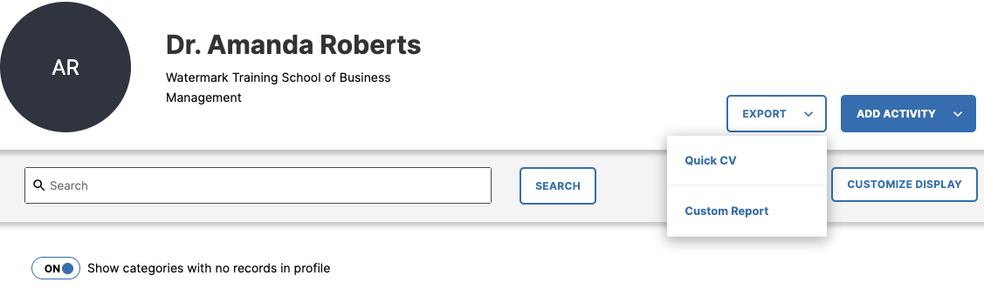
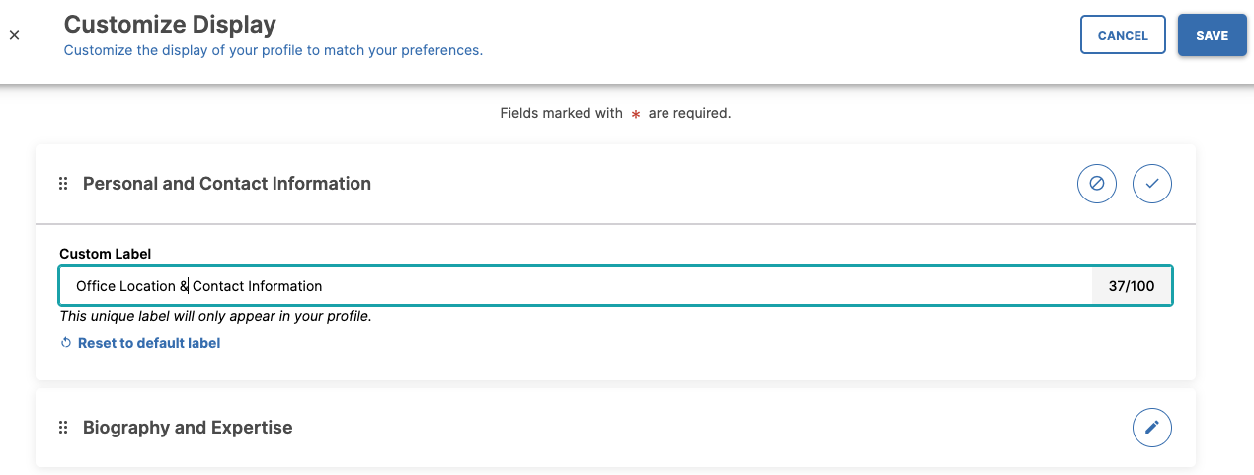
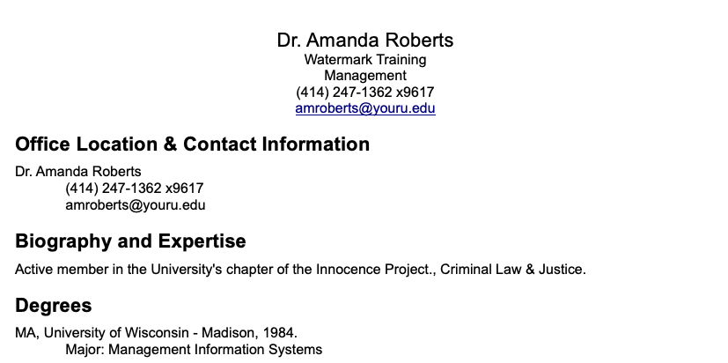
Customize Profile & Quick CV
From My Profile, click “Customize Display” and choose the order and heading labels you want for your profile.
Toggle option to view or hide sections with no activity data.
Click Export > Quick CV to generate a preformatted CV based on your individual profile!

Slide 33
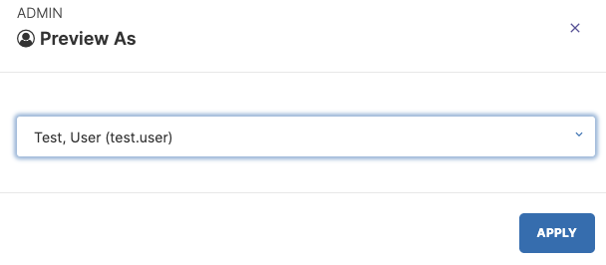
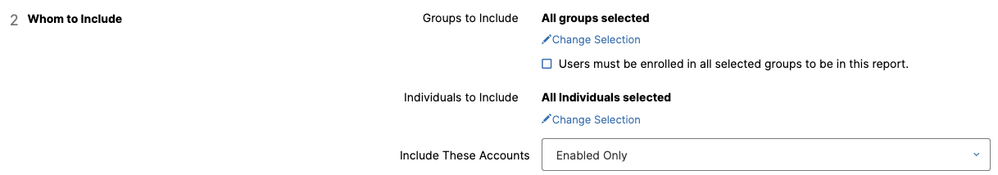
Reports as a Proxy User
Access Reports tab via your own account (not via Manage Data)
Run a report for another user:
Self-Service Report: Options > Preview As and/or Export Group
Full-Service Report: Select user(s) under “Whom to Include”

Slide 34
Self-Service Reports
Saves time and provides you more autonomy
Generate individualized reports on faculty activities in the system
Robust suite of easy to use formatting options; polished outputs
Custom CVs for Faculty and Admins can share CV templates for institutional consistency
Examples:
Your institution has standardized annual reporting requirements, but each unit wants to display activities in a different order.
You apply for a grant every year and need to include only publication and research activities.

Slide 35
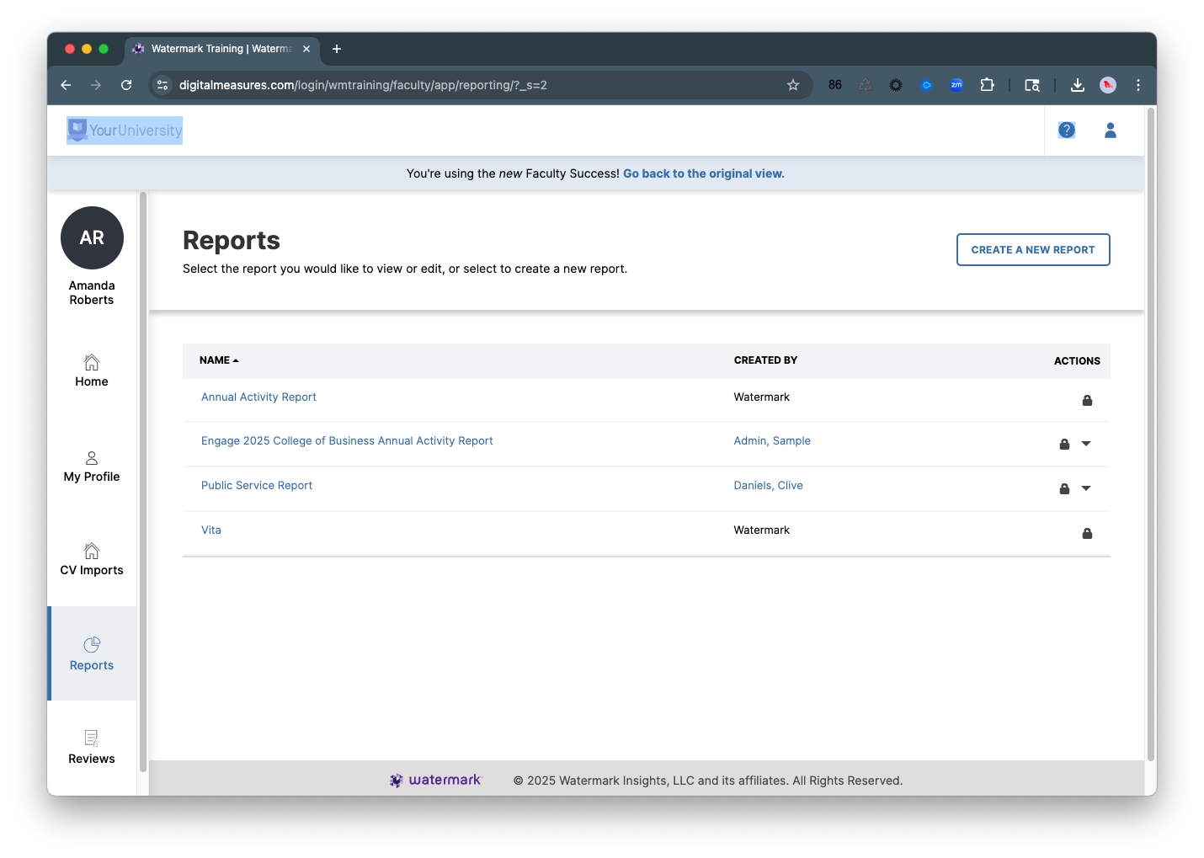
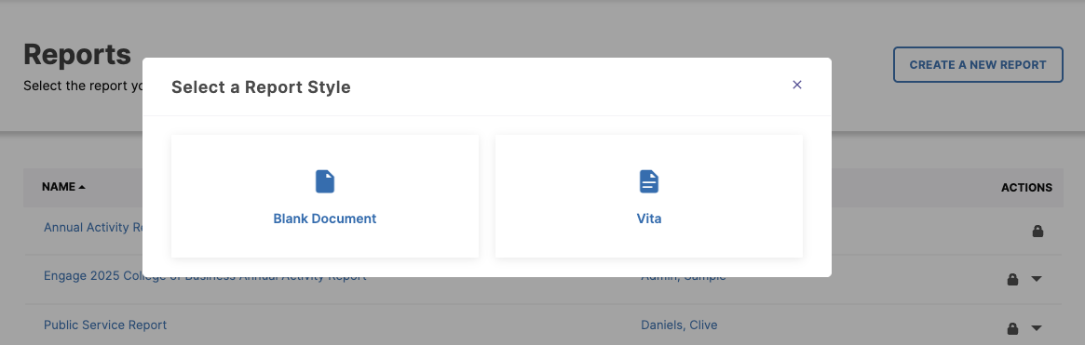
Create Self-Service Report
From My Profile, click “Export” and choose Custom Report or select Reports from your left hand navigation and click Create a New Report.
Select a Report Style:
Blank Document
Add all sections needed
Examples: a report that only needs research
Vita
Edit/revise default CV sections

Slide 36
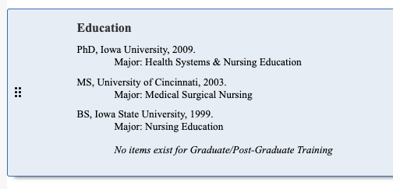
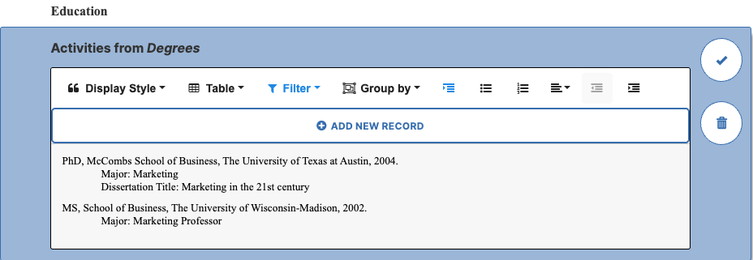
Self-Service Options and Capabilities
Add and reordering sections
Activity display style options (publication citations; default or custom citations; table view)
Filter and Group by options
Formatting (hanging indent, lists, alignment and indents)
Add/Edit Records

Slide 37
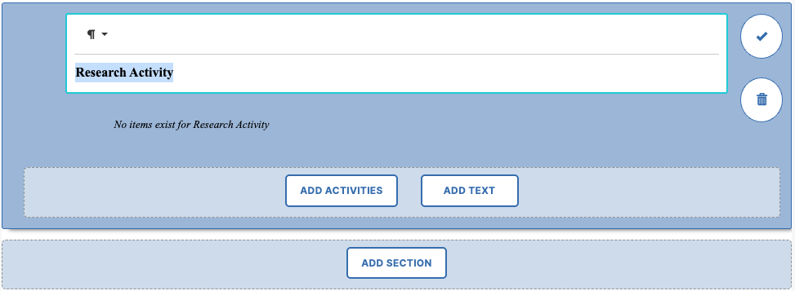
Add Section & Activities
Click the section heading above where the new section should appear
Click “Add Section” and provide a title
To add data, click “Add Activities”
To add static text, click “Add Text”

Slide 38
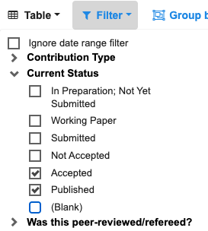
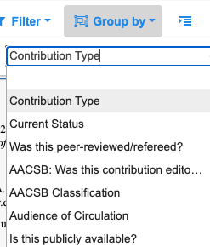
Filter and Group by
Apply a filter to display only records meeting specific criteria.
More than one filter can be applied.
Group activities to create sub-sections based on a common attribute
Filters and groups are based on the screen’s drop-down lists and checkbox lists

Slide 39
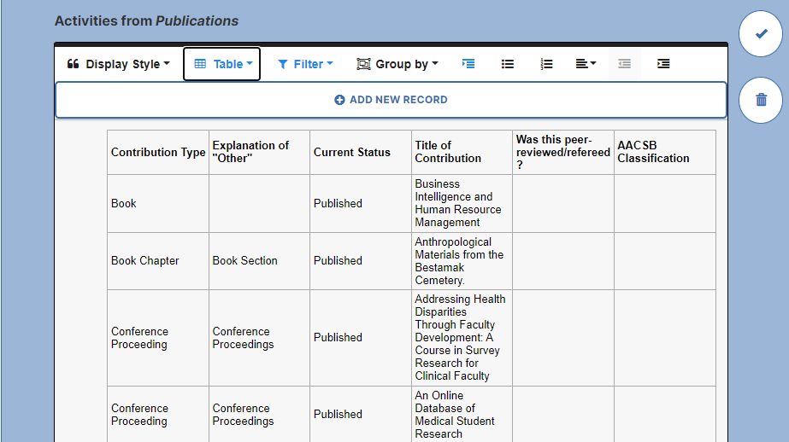
Table View

Slide 40
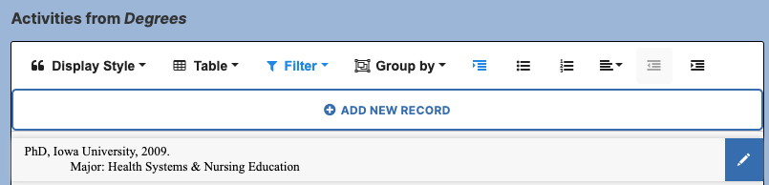
Add and Edit Records
Allows faculty to add new records or revise existing records in the system directly from their Self-Service Reports
Previewing for a specific faculty member allows administrators or others with access to manage data directly from report

Slide 41
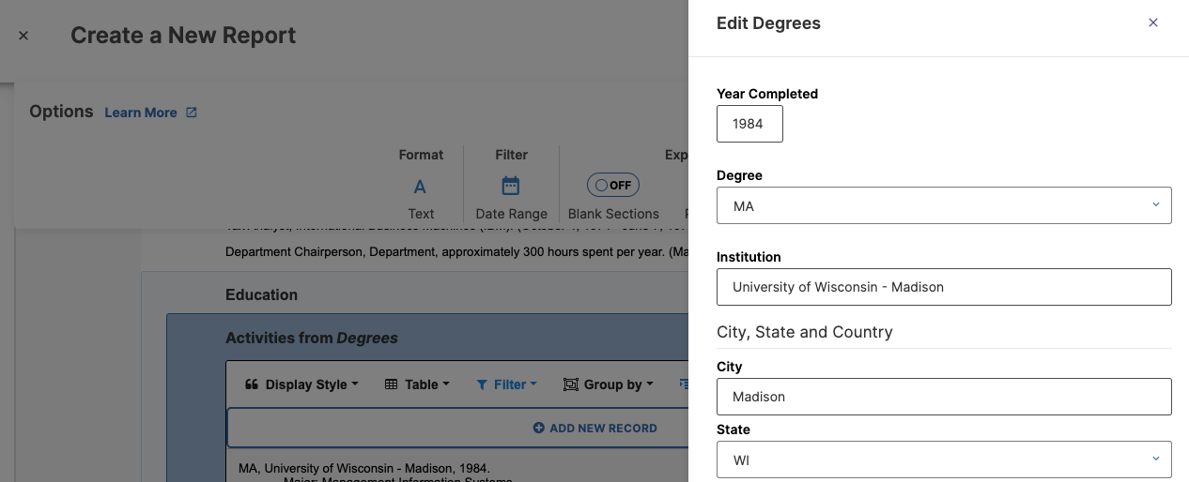
Add and Edit Records

Slide 42
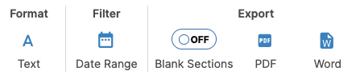
Options Tab: Choose Dates and Export
Format
Change the styling of the headings and subheadings
Report Date Ranges
Choose all activity dates, or apply a specific date range to your report
Global date range can be overridden within “Filter” option of each activity section
Export Options
Blank Sections
Word and PDF format

Slide 43
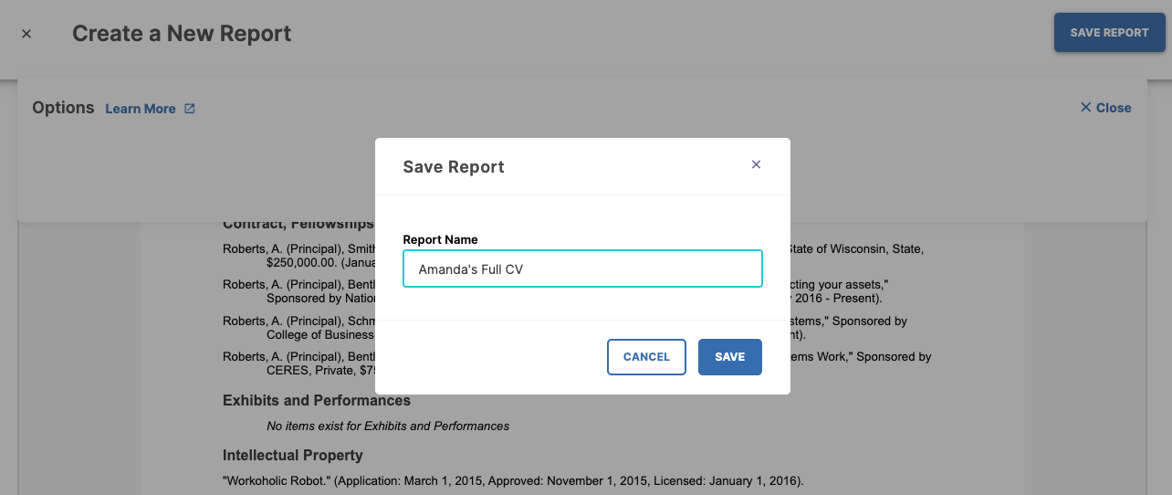
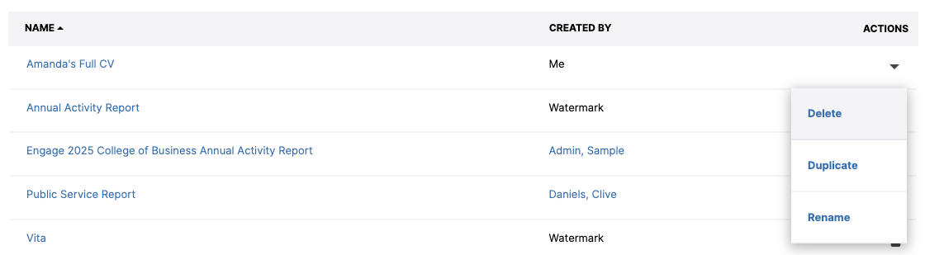
Save Report

Slide 44
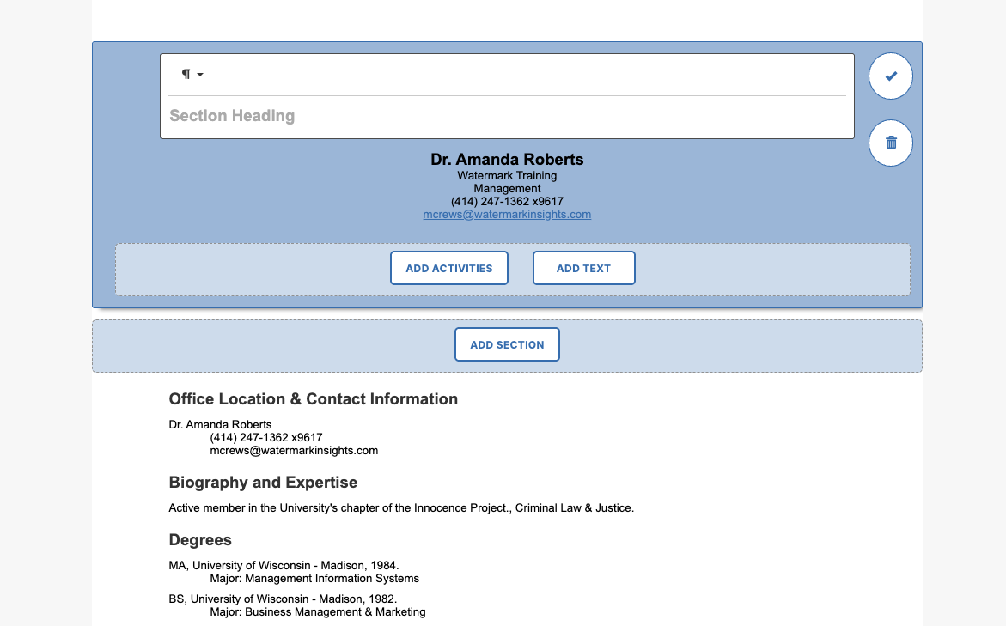
Activity: Create a New Self-Service Vita
Click Reports > Create a New Report and Choose Vita, or from Home > Export > Custom Report
Make adjustment(s):
Change the font
Rename or Reorder a section
Adjust a Display Style
Apply a Filter or Group
Save

Slide 45
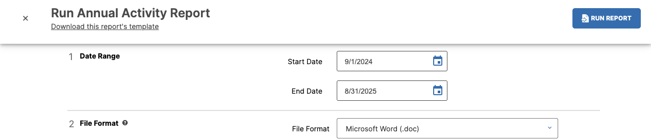
Full-Service Reports

Slide 46
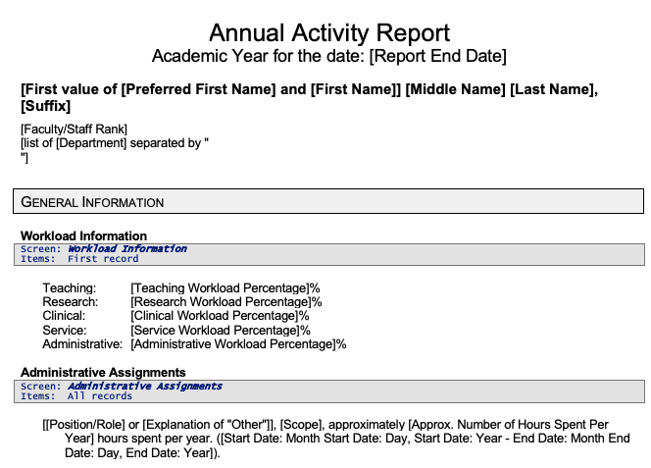
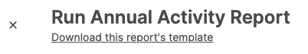
Download Report Template

Slide 47
Troubleshooting Reports
Issue: An activity I created is missing from my report.
Check the report’s date range against the record’s date
The record’s date(s) must overlap the report’s timeframe
Check the report template for exclusions
Check to make sure the screen is included in the report and whether any criteria may exclude the record (for example, if the Publications section is including only “Accepted” and “Published” records, your “Submitted” publication will not appear).
Issue: I see my activity, but some of the fields I entered are missing or incorrect.
Compare the report template and the record
Not all fields will be set to display on a report. Make sure to compare the report template with the screen: do you see the field name listed? If not, this particular field is not designed to appear in the citation.
Still not sure? Contact your administrator!

Slide 48

Activity: Run a Full Service Report
Open Reports and select Annual Activity Report
Enter a Date Range (9/1/2023 - 8/31/2025)
Run the Annual Activity Report
Download and review the Report Template
What questions do you have?

Slide 49
Finishing Up

Slide 50


Help Tools and Faculty Essentials
Navigate to the Help Center via the question mark icon in the upper right of Faculty Success or click Faculty Success Guide from Home.
Review “Faculty Essentials” to find information and guides about each section we discussed today.
Use the Contact Us option to reach out to your administrator or Watermark Support with questions or issues.

Slide 51
What are your next steps?
Enter activities
Manually enter/edit records
Complete publication import
Try out CV Import
Run reports
Create your own CV
Review reports shared by administrators
Verify your data and revise as needed
Watch for updates from your Faculty Success Implementation Team with news about annual reviews and promotion and tenure.
Utilize resources to assist with your primary goals!
Save this End-User Training slide deck and recording for reference
Access the Faculty Essentials guide in Help Center
Review additional training and/or materials provided by your campus administrators
Know who your campus subject matter experts and administrators are that can assist you with questions as you complete tasks

Slide 52
Questions?

